Slide 1
Done by : Entisar Al-Obaidallah MG4- Revision unit 2

Slide 3
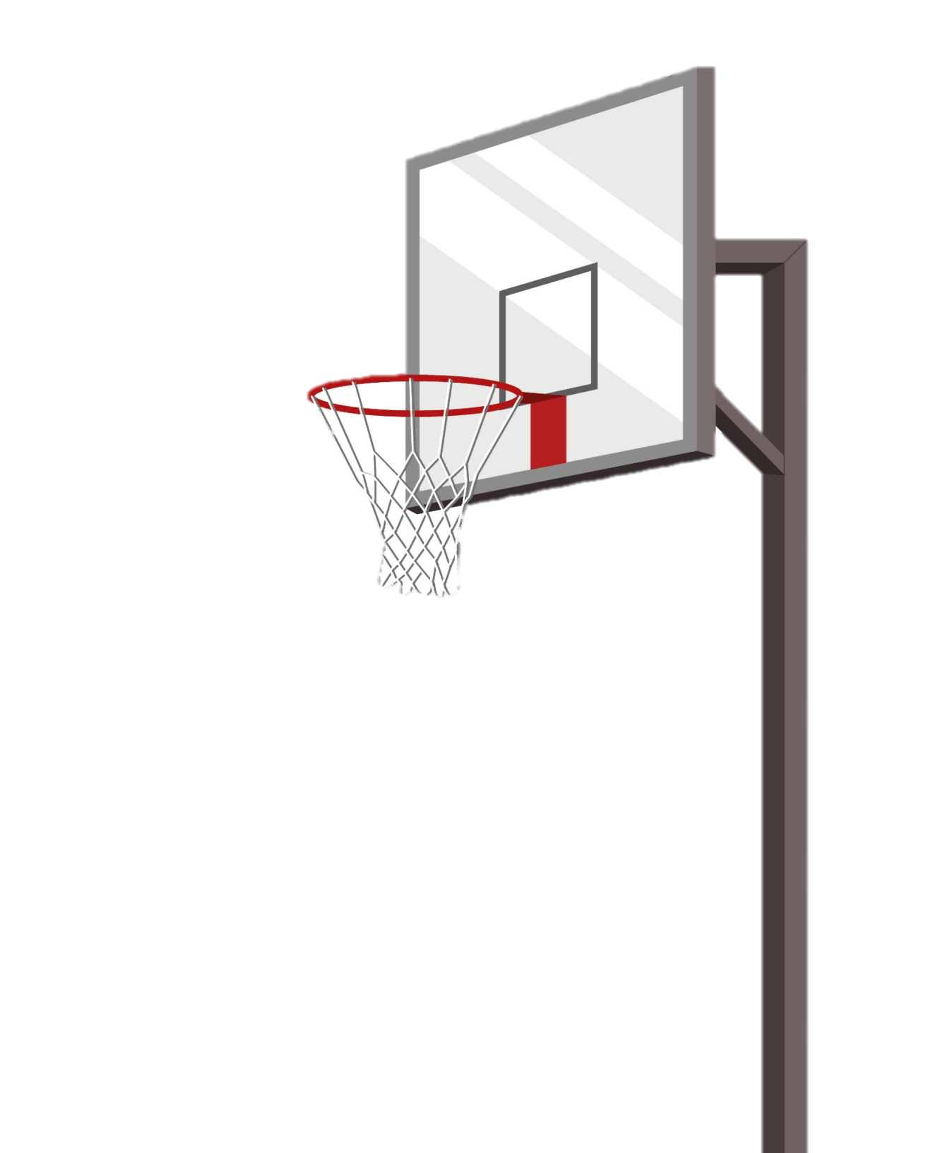
Who is the _____football player you've ever seen ?
better
best
good

Slide 4
How _______you been learning to ski ?
long
many
much

Slide 5
She has _______three lessons .
explain
explains
explained

Slide 6
He has been ____since
2002 .
teach
teaching
teaches

Slide 7
He drives _______.
carefully
care
careful

Slide 8
The _______book I have ever read was "War and Peace" .
long
longer
longest

Slide 9
Bahrain is not as _____as Saudi Arabia .
biggest
big
gigger

Slide 10
This is ( good ) _____ game I have ever seen in a long time .
the best
better
the worst

Slide 11
Thousands of runners participate in the _______every year .
practice
revived
marathon

Slide 12
The board game chess ____in India in the 6th century. .
اكتب إجابة خاطئة هنا
originated
اكتب إجابة خاطئة هنا

Slide 13
a stick with fire at the end is ______
torch
medal
net

Slide 14
circular award is___
net
torch
medal

Slide 15
The opposite of “defending” is___
local
attacking
boring

Slide 16
The opposite of “thrilling” is___
boring
local
useful

Slide 17
This picture shows :
pigeon
torch
net

Slide 18
ball – net - racket – snow
The odd word is ______
ball
net
snow

Slide 19
This picture shows :
medal
torch
puck

Slide 20
This picture shows :
puck
torch
racket

