Slide 1


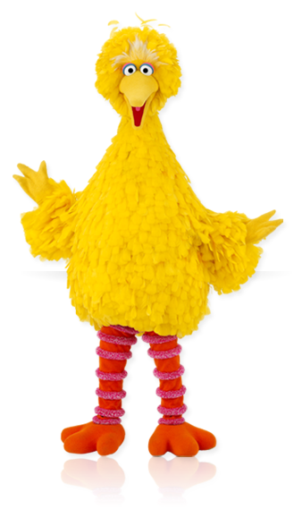

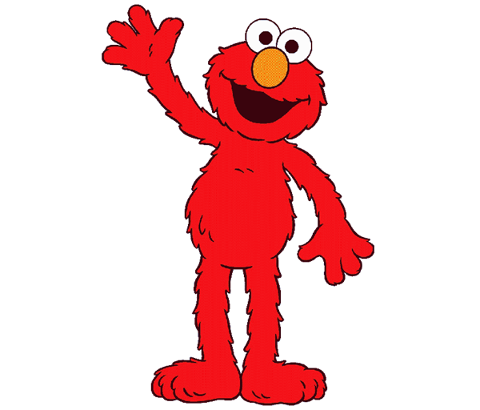

هيا لنلعب مع افتح يا سمسم
Revision Unit 4
MG 3.1
By : Entisar Al-Obaidallah

Slide 2
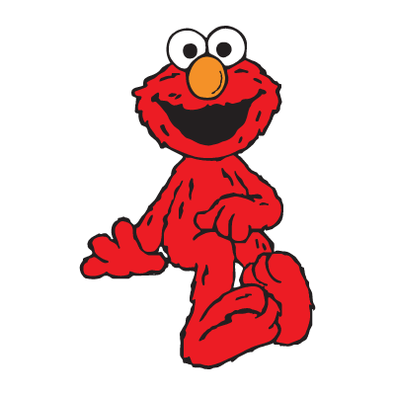
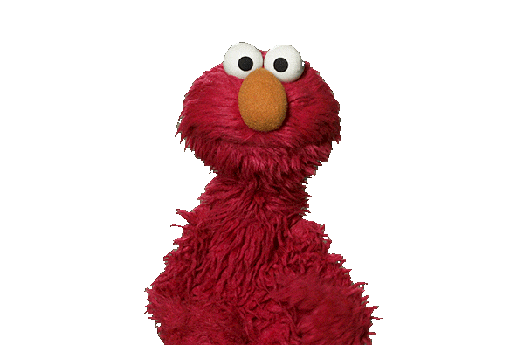
She said that she (like – likes – liking -liked) ice cream.
liked

Slide 3
That's the restaurant (who – which – where – when ) we ate last Friday.
where

Slide 4


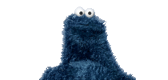
I can speak Spanish fluently.
(So will I- So do I – So can I - So did I)
So can I

Slide 5
I don't sleep early.
( Neither do I – Neither does I – Neither did I )
Neither do I

Slide 6
I didn't like the pizza.
( I did – I do – I does – I will)
I did

Slide 7
Correct:
He said he had (eating) …………..too much .
eaten

Slide 8
Ali said : " I learned English in Canada"
( Report)
He said that he had learned English
in Canada"

Slide 9
I don't know the answer ( Express disagreement)
I do

Slide 10
♥ Circle the odd words:
Flood – Tornado - countryside - Earthquake
countryside

Slide 11
♥ Circle the odd words:
save – rescue - protect – harm
harm

Slide 12
Where does she live?
(Ask an indirect question)
Do you know where she lives?

Slide 13
Fill in the space:
( natural – quote - environmental )
The ………………………… is words full of wisdom that someone important said.
quote

Slide 14
Fill in the space:
( natural – quote - global – environmental )
Earthquake, flood, and tsunami are examples of ……………… disaster.
natural

Slide 15
Fill in the spaces with suitable word :
( natural – quote - global – environmental )
Most people still don’t believe that ………… warming was a problem.
global

Slide 16
Which of the following words is NOT
related to the category of “Environmental issues ” ?
air pollution – overfishing - volcano - global warming
volcano

Slide 17
Which of the following words is NOT related to the category of “Natural Disaster ” ?
tsunami – air pollution – flood - volcano
air pollution

Slide 18
The word “proof” means
(writer – evidence – candidates )
evidence

Slide 19
The opposite of the word
“wise men”
(evidence – writer – fools)
fools

Slide 20
The opposite of the word
“ healthy”
(powerless– unhealthy – informal)
unhealthy

Slide 21
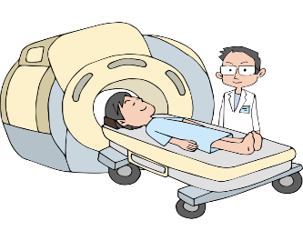
This picture shows
( scan – bother – raise)
scan

Slide 22

This picture shows
(peach - pumpkin -pomegranate)
pumpkin

Slide 23

Thank You

