Slide 1
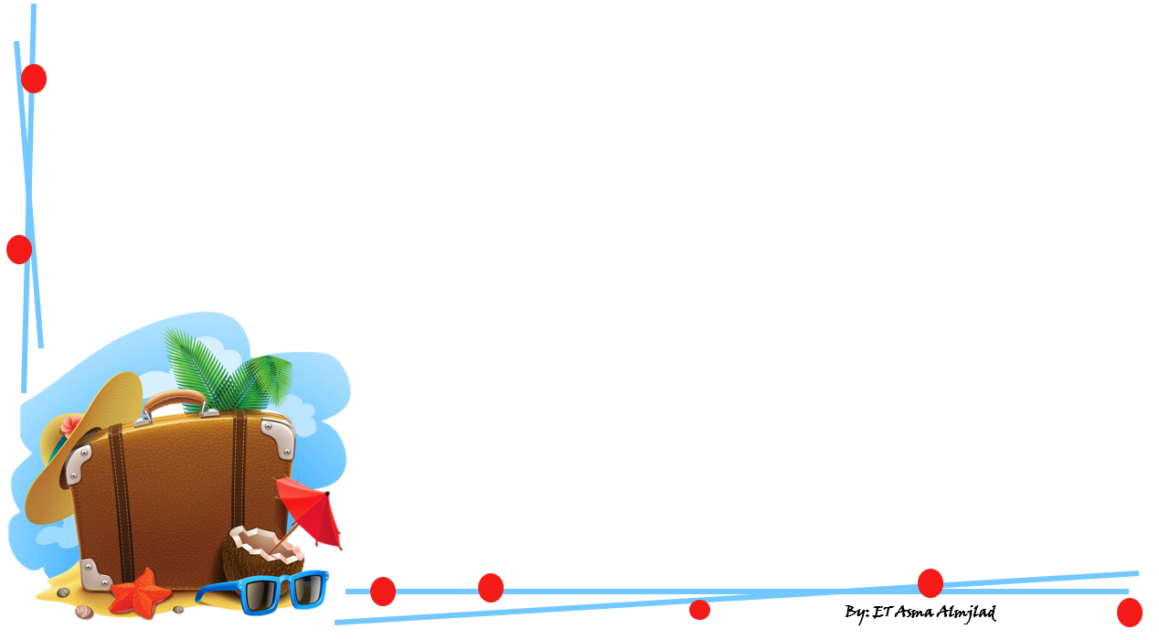

Are You Here on
?
By: ET Asma Almjlad

Slide 2
Objectives
1
2
Differentiate between greetings and farewells.
3
Match the characters with their description
Name a local festival

Slide 3
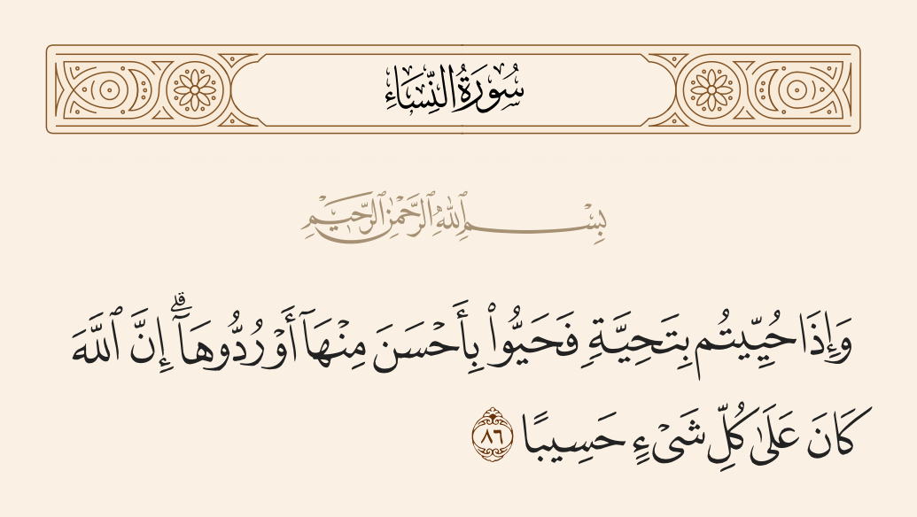

Slide 4
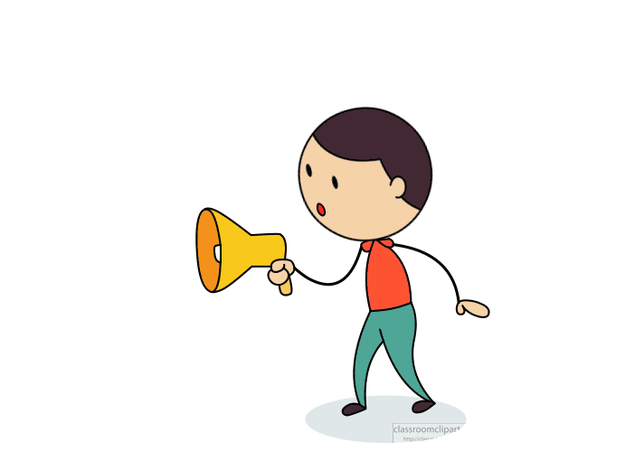
What do you do in your summer vacation?
Let’s talk
Do you travel in your vacation ?
Do you improve your skills and knowledge ?

Slide 5


Good morning
My name is Asma Almjlad
A – s – m - a

Slide 6
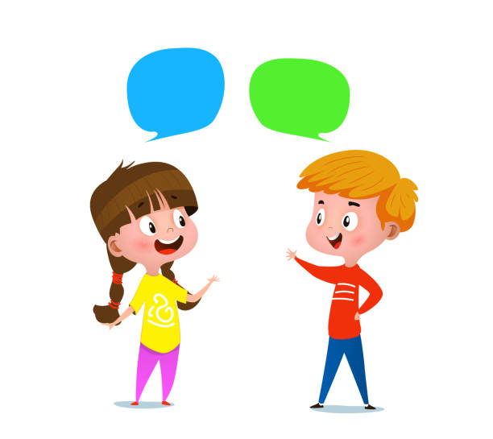
Let’s practice
How do you spell your first name?
How do you spell your last name?
What’s his your first name?
What’s his your last name?

Slide 7
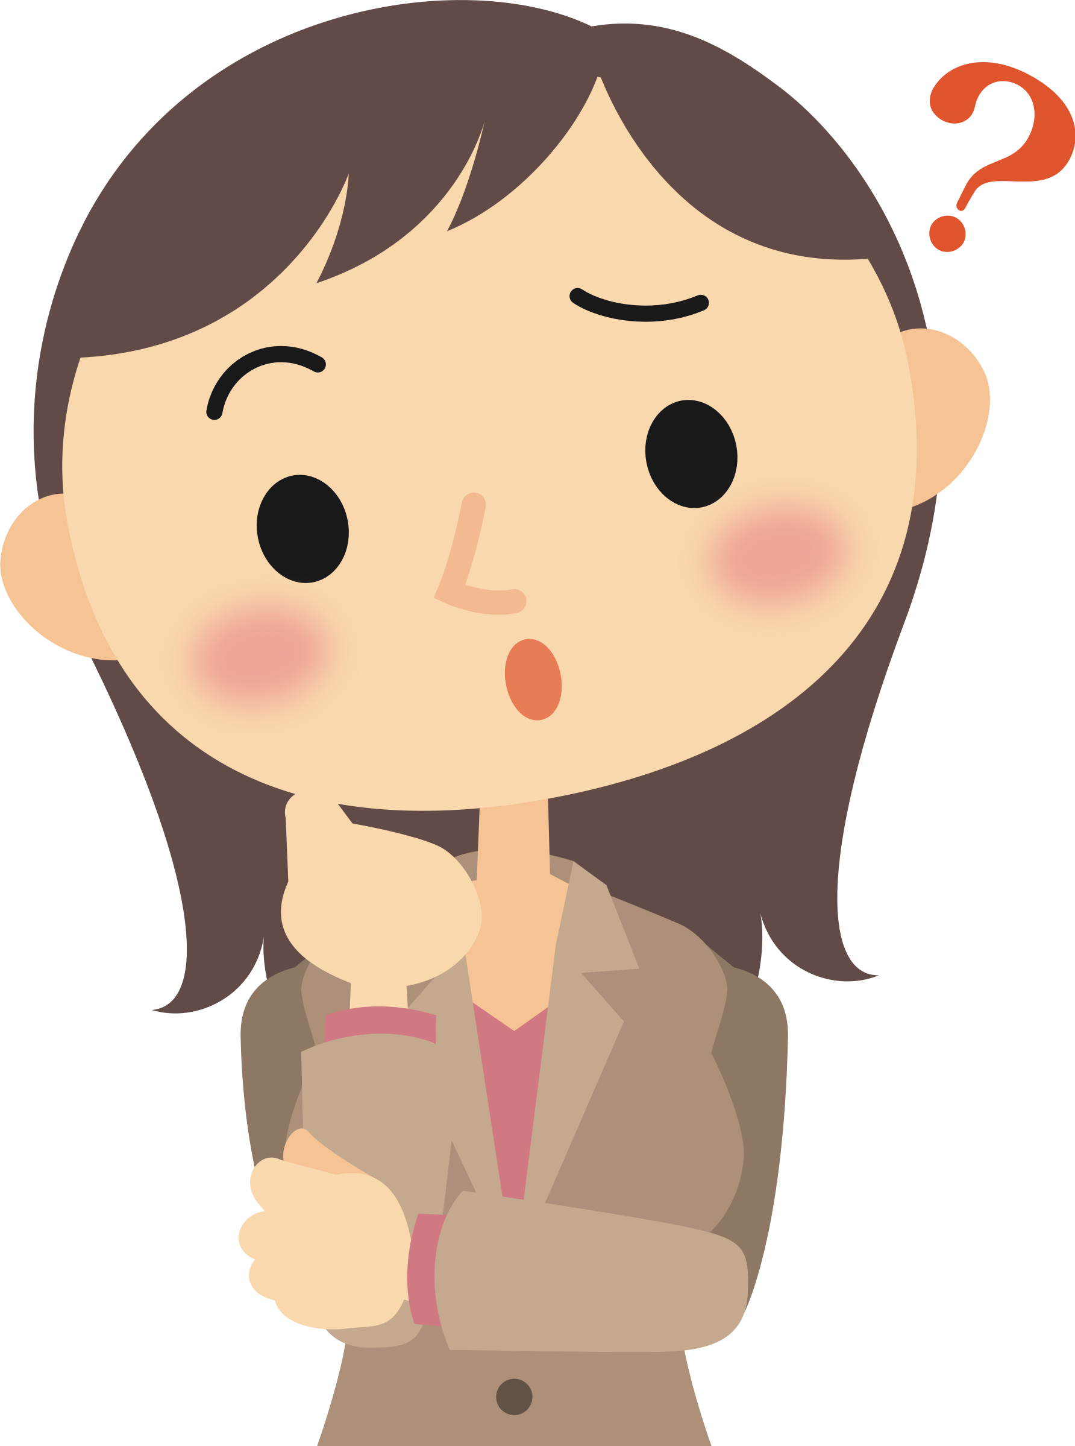
where you were born and raised?
I was born in _____, but I was raised in _____.
I was born and raised in _____.

Slide 8

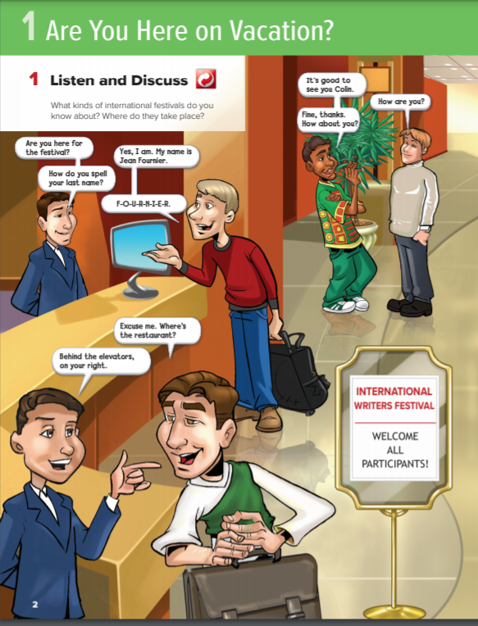
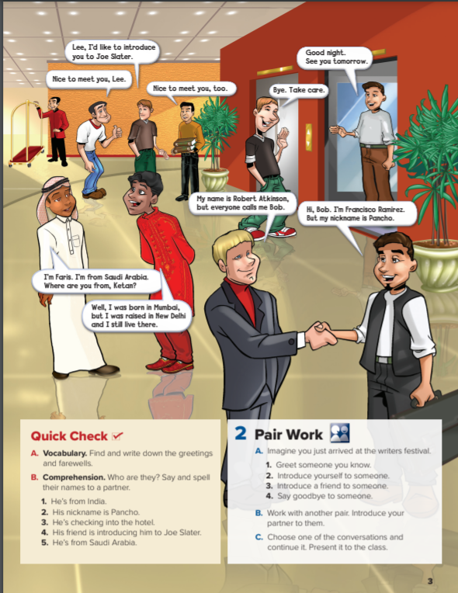



Open your book page 2
Listen

Slide 9
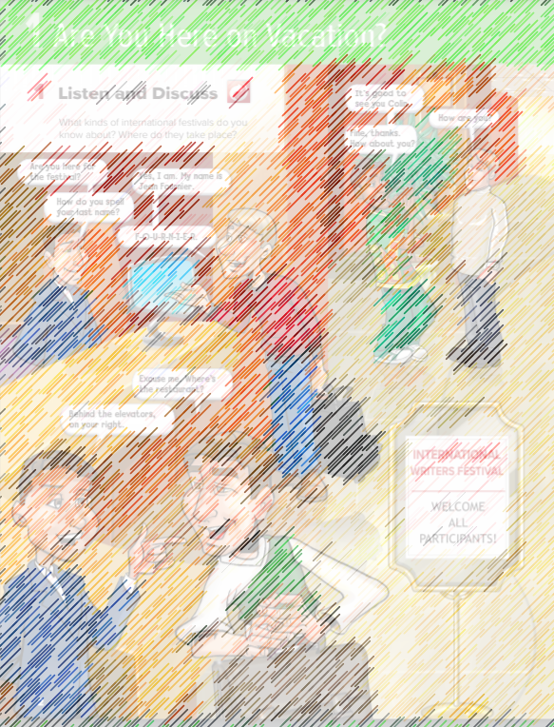
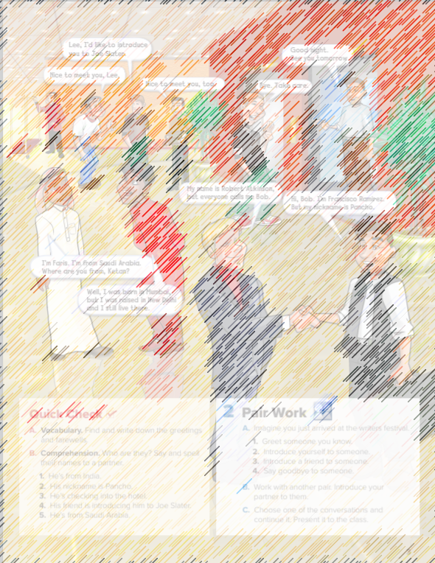
Let’s discuses
Where are the people?
What are the people doing?
Why are so many people there?
How do you know?
Is everyone from the same country?
Where are they from?
How many people are checking into the hotel?

Slide 10

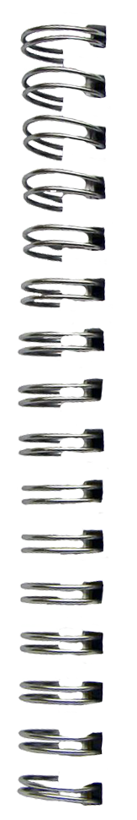

New Words

Slide 11

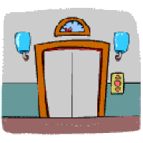
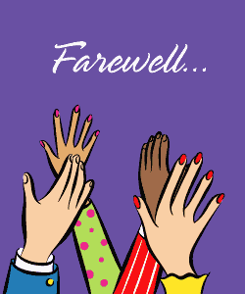
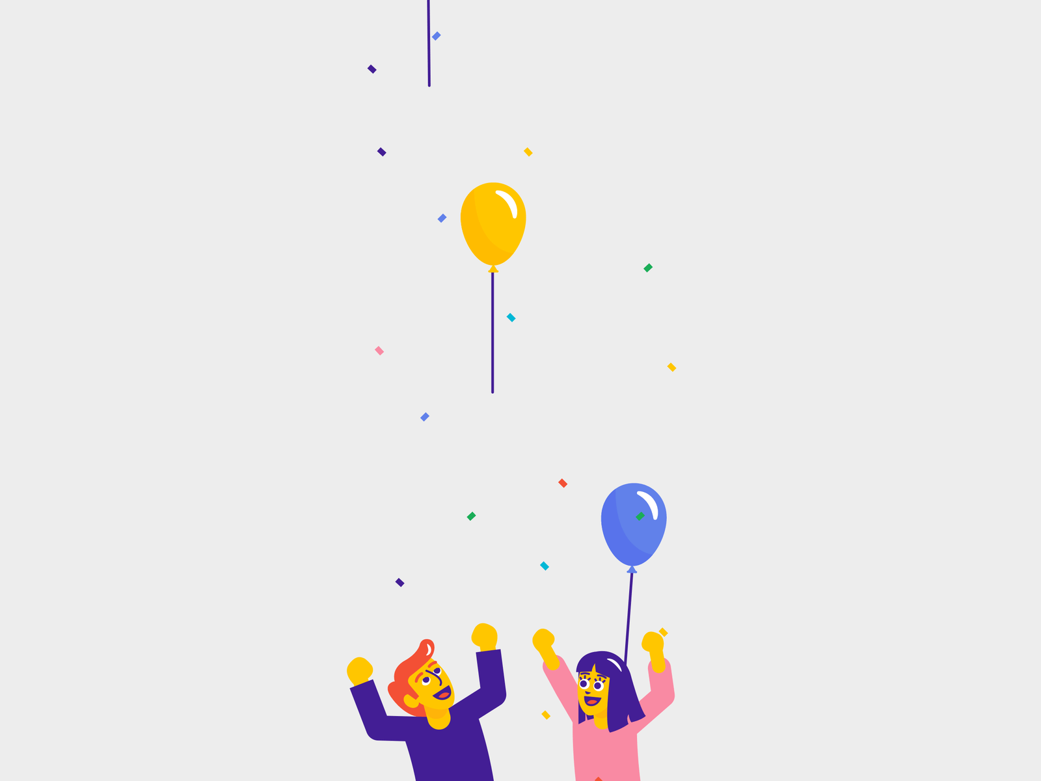
elevator
vacation
festival
farewells

Slide 13

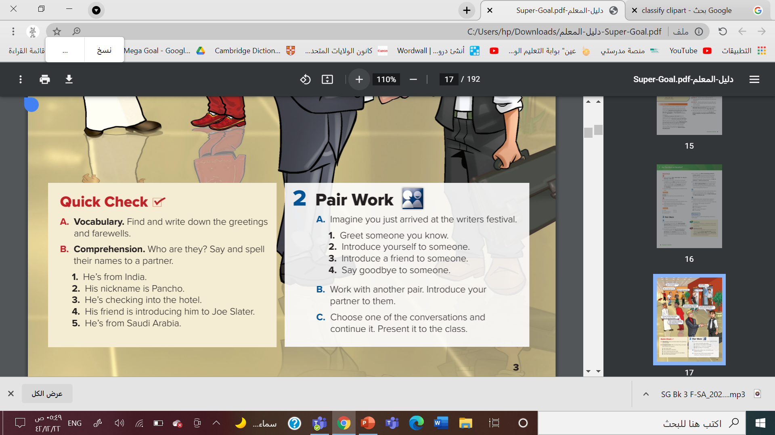
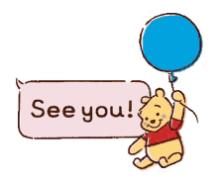
greetings
Nice to meet you
Farewells
Good afternoon
Hi
Take care
See you tomorrow
Bye
How are you?
Hi
Nice to meet you
How are you?
Bye
Good afternoon
See you tomorrow
Take care

Slide 14
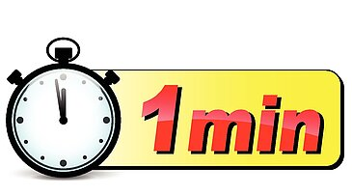
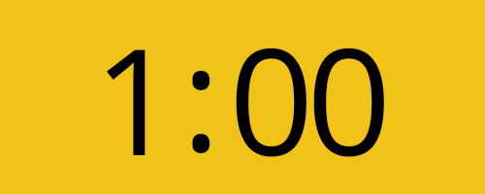
1. Ketan
2. Francisco Ramirez
3. Jean Fournier
4. Lee
5. Faris

Slide 15
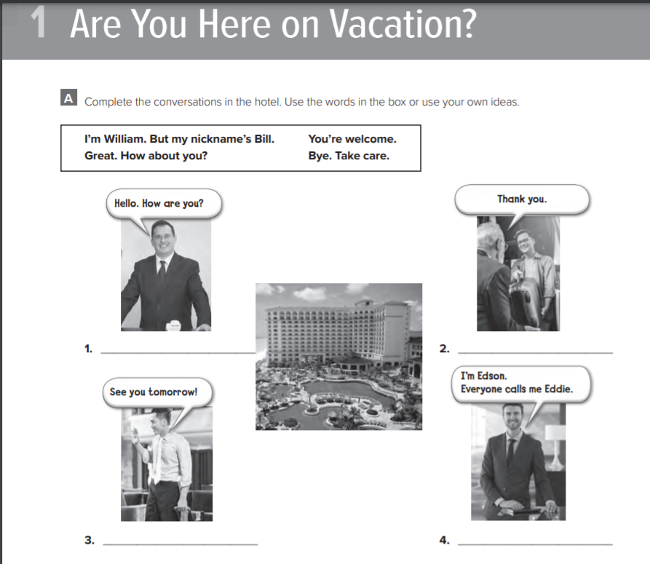

Slide 16

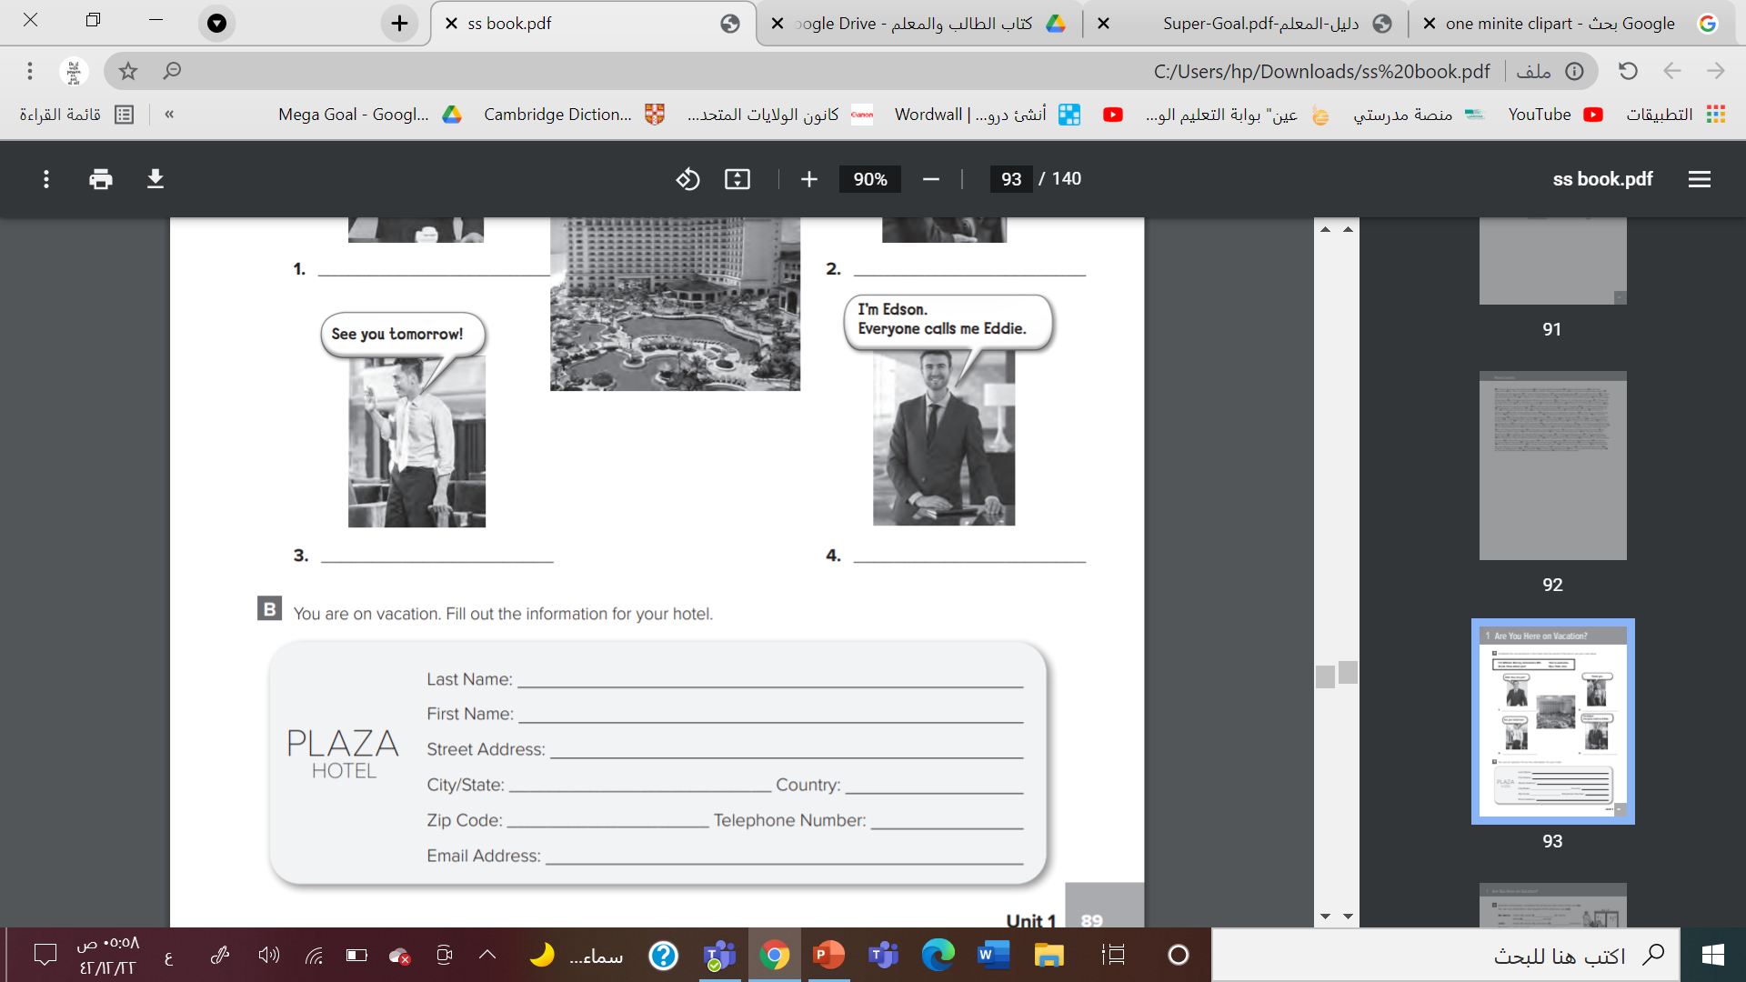
Page 89 Workbook

Slide 17

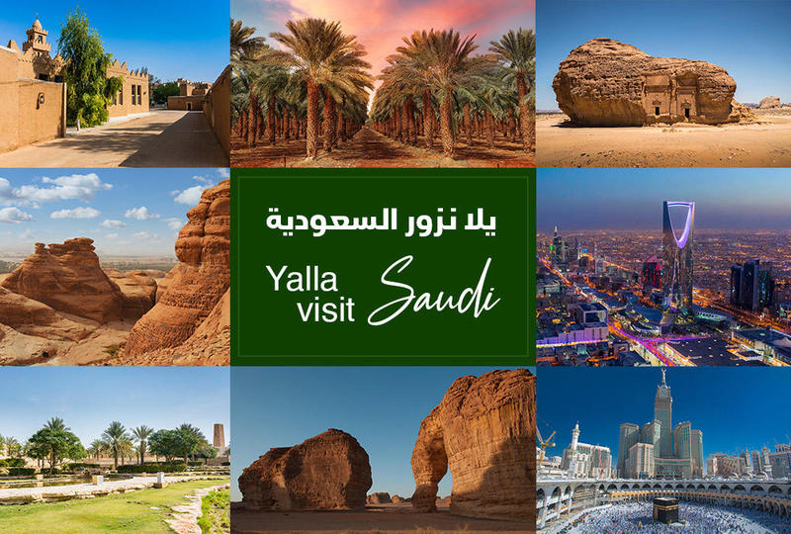

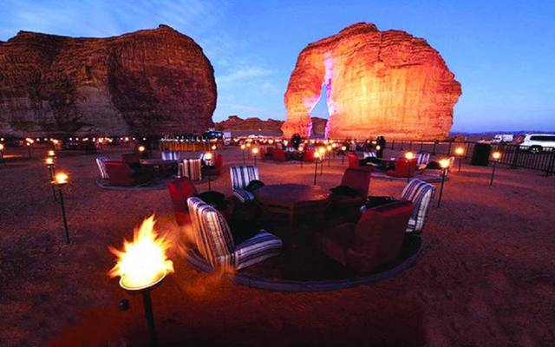


Slide 18


