Slide 1
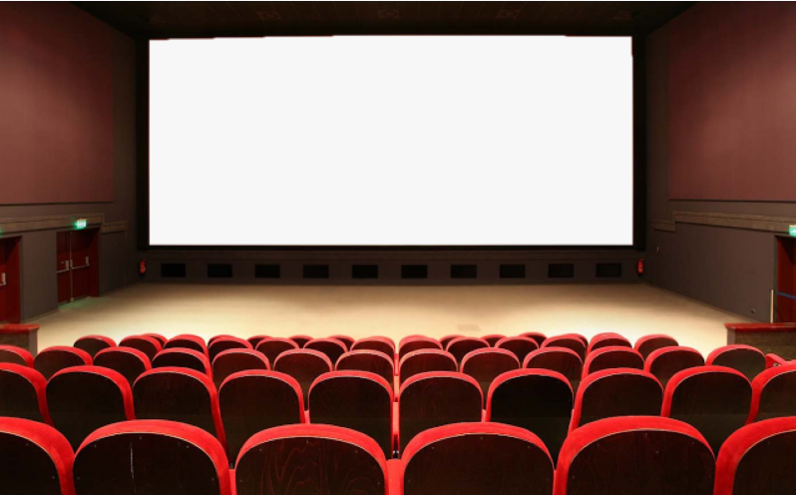
U : 2 L: 1
What are they making ?
By : ET Asma Almjlad

Slide 2
Classify words that express approval and disapproval
Make correct questions
match parts of sentences based on a picture
Objectives

Slide 3
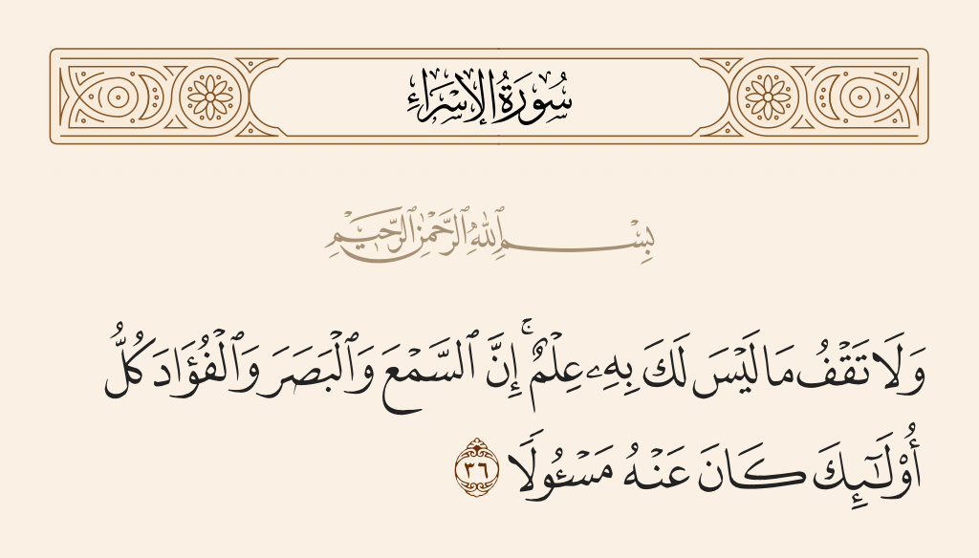

Slide 4
Open your book page 10-11

Slide 5
What do you think martial arts films mean?
Do you like martial arts films?
What are the names of some famous martial arts films?
Who are some famous martial arts actors?

Slide 6
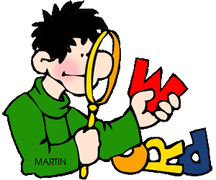

Slide 7
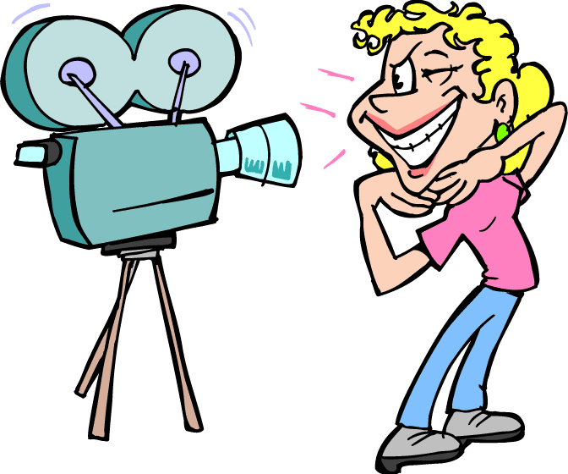
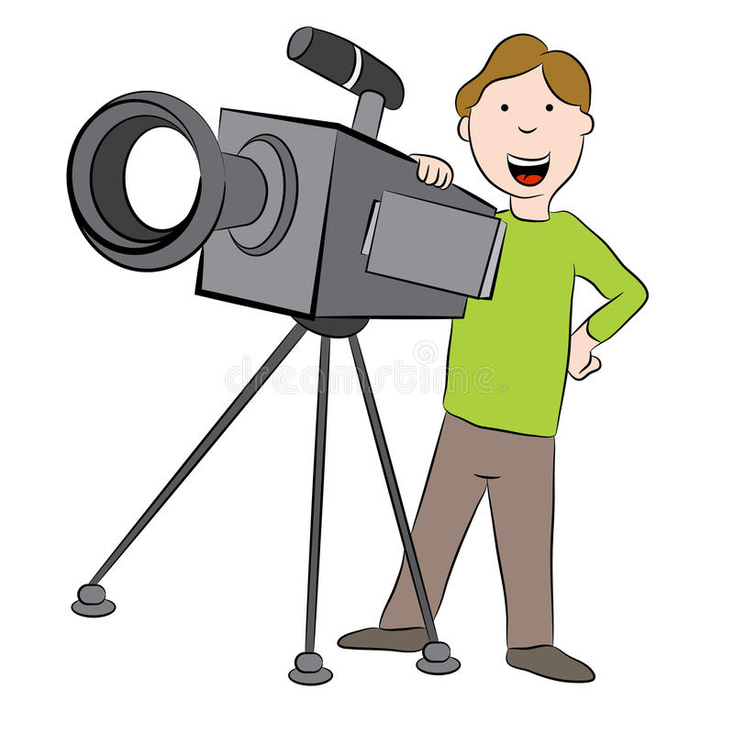
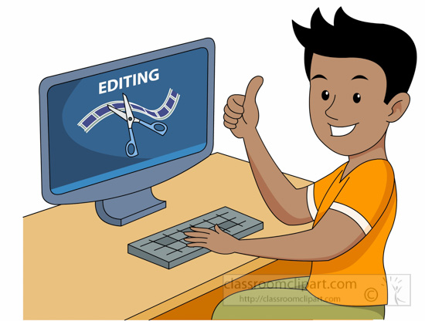
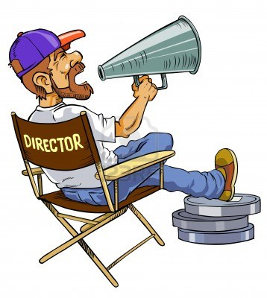
camera operator
actor
film editor
Director

Slide 8
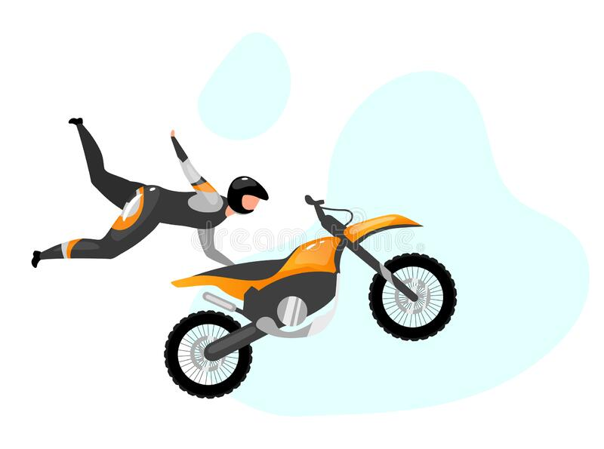
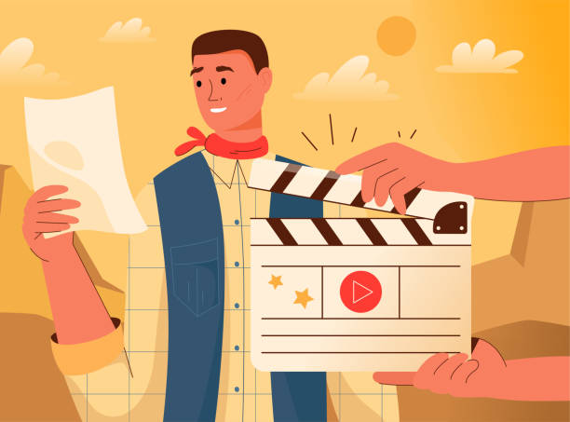
Script
stuntman

Slide 9
What do you think the TV film is about?
What is happening?
Who is the director talking to?
What are the actors’ names?
Who is eating?

Slide 10
Why is one of the actors going up a wall?
Who is feeding the fish?
Does the director want him to feed the fish?
Are all the actors acting right now?

Slide 11
True or false
The writer is happy with the script.
The director is talking to the actors.

Slide 12
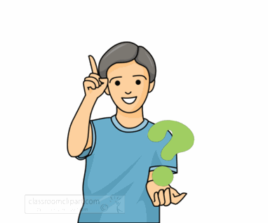
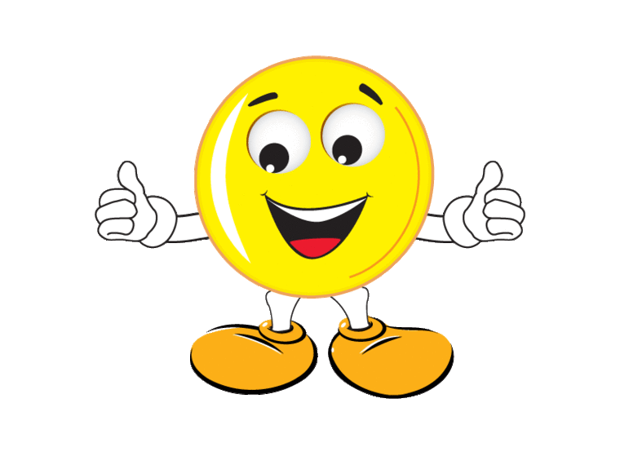
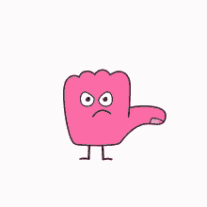
Does the director like what all the actors are doing?
Who is doing a good job?
The director approves of what Chen is doing.
Who is not doing a good job?
approval = That’s good.
disapproval = That’s bad.

Slide 13
disapproval
approval
No, that’s wrong
That’s great
…you’re doing fine
No, that’s wrong
t’s excellent
…but it tastes terrible
I love
That’s great
What are you doing?
…you’re doing fine
…but it tastes terrible
t’s excellent
What are you doing?
I love

Slide 14
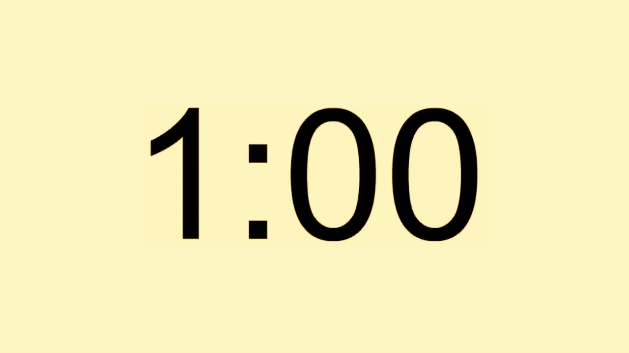
e
c
d
a
b

Slide 15
Who I am ?
someone who performs in plays, in movies, or on television

Slide 16
Who I am ?
the words of a movie, play, or speech

Slide 17
Who I am ?
someone who tells the actors in a movie or play what to do.

Slide 18
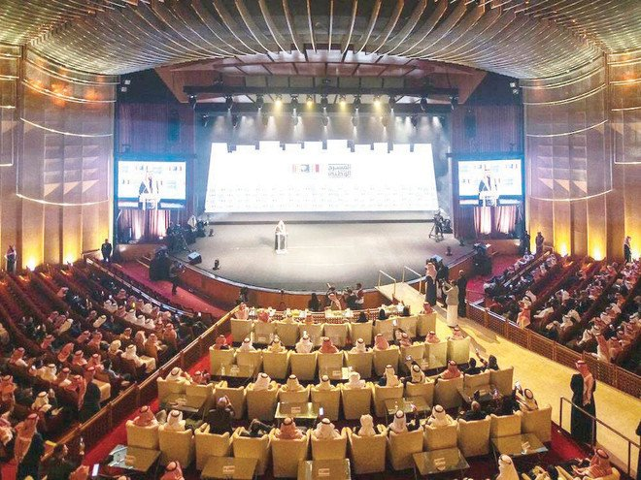
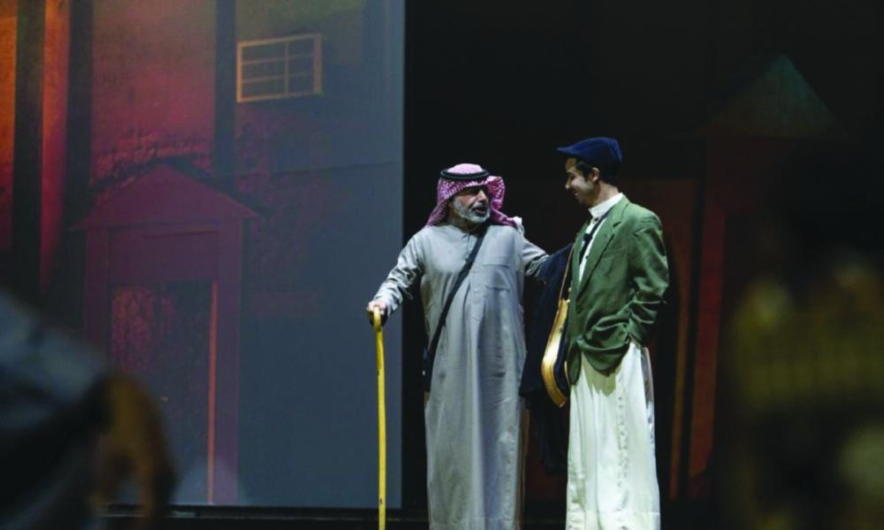

Slide 20
