Slide 1
Unit 1 ( writing )
Nora Khalid

Slide 4
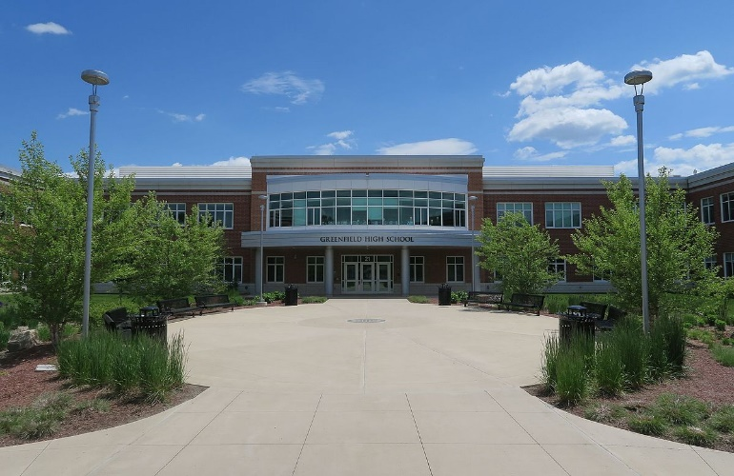
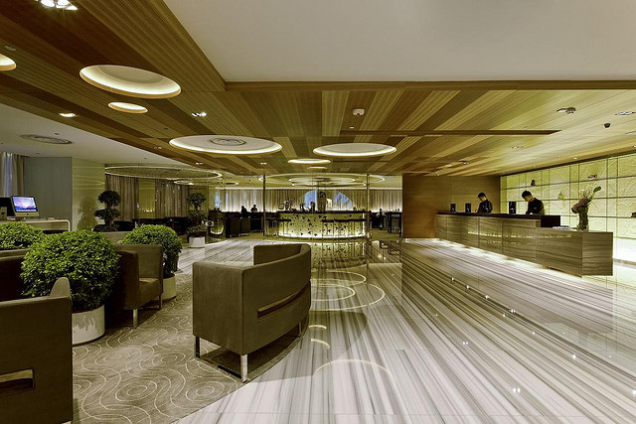
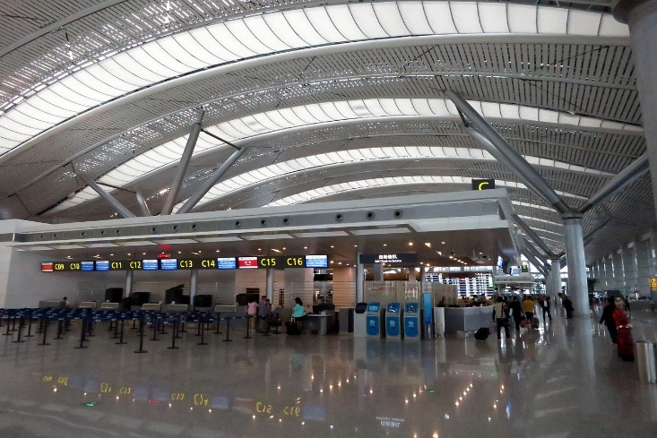
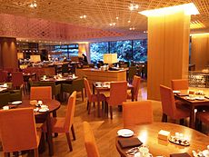
when I’m at a/an hotel, airport, School, restaurant …..
I use “would like” to make requests.

Slide 5
Want
Would like
I would like a single room.
I want a single room.
Do you want some coffee?
Would you like some coffee?

Slide 7
Read

Slide 8
first and last name
Address and telephone number
Number of guests
passport
Method of baying

Slide 9
Create a hotel or hostel registration form. Use ideas from the chart, and add any other information you think is important.
Give your hotel a name and design a logo. Then, with a partner, practice asking for information to fill in your registration form.

Slide 10
I’m fine. How are you?
is Nora.
N.O.R.A
Yes, I’m.
No, I’m here for a week.
My email address is nokhfh86@gmail.com
is the gym?
is breakfast?

