Slide 1

U 3 Who’s who?
TR. Nora khalid

Slide 2

LISTENING:
Listen for specific information about a profession and career goals
VOCABULARY:
Jobs
Job duties
and locations
Career goals

Slide 3

What do I do?

Slide 4
I’m a teacher

Slide 5
What do you do?

Slide 6

I’m a student

Slide 7
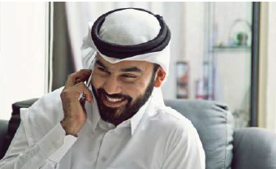
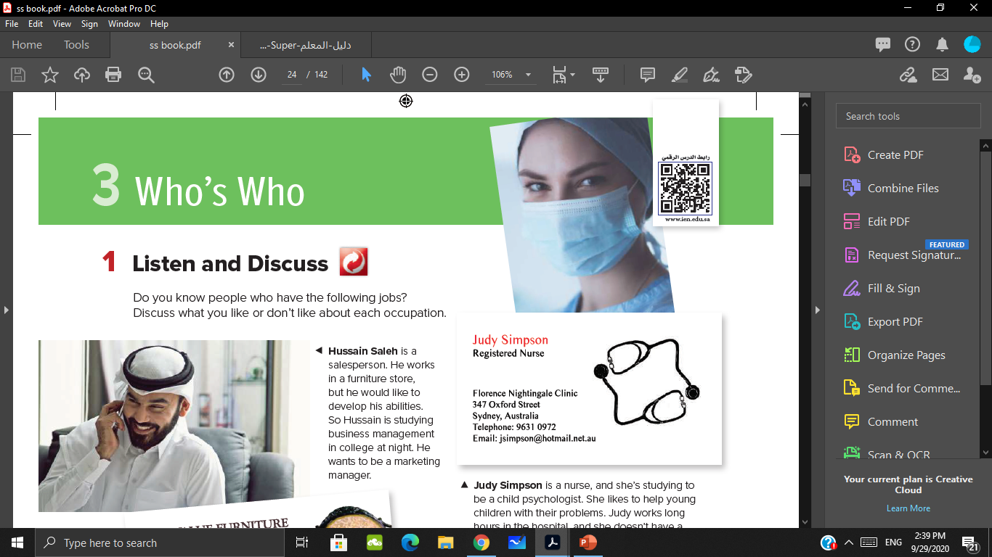
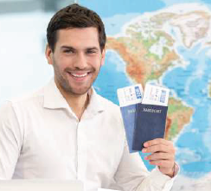
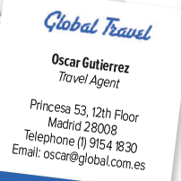
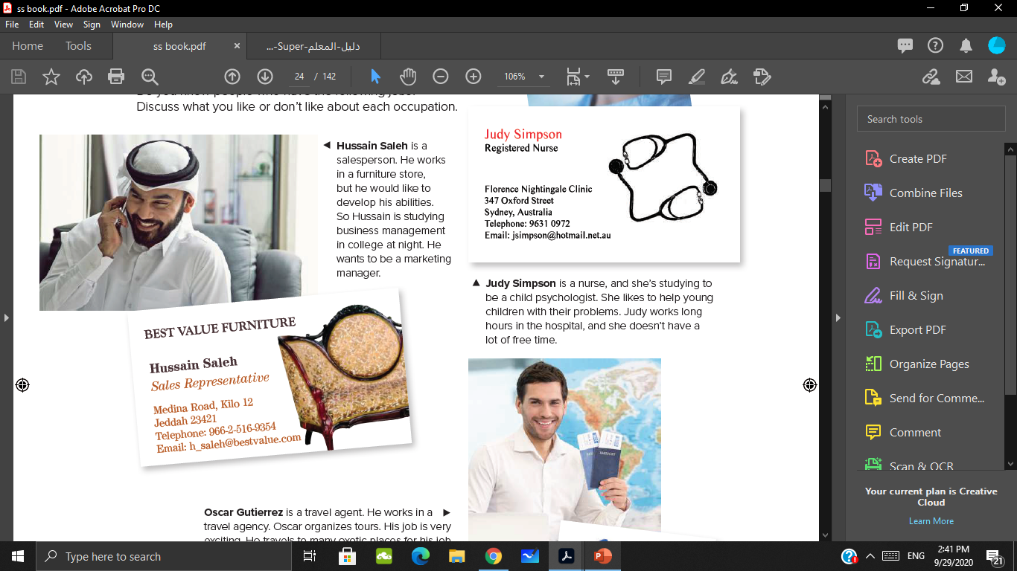

Slide 8
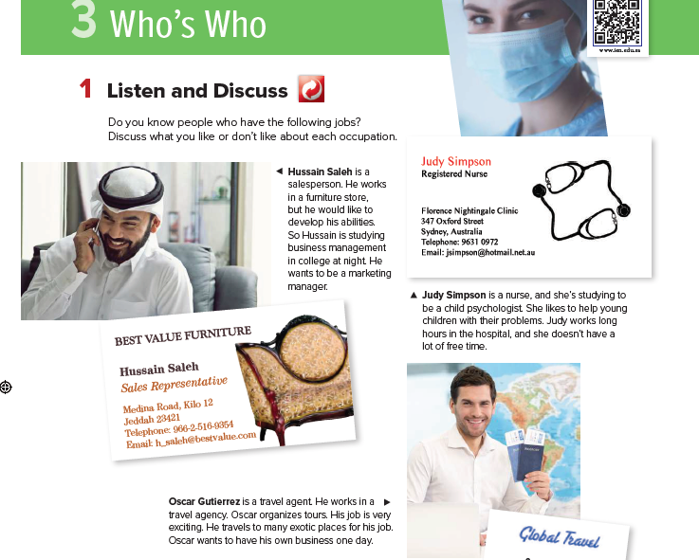


Slide 9
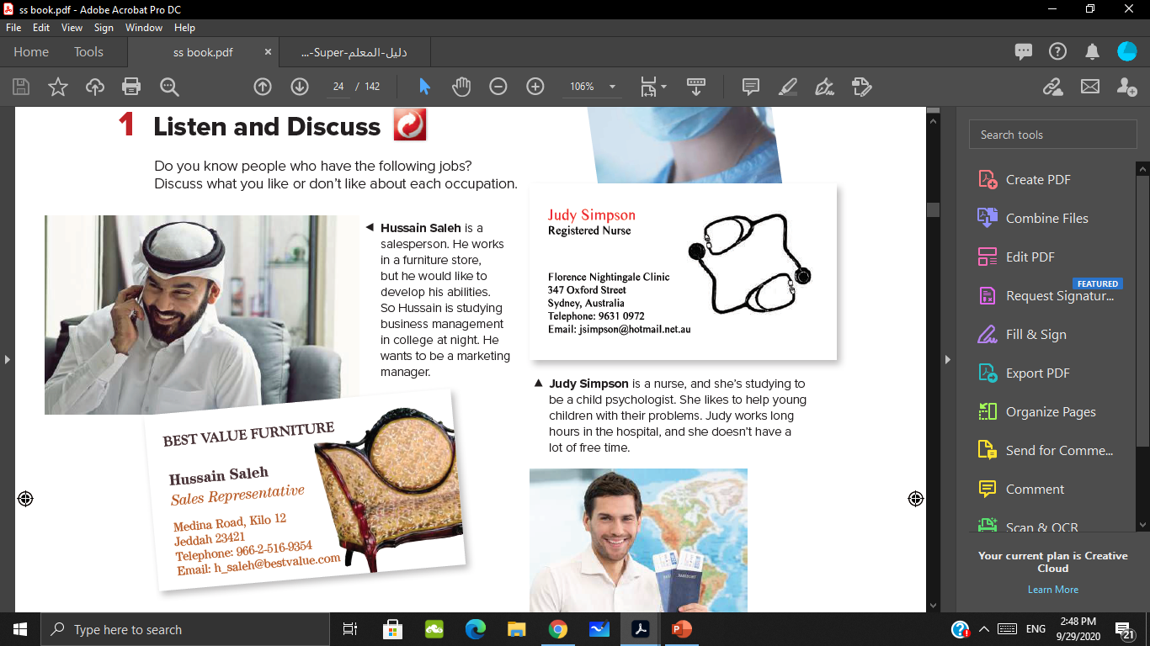
What does Hussain do?
What does he work for ?
Where does he work?

Slide 10
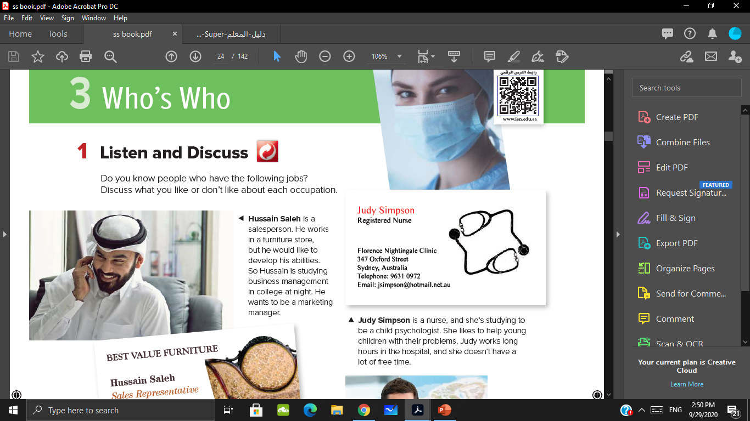
What does Judy do?
What does she like?
Where does she work ?

Slide 11
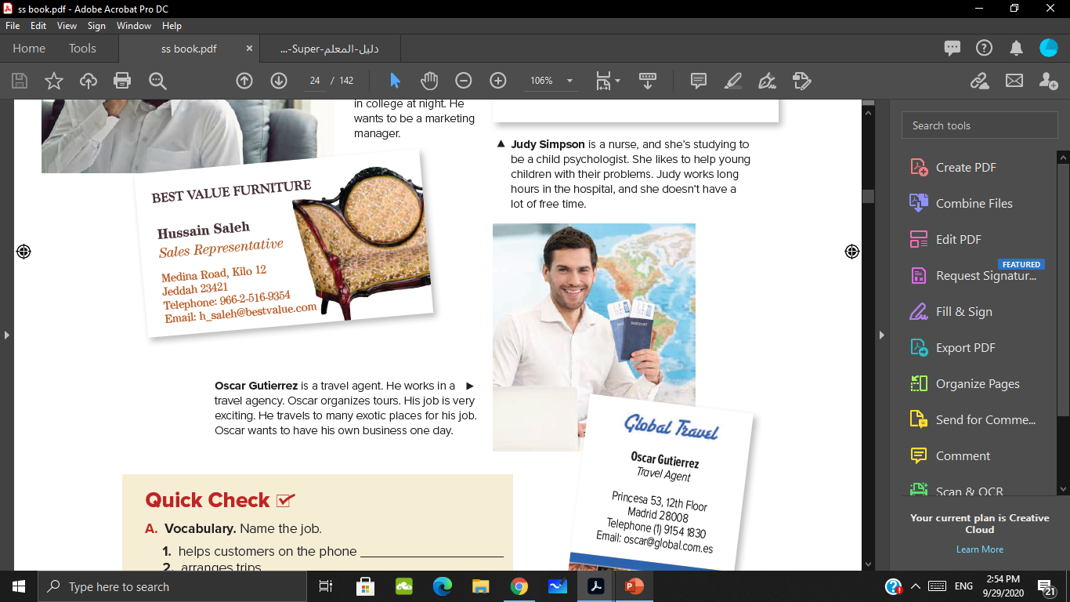
What does Oscar do?
Where does he work ?
Does he like his job? Why ?

Slide 12
Travel agent
Salesperson
Nurse

Slide 13
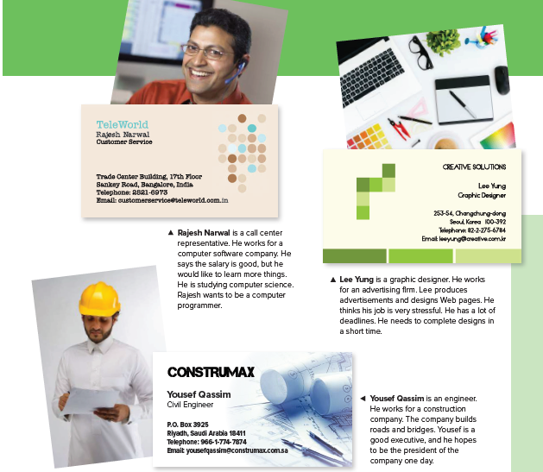

Slide 14
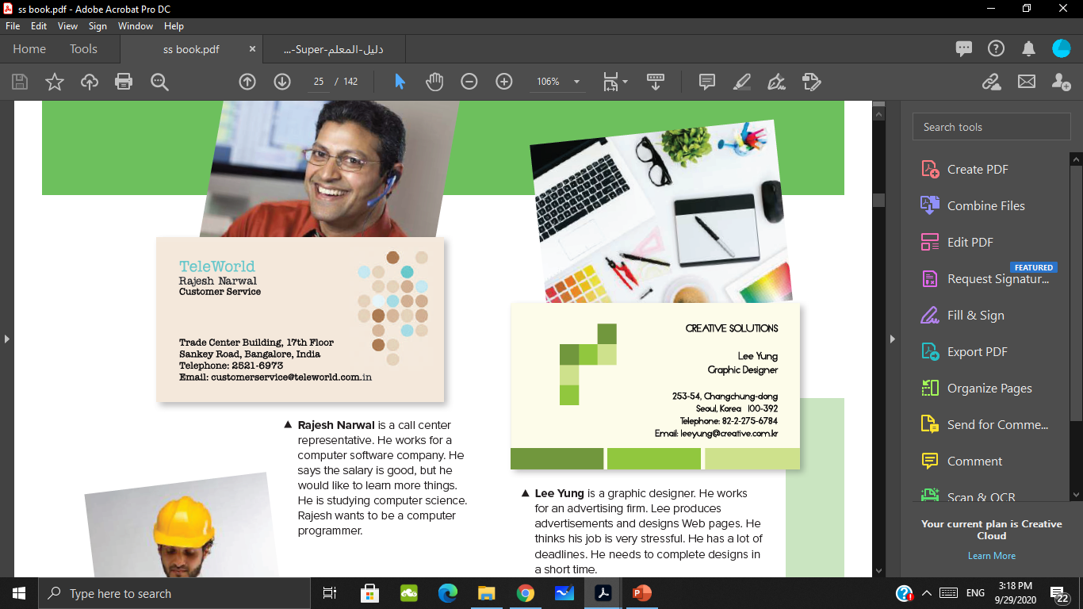
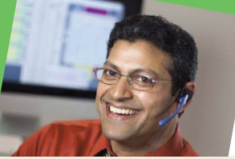
What does Rajesh do?
Where does he work ?
What does he want to be ?

Slide 15
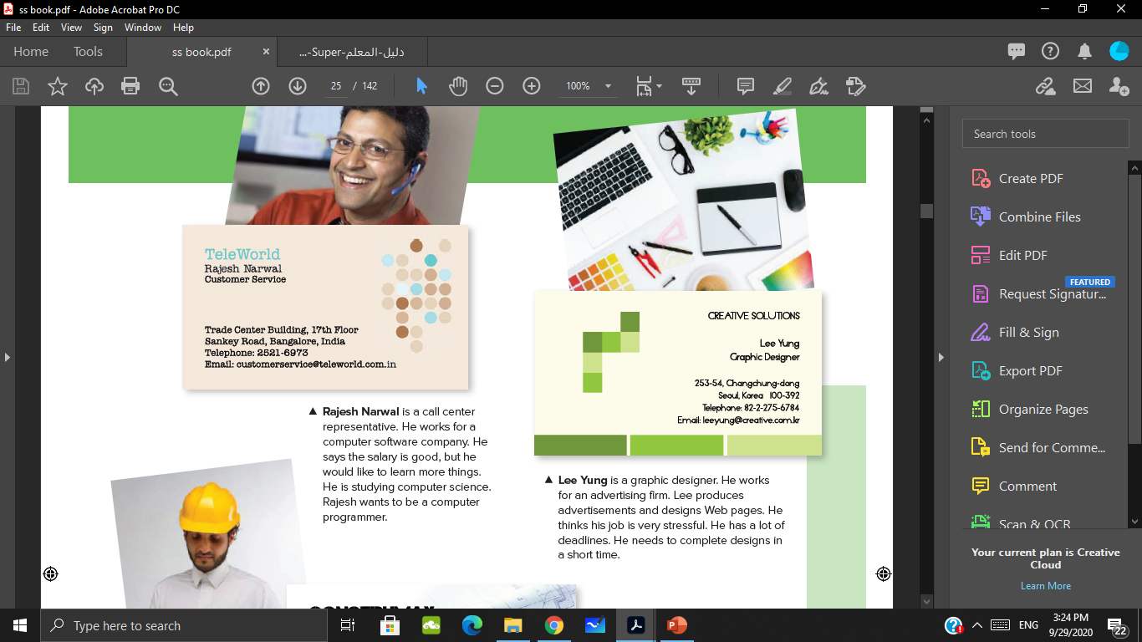
What does Lee do?
Where does Rajesh do?

Slide 16
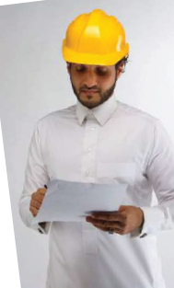

What does Yousef do?
Where does he do?
What does he want to be?

Slide 17
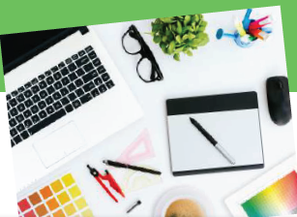
Graphic designer
Call center representative
Civil engineer

Slide 18
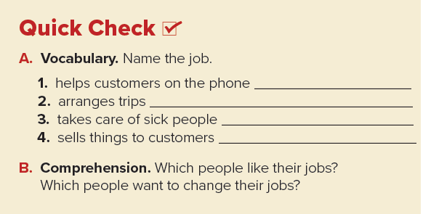
call center representative
Travel agent
Nurse
Salesperson

Slide 19


Which people like their jobs?
Which people want to change their jobs?
Judy Simpson
Hussain Saleh
Rajesh Narwal
Lee Yung.
Yousef Qassim
Oscar Gutierrez

Slide 20


Slide 21


