Slide 1

U 3 READING
P23
Tr. NORA KHALID

Slide 2

To read the text for comprehension.
To know some new vocabularies related to the topic “jobs and employment.
To discuss questions related to the topic.
To suggest some advice to unemployed people

Slide 3
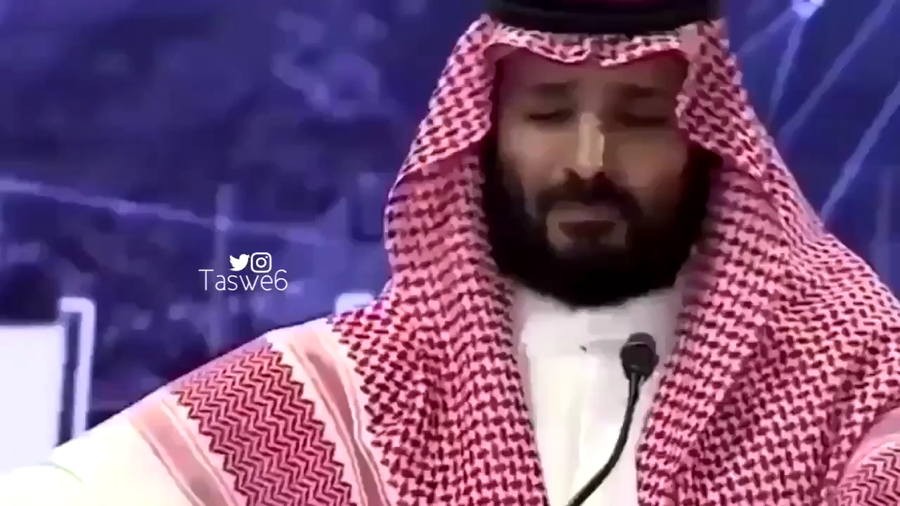

Slide 4

What does this picture refer to ?

Slide 5
What do you know about Saudi vision 2030?

Slide 6
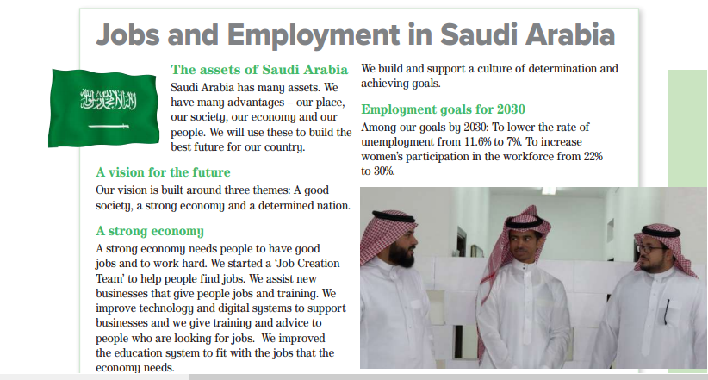

What is the title of this article?

Slide 7
How many subtitles are there?

Slide 8
Listen & read

Slide 9
Listen & read

Slide 10

Culture
Lower
Economy
Increase
Society
Unemployment
Assets
Workforce

Slide 11

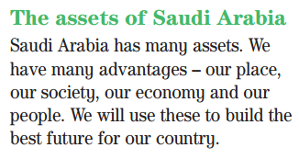
what are the assets of Saudi Arabia?

Slide 12
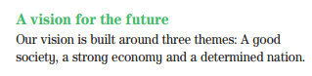
what are the three themes that the vision is built around?

Slide 13
Listen & read

Slide 14
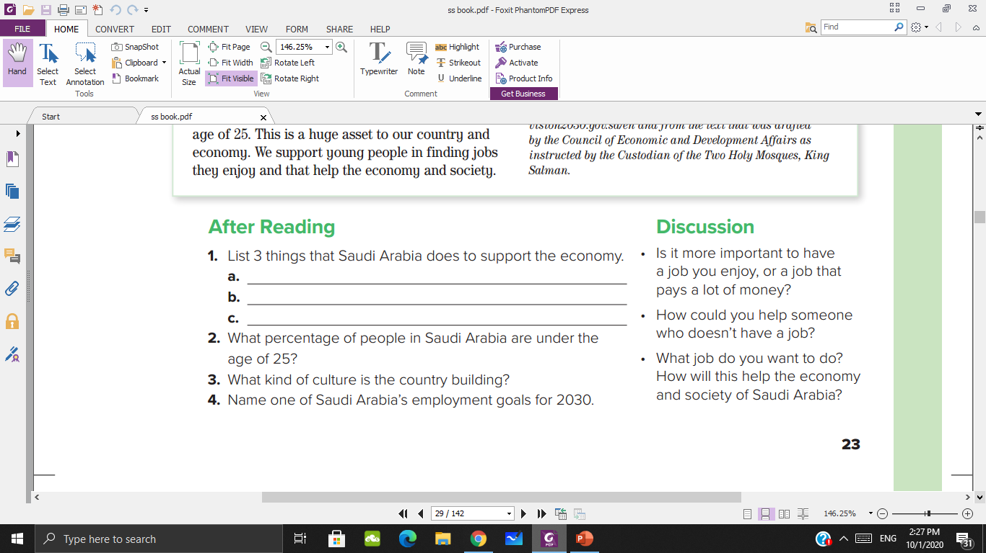
Has a ‘Job Creation Team’ to help people find jobs.
Assists new businesses that give people jobs and training.
Improves technology and digital systems to support
businesses.
50%

Slide 15
3- A culture of determination and achieving goals.
4- To lower the rate of unemployment from 11.6% to 7%
To increase women’s participation in the workforce
from 22% to 30%

Slide 16

what would you like to be in the future?

Slide 17


Is it more important to have a job you enjoy, or a job that pays a lot of money?

Slide 18



How could you help someone who doesn’t have a job?
Training
Marketing himself on social media
Volunteering

Slide 19


