Slide 1
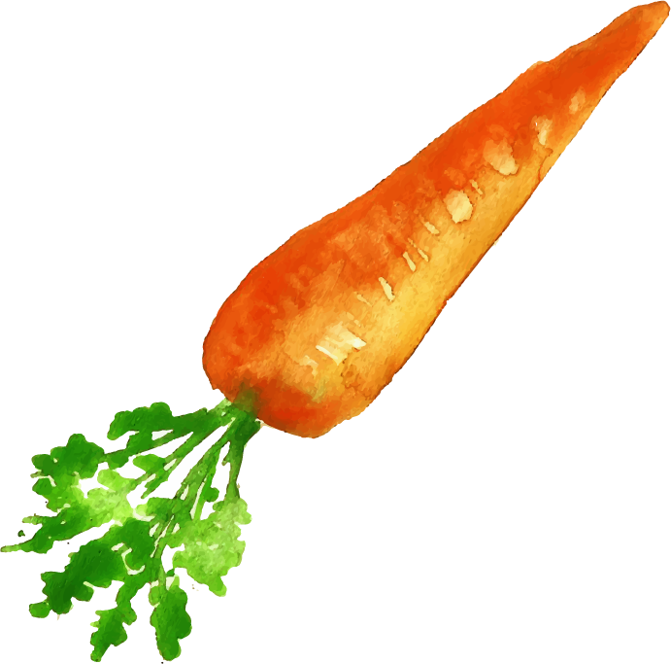
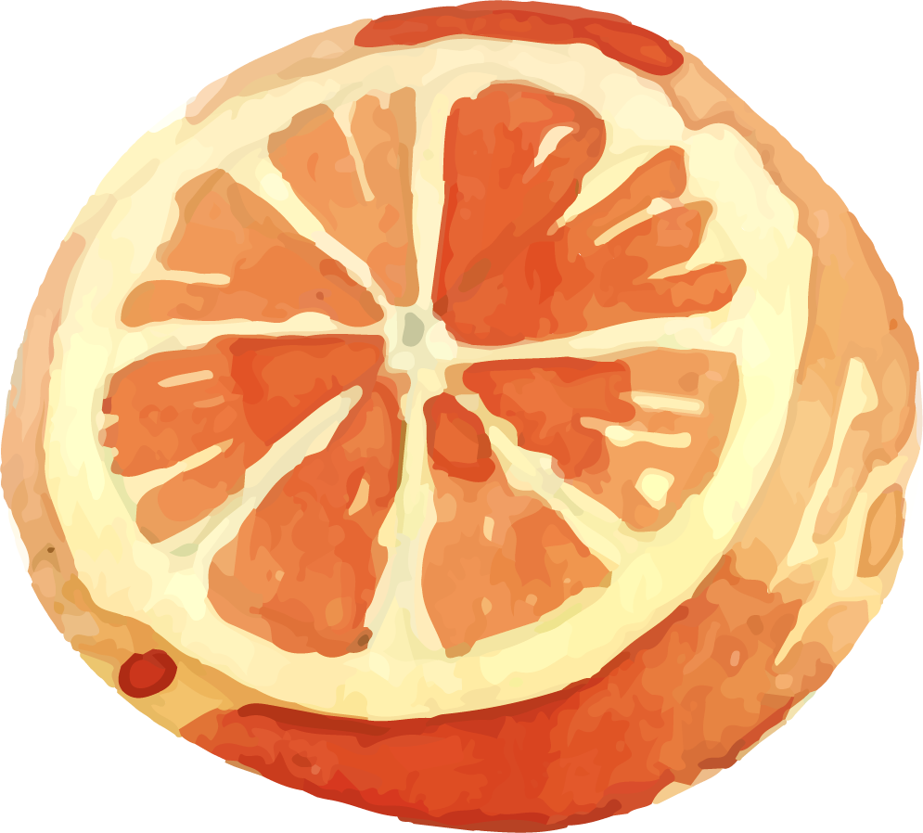

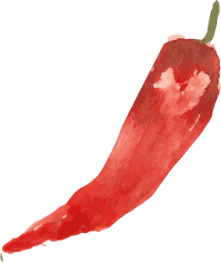
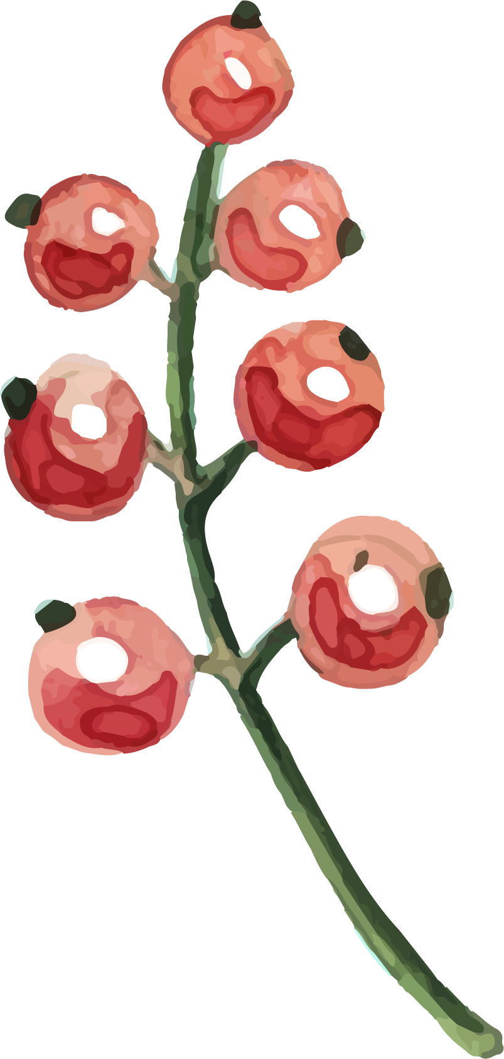
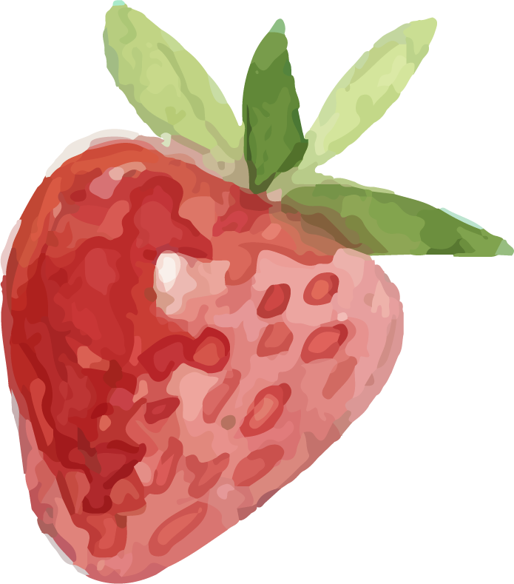
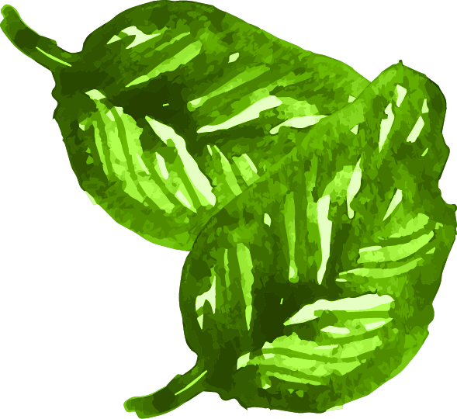
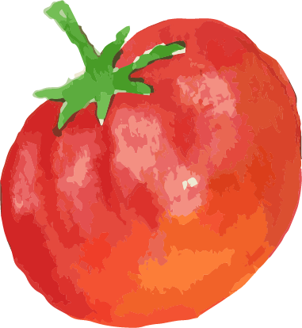
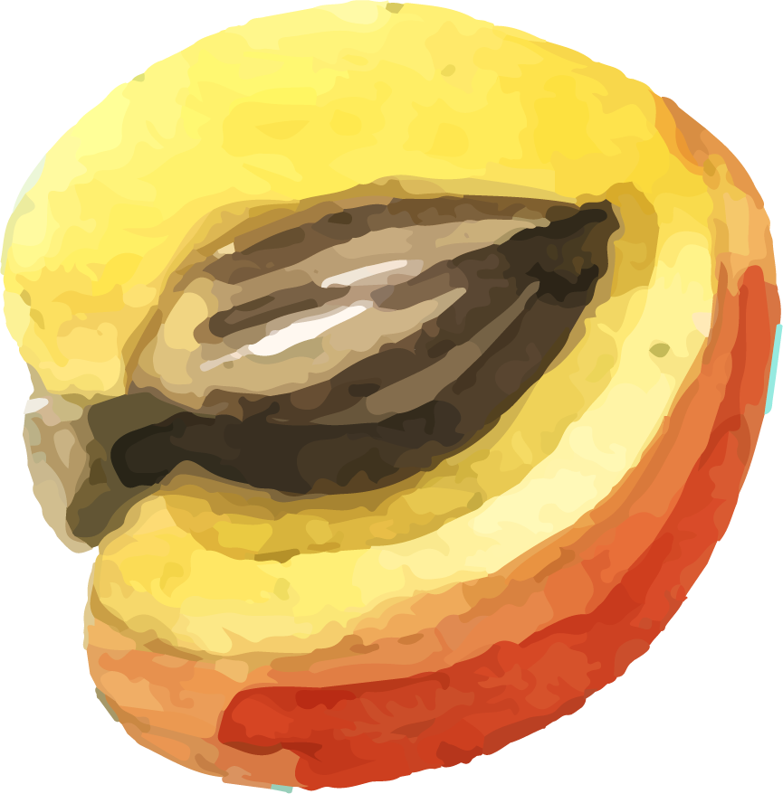
U 5
Is There Any Ice Cream?
Tr. Nora Khalid

Slide 2


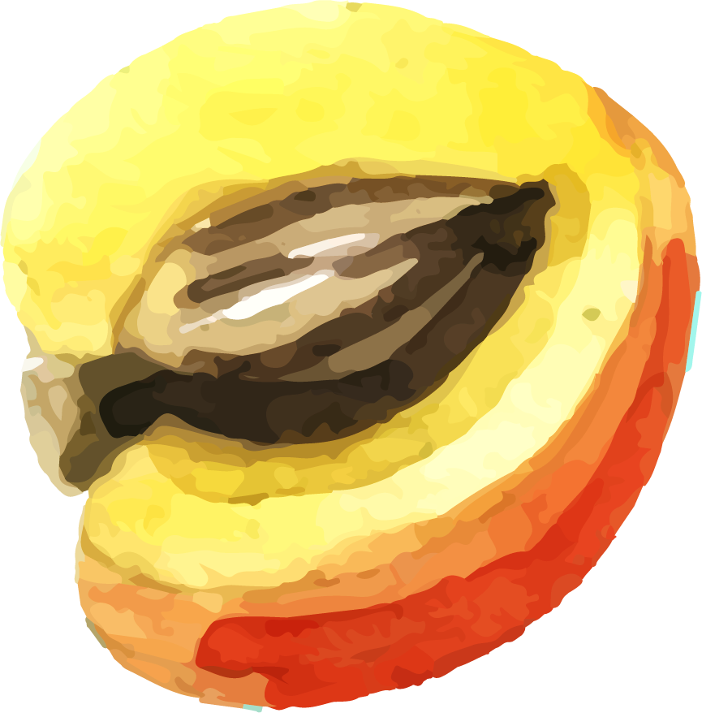
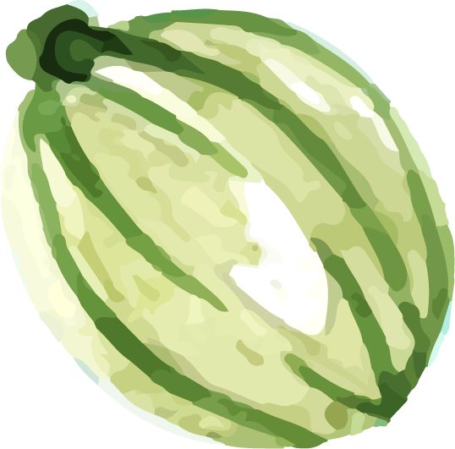
Goals
To listen for specific information from a meal order.
To introduce some vocabularies related to food and drinks .

Slide 3
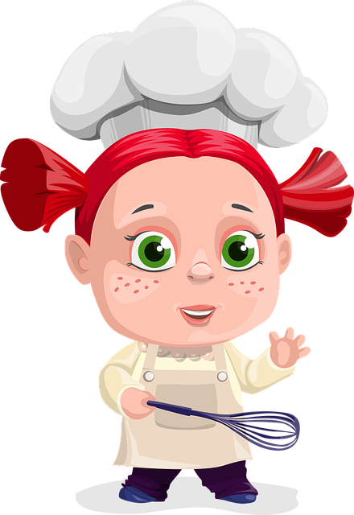
What’s your favorite food?

Slide 4
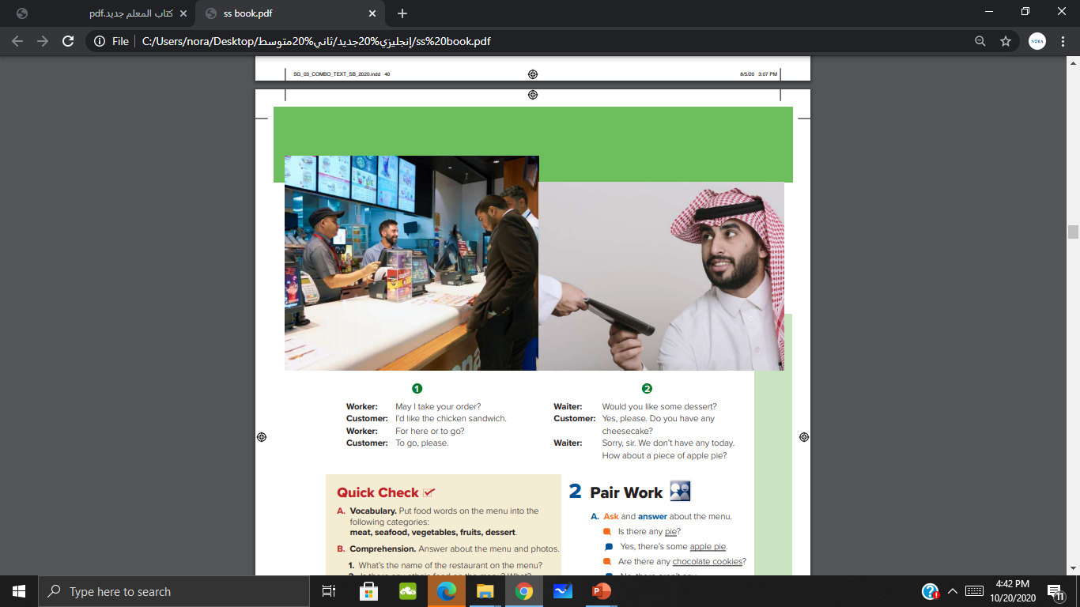
Where are
the people?
They are at restaurant

Slide 5
Table servers
How are
the restaurants different?
Fast food

Slide 6
They are ordering food
What are the customers doing?

Slide 7
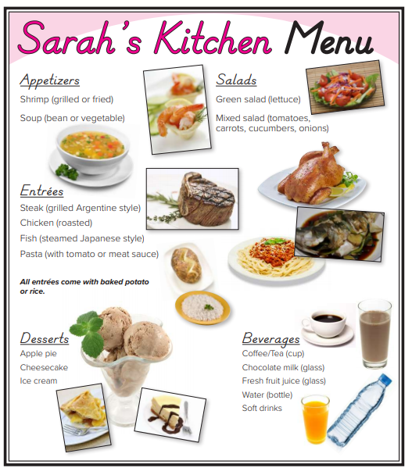
What can you see?

Slide 8
What kind of salad do you see?
What kinds of appetizers do you see?

Slide 9
What kinds of entrees do you see?
What kinds of desserts do you see?

Slide 10
What kinds of drinks do you see?

Slide 11
What about the baked potato and rice? Why are there pictures of them?

Slide 12
Which of these food do you like ? Don’t you like?

Slide 13

Circle the items that don’t have a picture.

Slide 14

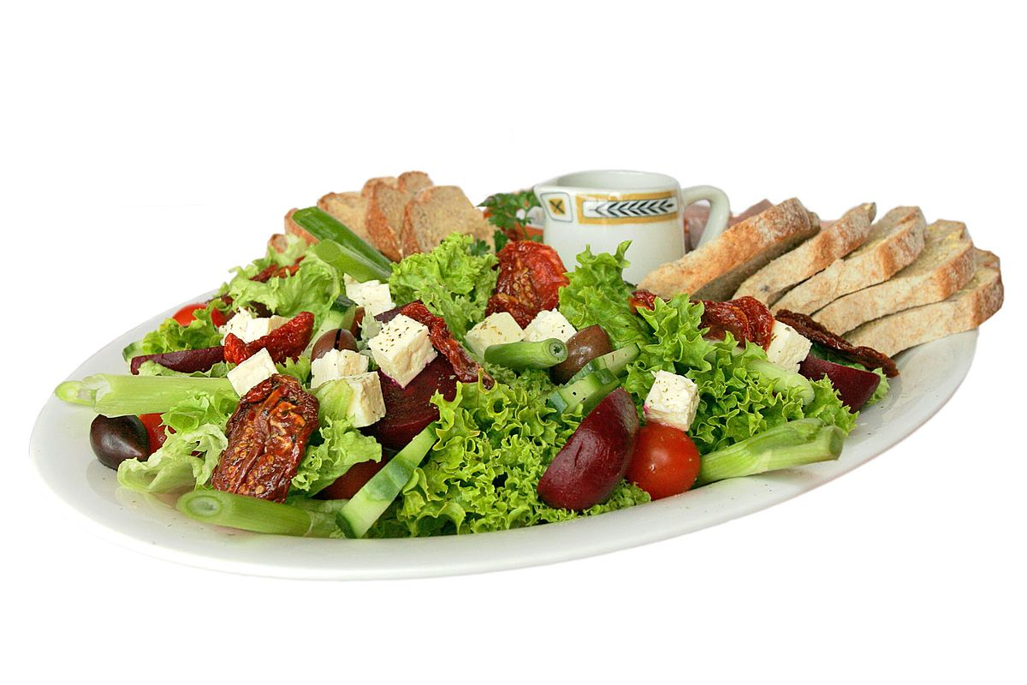
Salad

Slide 15
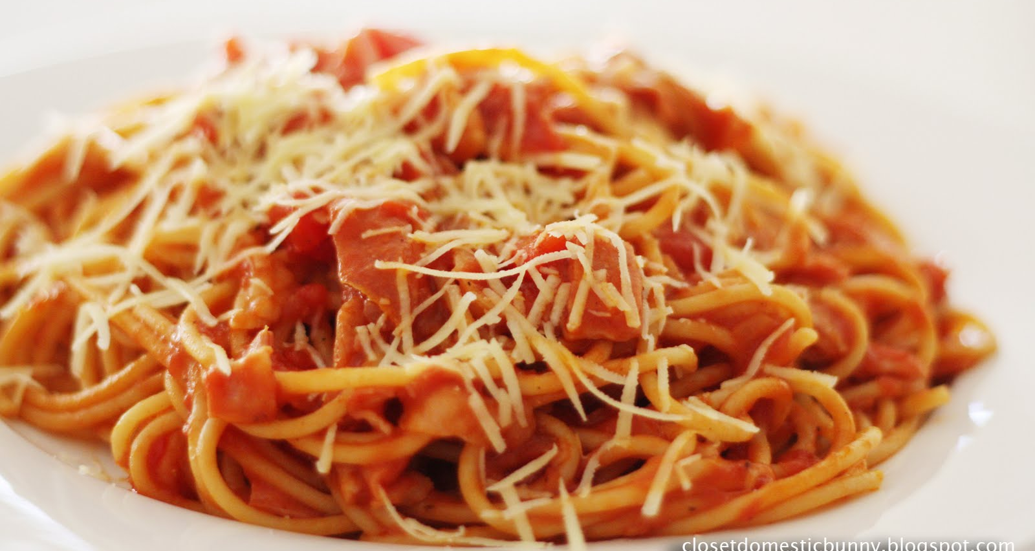
Entrées

Slide 16
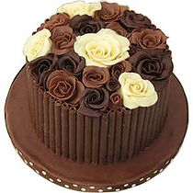
Desserts

Slide 17
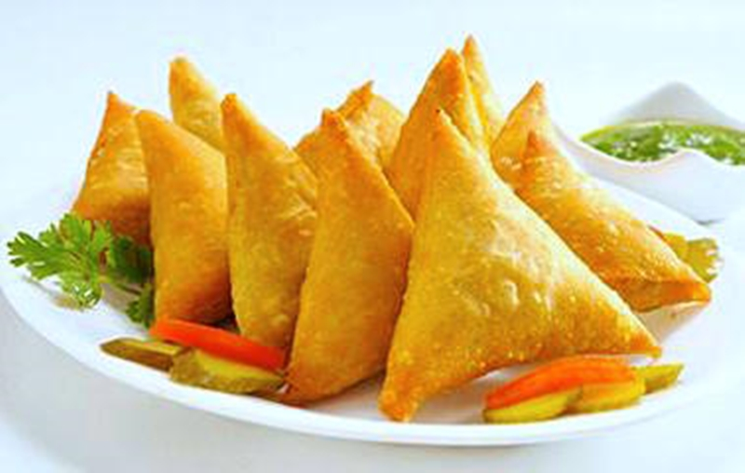
Appetizers

Slide 18
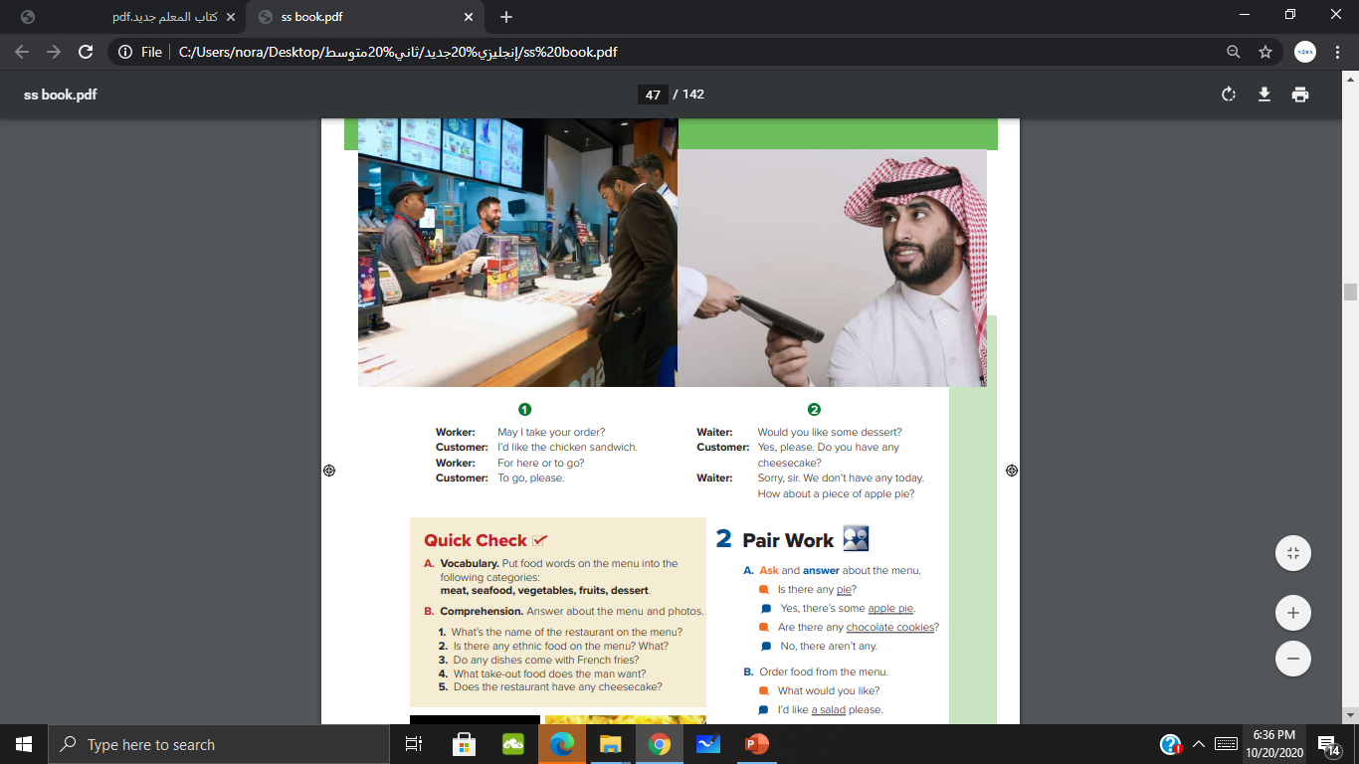
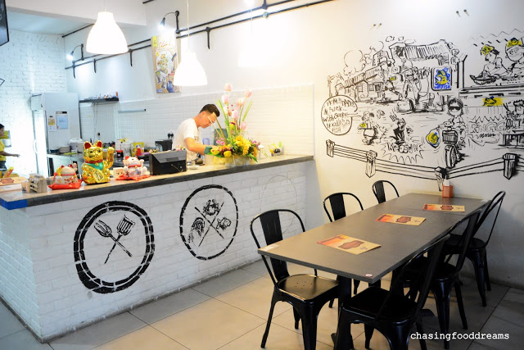


Slide 20
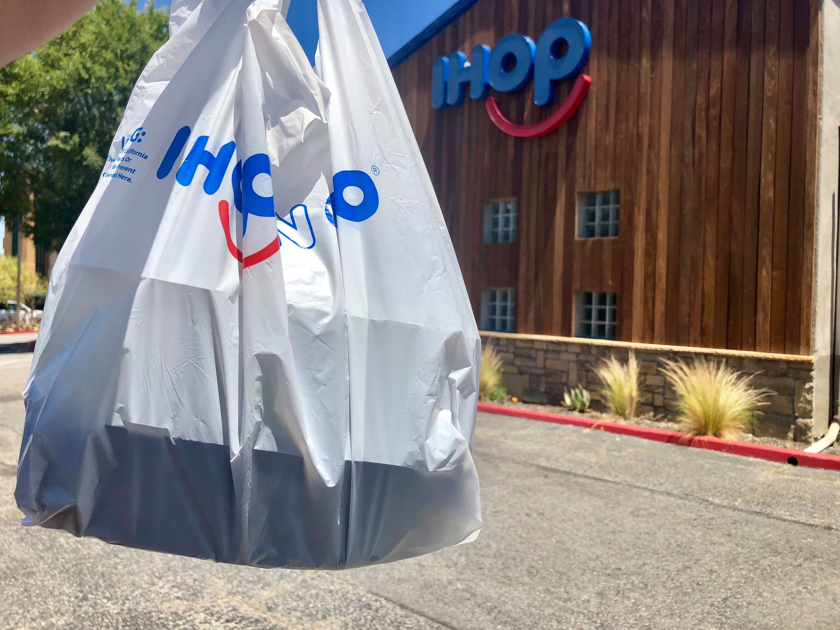
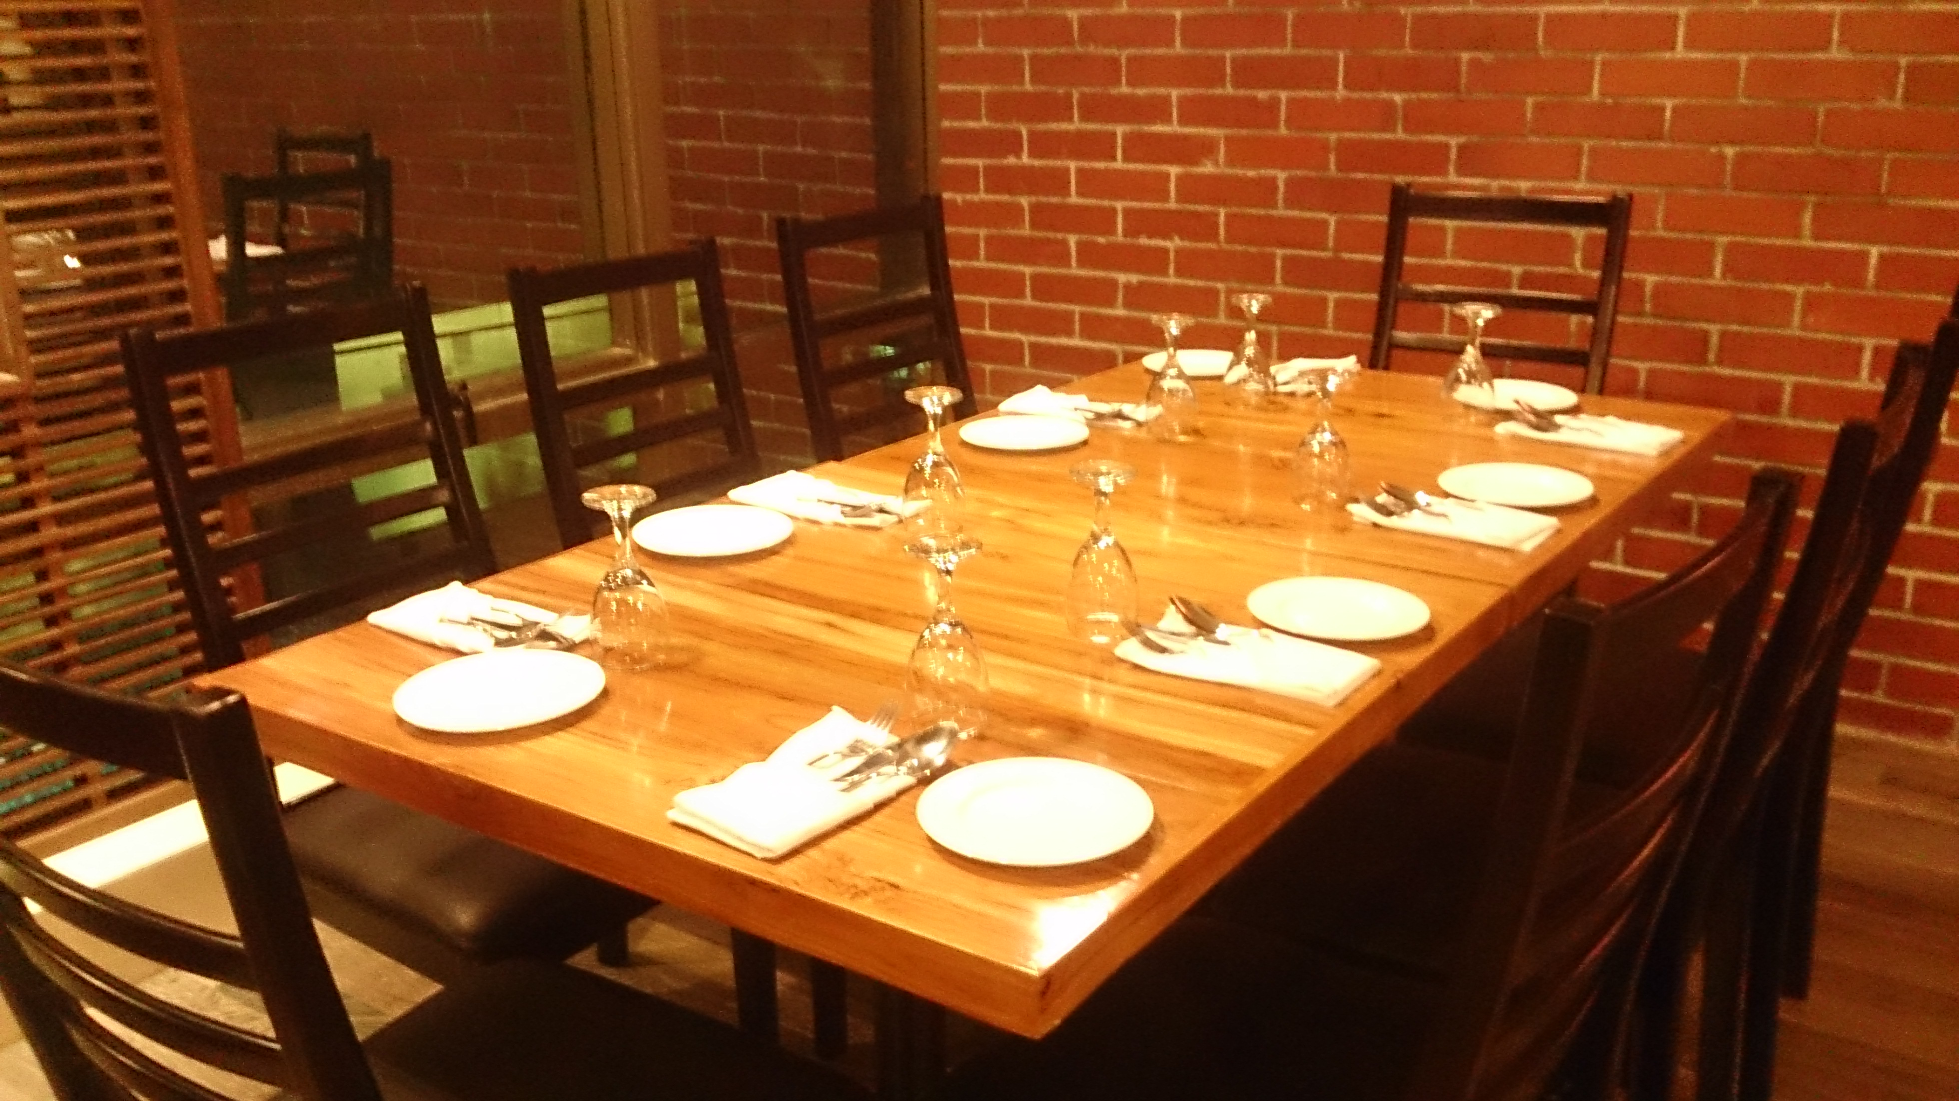
For here
To go

Slide 21
Put food words on the menu into the following categories:
Desserts | Fruits | Vegetables | Seafood | Meat
steak chicken
Carrots
Cucumbers
Lettuce
Onions
Potato
Tomato
Apple pie
Cheesecake
Ice cream
Shrimp fish
Apple

Slide 22
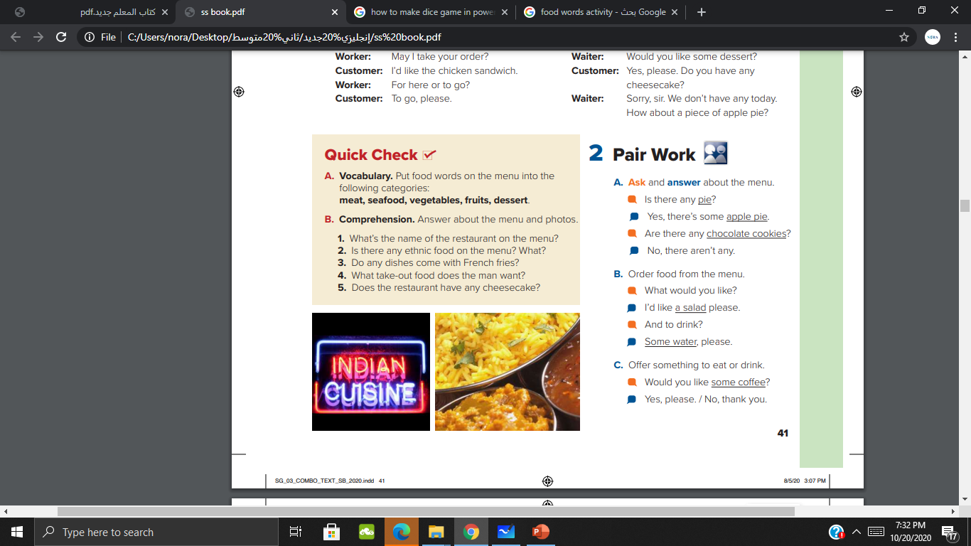
1- Sarah’s kitchen
2- Yes, there is steak Argentine style and fish steamed Japanese
3- No
4- A chicken sandwich
5- Yes

Slide 23
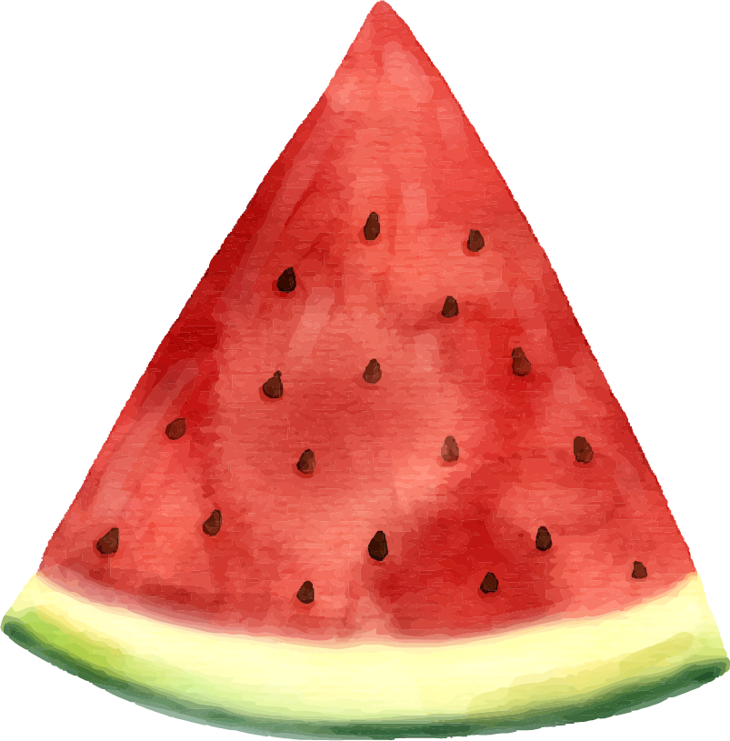
READ
“eat and drink, but be not excessive. Indeed, He likes not those who commit excess”

Slide 24



P 107 (A)
THANK YOU
SAY YOU AGAIN

