Slide 1
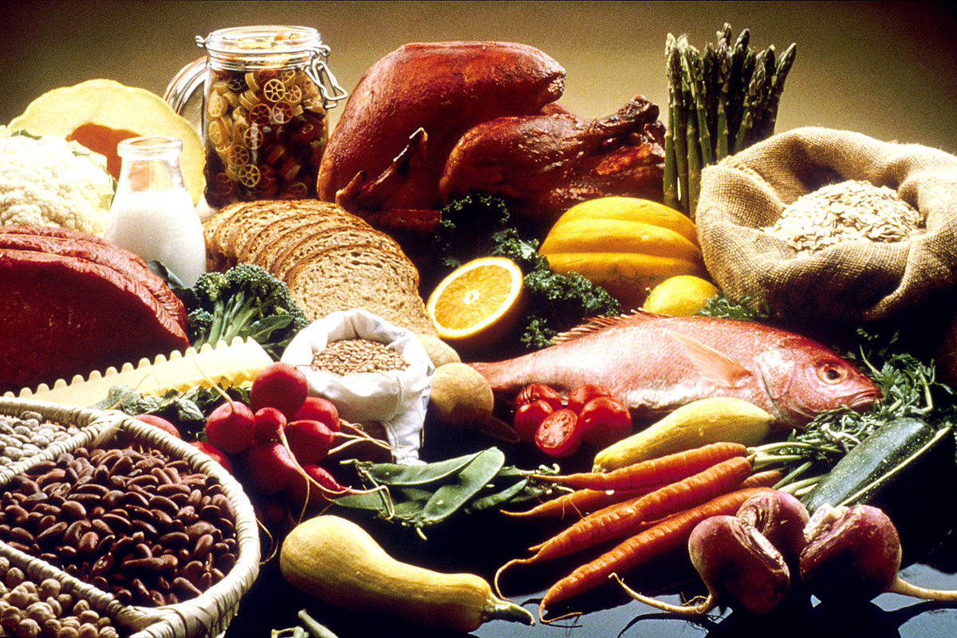
U 5
Writing p 46
Tr. Nora Khalid

Slide 2
To write a recipe using the
imperative, sequence words and time words.

Slide 3
What’s your favorite food?

Slide 4

Tell us the ingredients and we’ll guess the dish

Slide 5
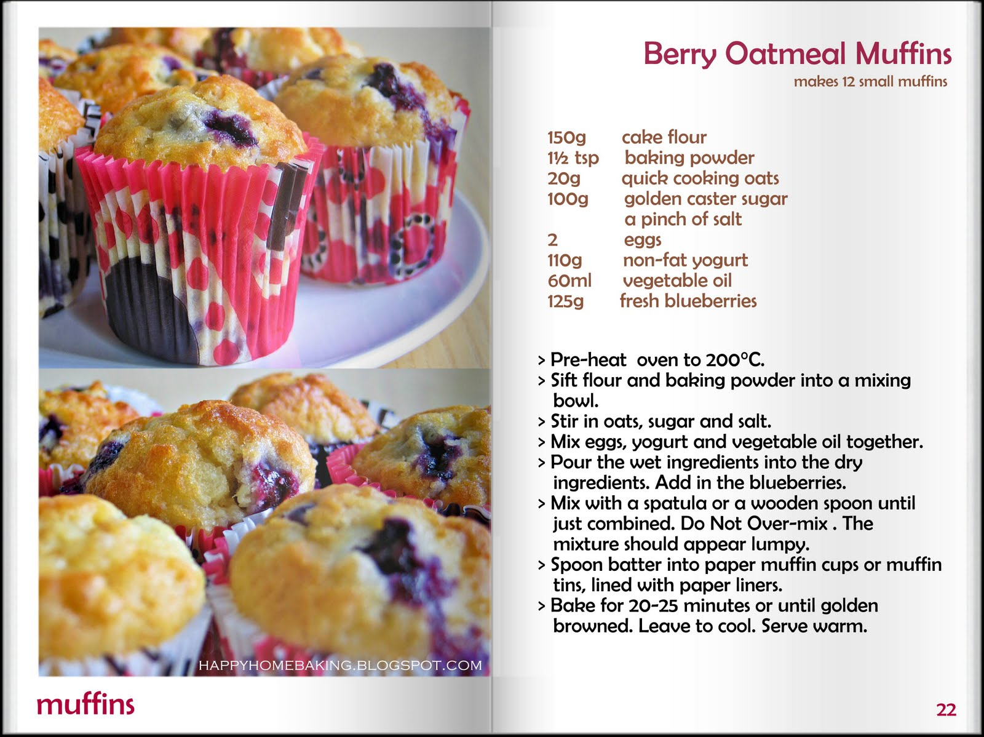
This is a recipe of Muffin
What does “recipe” mean?

Slide 6
To write a recipe, we use:
Sequence words
Time words
Imperative
Boil – Melt – put –
Add – pour
fist, next, then, after that, finally
when and until.

Slide 7
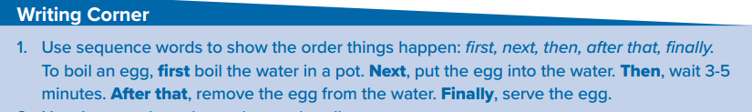
Sequence words

Slide 8

Time words

Slide 9
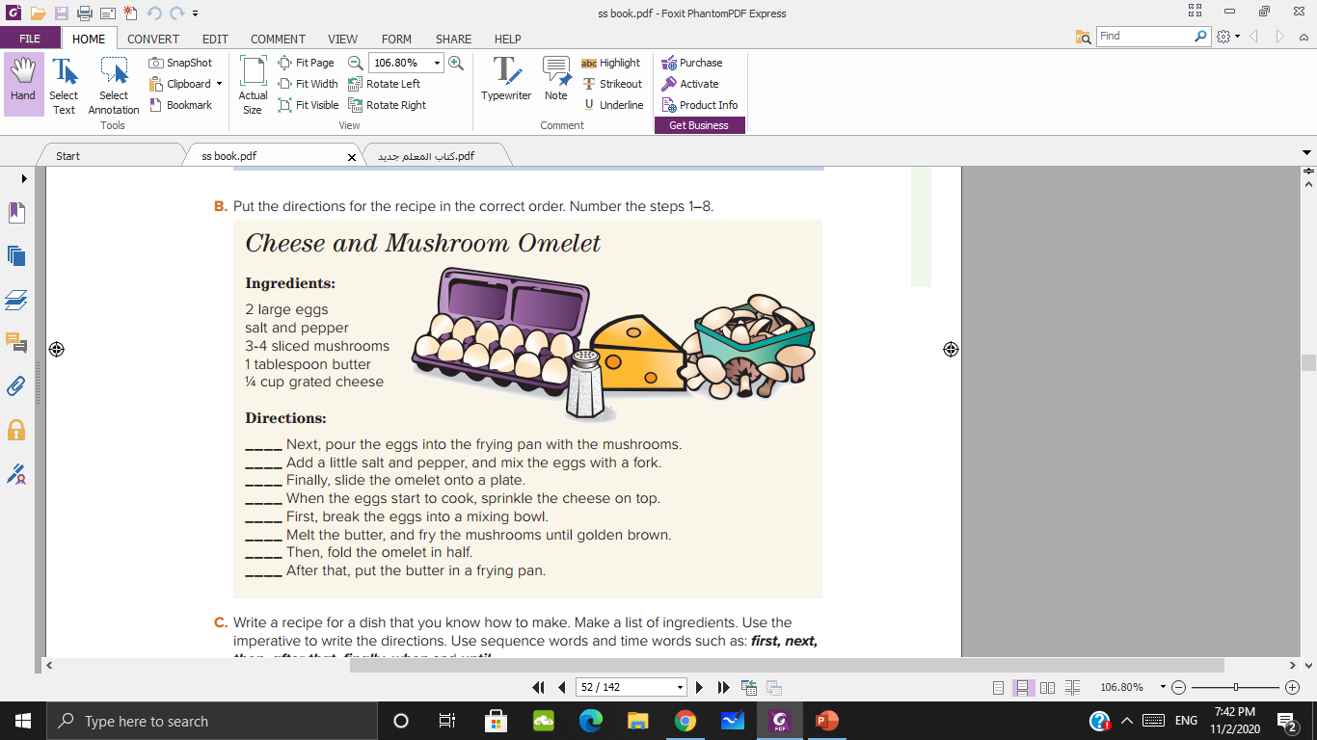
Time words + sequence words

Slide 10
5
2
8
6
1
4
7
3

Slide 11
Write a recipe for a dish that you know how to make. Make a list of ingredients.
Use the imperative to write the directions.
Use sequence words and time words such as: fist, next,
then, after that, fially, when and until

Slide 12



