Slide 1
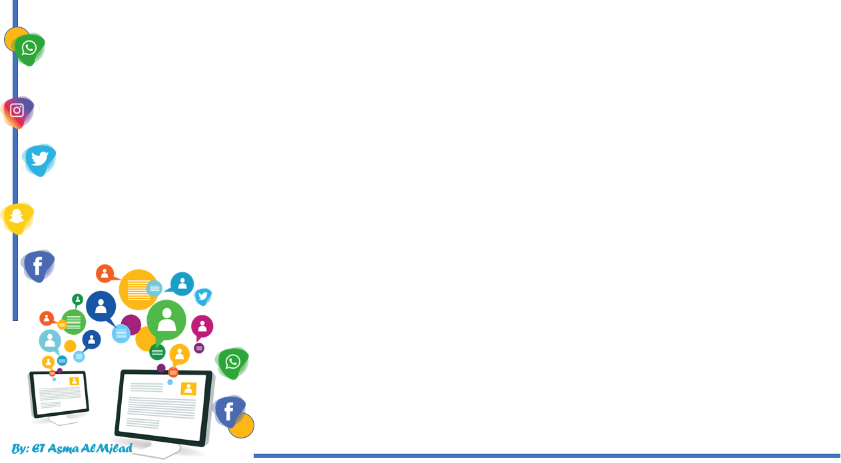


    Connected by
Grammar
By : Asma AlMjlad

Slide 2
Objectives
1
Use the auxiliary verbs (do, have and be) in the correct way
2
Use auxiliary verbs with the main verbs correctly.
3
Use Be with progressive statements.

Slide 4

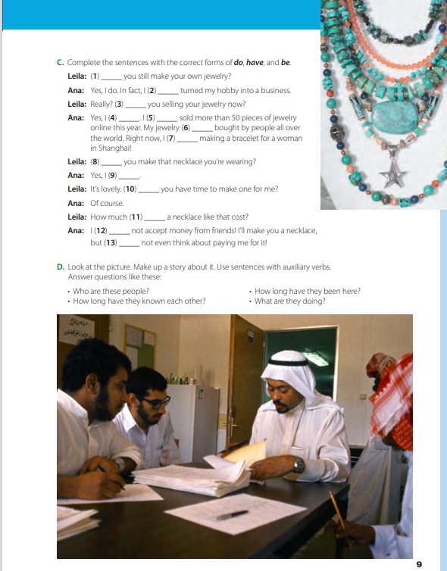
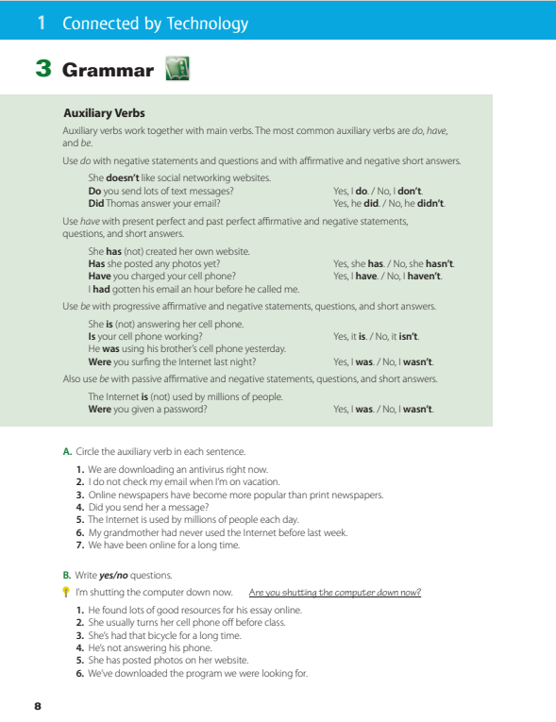
@ page 8 + 9

Slide 5
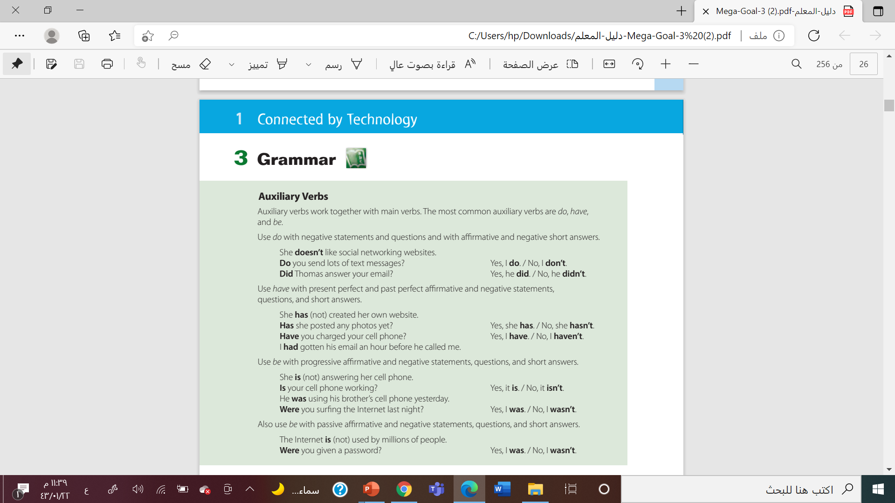

Slide 6
What are the colored words called?
Sara is cooking the lunch
They don’t play football
Have you charged your cell phone?
I was working here
Dose he go to the mall?

Slide 7
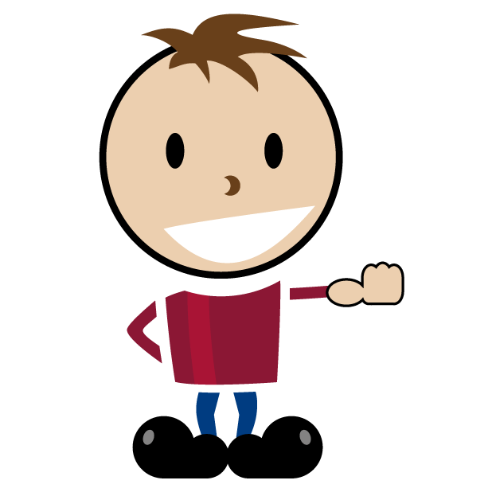
Auxiliary Verbs
Auxiliary verbs
be
have
do
Don’t have meaning
Show the tenses
Used in making questions
Used in making negative

Slide 8







do
I they you we
Do
does
She he it
did
I they we you she he it
Use do with
negative statements
questions
with affirmative
negative short answers.

Slide 9







have
I they you we
have
has
She he it
Use have
with present perfect
past perfect affirmative and negative statements,
questions,
and short answers.
had
I they we you she he it

Slide 10
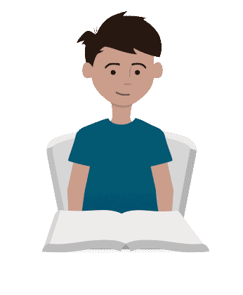






are
they you we
be
is
She he it
Use be
with progressive affirmative and negative statements,
questions,
and short answers.
Passive
am
I
were
they we you
was
I she he it

Slide 11

Do
Form
Subject + (do / does / did) not + v
She doesn’t play tennis
(Do / Does / Did) not + subject + v …… ?
Did you read the book ?

Slide 12

have
Form …. ?
Subject + HAVE (not) + v3 ……….
Omar has finished his homework
HAVE (not) + subject + v3 ……. ?
Have you tried sushi ?

Slide 13
Be
Form
Subject + (Be) not + V-ing ……….
They are hanging out
Be + subject + V-ing ……. ?
Was he working in the bank?
Subject + (Be) not + V3 ……….
The door was opened by Ali
Be + subject + V3 ……. ?
Were you given a password?

Slide 14
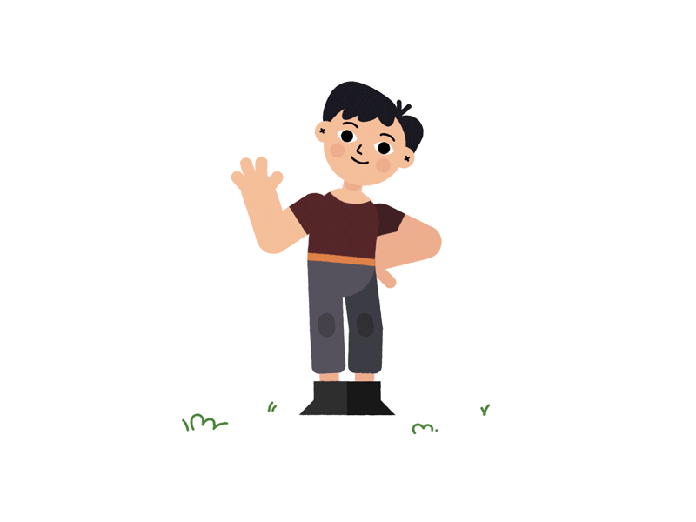



Slide 15
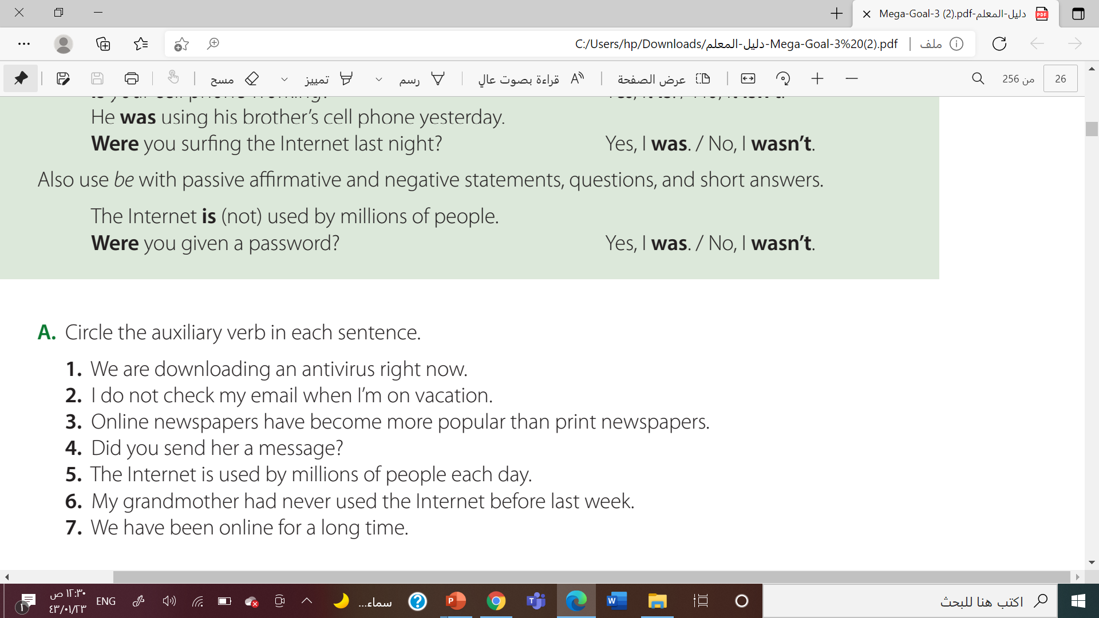
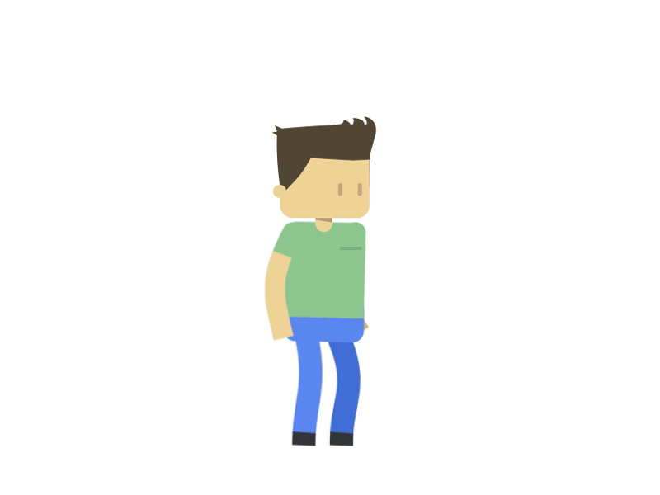



Slide 16
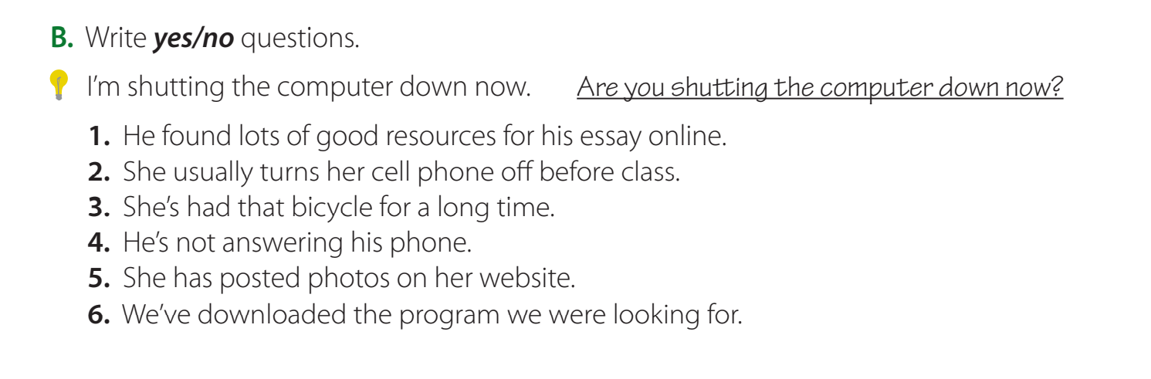


1. Did he find lots of good resources for his essay online?
2. Does she usually turn her cell phone off before class?
3. Has she had that bicycle for a long time?
4. Is he not answering his phone?

Slide 17
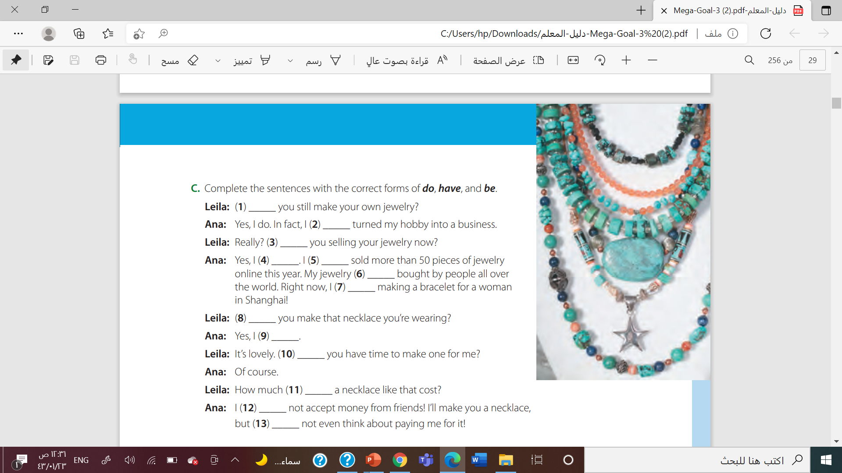

do
have
are
am
have
is
am
Did
Did
do
does
do
do

Slide 18
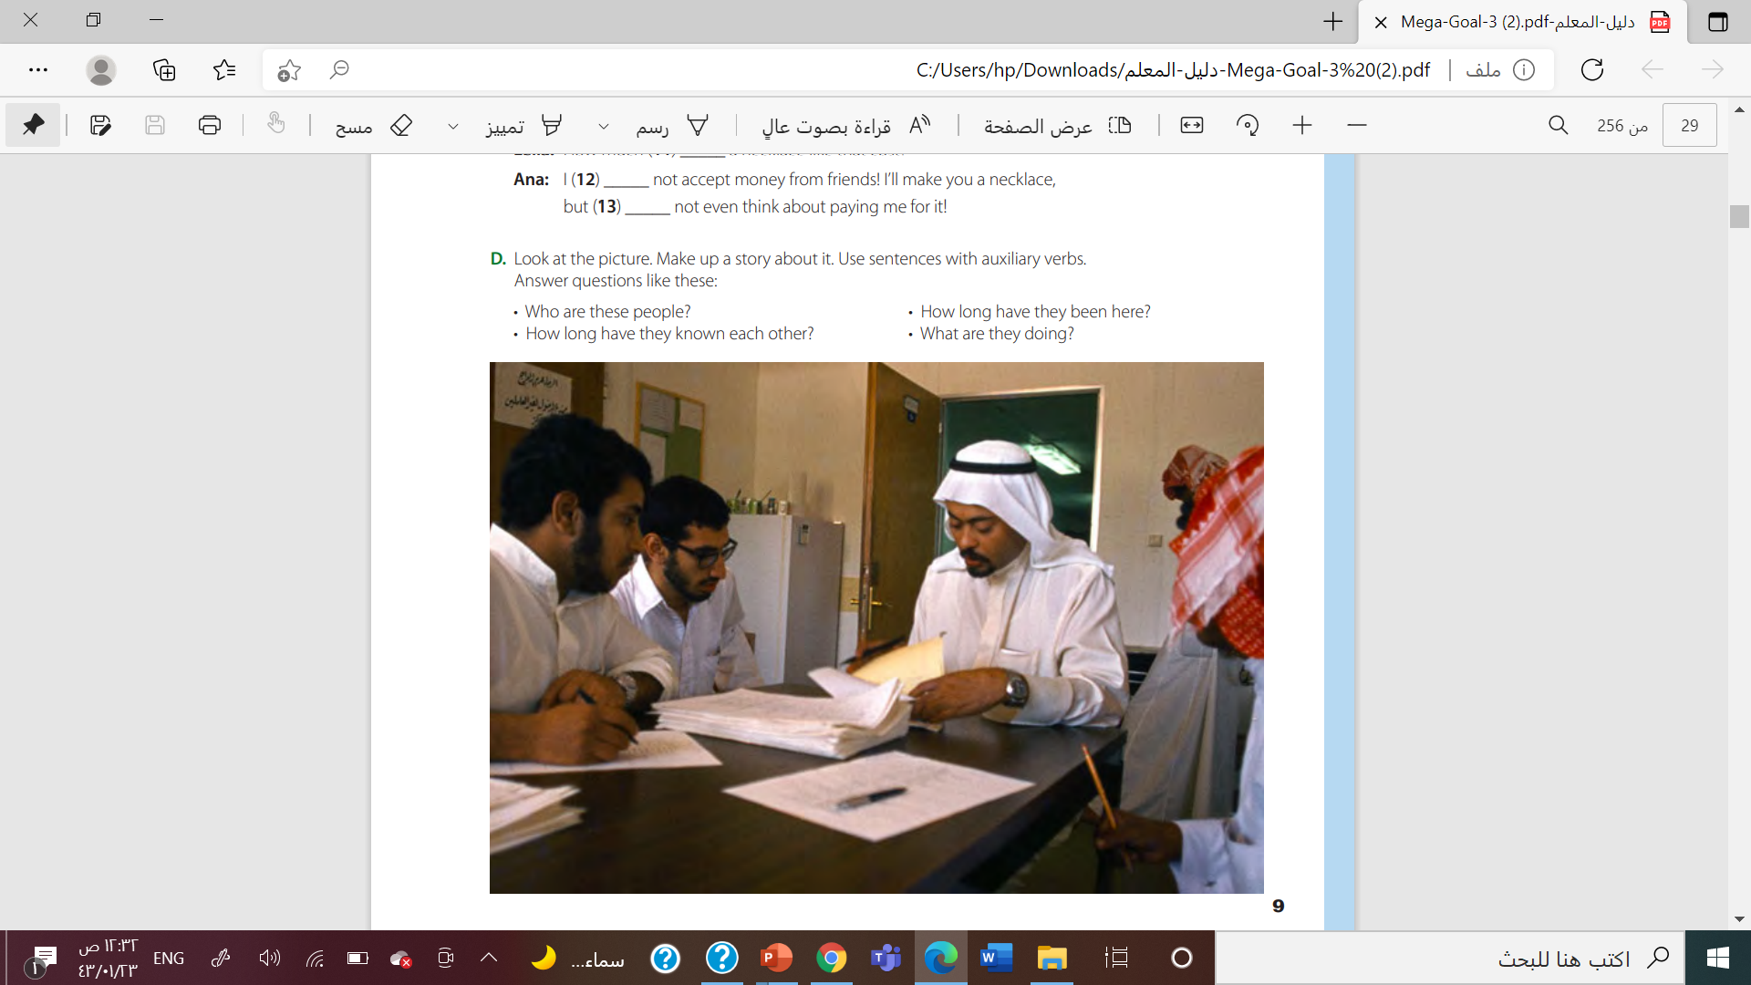

Slide 19


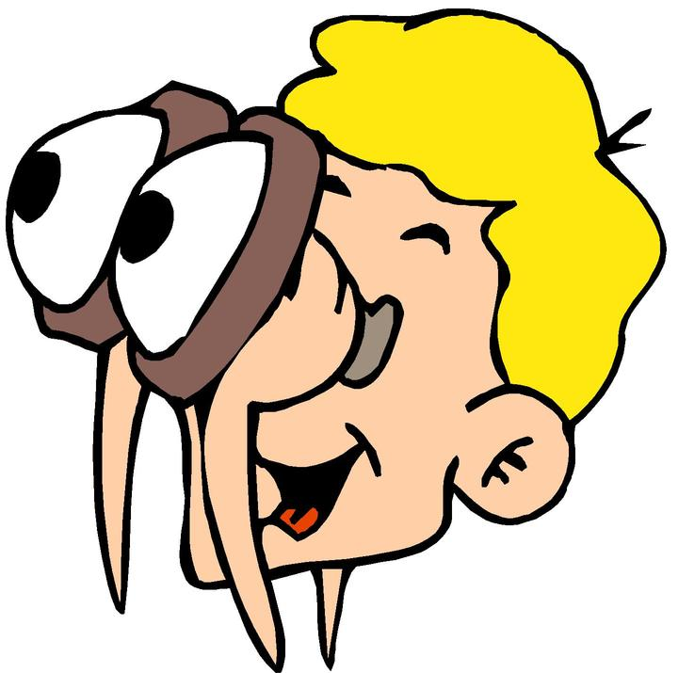
Find the fib
I has seen this movie already .
I have seen this movie already .

Slide 20
Find the fib
She don’t watch T.V after school
She doesn’t watch T.V after school

Slide 21
Find the fib
I has seen this movie already .
I have seen this movie already .

Slide 22
Find the fib
The book were written by Marry
The book was written by Marry

Slide 23

Work book

Slide 24
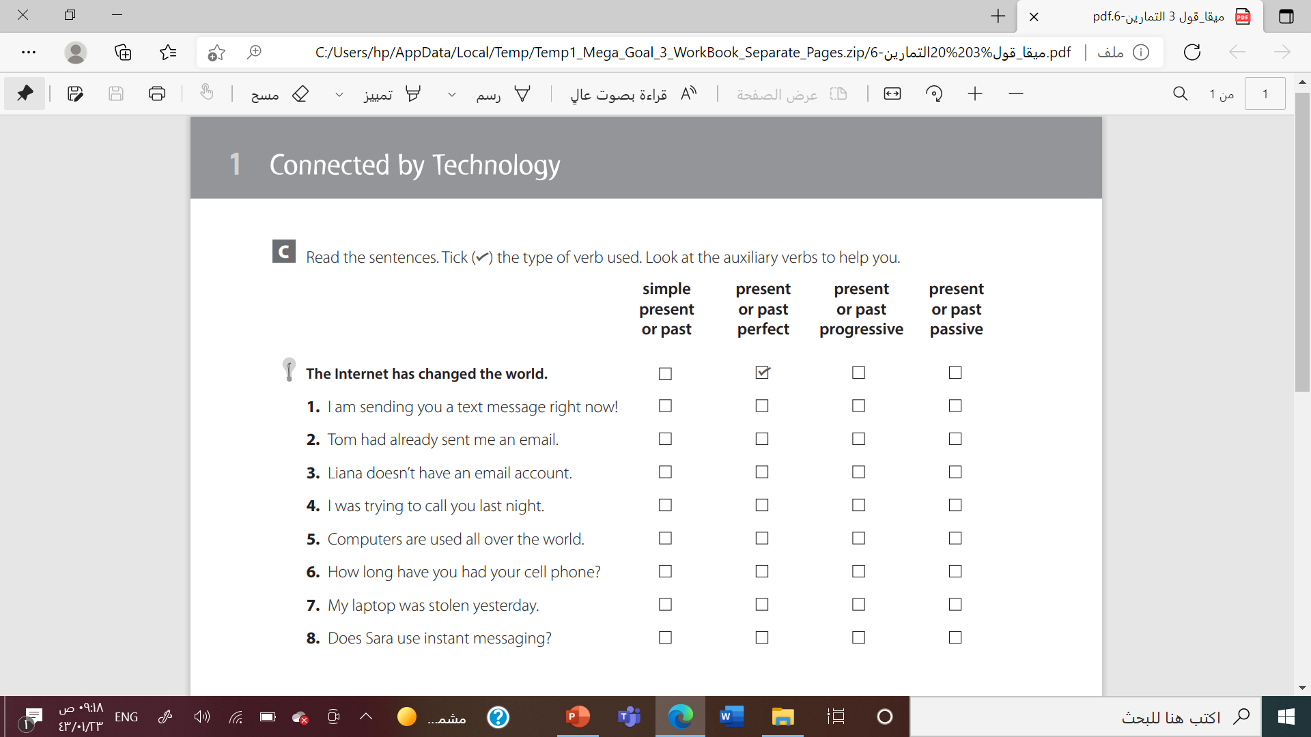
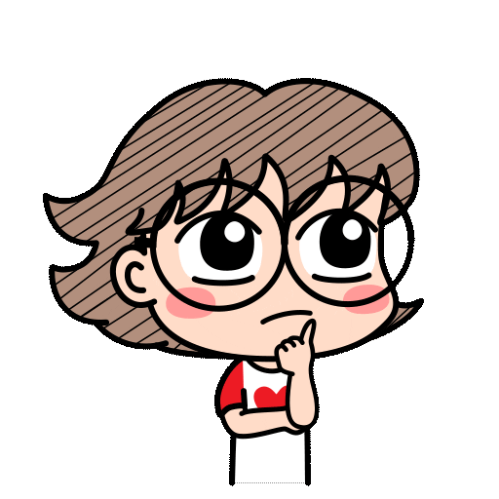


Slide 25
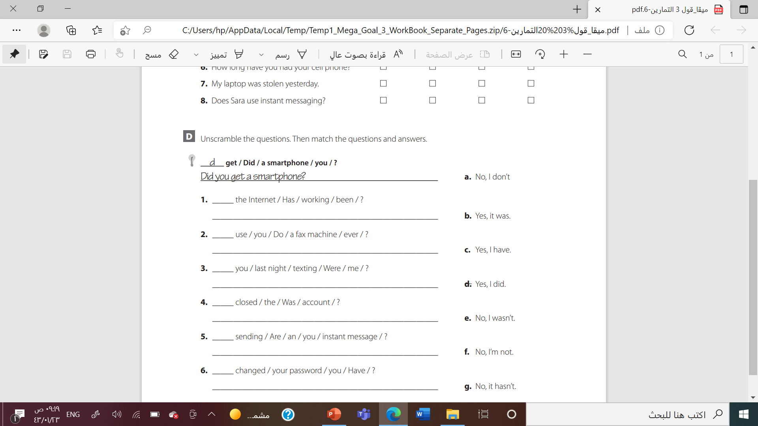
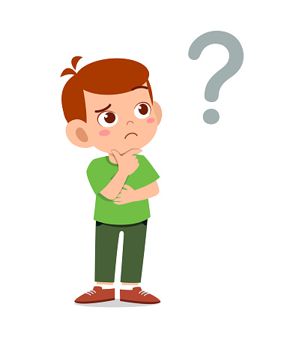
g
Has the internet been working?
a
Do you ever use a fax machine?
e
Were you texting me last night?
b
Was the account closed?
f
Are you sending an instant message?
c
Have you changed your password?

Slide 26
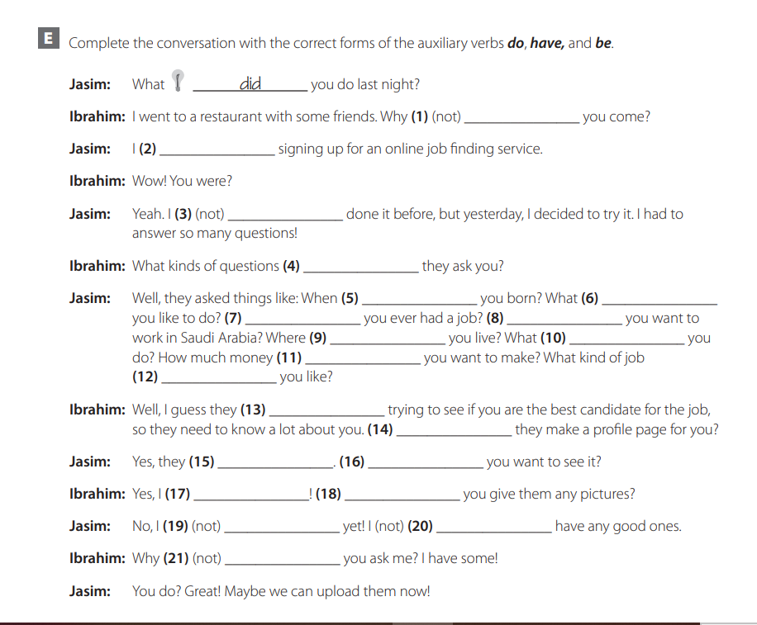


Slide 27
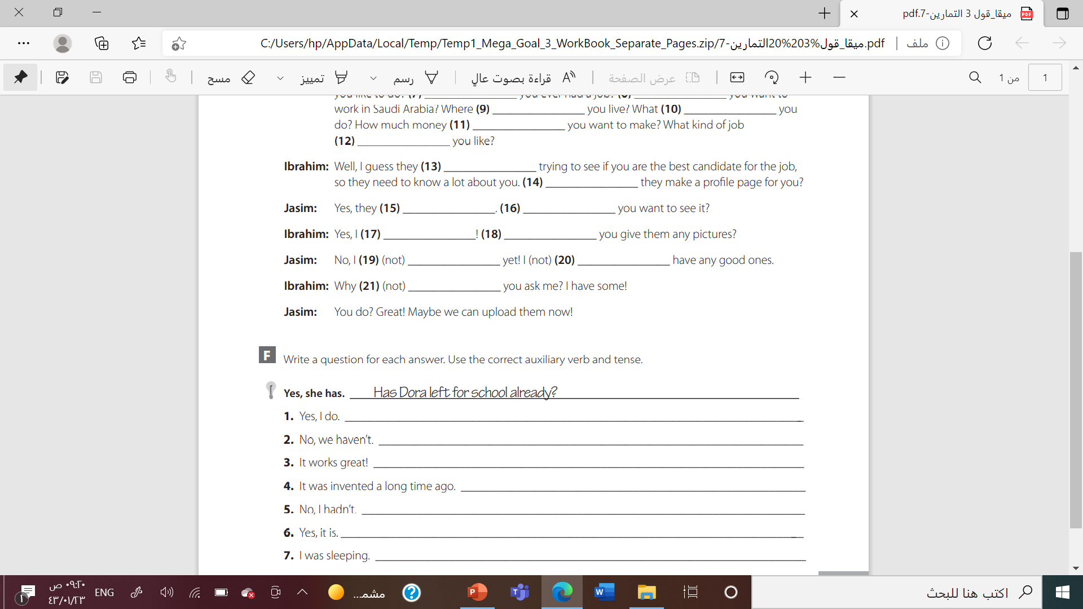

Slide 28
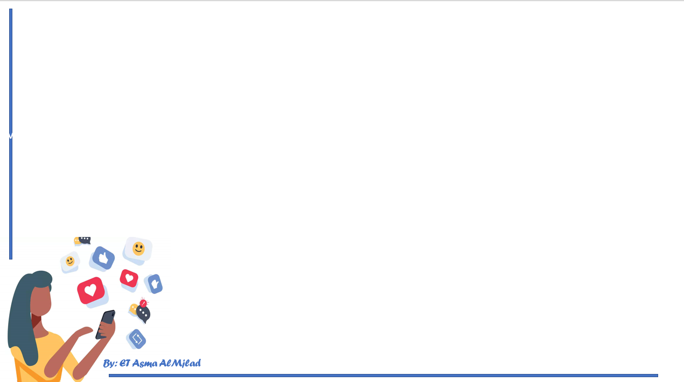



Slide 29

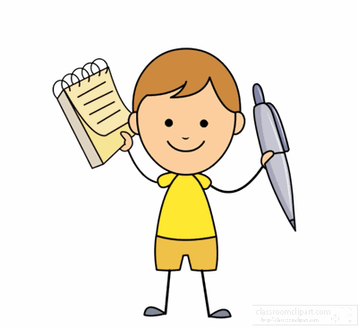


Slide 30

By: ET Asma AlMjlad

