Slide 1
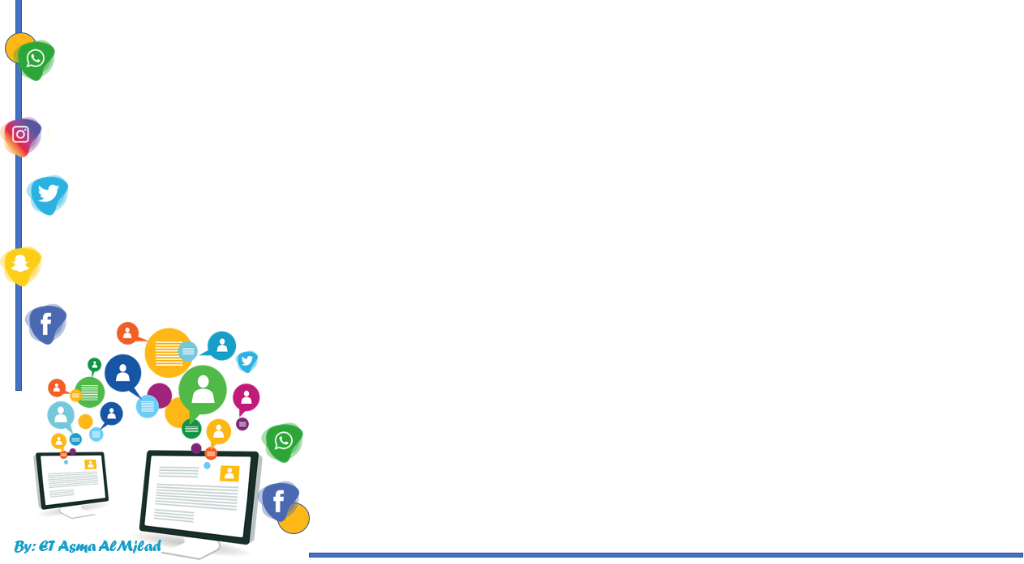


    Connected by
Listen and Discuss
By : Asma AlMjlad

Slide 2
Objectives
1
Name some apps to contact with others
2
Find important details from a person’s profile
3
Write person’s characteristics

Slide 3
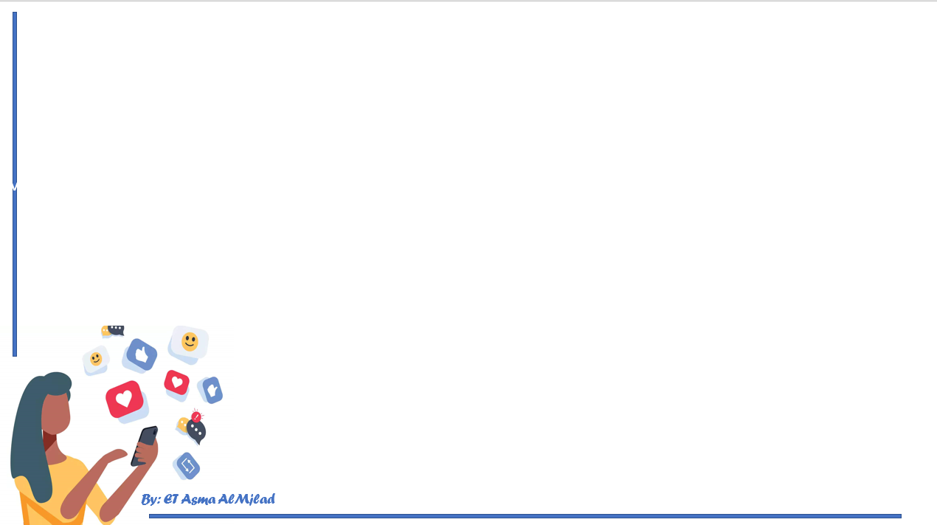


Slide 4
How do you communicate with your friends when you are not in the school?
Name some means of communication involved technology?
Who can you get your lessons before now ?

Slide 5

What are applications do you use ?
Do you have an account on social media ?
What do you post in your account ?

Slide 6
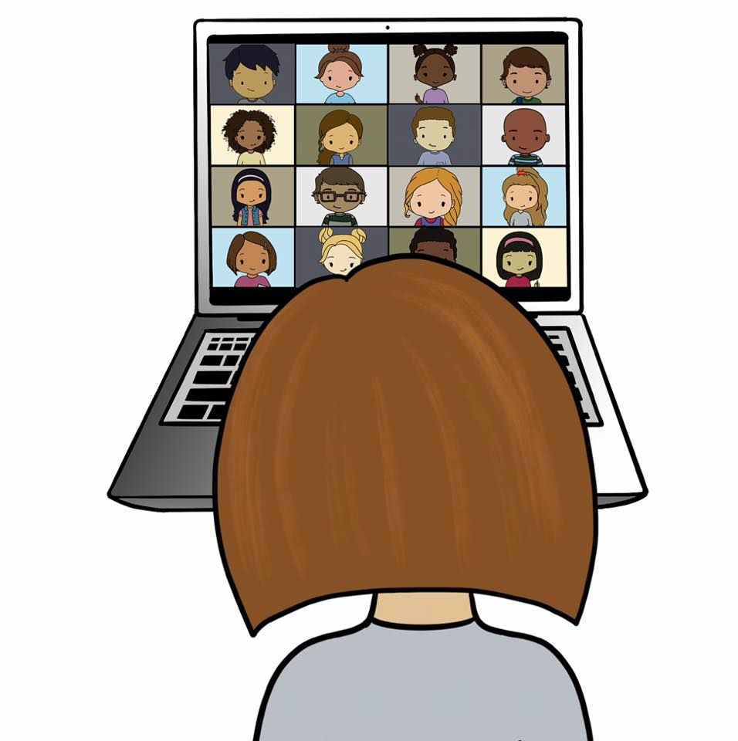
Who can you get your lessons before now ?
Do you prefer online or face to face learning ?
Why ?

Slide 7

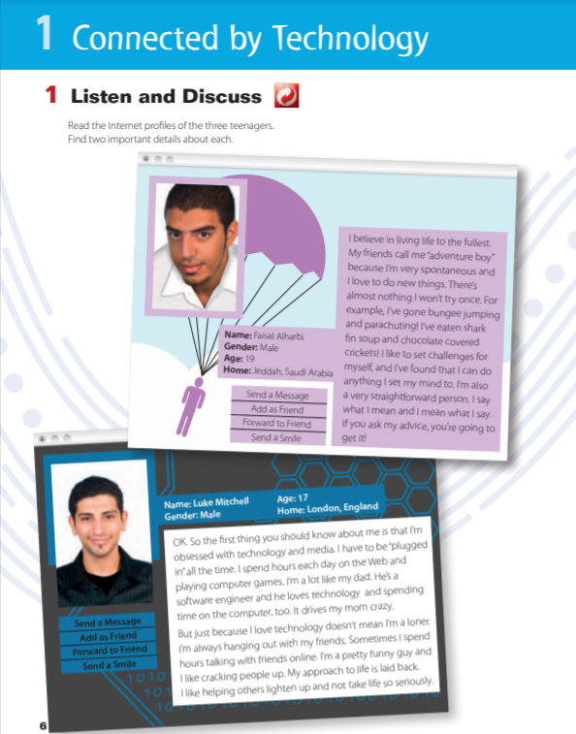
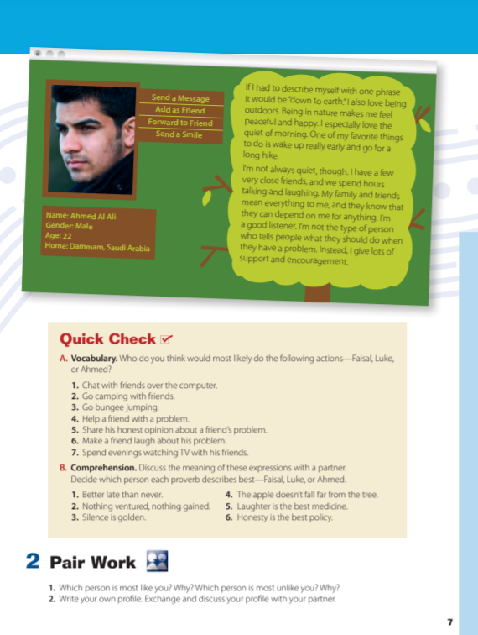



@ Pages: 6-7
Listen

Slide 8




where you see like these in?
How many characters are they ?
what are these called?

Slide 9





Slide 10




spontaneous
straightforward person
Fin soup
obsessed

Slide 11



software engineer
cracking people up
loner

Slide 12


Laid back
encouragement

Slide 13
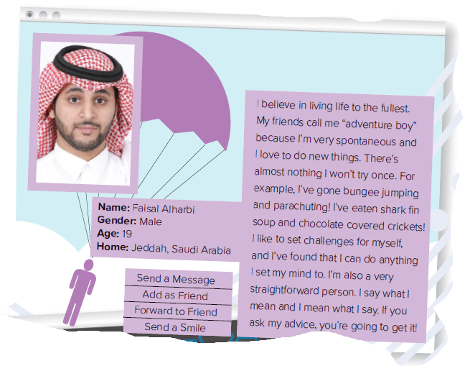
Who is he ?
Where is he from ?
Describe Faisl .

Slide 14
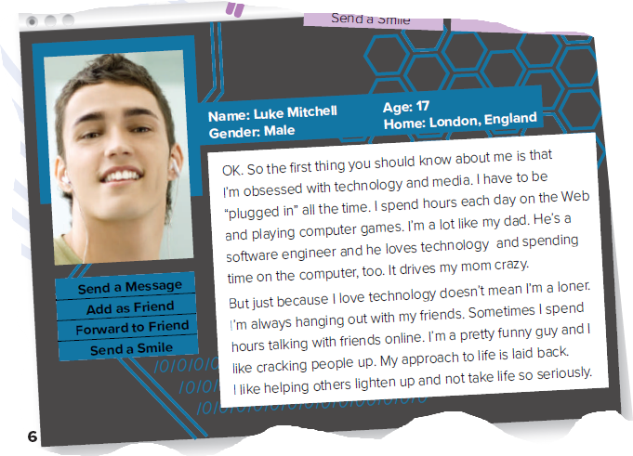
Who is he ?
How old is he ?
What is his father do ?

Slide 15
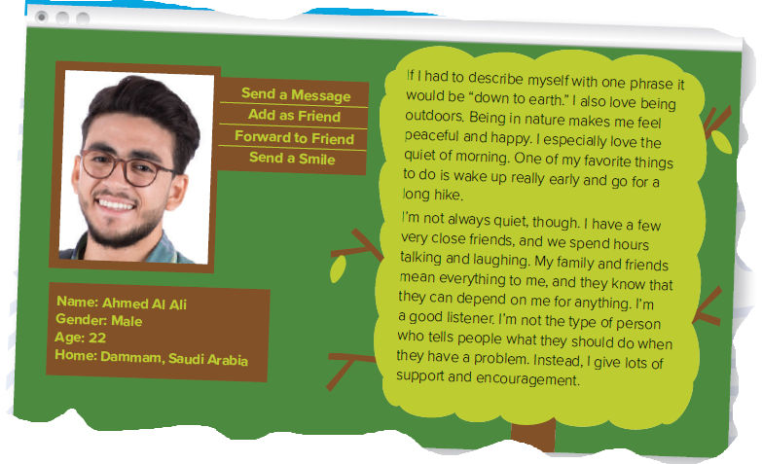
Who is he ?
Is he from Oman ?
What are important things about Ahmad?

Slide 16



Slide 17
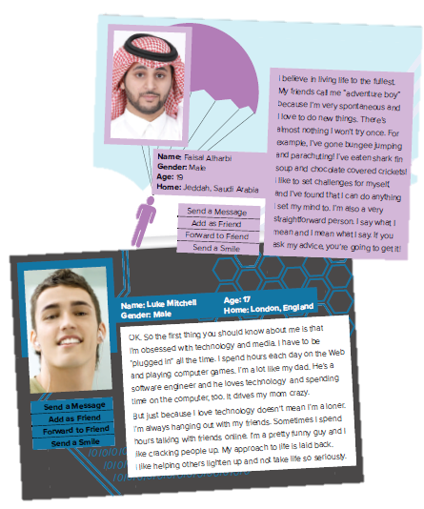

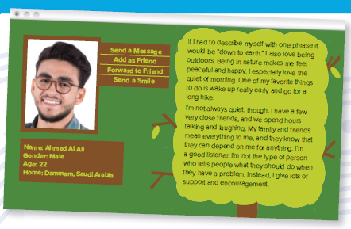
List 3 or 4 words or phrases that describe the person’s personality

Slide 18




spontaneous means…
a person is ready to do something without a lot of planning
a person do every thing with a olt of planning

Slide 19
crack people up means..
Make people like you
make people laugh

Slide 20
lighten up
not be too serious
To become worried

Slide 21
down to earth means ..
Adventure person and love to do new things
a person who likes simple things in life

Slide 22

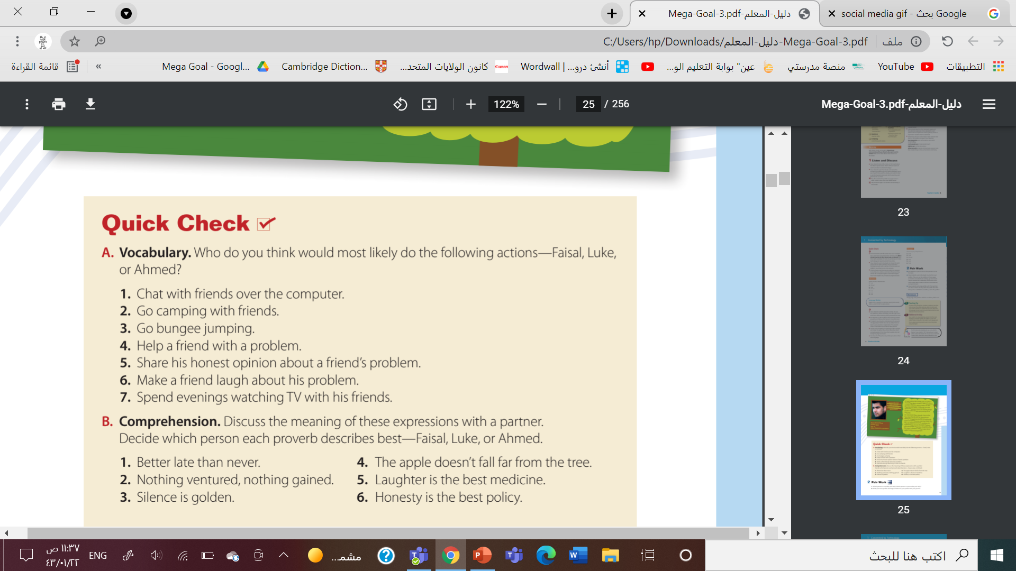

Luke
Ahmed
Faisal
Ahmed
Faisal
Luke
Luke
By: ET Asma AlMjlad

Slide 23


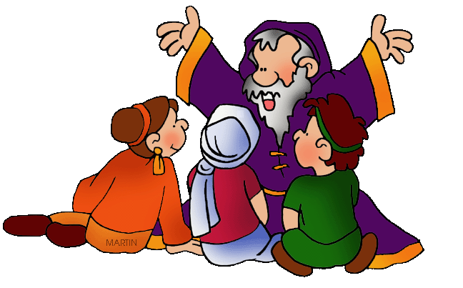
Proverb
a famous phrase or sentence that gives you advice
By: ET Asma AlMjlad

Slide 24

Faisal
Luke
Faisal
Luke
Ahmad
Faisal

Slide 25
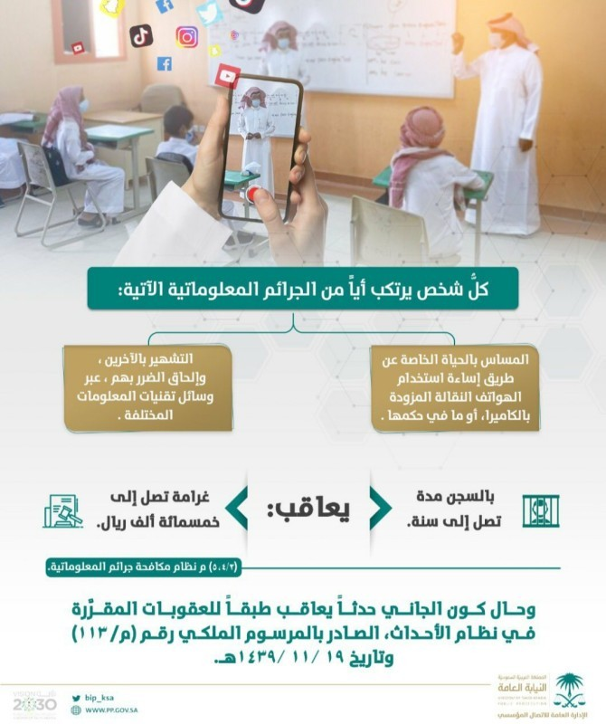


Slide 26



Write your own profile .

Slide 27
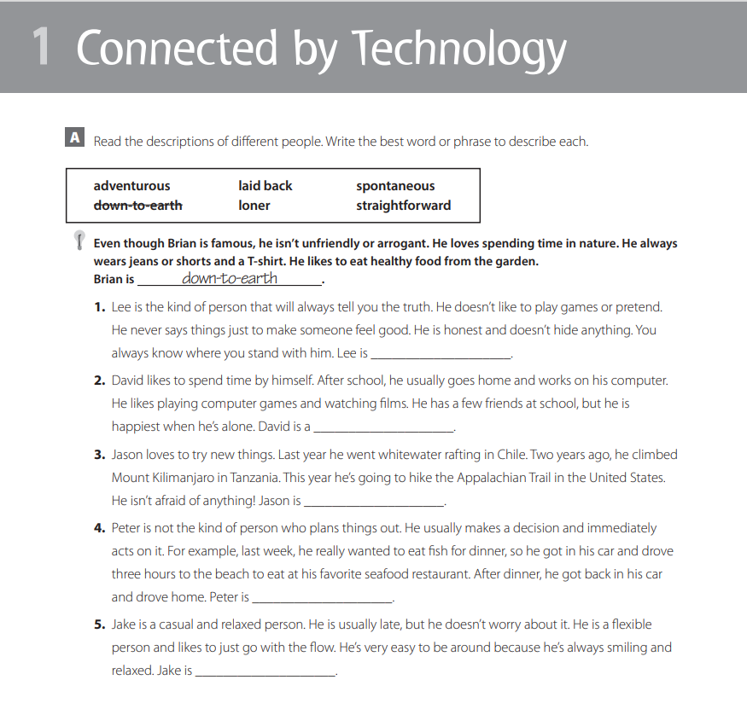

Slide 28
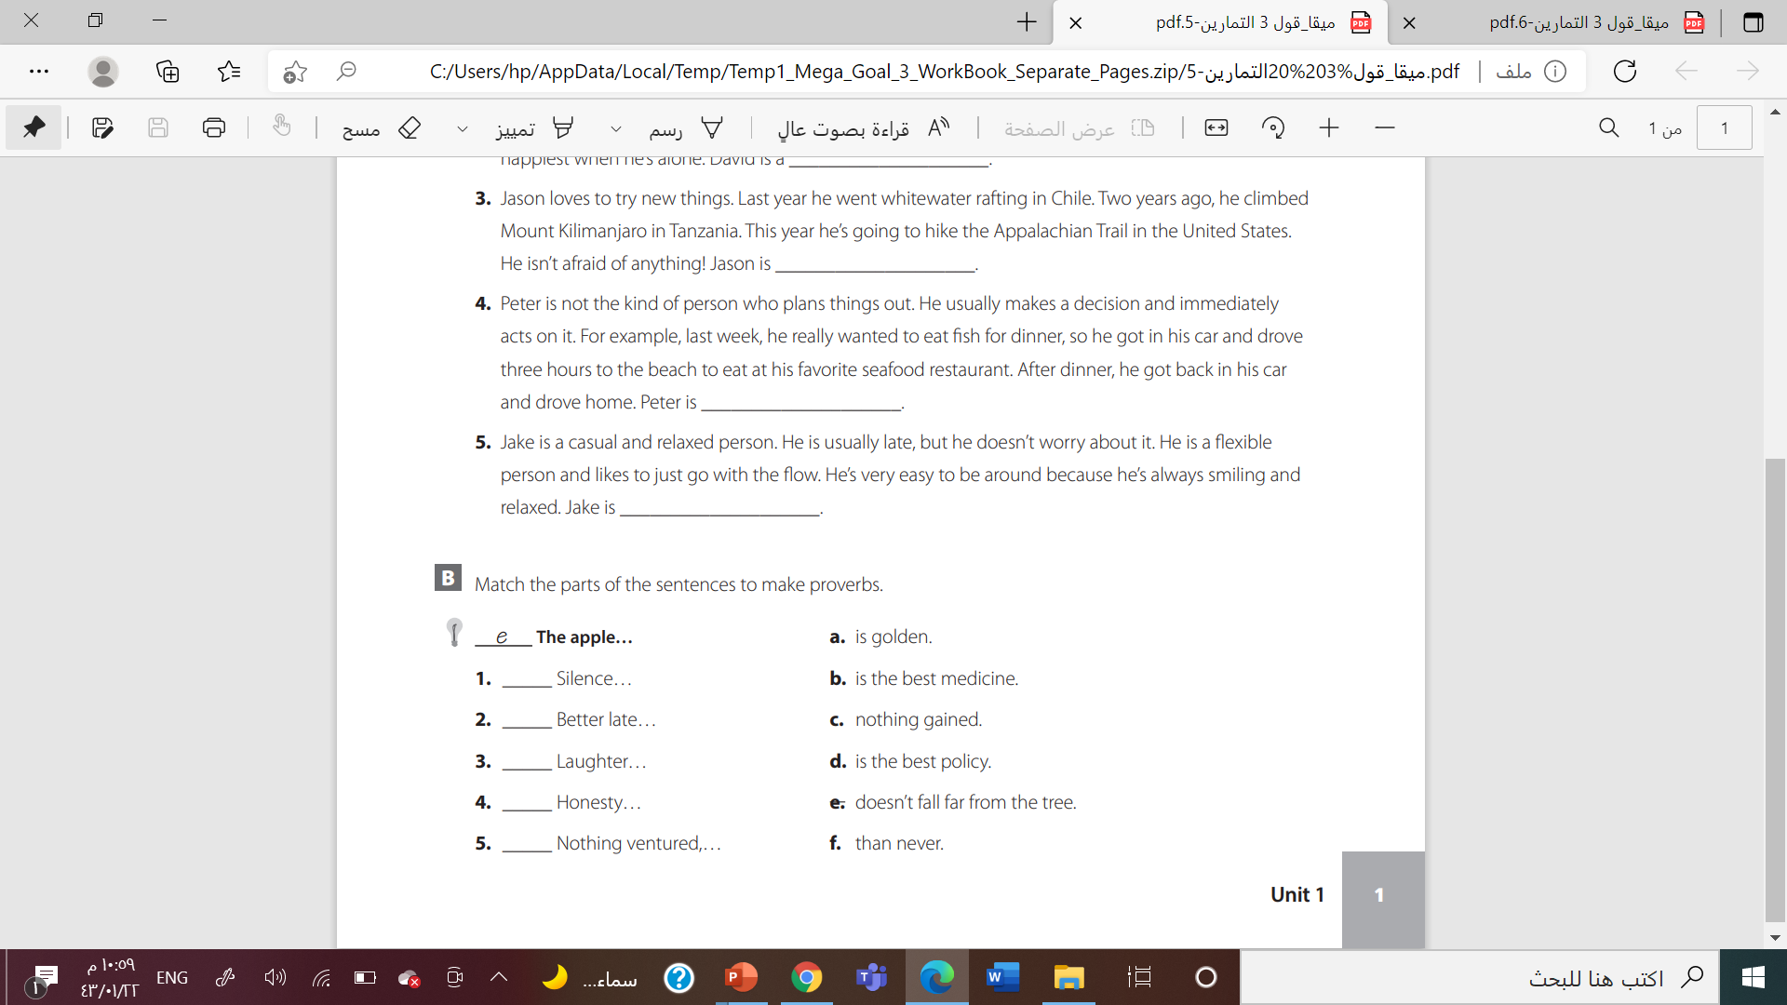

Slide 29



Slide 30




Slide 31

By: ET Asma AlMjlad

