Slide 1
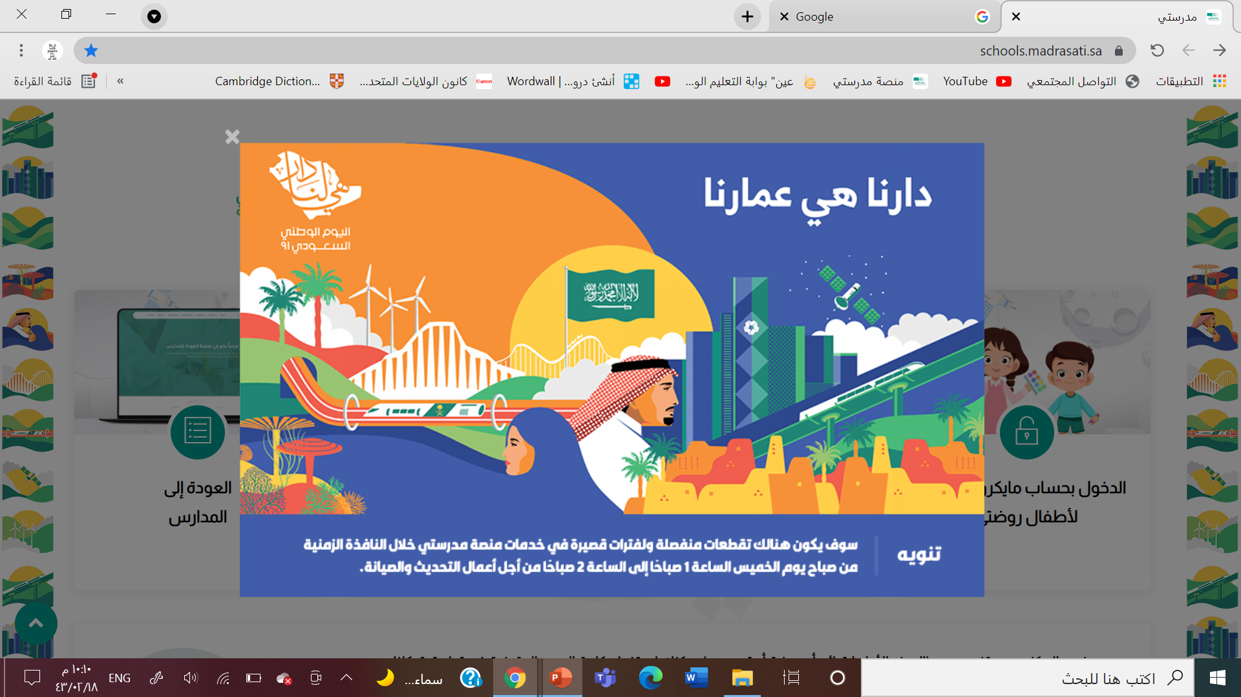
Happy national day

Slide 2
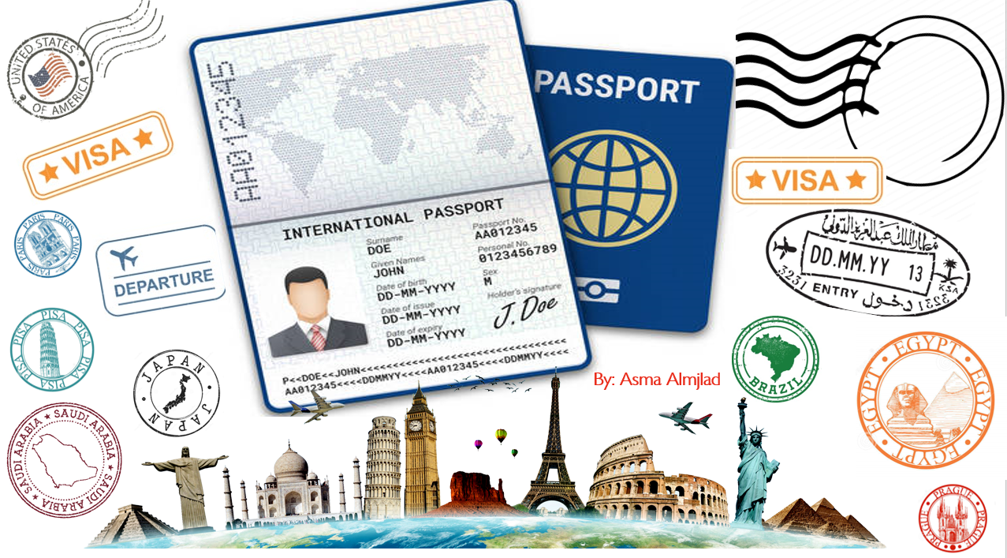

U:3
Far and away
MG3
U3:Far and away
Listen and discuss
Sept 2021

Slide 3
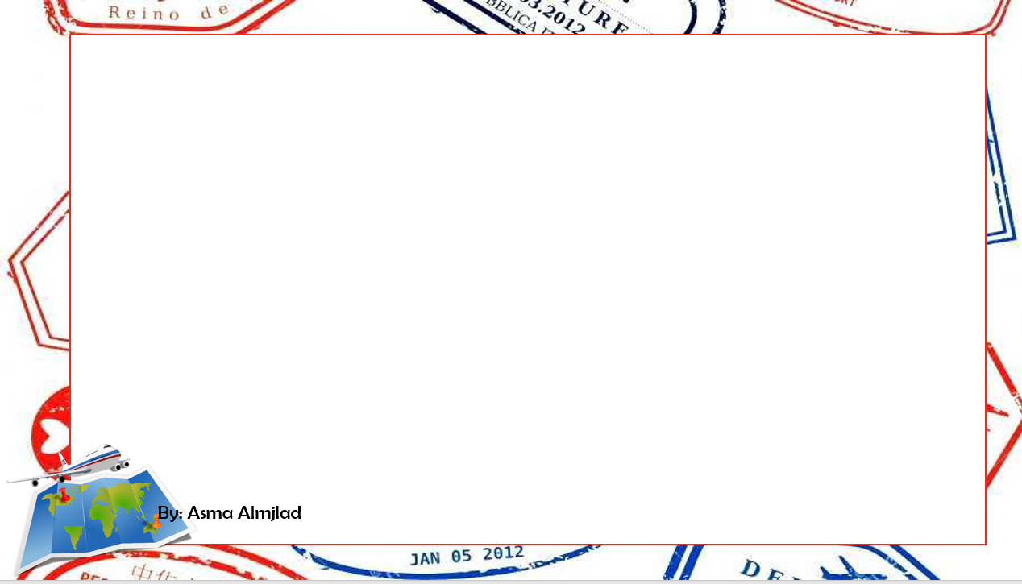


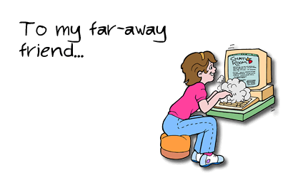
You use the expression far and away when you are comparing something or someone with others of the same kind,
in order to emphasize how great the difference is between them.
.
E.G.
that Mexican restaurant is far and away the best in the area

Slide 4
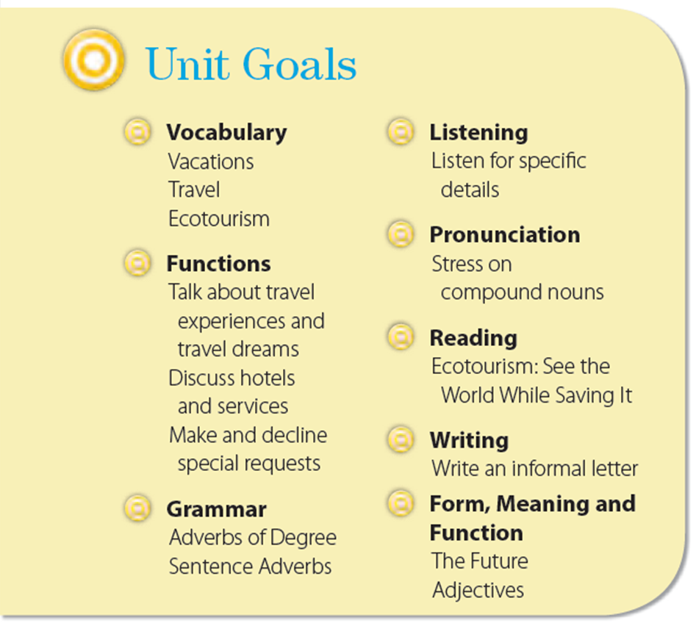
Unit 3: Far And Away
General Unit 3 Goals
3
By: Tala AlHazmi

Slide 5
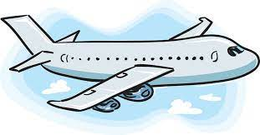
Objectives
List the benefits of traveling
List five things every hotel must have
Match the words with their meaning.

Slide 6
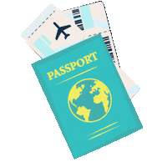


Hello…..
Welcome to our class
Are you ready to fly with us?
Show me your tickets please

Slide 7
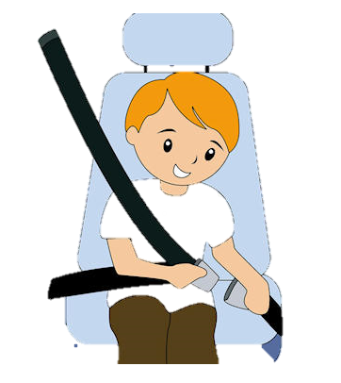

Put on your seatbelt please
Let’s REPEAT together.

Slide 8


Slide 9
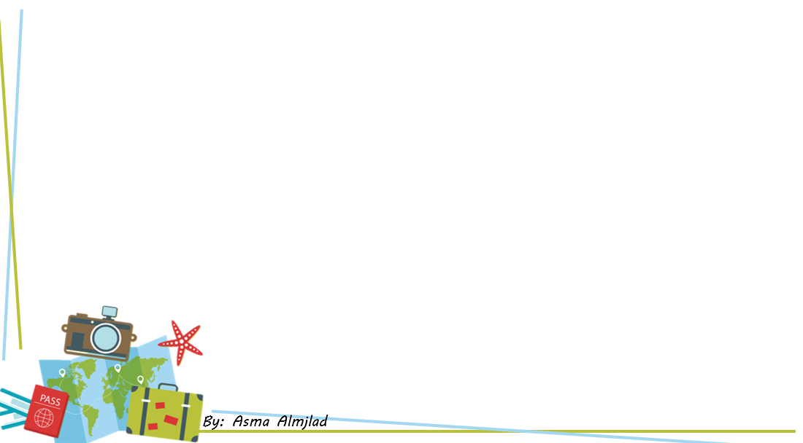

After CORONA will finish…
What are you going to do
What kind of vacation do you prefer?
Travel around?
Or
Relaxing in one place ?
Enhance your creativity
Understand yourself
List the benefits of traveling
Have fun
Improve your communication skills
Get real-life education

Slide 10
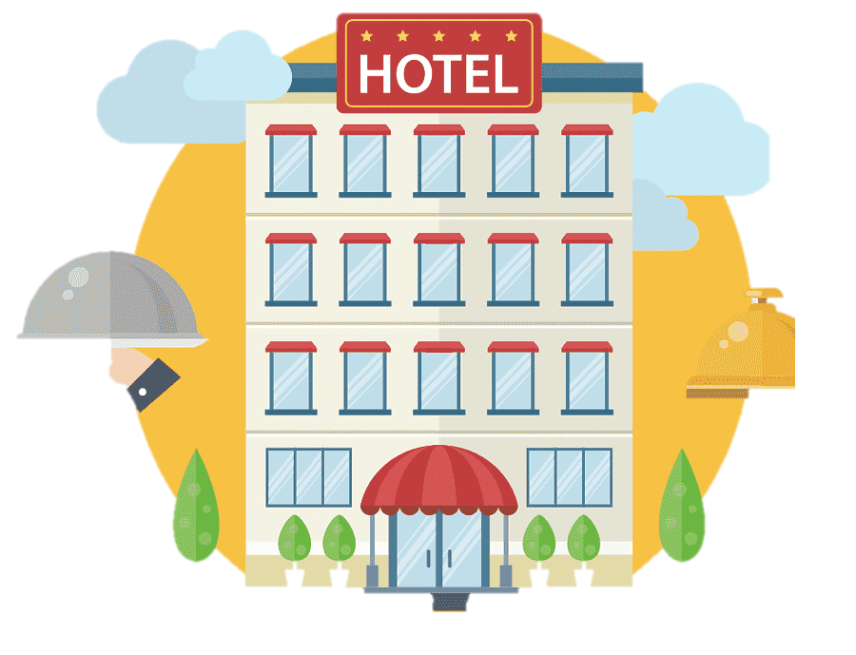

Where do you stay when travelling ?
Do you care on the hotel type ?
What are the five things you expect a hotel to have?
Do you try unusual hotels before ?.

Slide 11
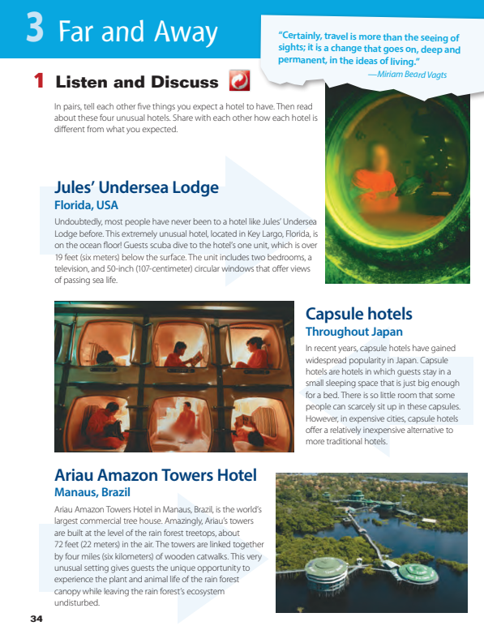
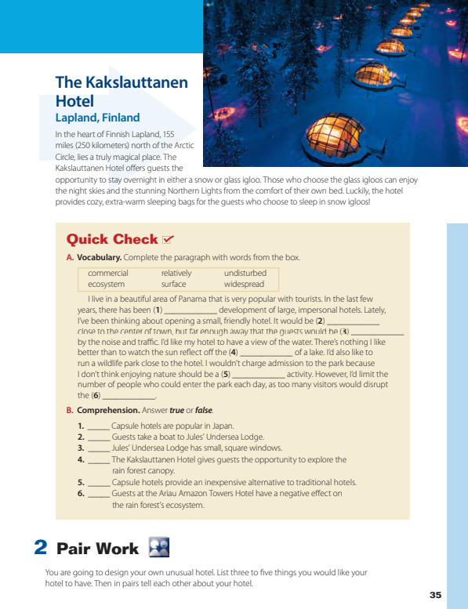


@ page 34 + 35

Slide 12
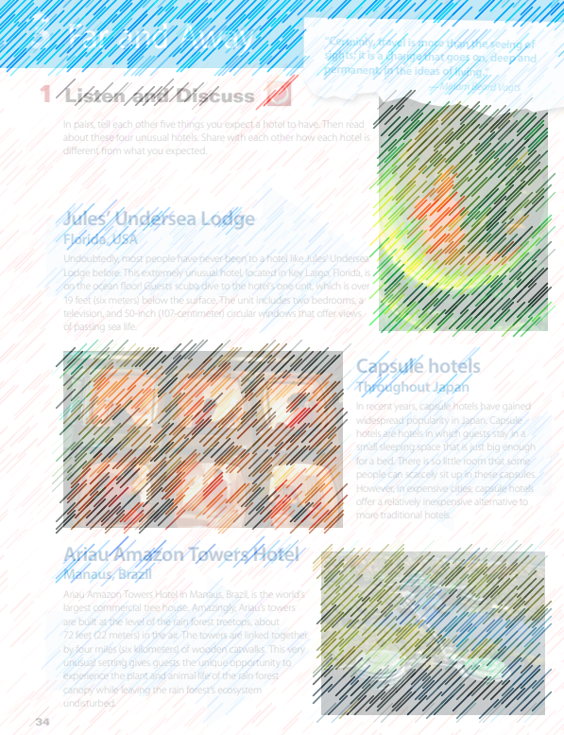
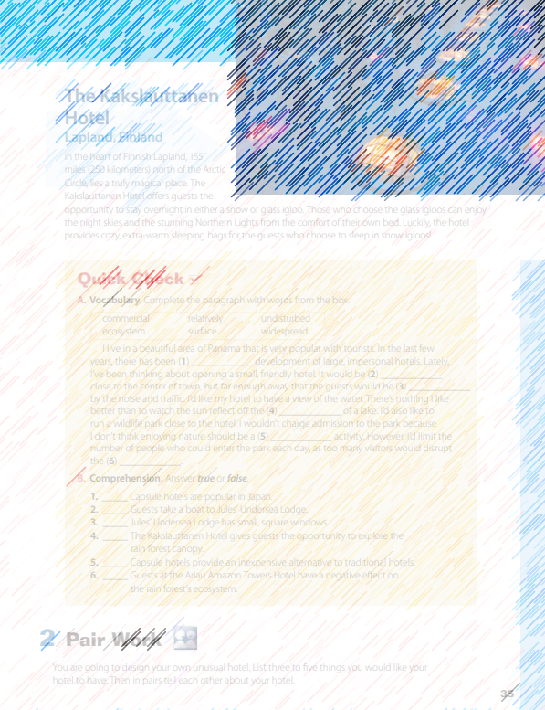
What is the title ?
How many articles are there?
What are the pictures show?

Slide 13

Listen
Which hotel is a tree house?
Which hotels have very small rooms?
Which hotel has rooms made of snow?
Which hotel do you have to scuba dive to get to?

Slide 14
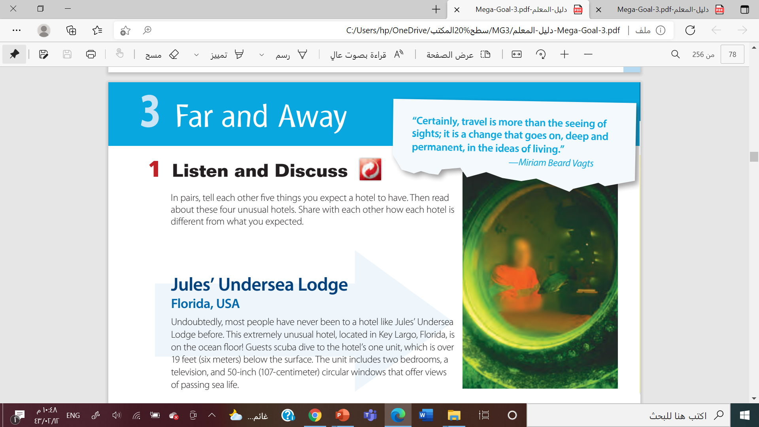
What is the hotel name?
How do the guests reach to the hotel ?
What are the windows shape ?

Slide 15
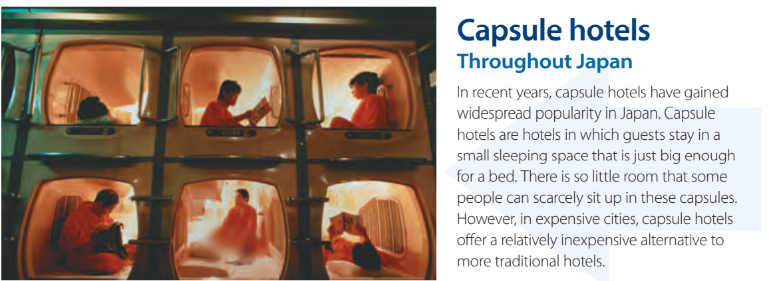
What are capsule hotels ?
Are they expensive?

Slide 16
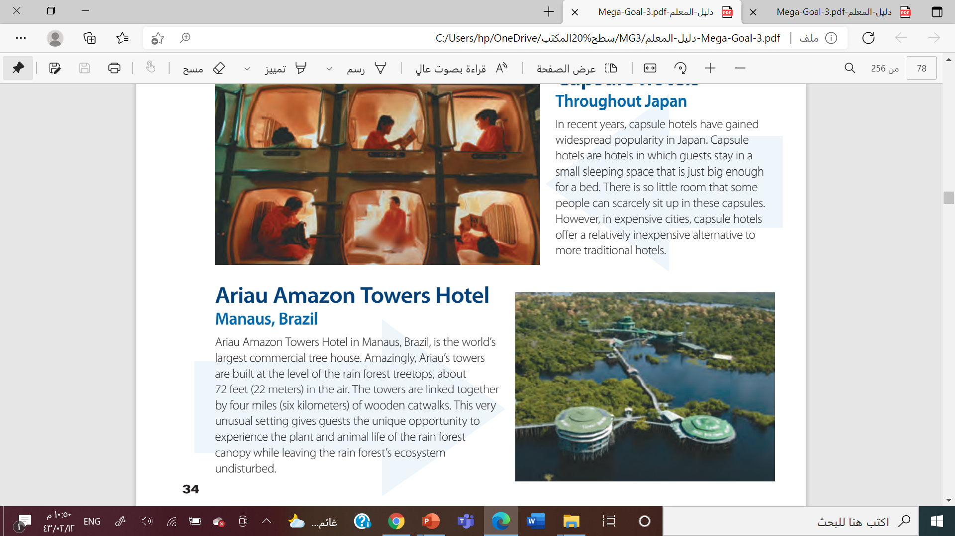
Where is it ?
Why is it unusual hotel ?

Slide 17
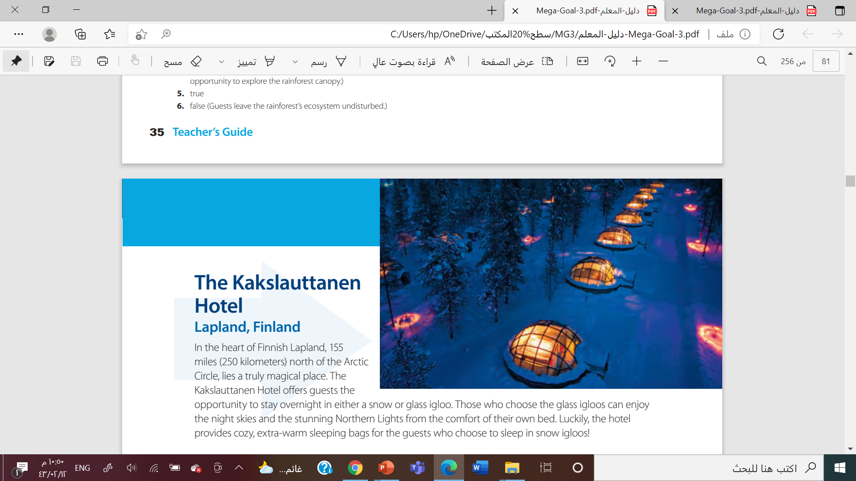

What does the Kakslauttanen Hotel offer ?
What does the hotel provides for the guests ?

Slide 19


Jules’ Undersea Lodge
Find a ward means ……
Round

Slide 20

Capsule Hotels
Find a ward means ……
another choice or option

Slide 21

Ariau Amazon Towers Hotel
Find a ward means ……
connect

Slide 22
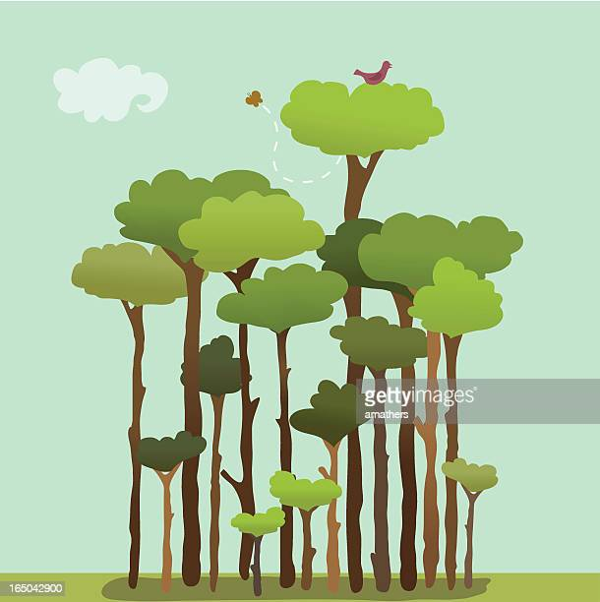
Ariau Amazon Towers Hotel
Find a ward means ……
the tops of the trees in a forest

Slide 23
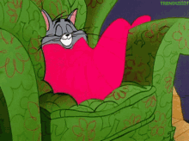
Kakslauttanen Hotel
Find a ward means ……
comfortable and warm

Slide 24
Kakslauttanen Hotel
Find a ward means ……
extremely beautiful

Slide 25
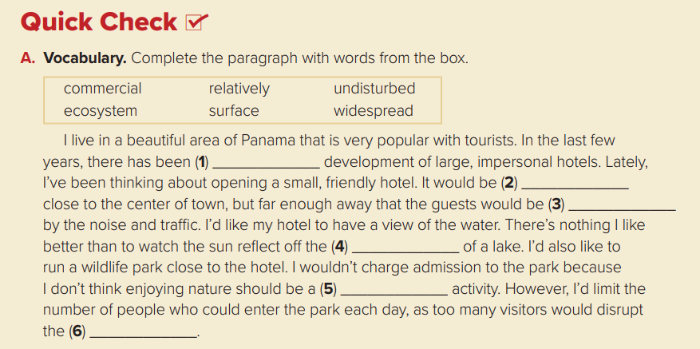
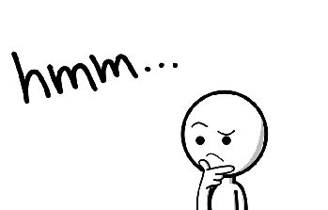
widespread
relatively
undistur6b
surface
commercial
ecosystem

Slide 26
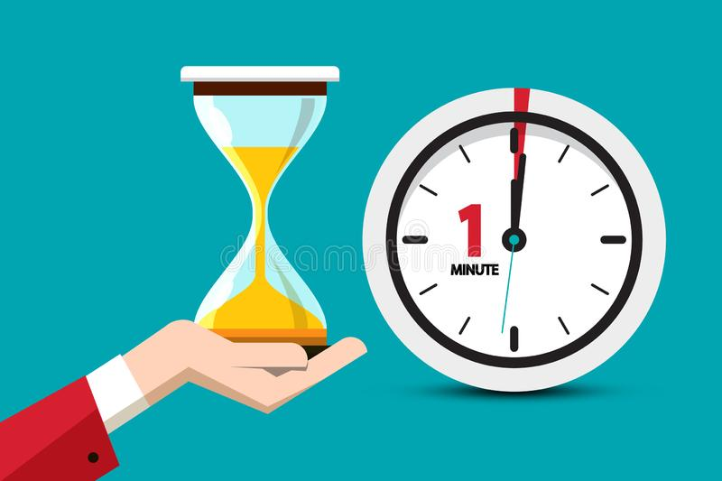
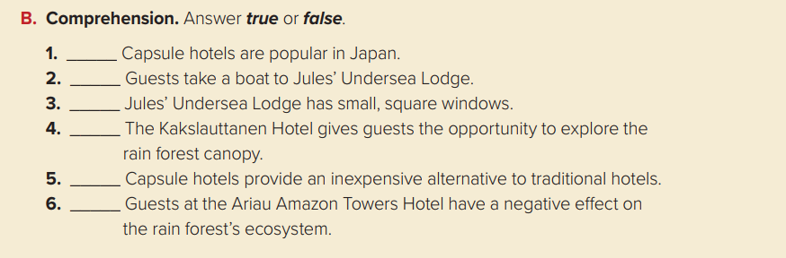
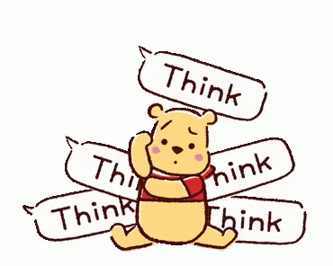
true
false
false
false
true
true

Slide 27
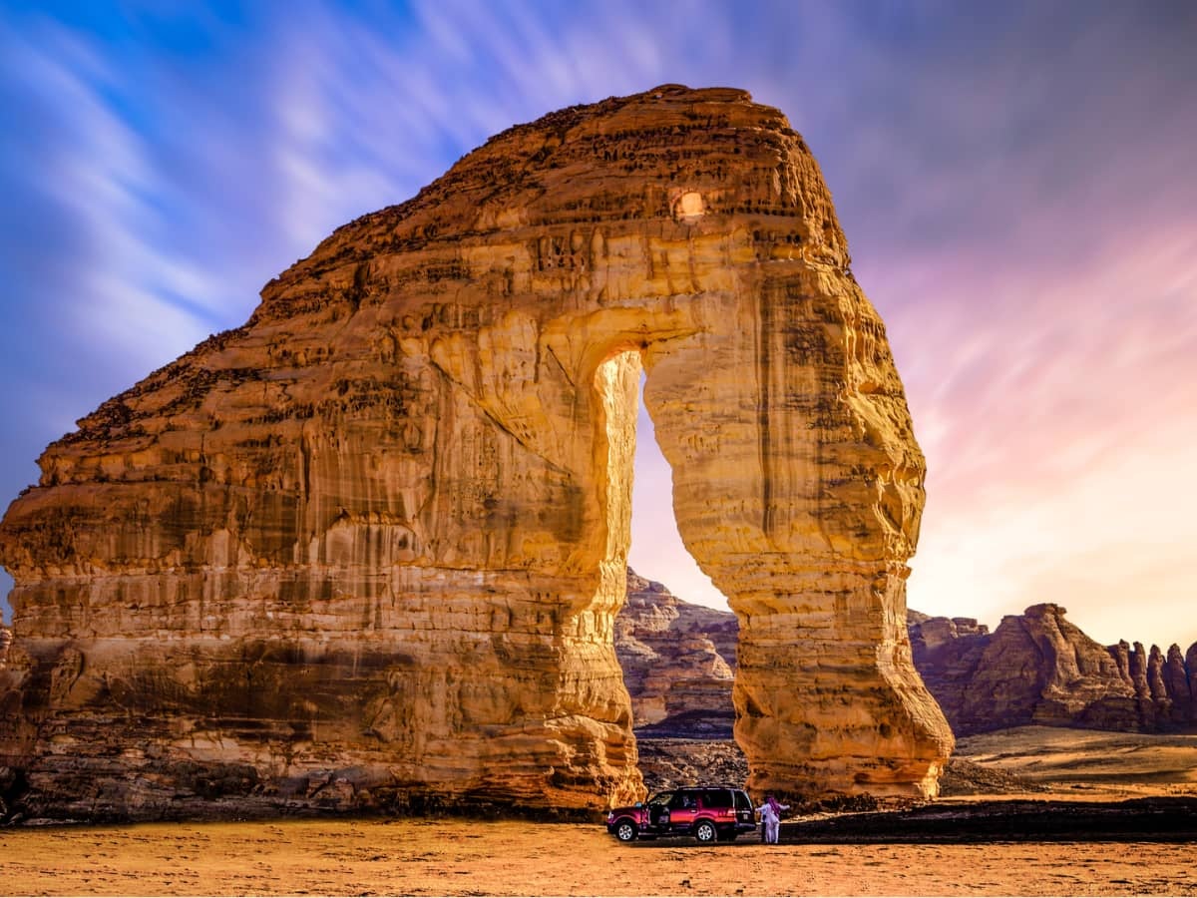
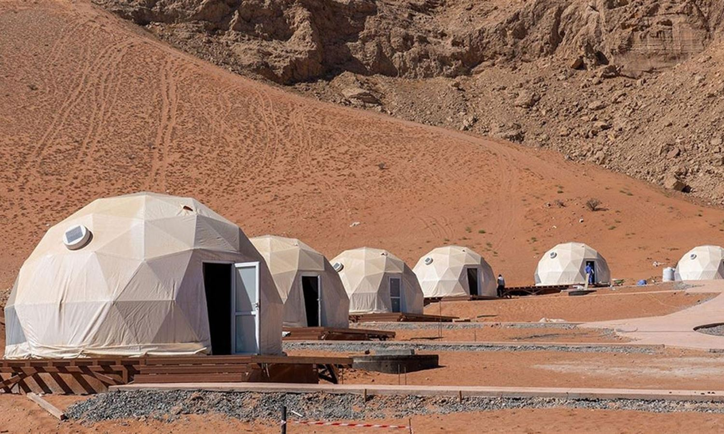
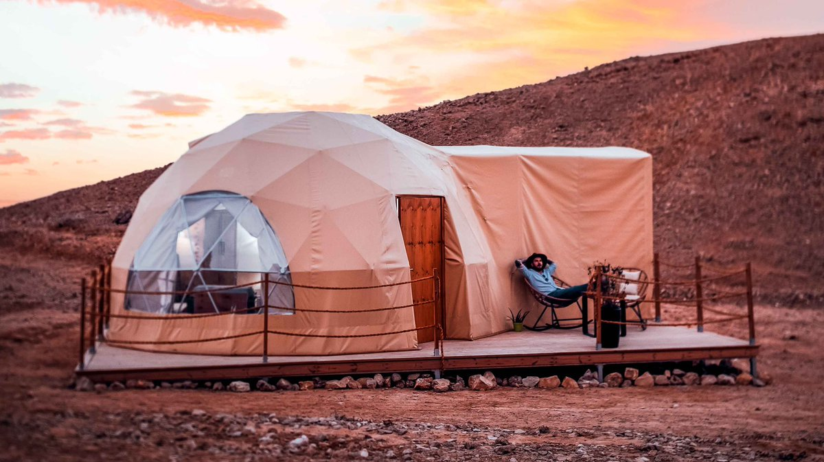
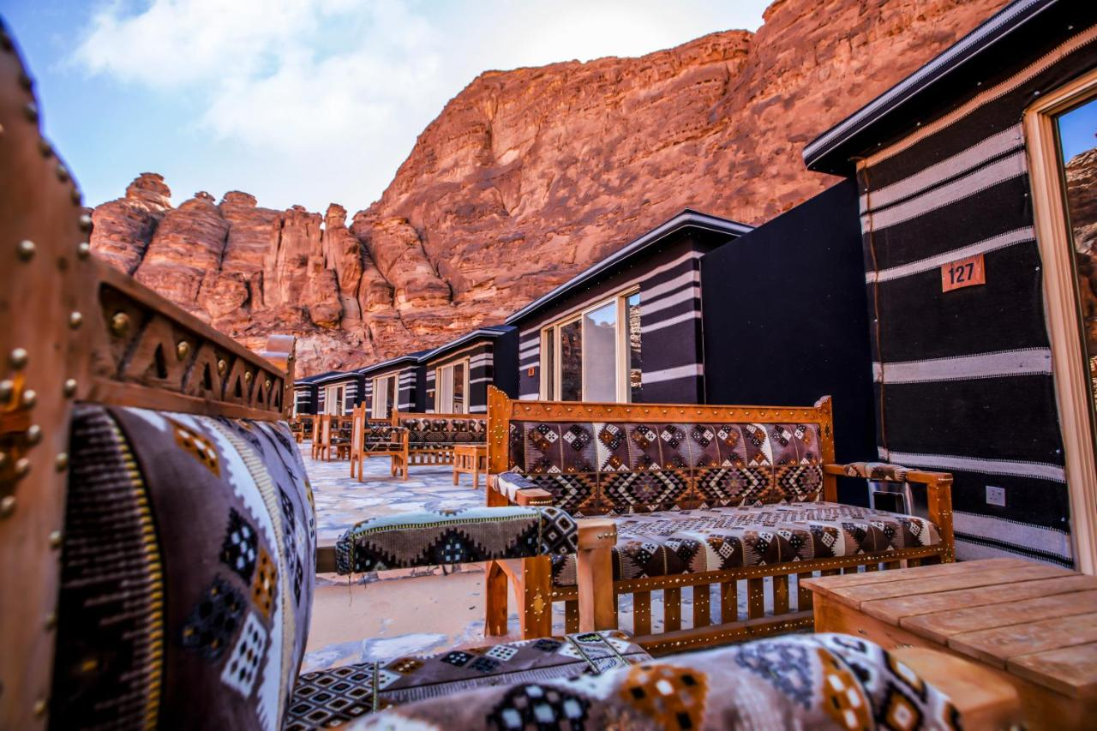

Slide 28
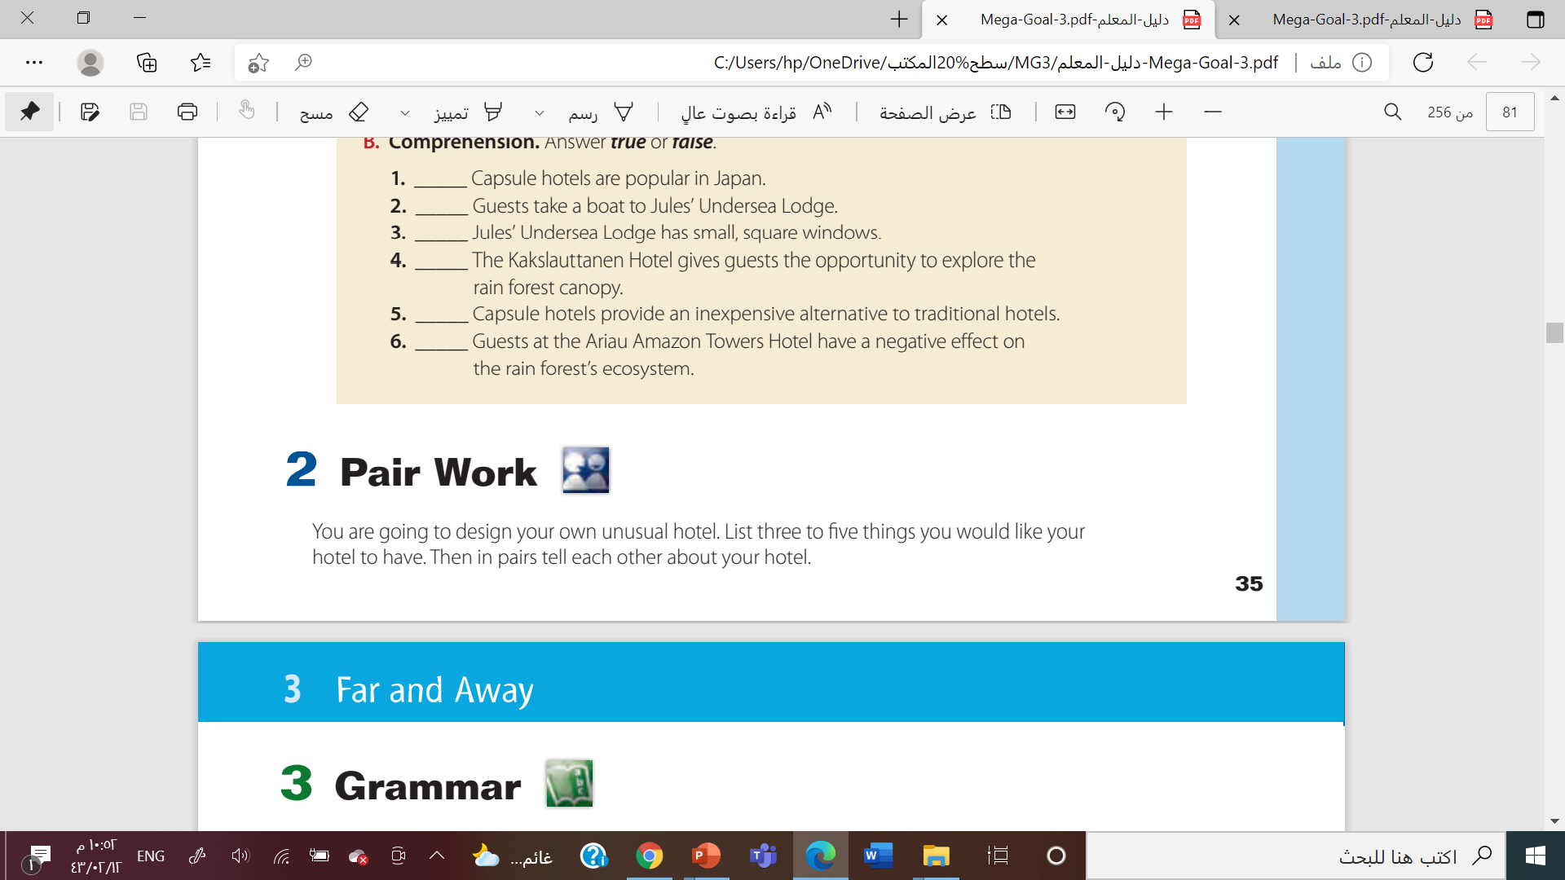
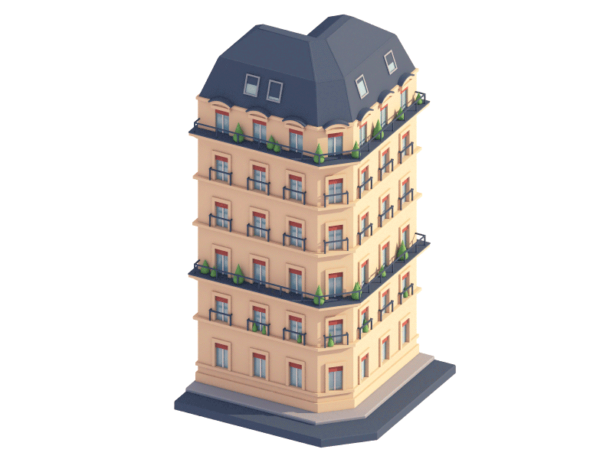

Slide 29

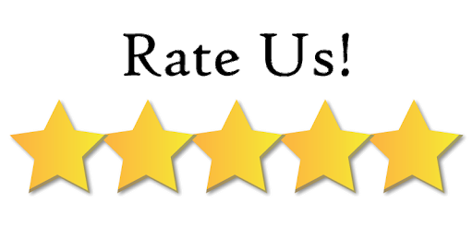
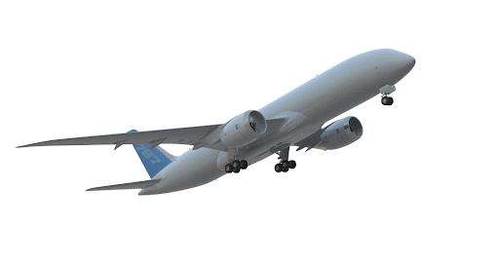

Slide 30



Slide 31

By Asma Almjlad

Slide 32

Far
and
Away
By: Asma Almjlad

