Slide 1

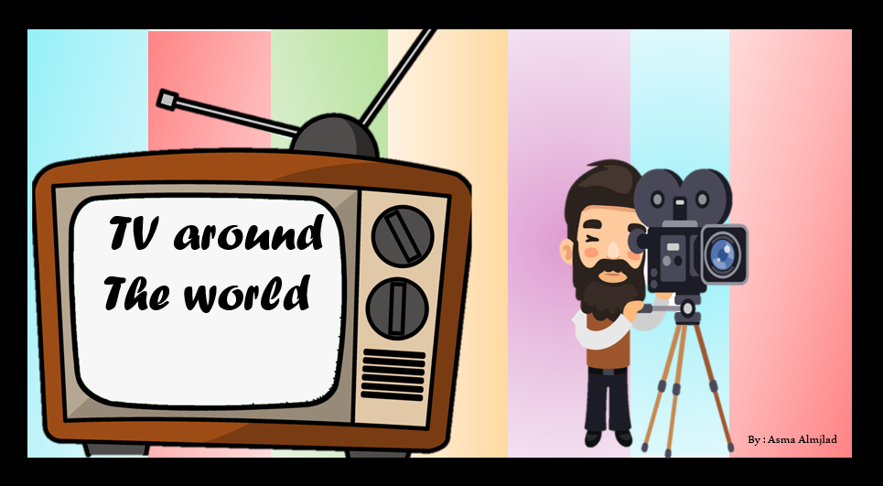

Listen and discuss

Slide 2
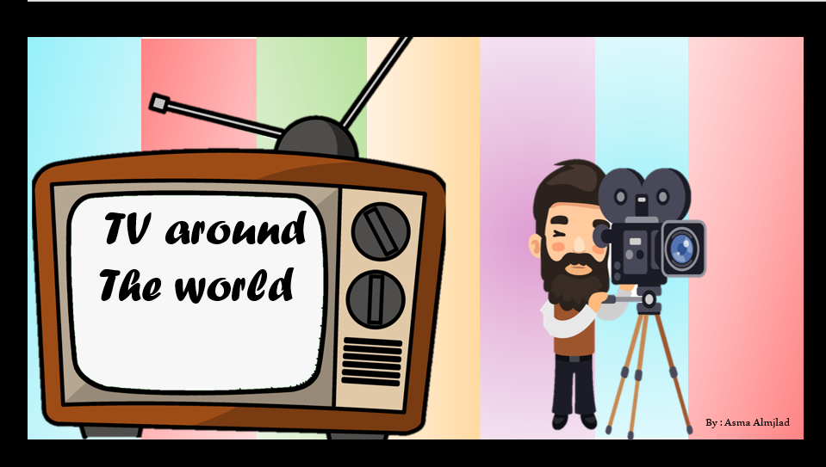


Slide 3
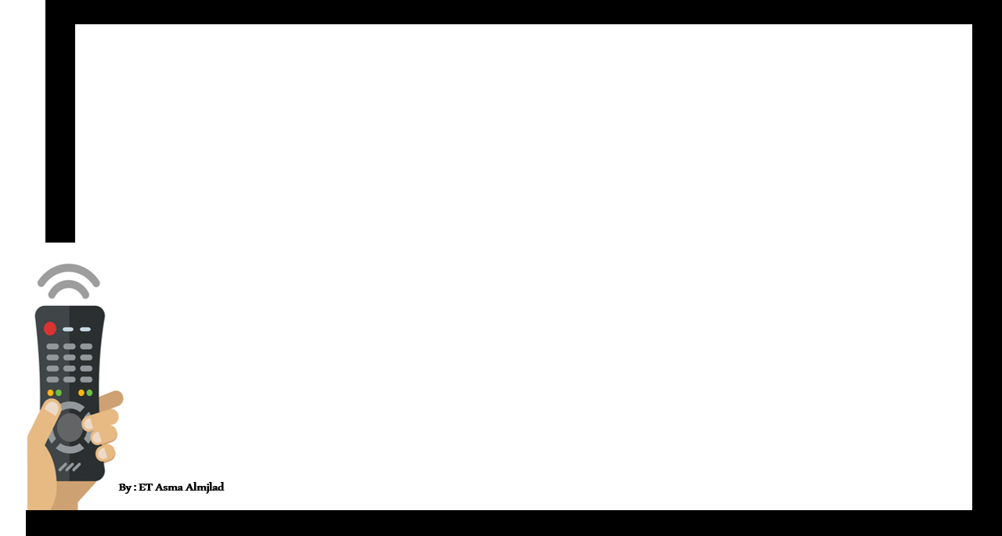

Objectives
Identify direct object and indirect object in a sentence
Use “ for " and “ to " before the indirect object
Decide whether the words are direct or indirect objects

Slide 4
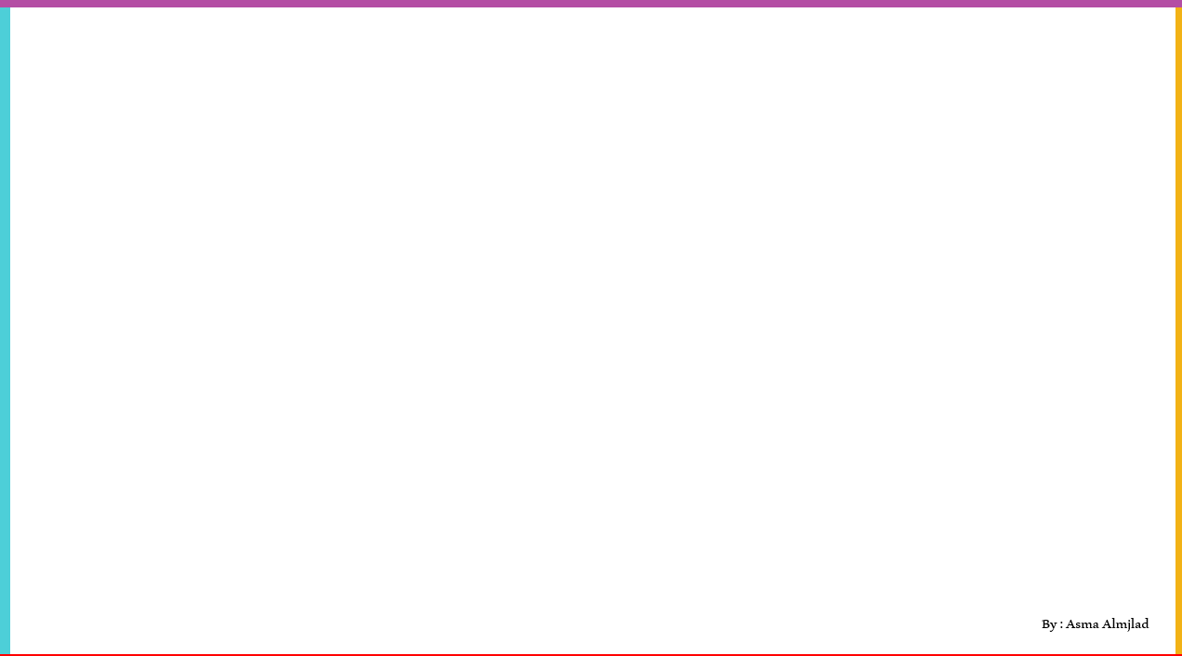

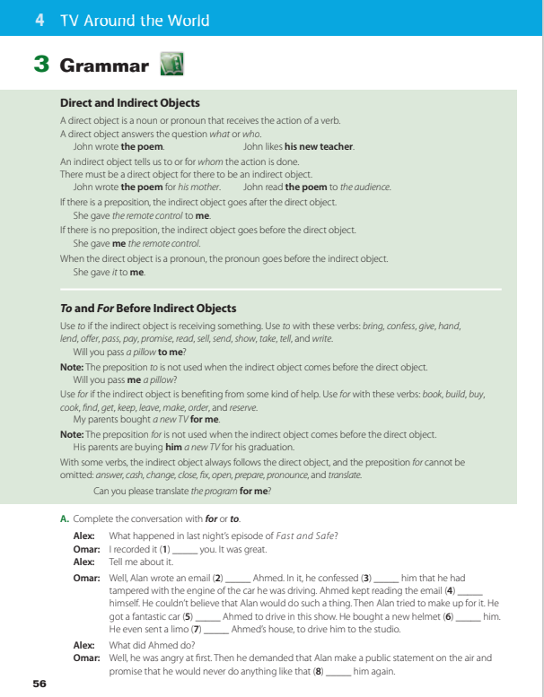
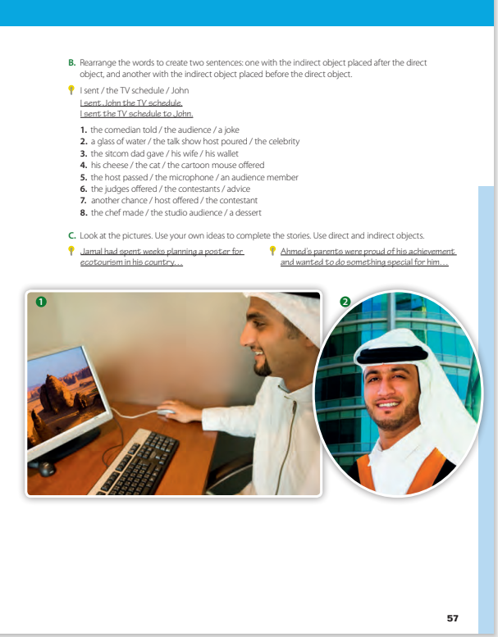

@ page 56+57

Slide 5

How can you form a sentence ?
S + V + O
e.g. Ali eats an apple
subject
Who do the action ( Ali)
verb
The action ( eats )
object
Who receives the action ( an apple )

Slide 6

Arjwn calls me at weekends
Lana and Renad write the lesson in the morning
Find out the direct objects
Walla drinks coffee everyday .

Slide 7



Direct object
can be found by asking who ? Or what ? About the action verb
Direct object
is never an adverb or object of preposition
What did they give ?
They gave Omar a new car
What did she offer ?
Direct object
Rahaf offered the girl a cake

Slide 8



indirect object
pronoun or noun
Tells us to what or for what or for whom or to whom the action of the verb is done
To whom ?
Jori bought me a flower
To whom ?
Shoug showed the class new glasses

Slide 9


they send a letter
s
V
direct
object
What do they send ?
they send a letter to their friend
s
V
direct
object
Indirect
object
For whom they send a letter ?

Slide 10





Amal cooked the dinner
What did Amal cook ?
Bdoor cooked us dinner
For whom did Bdoor cook?

Slide 11

My father bought a new house for us
Direct
object
indirect
object
What did the father buy ?
A new house
For whom the father buy the new house ?
us

Slide 12
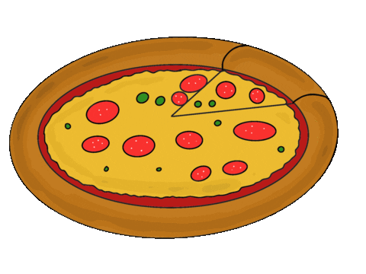
She made a pizza for Rana
Direct
object
indirect
object
What did she make ?
A pizza
For whom she make a pizza ?

Slide 13


How to Find the Indirect Object?
If there is a proposition ( for or to )
Jumanah told a secret to me
S + V + D.O + prop + I.O
If there isn’t a proposition ( for or to )
Ghadi told me a secret
S + V + I.O + D.O

Slide 14
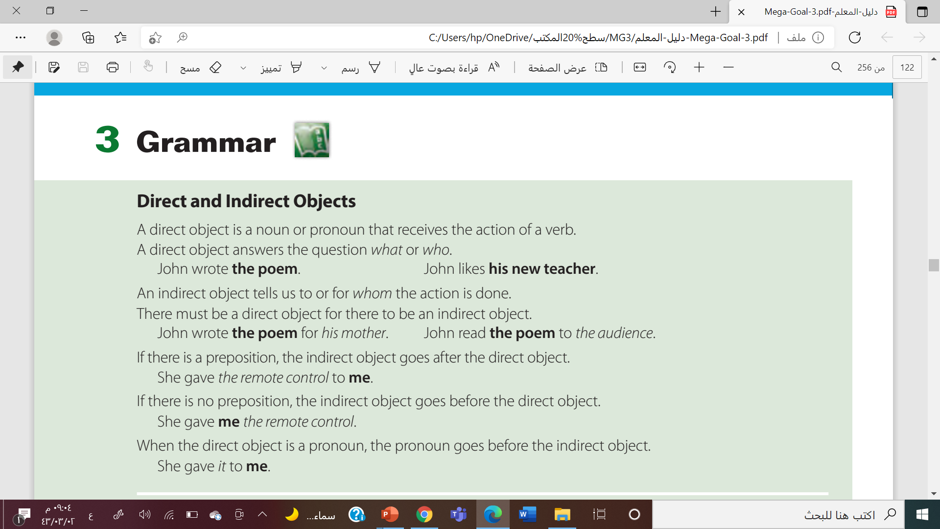

Slide 15
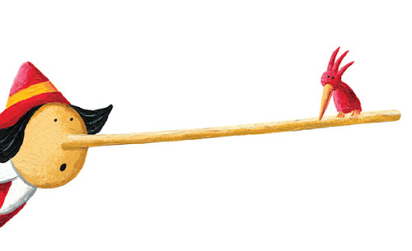


Find the fib
Impossible
She gave me it
She gave it to me

Slide 16

Find the fib
Ahmad ordered a burger to me

Slide 17

Find the fib
Impossible
Khalid found me it
Khalid found it for me

Slide 18

Find the fib
Omar lends some money for him

Slide 19

Find the fib
I read him to the story
I read a story to him
I read him a story

Slide 20
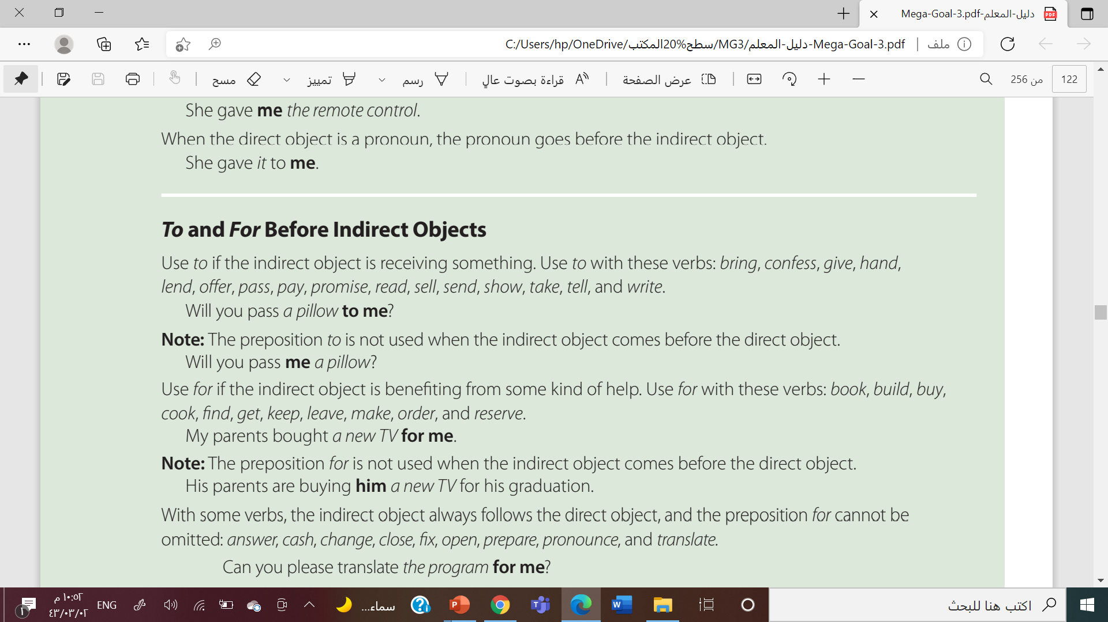
to
for
Receiving
Benefiting

Slide 21
to
for
buy
read
make
cook
send
write
cook
send
read
make
write
buy

Slide 22


Slide 23


By : Asma Almjlad

Slide 24


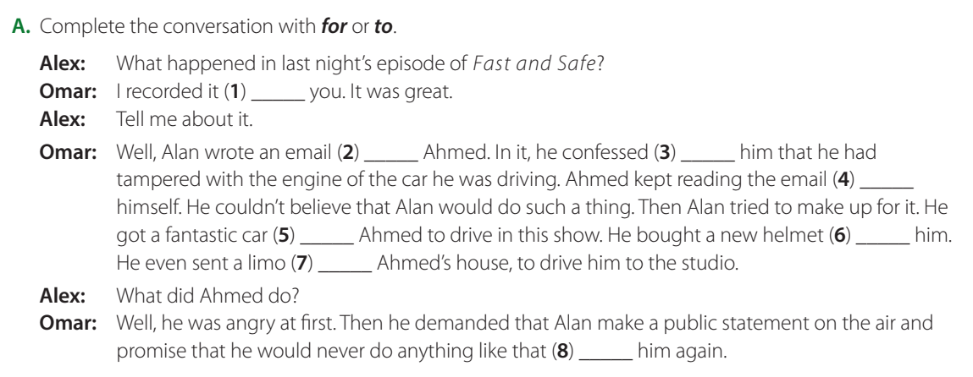
for
to
to
to
for
for
to
to

Slide 25
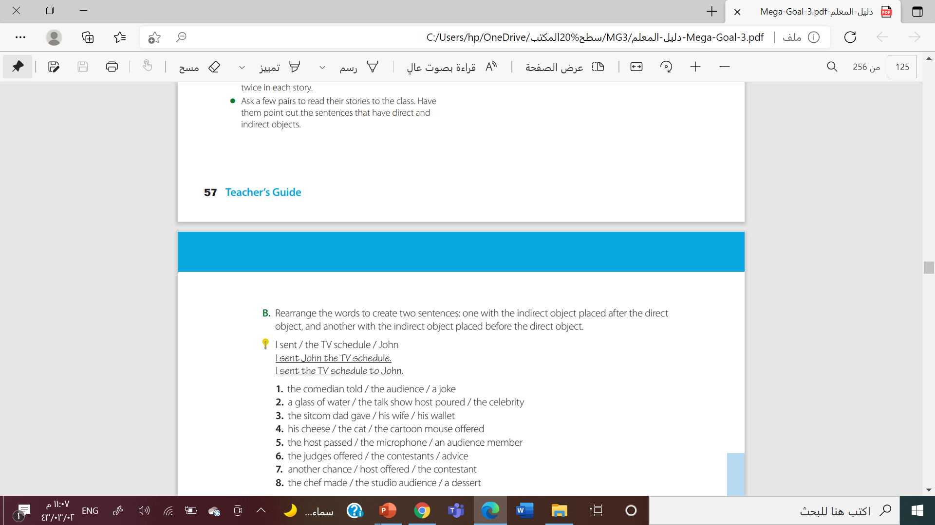
The comedian told the audience a joke./The comedian told a joke to the audience
The talk show host poured the celebrity a glass of water.
The sitcom dad gave his wife his wallet./
The cartoon mouse offered the cat his cheese./

Slide 26
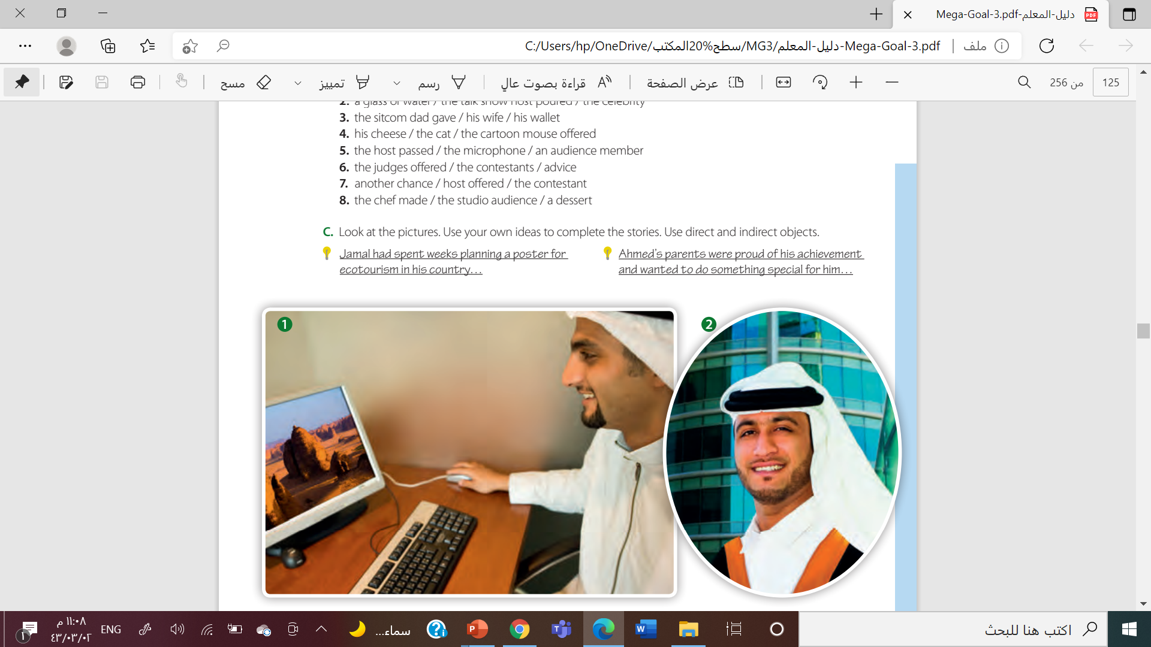

Slide 27
Work
book
By : Asma Almjlad

Slide 28
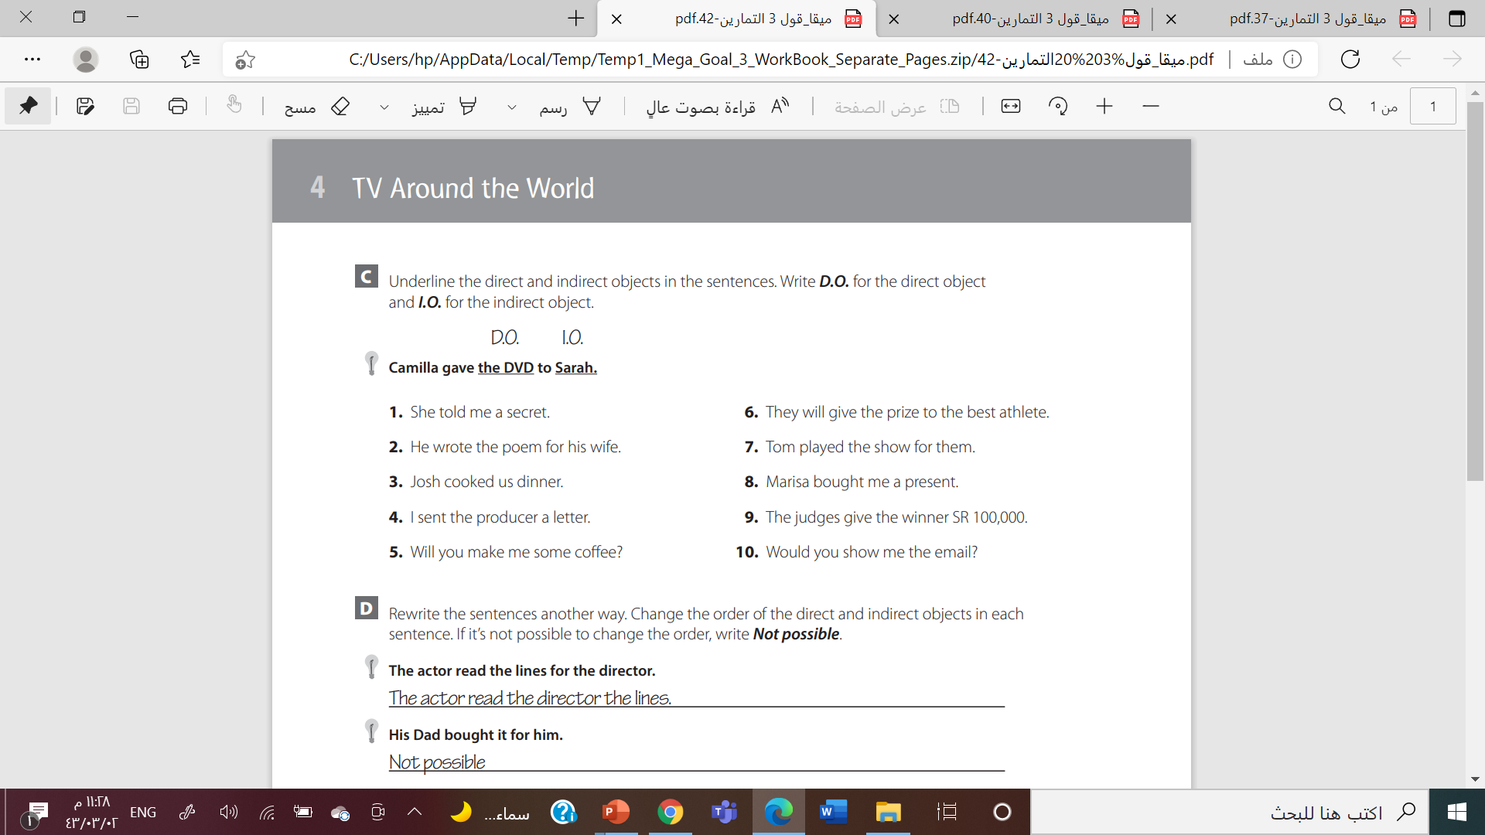
I.O.
D.O
D.O
I.O.
D.O
I.O.
D.O
I.O.
D.O
I.O.
I.O.
D.O
I.O.
D.O
I.O.
D.O
I.O.
D.O
I.O.
D.O

Slide 29
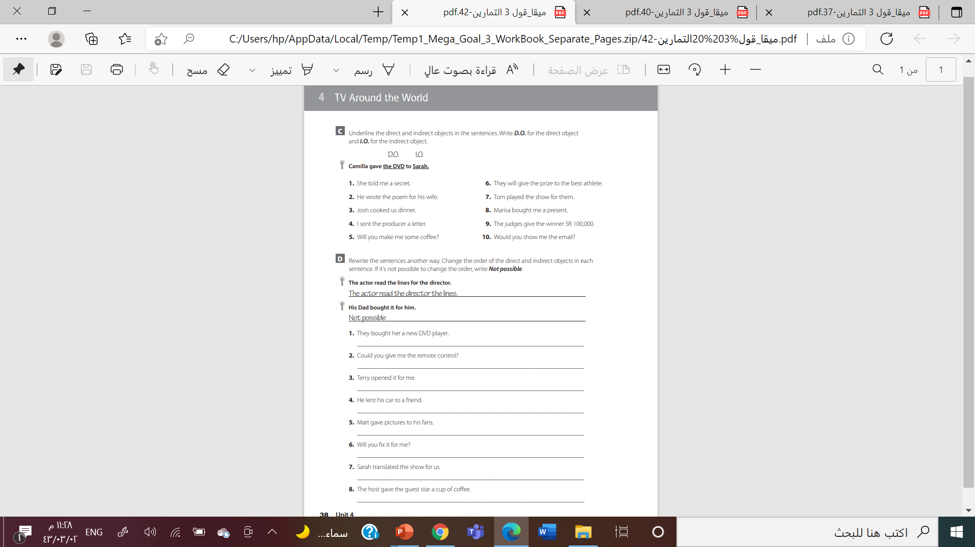

They bought a new DVD player for her.
Could you give the remote control to me?
. Not possible
He lent a friend his car.
Matt gave his fans pictures
. Not possible
. Not possible
. The host gave a cup of coffee to the guest star.

Slide 30
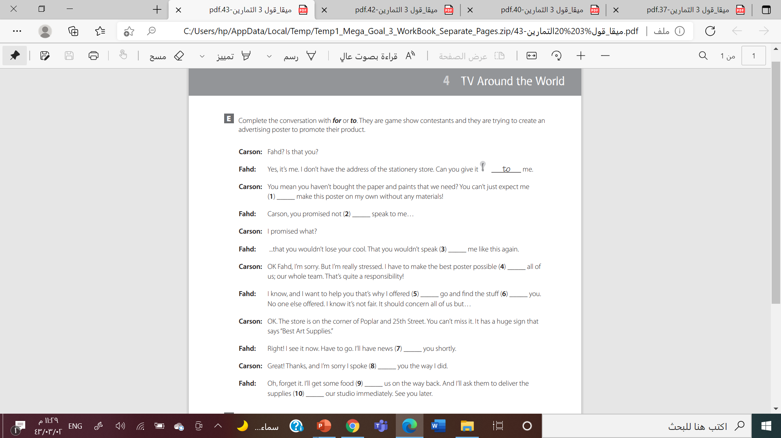

Slide 31
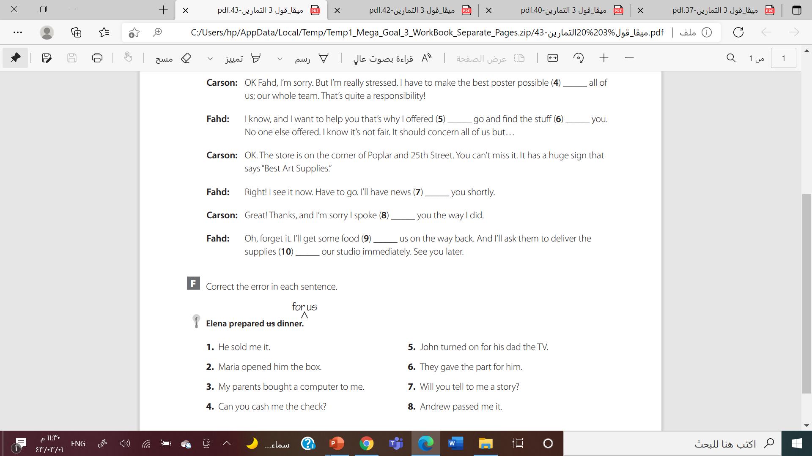

He sold it to me.
John turned on the TV for his dad.
Maria opened the box for him
They gave the part to him.
My parents bought a computer for me
Will you tell me a story?
. Can you cash the check for me?
Andrew passed it to me.

Slide 32





Slide 33



