Slide 1
Unit 2
Crime Doesn’t Pay
Listen & Discuss
Mega Goal 2.1
Done by: Entisar Al-Obaidallah

Slide 2
Lesson Goals
01.
02.
03.
Discuss
Listen
Match
04.
05.
06.
Match
Read
Answer
The topic of crimes and punishments
for specific information
the headline with the article correctly.
words with their meanings correctly.
for specific information
true - false questions about crime's information.

Slide 3
Warm Up

Slide 4
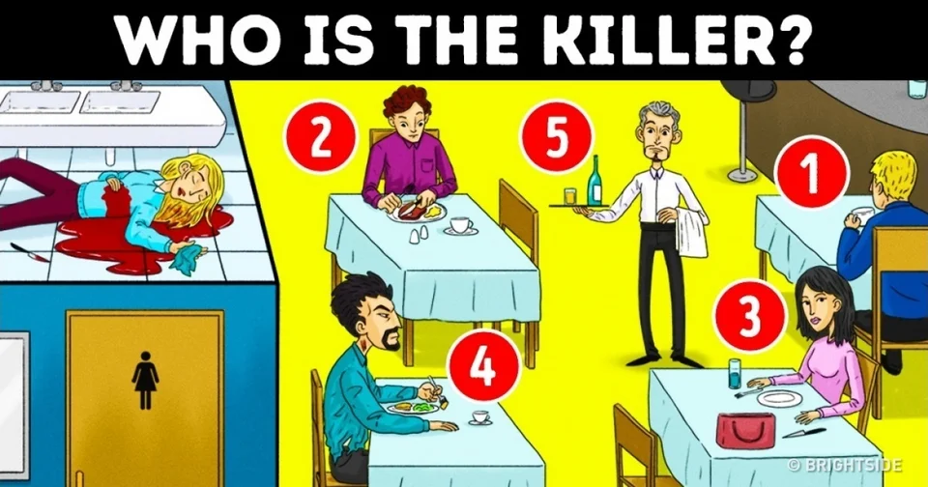
Warm up!
Look at the picture and using your logic find who the killer is?Give your reasons?

Slide 5
Warm up!
The guy sitting at number 4
His shirt is torn, and the torn piece is in the dead girl’s hand. Blood on his neck, too

Slide 6

Open
Your student’s book p. (20-21)

Slide 7
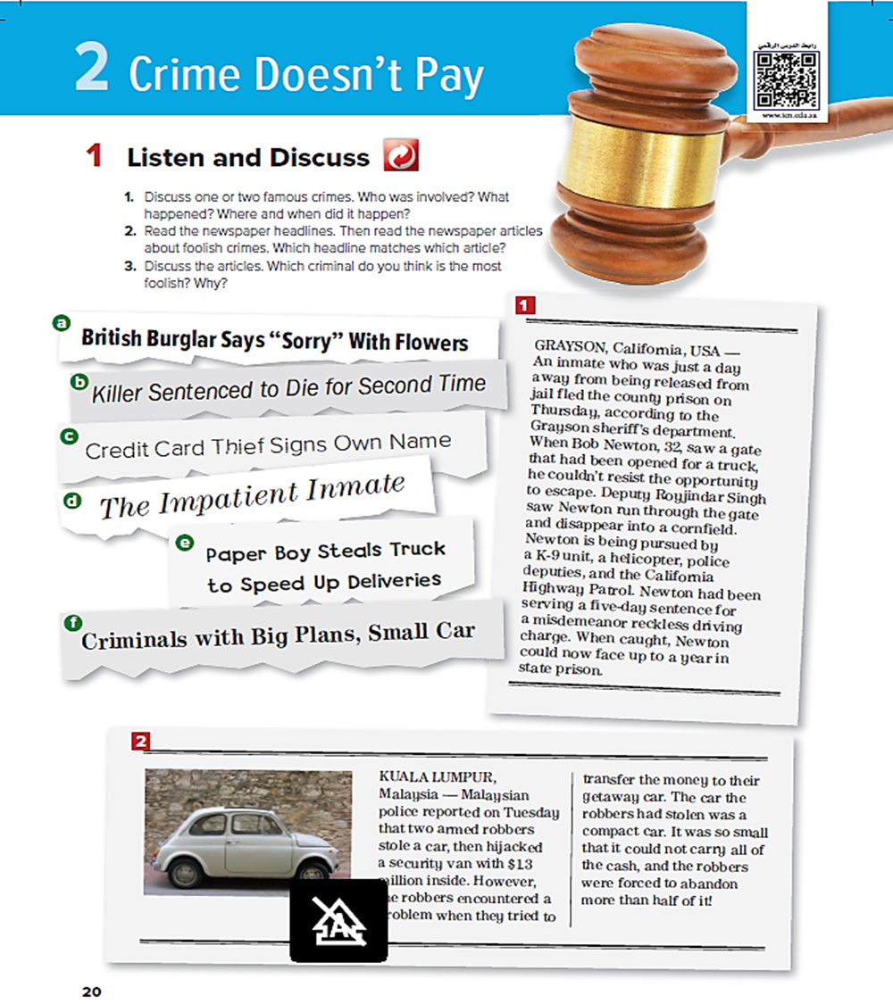
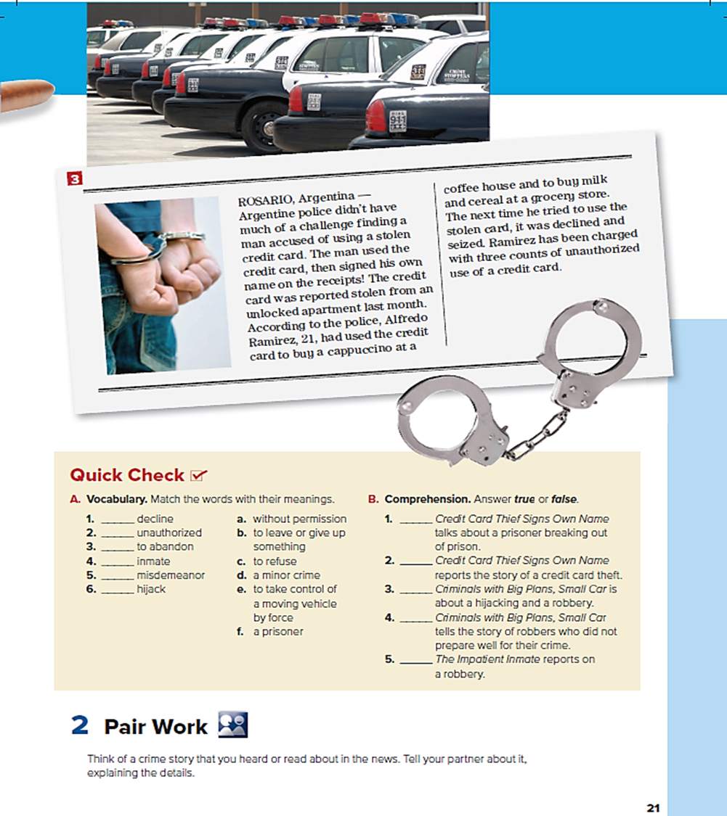


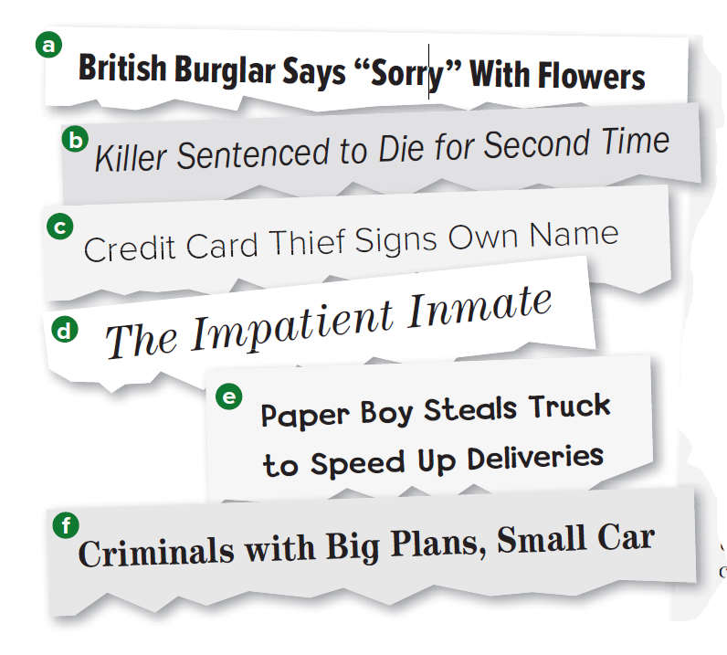
What are theses ?
Newspaper headlines
How many headlines are there?
6 headlines

Slide 8
How many articles are there?
3
3 articles
1
What are they about ?
2
About foolish crimes

Slide 9
articles about foolish crimes
c
d
Skim & match
stories with headlines
f

Slide 10
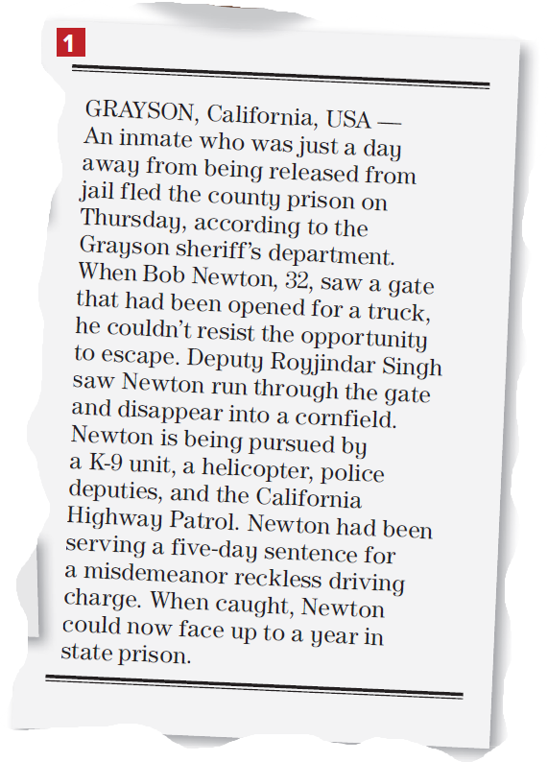
Read along as u Listen
Where does the story take place?
California
How did Newton escape?
He went through an open gate
What was Newton’s crime?
reckless driving

Slide 11
Read along as u Listen
How long was his sentence?
5 days
How long might Newton be in prison now when they catch him?
1 year

Slide 12
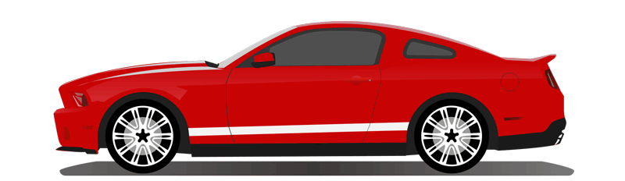
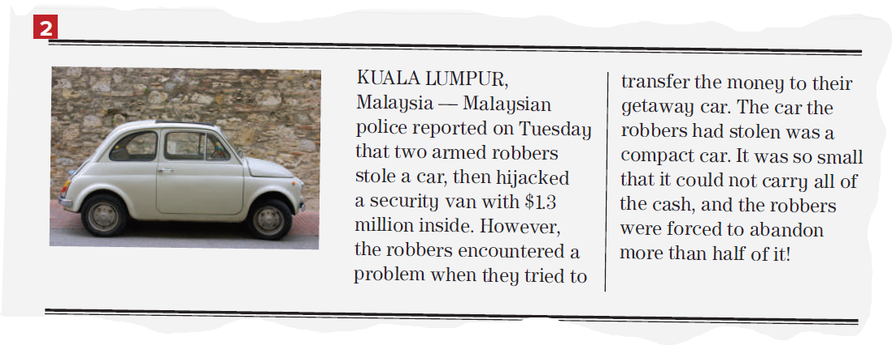
Read along as u Listen
What did the robbers do?
They stole a security van with $1.3 million in it

Slide 13
Read along as u Listen
What kind of car did they steal for the getaway car ?
a small, compact car)

Slide 14
Read along as u Listen
What problem did they have?
There wasn’t enough room in the small car for all the money they had stolen.

Slide 15
Read along as u Listen
What problem did they have?
There wasn’t enough room in the small car for all the money they had stolen.

Slide 16
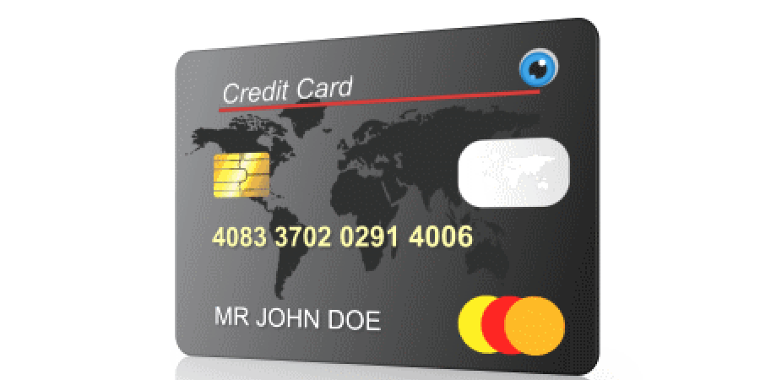
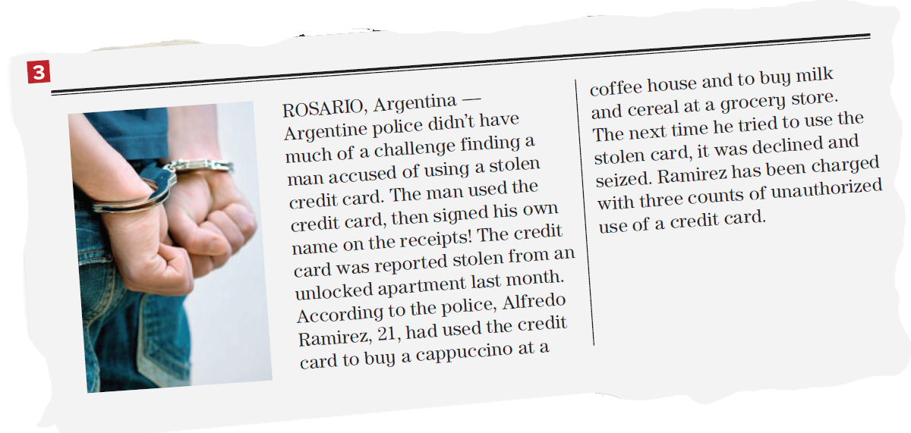
Read along as u Listen
What did the criminal steal?
a credit card.

Slide 17
Read along as u Listen
What mistake did he make when he used the credit card?
He signed his own name, not the name on the card

Slide 18
Read along as u Listen
Did he buy expensive things with the card?
No, he bought coffee, milk and cereal

Slide 19

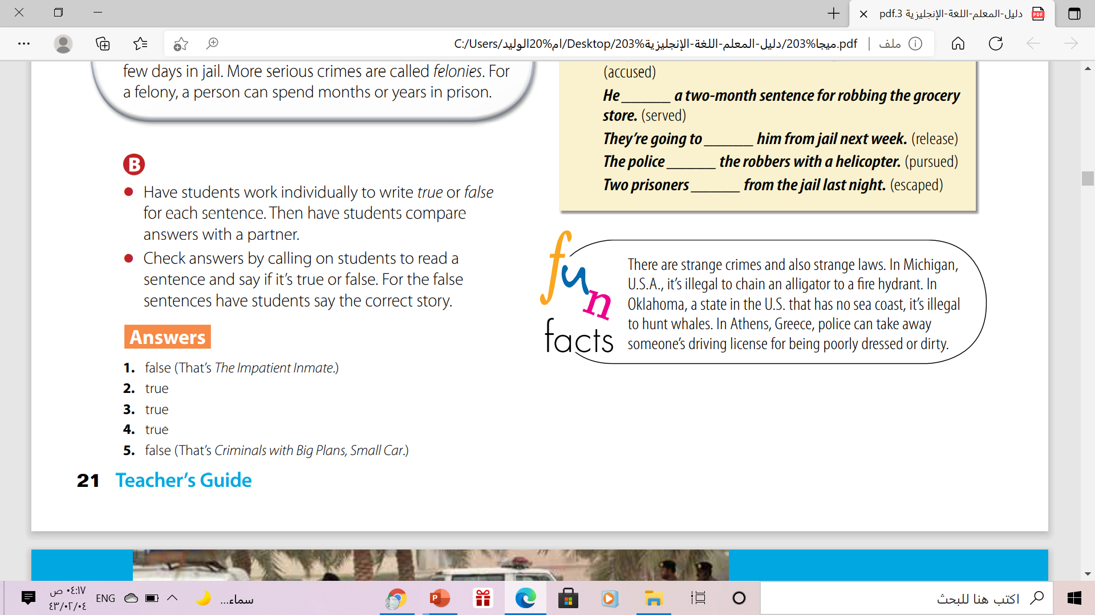
Which criminal do you think is the most foolish?
Why?

Slide 20
Open
Your student’s book p.( 21)

Slide 21
Classify the words into the correct category
inmate / release / drunk driving / accused / charged / armed robber / hijack / escape / jail / prison / getaway car / sheriff / deputy / serve a sentence / misdemeanor / stolen (steal)
PUNISHMENT | CRIME
inmate
release
jail
prison
sheriff
deputy
serve a sentence
misdemeanor
accused
charged
drunk driving
armed robber
Hijack
getaway car
stolen (steal)
escape

Slide 22
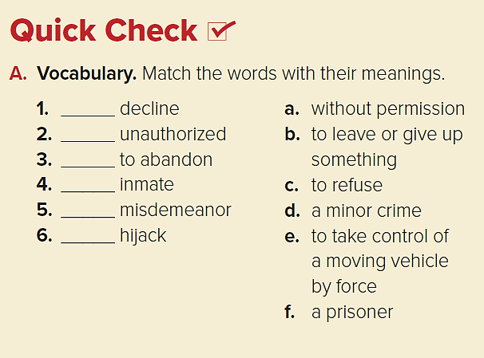
Quick Check
c
a
b
f
d
e

Slide 23
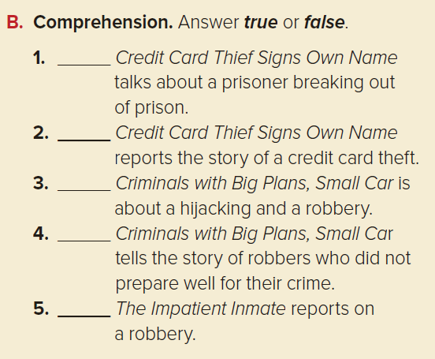
F
T
T
T
F

Slide 24
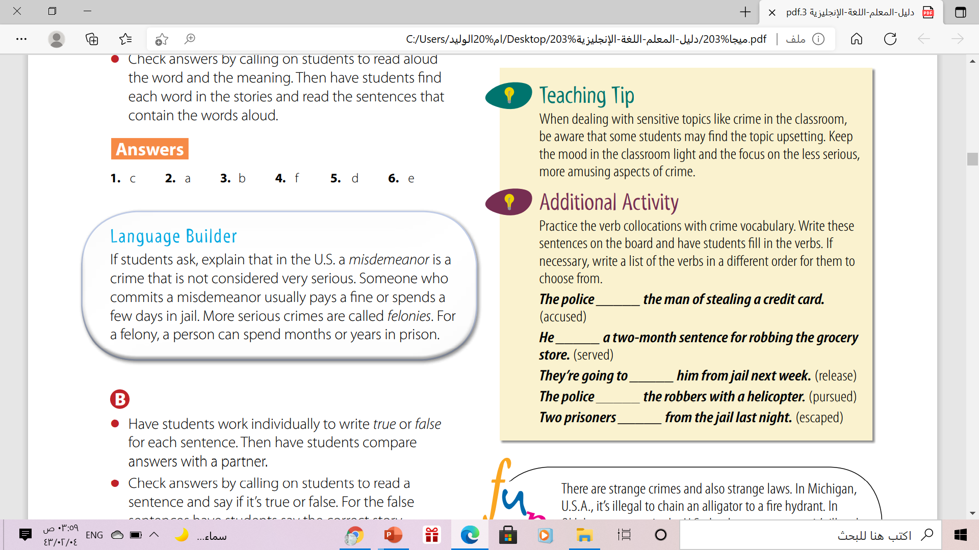
Misdemeanor vs felony

Slide 25


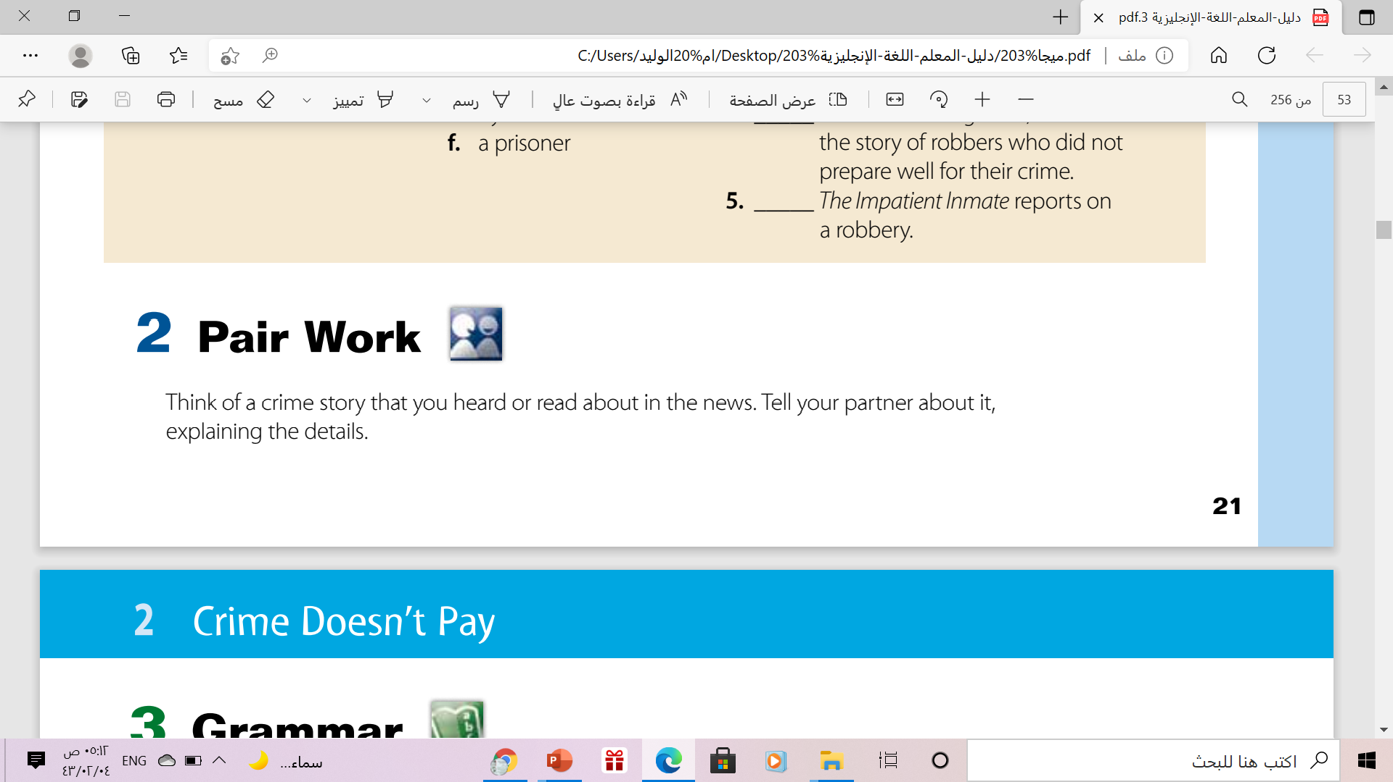

Slide 26

From The Holy Qura’an

Slide 27
Homework
On your Workbook p.( 93 ), exercise ( A)

Slide 28

THANKS!

