Slide 1
Unit 2
Crime Doesn’t Pay
Reading
Mega Goal 1.1
Done by: Entisar Al-Obaidallah

Slide 2
Lesson Goals
Read for specific information
Find the meaning of new words in the text.
Answer True – False questions correctly
Talk about the characteristic of a good detective.

Slide 3
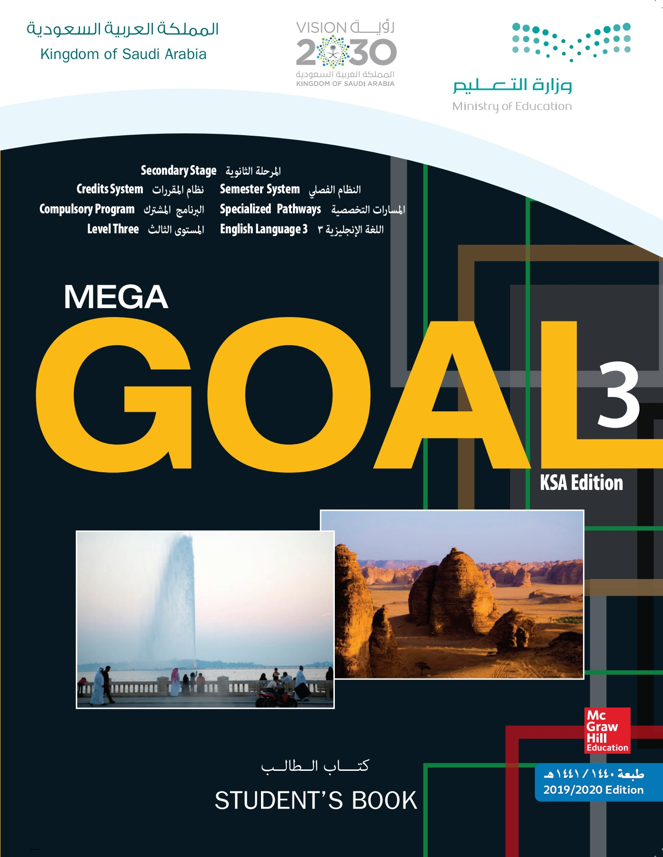
Open
Student’s book p. (26)

Slide 4
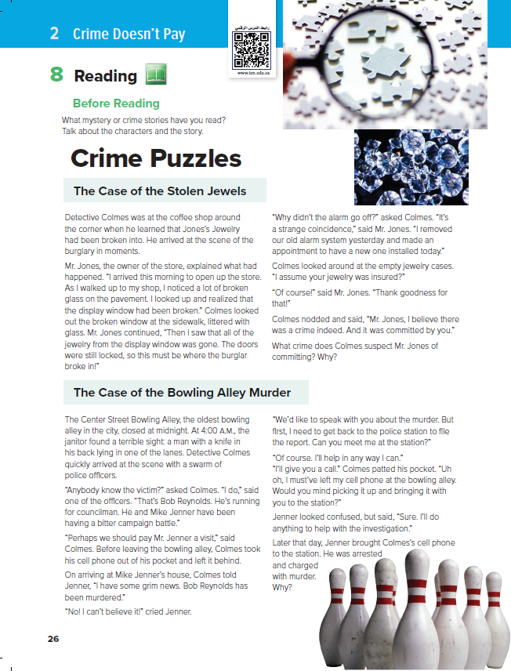
1
2
What is the title?
Crime Puzzles
How many pictures are there?
Three
What does each picture show?
1- Puzzle 2-jewels 3-bowling
3

Slide 5
1
How many stories are there?
Tow stories
What is the first story about?
2
The Case of the Stolen Jewels
What is the second story about?
The Case of the Bowling Alley Murder

Slide 6

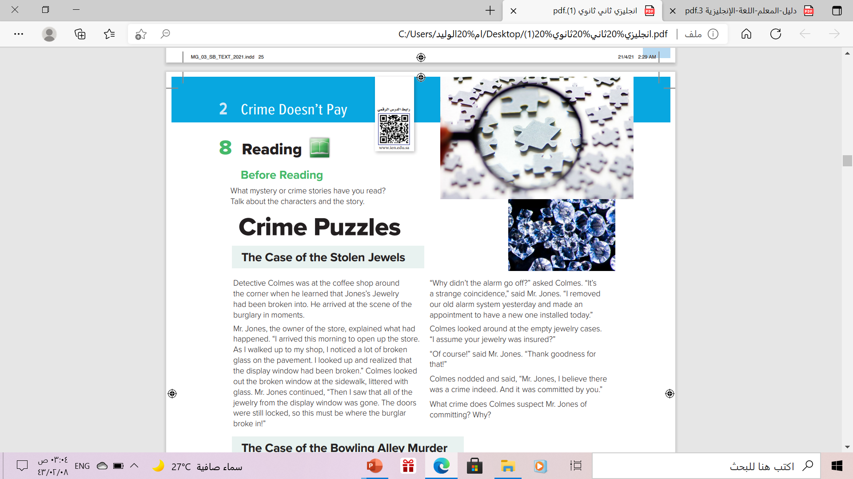




Case # 1
Read along as u listen

Slide 7
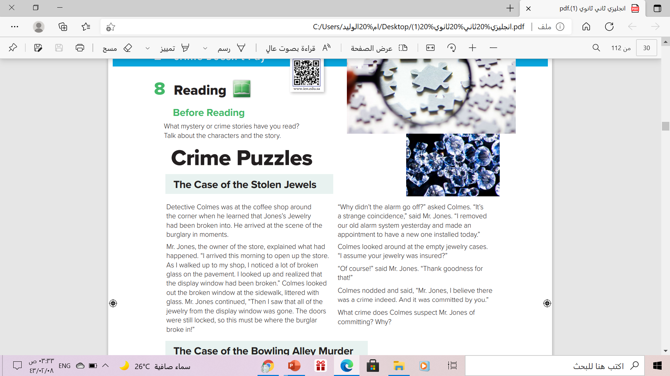
What is the Detective’s name?
Detective Colmes
Who is the owner of the store?
Mr. Jones
Why didn’t the alarm go ff?
Mr. Jones removed the old alarm system
Was the jewelry insured?
Who was the first subsect of the burglary?
Yes . It was
The owner , Mr. Jones

Slide 8
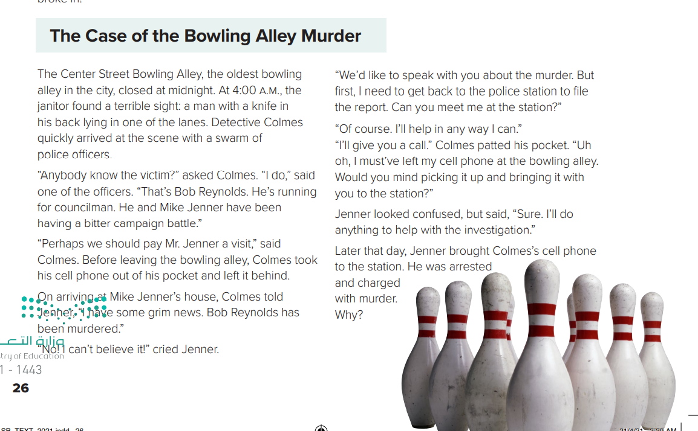
Case # 2
Read along as u listen

Slide 9
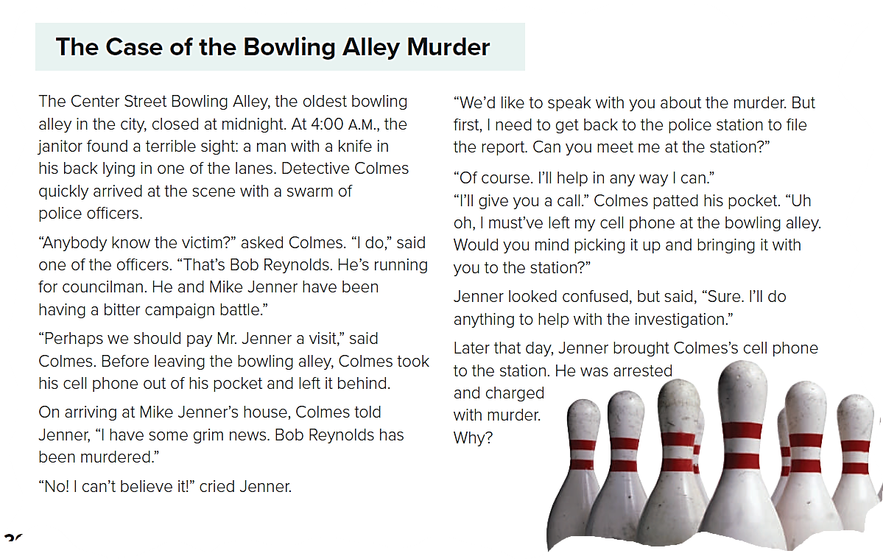
Who found the stabbed man?
The janitor
Who were running for the councilman?
Mike Janner and Bob Reynolds
What did detective Colmes leave behind in the bowling alley?
His cell phone

Slide 10
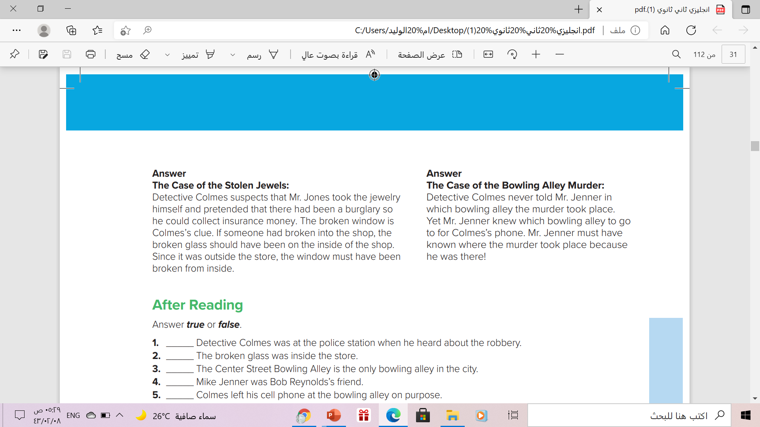
1
2

Slide 11

1
2

Slide 12


Slide 13

jewelry
decorative objects worn on your clothes or body that are usually made from valuable metals, such as gold and silver, and precious stones

Slide 14
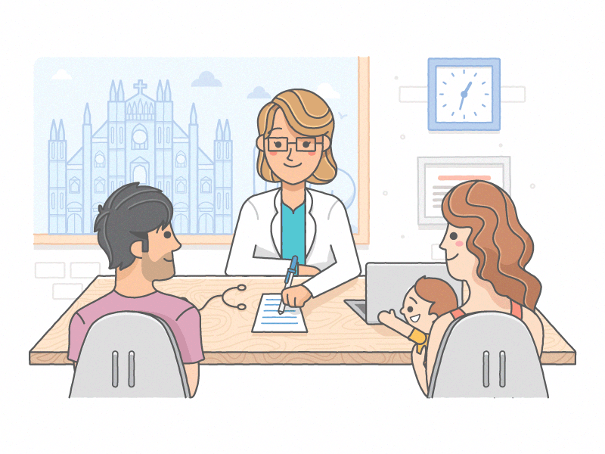
appointment
a formal arrangement to meet or visit someone
at a particular time and place:

Slide 15

scene
a place where an event or action happened

Slide 16
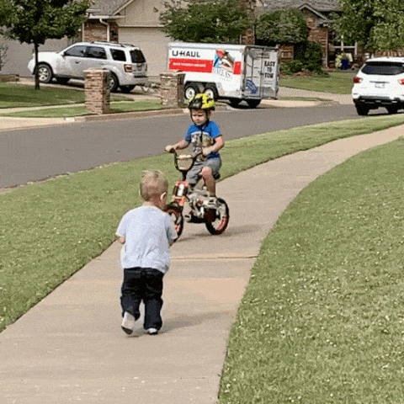
sidewalk
a path with a hard surface on one or both sides of a road, that people walk on

Slide 17
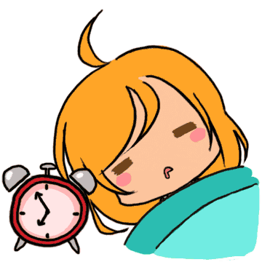
Go off
If a light or a machine goes off, it stops working:

Slide 18

nod
to move your head down and then up,

Slide 19
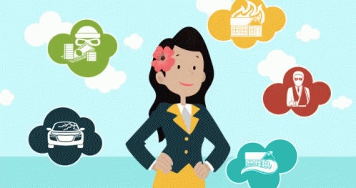
insurance
an agreement in which you pay a company money and they pay your costs if you have an accident, injury, etc.:

Slide 20

clue
a sign or some information that helps you to find the answer to a problem, question, or mystery

Slide 21
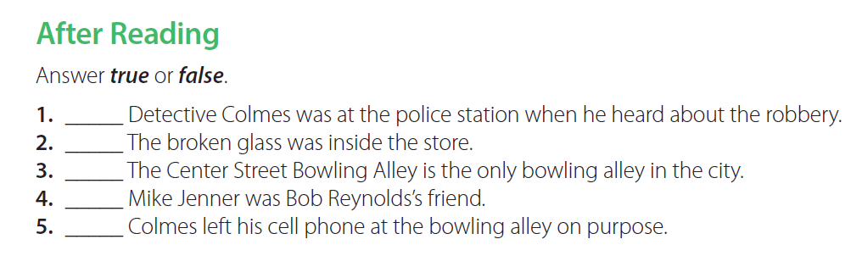
False
False
False
False
True

Slide 22
Homework
Workbook p. (98), exercise ( I )

Slide 23

Thanks!

