Slide 1

Unit 2
Crime Doesn’t Pay
Writing
Mega Goal 2.1
Done by: Entisar Al-Obaidallah
HOME
BACKGROUNDS
AVATAR KIT
PLANNERS
HOMEWORK

Slide 2
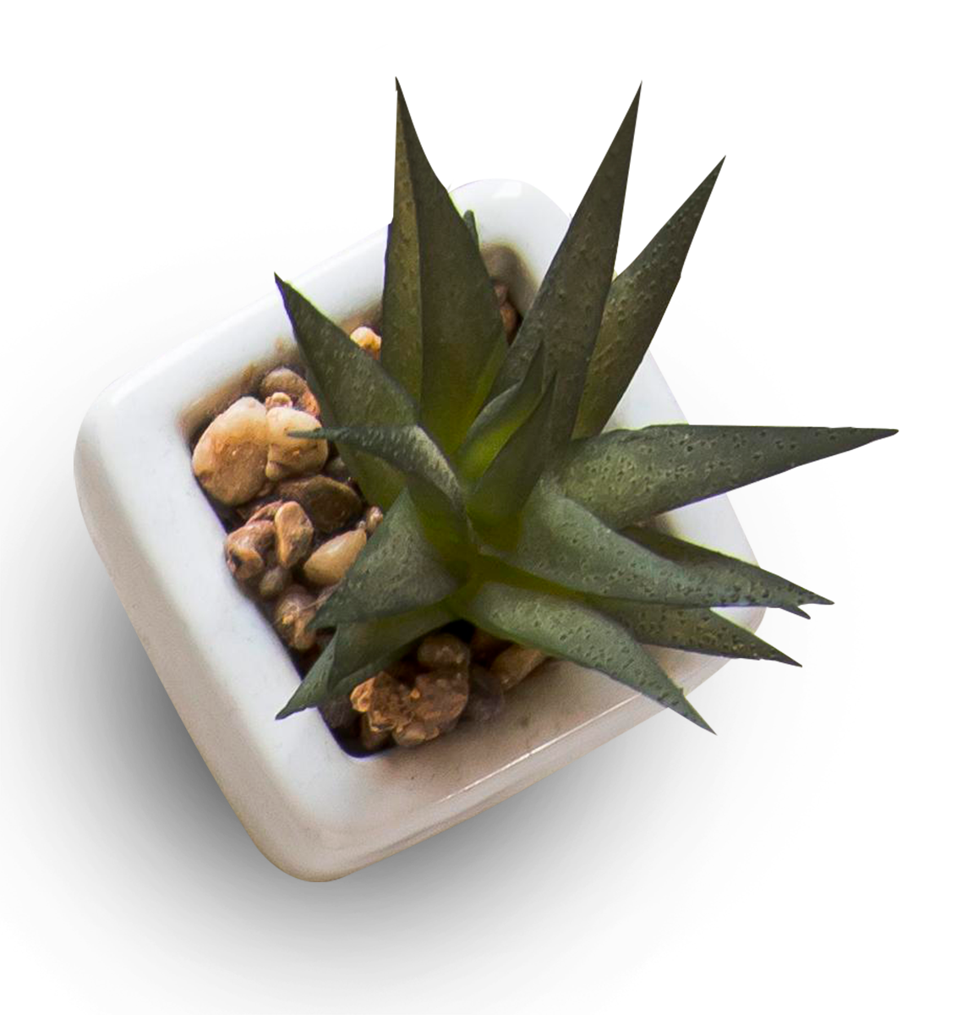
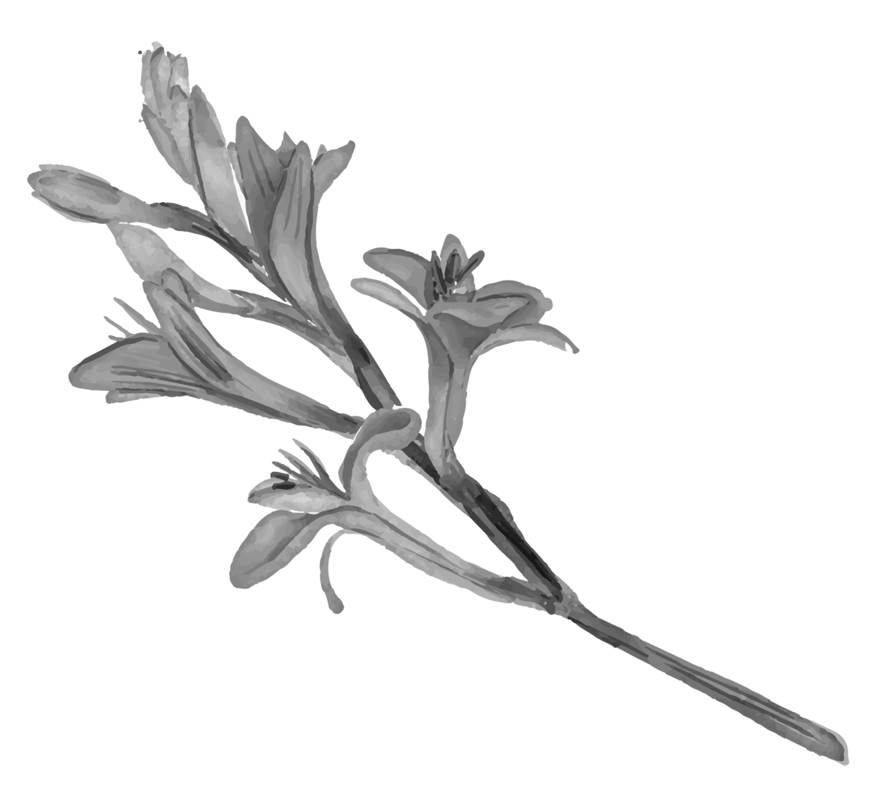

Lesson Obectives:
01
Read
02
Analyze
03
Answer
04
Use
05
Write
For specific information
a crime story to its main elements
the main questions about a crime story .
time markers to follow the order of events .
about a detective character they know
HOME
BACKGROUNDS
AVATAR KIT
PLANNERS
HOMEWORK

Slide 3
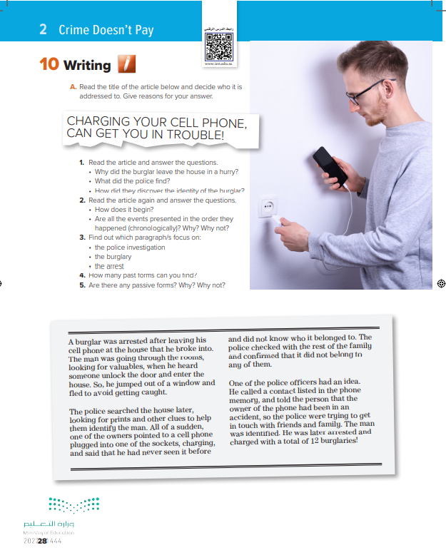

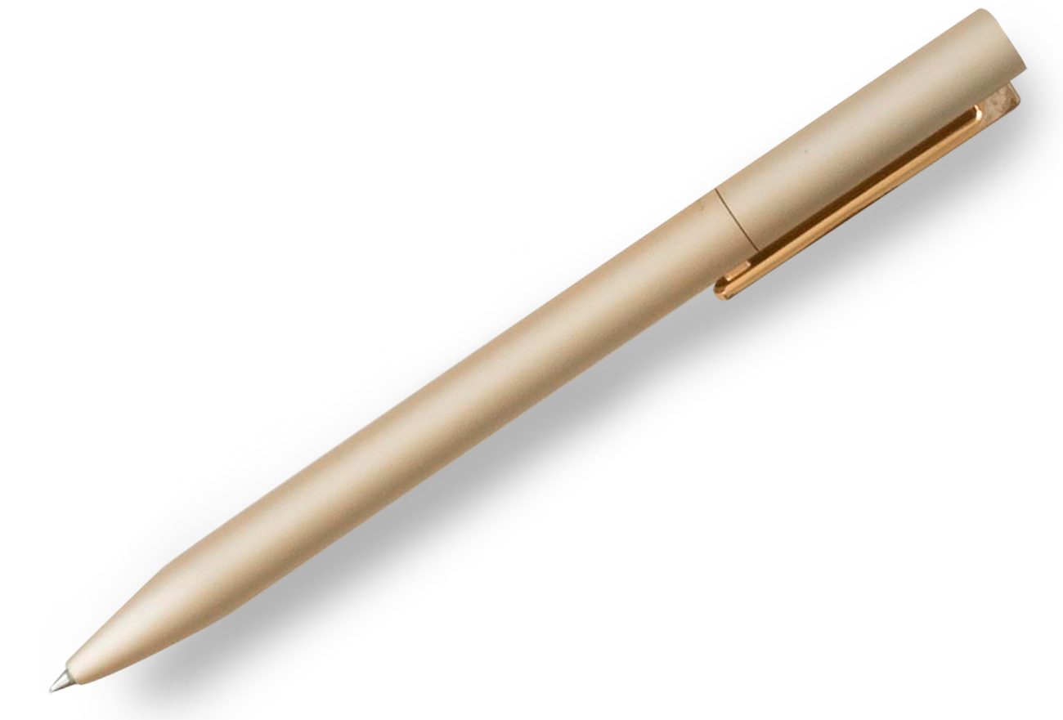
Open Book
pages ( 28)

Slide 4

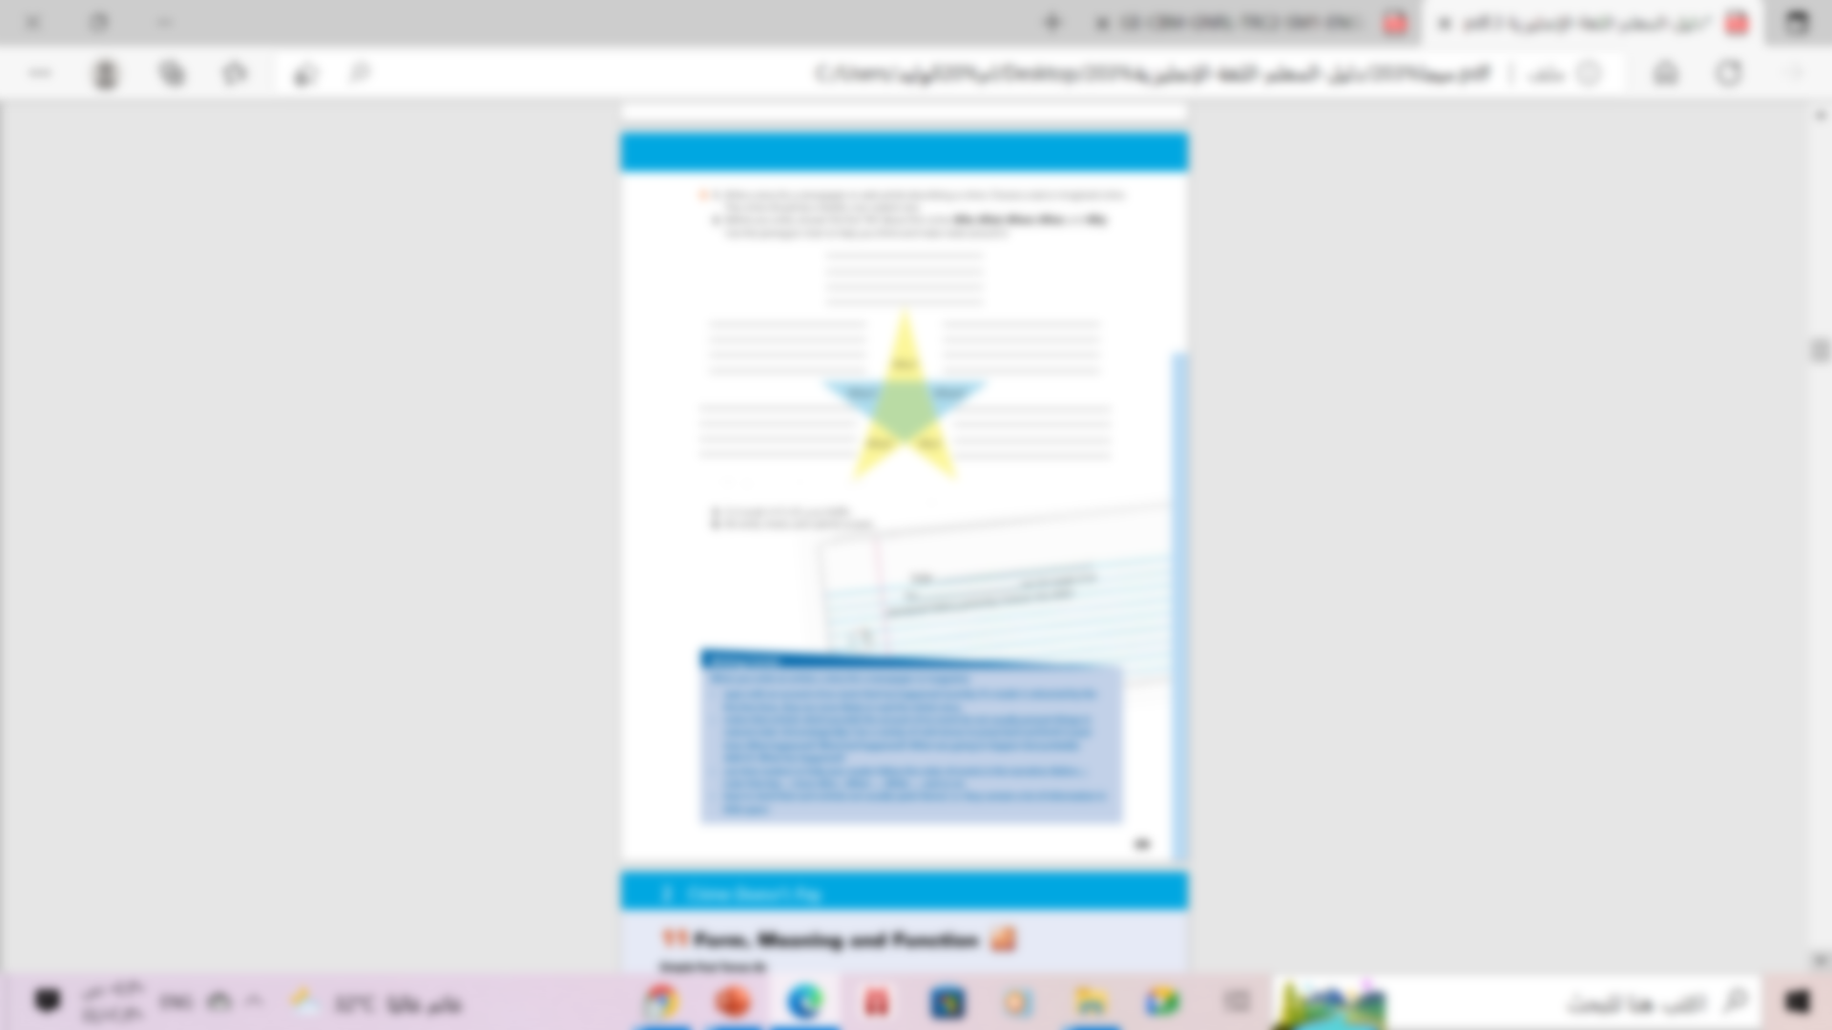

Book Open
pages ( 28- 29)

Slide 5

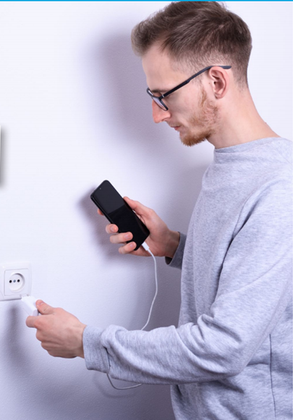
Warm up
Who do you think the person is?
What
is he doing in the picture?
Where do you think he is? Why?

Slide 6



What is the title referring to ?

Slide 7


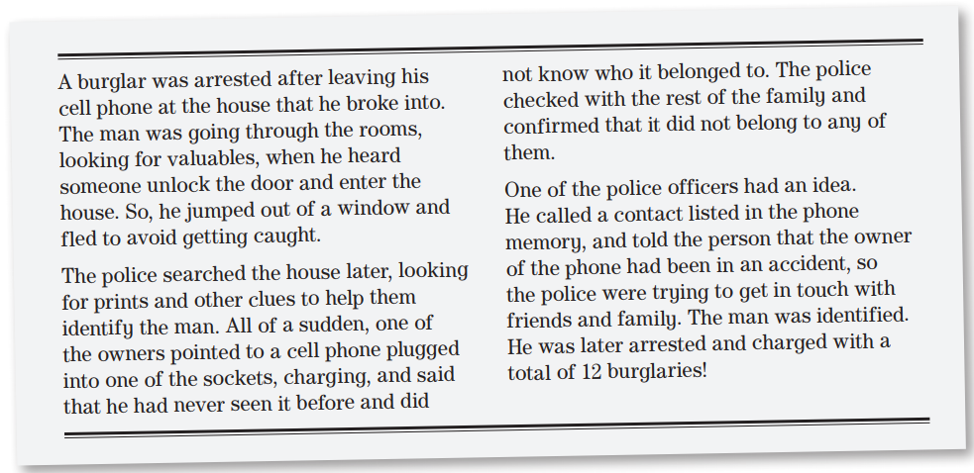
Read as long you listen

Slide 8
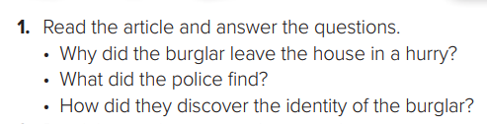
• Because he heard someone enter the house and he didn’t want to get arrested.
• They found a cell phone that did not belong to anyone in the family, plugged into a socket
• One of the police officers called a contact listed in the phone memory & the man was identified .

Slide 9
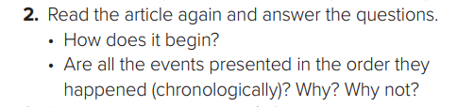
➔A burglar …broke into.
➔It begins with the final event and the reason that led to it to raise reader interest and expectations .

Slide 10
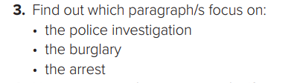
paragraph 2: police , searched , prints , clues , identify the man .
paragraph 1: arrested , broke into , looking for valuables .
paragraph 3: police officers , idea , get in touch , identified , arrested and charged with 12 burglaries.

Slide 11

There are a few passive forms. For example: A burglar was arrested (paragraph 1) and the man was identified , was arrested / charged.
The passive forms are used to focus on the burglar and the burglary and not the person or people who acted, in this case the police, because it is understood that the police investigated the case and caught the burglar .

Slide 12
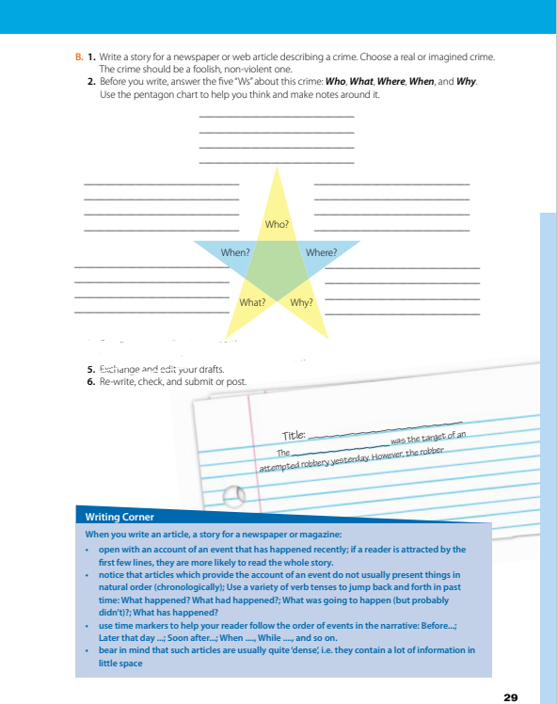
Open Book
pages ( 29)

Slide 13
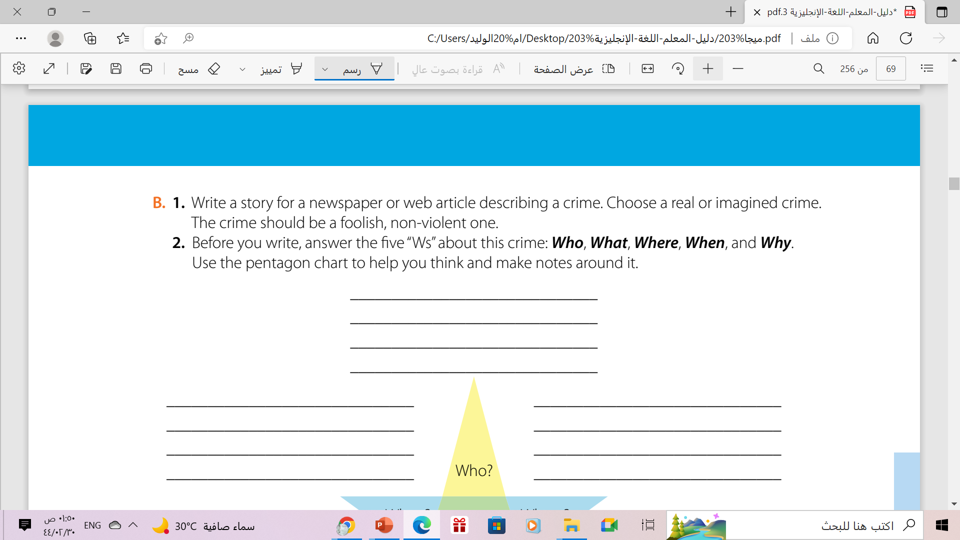
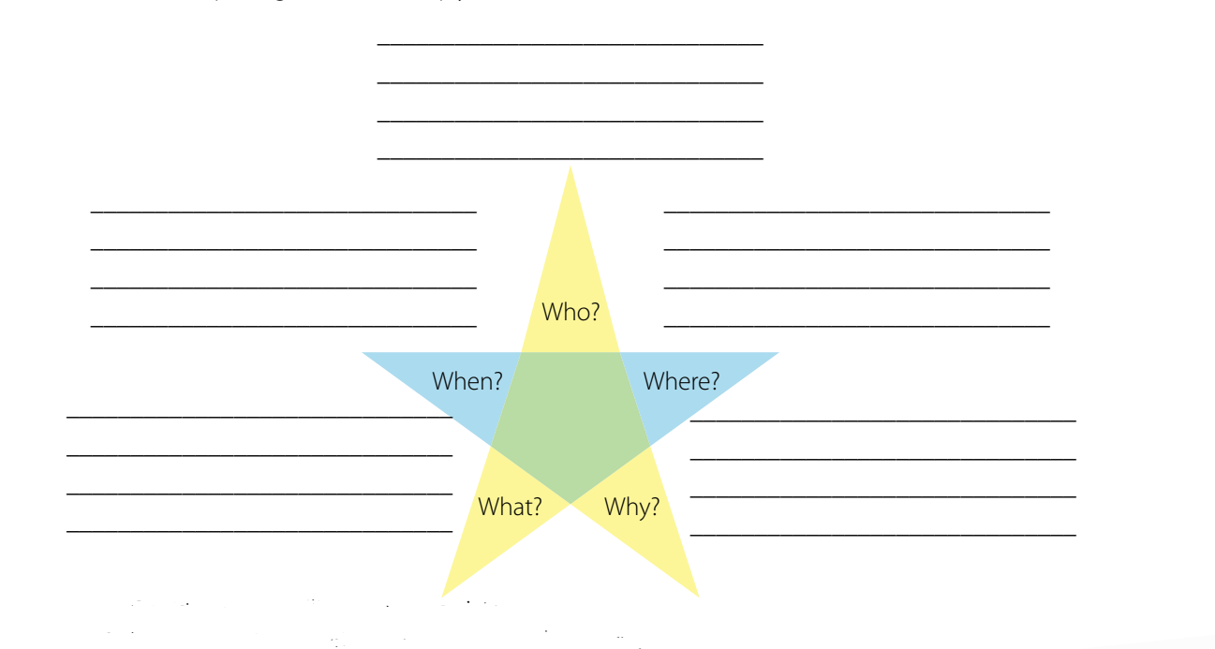
HOME
BACKGROUNDS
AVATAR KIT
PLANNERS

Slide 14
Groups of Hackers
In 2014
San Francisco ,USA
They had hacked the road signs for temporary period & changed all signs to “Godzilla attack!! Turn back”
Just to show people they back again

Slide 15
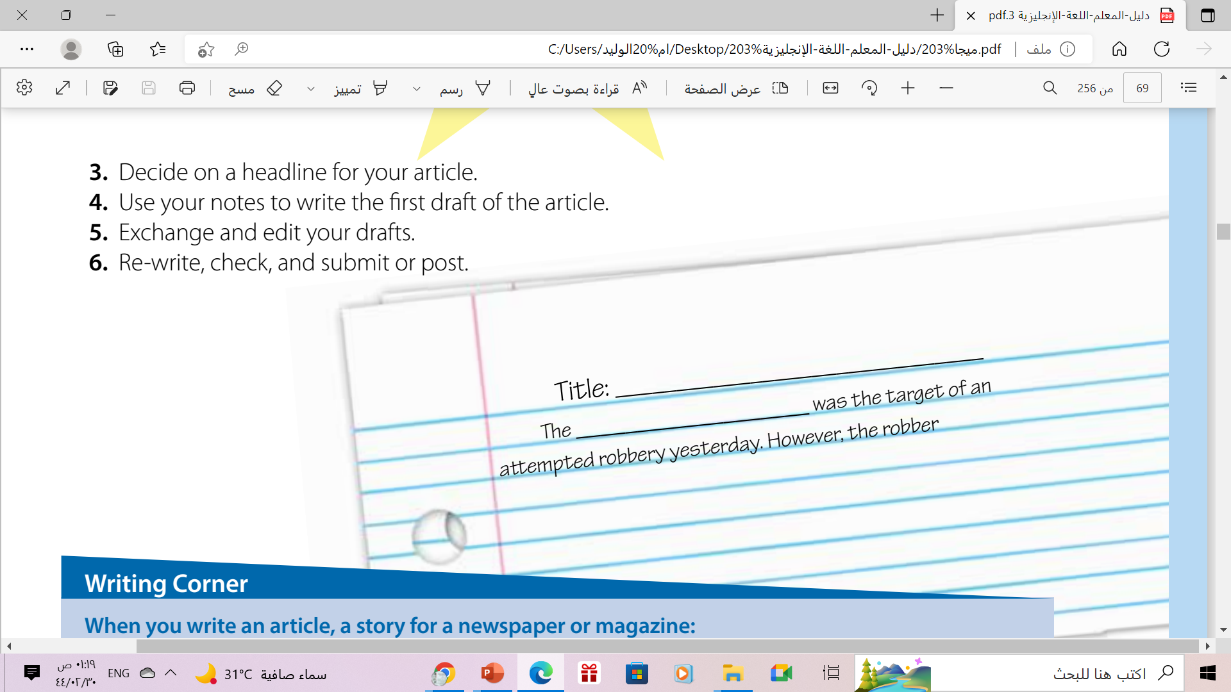
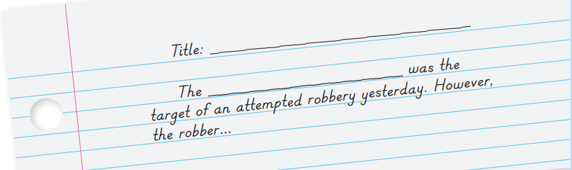

Slide 16
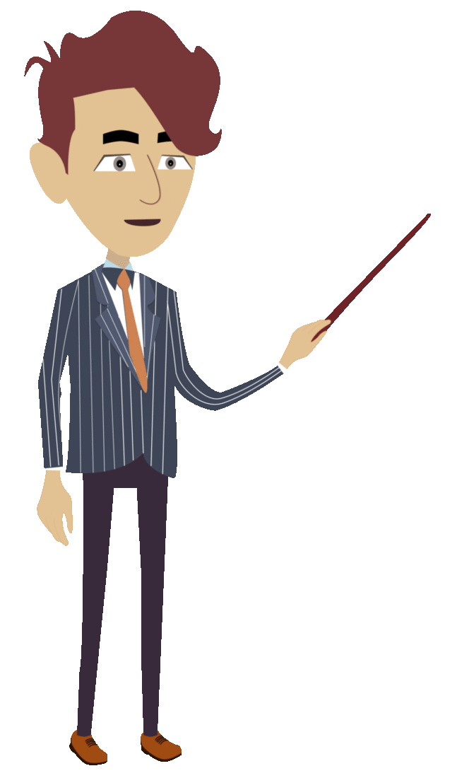
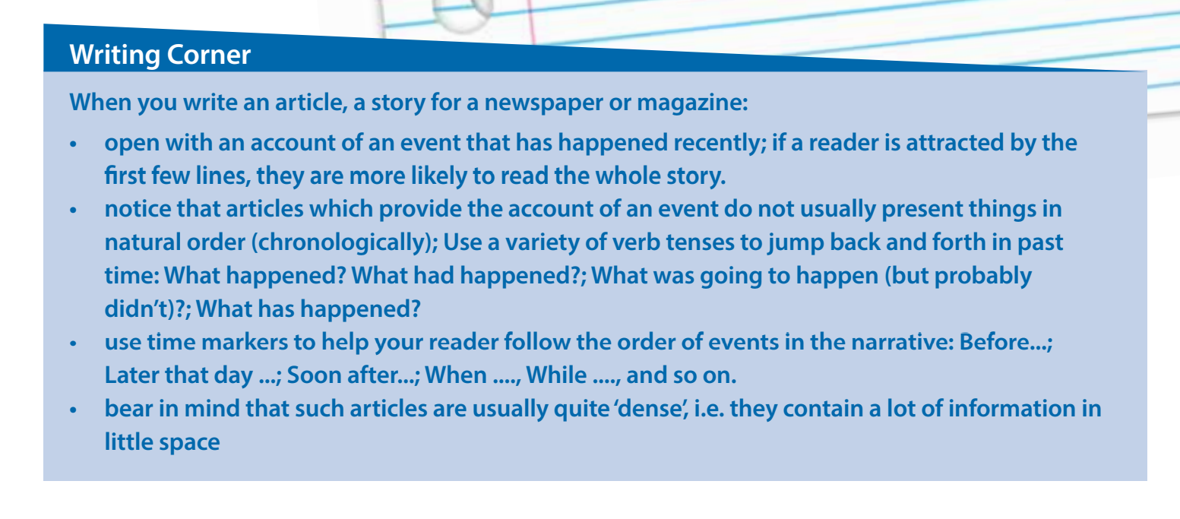
Follow these steps when you write an article , a story , newspaper or magazine

Slide 17
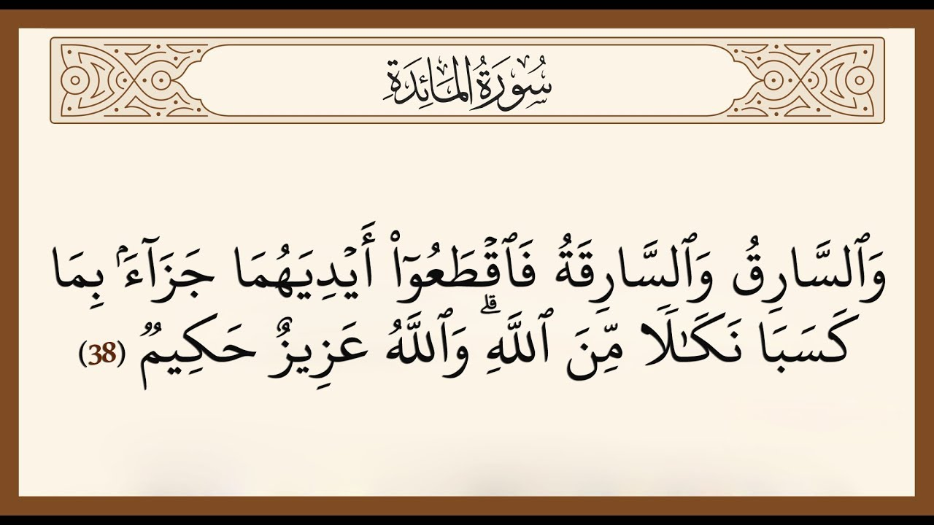
Remember
HOME
BACKGROUNDS
AVATAR KIT
PLANNERS
HOMEWORK

Slide 18

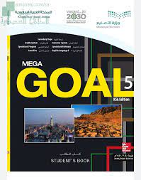
Homework
Workbook P. ( 100 ) , Exercise (K)
HOME
AVATAR KIT
PLANNERS
HOMEWORK

Slide 19


Thanks!

