Slide 1
Unit 2
Crime Doesn’t Pay
Form , Meaning & Function
Mega Goal 2.1
Done by: Entisar Al-Obaidallah

Slide 2
Lesson Objectives
01
02
Use
Differentiate
04
05
Use
Use
03
Practice
simple past tense of Be correctly
between regular and irregular verbs in the past
Using Time Expressions for the Past
06
Apply
The Past with Used to and Would
The Past Progressive Correctly.
The rules to do the exercises Correctly.

Slide 3
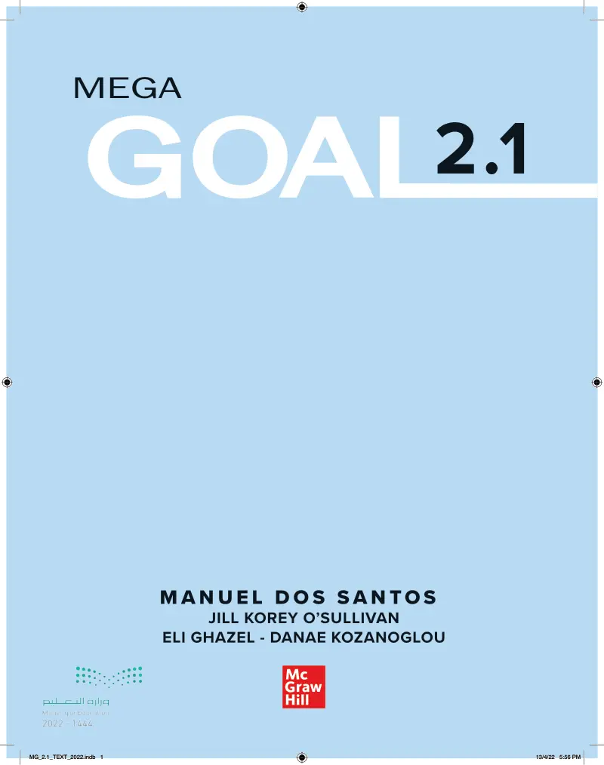
Open
Your studen’s book p. ( 30-31 )

Slide 4
01
Simple Past Tense

Slide 5
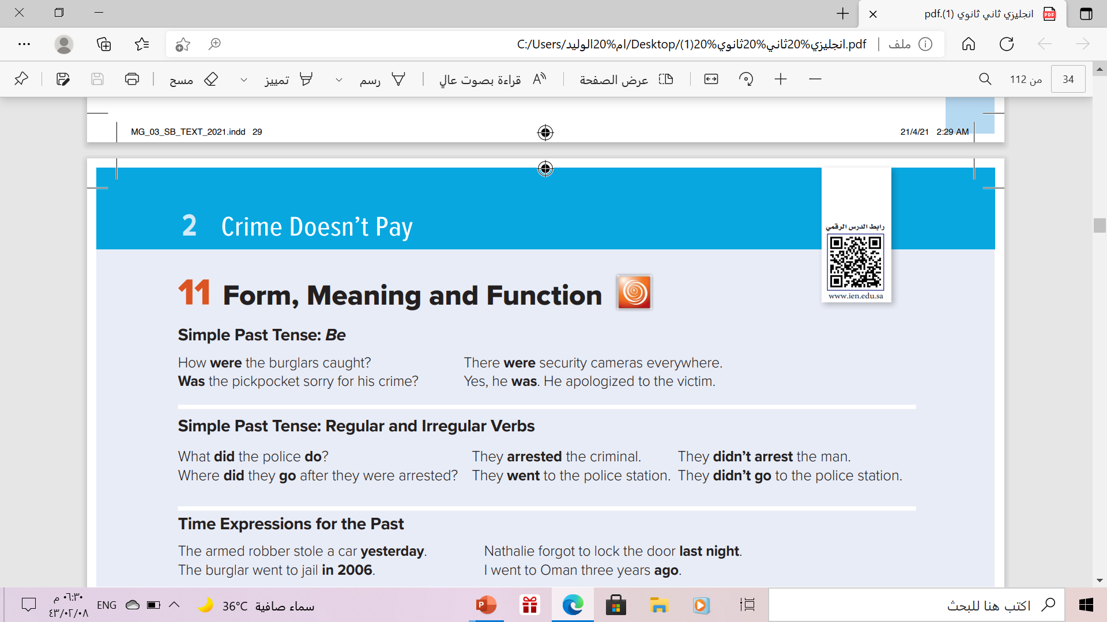
Simple Past Tense:

Slide 6
Simple Past Tense:
Use
To express Actions that started and finished in the past
Example
I saw a movie yesterday.
Last year, I traveled to Japan.
He washed his car two days ago
His mother arrived yesterday .

Slide 7

Simple Past of the Verb Be :
The past tense of To Be in English has two forms: WAS and WERE
To Be - Affirmative
I
She
He
It
You
We
They
Were
Was
Example
He was poor .
They were happy with their test results.

Slide 8
Simple Past of the Verb Be :
The negative of To Be can be made by adding not after the verb (was or were).
To Be - Negative
I
She
He
singular
You
We
They
plural
Was not
Were not
Example
He was not poor .
They were not happy with their test results.

Slide 9

Simple Past of the Verb Be :
To create questions with Be, you put the Verb before the Subject.
To Be - Question
WH
Was - were
subject
complement
Example
when was she sick ?
Where were you yesterday ?

Slide 10
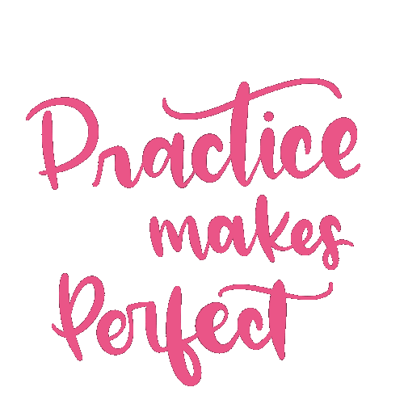

Slide 11

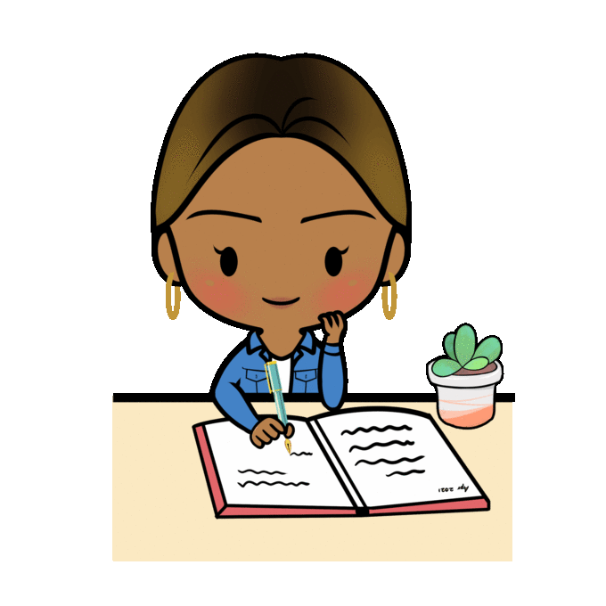
Correct Using Past Simple Tense:
- He………… ( get ) an A in the English test.
.
got
She…………… ( write ) her homework .
wrote

Slide 12

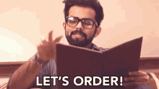
Correct Using Past Simple Tense:
- He………… ( sell ) refreshing drinks.
sold
Yesterday he …………… (have) dinner in a restaurant.
.
had

Slide 13


Correct Using Past Simple Tense:
- She……………. (clean) the rooms yesterday.
cleaned
She went to the mall and …………………(shop) a lot..
.
shopped

Slide 14

02
Simple Past with Regular and Irregular Verbs

Slide 15
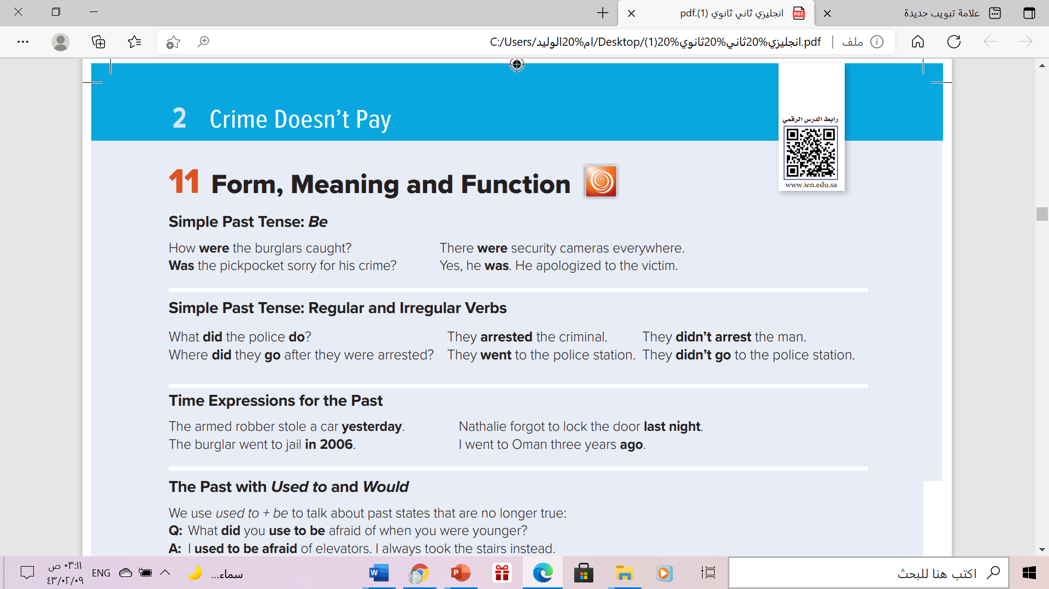
Simple Past with Regular and Irregular Verbs

Slide 16
Simple Past with Regular and Irregular Verbs
Use ‘did’ and the verb, but don’t change the verb to the past form!
1-Yes- No Question ?
Did
Subject
V( base form)
Example
Irregular verb
Did you have a nice weekend?
regular verb
Did you play a game yesterday?

Slide 17
Simple Past with Regular and Irregular Verbs
Use ‘did’ and the verb, but don’t change the verb to the past form!
2- WH- Question ?
WH
did
Subject
V( base form)
Example
Where did you go for your last holiday?
Irregular verb
I went to Dubai for my last holiday
What did you watch on TV last night?
regular verb
I watched a movie on TV last night

Slide 18
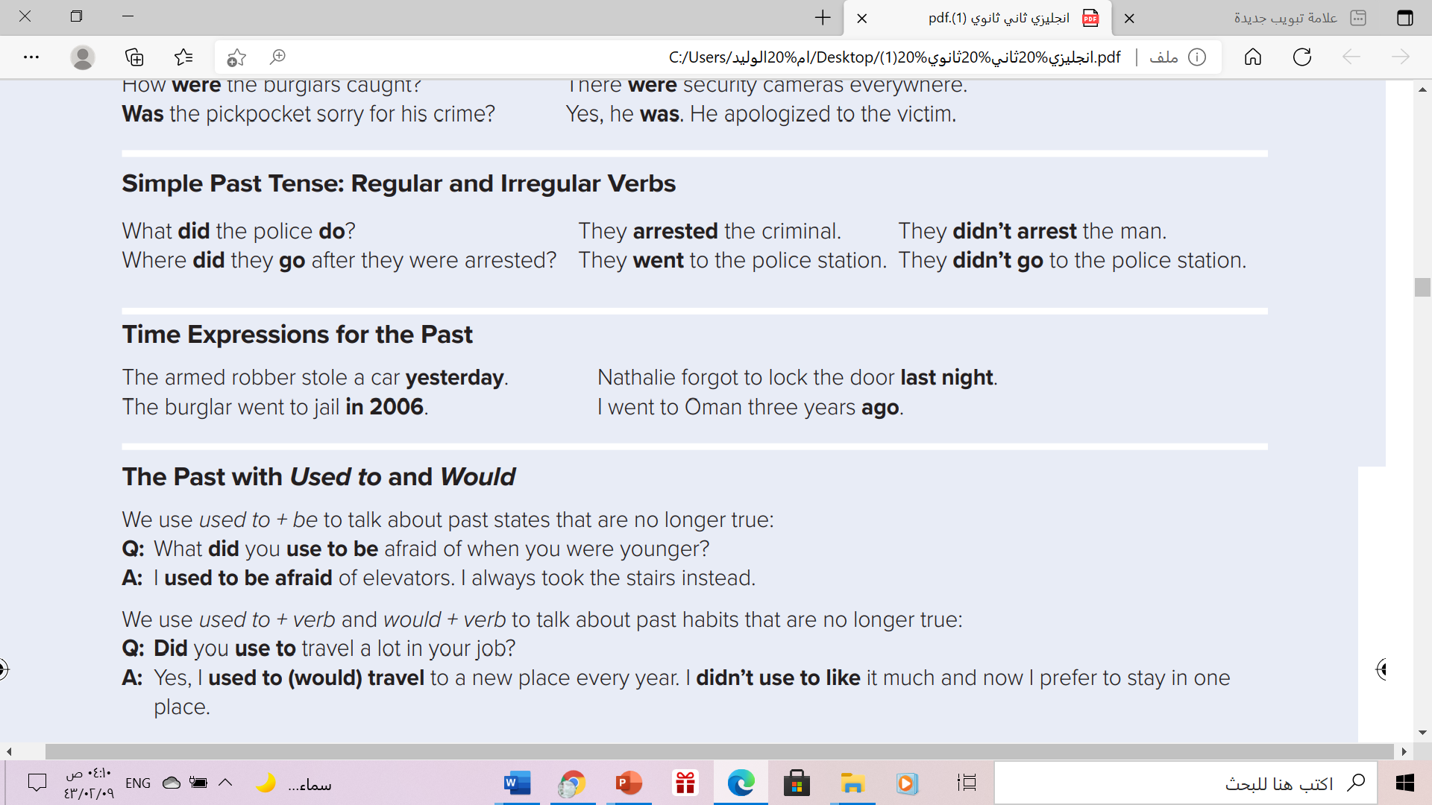
Time Expressions for the Time

Slide 19
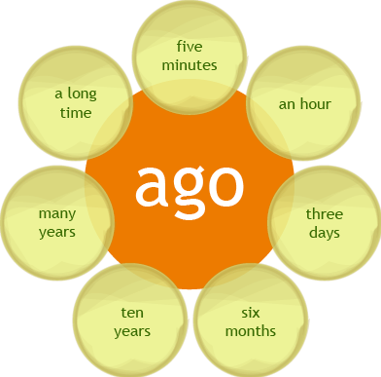
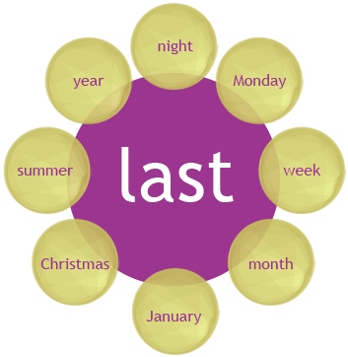
Time Expressions for the past

Slide 20
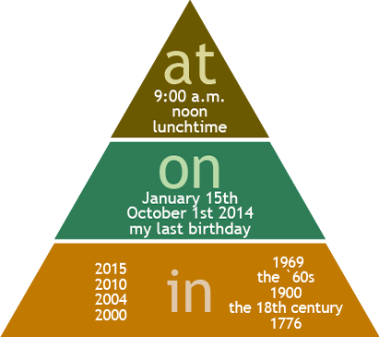
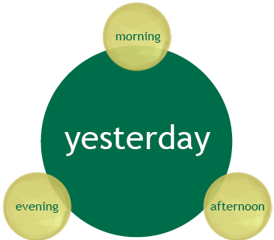
Time Expressions for the past

Slide 21
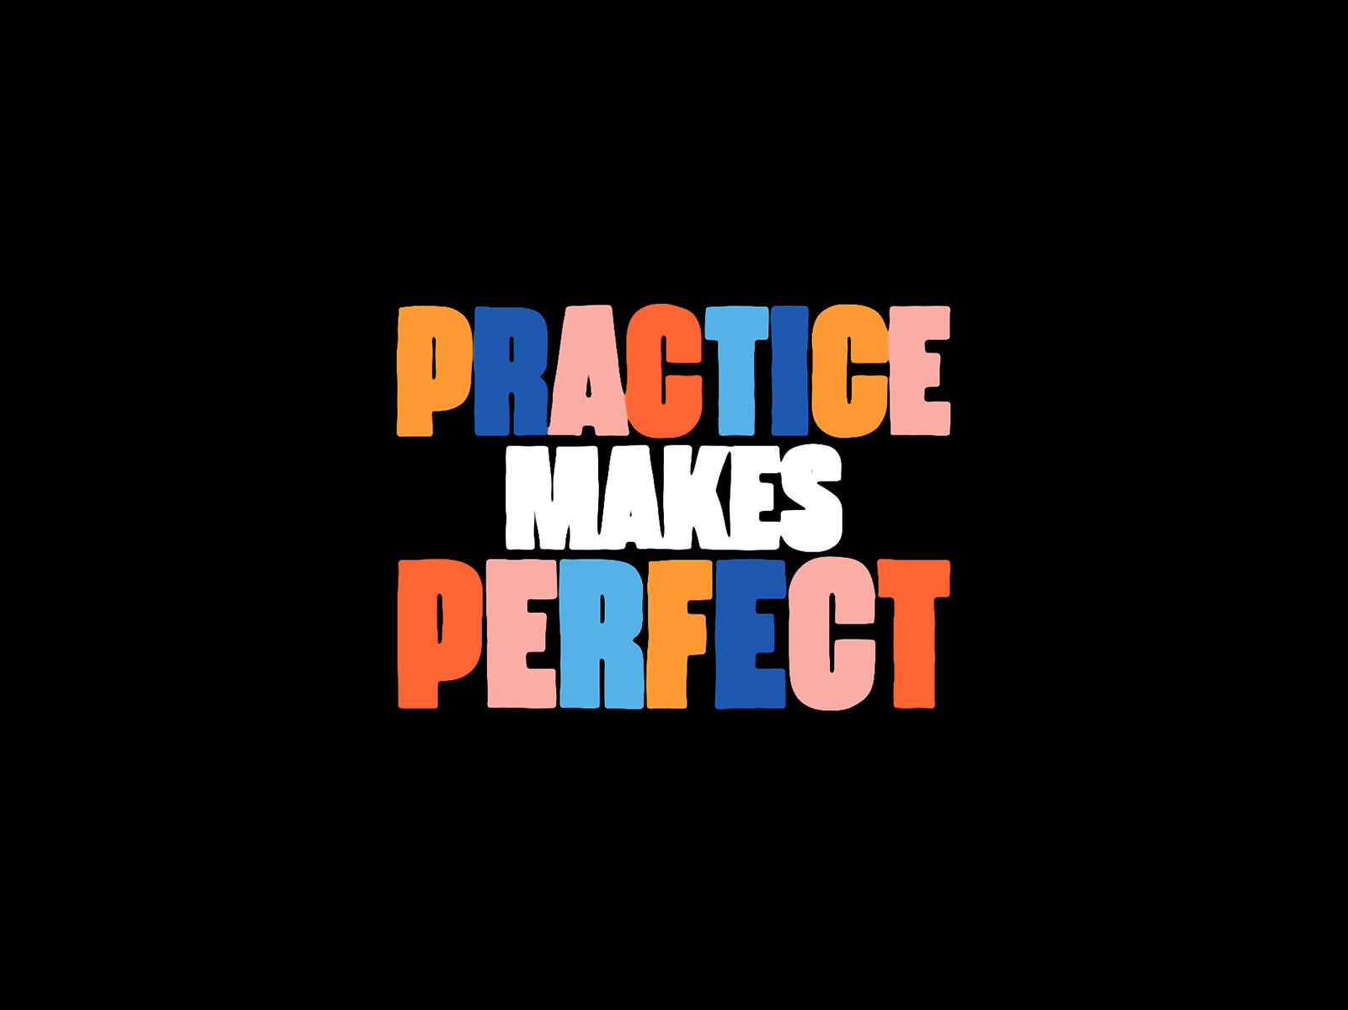

Slide 22
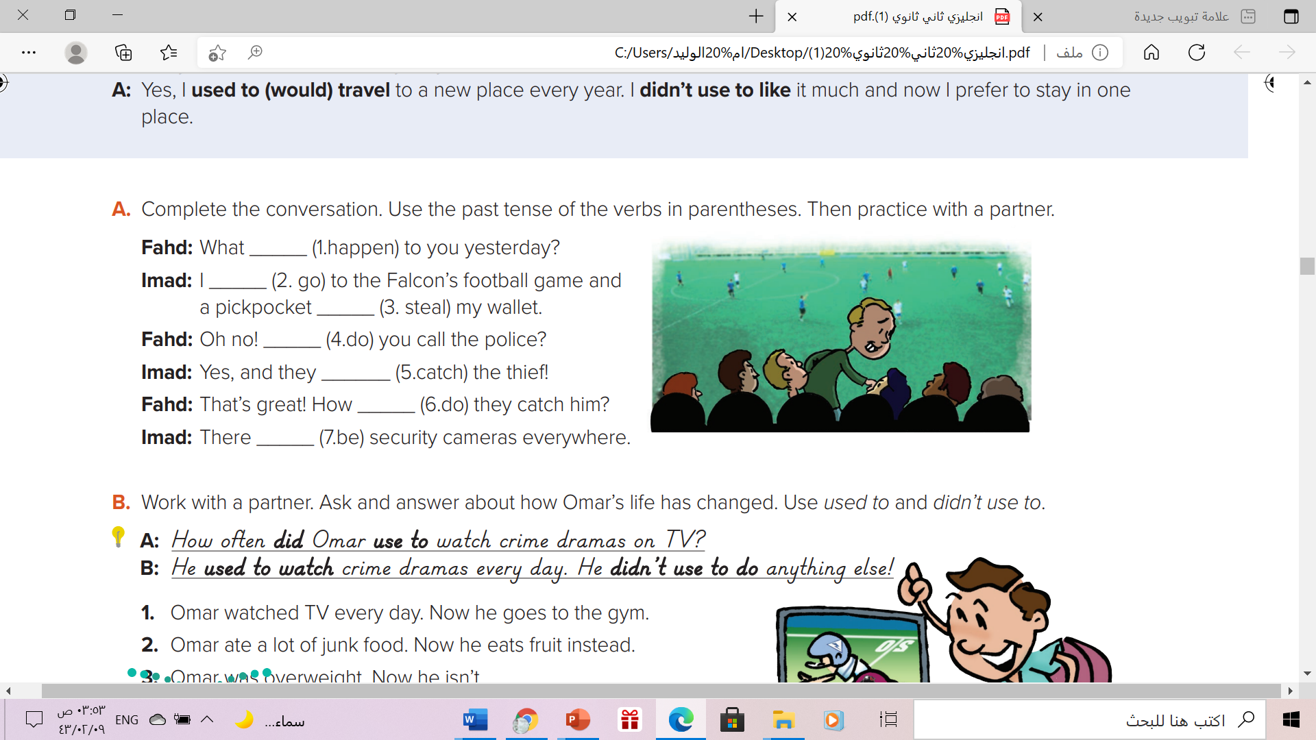
Simple Past with Regular and Irregular Verbs
happened
went
stole
did
caught
did
were

Slide 23
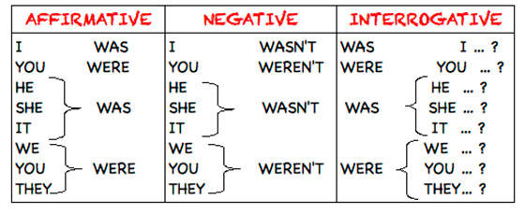
In brief

Slide 24
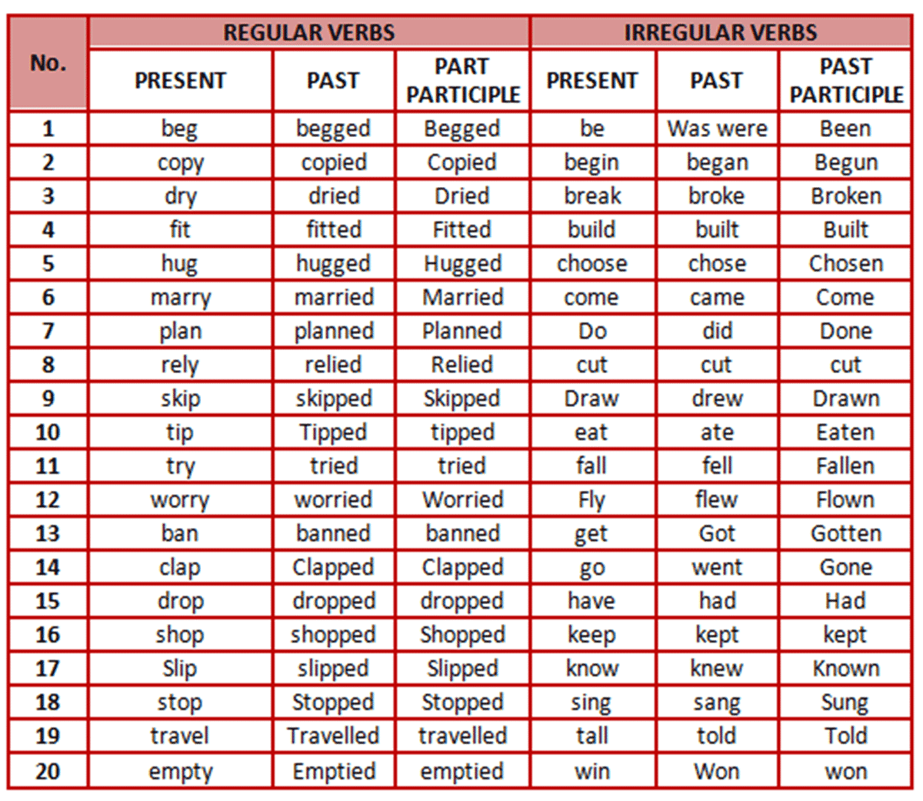
List of regular and irregular verbs

Slide 25
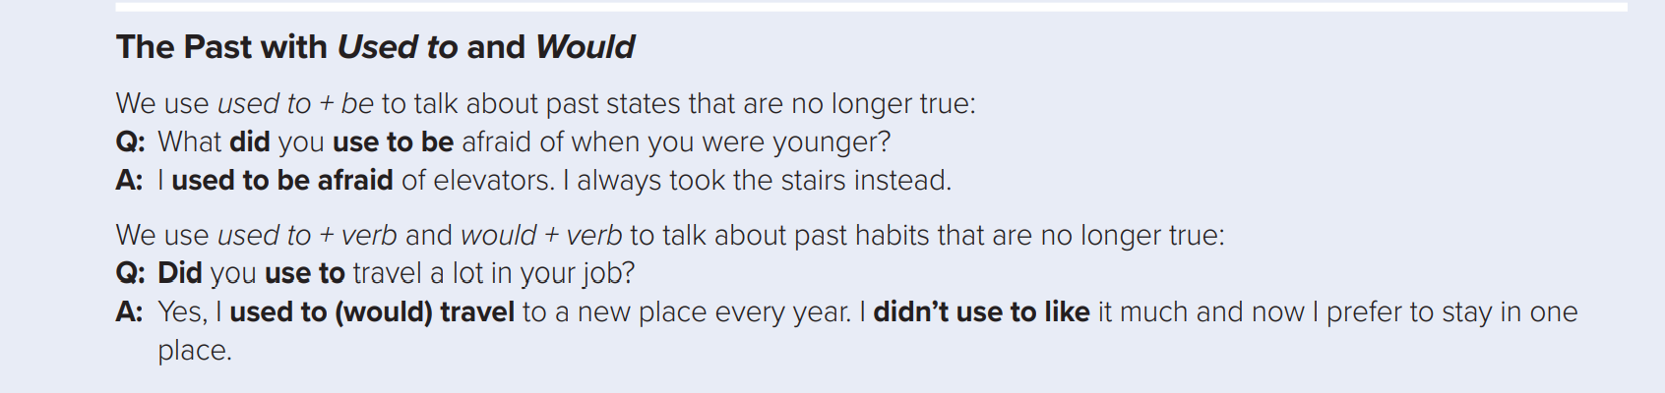

Slide 26
Use:
We can use (used to - would) to talk about past habits that are not true anymore.
Form:
Subject
Used to / would
verb ( infinitive)
Example:
I used to work very hard
I used to watch Disney cartoon when I was a child
He used to walk to school

Slide 27
Use:
We can use (used to be) to talk about past states that are not true anymore.
Form:
Subject
Used to
be
Example:
I used to be afraid of dark, but not anymore.
I used to be overweight when I was a child
He used to be afraid of elevator , but not anymore.

Slide 28

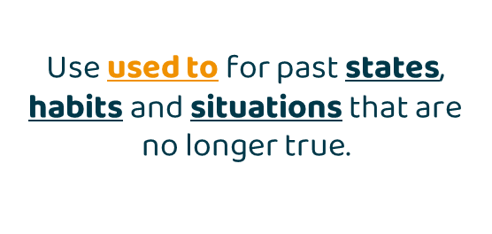
Used to & Would
would
Used to
We can also use would in place of used to for past habits but we cannot use would for past states.
So , Would can only be used for actions.

Slide 29
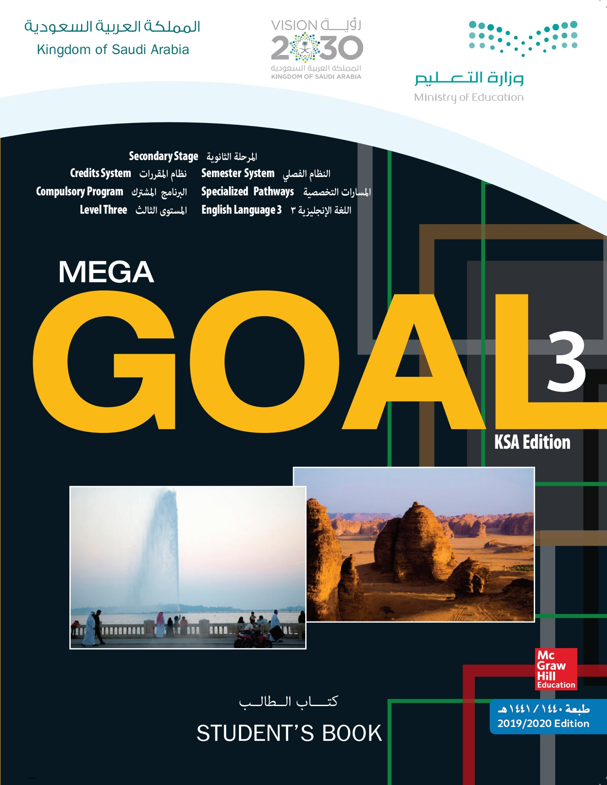
Open
Your student’s book p. 31

Slide 30
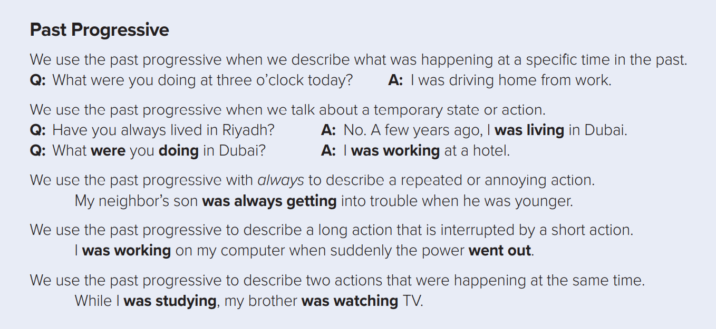
1
2
3
4
5

Slide 31
Form:
Affirmative (+)
Subject (I-She- He-It -singular)
Was
V ( ing)
He was working at a hospital.
were
V ( ing)
Subject ( you - we - They - plural)
You were working at a hospital

Slide 32

Form:
Negative (-)
Subject (I-She- He-It -singular)
Was
not
V ( ing)
He wasn’t working at a hospital.
Subject ( you - we - They - plural)
were
not
V ( ing)
You weren’t working at a hospital

Slide 33

Form:
Question (?)
WH
was
Subject (I-She- He-It -singular)
V-ing
Where was he studying English?
V-ing
WH
were
Subject (you - we - They - plural)
What were you doing in Dubai?

Slide 34
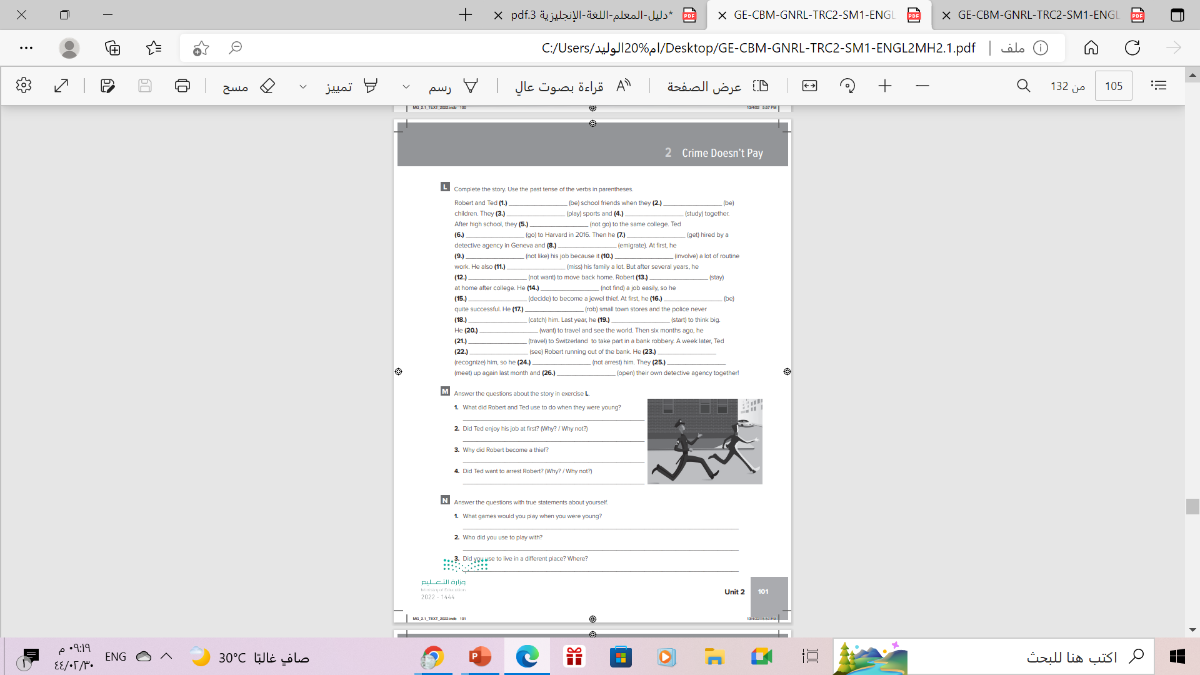
Homework workbook p.(101) exercise (L)

Slide 35

Thanks!

