Slide 1

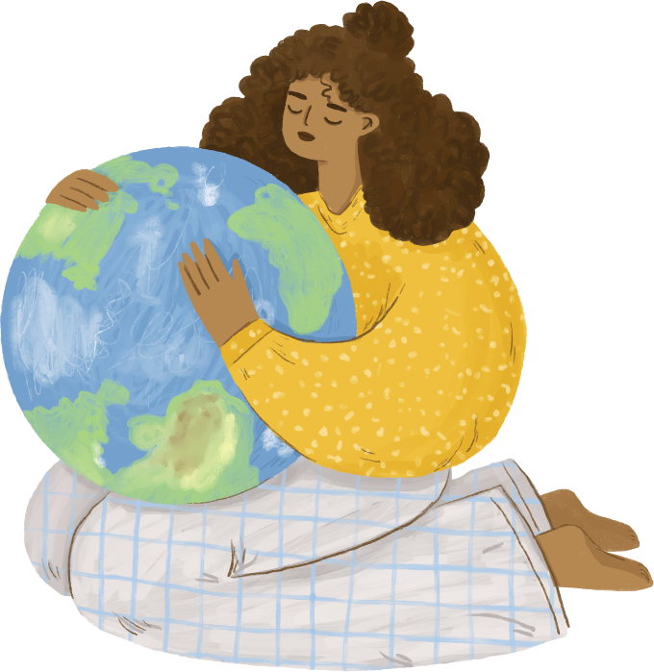
Unit 3
Far And Away
Reading
Mega Goal 2.1
Done by: Entisar Al-Obaidallah

Slide 2
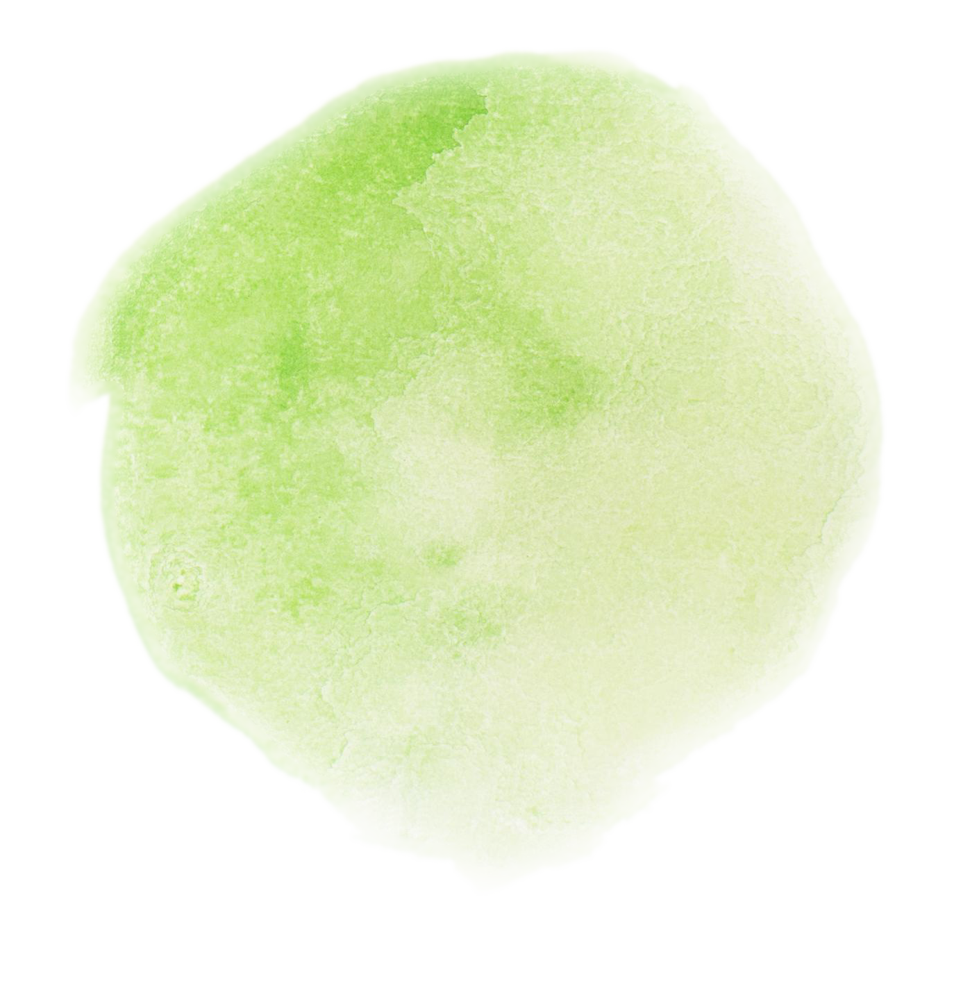
Lesson Objectives
01
03
02
04
Find
Complete
the meaning of “ecotourism”
Some sentences about the text correctly
Read
Talk
the text for specific information
About the characterstics and benefits of ecotourism

Slide 3


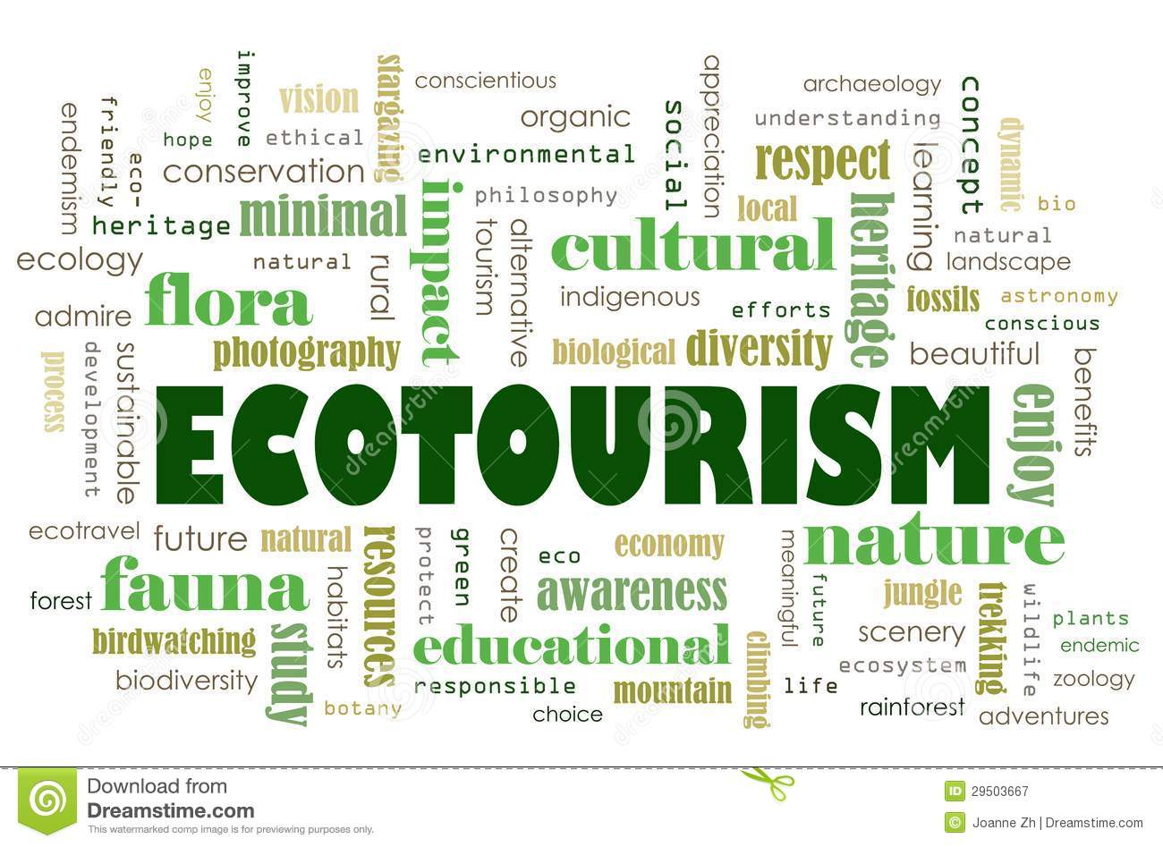

Write this word backwards to get the title of our lesson today
Warm Up (Book Closed)

Slide 4
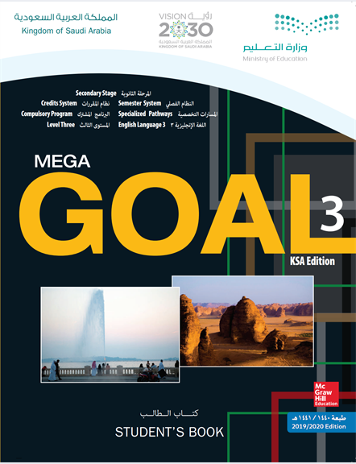
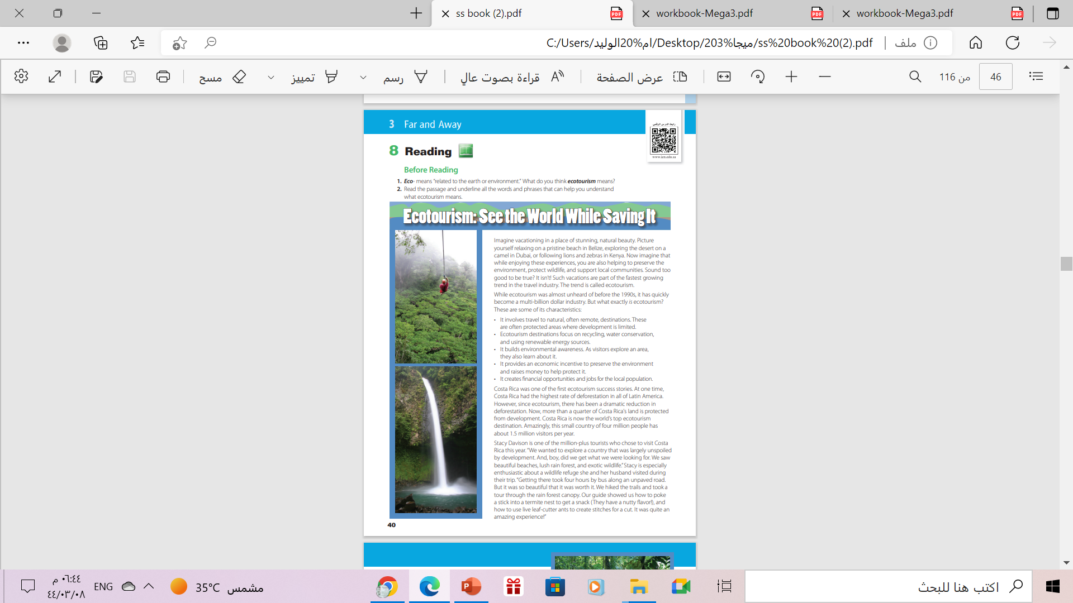
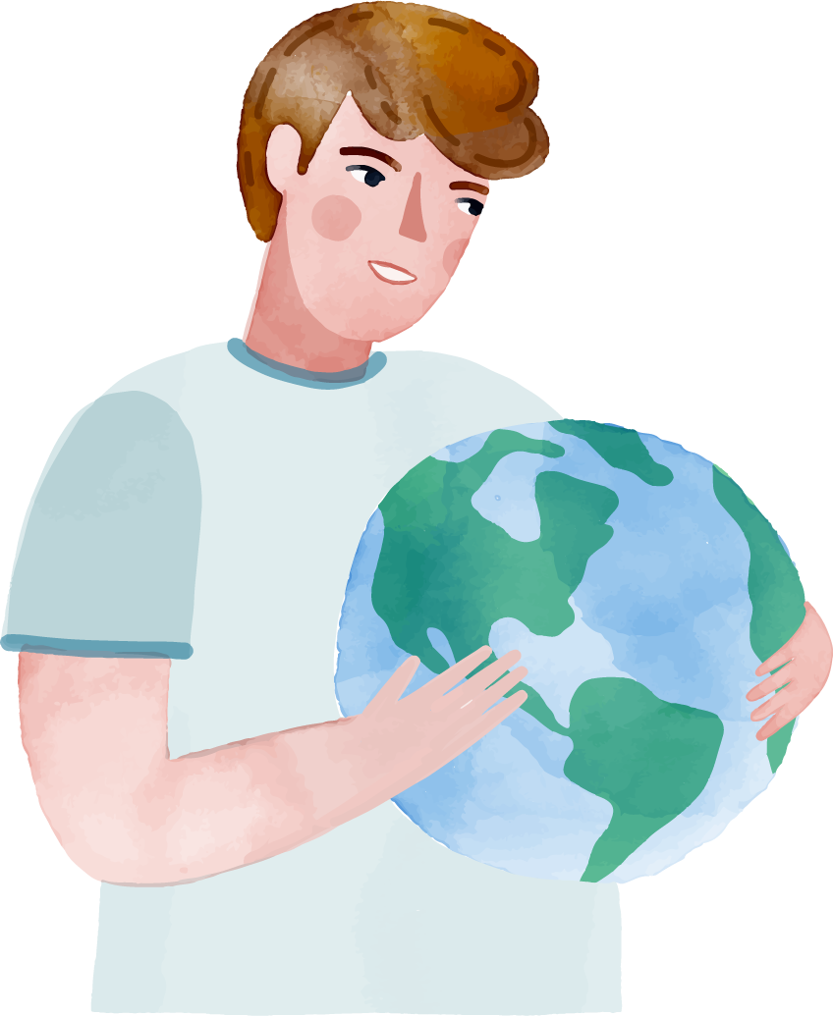

Pages (41-42)
Books OPEN

Slide 5


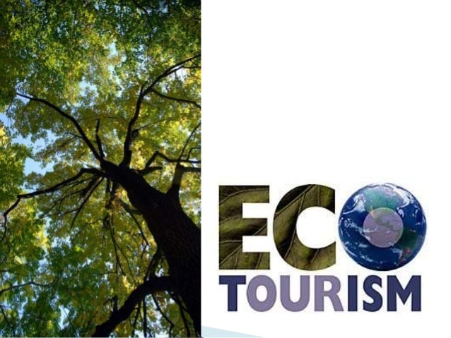
What does “ ecotourism” mean?
related to the earth or the environment
Travel that involve causing less damage to the environment than usual and that make people aware of the need to protect the environment

Slide 6
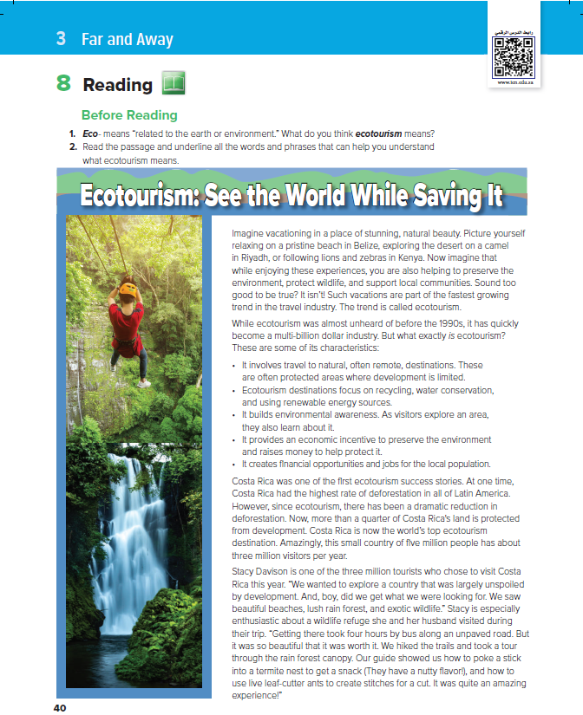
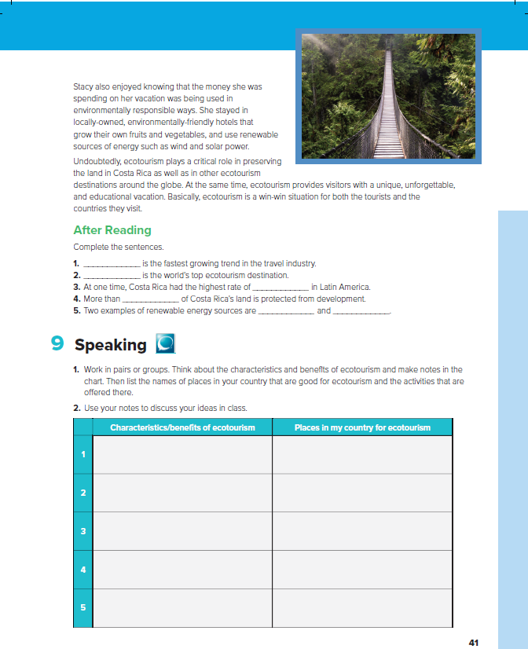


4
5
1
What’s the title ?
Ecotourism: See the World While Saving it
What do the pictures show ?
Places of natural beauty
2
How many paragraphs are there ?
5 paragraphs
3
What’s the main idea of this article ?
Ecotourism

Slide 7
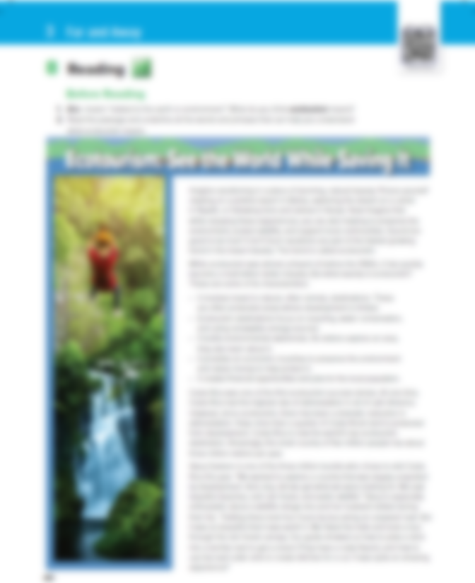



Read along as U Listen

Slide 8
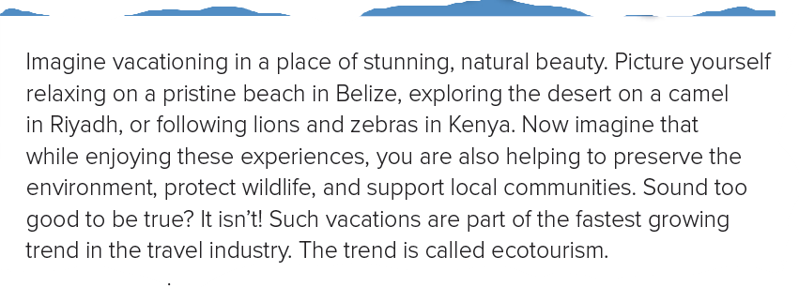

What and how is ecotourism
What is the main idea of this paragraph?
1

Slide 9
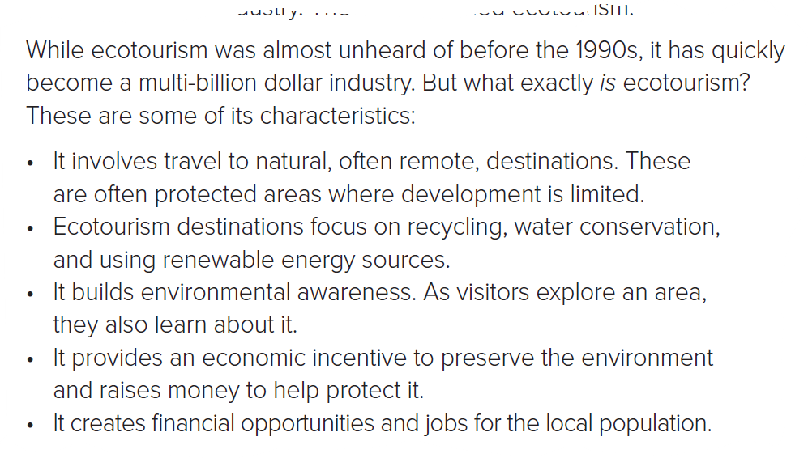
The characteristic of ecotourism
2
What is the main idea of this paragraph?

Slide 10
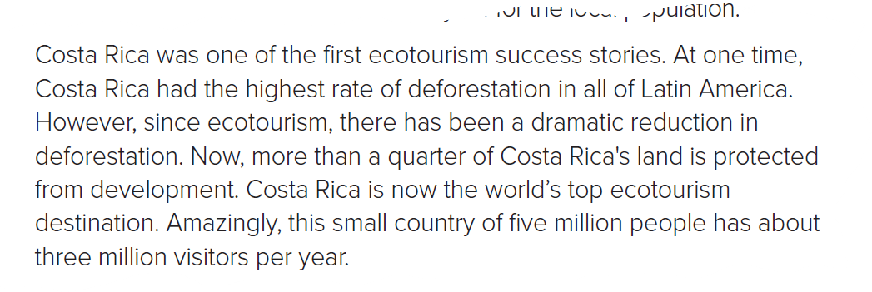
The positive result of ecotourism on Costa Rica
What is the main idea of this paragraph?
3

Slide 11
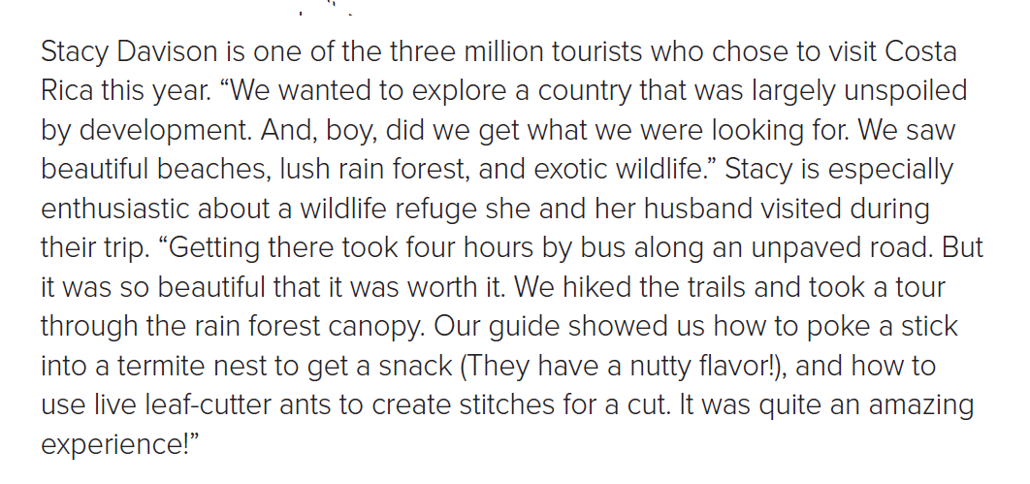
Stacy Davison’s personal ecotourism experience
What is the main idea of this paragraph?
4

Slide 12
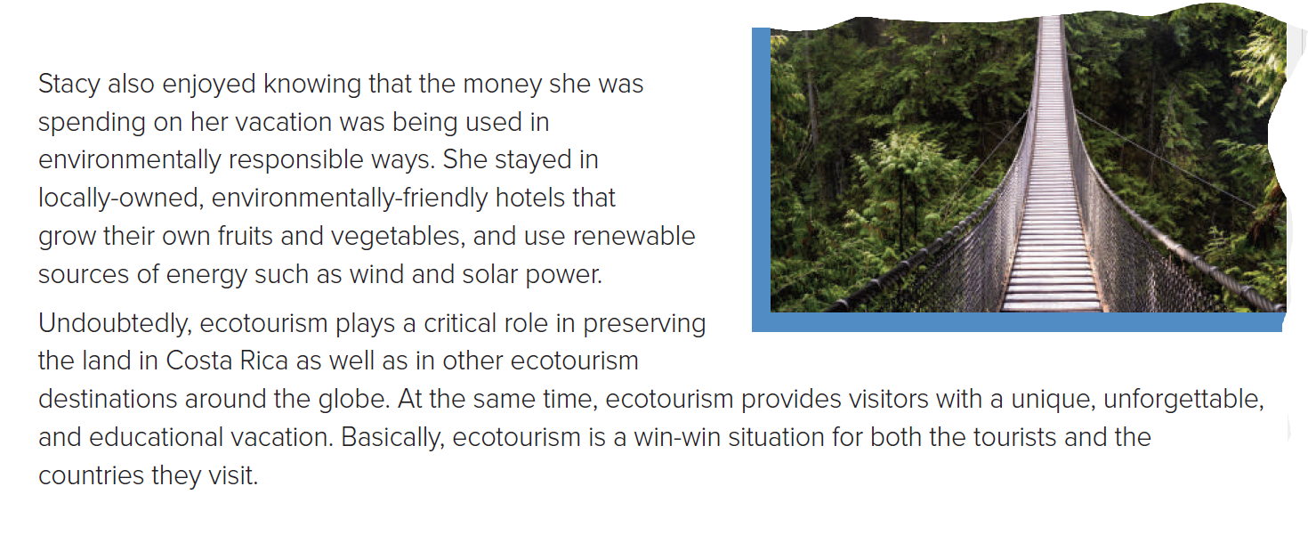
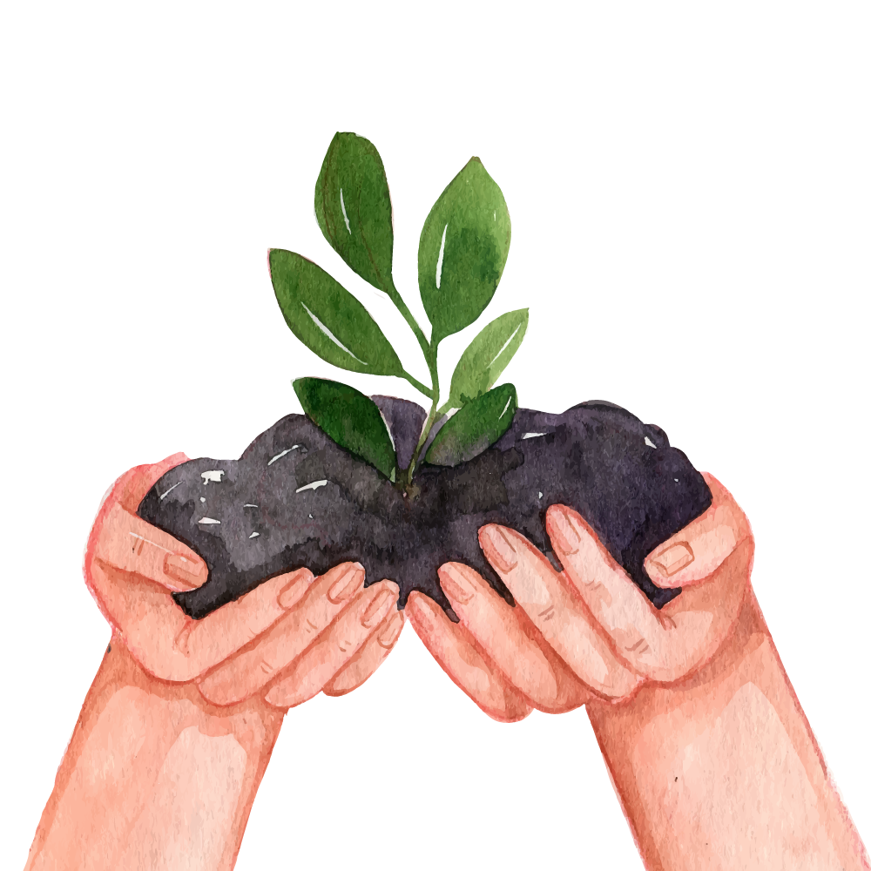
Stacy satisfaction with ecotourism
What is the main idea of this paragraph?
5

Slide 13
( Conclusion) Ecotourism is win-win situation for both the tourists and the country they visit
What is the main idea of this paragraph?
6

Slide 14
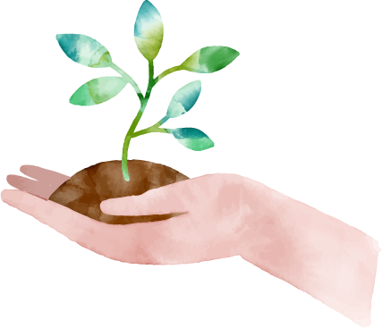
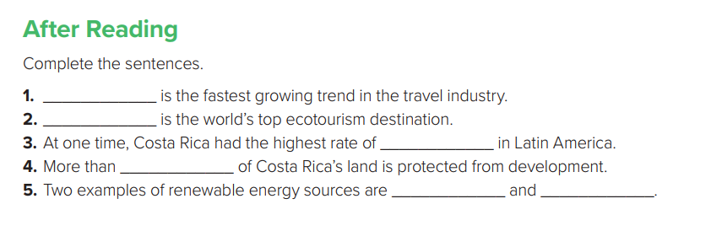
ecotourism
Costa Rica
deforestation
a quarter
wind
solar power

Slide 15
Awesome new words

Slide 16
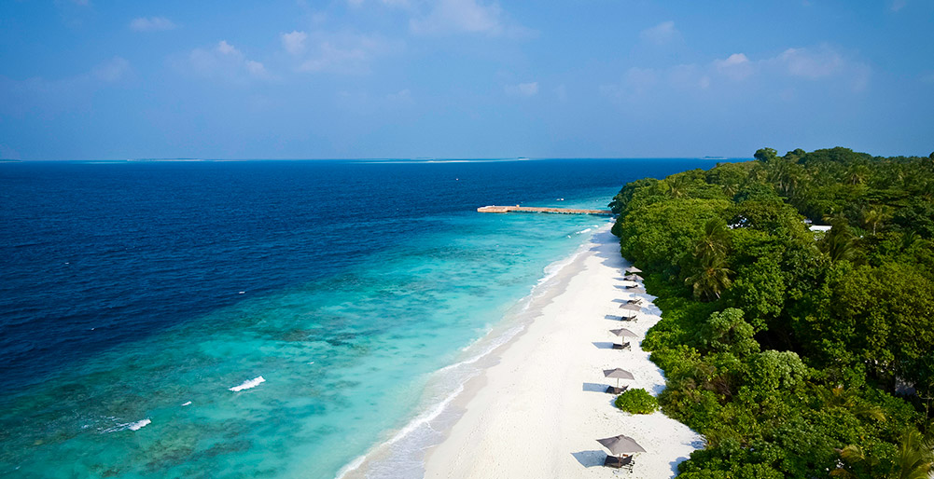
pristine beach
a beach in its original condition

Slide 17
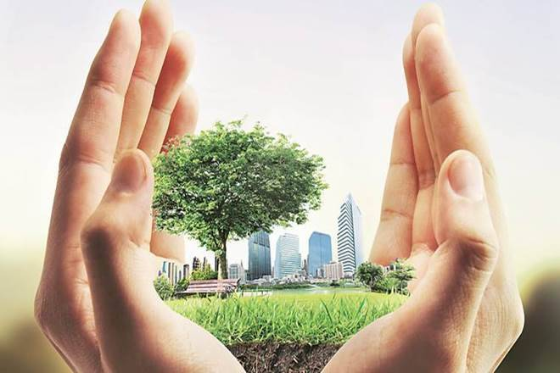
Preserve the environment
Keep it safe from harm and destruction

Slide 18

characteristics
Distinguishing qualities

Slide 19
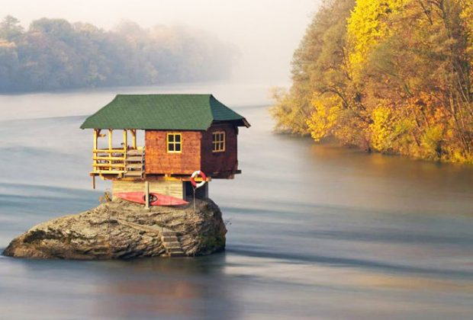
remote destination
Geographical isolated

Slide 20
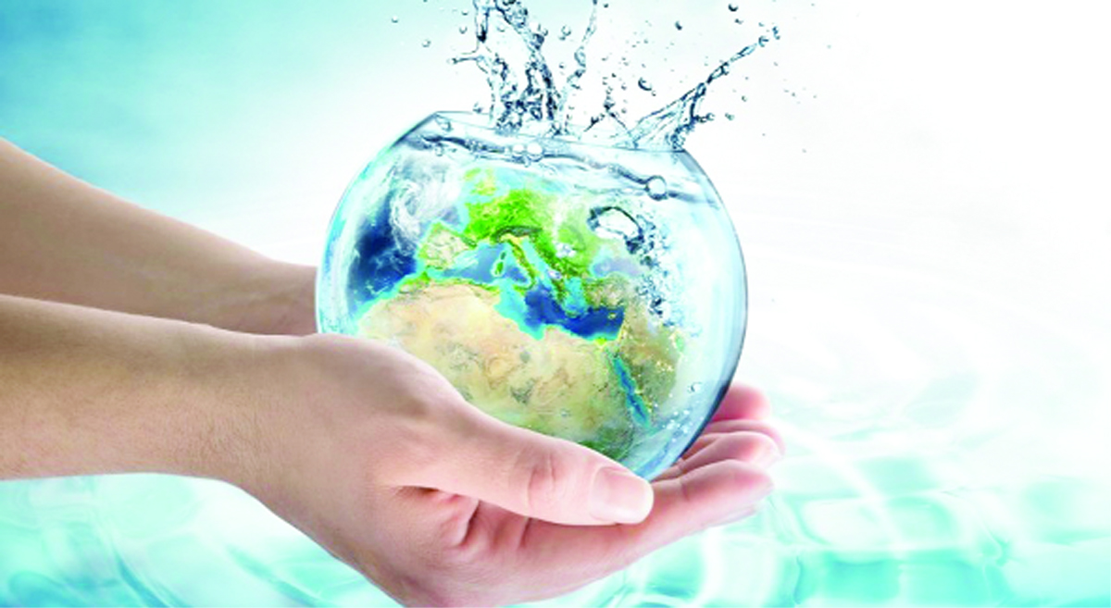
Water conservation
Protection of water

Slide 21
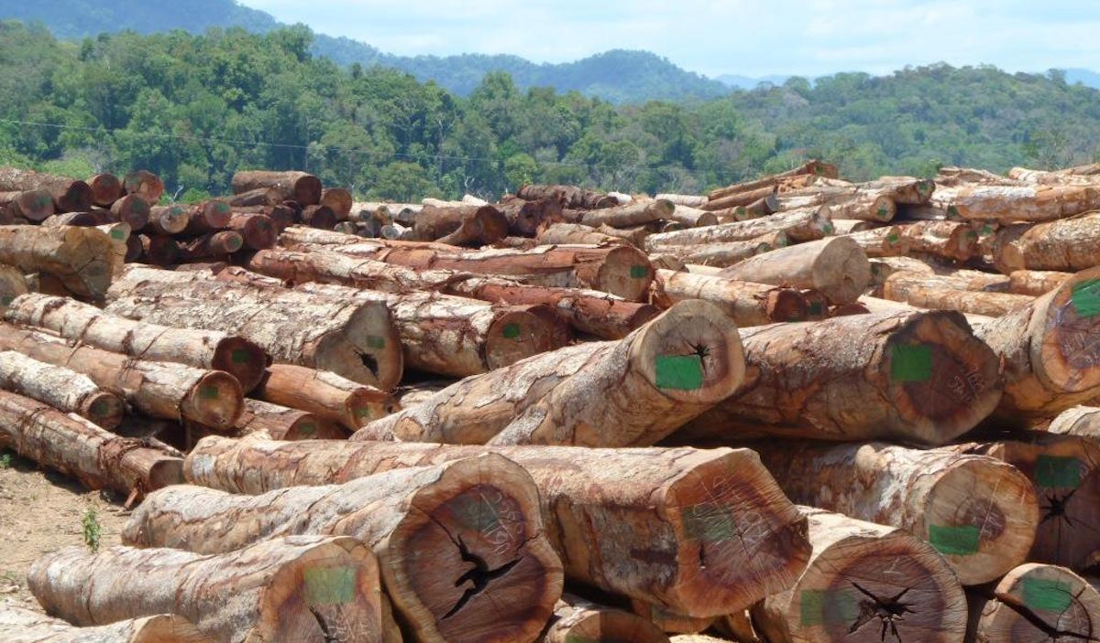
deforestation
Cutting down trees to clear forests

Slide 22
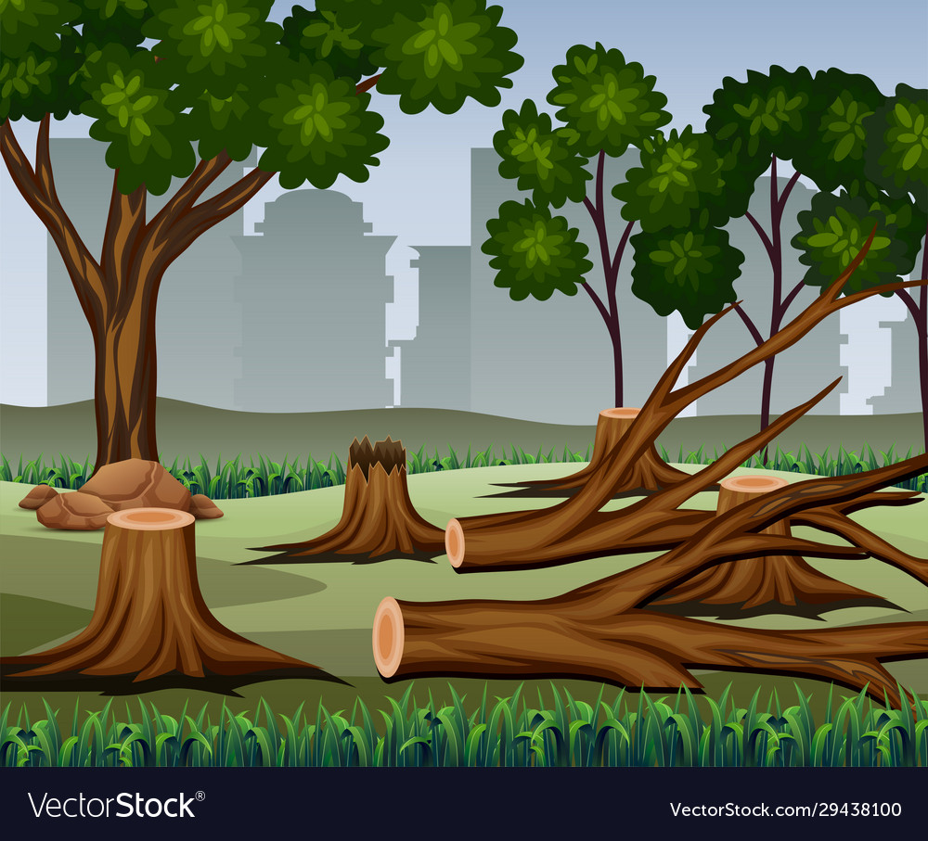
a dramatic reduction
Lessening - diminishing

Slide 23
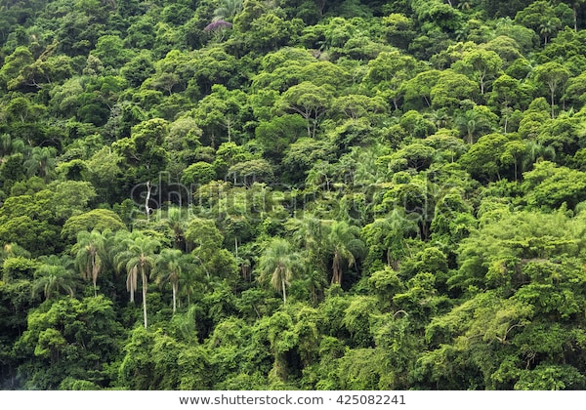
lush rainforest
Abundantly green - fertile

Slide 24
2
Summarize what you read

Slide 25
Summarize what you read
3

Slide 26
Summarize what you read
4

Slide 27
Summarize what you read
5

Slide 28
Summarize what you read
6

Slide 29

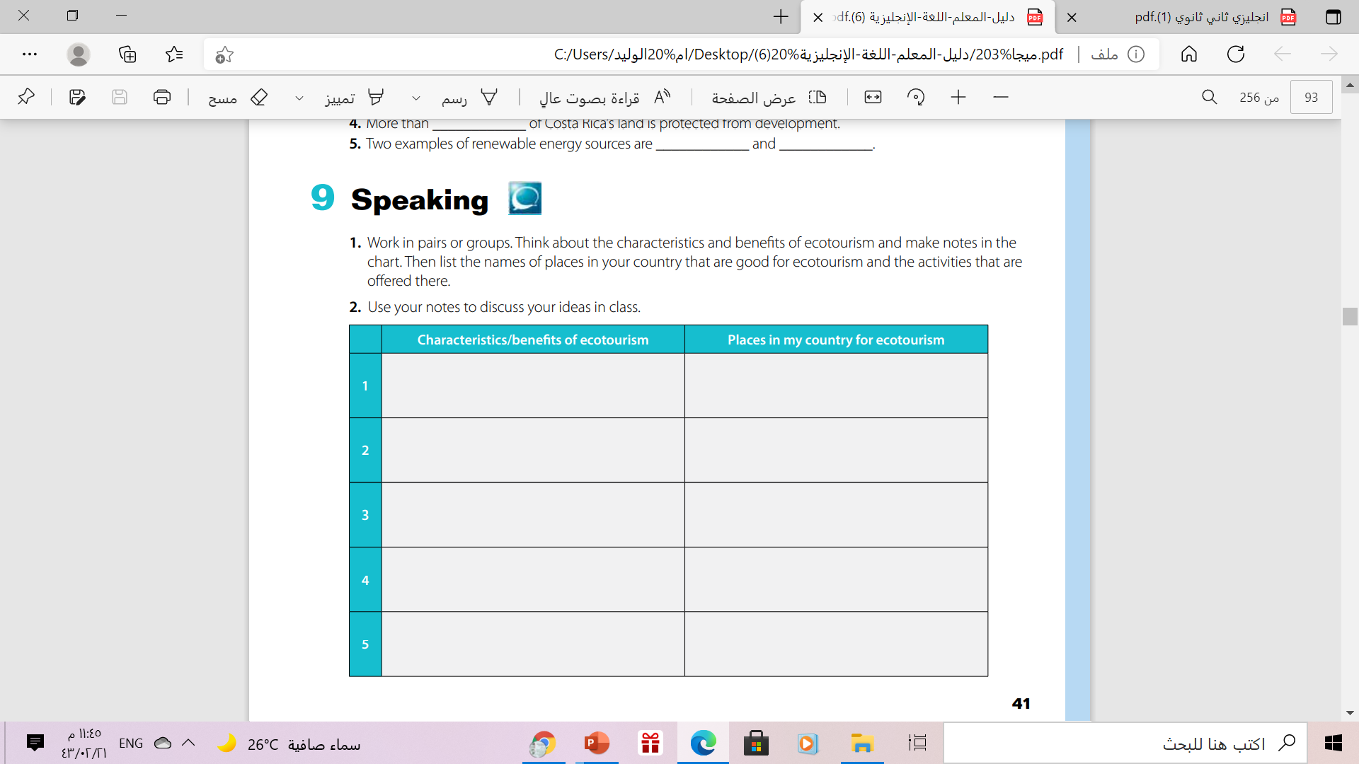

Slide 30
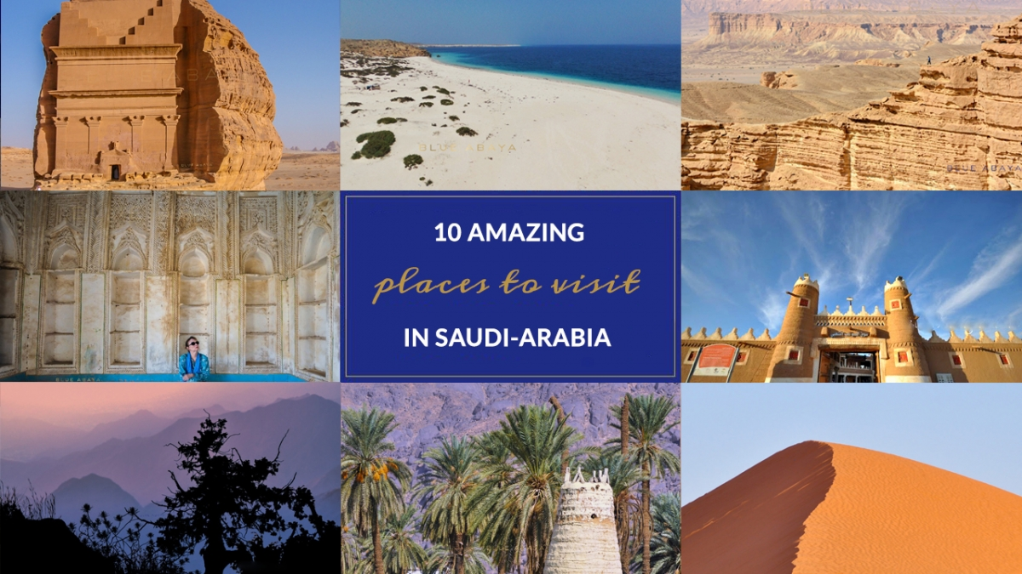

Slide 31
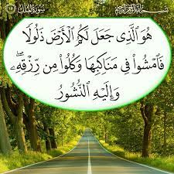
From the Holy Qura’an

Slide 32
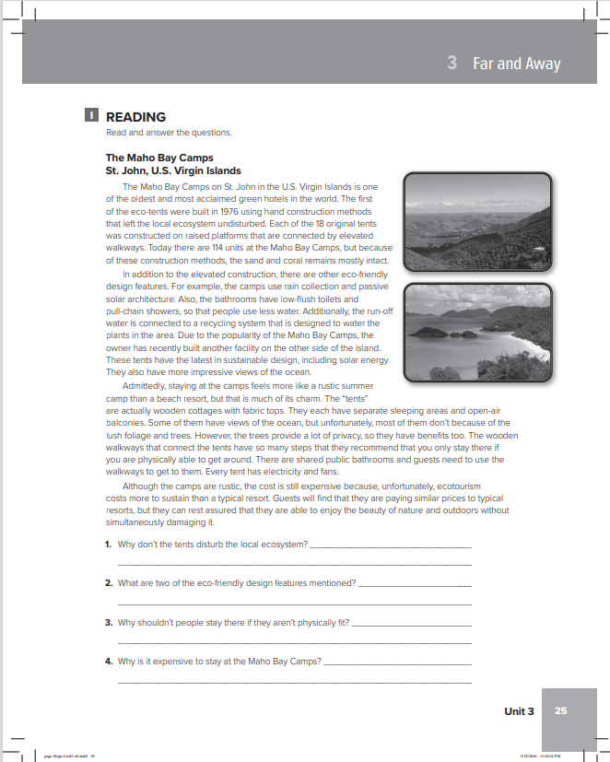
Homework
workbook
Exercise (I) . P.(25)

Slide 33



Thanks!

