Slide 1
Unit 3
Far And Away
Form, Meaning & Function
Mega Goal 2.1
Done by: Entisar Al-Obaidallah

Slide 2
Lesson Goals
01
02
03
04
Use
Use
“Be going to “ for the future to talk about plans
Present progressive for the future arrangements
Make
Use
WH-information questions correctly
Going to & will for future plans

Slide 3
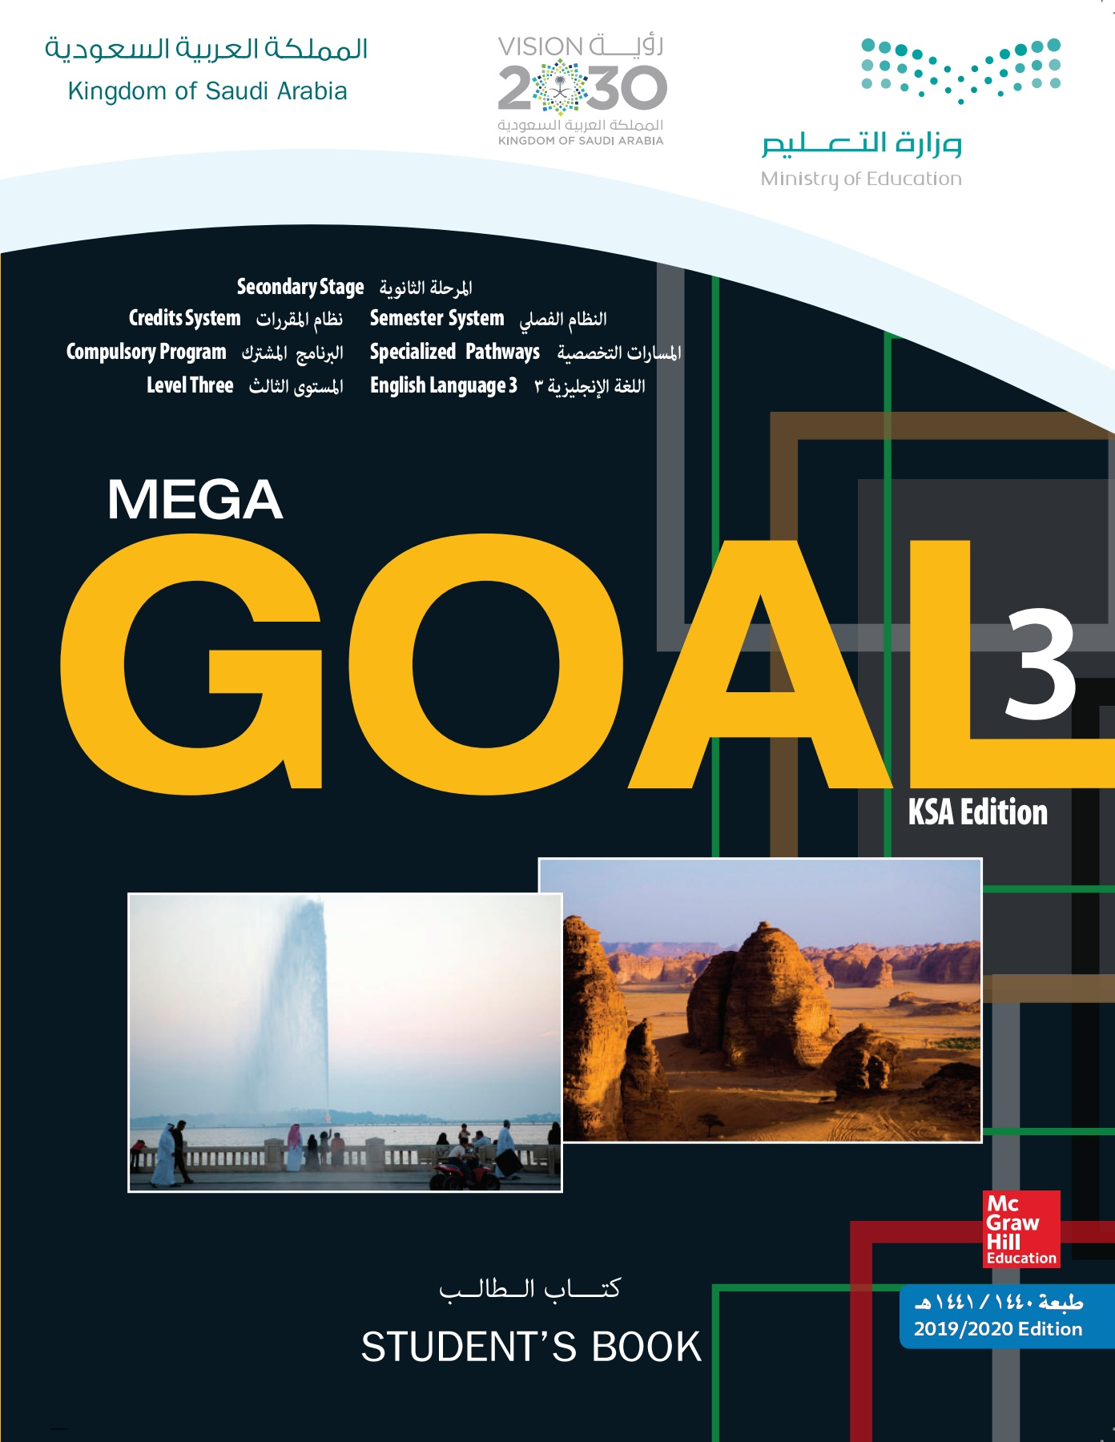
Book Open
Student’s book p. (44-45)

Slide 4
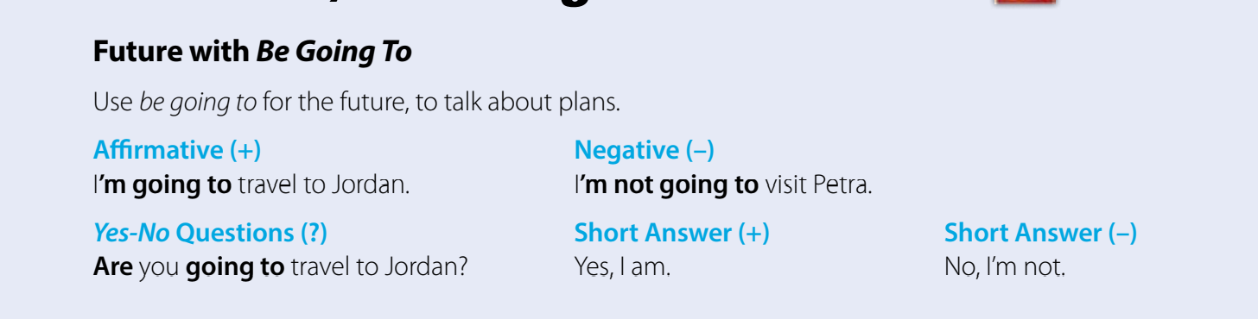
Future with Be Going To
Affermative
subject
Be
Going to
V( infinitive)
Negative
S
Be
not
Going to
V( infinitive)
Question
Be
subject
V( infinitive)
Going to

Slide 5
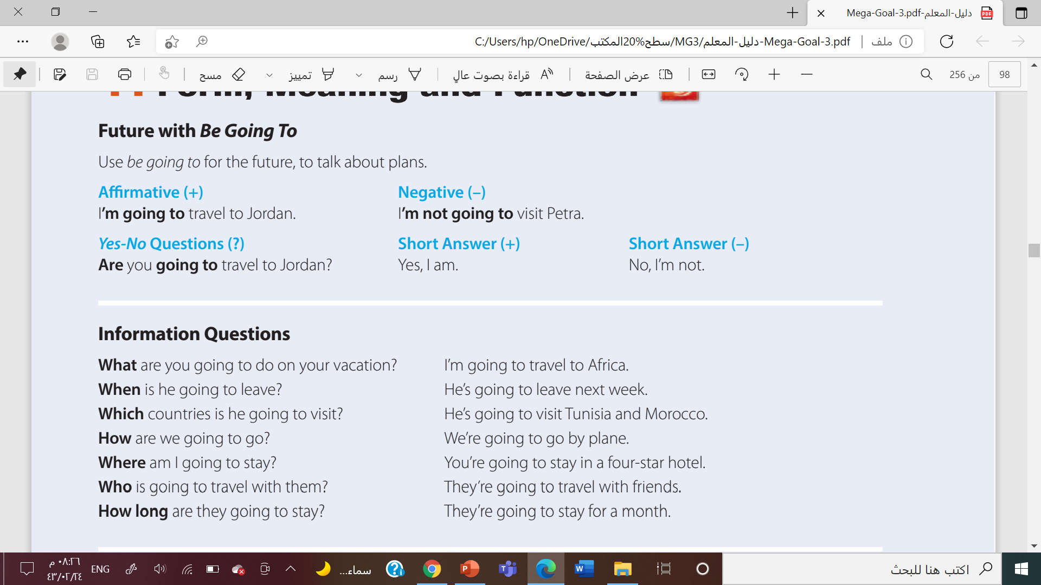
Information Questions

Slide 6
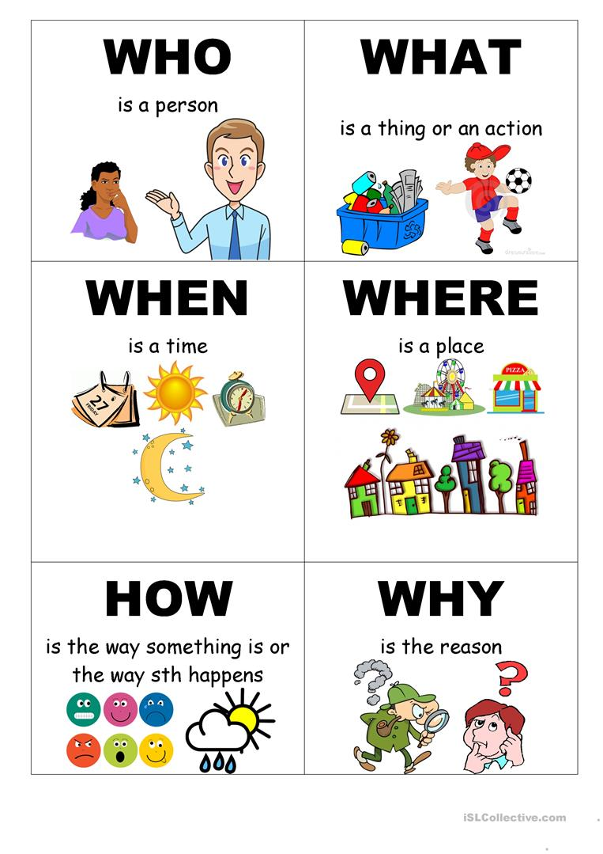
WH-Question Word

Slide 7
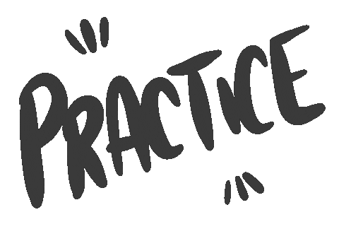
Let’s

Slide 8



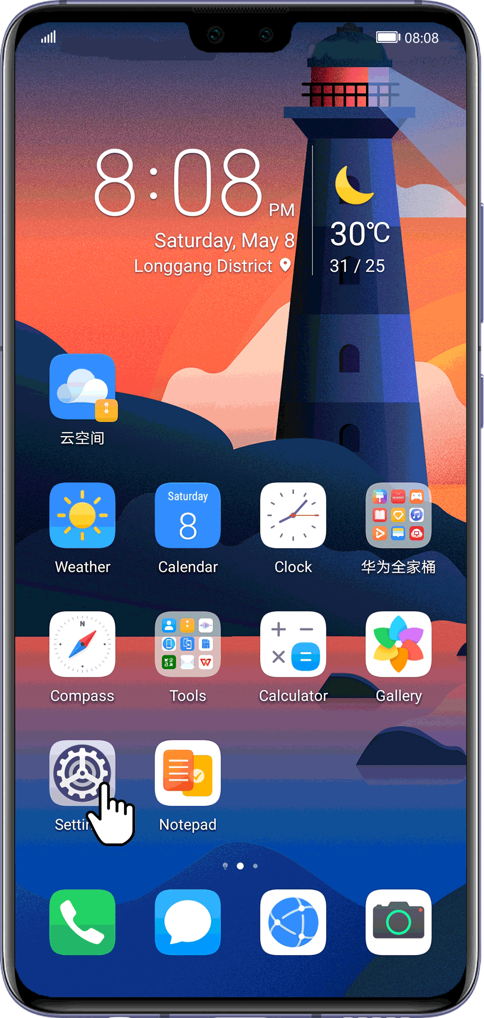

Fill in the space
When
…………. is your birthday?
Who
…………do you live with ?
Where
…………did the interview happen?
What
How
…………is your phone number?
……. do you get to school?

Slide 9
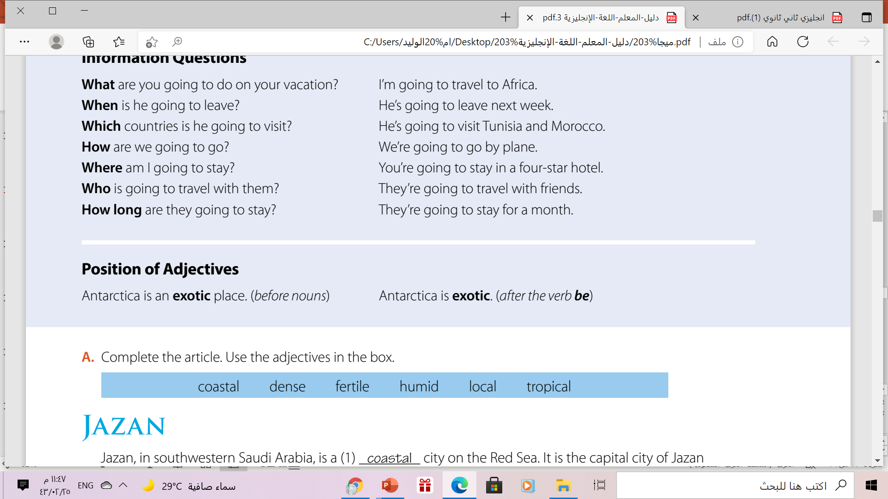

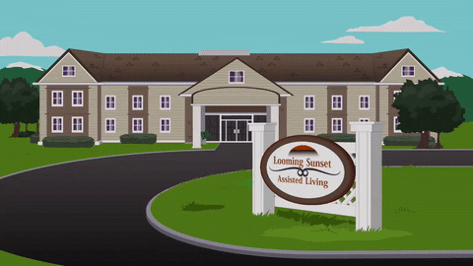
Example:
✓ subject
✓ adjective
✓ noun
He is an intelligent boy
Before noun
✓ Verb (be)
✓ adjective
Example:
Your house is large
After verb to “be”

Slide 10
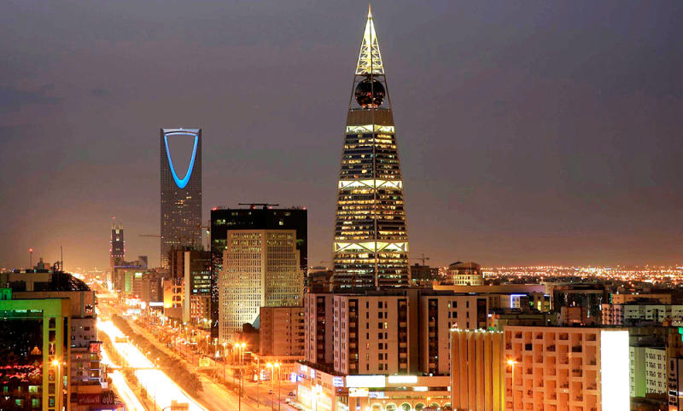

Position of Adjectives
Example:
beautiful
Riyadh is a…………...… city.
Interesting
Riyadh is an…………...….. city.
Use(an) if an adjective starts with vowel sound

Slide 11
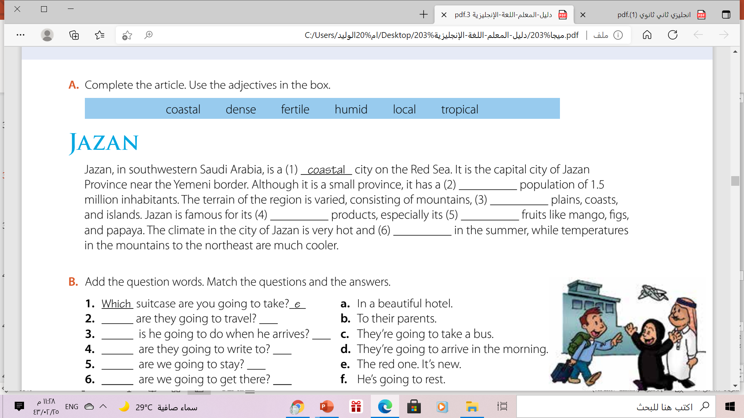
Capitalization Rules
dense
fertile
local
tropical
humid

Slide 12
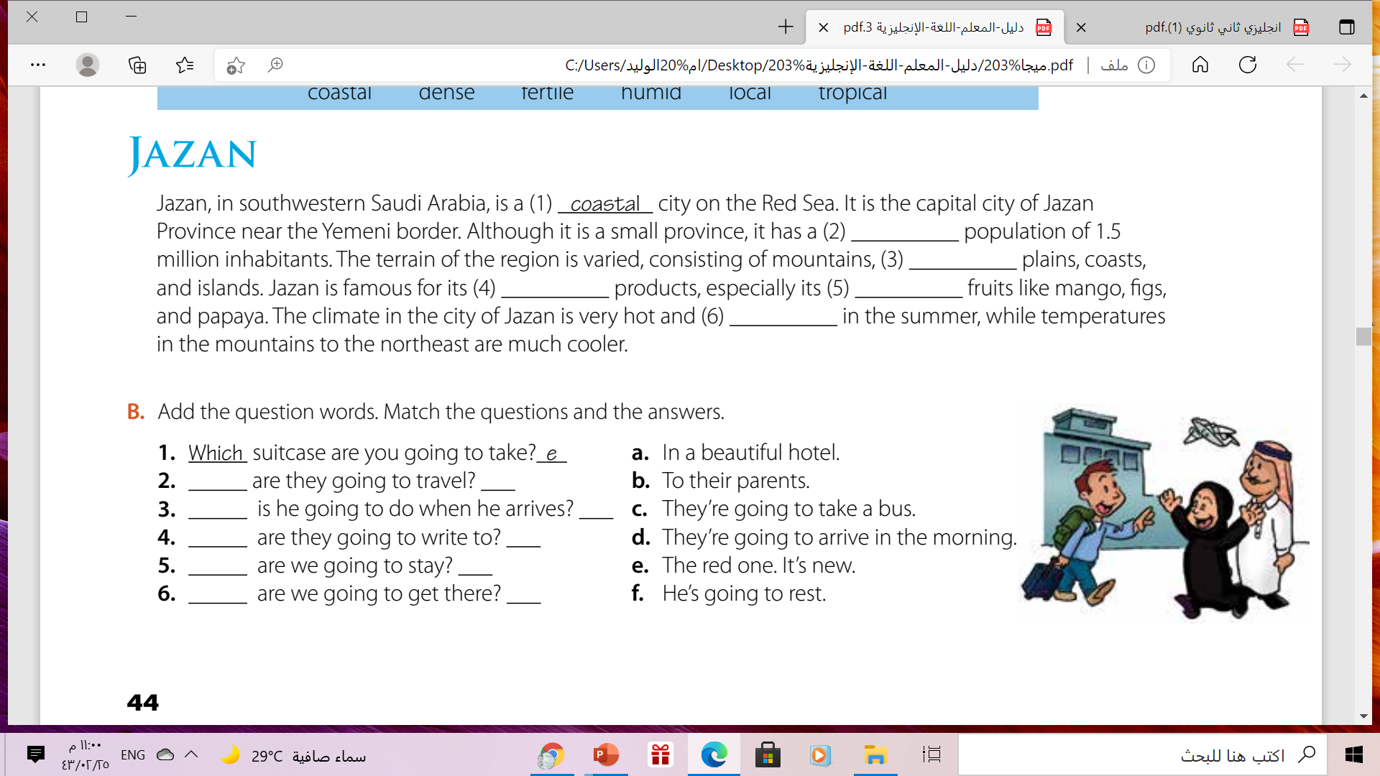
Let’s Practice
How
C
What
F
Who
b
Where
a
When
d

Slide 13
Open
Your student’s book ,Page ( 45)

Slide 14
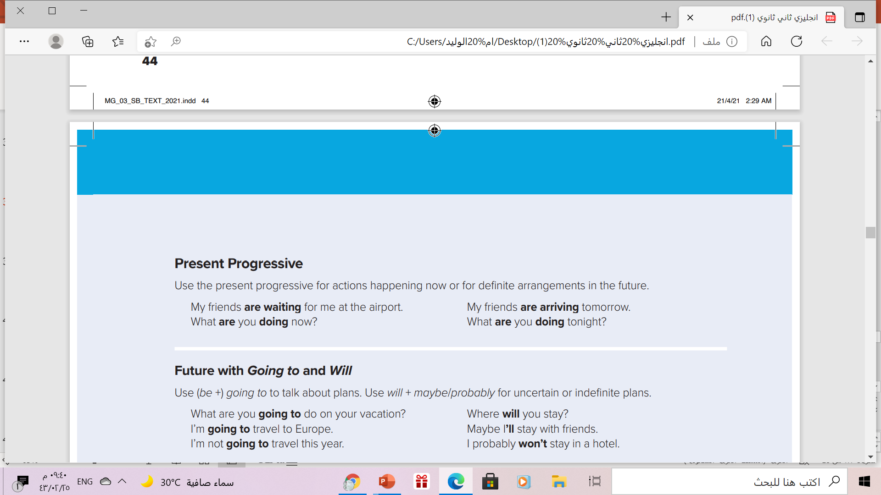
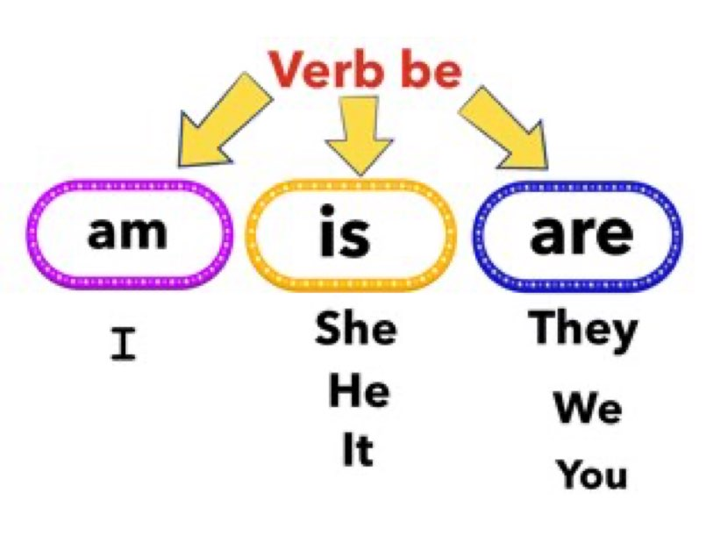
Present Progressive
Use:
for actions happening NOW
for definite arrangements in the future
Form:
Be (am- is -are)
V +(_ing)
Example:
My friends are waiting for me right now.

Slide 15
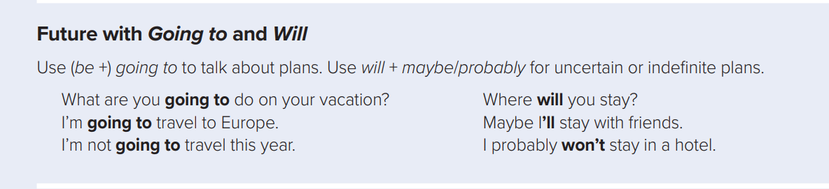
Future with Going to and will
Affermative
Will / Going to
V ( infinitive)
Negative
Will / Going to
Not
V ( infinitive)
Question
Wh-Word
Will
subject
V ( infinitive)
Wh-Word
Be( am-is-are)
subject
V ( no end)

Slide 16
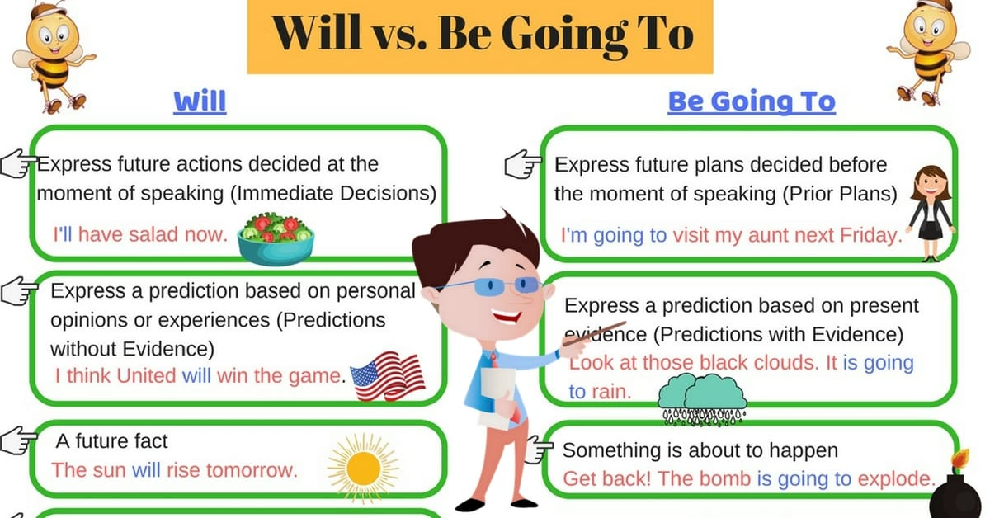
think maybe probably

Slide 17
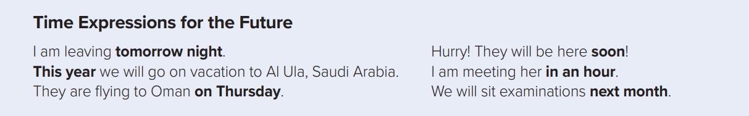
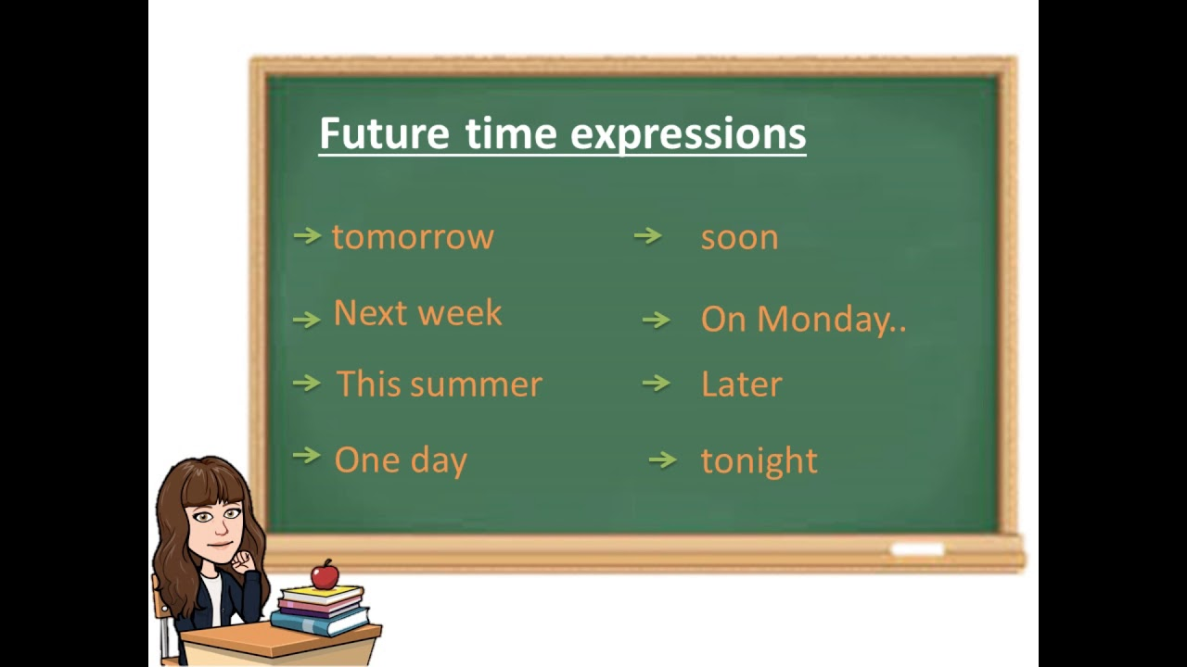
Time Expressions for the Future

Slide 18
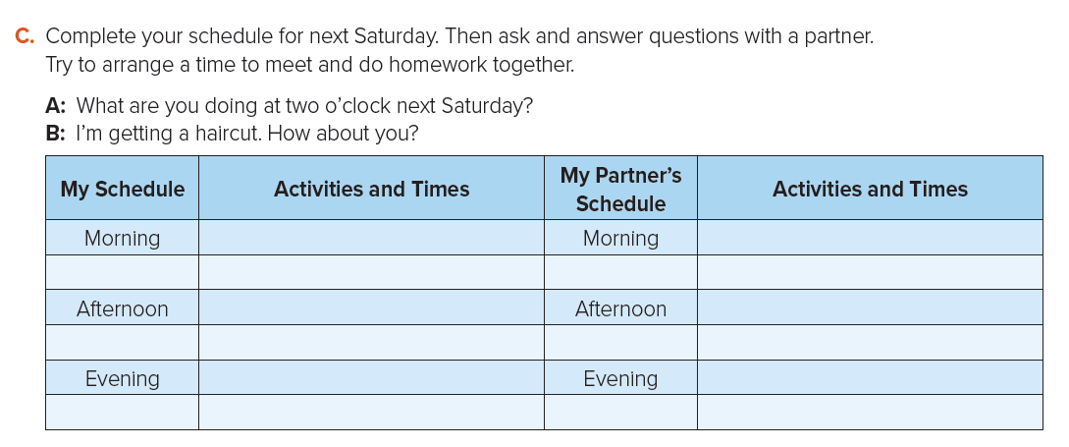

Slide 19
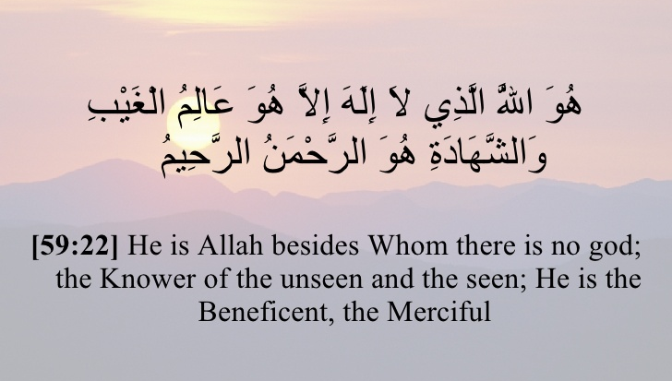
From The Holy Quraan

Slide 20
Homework
Work Book p. ( 29) , exercise
( M-N)

Slide 21

Thanks!

