Slide 1
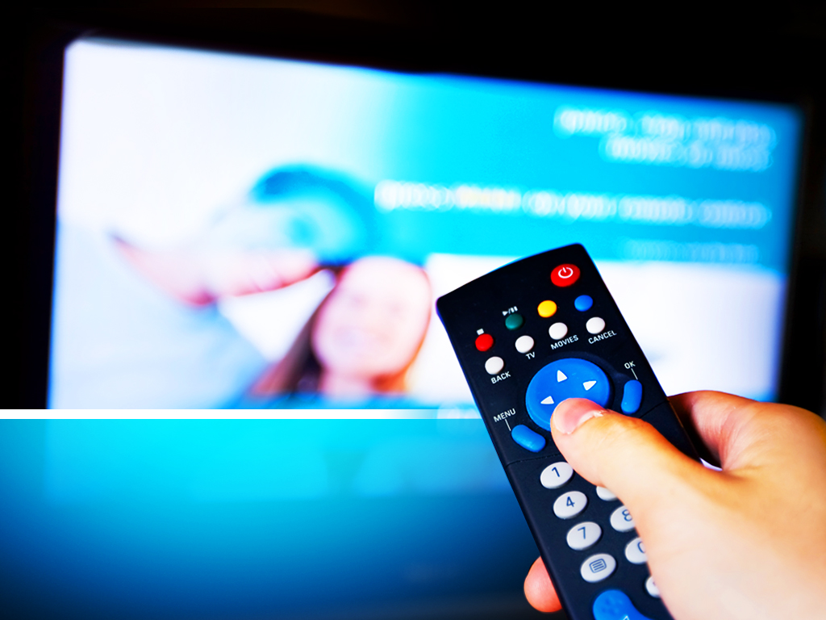
TV Around the World
Unit 4
Listen & Discuss
Done by: Entisar Al-Obaidallah

Slide 2
Lesson Goals
1- List TV programs that they like or dislike .
2 - Determine the types of TV programs .
3 - Complete the sentences with the new words .
4 - Match TV programs with their description

Slide 3

Help me to find out What UNIT ( 4 ) is about using the codes below?
a | b | c | d | e | f | g | h | i | j | k | L | m | n | o | p | q | r | s | t | u | v | w | x | y | z
 |  |  |  | ◻ | ☺ |  |  |  | ↑ |  | 😐 |  |  |  |  | ✓ |  | ★ |  |  |  |  |  |  | ✗

😐
The Title of this unit is :- ………..……………………around the ………………………………

Slide 4
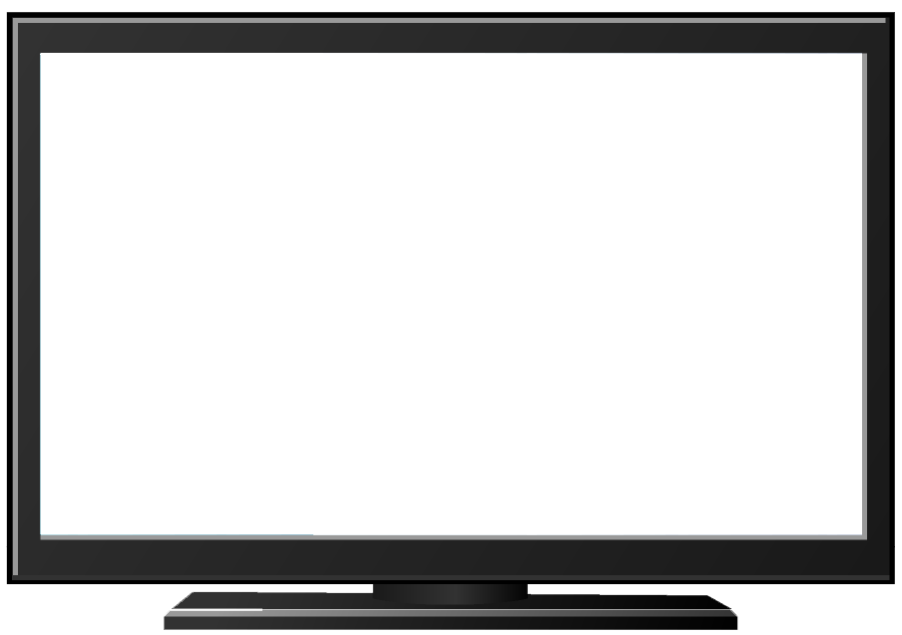

What Kind of TV programs do you Like / dislike?

Slide 5

Books OPEN
Pages: 54 - 55

Slide 6
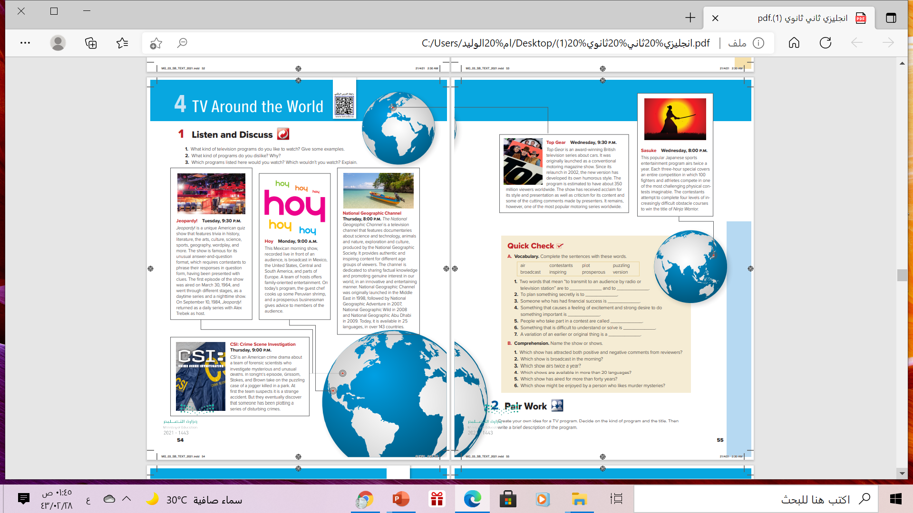
6
5
1
2
3
What are these?
These are TV shows
4
How many TV shows are there?
6 programs

Slide 7
Which program is about cars?
Top Gear
Which program is a documentary?
National Geographic videos and shows
Which program is a quiz show?
Jeopardy
Which program good for family viewing?
Hoy
Which is a sports program?
Sasuke
CSI
Which program is from the U.S.?

Slide 8
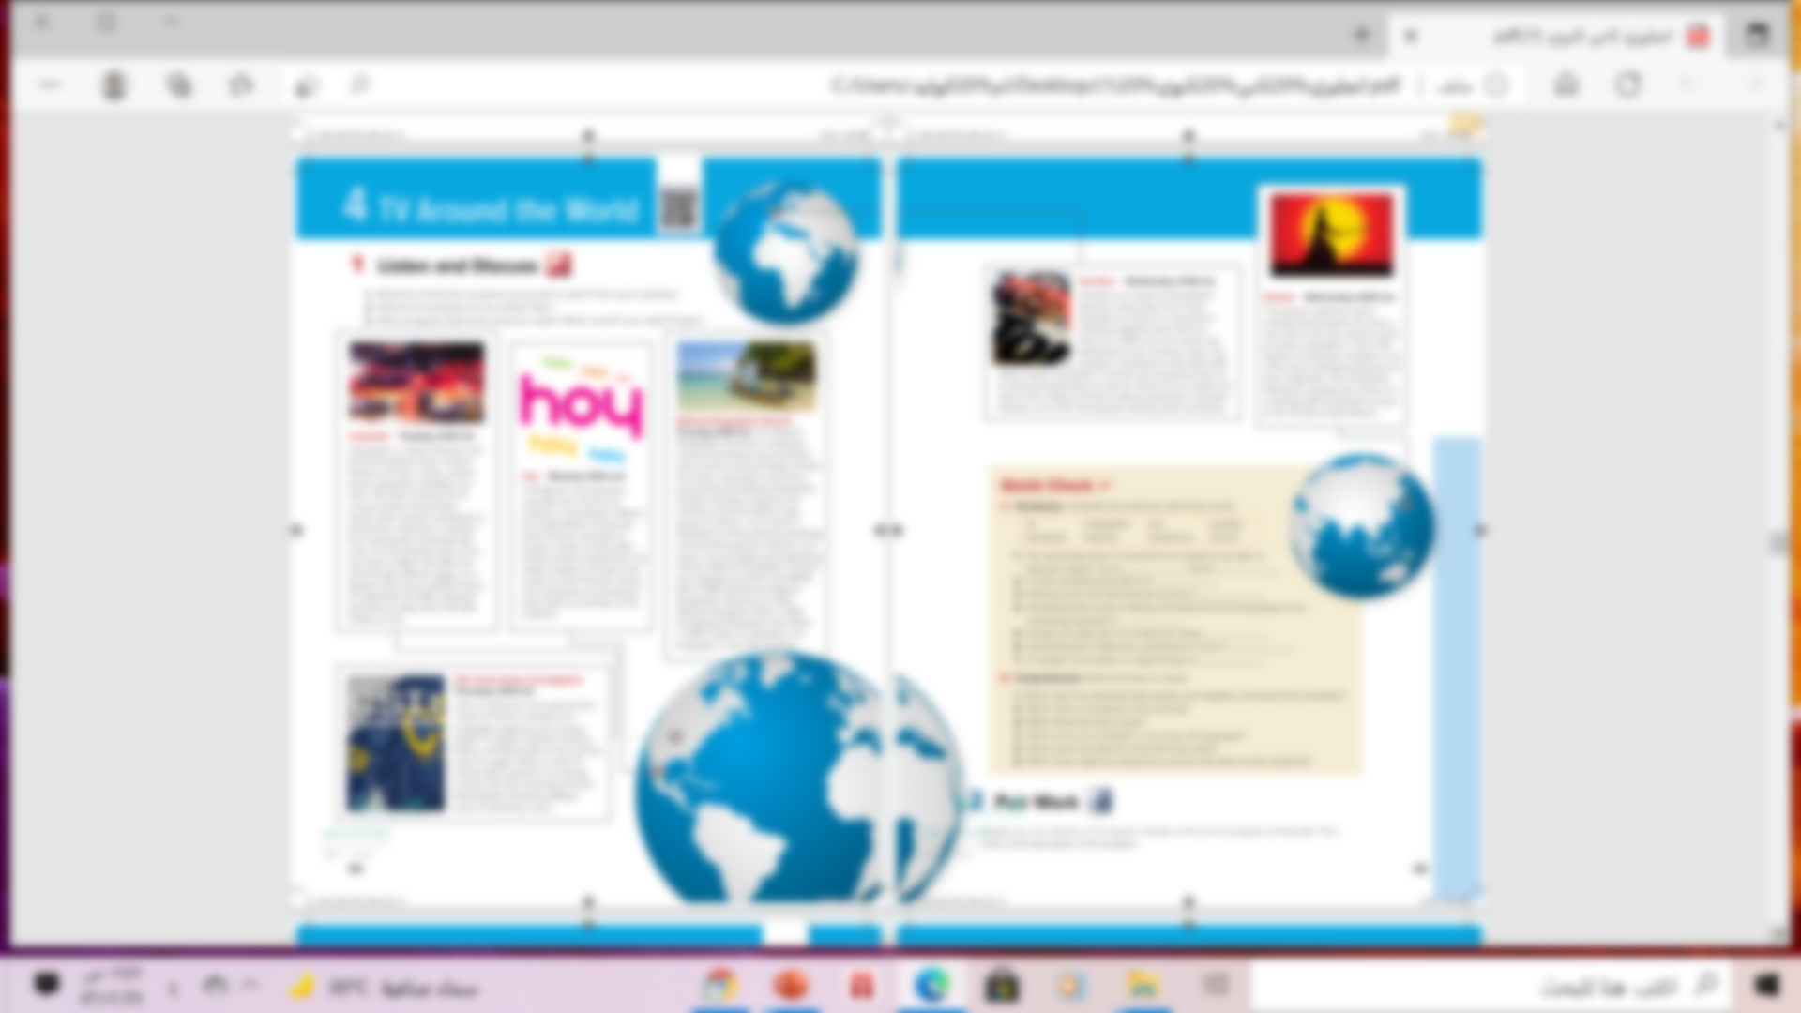


Read along as U Listen

Slide 9
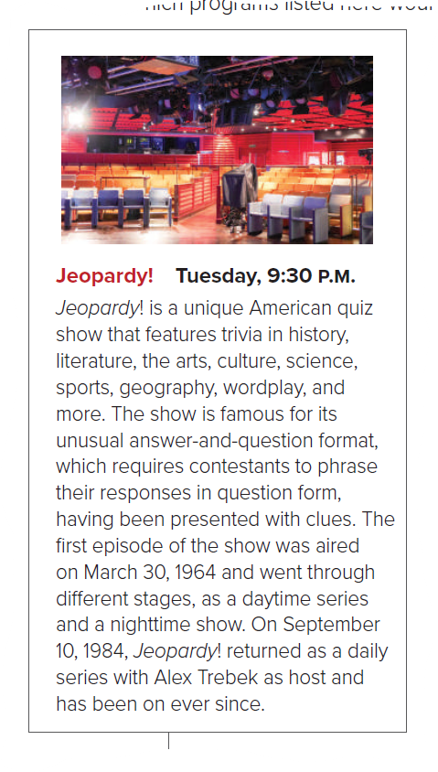

What is “ Jeopardy”?
American quiz show
When does it show?
Tuesday.9:30 P.M.
When was the 1st episode aired?
On March 30, 1984

Slide 10
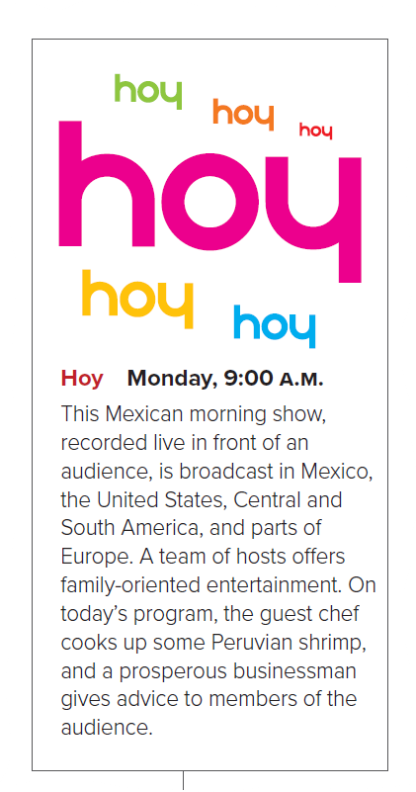

What is “ hoy”?
Mexican morning show
What time it shown?
Monday.9:00 A.M.
Where does it broadcast?
In Mexico, United States, Central & South America and parts of Europe

Slide 11
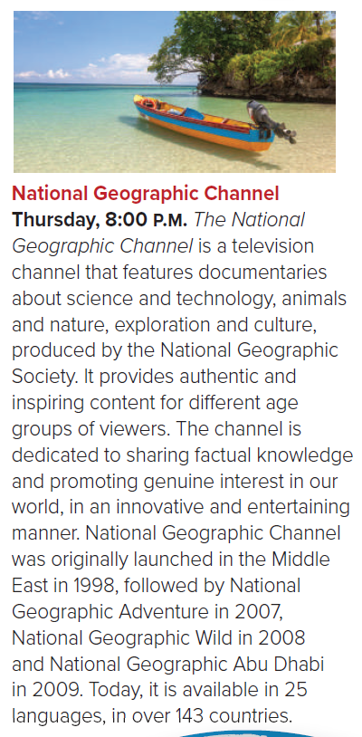
Where was it launched ? When
In the Middle East in 1998
What time it shown?
Thursday.8:00 P.M.

Slide 12
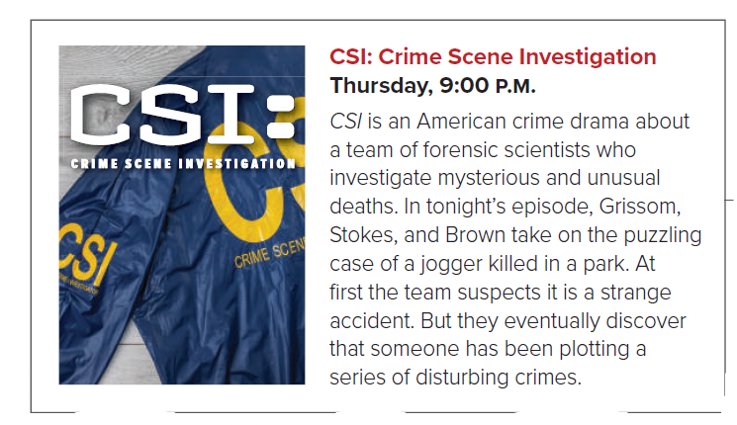
What does CSI mean?
What time it shown?
Crime Scene Investigation
Thursday , 9:00 P.M.

Slide 13


What is it about?
cars
In 2002
When did it relaunch ?
How many viewers of the program ?
350milliom

Slide 14
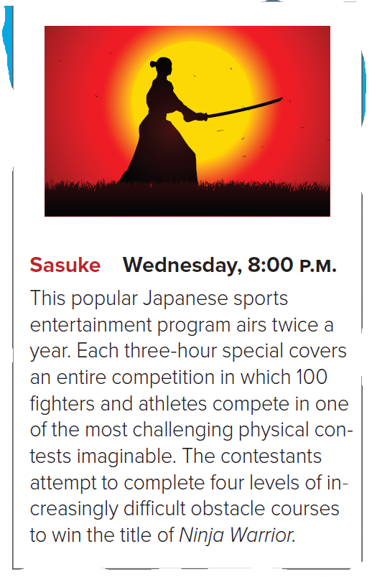
How many times does it air ?
Twice a year
What kind of sport is it ?
Ninja Warrior

Slide 15



Have you ever seen one of these shows or similar ones ?

Slide 16
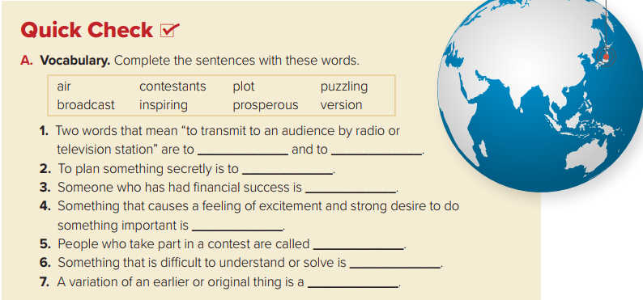

air
broadcast
plot
prosperous
inspiring
contestants
puzzling
version

Slide 17
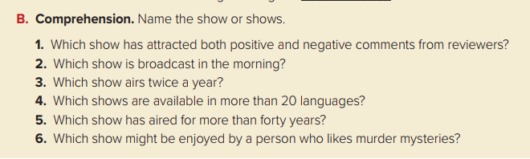
1- Top Gear
2- Hoy
3- Sasuke
4- National Geographic shows and documentaries
5- Jeopardy!
6- CSI

Slide 18

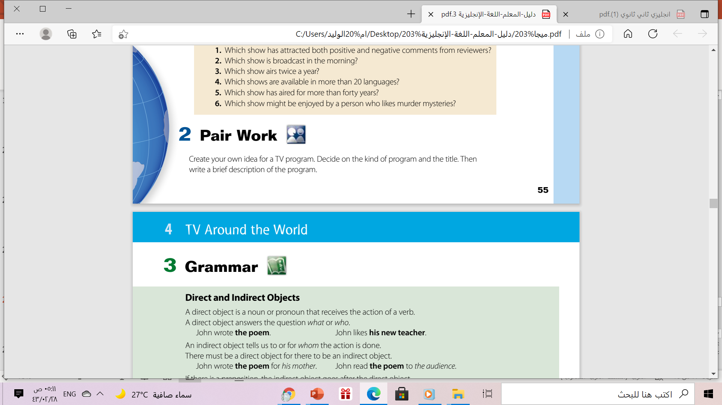

Slide 19


Slide 20
Homework
Workbook P. (113)
Exercise (A)

Slide 21

Thanks!

