Slide 1
Unit 4
TV Around the World
Conversation+Listening
Mega Goal 2.1
Done by: Entisar Al-Obaidallah

Slide 2
Lesson Objectives
Express
Listen
Use
Find
certainty correctly
For specific information in the conversation
the (real talk) phrases in new sentences
the meaning of the new words in the conversation

Slide 3
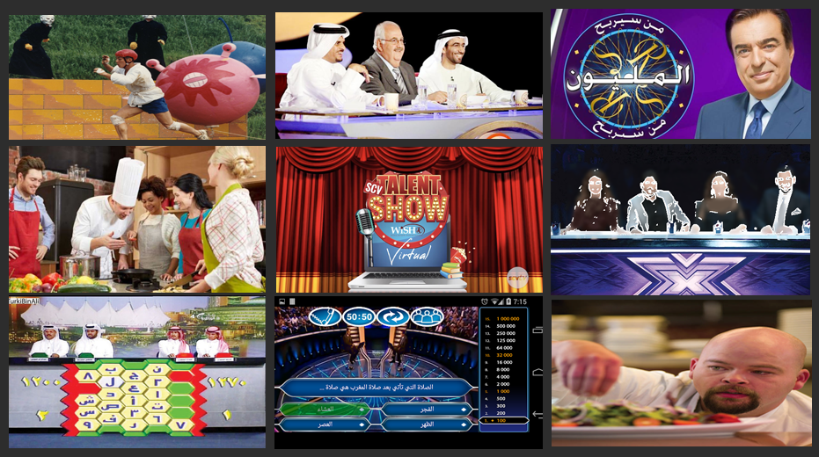

Guess
the kind of TV program we’re going to introduce?
Reality Show
a television programe about ordinary people who are filmed in real situations:

Slide 4
Book Open
Pages (52)

Slide 5
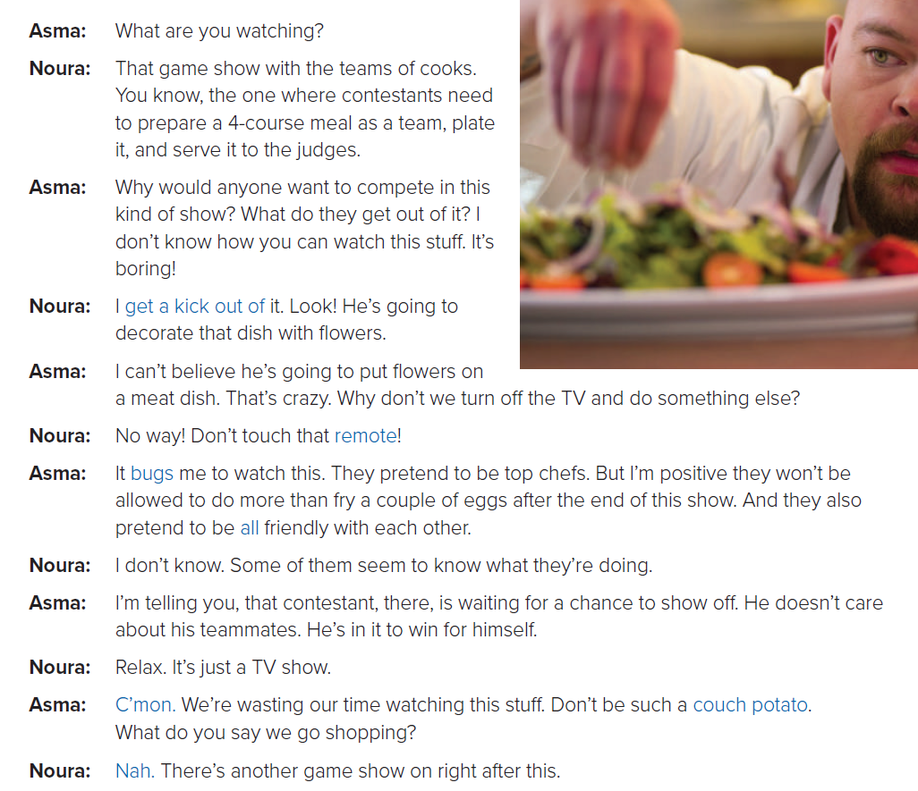


Read along as U Listen

Slide 6
Describe the TV show Noura is watching.
It is a game show in which a team of cooks need to prepare a meal
and serve it to the judges
How does Asma feel about this program?
Give examples from the conversation.
She doesn’t like it.
(What do they get out of it, It bugs me to watch this, etc.)
Would you watch this program? Why or why not?

Slide 7
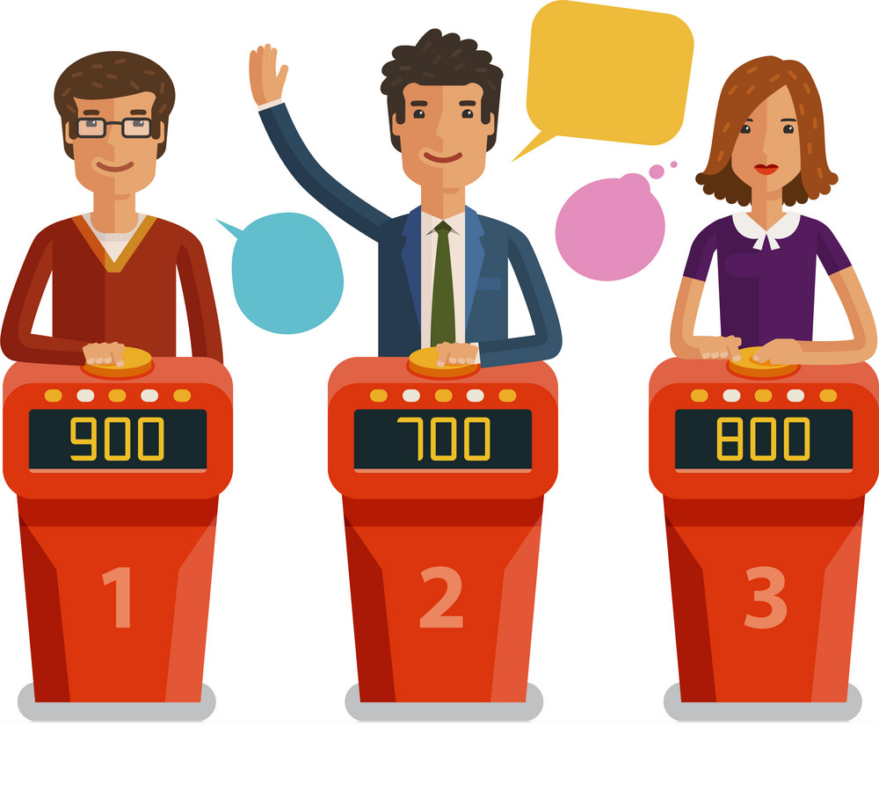
Who are the contestants?
Team of cooks
What do the contestants do?
contestants need to prepare a 4-course meal as a team, plate it, and serve it to the judges
What’s one of the contestants waiting for?
waiting for a chance to show off

Slide 8


Slide 9


Who says ………
get a kick out of
Nora
(Noura says this, meaning:
she has fun watching reality shows

Slide 10
Who says ………
bugs
Asma
Asma says this, meaning that
the shows annoy her.

Slide 11
Who says ………
Show off
Asma
Asma says this, meaning that
the contestant tries to show how clever or skilled he is so that other people will admire him.

Slide 12
Who says ………
couch potato
Asma
Asma says this, meaning that
Noura
spends too much time watching TV

Slide 13
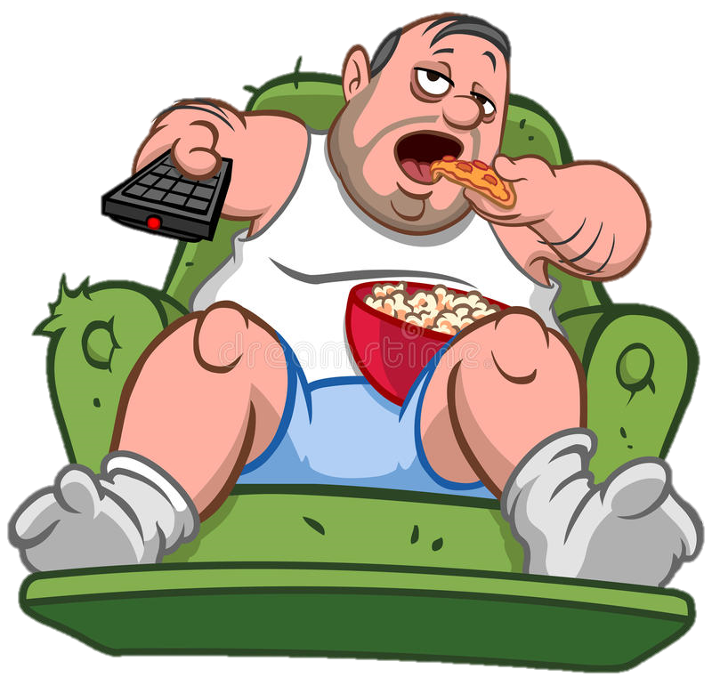
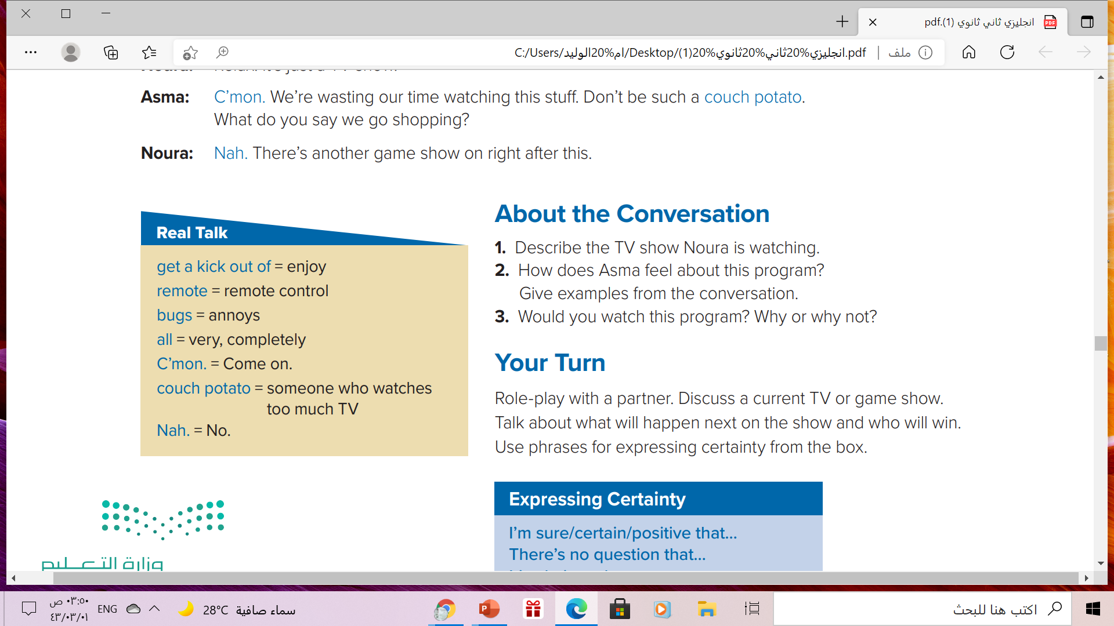


Slide 14

What do you get a kick out of?
What bugs you?
Have you met anyone who likes showing off?
Are you a couch potato?

Slide 15
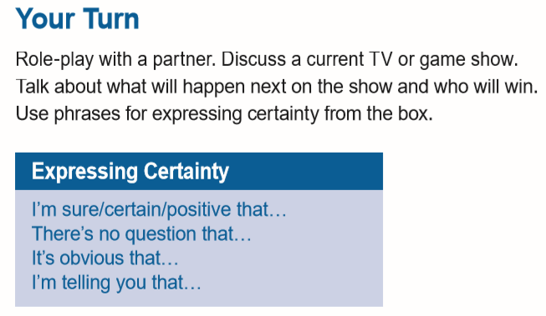

Use these phrases when you are very sure about something
What Expression Asma uses ..?

Slide 16
Book Open
Pages ( 53)

Slide 17
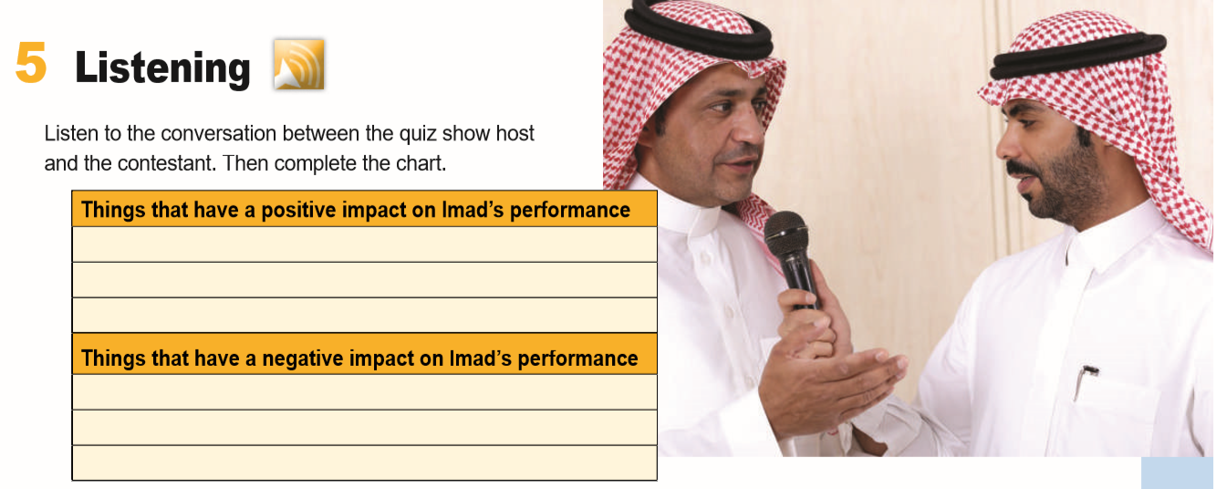
Fantastic trainer
In the best physical & mental shape
wonderful, supportive family
A broken toe
Father in the hospital
A cold

Slide 18
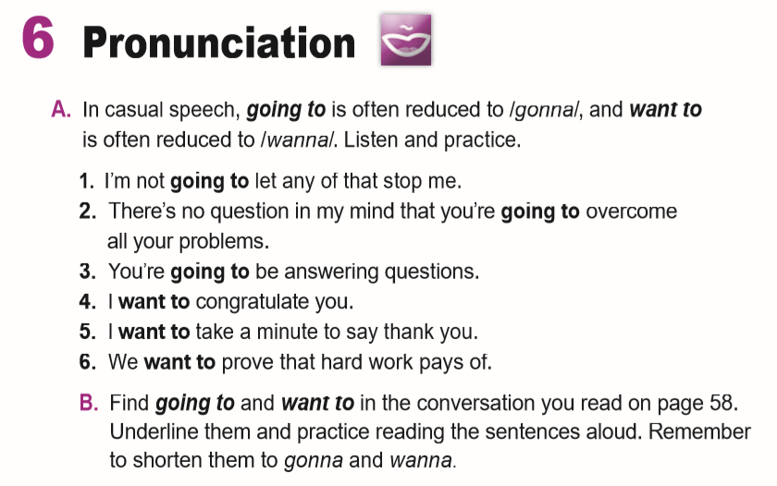

Slide 19
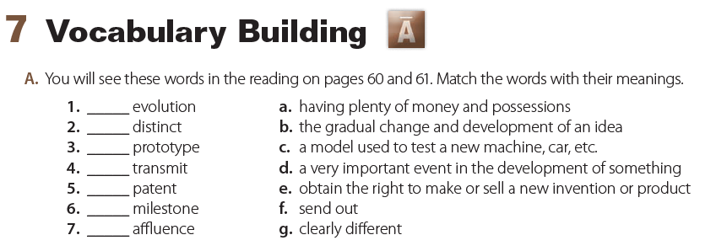
b
g
c
f
e
d
a

Slide 20

Remember

Slide 21

Homework
On workbook , p.(116) . Exercise ( H )

Slide 22

THANKS!

