Slide 1

Unit 4
Mega Goal 2.1
TV Aound the World
Writing
Done by: Entisar Al-Obaidallah

Slide 2
Lesson Objectives
01
02
03
04
Find
information in a TV film review.
Answer
Some questions about the review of TV film
Use
The organizer to outline the major 3 key events in the plot
Write
a short review of a movie, a TV show or a book.

Slide 3
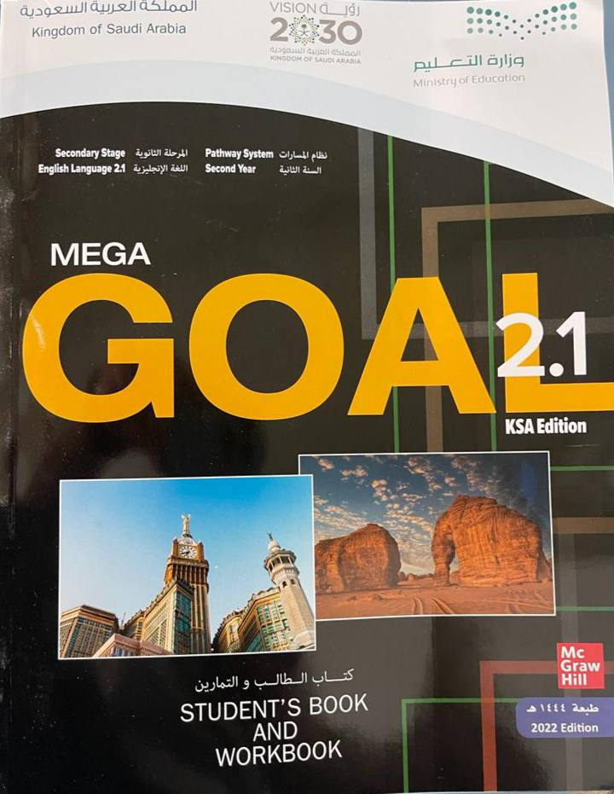
Open
Student’s book p.(56)

Slide 4


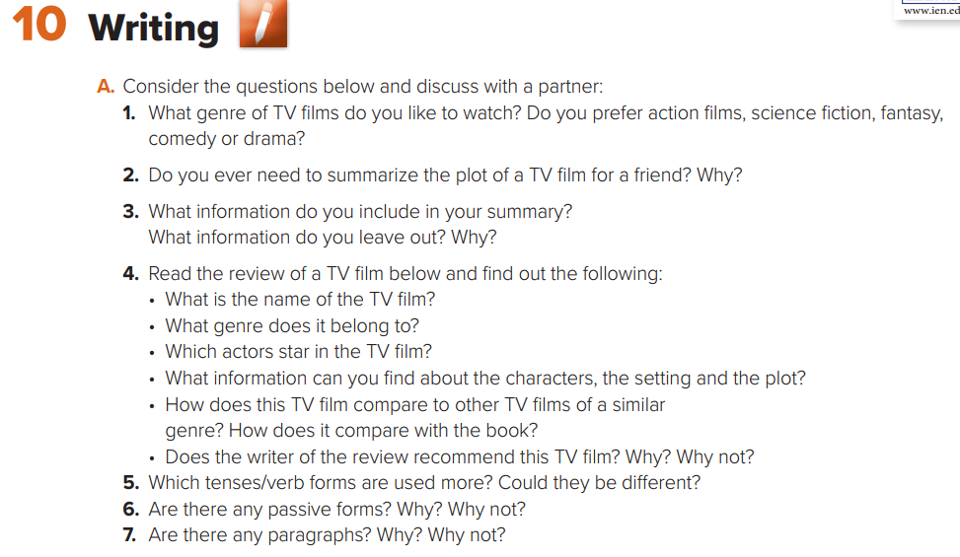
3- include: director – actors – setting – genre – author
Leave: Country & Duration

Slide 5
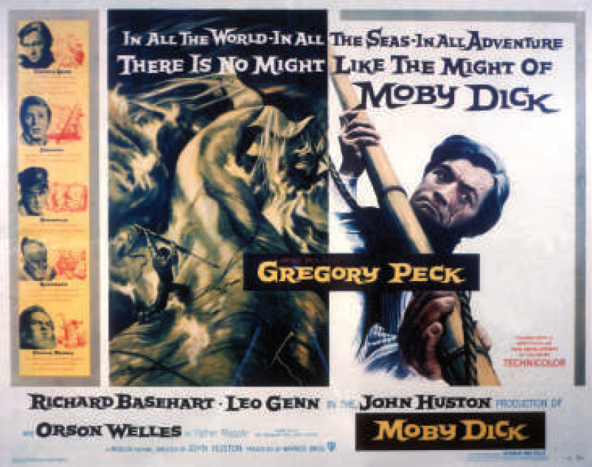
What do you see?
A poster advertising a TV film

Slide 6
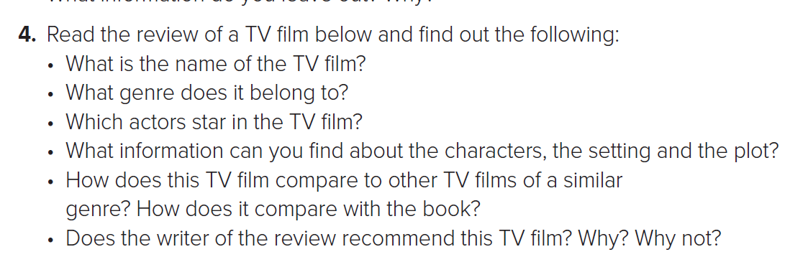
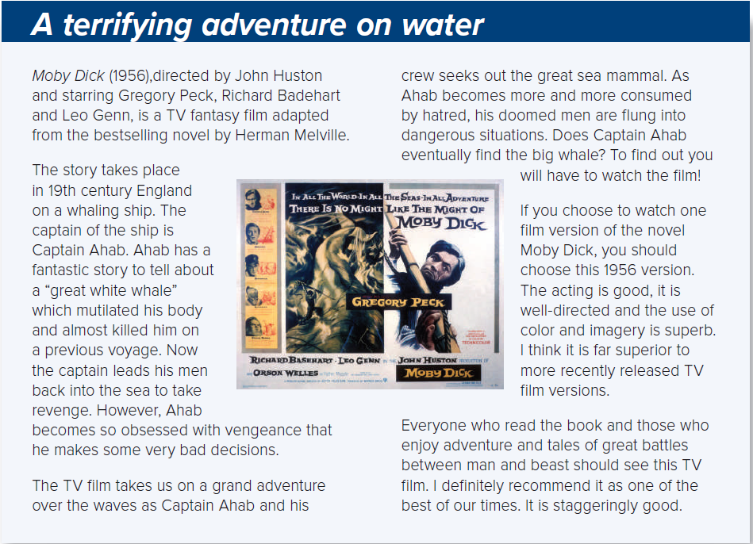
1- Moby Dick
2- Fantasy – Adventure
3- Gregory Peck, Richard Badehart & Leo Genn
4 -
Characters:
Captain Ahab and the ship’s crew; a whale
Setting: 19th century England; on a whaling ship; a sea voyage
Plot: Captain Ahab sets out a sea voyage to find a great whale and take revenge

Slide 7
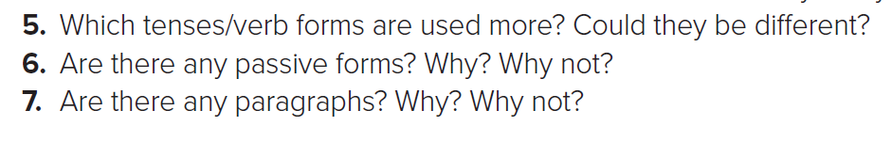
5- Present Tense
6- Yes. To describe who directed and starred the film
7- Yes. 5 Paragraphs

Slide 8

A book Review
Each paragraph has a particular focus .
director
stars in the TV film
date
Character
Plot
The writer’s opinion
Character
Plot
Writer’s
recommendation

Slide 9
Open
Student’s book p.(57)

Slide 10
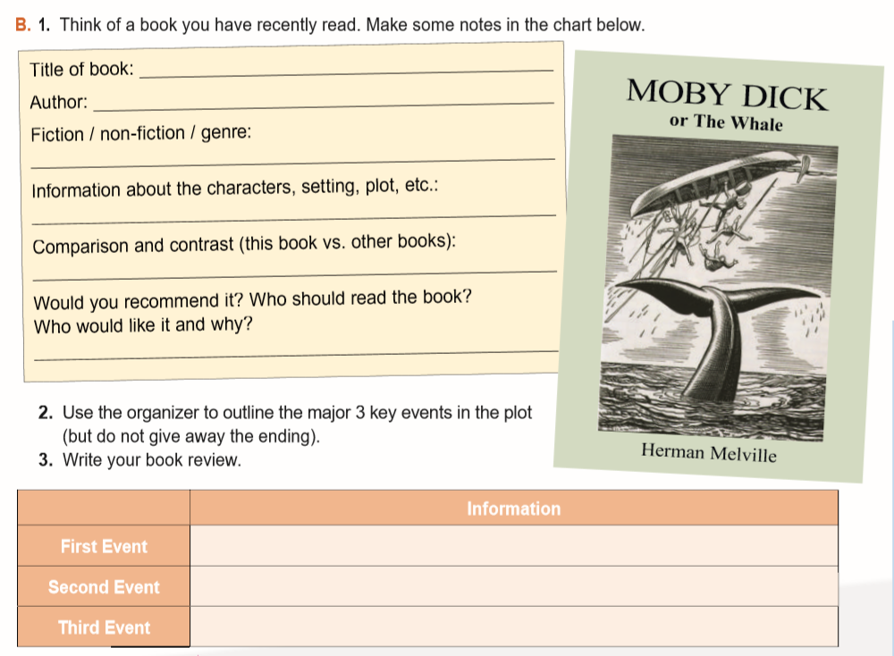

Great Expectations
Charles Dickens
Fiction novel
A poor little orphan , grows to become a gentleman – Pip- 19th century
more interesting - full of mystery & romance - careful plotting, deep characters
Yes – for young adults
Pip met the escaped convict & gave him food. Later, he sent to London where
he became a gentleman.
Magwitch illegally returns from abroad and announces that he is Pip's secret benefactor.
After Pip unsuccessfully tries to get Magwitch out of the country, Magwitch dies in prison
and Pip loses his fortune.

Slide 11
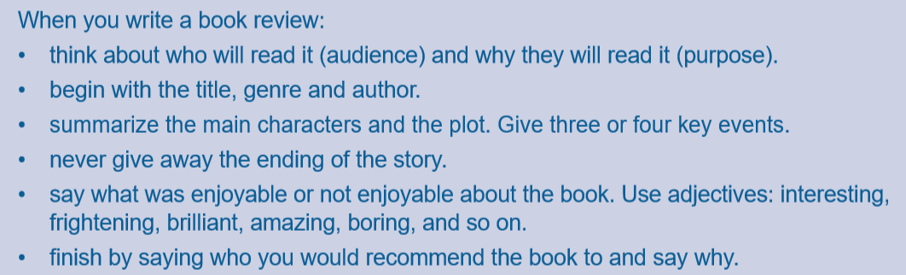
Writing Corner

Slide 12

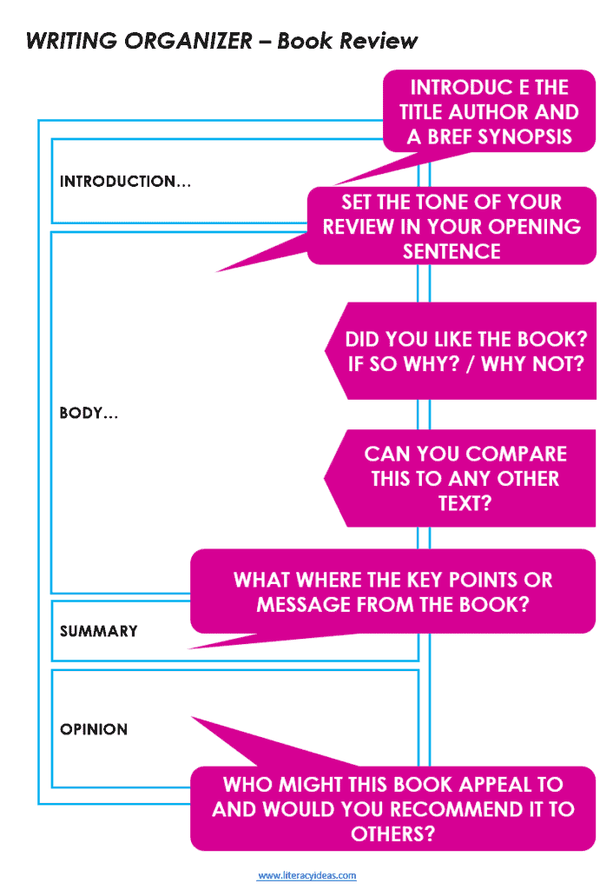

Slide 13
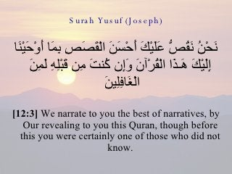
From The Holy Quraan

Slide 14
Homework
Workbook P. (120)
Exercise (L)

Slide 15

THANKS!

