Slide 1
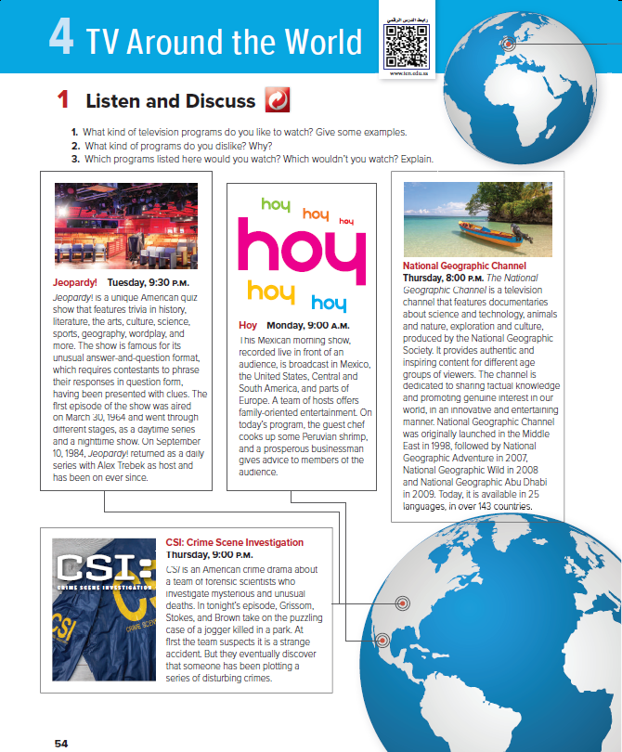
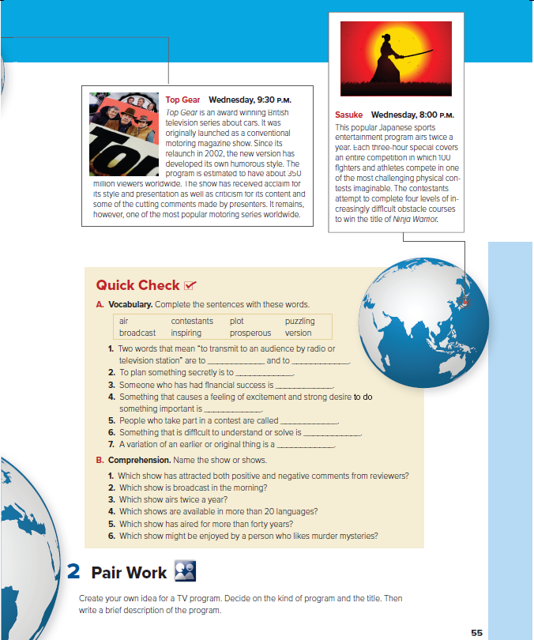


Who am I?
Who am I ?
Mega Goal 2.1
TV around the World
U: 4 L:1
Listen & Discuss
By: Essa Al Hussaini

Slide 2
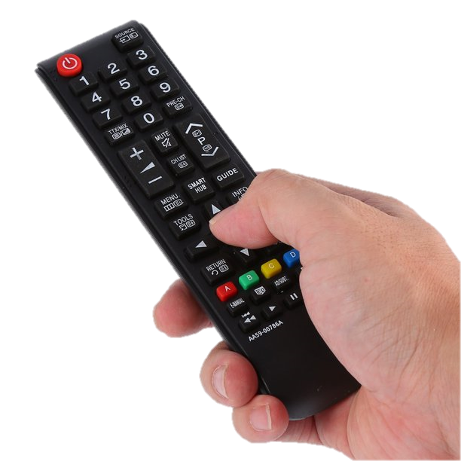
Who am I ?
  A Worldwide Show
  Not An American Show
  Watched By Millions
  Have My Own Funny Style
  About A Classic Vehicle / Automobile
  Won Prizes
Top Gear

Slide 3

Who am I ?
  Not Broadcast A Lot
  Aired For 3 Hours
  About Working Hard Game
  A Game But Not Mental
  A Game But Not Easy Levels
Sasuke

Slide 4

Who am I ?
  NOT A TV Program But Famous
  Watched By Different Age
  People Think I Am About Only Animal
  Use Different Languages
  Share True Knowledge
  Have Entertainment Contents
National Geographic Channel

Slide 5

Who am I ?
  Offer A Family Content
  An Entertainment Show
  With Hosts, Guests & Audience
  Guests Can Make Something E.G. Food
  Guests Give Good Words / Recommendation
Hoy

