Slide 1
Mega Goal 1.1
Unit 1 - BIG CHANGES
4- Language in context
5- Listening
6- Pronunciation
By: Essa Al Hussaini

Slide 2
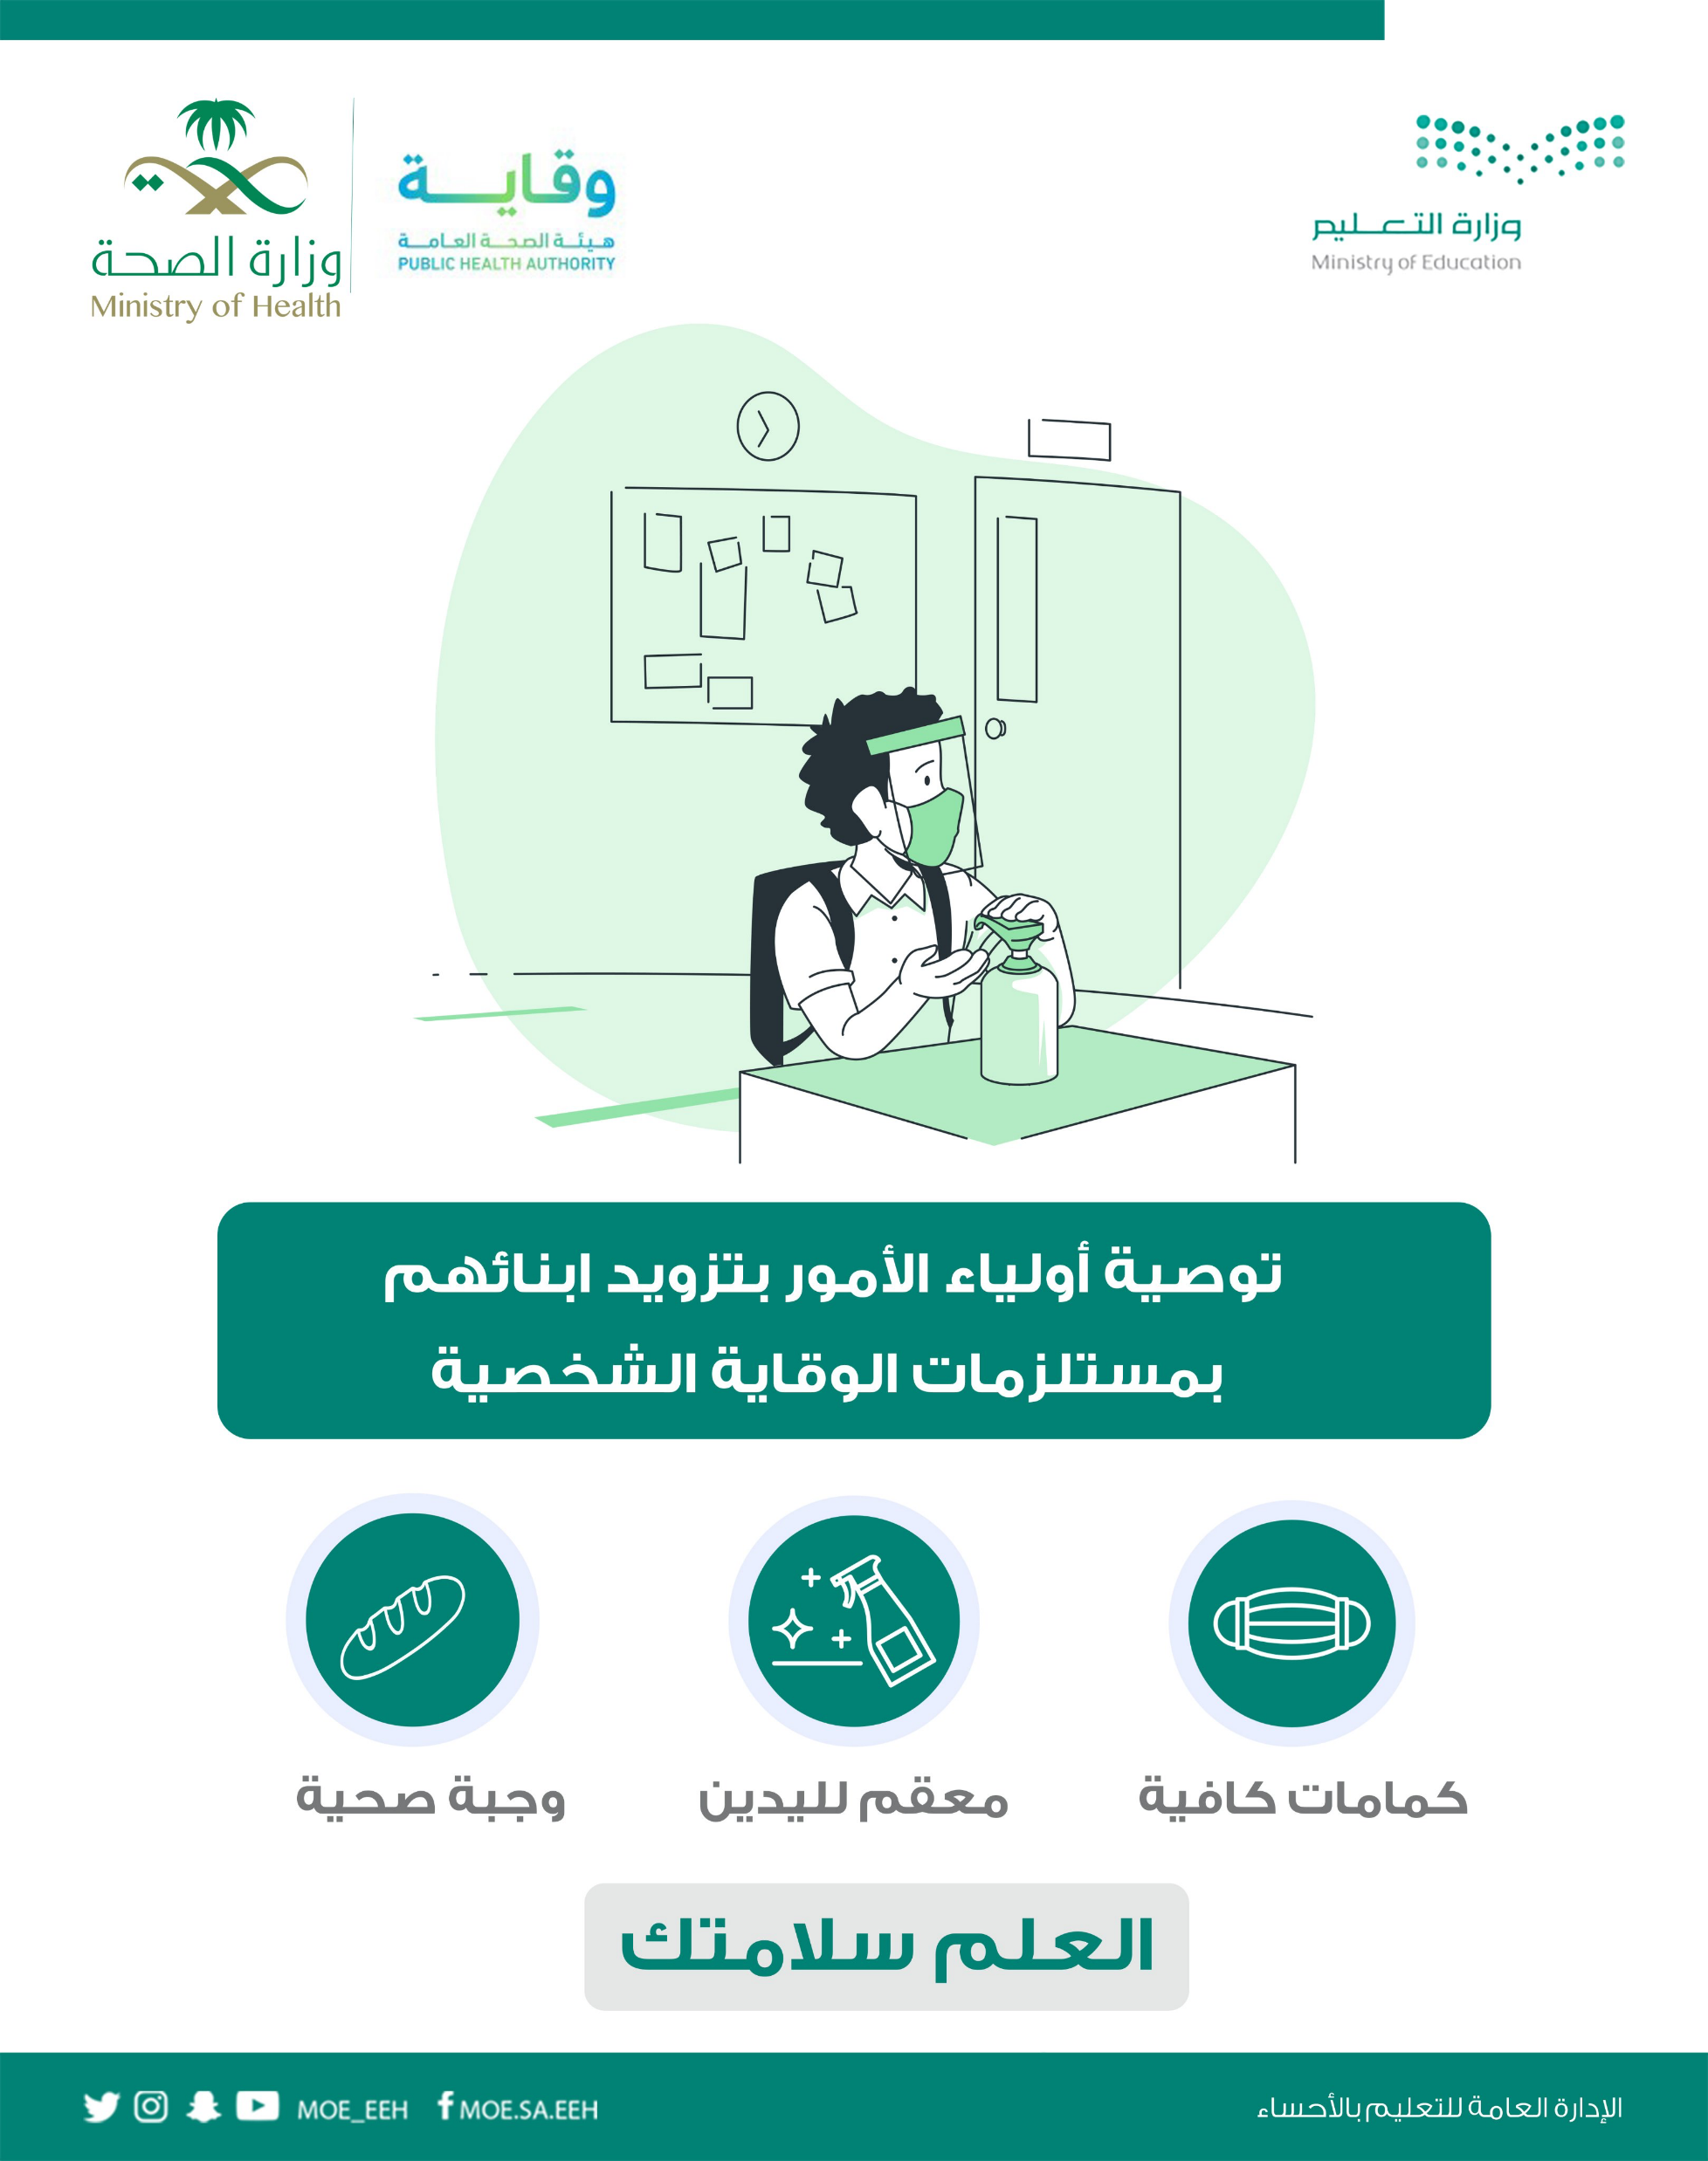
Let’s continue
to protect ourselves!

Slide 3



Previous Lesson Flashback

Slide 4




Previous Lesson Flashback
Simple Present
Present
Progressive
for actions and situations happening now or in progress or for temporary situations
for facts, permanent situations, or habits and routines
S + Be + V-ing ________
S + V + ________
He lives in Al-Ahssa.
I read the newspaper everyday.
They don’t read newspaper online.
It is raining now.
I am living in Riyadh this year for study.
Where are they going to?

Slide 5

Previous Lesson Flashback
Simple Past
Present
Perfect
Now
2021
Now
2021
to talk about events that began and ended in the past
- to talk about an event or action that was completed in the past. (an indefinite time)
- to talk about events that began in the past and continue into the present
S + V2 + ________
S + have / has + V3 ________
I studied English last week.
He did not study math.
The Russian satellite took off up into space.
He was at school when my father came home.
They have played PS5.
Saudi Arabia has established many projects to achieve its vision 2030.

Slide 6

REMEBER
I ➔ am
He / She / It ➔ is
You / They / We ➔ are
He / She / It ➔ does
I / You / They / We ➔ do
He / She / It ➔ has
I / You / They / We ➔ have
irregular verbs – (page 72)
Present
verb to Be (am – is – are)
do – does
Past
verb to Be (was – were)
did
irregular verbs – (page 72)

Slide 7
Mega Goal 1.1
Unit 1 - BIG CHANGES
4- Language in context
5- Listening
6- Pronunciation
By: Essa Al Hussaini

Slide 8

Objectives
introduce
a partner to the class
Answer
questions about immigrant's story
Practice
listening to a recorded text to correct statements
Model
sentences with stress on important words
Report
someone’s notes to the class

Slide 9

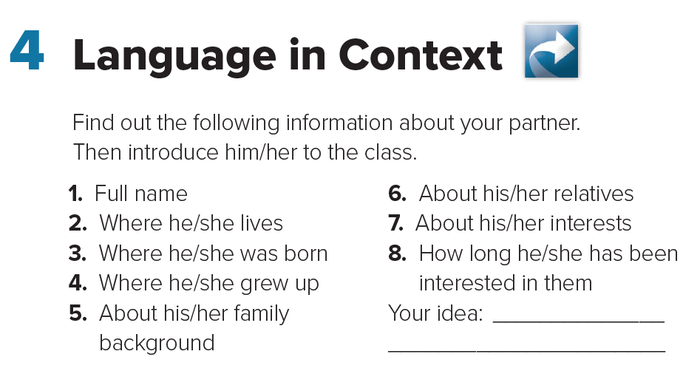
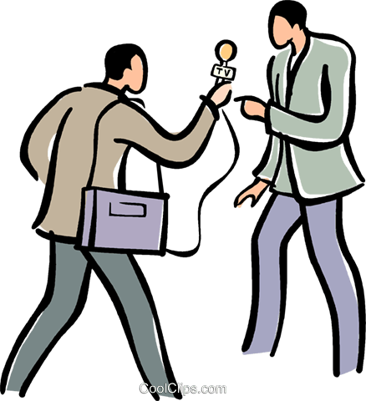
Pair Work
10

Slide 10


What major change have you made in your life?
When was it?
Why?

Slide 11

Have you ever
considered immigrating to other countries?
Why do people take it into consideration?
.. their feeling
when they immigrate?

Slide 12
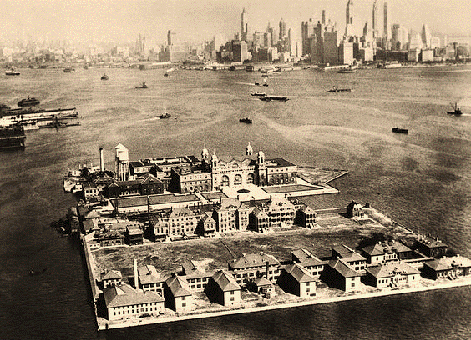

In the photo
I can see …….

Slide 13
In the photo
I can see …….

Slide 14
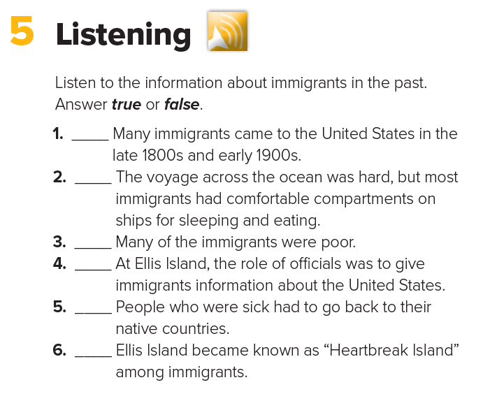





BOOKS CLOSED
Listen to the information about immigrants in the past
and answer the followings
1- Where did people emigrate from?
2- Where did they immigrate to?
3- How do they immigrate by?

Slide 15


BOOKS OPEN
T
F
T
F
T
T
show all

Slide 16
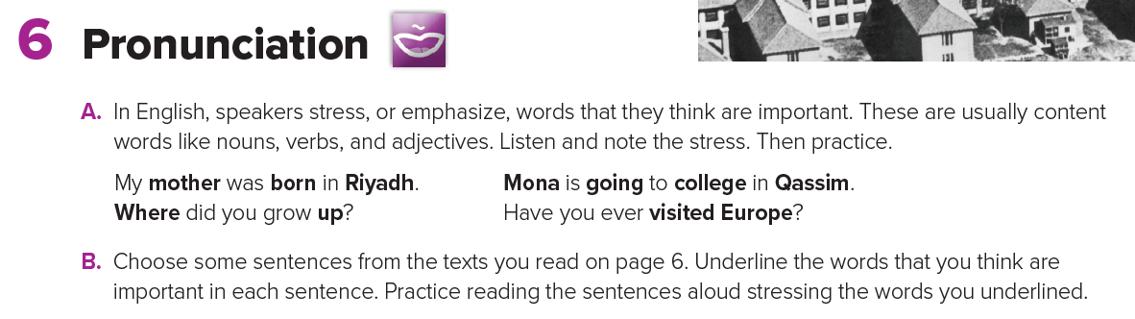


Slide 17
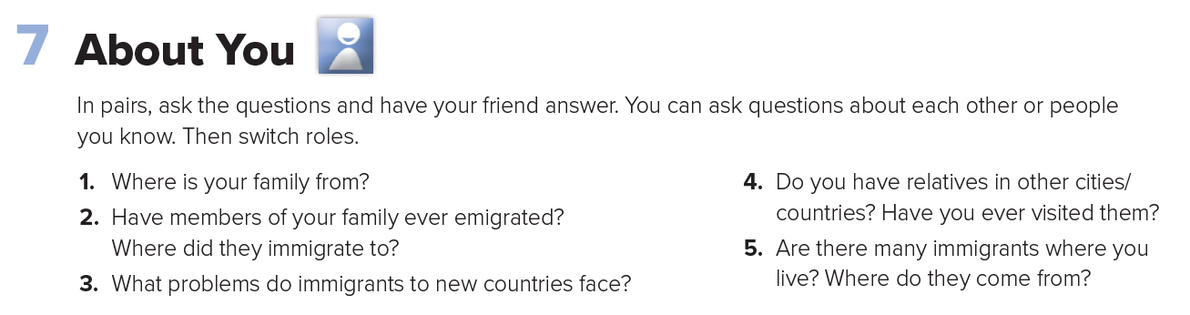


Group Work

Slide 18


