Slide 1
Unit 1
Big Changes
Mega Goal 1.1
Language in Context + Conversation
Done by: Entisar Al-Obaidallah

Slide 2
Lesson Objectives
1
Answer
2
Listen
3
Use
4
Use
questions about immigrant's story
For specific information
stress on important words correctly
the “Real Talk” in a sentence correctly

Slide 3

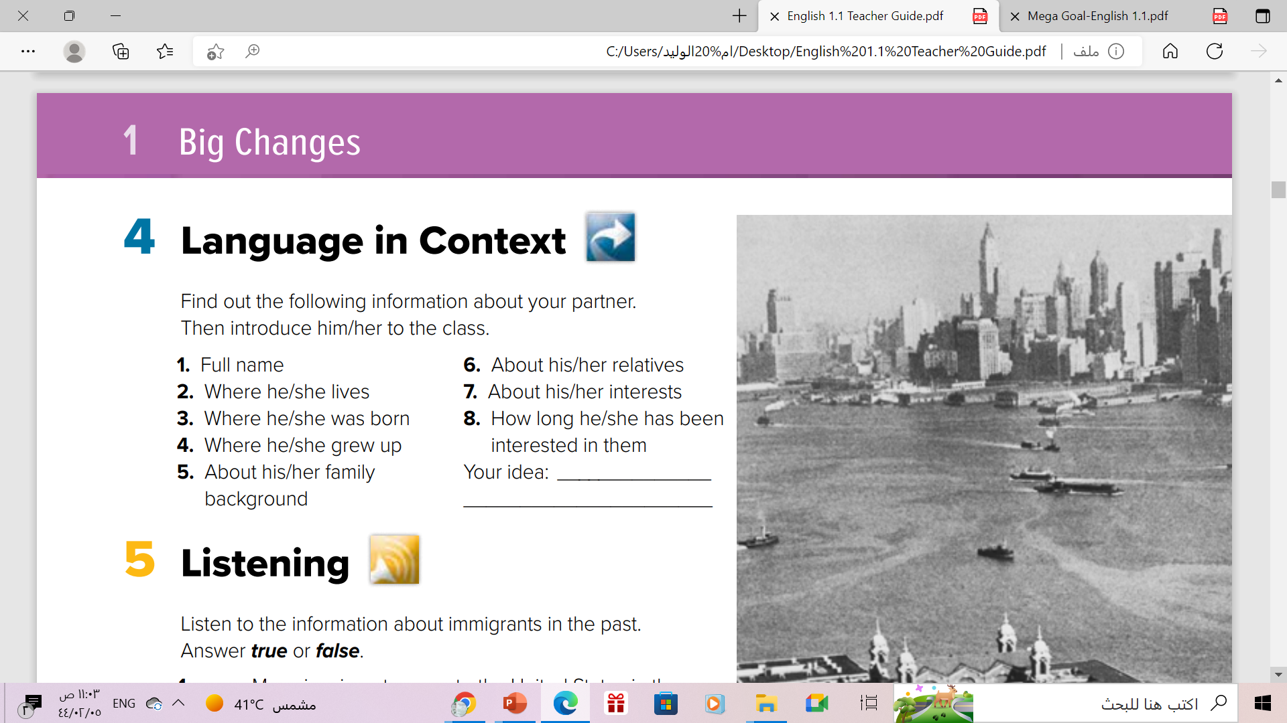
Pair work

Slide 4
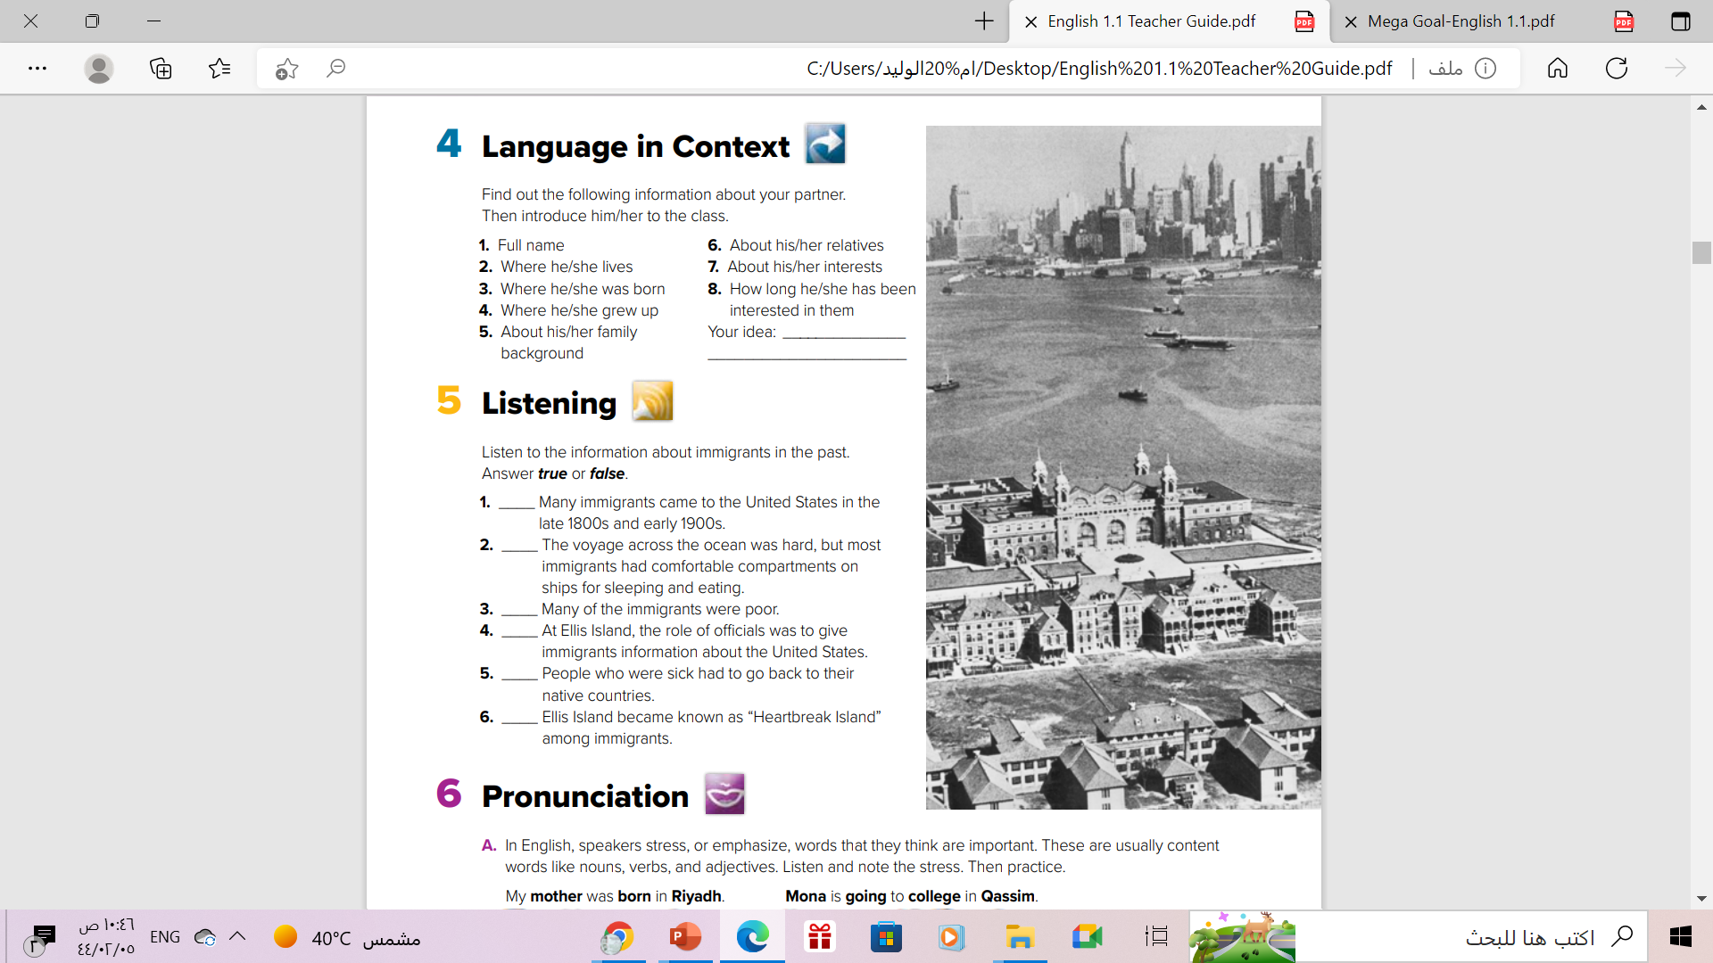

Read the Picture Strategy
What can you see in the picture?

Slide 5

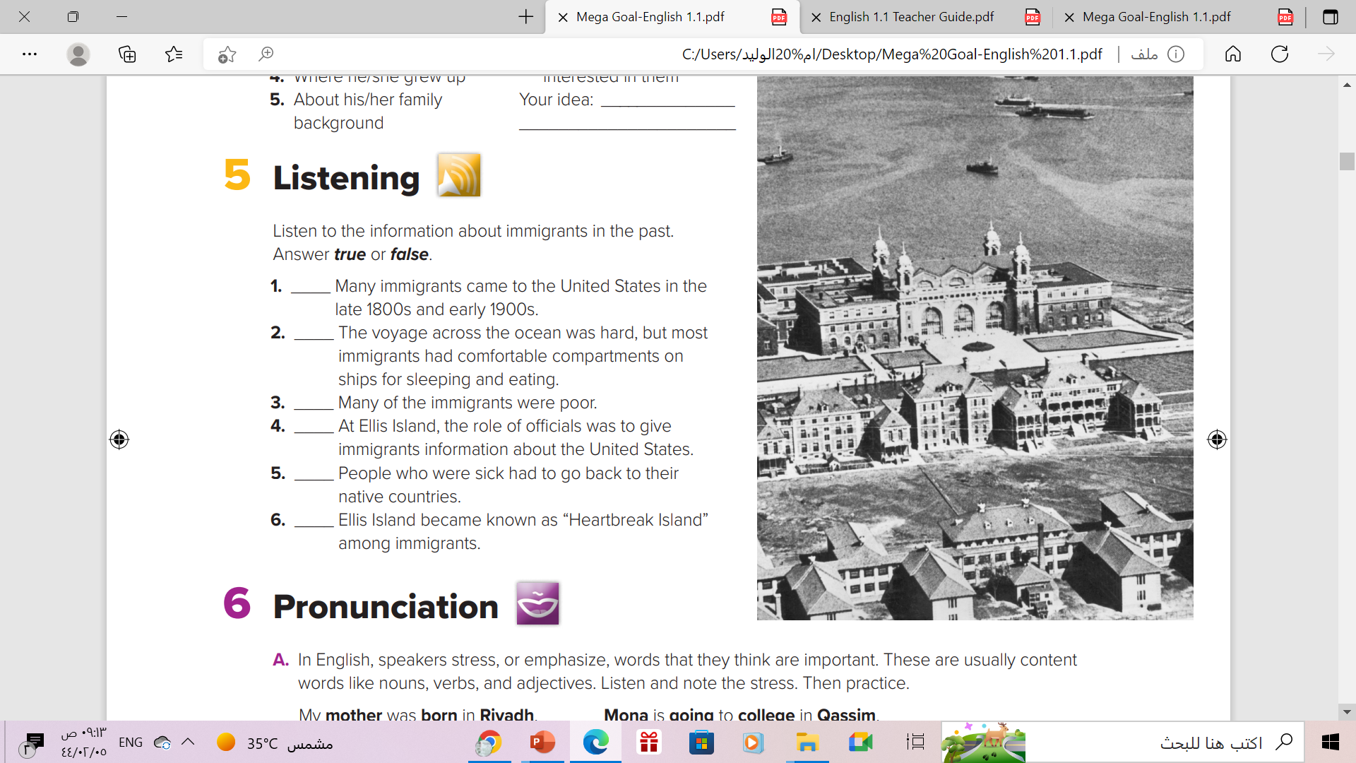
Listen & Answer
Where did people emigrate
from ?
Where did people emigrate
to?
Why did they emigrate?
How did people emigrate by ?

Slide 6
True
False
True
False
True
True

Slide 7

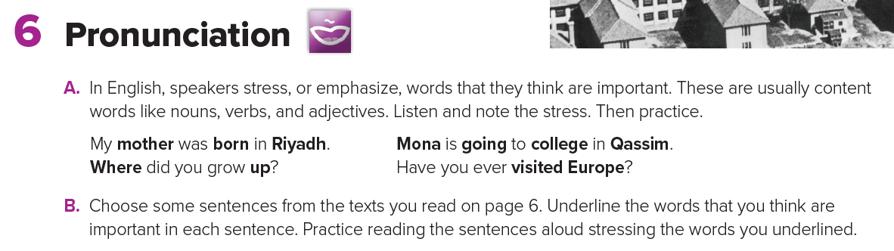
Stress
The force or emphasis that you put on a word or part of
a word when you say it .

Slide 8
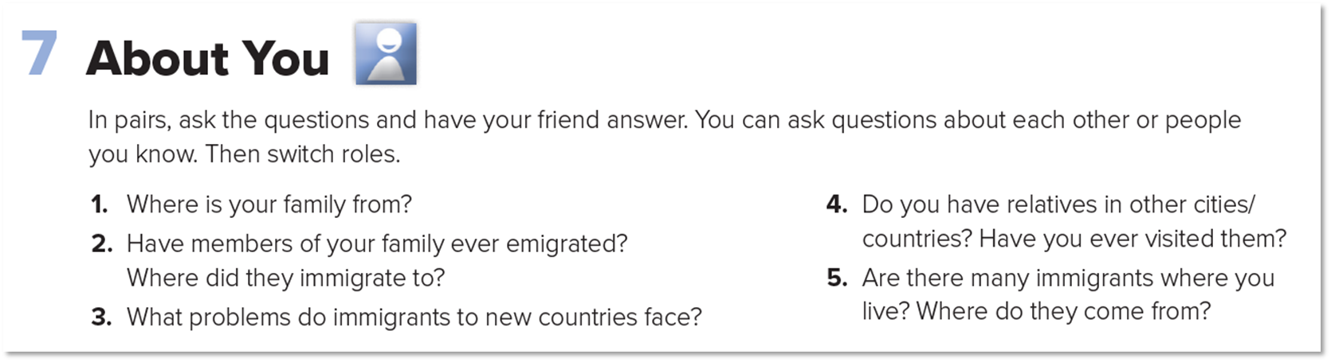


Pair Work

Slide 9
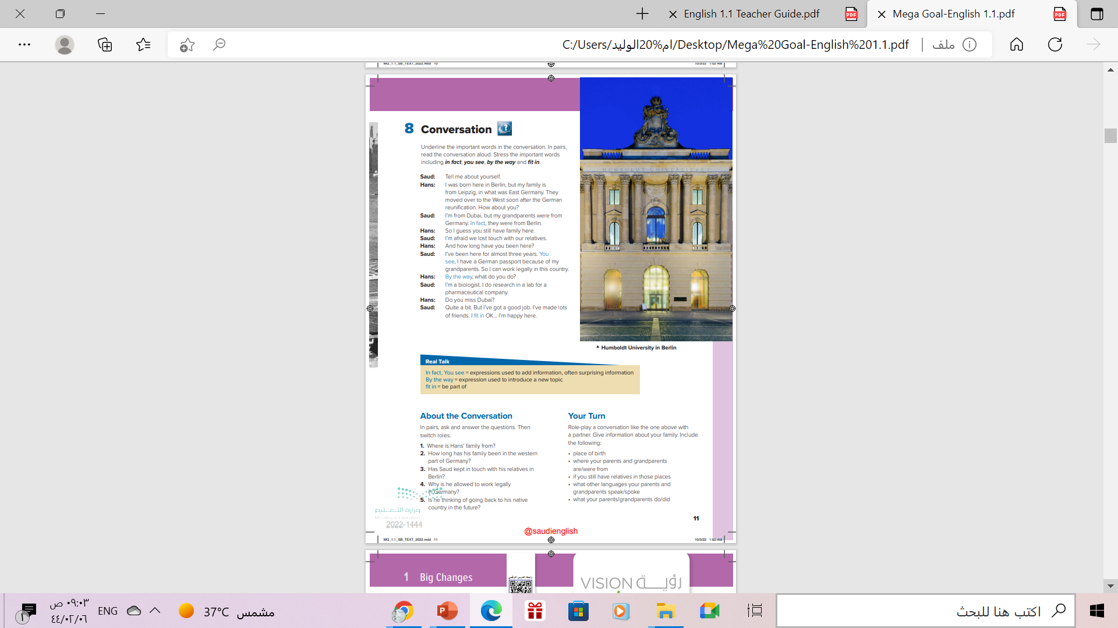
Book Open
P.(11)

Slide 10
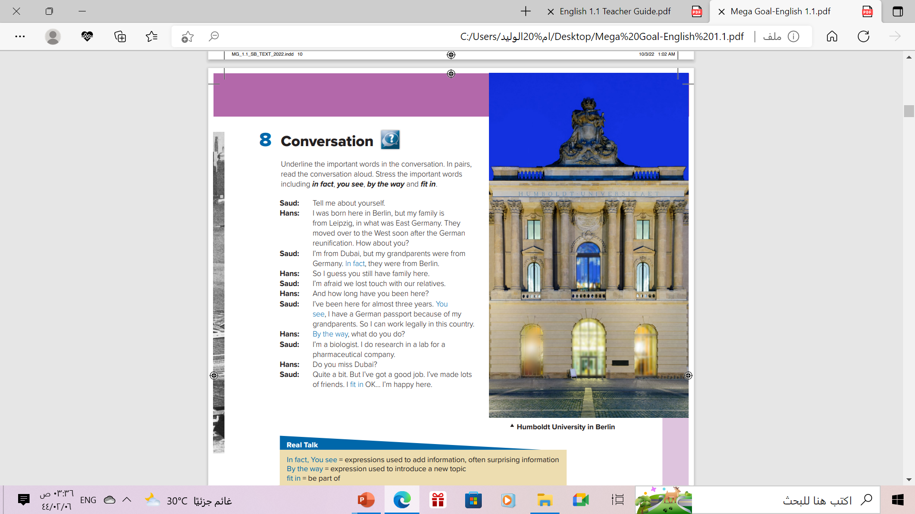
Look at the photo:
What do you
think this conversation will be about?

Slide 11
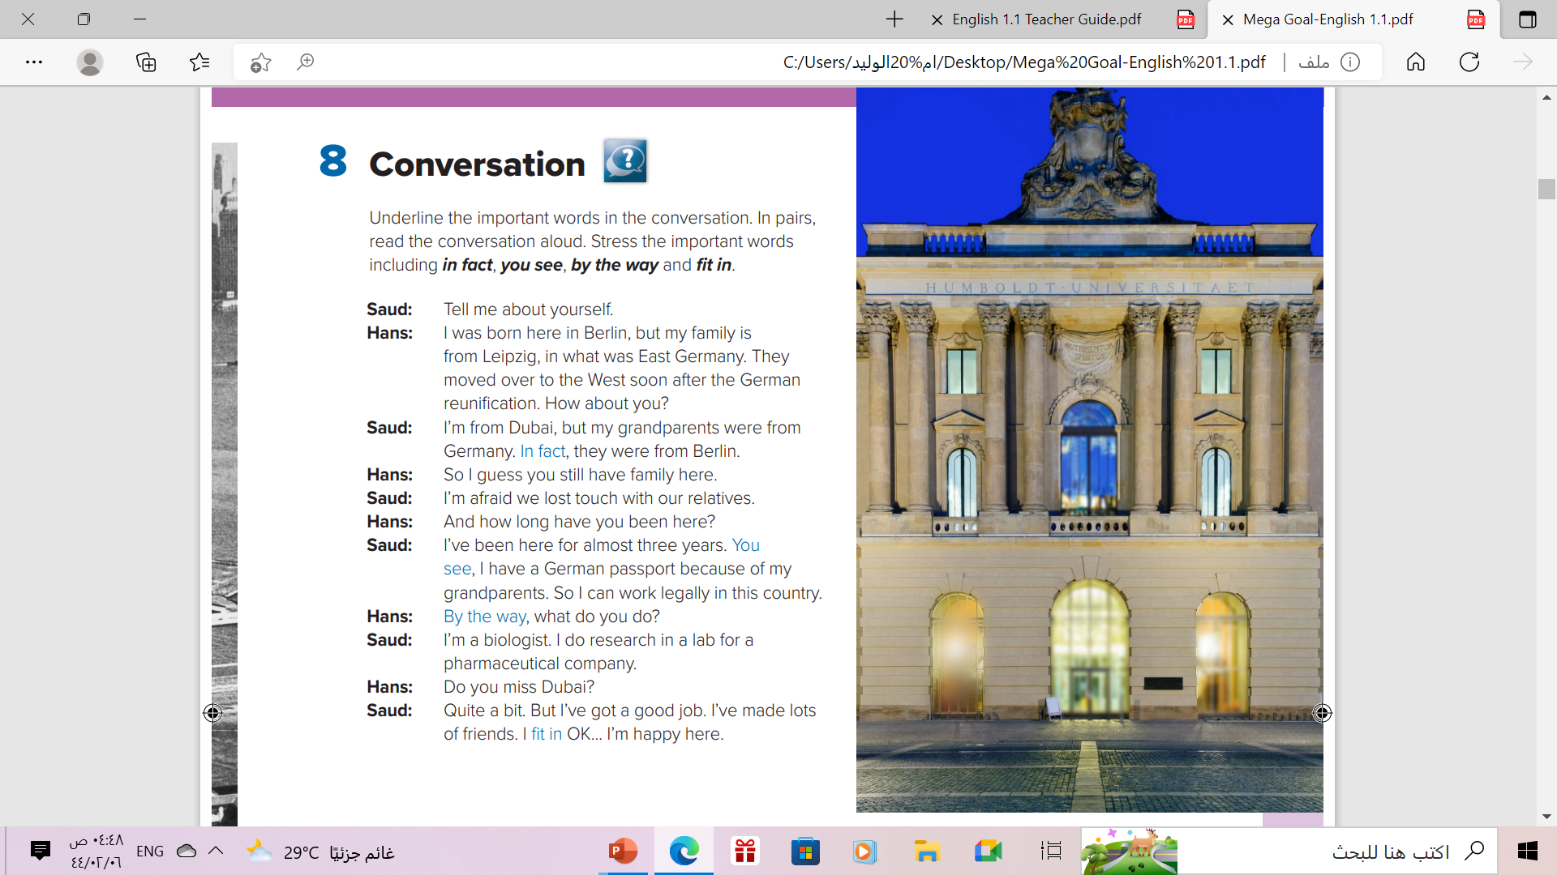

Book open p.(11)
Read along as u listen

Slide 12
Scanning
How many persons ? Who are they?
Two: Saud & Hans
Where does the conversation take place?
In Berlin
Where was Hans born? What about Saud
Hans : Berlin .
Saud :Dubai

Slide 13


Slide 14


Who says
In fact, …….
Who says
fit in…….
Who says
You see…….
Who says
by the way…….
Saud
Saud
Hans
Saud

Slide 15
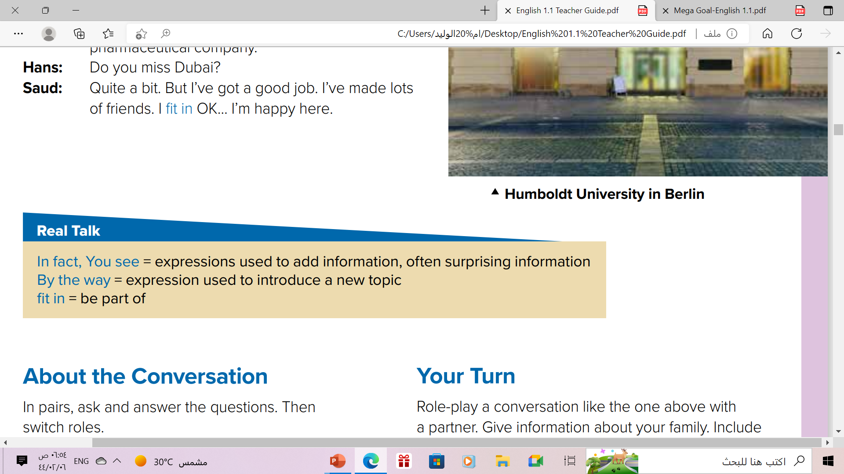
Read the phrases and their meaning:

Slide 16
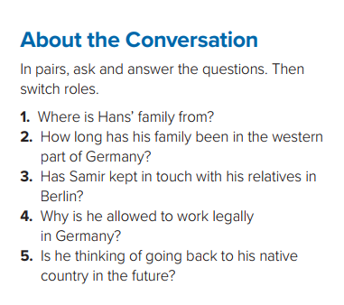

1. They are from Leipzig, Germany.
2. His family has been in the western part of Germany since soon after the reunification.
3. No, he hasn’t.
4. He’s allowed to work legally in Germany because his
grandparents were from Germany.
5. No, he isn’t. He is happy in Germany

Slide 17


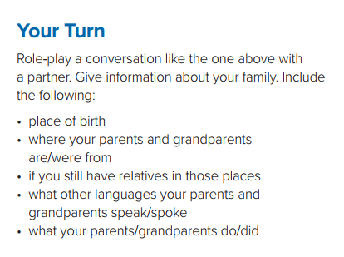


Slide 18
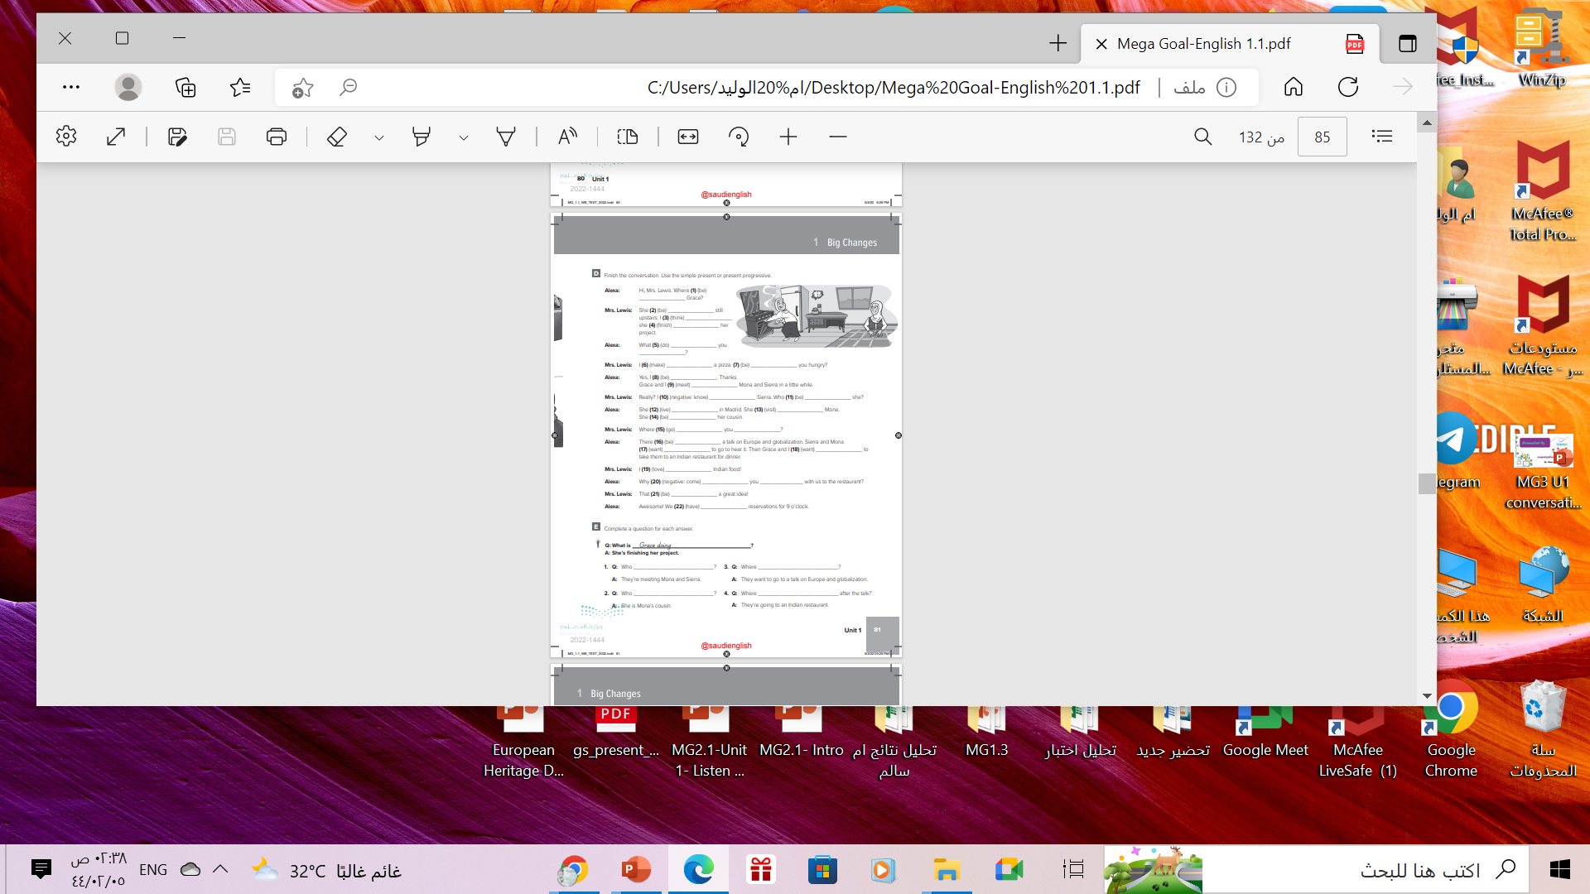
Homework
Workbook, P.(81),
exercise ( E )

Slide 19
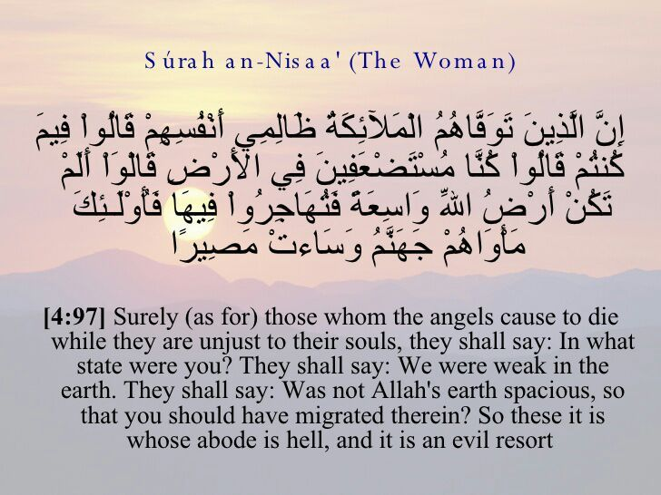

Slide 20

Thanks!

