Slide 1


Unit 1
Big Changes
Reading
Done by : Entisar Al-Obaidallah

Slide 2
Lesson Obectives
Predict
Answer
01
04
Read
Discuss
02
05
Deduce
03
The topic of the text through the pictures
Questions on the reading text
The article for specific information
The most important changes in Saudi Arabia
The meaning of the new words

Slide 3
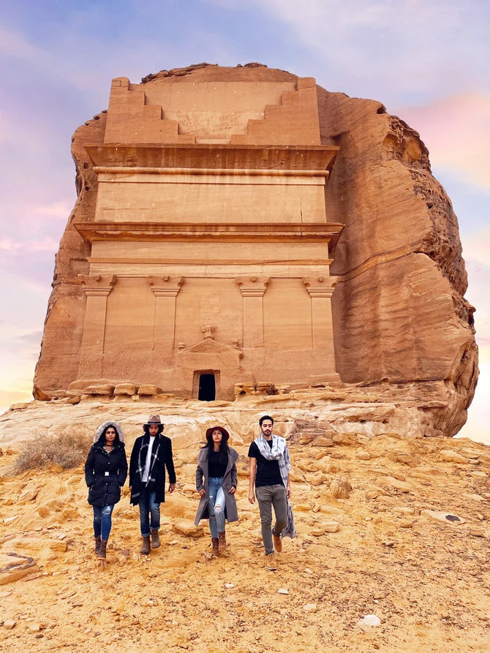
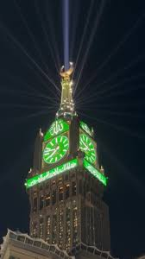
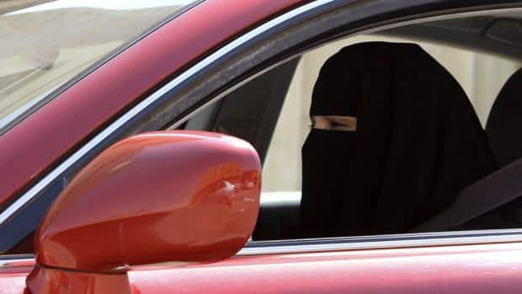
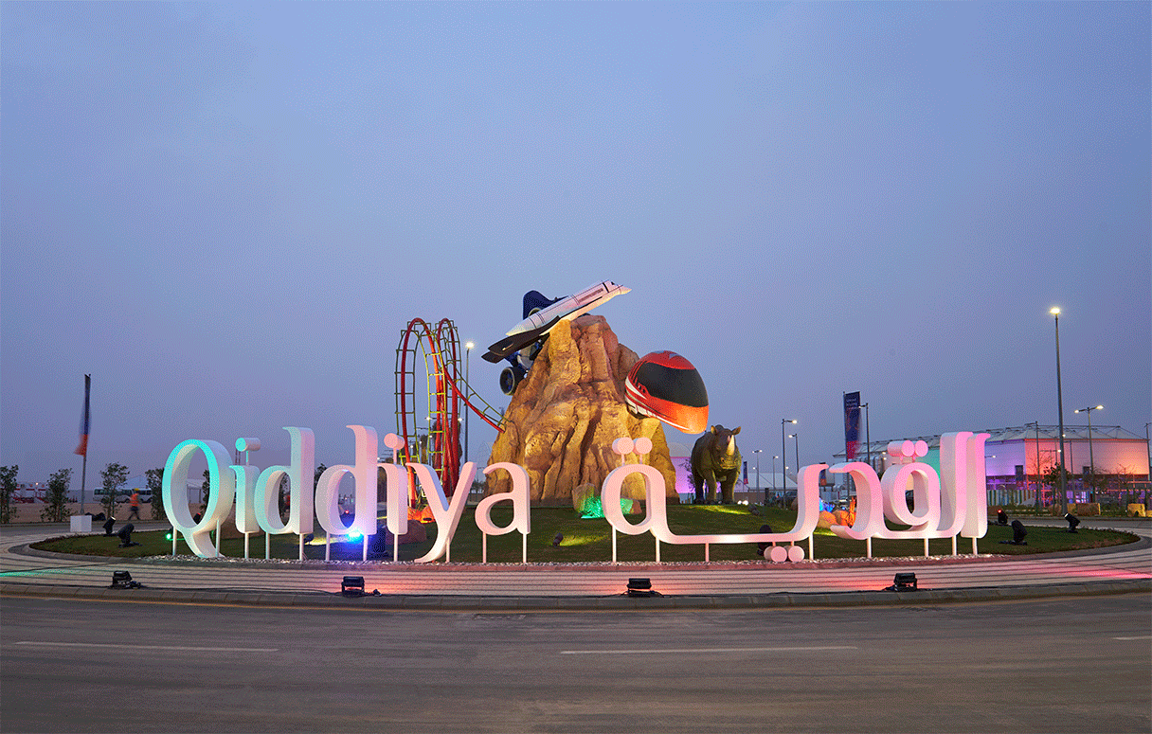
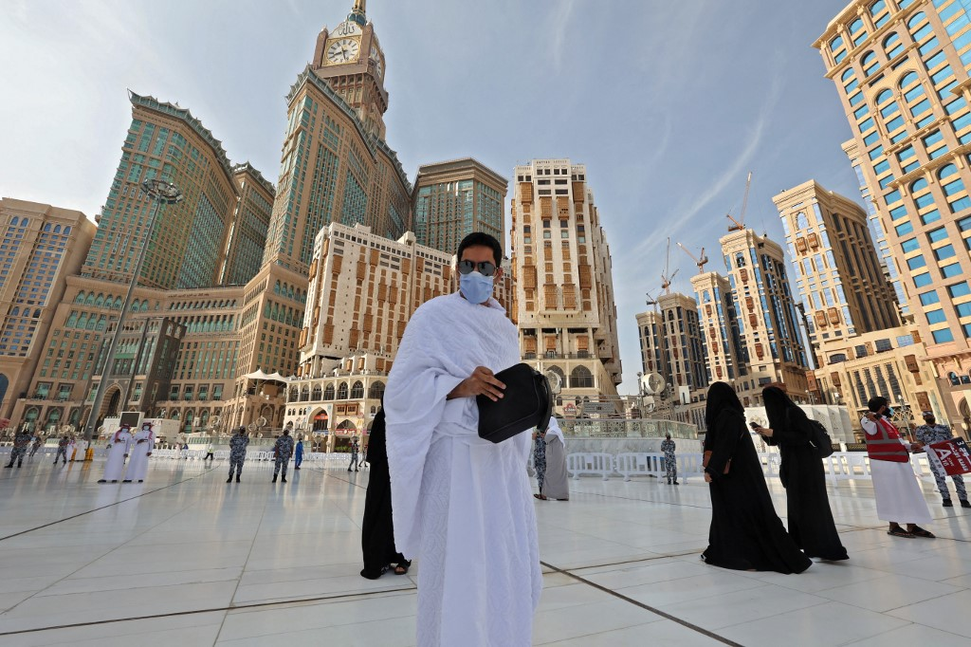
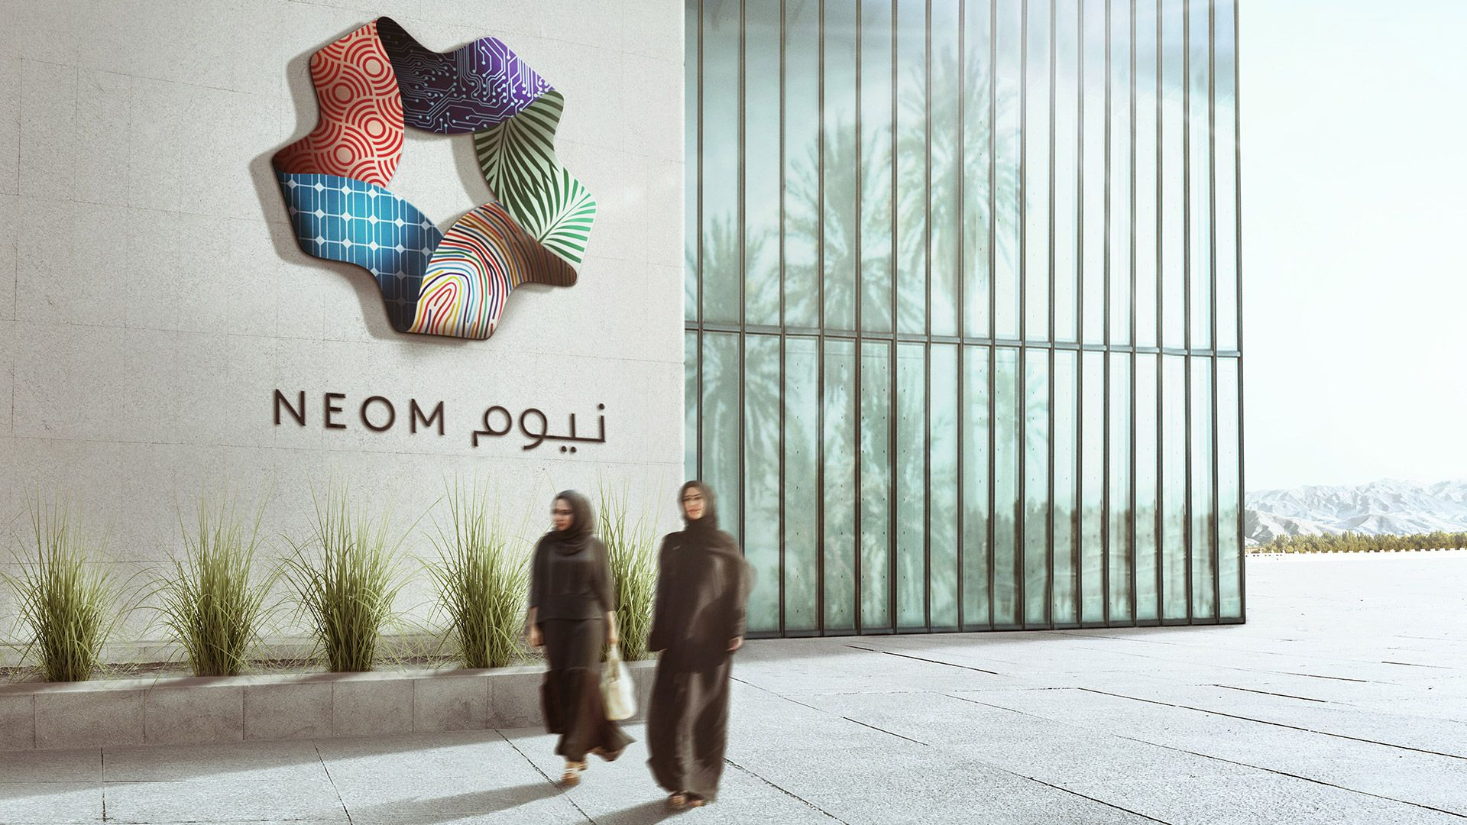
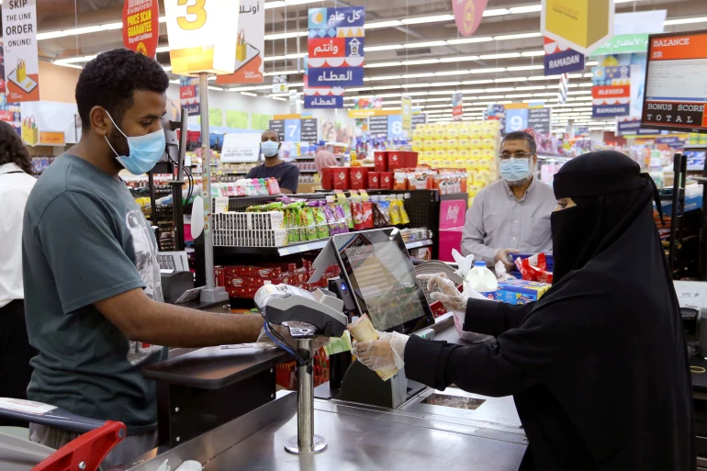
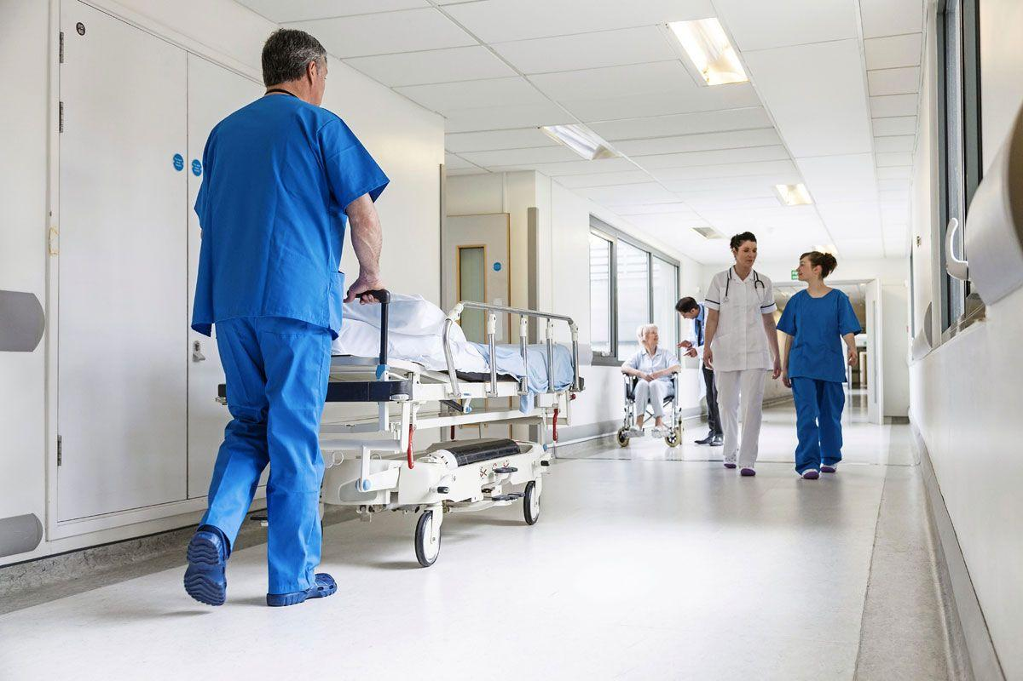
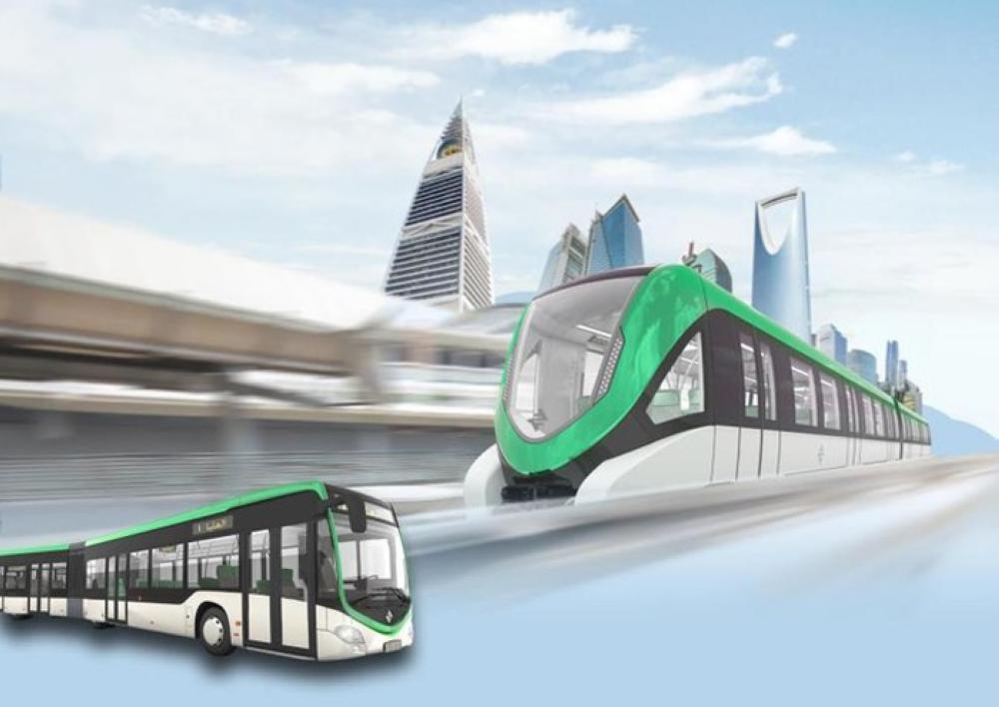
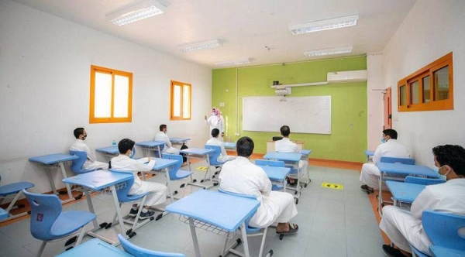
Warm up
Since 1932 until now what are
the most changes in Saudi’s progress?

Slide 4

Vocabulary
Pillar
Theme
Transforming
Hub
Vibrant
Ambitious
Enterprises
Transparent
Diversify
Thriving

Slide 5

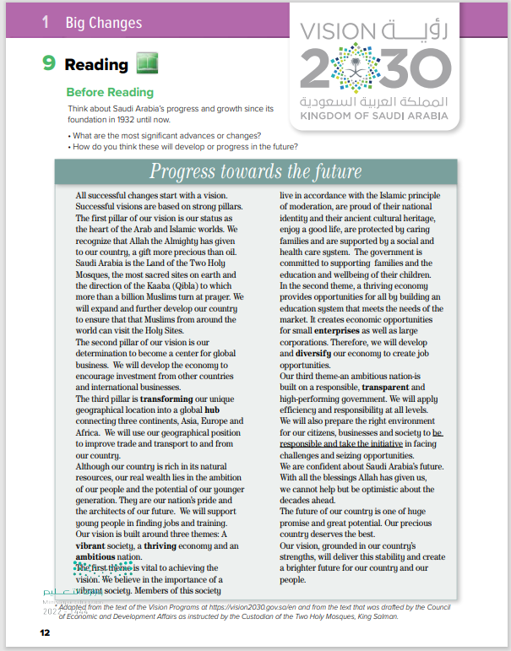

Open
Your student’s book
p. ( 12)

Slide 6
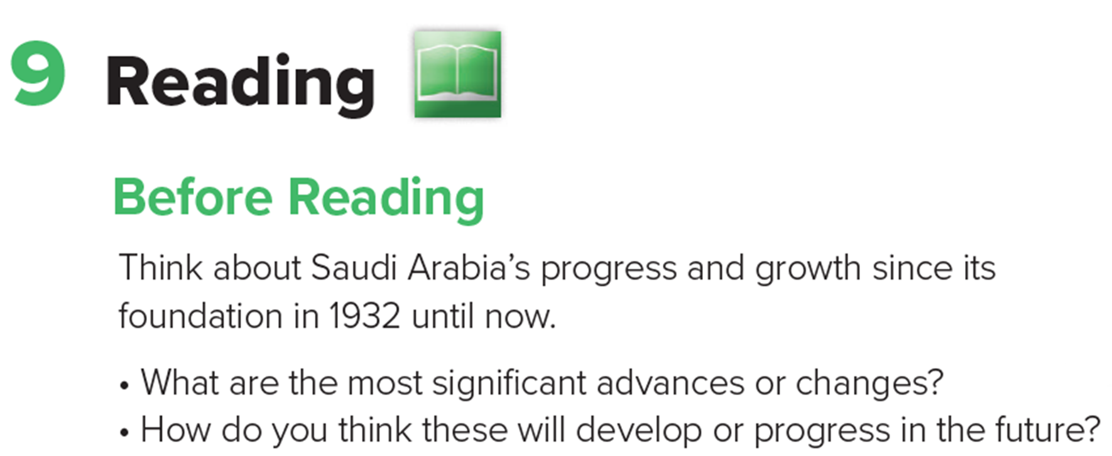
Before Reading

Slide 7
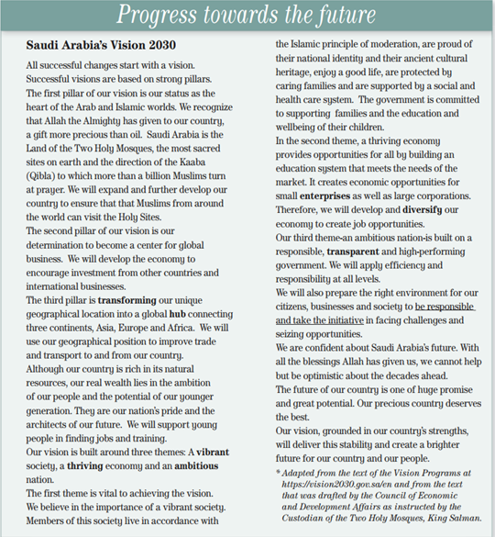
READING STRATEGY: Predicting
What is the title of the text?
Progress Towards The Future
What do you think the text will be about?
Saudi Vision 2030

Slide 8


Read along as you listen

Slide 9
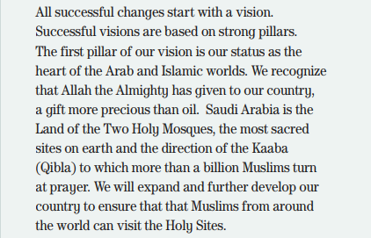
What is the gift that Allah the Almighty has given to our country and more precious than oil ?
Saudi Arabia is the Land of the Two Holy Mosques .

Slide 10
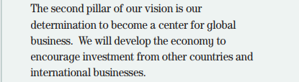
Why will we develop the economy?
to encourage investment from other countries and international businesses

Slide 11
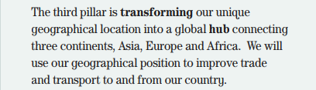
Why will we use our geographical position ?
to improve trade and transport to and from our country

Slide 12
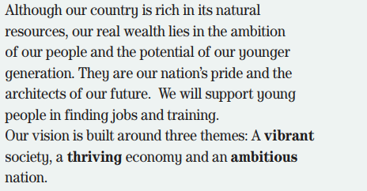
What are the 3 themes that Saudi Vision 2030 is built around?
a vibrant society,
a thriving economy
and an ambitious nation

Slide 13

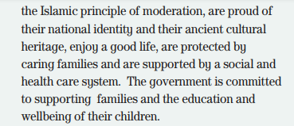




What is the government committed to??
supporting families and the
education and wellbeing of their children.

Slide 14



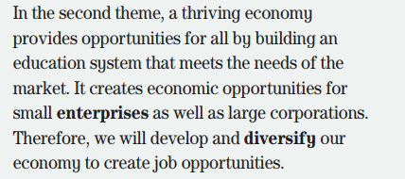
Why will we develop and diversify our economy ?
to create job opportunities.

Slide 15
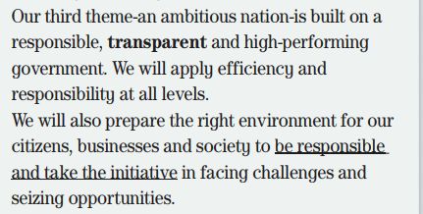
What is our third theme built on ?
a responsible, transparent and
high-performing government.

Slide 16
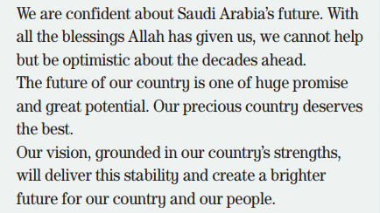
What is the overall theme of the text?
The future of Saudi Arabia and plans for its development and
growth

Slide 17
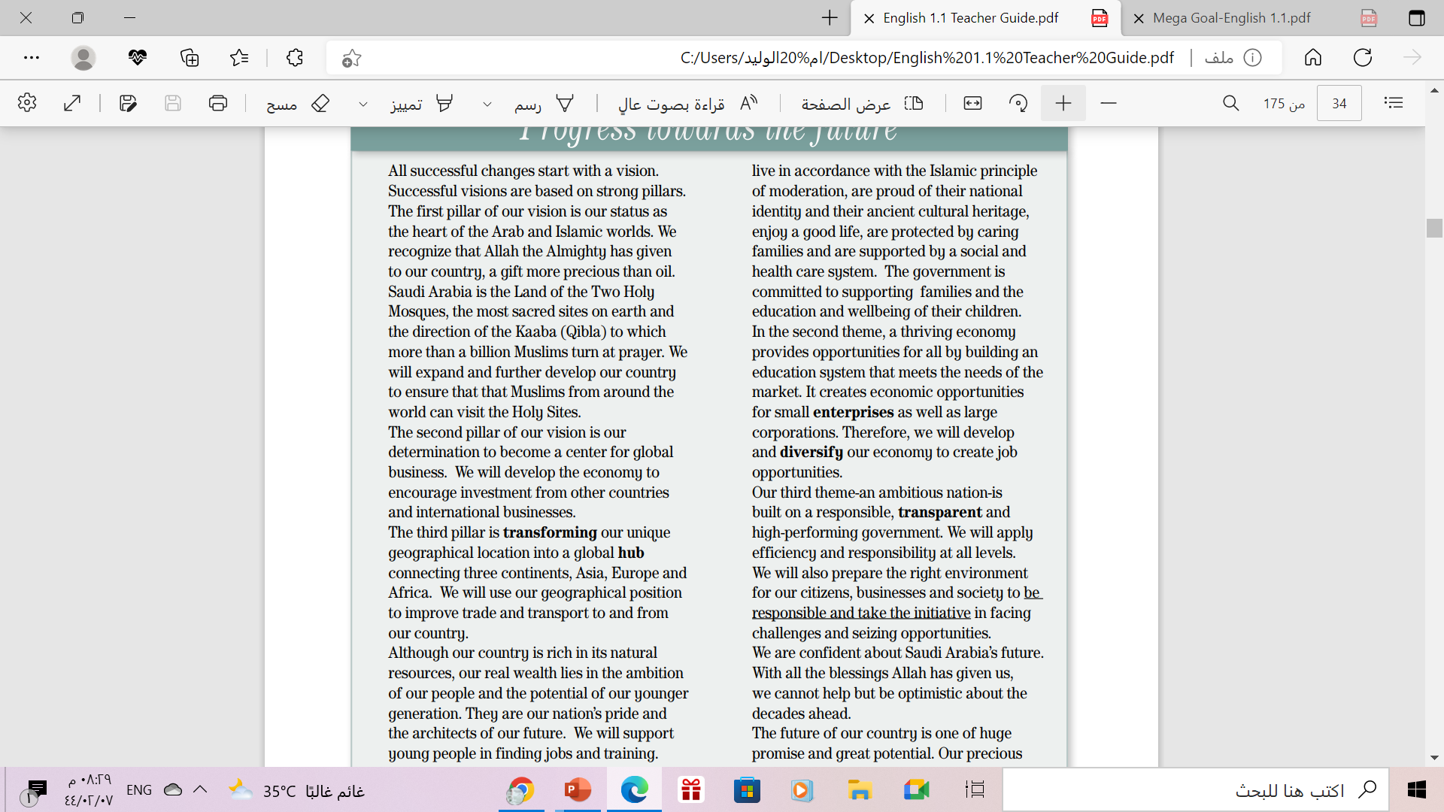
1
What are the three pillars of Saudi Arabia’s vision for 2030?
2
1. The country’s status at the heart of the Arab and Islamic worlds.
2. determination to become a center for global business.
3. transforming the unique geographical position into a global hub to connect 3 continents.
3

Slide 18
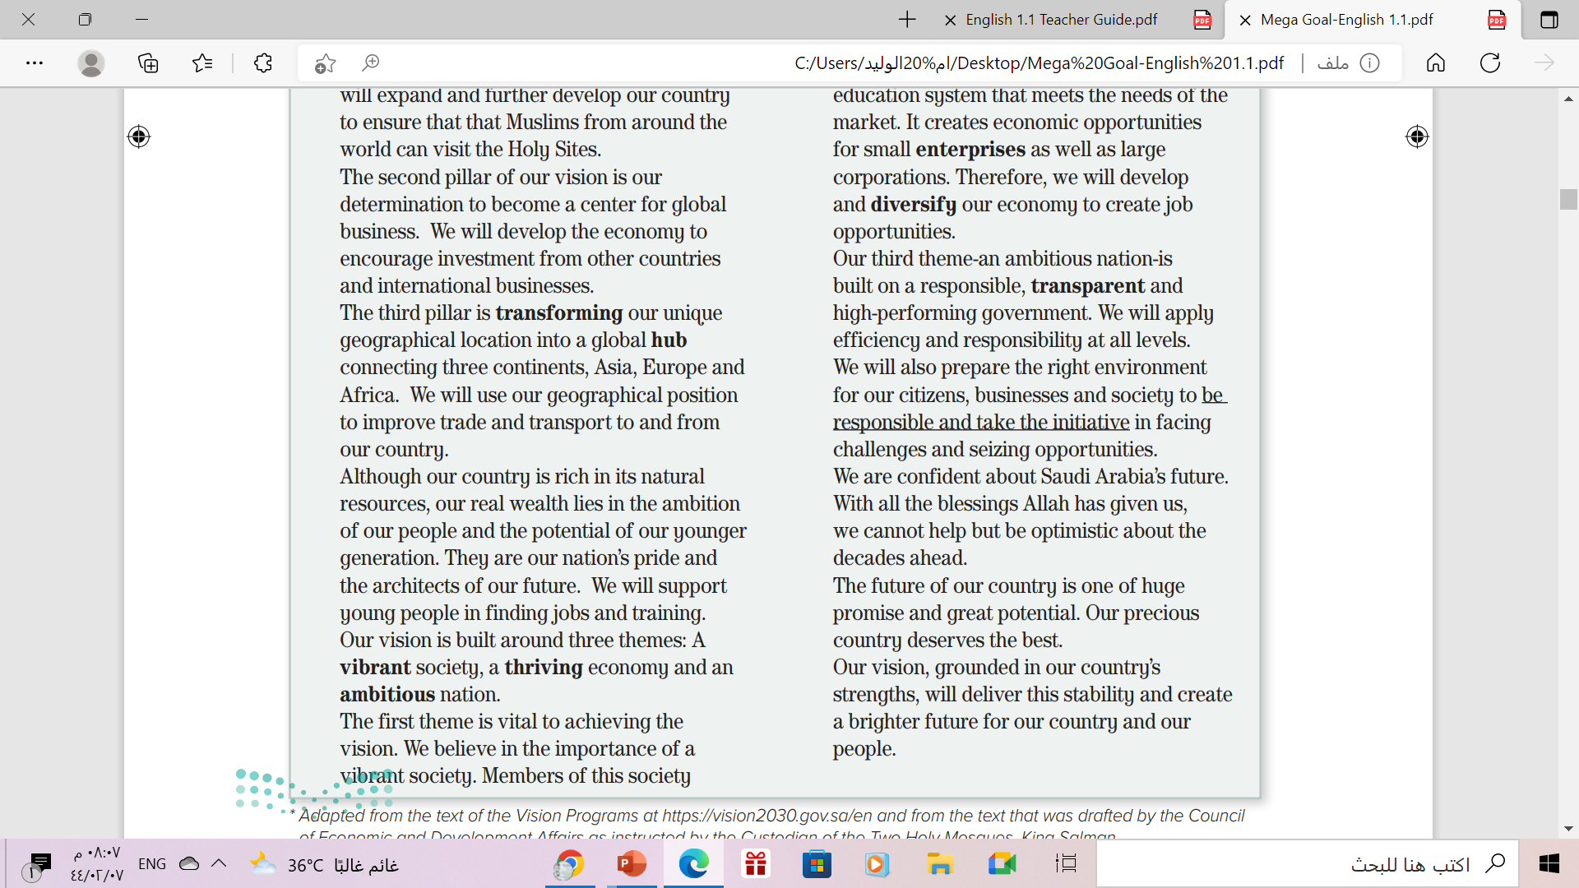
What themes is Saudi Arabia building its vision for future around?
a vibrant society,
a thriving economy
and an ambitious nation

Slide 19
Is the text optimistic about the future of Saudi Arabia?
What words or phrases did you use as clues to decide this?
Successful - Determination - nation’s pride Committed – opportunities for all responsible - high-performing -
future confident - Optimistic -
huge promise - great potential

Slide 20
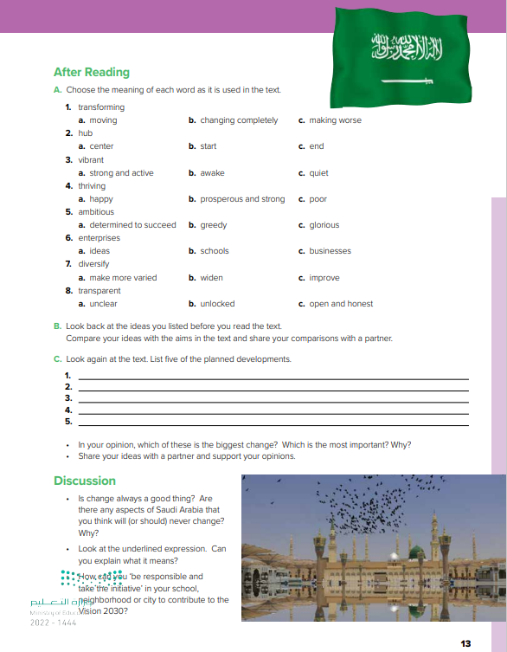
Open
Your student’s book
p. ( 13)

Slide 21
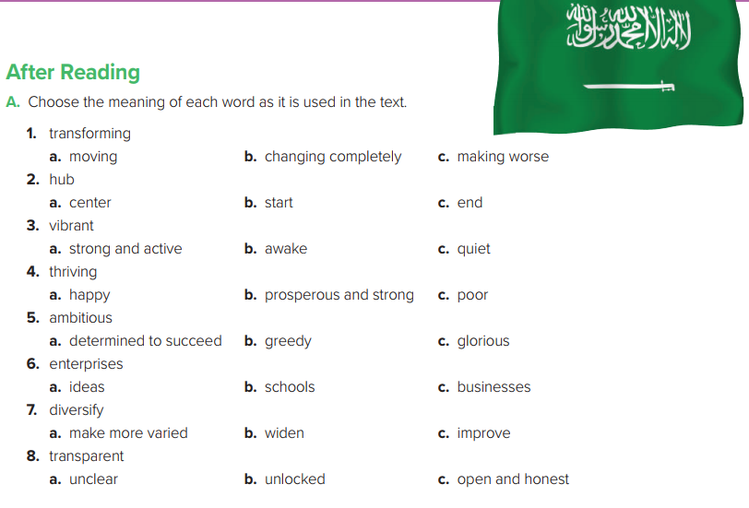

Slide 22
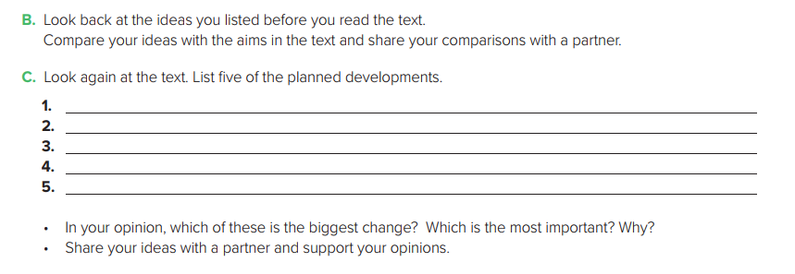
expand and develop country to ensure Muslims from around the world can visit the Holy Sites.
develop economy to encourage investment from other countries and international businesses
use geographical position to improve trade and transport to and from our country
support young people in finding jobs and training
develop and diversify the economy to create job opportunities

Slide 23
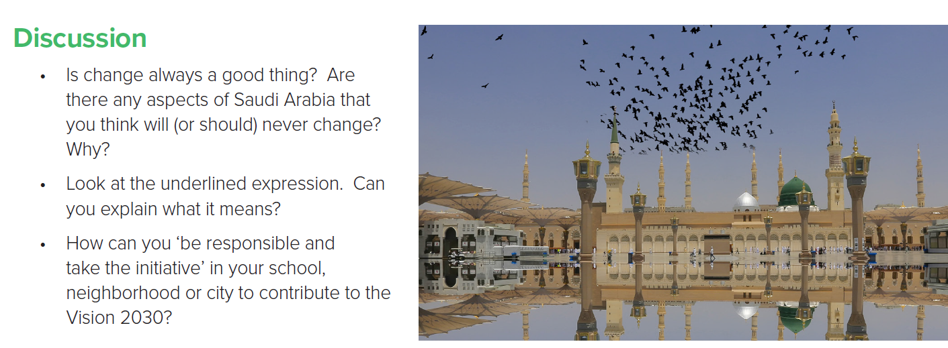

Slide 24
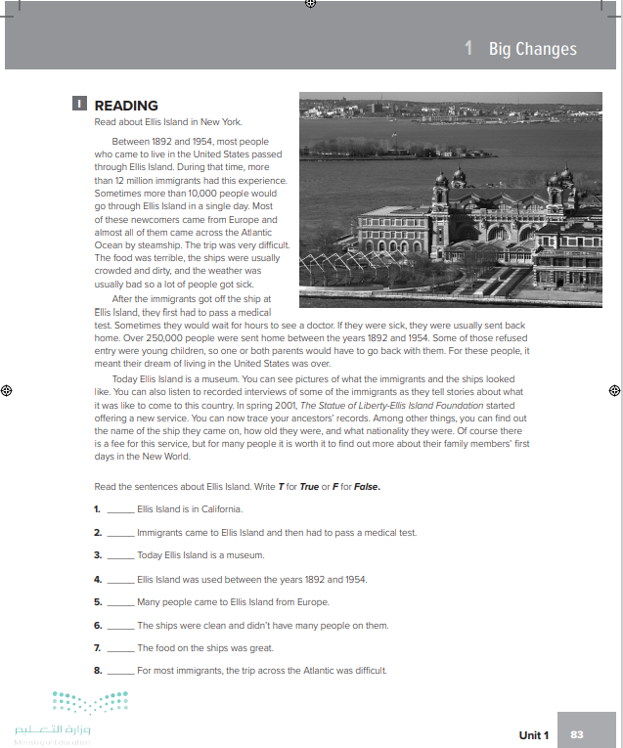
Homework
Workbook , P.(83)
Exercise (I)

Slide 25


Slide 26


Thanks!

