Slide 1
Unit1
Big Changes
Writing
Mega Goal 1.1
Done by :Entisar Al-Oaidallah

Slide 2
Lesson Objectives
01
03
02
04
Use
Fill in
Capital letters correctly
a chart with the important information from the article
Take
Write
notes on a written text
An essay about the important changes

Slide 3
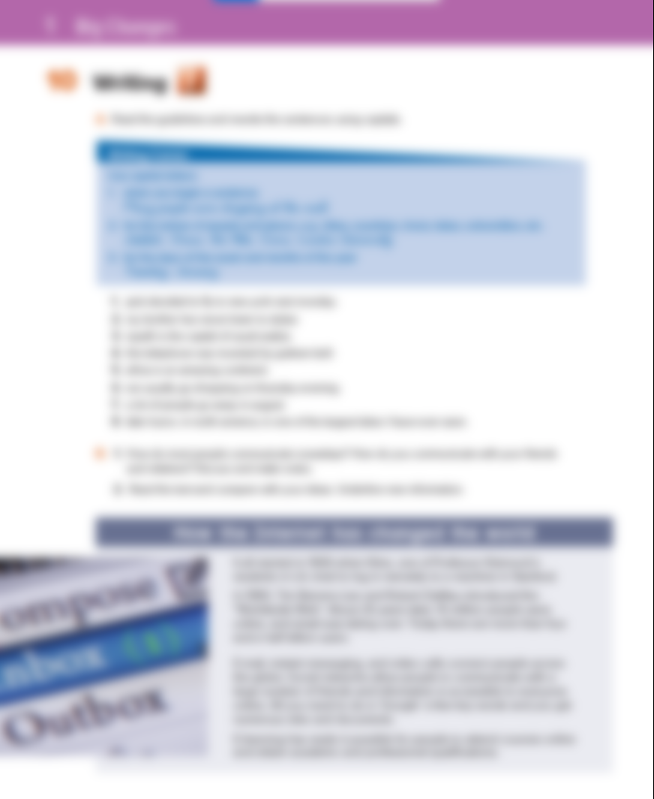
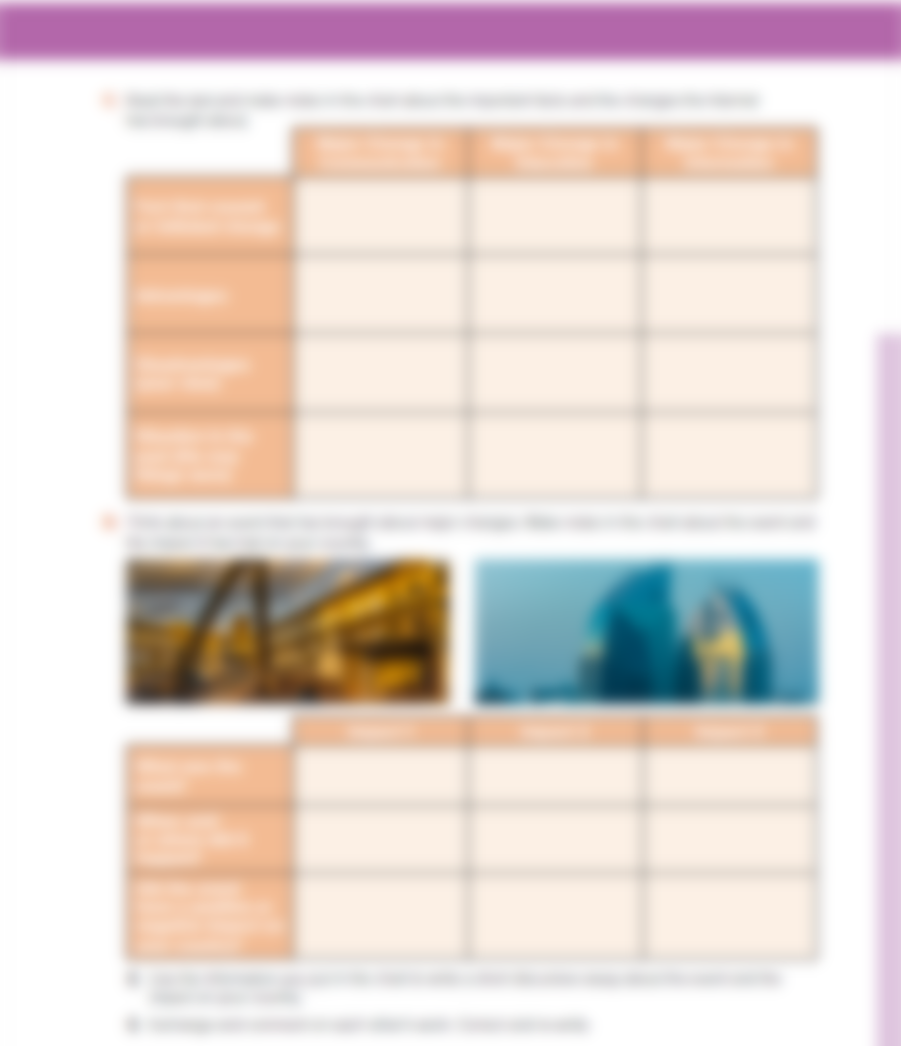

14 - 15

Slide 4
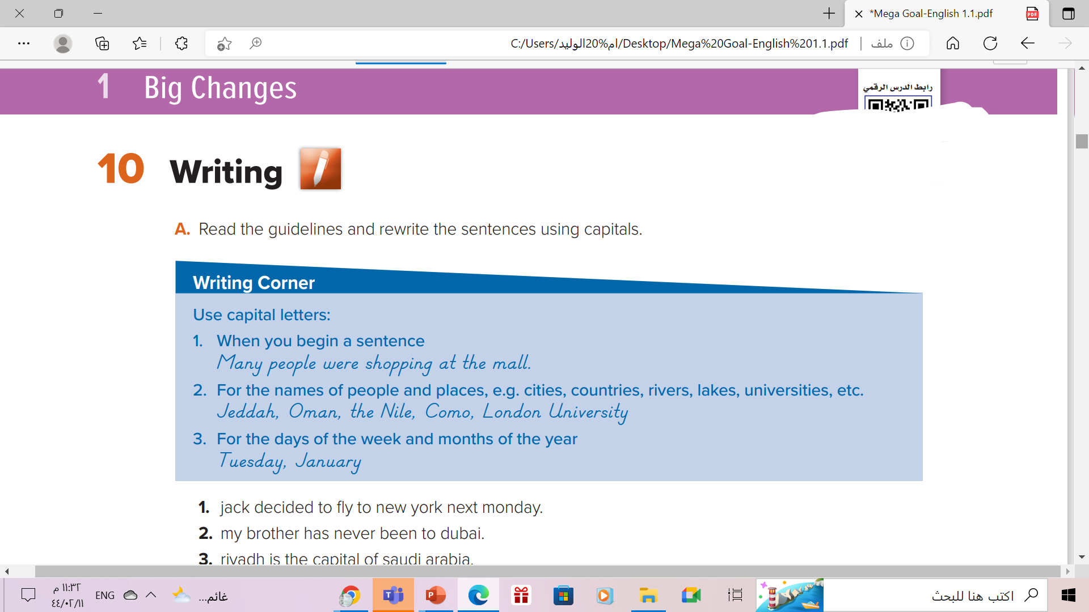

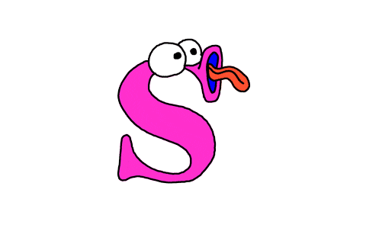




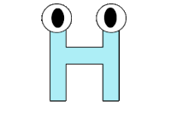

Slide 5
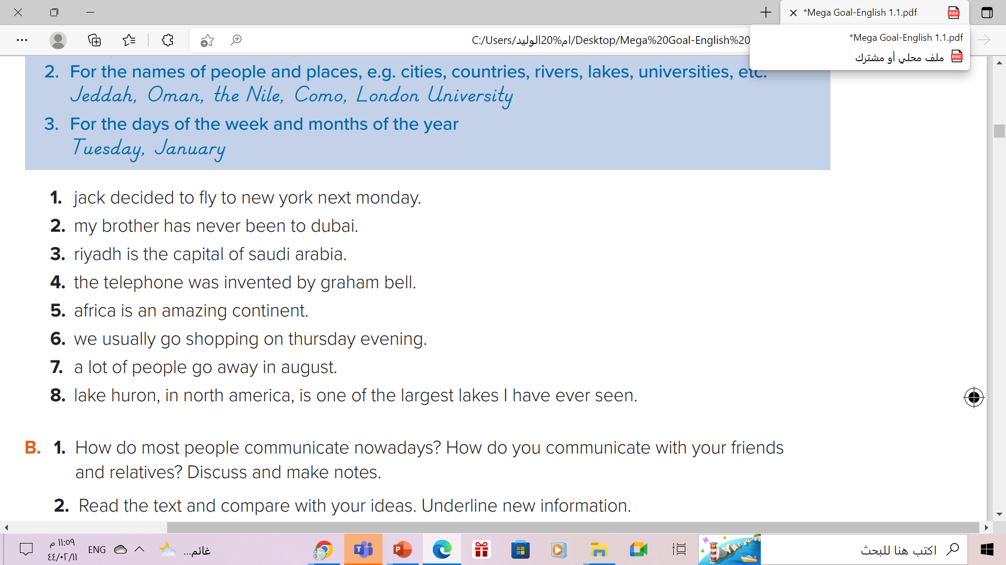
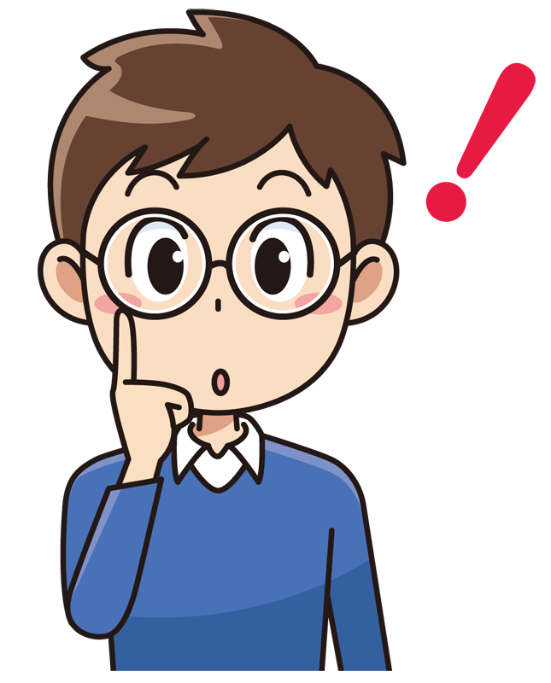



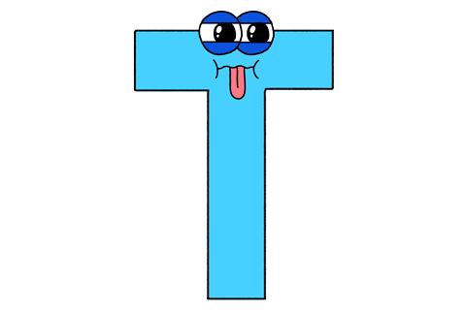



1. Jack decided to fly to New York next Monday.
2. My brother has never been to Dubai.
3. Riyadh is the capital of Saudi Arabia.
4. The telephone was invented by Graham Bell.
5. Africa is an amazing continent.
6. We usually go shopping on Thursday evening.
7. A lot of people go away in August.
8. Lake Huron, in North America, is one of the largest lakes I have ever seen.

Slide 6
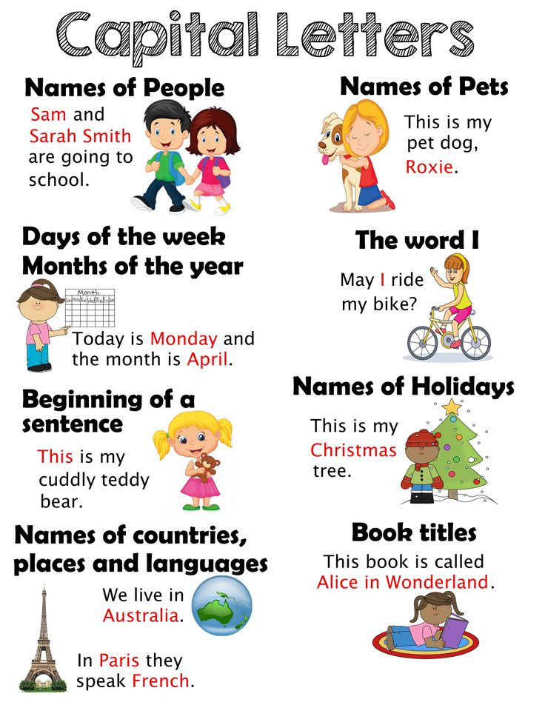
Using Capital Letters!

Slide 7


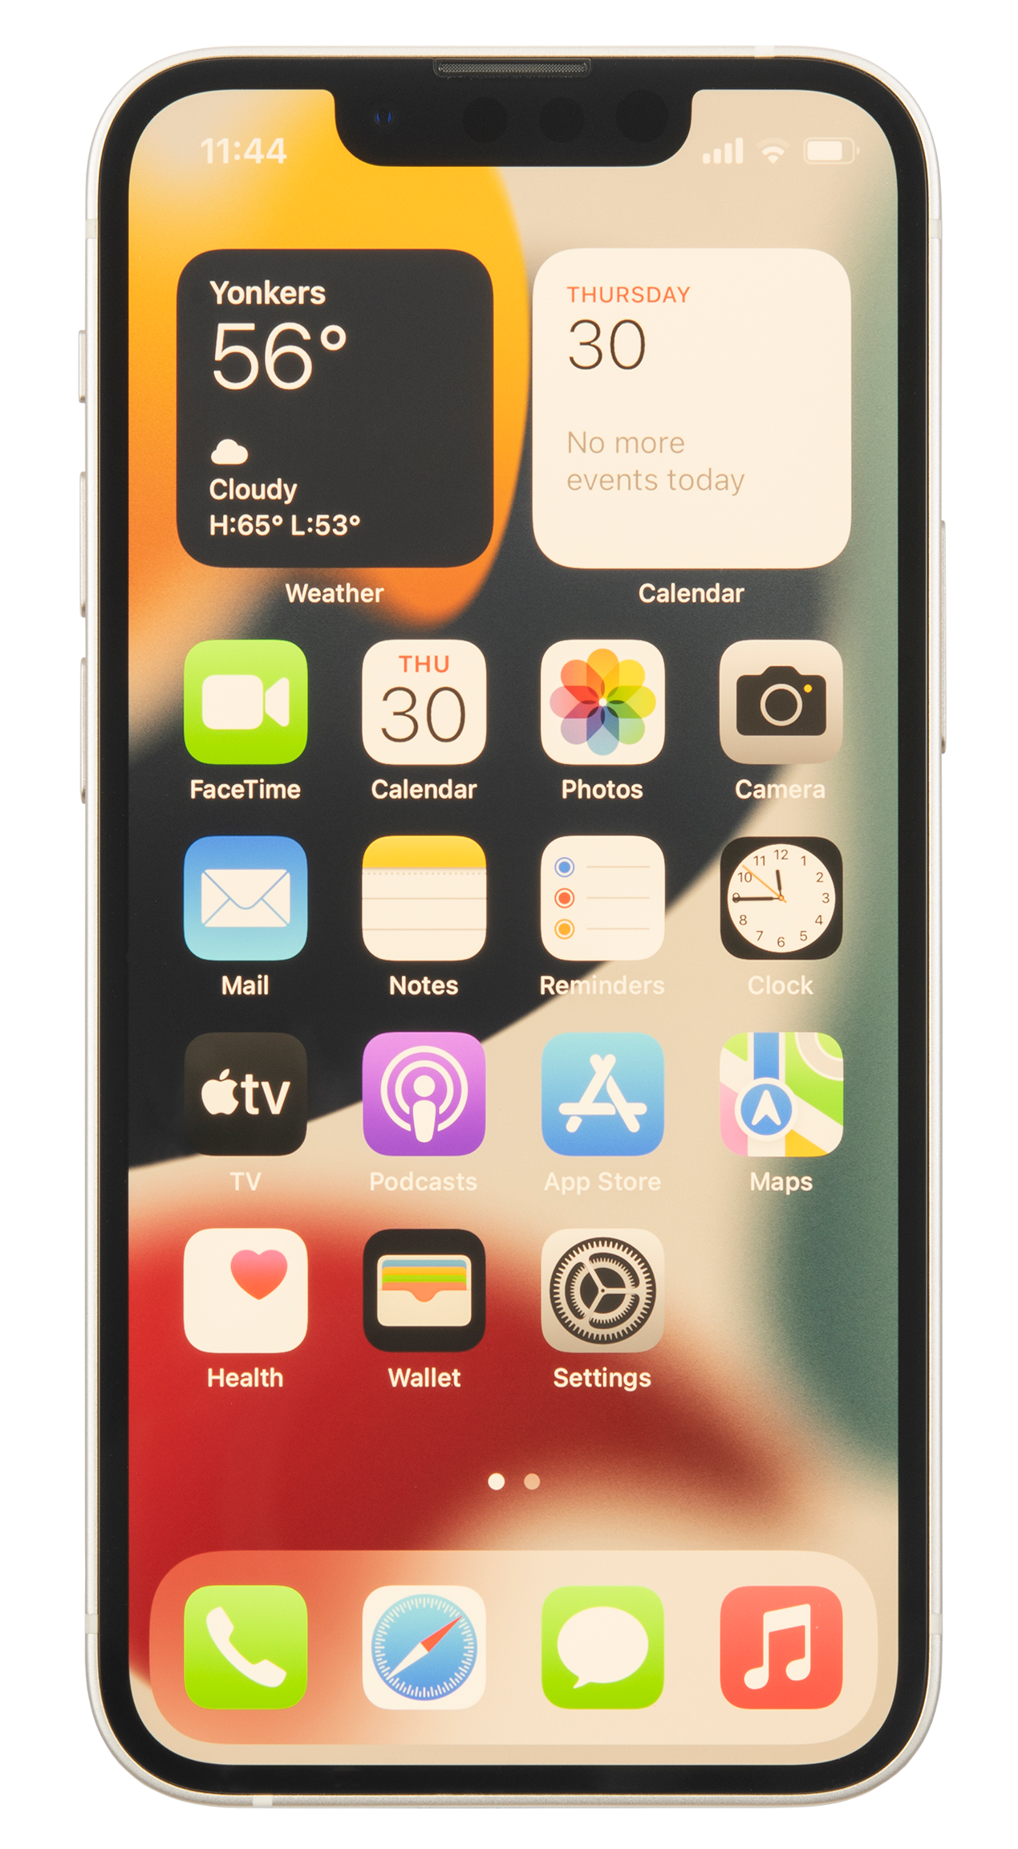



How do you communicate with your friends and relatives?
How do most people communicate nowadays?

Slide 8
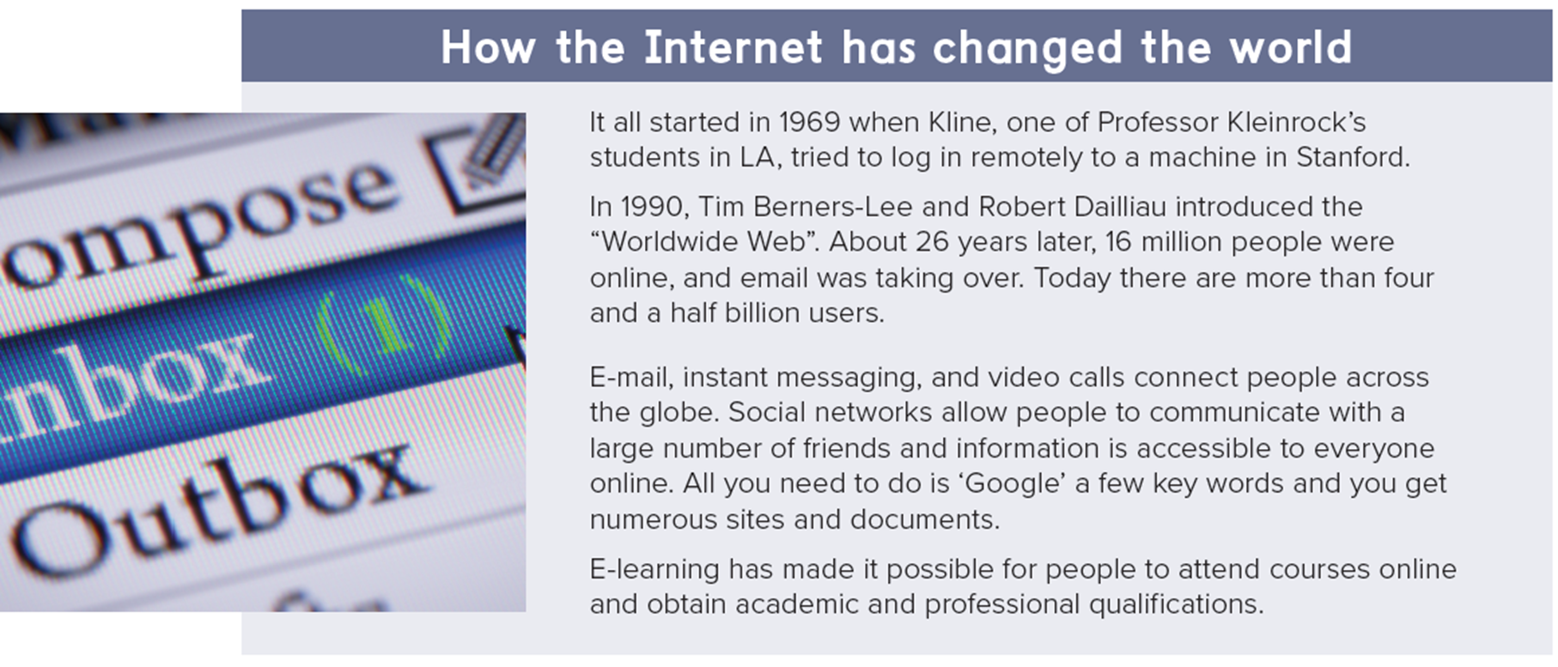

Read the text and compare with your ideas. Underline new information

Slide 9
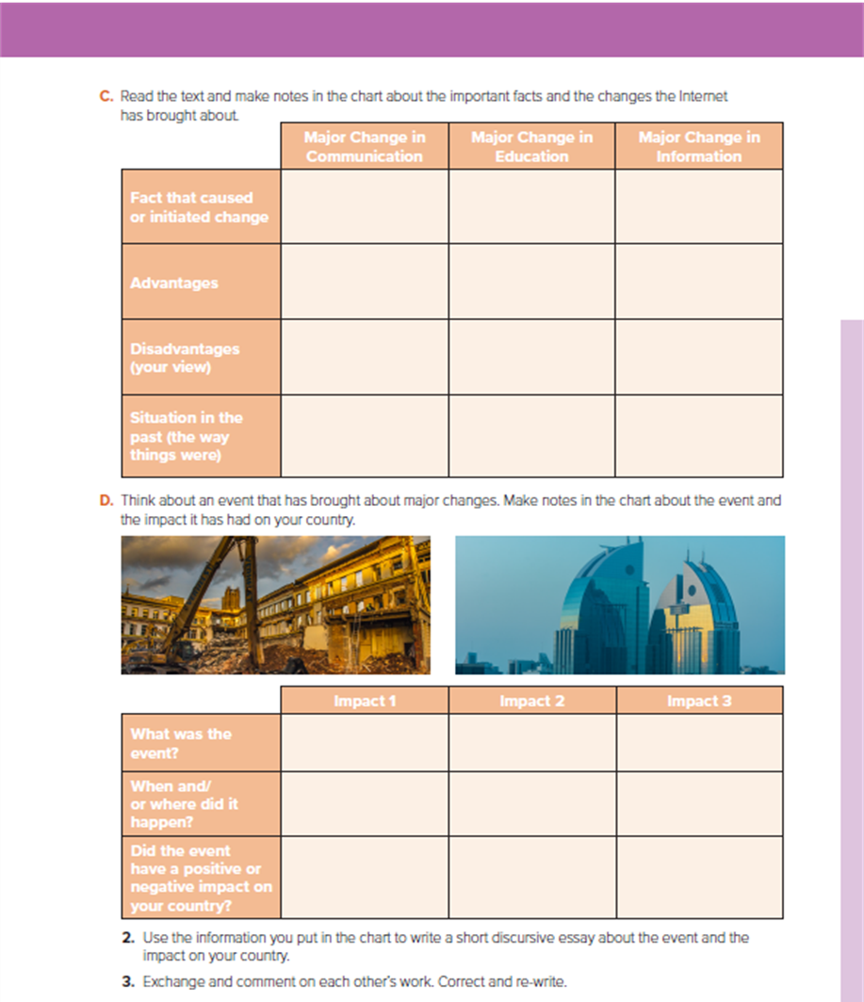
Open
Book p. ( 15)

Slide 10
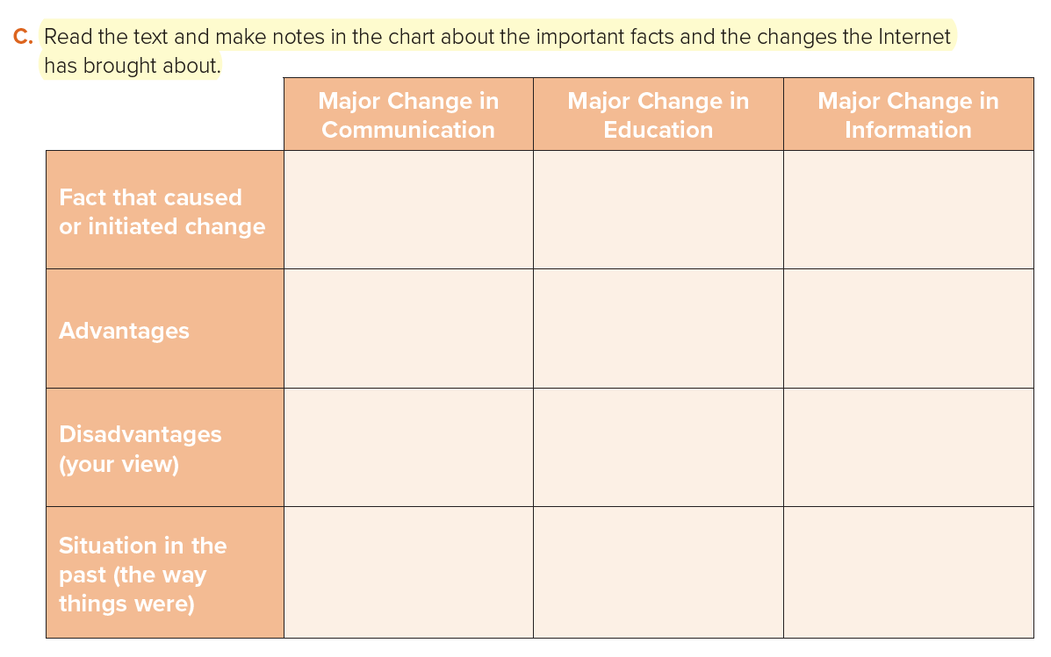
-1969/log in remotely to university computer
-1990 Worldwide Web
E-learning
accessible to all
- connect people/across
globe
- communication with
friends
google’ key words/
numerous sites and documents/saves time
attend courses online
-restricts face-to-face
communication
no chance to meet
people face-to-face
quality of
information/uncertain
-too long to contact
someone
obtaining information
was time-consuming
and costly
physical presence
was necessary

Slide 11

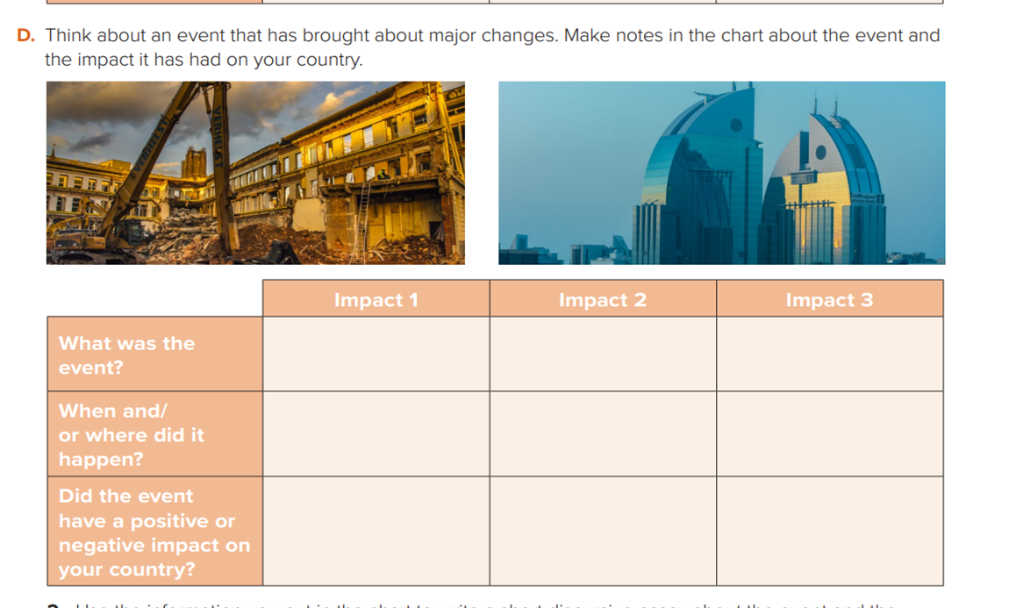
Discovery of oil
Saudi vision 2030
Coronavirus disease (COVID-19)
In 1963
In 2016
In 2020, China
Positive impact
Positive impact
Negative impact

Slide 12

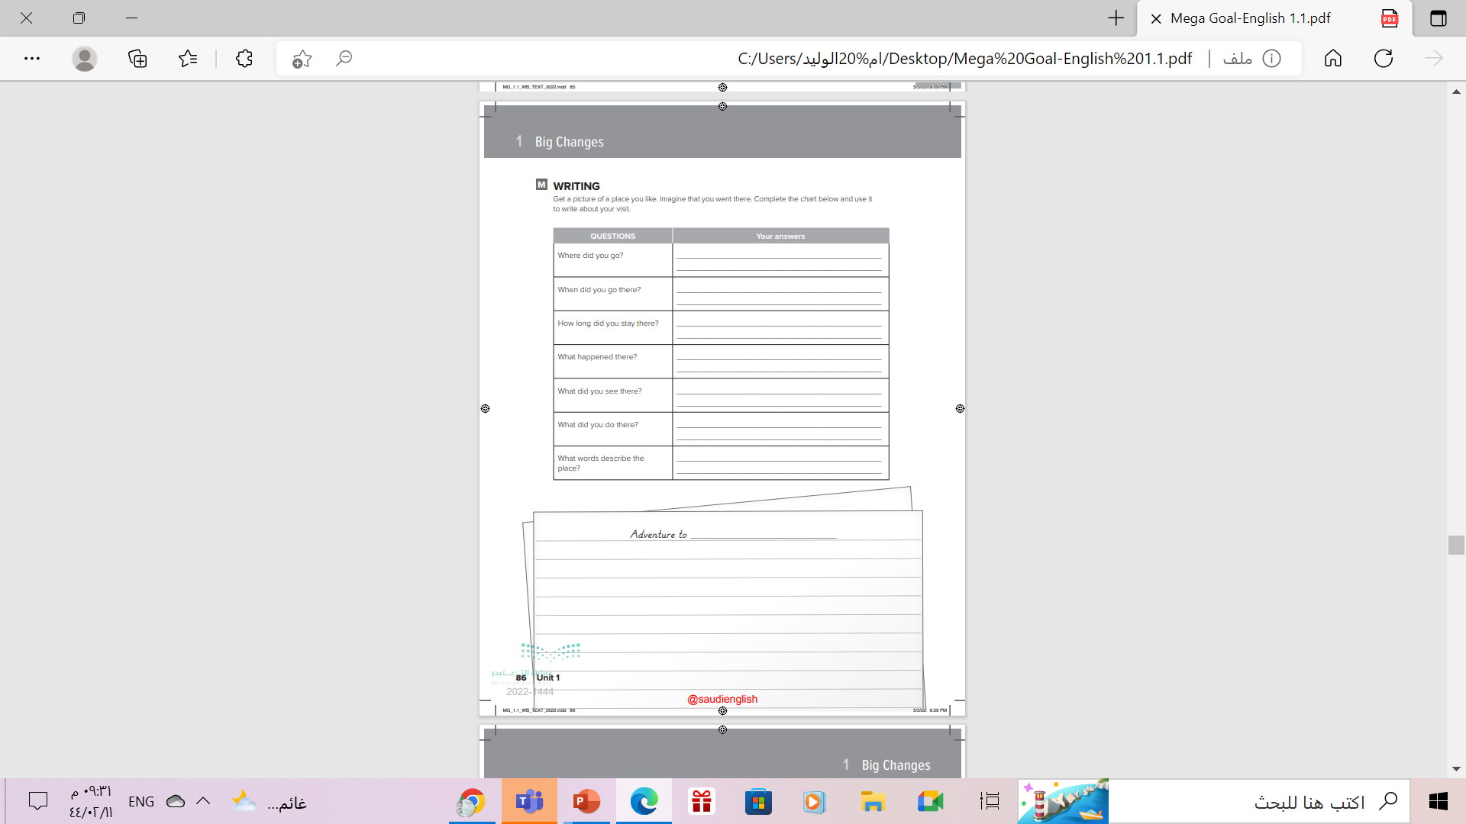
Homework
Workbook P. (86 ),
exercise ( M )

Slide 13

Thanks!

