Slide 1
Unit 1 Big Changes
Mega Goal 1.1
Form , Meaning & Function
Done by: Entisar Al-Obaidallh

Slide 2
Lesson Objectives
01
Use
02
Use
03
Use
04
Apply
simple past tense correctly
past progressive tense correctly
Past Progressive +When + SimplePast Tense
The rules to do the exercises

Slide 3
Open
Book , p.( 16 - 17)

Slide 4
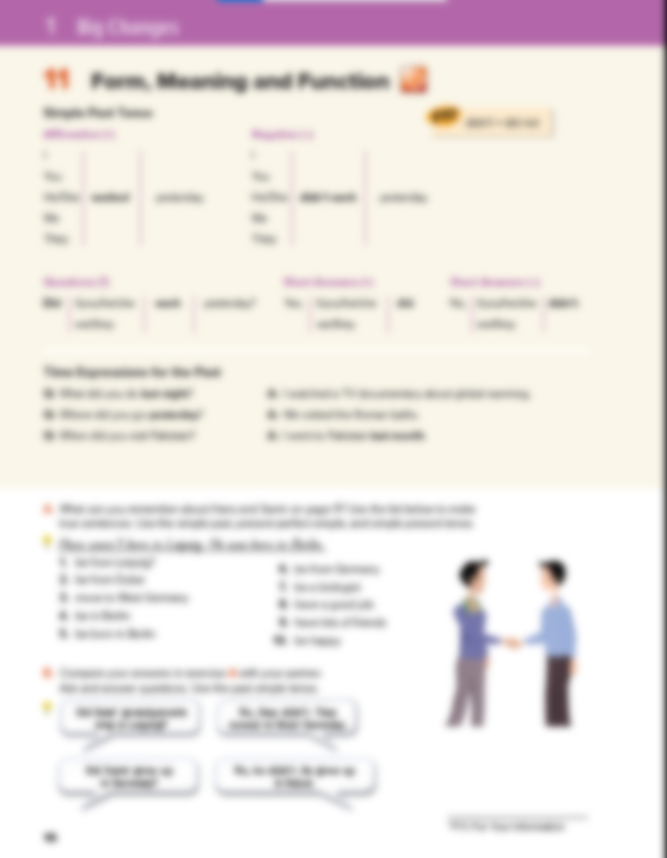
16 - 17

Slide 5
went
gone
Present
Past
Future

Slide 6
VERB 2(PAST)
Regular Verbs | Irregular verbs
add -ed Work → worked Stay → stayed Listen → listened | The form CHANGES eat → ate see → saw fly → flew

Slide 7
Affirmative
Negative
I
She
He
It
You
We
They
I
She
He
It
You
We
They
Did not
Didn’t
Infinitive V
Verb 2
Example:
He called me yesterday
He didn’t call me yesterday
He wrote the homework .
He didn’t write the homework

Slide 8
More Examples
I | WENT* | I | DIDN’T GO
HE | STUDIED | HE | DIDN’T STUDY
SHE | USED | SHE | DIDN’T USE
IT | RAINED | IT | DIDN’T RAIN
WE | ATE* | WE | DIDN’T EAT
YOU | WROTE * | YOU | DIDN’T WRITE
THEY | PLAYED | THEY | DIDN’T PLAY
* IRREGULAR VERBS

Slide 9
How to Ask Questions in the Past

Slide 10
Questions
I
She
He
It
You
We
They
Did
Verb 1( infinitive)
Example:
She cooked the lunch.
Did she cook the lunch ?
He wrote the homework .
Did he write the homework ?

Slide 11
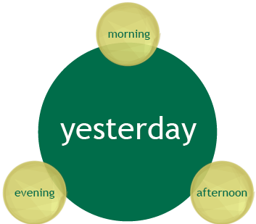
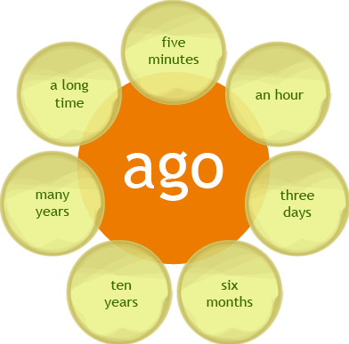
day

Slide 12
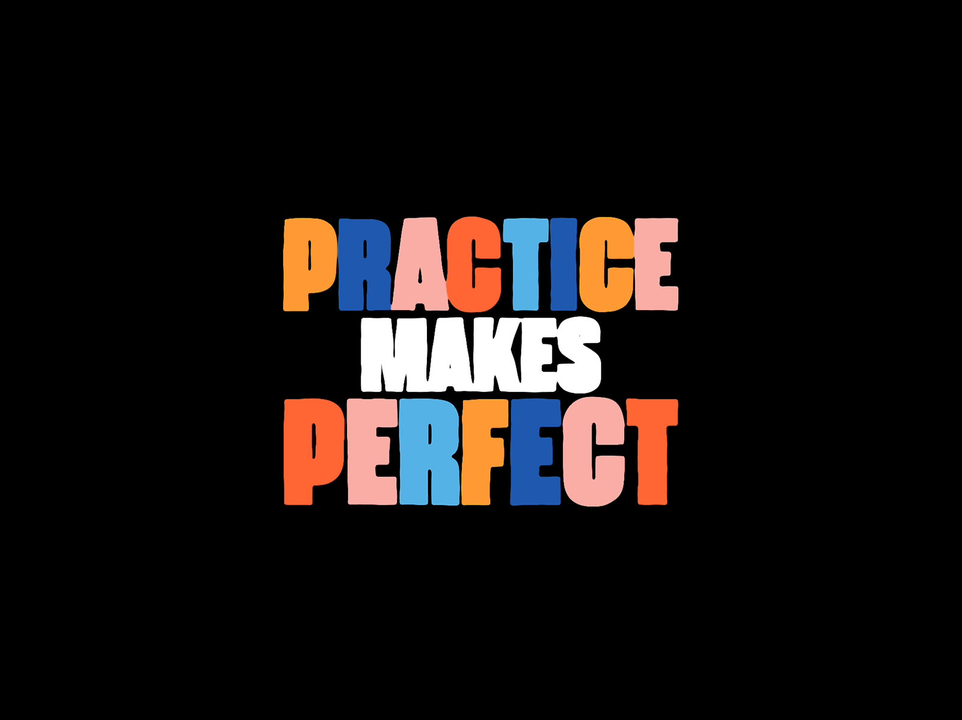

Slide 13
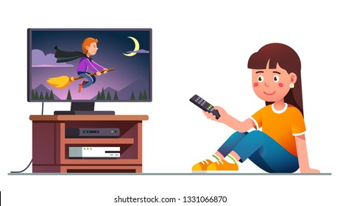
Correct the verb using “ Past Tense”:
She …..…………..( watch )TV at 10:00 yesterday evening.
watched

Slide 14
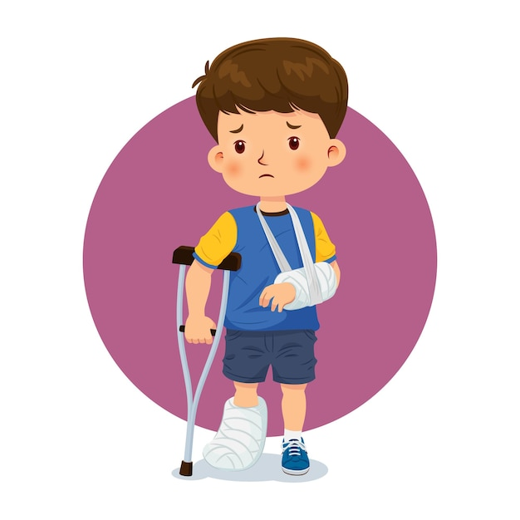
Correct the verb using “ Past Tense”:
He …..…………..( break ) his leg two days ago.
broke

Slide 15
Correct the verb using “ Past Tense”:
They …..…………..( not - played) basketball yesterday . They ……………… football.
didn’t play
played

Slide 16
Correct the verb using “ Past Tense”:
…..………….. it …………….( rained)
last week ?
Did
rain

Slide 17
Open
Book , p.( 17)

Slide 19
Affirmative
Negative
I
She
He
It
I
She
He
It
was
V-ing
was not
wasn’t
V-ing
You
We
They
You
We
They
were
V-ing
were not
weren’t
V-ing
Example:
He was sleeping.
He wasn’t sleeping
They were playing .
They weren’t playing .

Slide 21
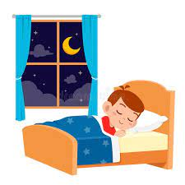
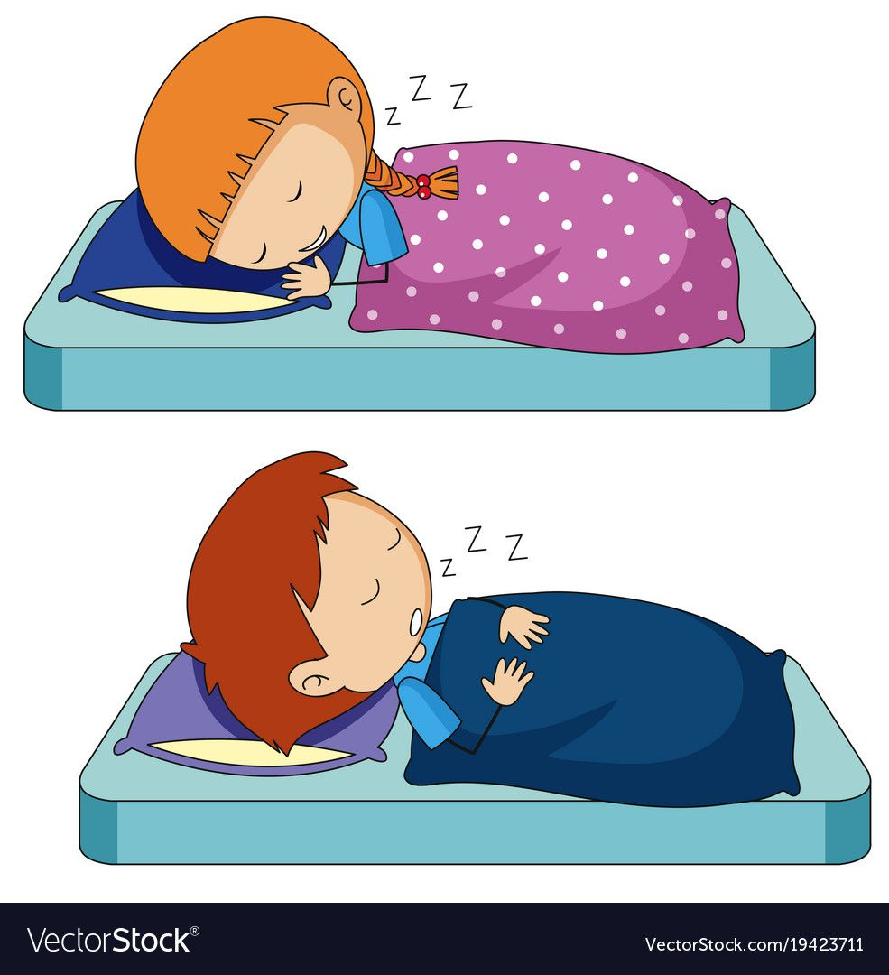
Questions
I
She
He
It
Was
V-ing
You
We
They
Were
V-ing
Example:
He was sleeping.
Was he sleeping?
They were playing.
Were they playing ?

Slide 22
f
d
e
c
b
a

Slide 23
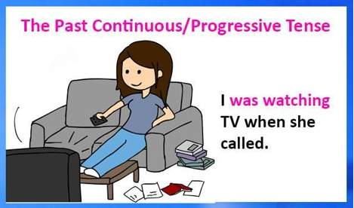
Examples:
The phone suddenly rang when I was having breakfast.
When she called , I was watching TV.

Slide 24
More Example

Slide 25
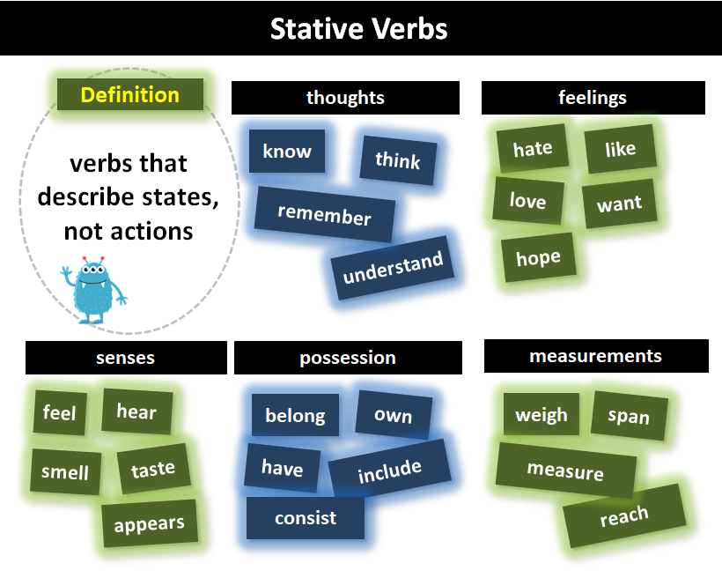
FYI
We do not usually use the progressive with verbs like the following:

Slide 26
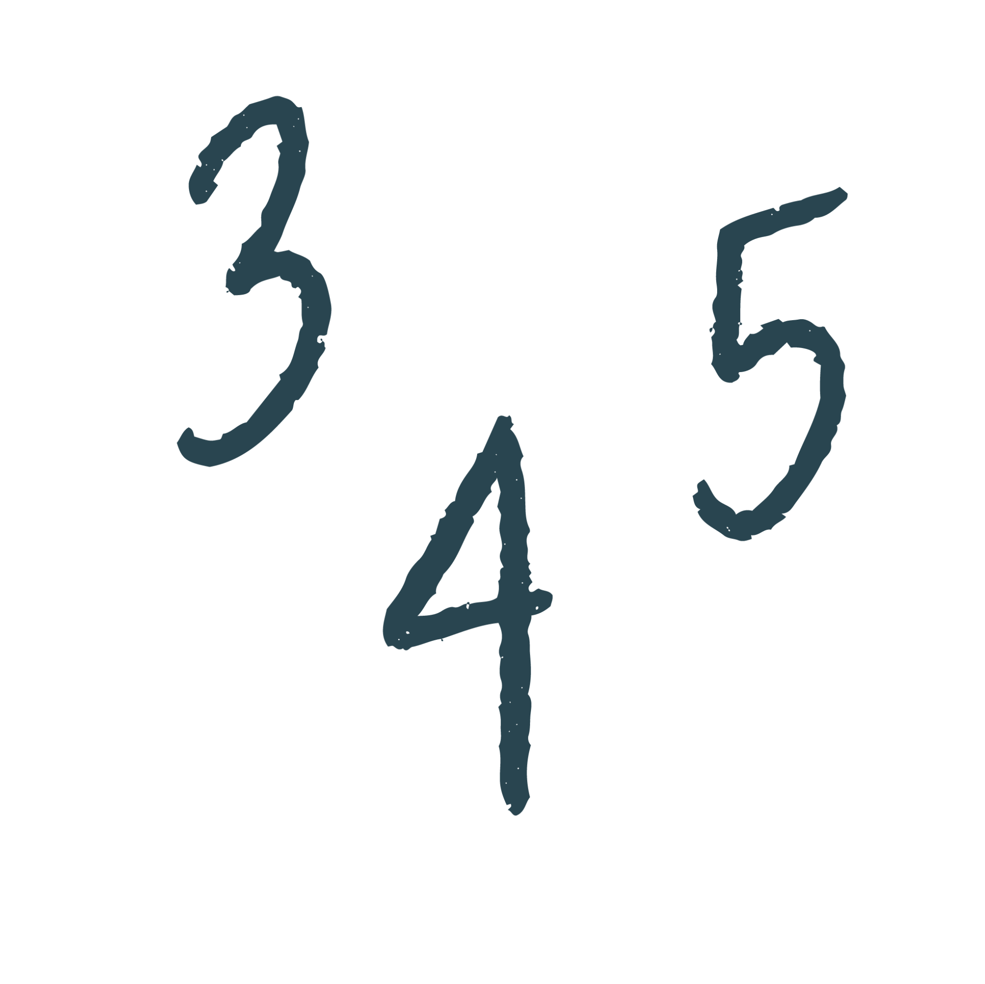
was sleeping
flooded
heard
was
weren’t rationing
started
located
was studying
Was
traveling
made
was representing
flew

Slide 27
Home work
Workbook , p.( 87) , exercise ( N)

Slide 28
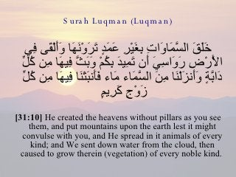

Slide 29
THANKS

