Slide 1
Unit 2
Careers
Listen & Discuss
Mega Goal 1.1
Done by: Entisar Al-Obaidalah

Slide 2
Lesson Objectives:
Mention
Discuss
01
02
Read
Answer
03
04
some jobs and the skills needed.
the 21st century skills.
For specific information
Some comprehension questions coreectly

Slide 3

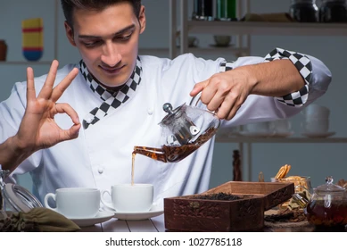
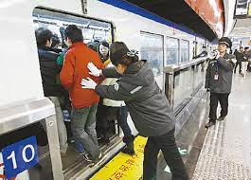

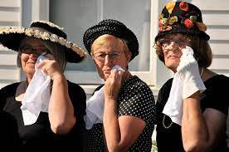

Warm Up
  Do you know any unusual jobs ?
  Can you guess the jobs in these pictures ?
Furniture tester
tea tester
Train pusher
A professional mourner
A professional sleeper

Slide 4

  Can you guess their job?
  What are they doing?
a hospital clown!!
A hospital clown visits sick children in the
hospital and makes them laugh

Slide 5

Open
Book , p(20)

Slide 6

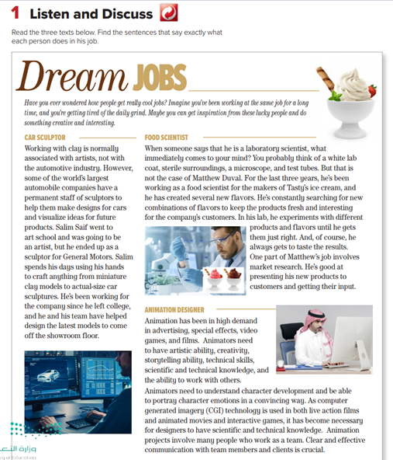
What’s the title of the text ?
1
2
How many subtitles are there ?
3
What is the title of each one?

Slide 7
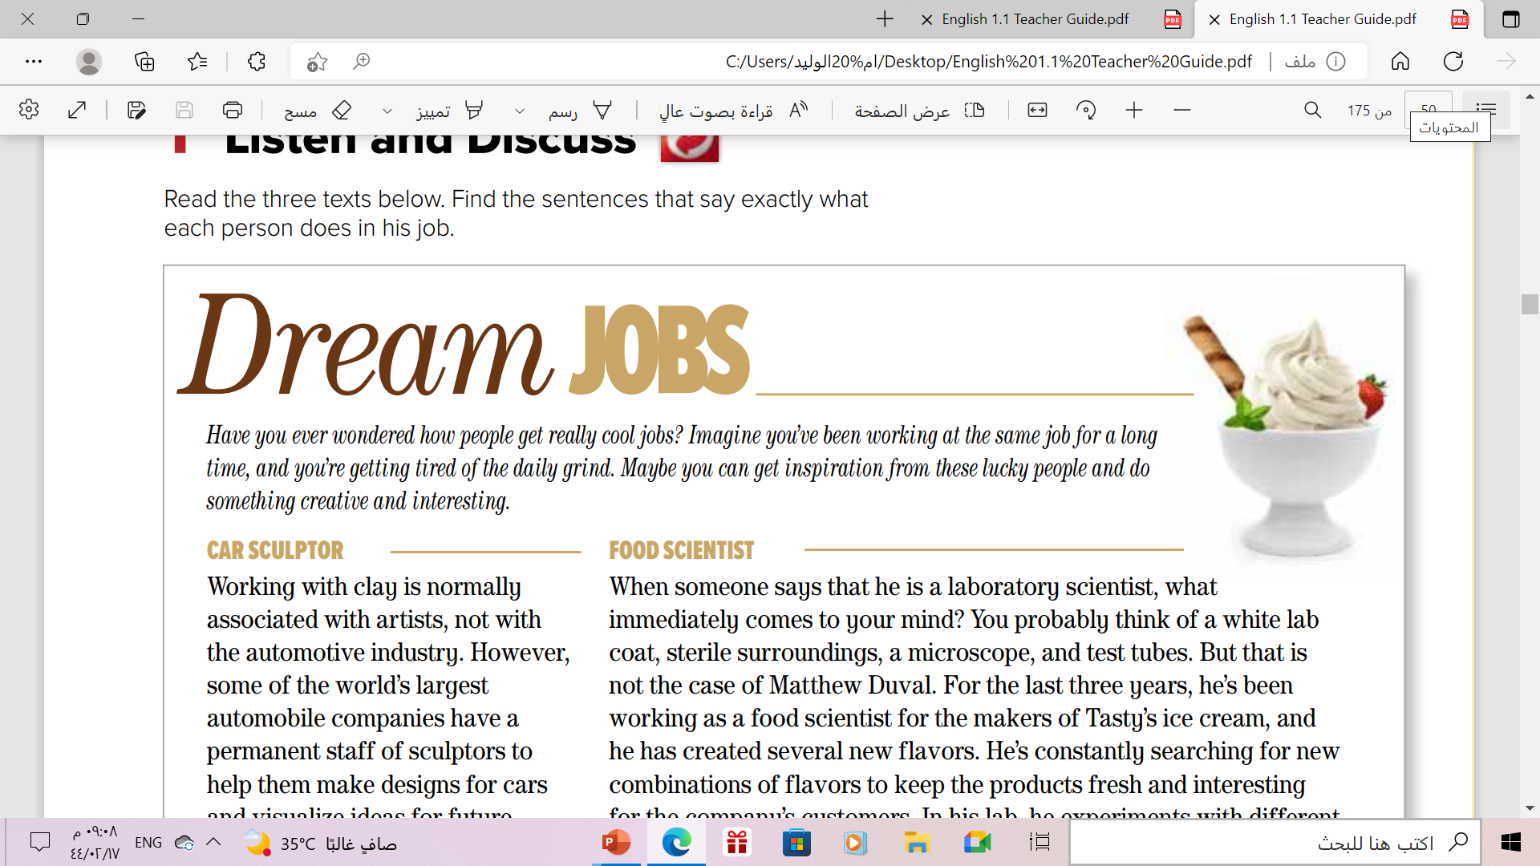

  We are going to read about three people with unusual jobs.
  scan for facts about each person.

Slide 8

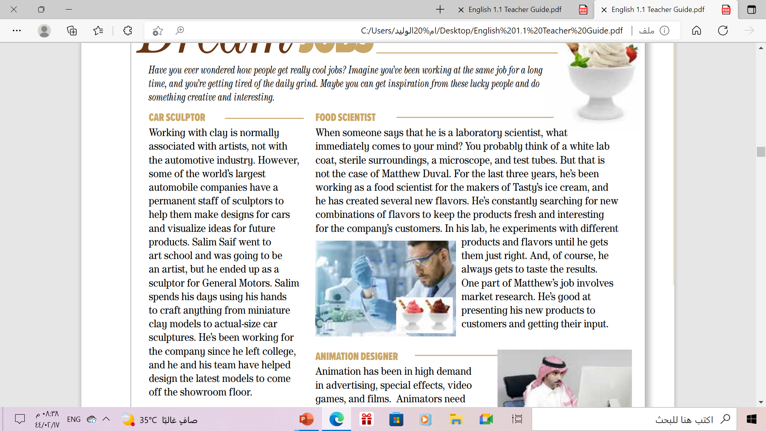
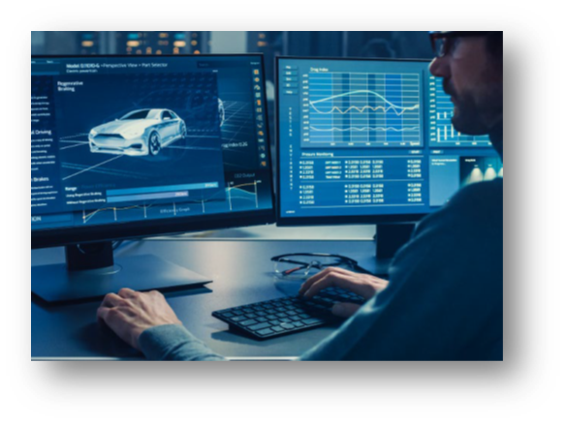
What is the person’s name?
Salim Saif
Where does he work?
General Motors
What does he do?
He makes clay models of cars

Slide 9
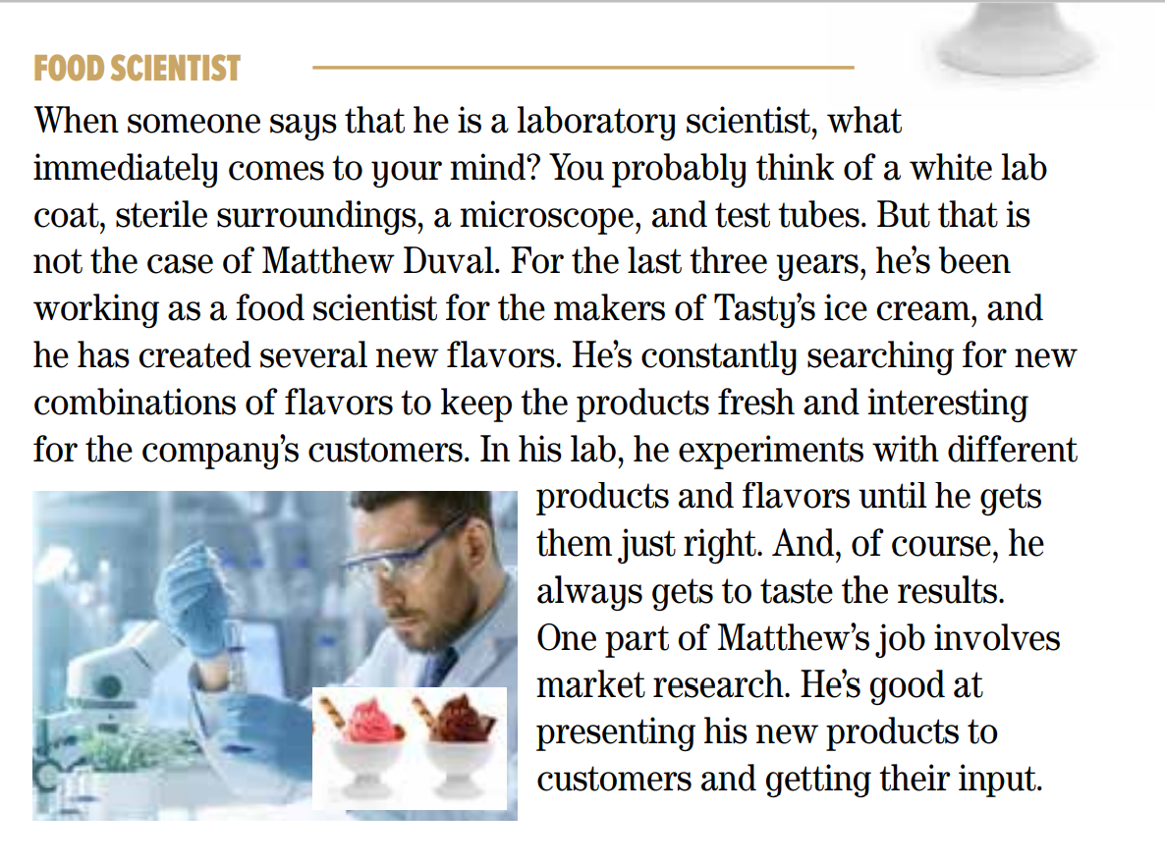
What is the person’s name?
Matthew Duval
Where does he work?
Tasty’s ice cream
What does he do?
He creates new ice-cream flavors

Slide 10
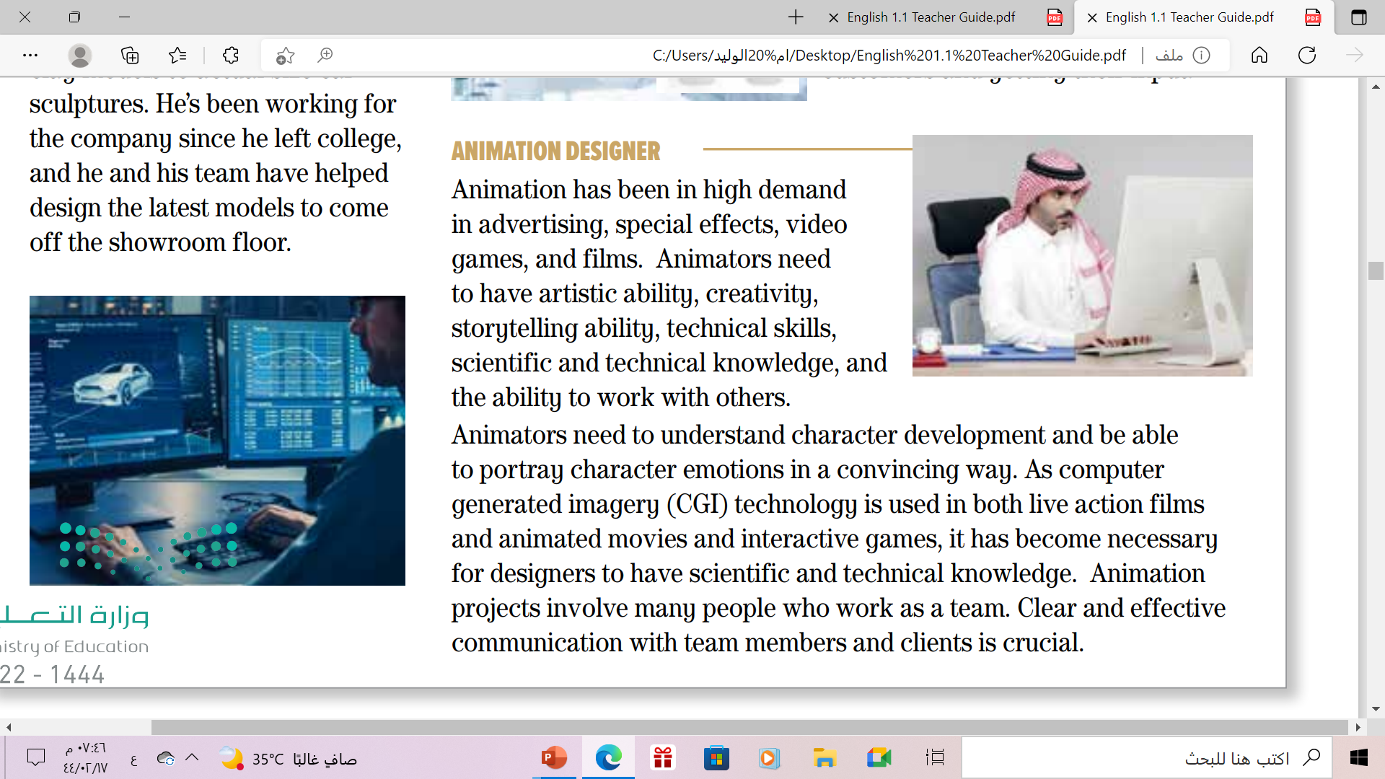
What skills do animators need to have?
artistic and storytelling ability, creativity etc.
What projects require an animator?
artistic and storytelling ability, creativity etc.
What is necessary to do their work?
computers

Slide 11
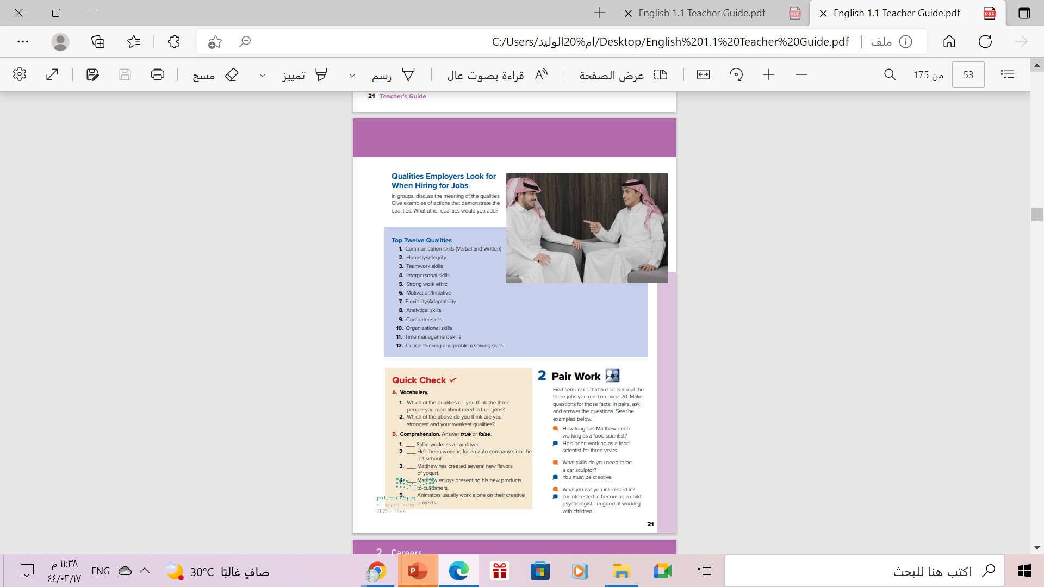
Open
Book , p( 21)

Slide 12
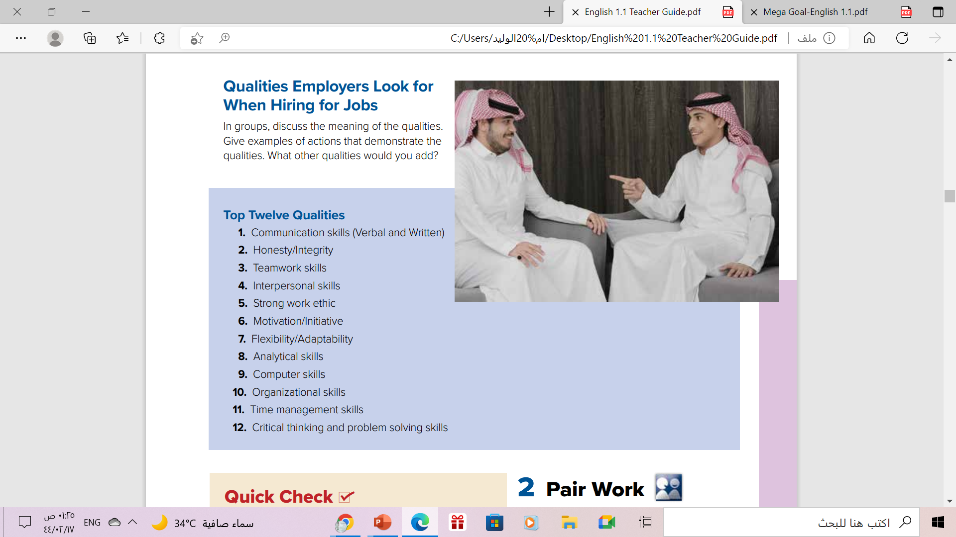
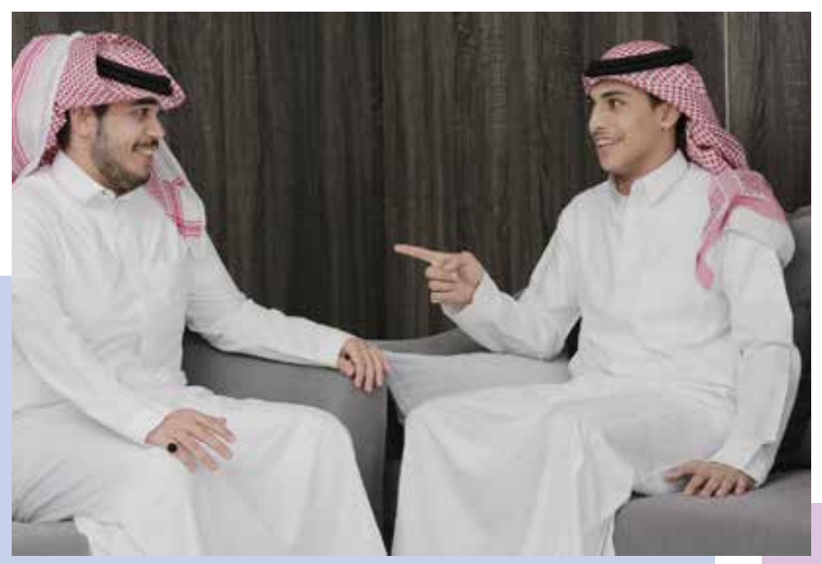
Discussion
Where are they?
How do you think each person feels?
Where are they doing?

Slide 13
Read along as u Listen
The 21st century skills

Slide 14

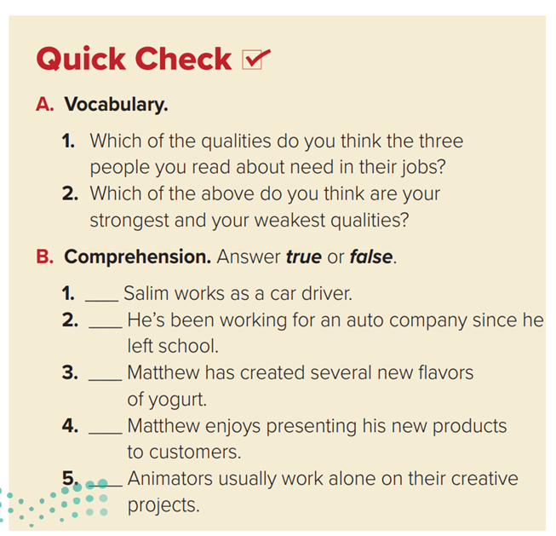
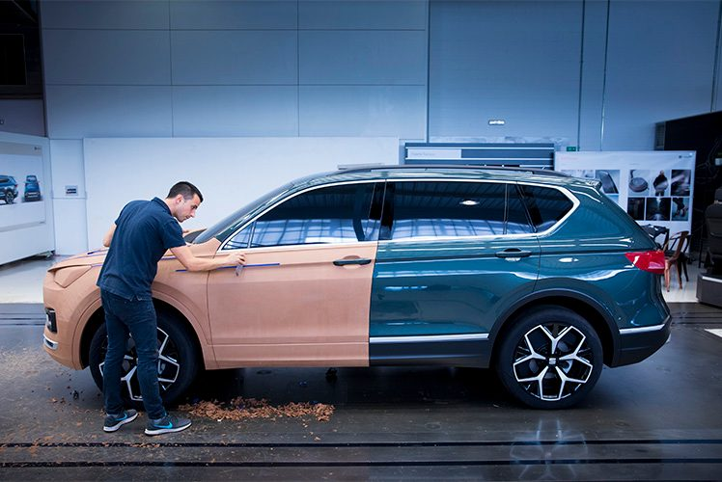


Answers will vary.

Slide 15
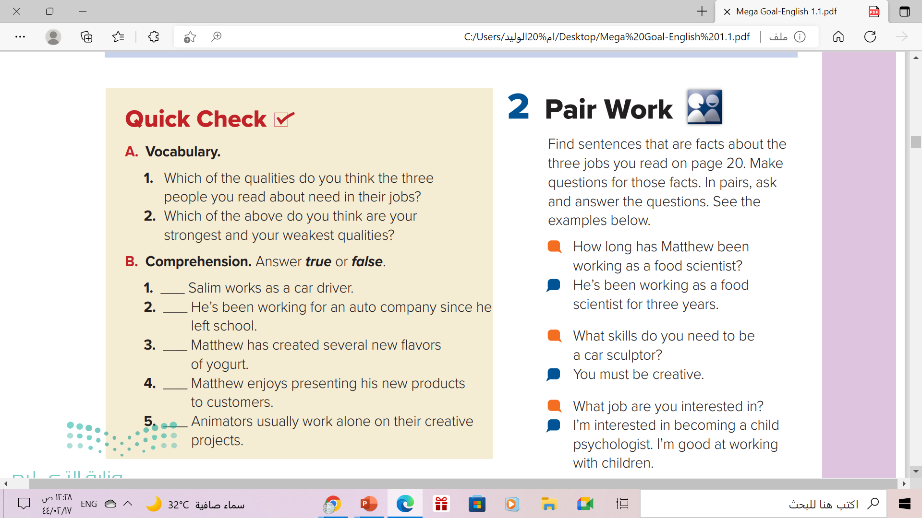
F
T
F
T
F

Slide 16

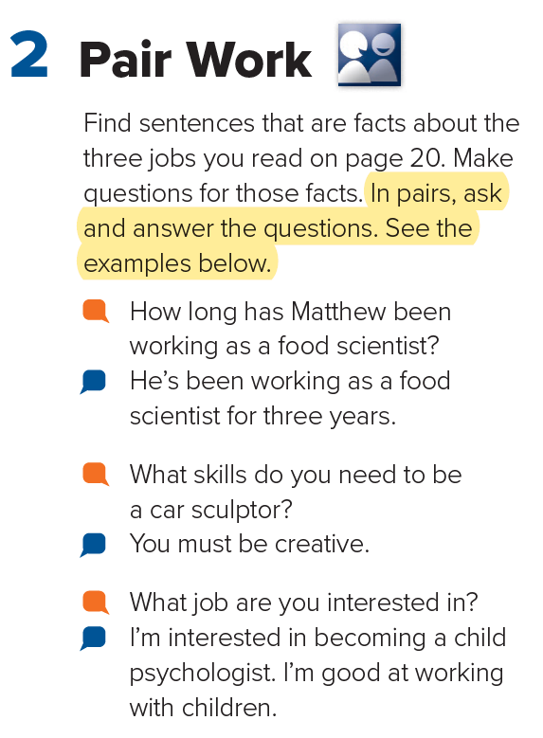

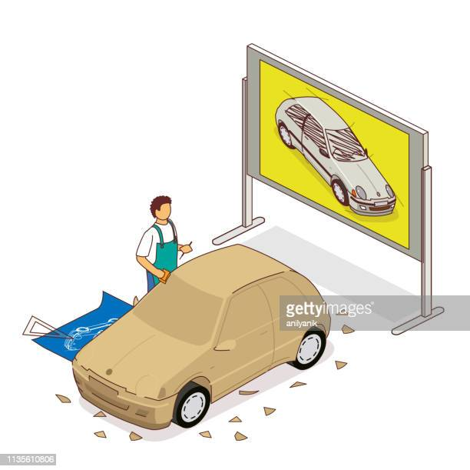
Listen , Repeat &
Take turns

Slide 17
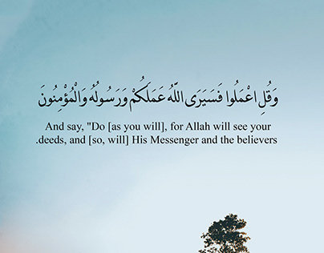

Slide 18
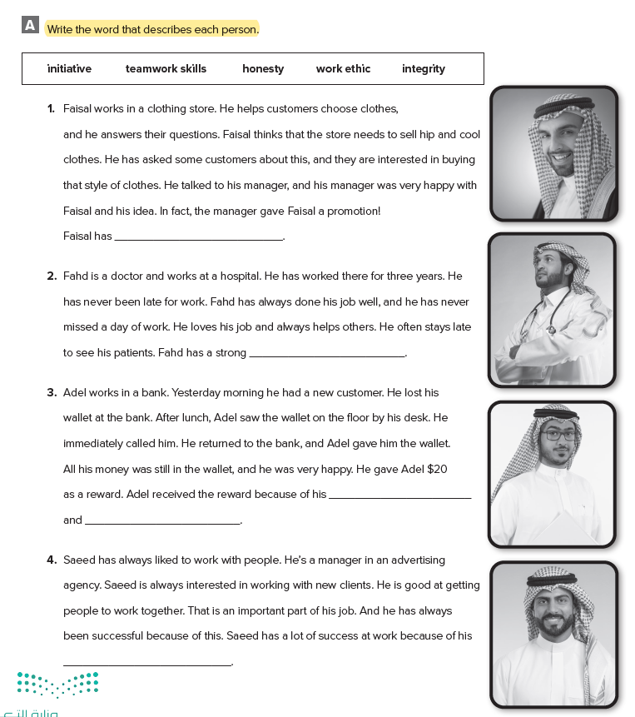
Homework
Workbook p.( 89 ),
exercise ( A)

Slide 19

Thanks!

