Slide 1




Slide 2
Mega Goal 1.1
Unit 2 - Careers
1. Listen and Discuss
By: Essa Al Hussaini

Slide 3


Slide 4


Objectives
identify
some jobs and the skills needed.
identify
the 21st century skills.
answer
comprehension questions
practice
a conversation

Slide 5
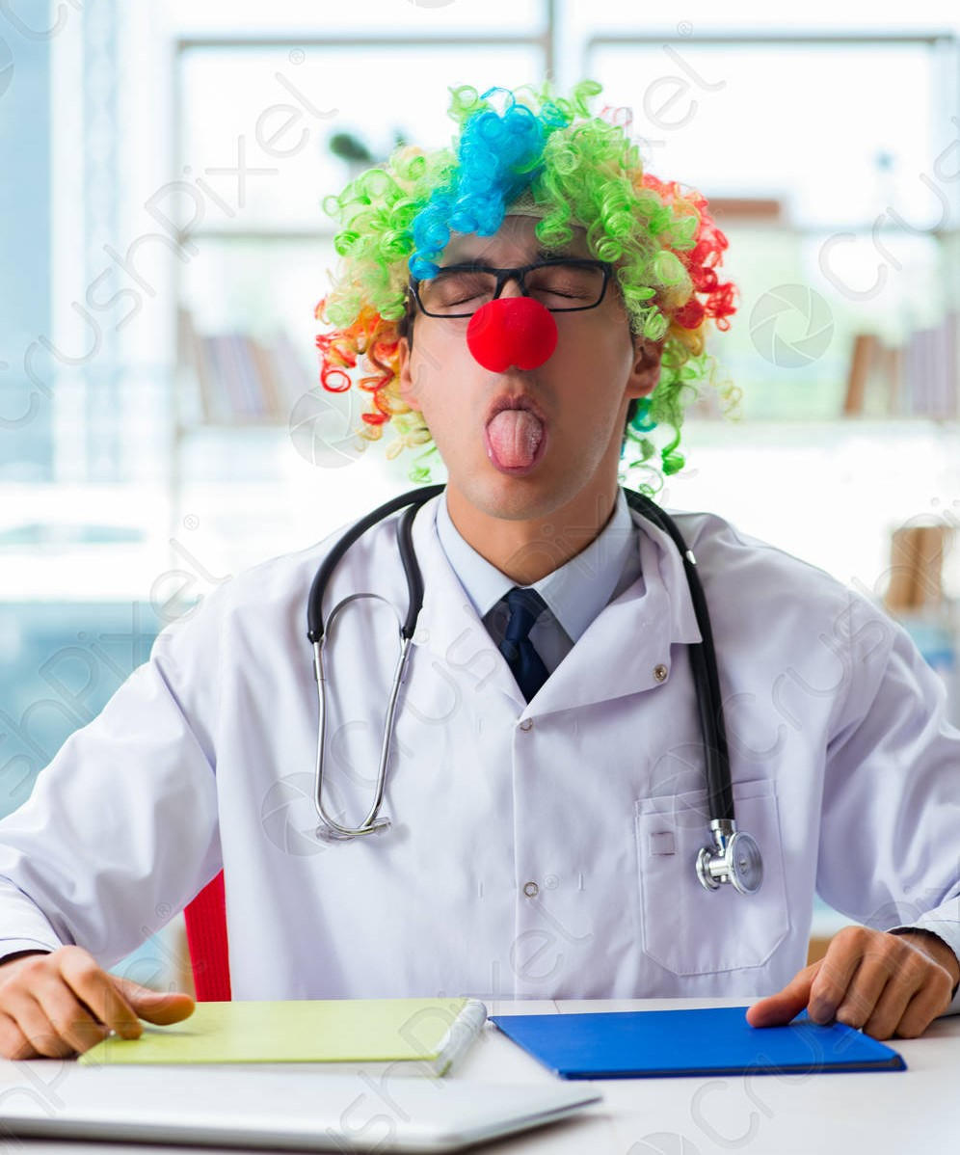
GUESS

Slide 6

GUESS

Slide 7
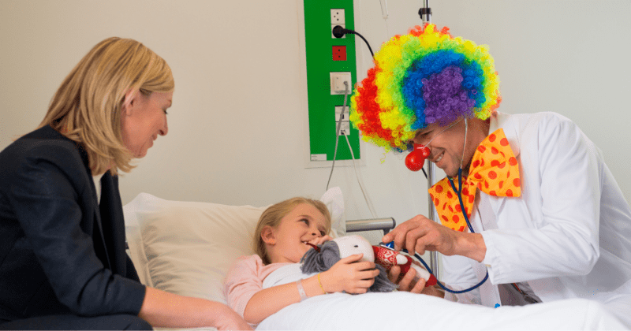
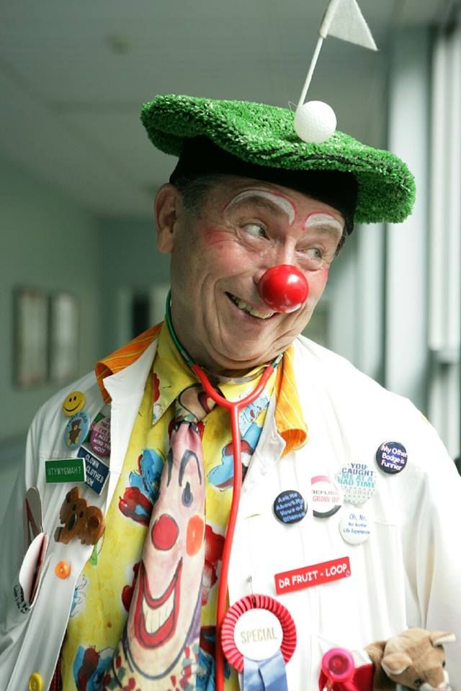
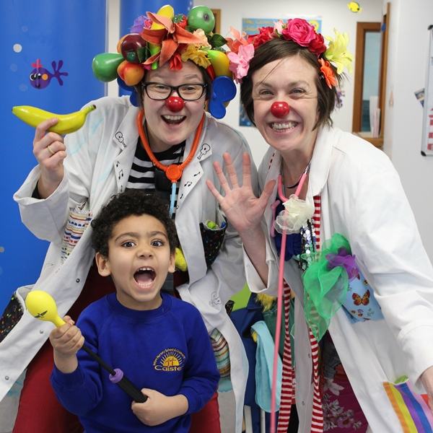
a hospital clown!!
which one do you want to have? WHY?
... any interesting or unusual jobs you know?
For what?!!
Notes:
A hospital clown visits sick children in the hospital and makes them laugh.

Slide 8
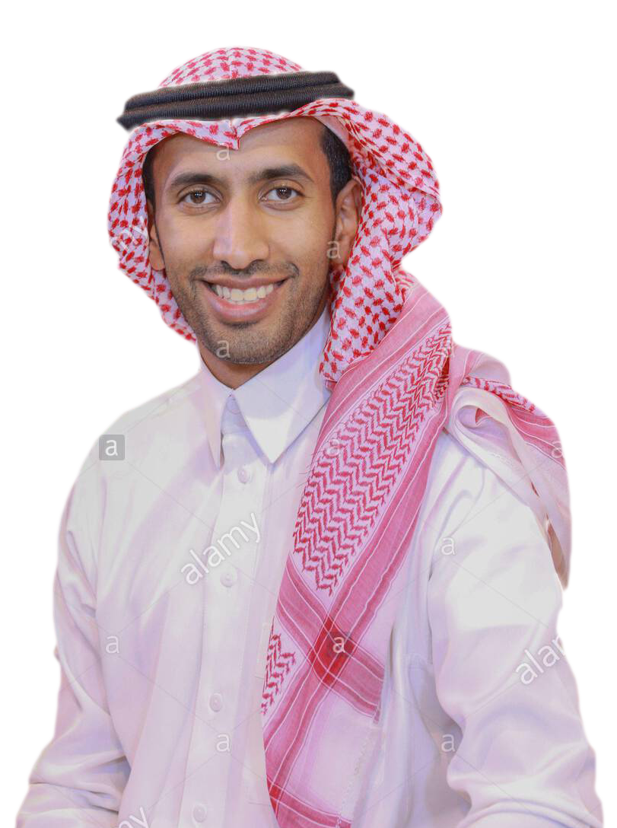
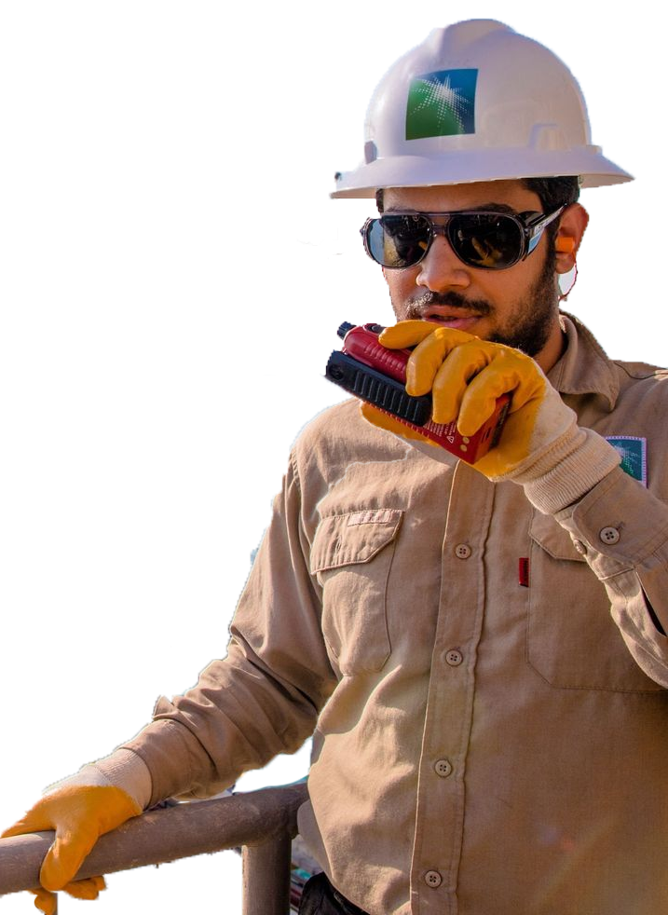



Slide 9
type of person would be suitable for each job
Skills needed for these job ..?
Notes:
Doctor: (male and female)
Educated, be able to control emotions and feelings, able to work under stress , working in different fields
Skills : e.g. Ability to work long hours, Ability to solve problems, Communication skills, Time management, Teamwork
Outdoor worker: (male)
working in different fields, educated, tough skin, hard working , able to work under stress and in the sun
Skills: e.g. Problem-solving, Teamwork, Leadership

Slide 10
YOU are good at ..?
SKILSS you have?

Slide 11
"وَقُلِ اعْمَلُوا فَسَيَرَى اللَّهُ عَمَلَكُمْ وَرَسُولُهُ وَالْمُؤْمِنُونَ" التوبة 105

Slide 12
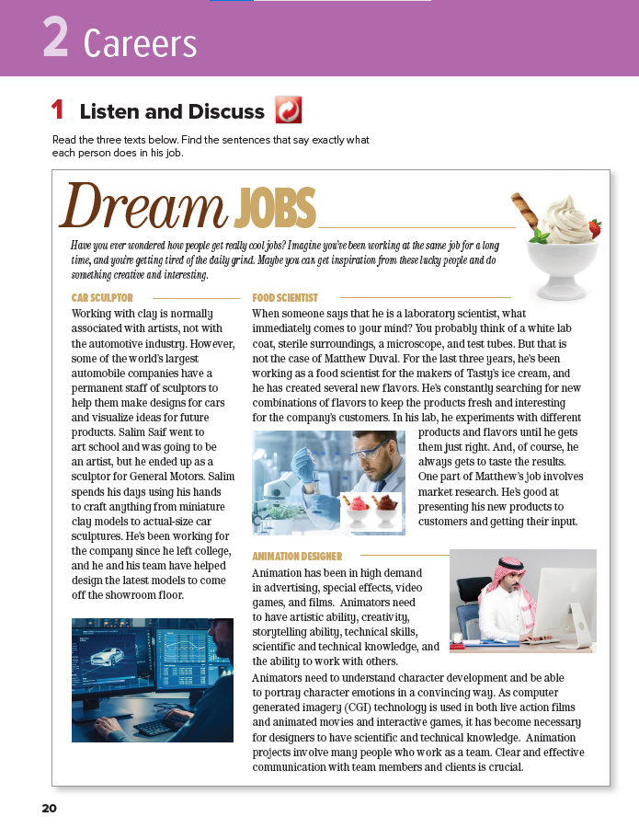
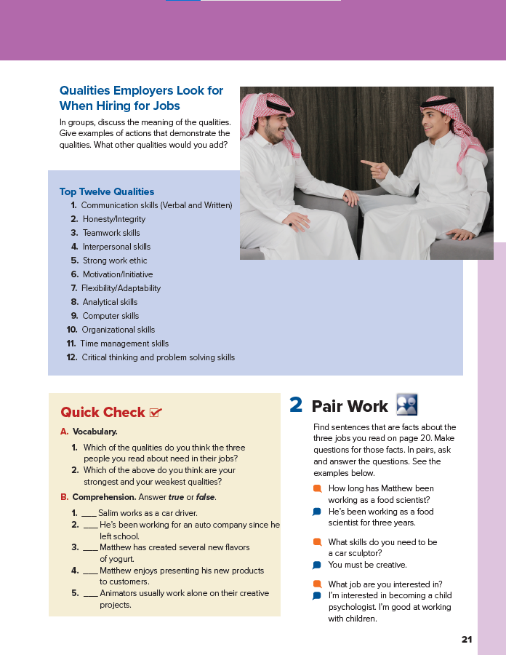


20-21
unit title?

Slide 13

The unit is going to talk about ...?
Guess what each does for job

Slide 14
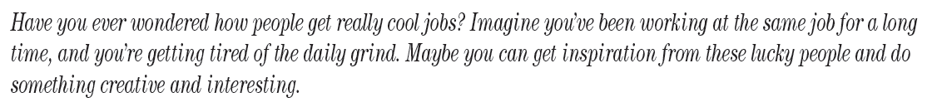
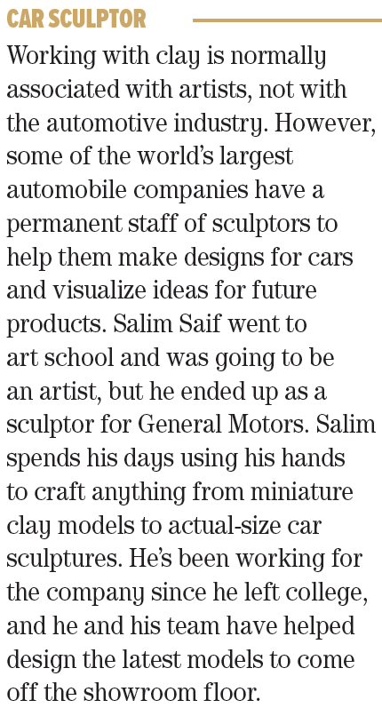

scan for facts about each person
Jigsaw Reading
e.g.
Person’s name?
His job?
Where?
Skills needed?
Project’s type?
Work necessity?
individual Reading
Lesson done By: Essa Al Hussaini
Notes:
Each student will read ONLY ONE Section
THEN answer the followings ….
scan for facts =
Find the sentences that say exactly what each person does in his job.
knowing these facts will help Students understand the whole passage better.
Remind them that to scan means to read quickly to find specific information

Slide 15


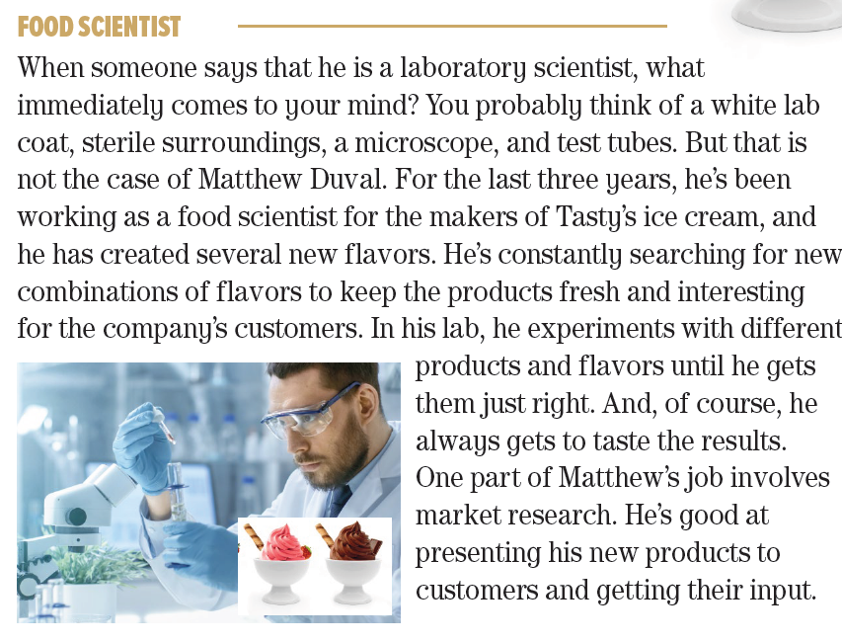
Listen &
read along
any unfamiliar words?
What does
he do?
person’s name?
Where?
Notes:
Each student will read ONLY ONE Section
THEN answer the followings ….
scan for facts =
Find the sentences that say exactly what each person does in his job.
knowing these facts will help Students understand the whole passage better.
Remind them that to scan means to read quickly to find specific information

Slide 16
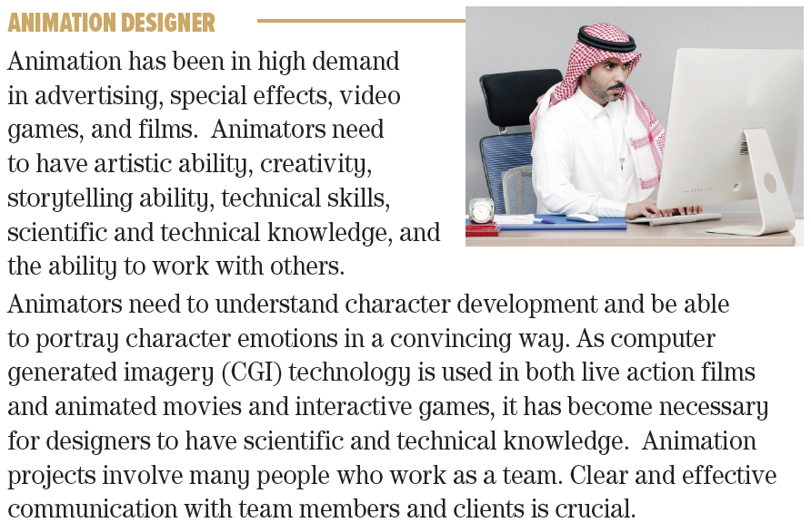
Listen &
read along
any unfamiliar words?
Where?
What does
he do?
person’s name?
Lesson done By: Essa Al Hussaini
Notes:
Each student will read ONLY ONE Section
THEN answer the followings ….
scan for facts =
Find the sentences that say exactly what each person does in his job.
knowing these facts will help Students understand the whole passage better.
Remind them that to scan means to read quickly to find specific information

Slide 17
What is necessary to do their work?
What skills do animators need to have?
any unfamiliar words?
What projects require an animator?
Listen &
read along
Lesson done By: Essa Al Hussaini
Notes:
Each student will read ONLY ONE Section
THEN answer the followings ….
scan for facts =
Find the sentences that say exactly what each person does in his job.
knowing these facts will help Students understand the whole passage better.
Remind them that to scan means to read quickly to find specific information

Slide 18
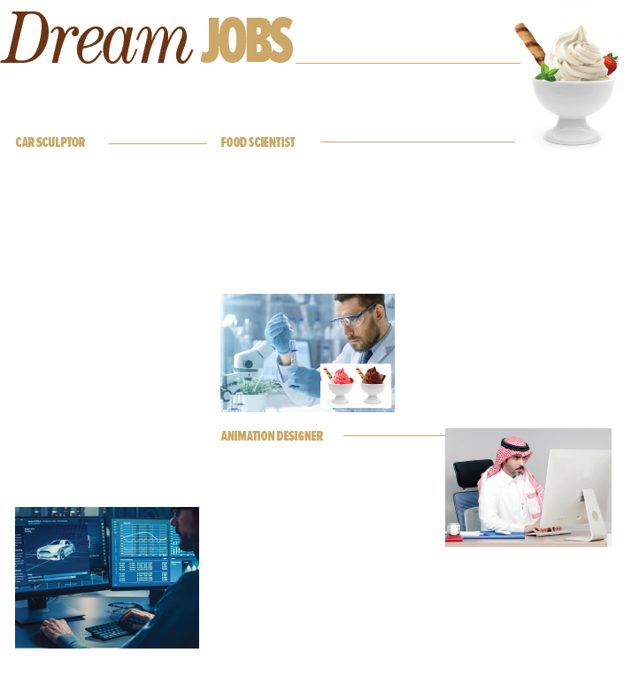
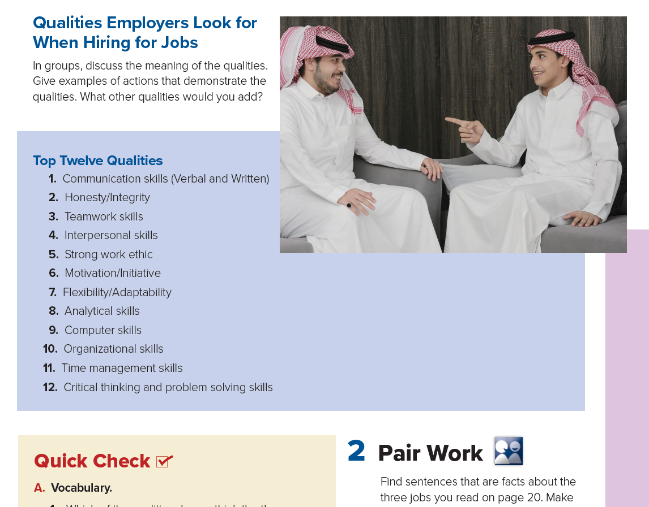


Books
CLOSED
Notes:
With books closed, have students summarize what they found out about each person.

Slide 19


As a manager of a company,
What are the qualities you’re looking for in an employee?
each person’s feelings?
Doing
what?
Listen &
read along
The 21st century skills
WHERE?
Notes:
Where are they?
What are they doing?
How do you think each person feels right now?

Slide 20


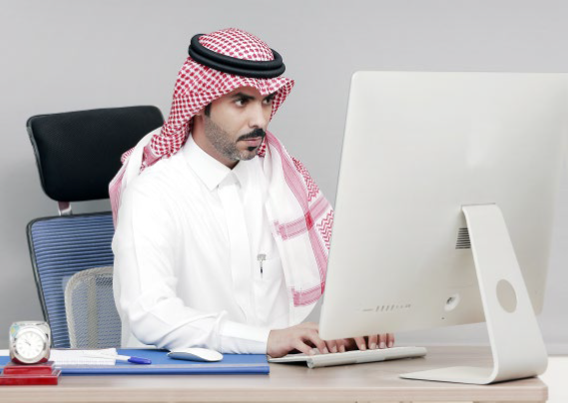
Notes:
With books closed, have students summarize what they found out about each person.

Slide 21
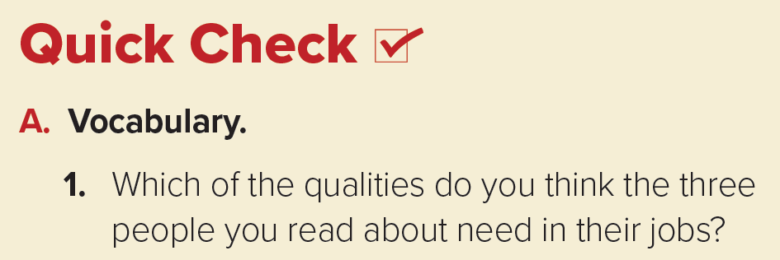
Answers will vary
Interpersonal skills
Organizational skills
car sculptor
Top Twelve Qualities
1. Communication skills (Verbal and Written)
2. Honesty / Integrity
3. Teamwork skills
4. Interpersonal skills
5. Strong work ethic
6. Motivation/Initiative
7. Flexibility / Adaptability
8. Analytical skills
9. Computer skills
10. Organizational skills
11 . Time management skills
12 . Critical thinking and problem solving skills
Motivation / Initiative
Teamwork skills
Which … your
strongest and weakest qualities?
Interpersonal skills
Flexibility/Adaptability
Motivation/Initiative
food scientist
Flexibility / Adaptability
Computer skills
Organizational skills
Teamwork skills
Computer skills
animation designer

Slide 22
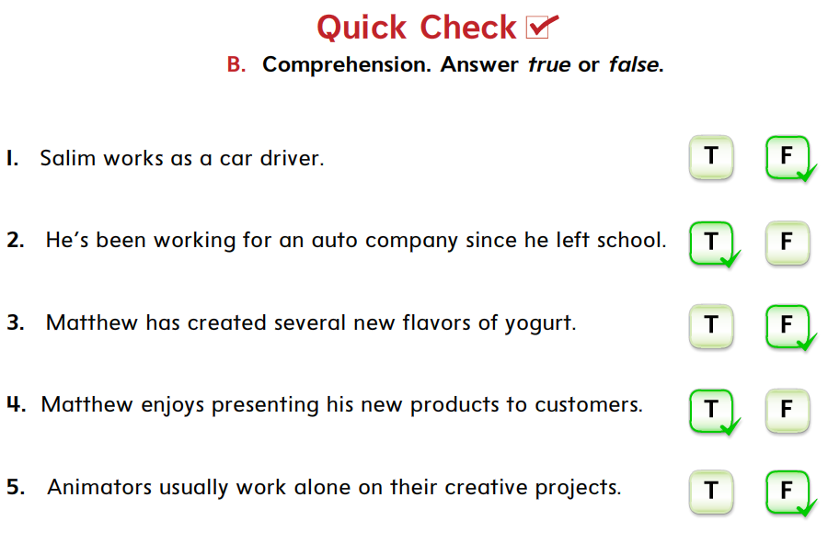



 
He makes clay model of cars
 
Since he left college
 
New flavors of ice-cream
 
 
They work with others.
Show all

Slide 23
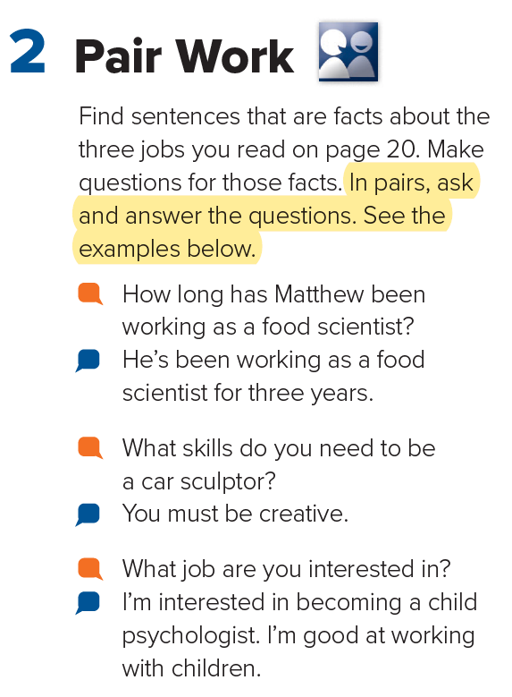

Listen,
Repeat &
Take turns

Slide 24

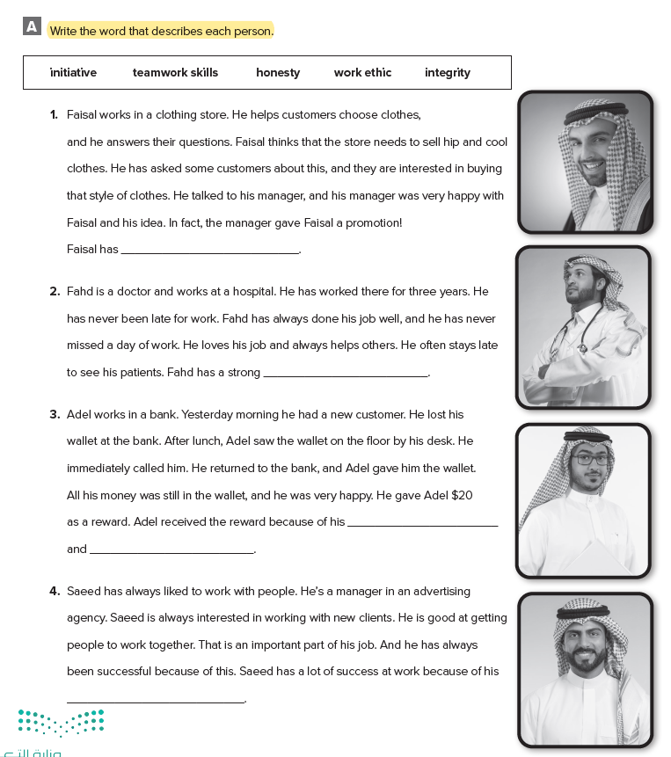
We will support young people in finding jobs and training.
We will develop and diversify our economy to create job opportunities.

Slide 25
HOMEWORK
WORKBOOK @
89

Slide 26


