Slide 1


Unit 2
Careers
Mega Goal 1.1
Reading
Done by: Entisar Al-Obaidallah

Slide 2
Lesson Objectives:
01
02
03
04
Analyze
Discuss
information on a job profile
other ways to find a job
Read
Answer
for specific information
Questions about the article correctly

Slide 3





Warm up
How can you find a job nowadays?
What would you like to be when you graduate from university?

Slide 4
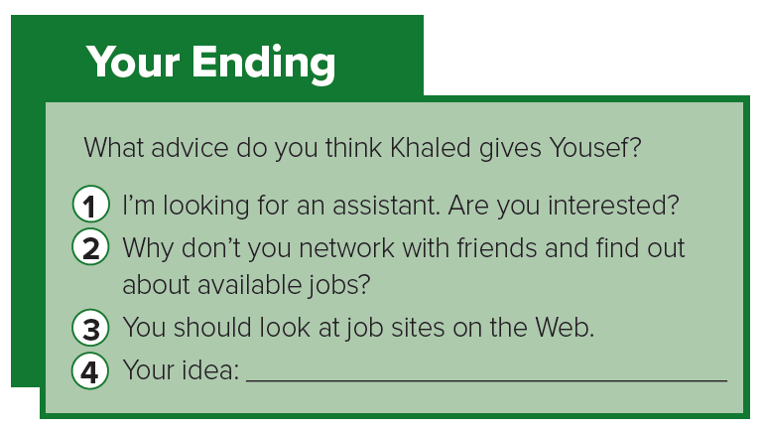


Advices from previous lesson

Slide 5

Reading Strategy
Analyzing Format

Slide 6
Analyzing Format
Format and design:
give some insight into the topic.
Subtitles:
provide information
about the content
Title:
to predict what the reading is going to be about

Slide 7
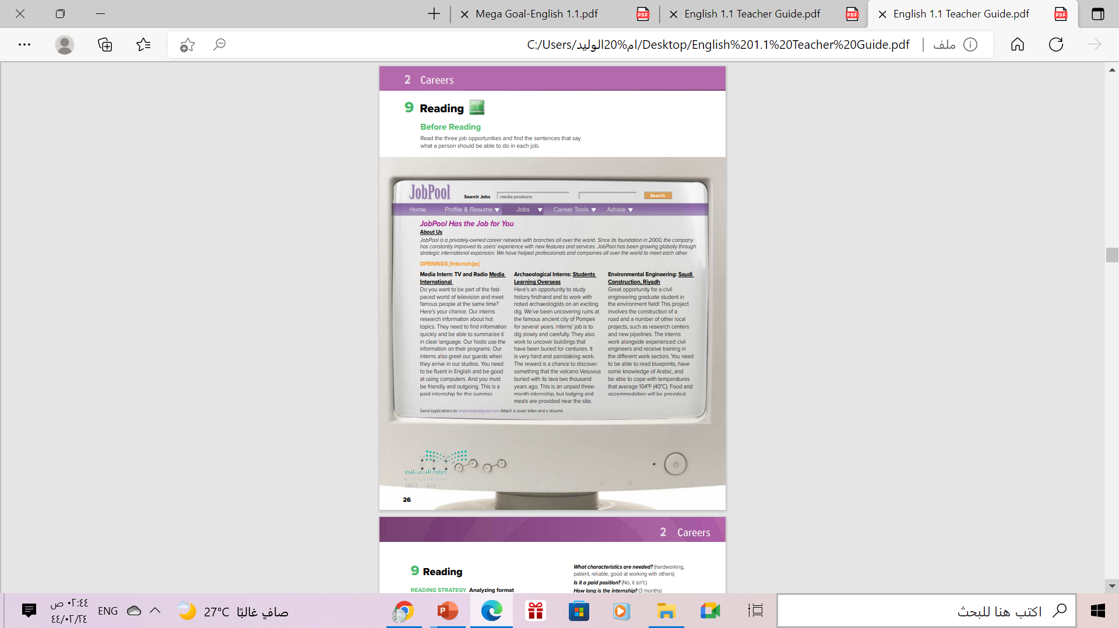
Open
Student’s book page: (26 )

Slide 8


What is Job Pool??

Slide 9
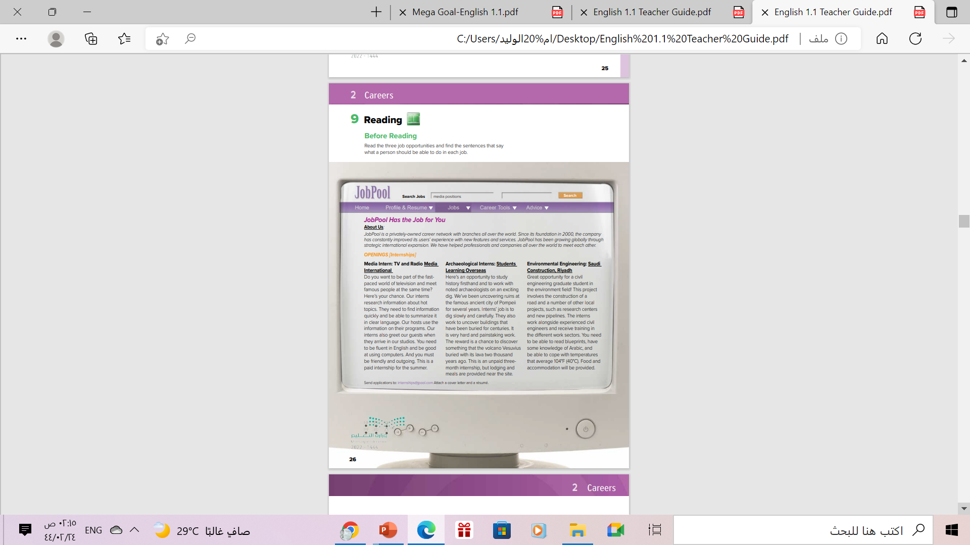
Scanning
Scan the text AND underline
the sentences or phrases that tell what a person should
be able to do in each job.

Slide 10


Read along as U Listen

Slide 11
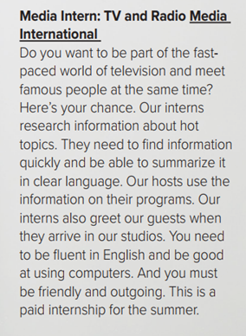
What do TV interns research ?
Hot topics .
Is it a paid position ?
Yes, it is .
Is it year-round ?
No, it’s only for the summer

Slide 12
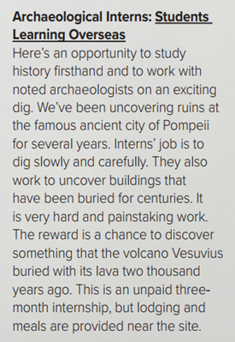
Where is the archeological internship ?
Pompeii
Is it a paid position ?
No, it isn’t.
How long is the internship??
3 months

Slide 13
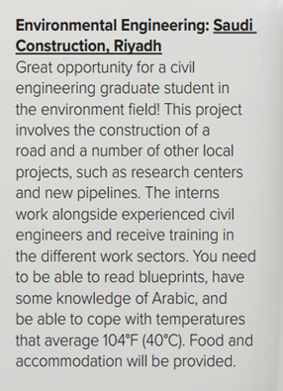
Who should apply for the internship in Saudi Arabia?
civil engineering graduate students
What will they do?
construct roads, research
centers, new pipelines)
Is it a paid position ?
No, it isn’t

Slide 14

Open
Student’s book p. ( 27)

Slide 15
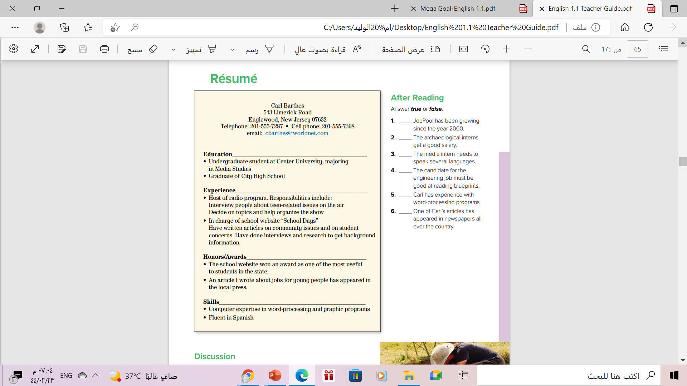
a short written description of your education, qualifications, experience as that prepared by an applicant for a job.
Listen and follow along

Slide 16
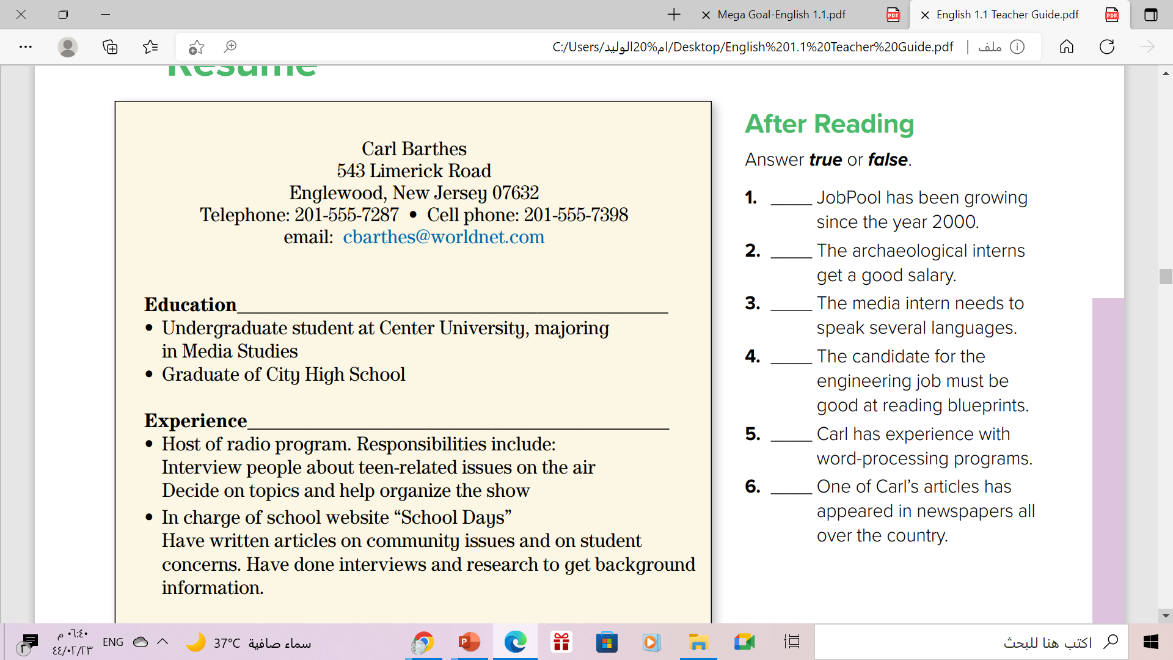
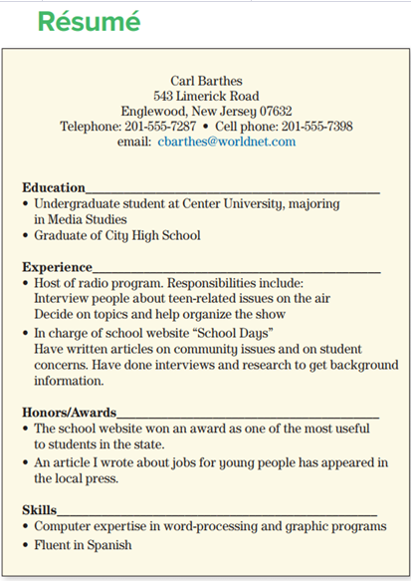
T
F
F
T
T
F

Slide 17
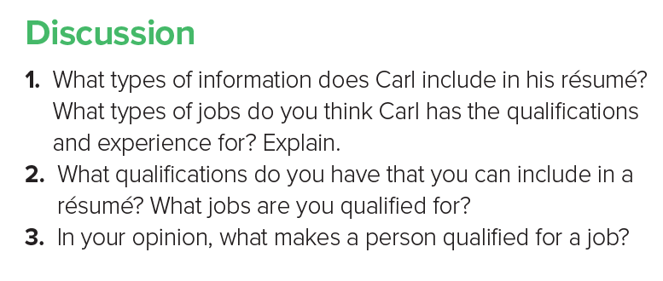
1- It includes :his education, Experience , Awards and Skills
He is going to work in a radio station as interviewer because he qualified for this job
2- The Answer will vary.
3- In my opinion, ( experience ) is the most important thing that makes a person qualified for
a job.

Slide 18
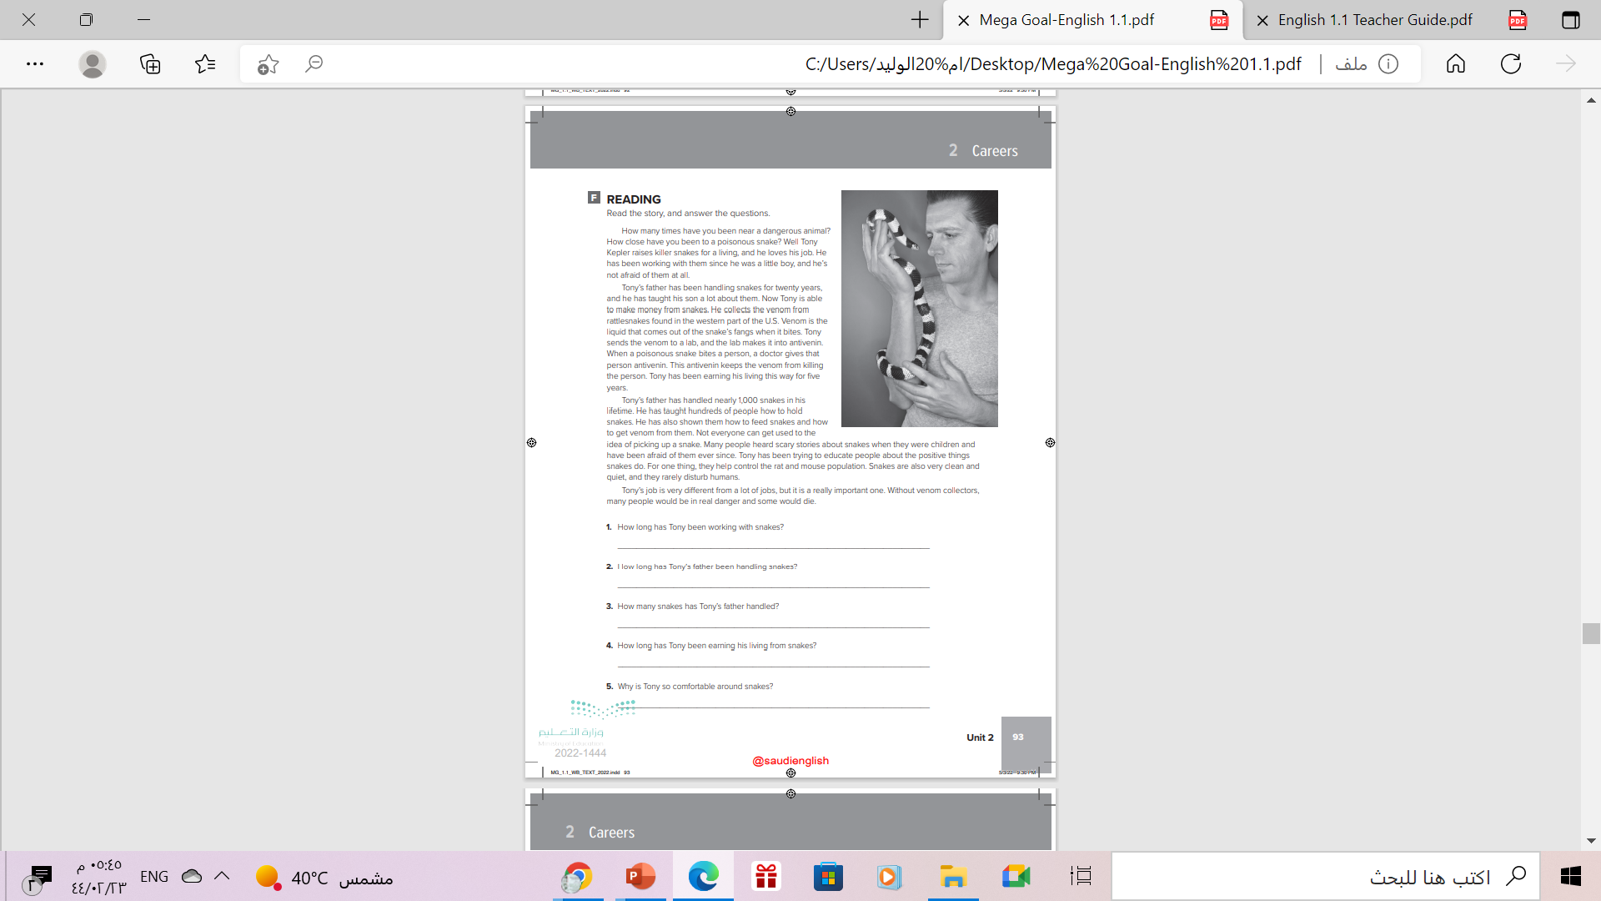
Homework
Workbook P. ( 93 ),
exercise ( F )

Slide 19
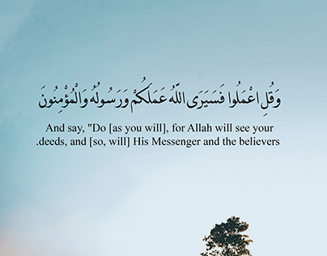
From the Holy Quran

Slide 20

Thanks!

