Slide 1
Unit 3
What Will Be , Will Be Listen & Discuss
Mega Goal 1.1
Done by : Entisar Al-Obaidallah

Slide 2
Lesson Objectives
01
02
03
04
Discuss
Answer
the topic of scince fiction
Some questions about the text
Find
Make
the completion of words from the text
predictions about the future.

Slide 3
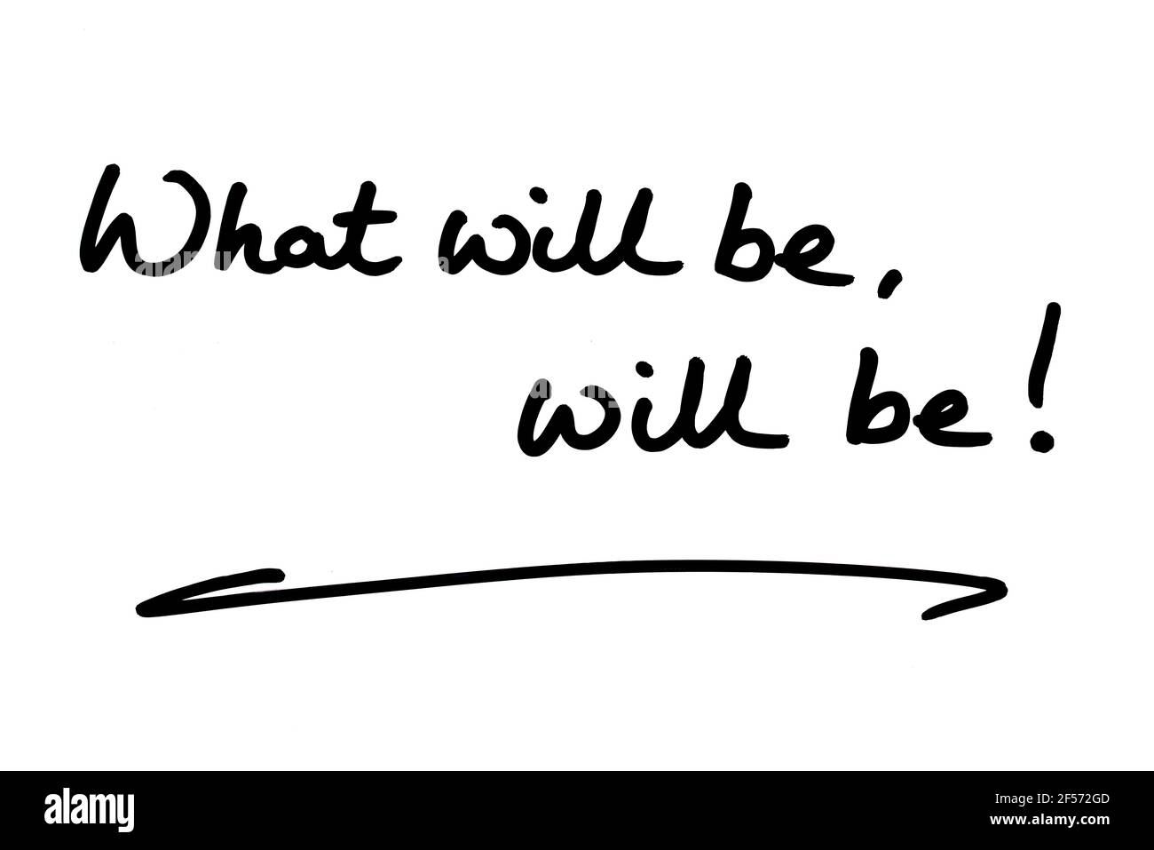
What does the title of the unit mean ?
Some things cannot be prevented from happening.
(expressing acceptance of future).
Does Arabic
language have a similar expression?

Slide 4
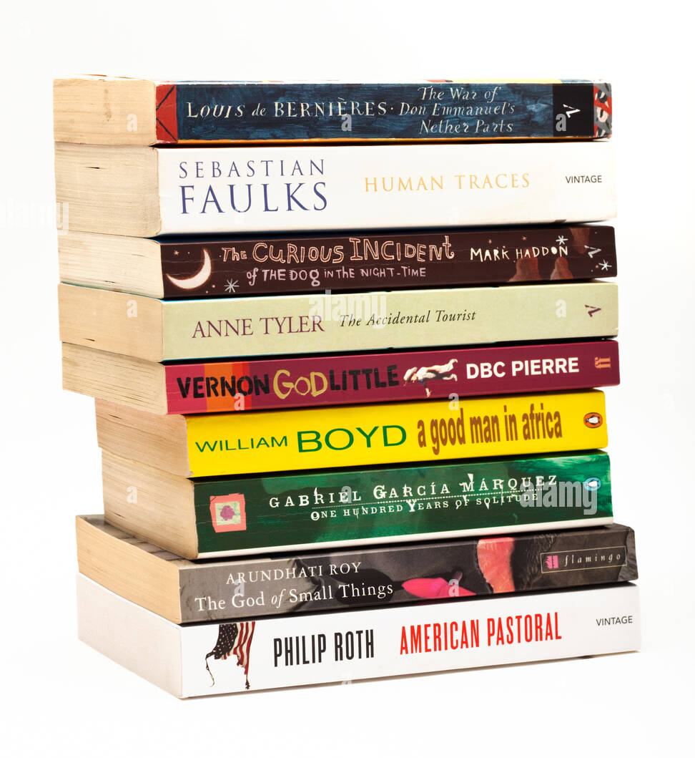
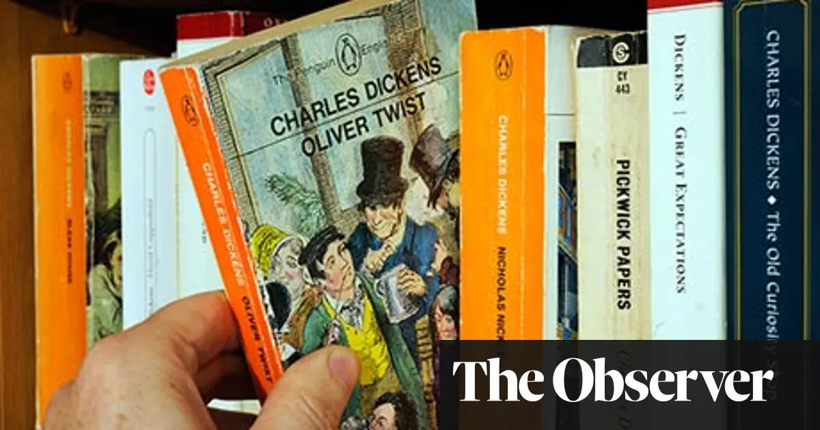
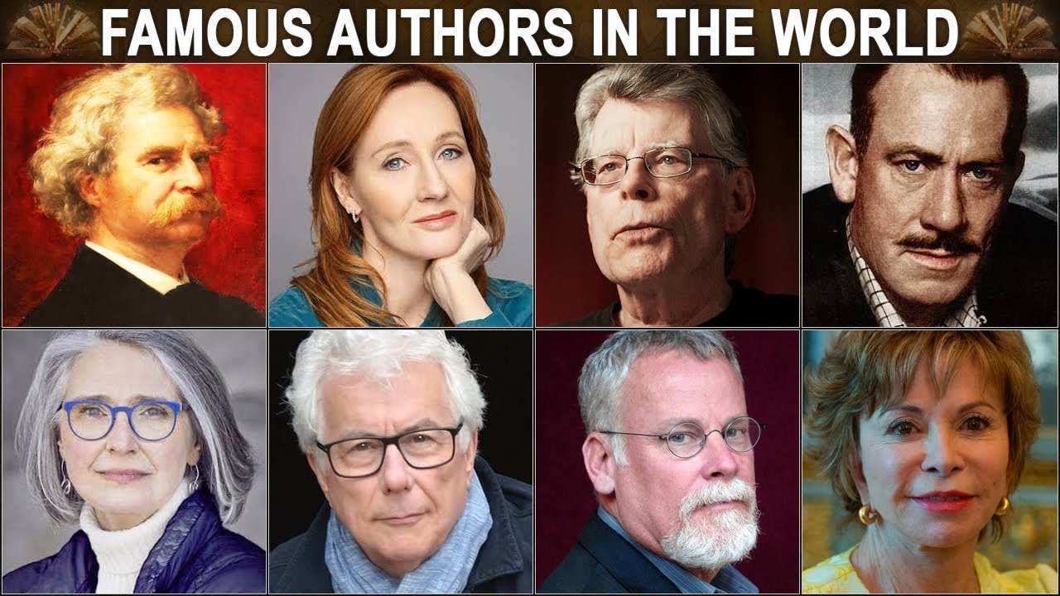
Warm Up
What KINDS of books do you read??
Have you ever read a novel ?
Who is your favorite author ?

Slide 5

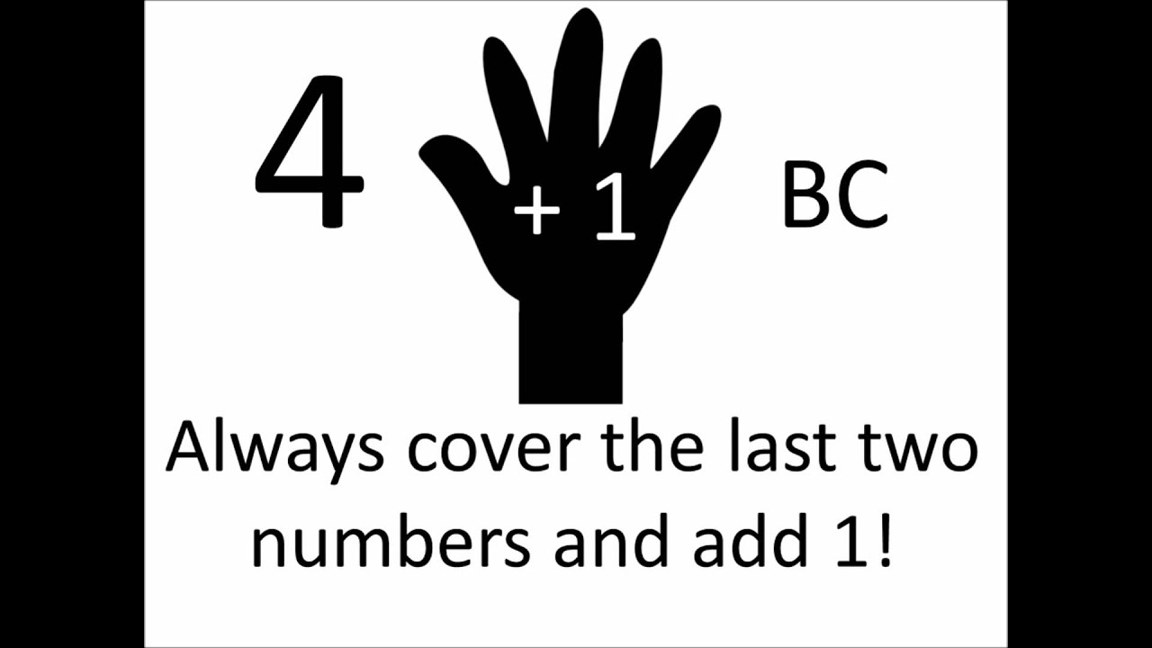
Warm Up
What is a century ?
A period of 100 years
1800–1899 What Century was this?
(the 19th )
1900–1999 What century was this?
(the 20th )
2000-2099 What century are we in now?
(the 21th )

Slide 6
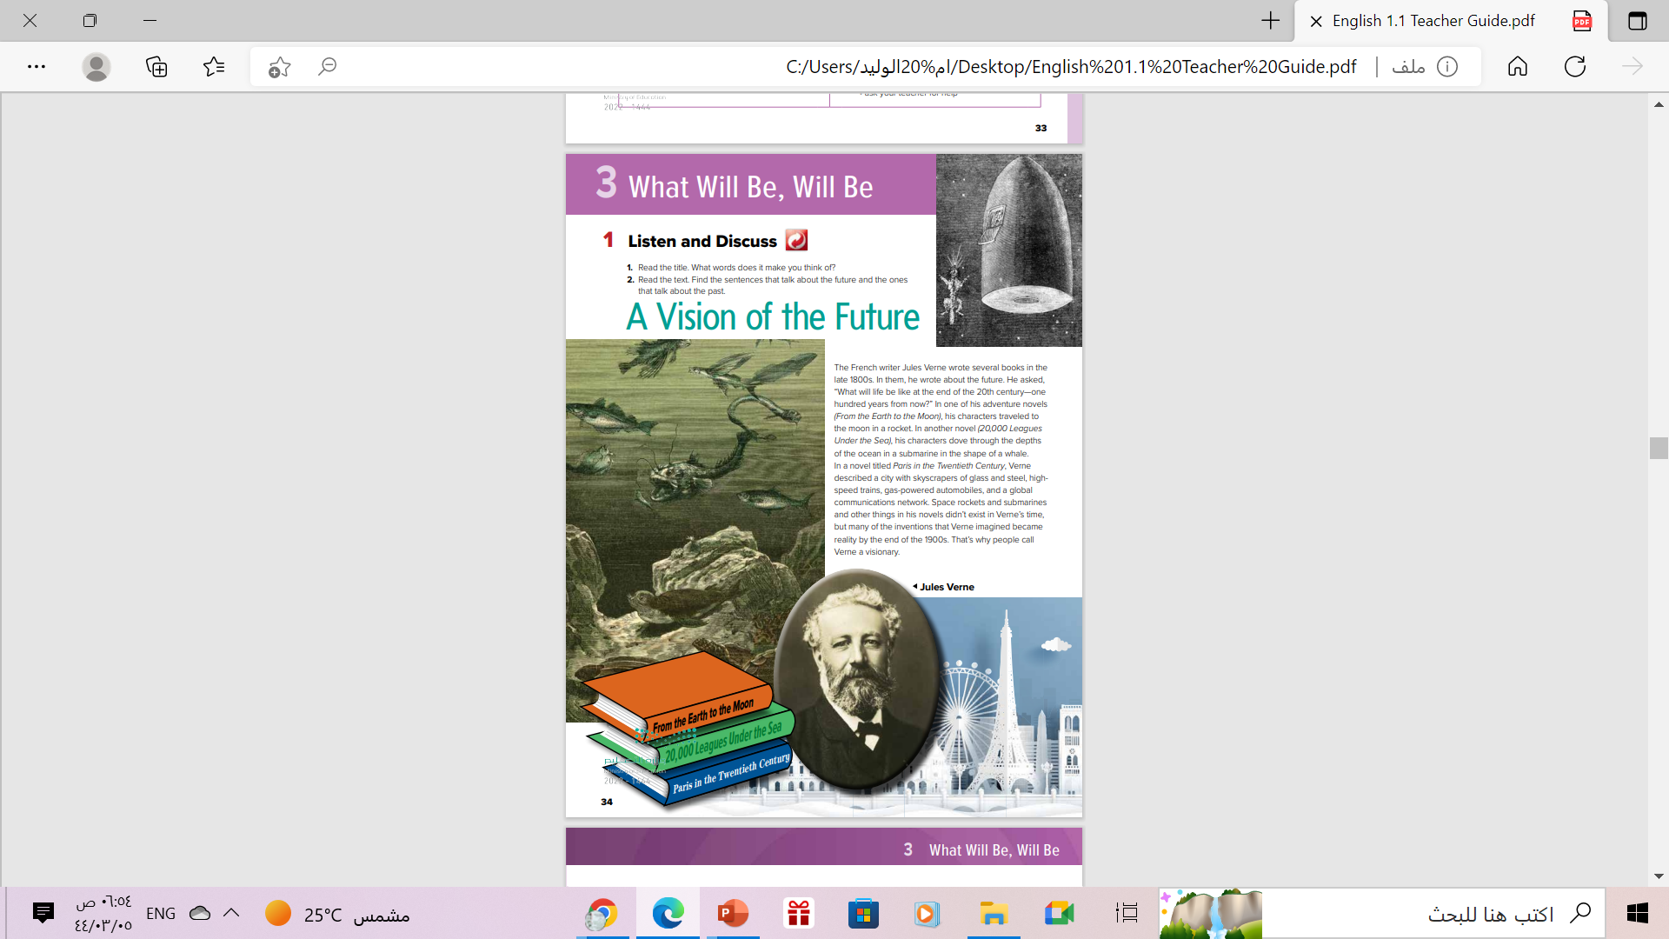
Open
Student’s book , page (34)

Slide 7
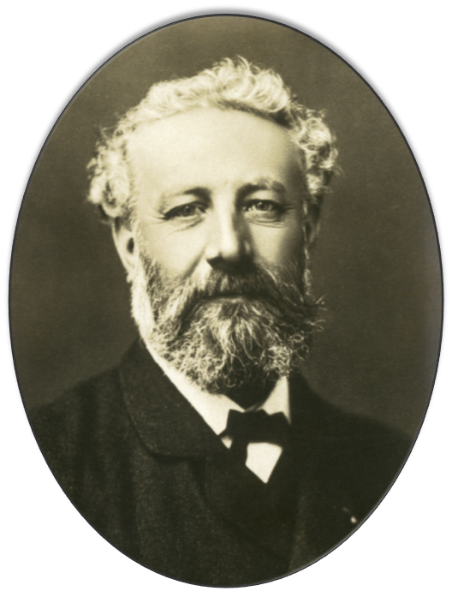
What do you know about Jules Verne ?
He was a French novelist who lived from 1828 - 1905, and he is considered the father of science fiction.
Jules Verne

Slide 8
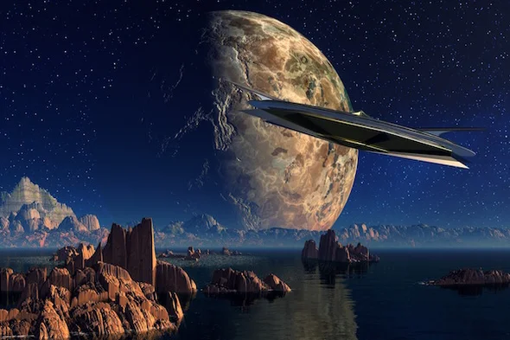
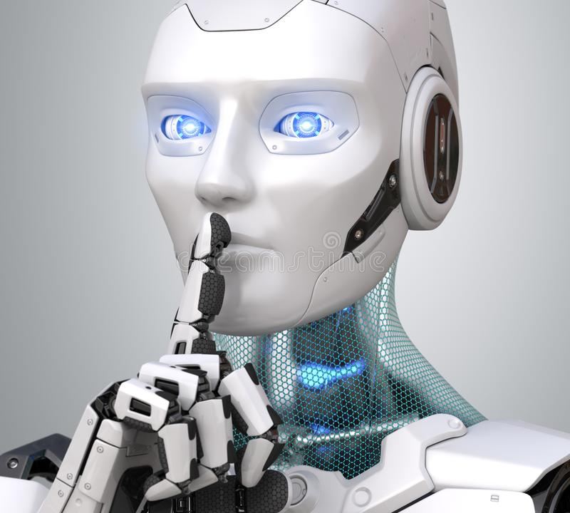
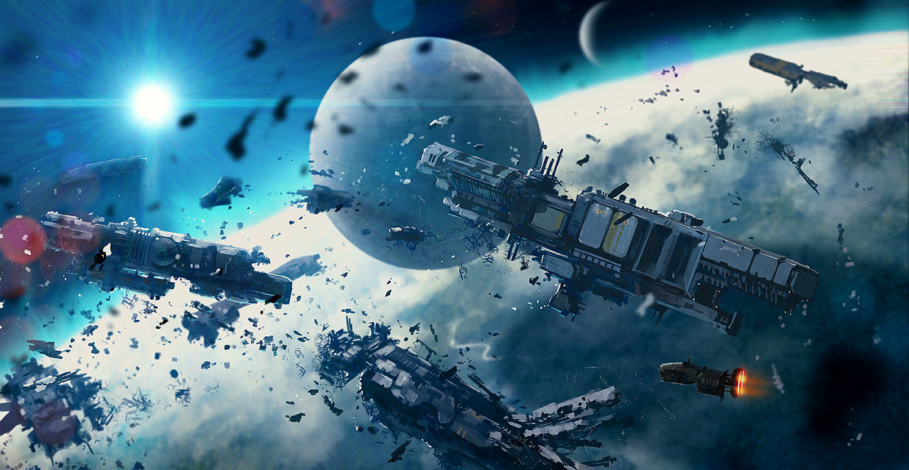
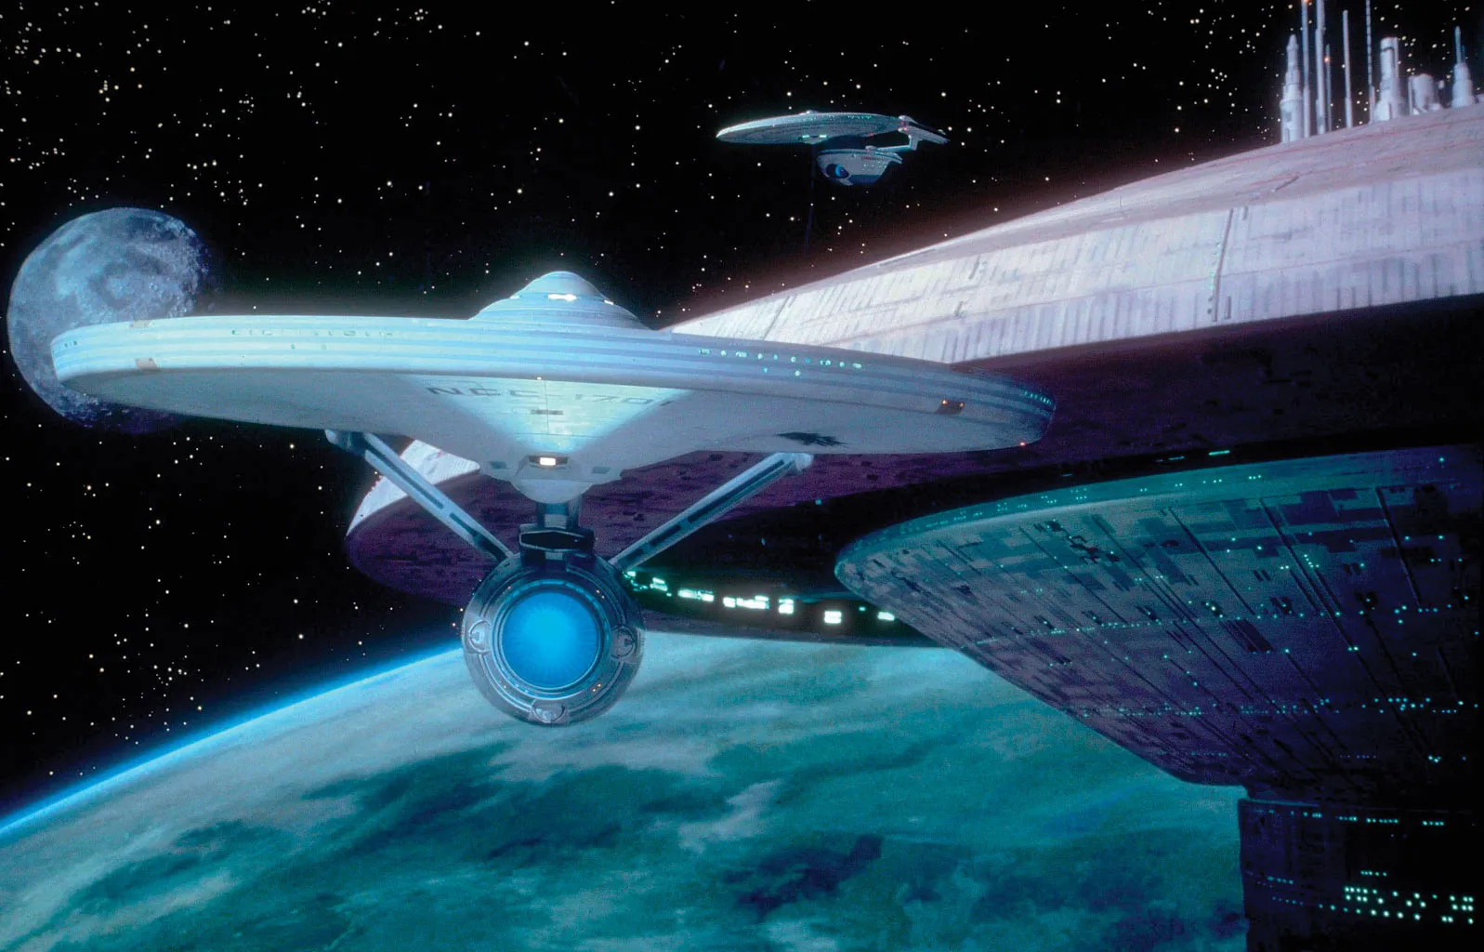
science fiction
It is a type of fantastic literature based on science or
pseudoscience. It had its beginnings in the late 19th
century.
At that time, things such as robots, space travel, and invasions from outer space were fantasies, but considered within the realm of future possibility.

Slide 9

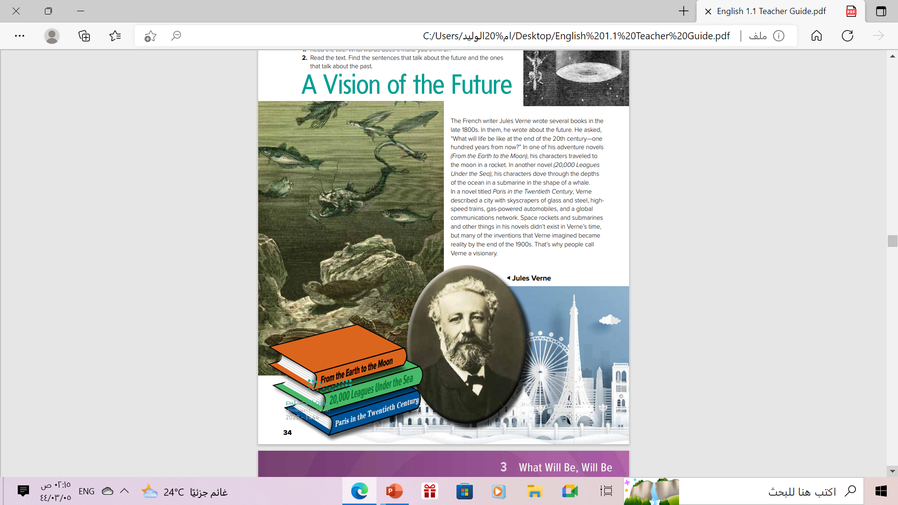
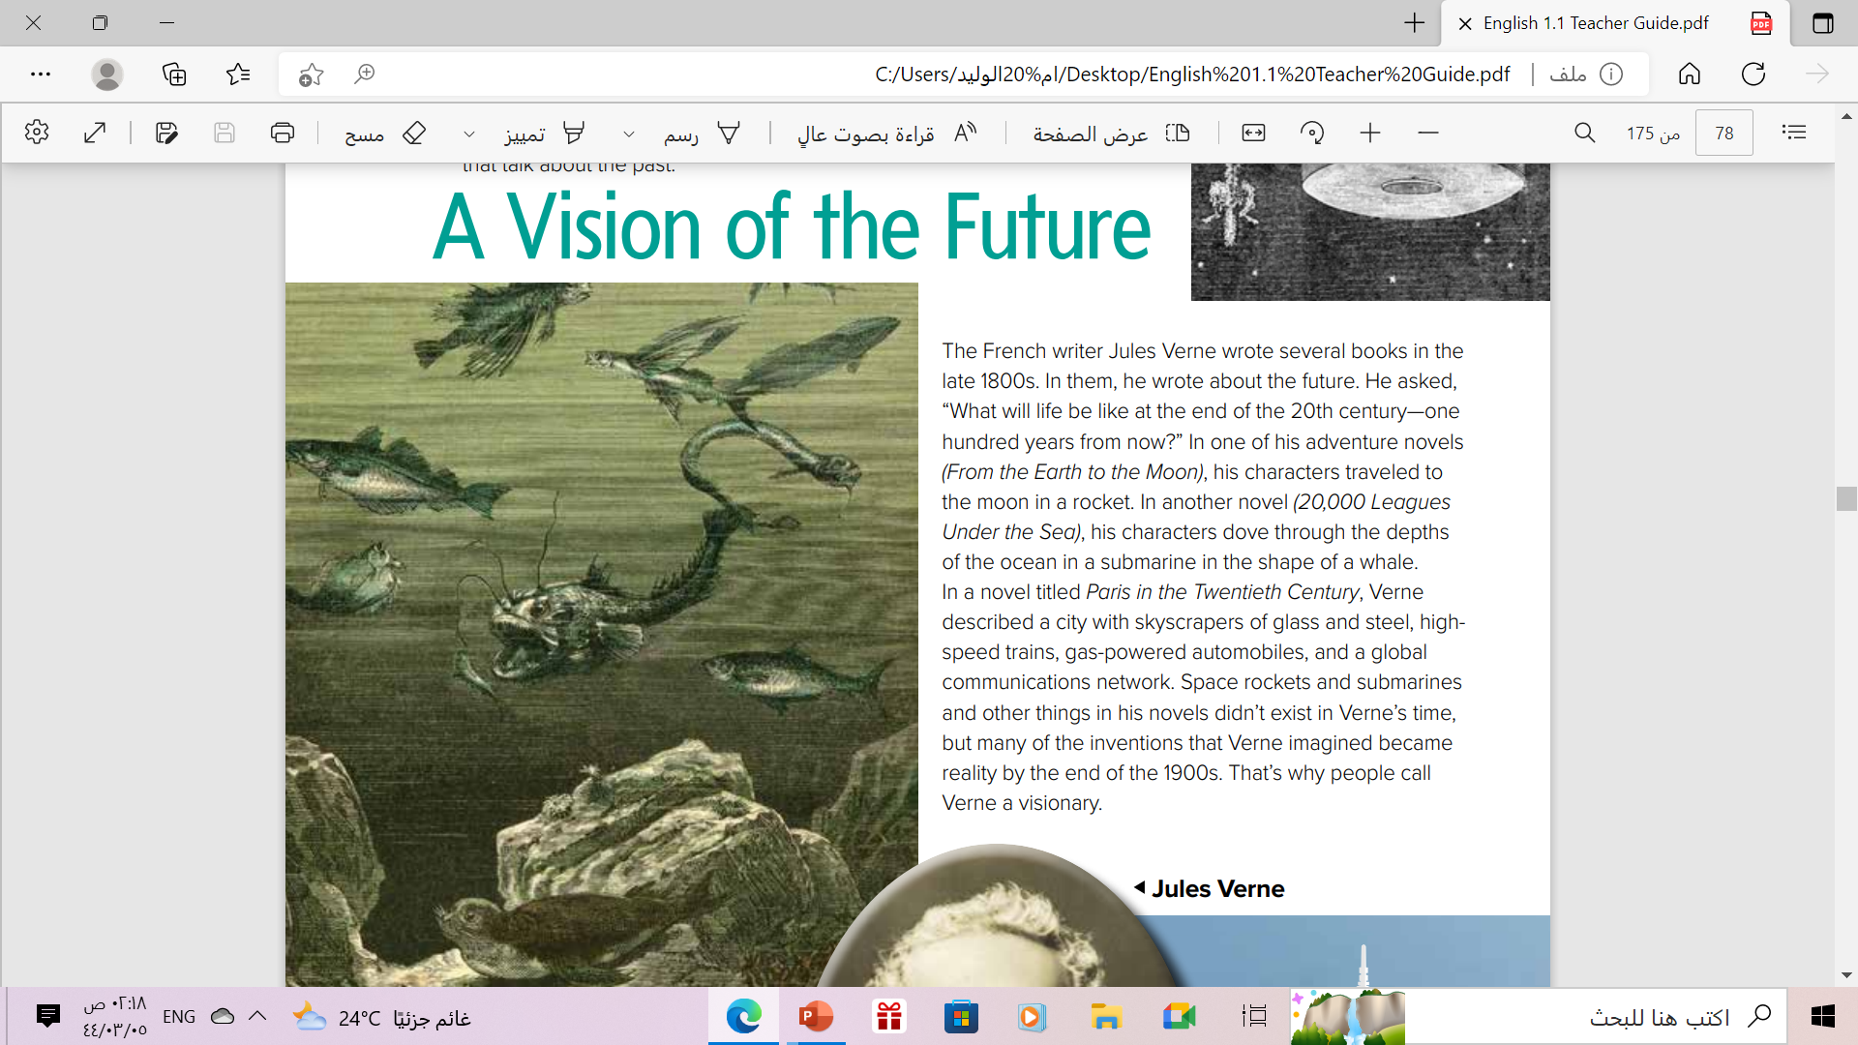
Find the sentences that talk about the future?
Find the sentences that talk about the Past?

Slide 10

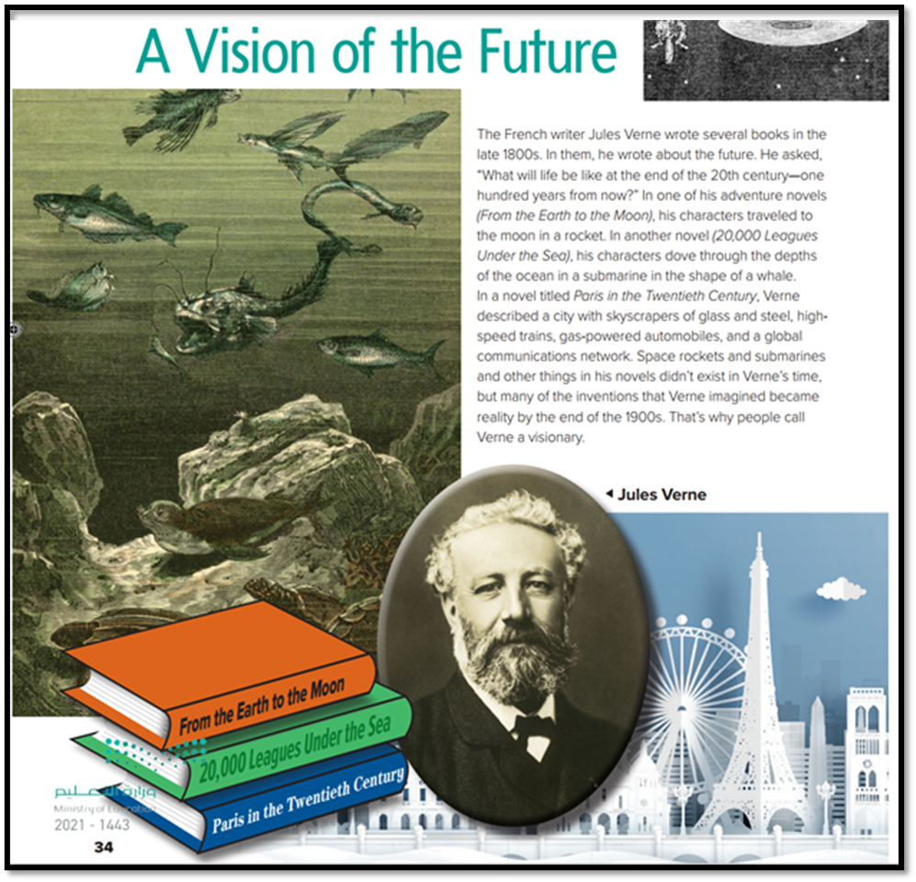
What is the title of the text ?
A vision of the Future
What does “ vision” mean?
The ability to see
Why do people call him a visionary?
He could “see” into the future

Slide 11
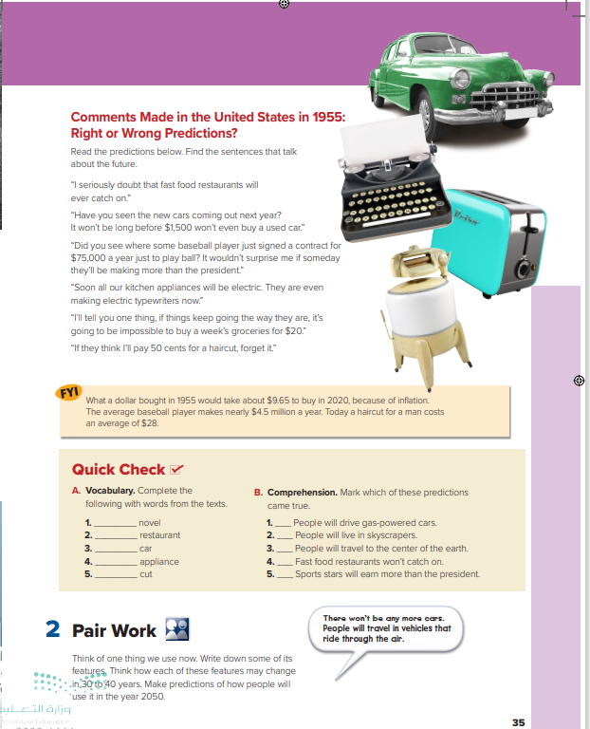
Open
Student’s book , p.( 35 )

Slide 12
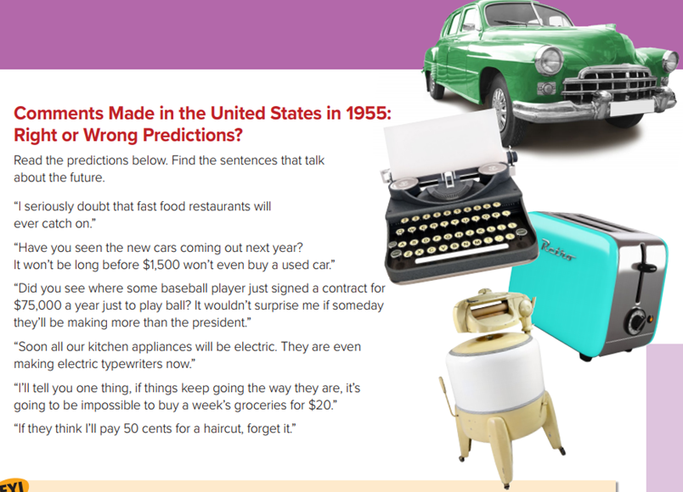
What can you see in the photos?
Can you say if the prediction was right or wrong?

Slide 13

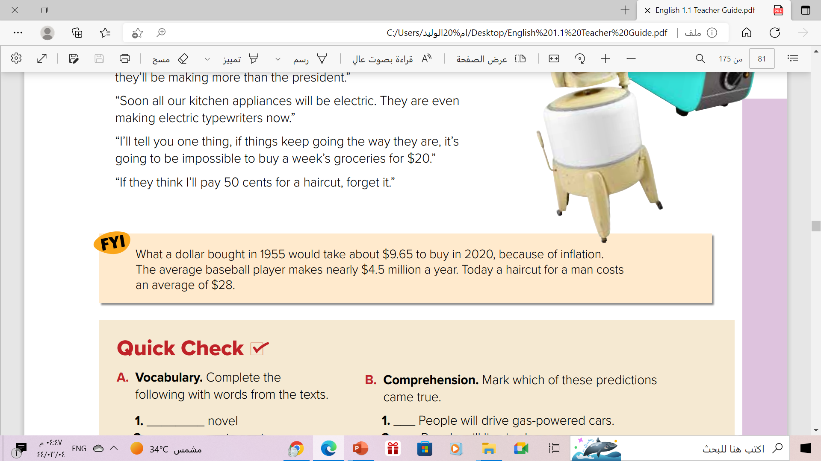
Read

Slide 14
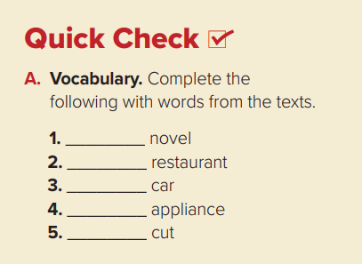
adventure
Fast food
used
kitchen
hair

Slide 15
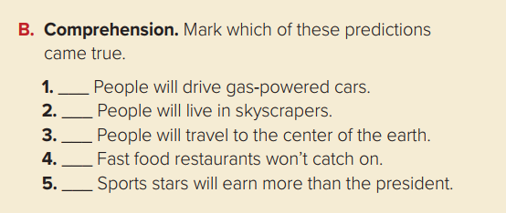


Slide 16
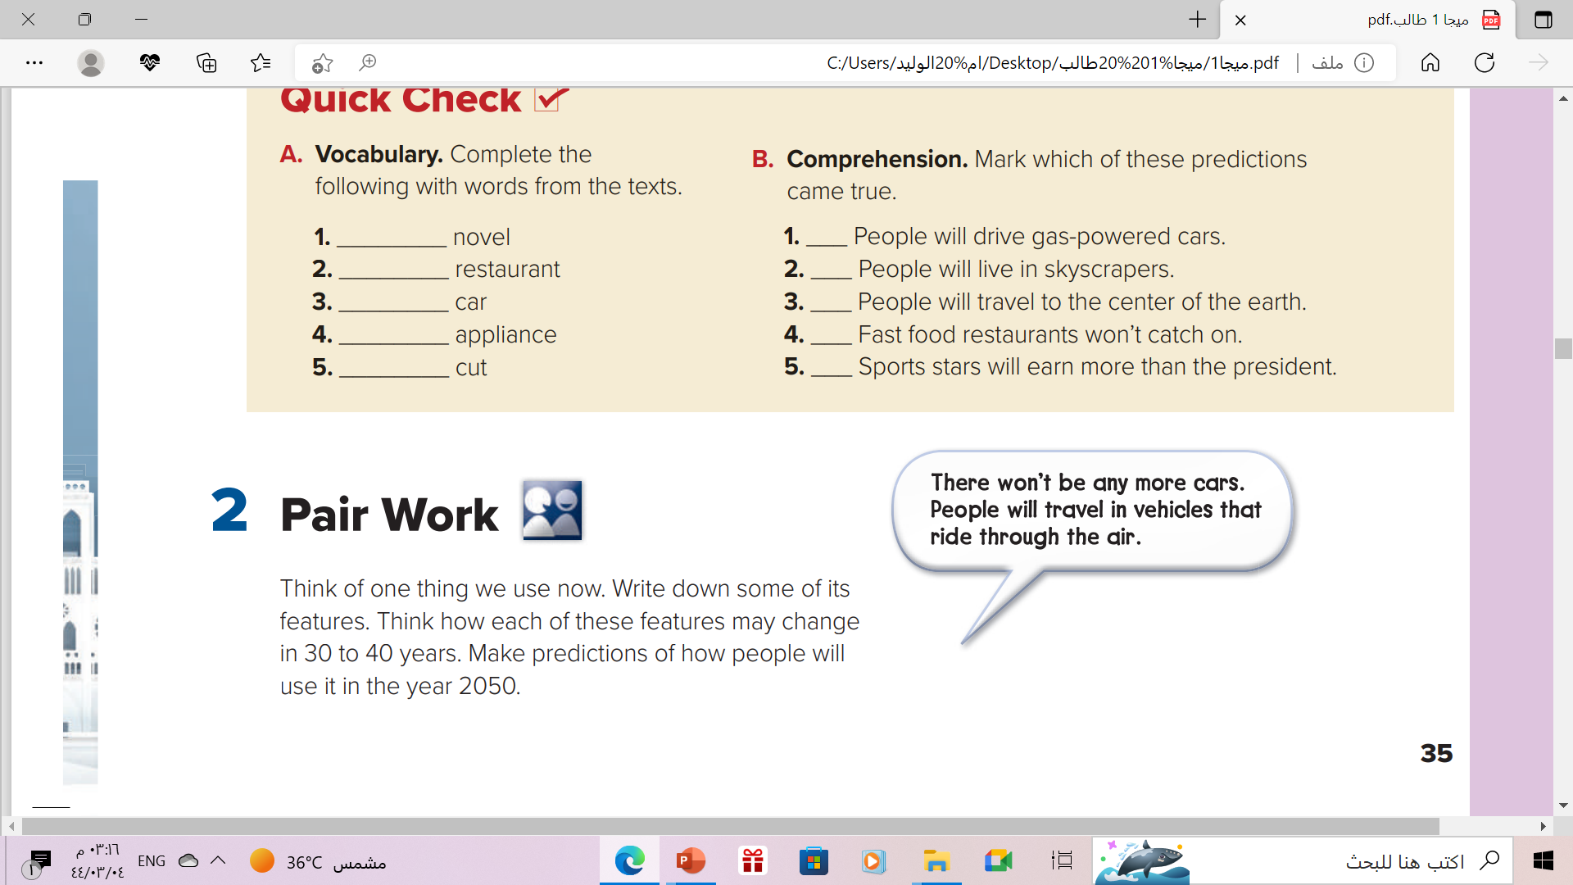

Slide 17
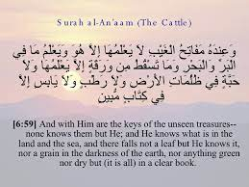
Remember
These are just predictions
Not anymore , because no one knows about future except
Allah

Slide 18
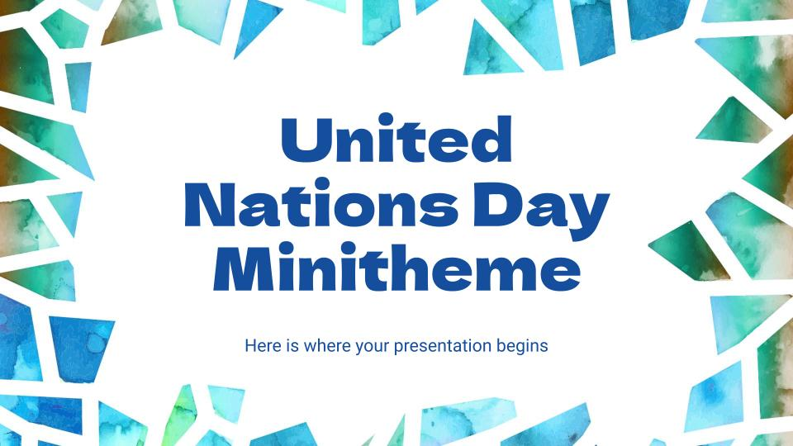
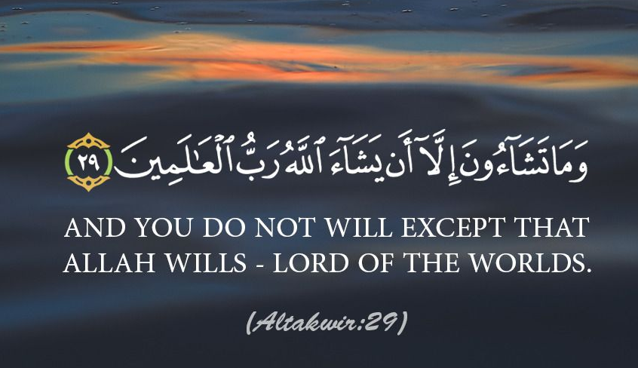
From The Holy Qura’n

Slide 19
Homework
Workbook P.(99)
Exercise (A)

Slide 20

Thanks!

Slide 21






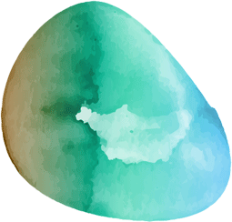


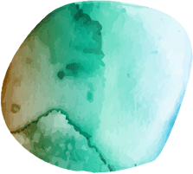
Alternative resources
Here’s an assortment of alternative resources whose style fits that of this template:
Vectors
Watercolor mosaic background
Abstract watercolor mosaic background
Blue and green watercolor mosaic background

