Slide 1
Mega Goal 1.1
U: 3
Grammar
By Manal

Slide 2

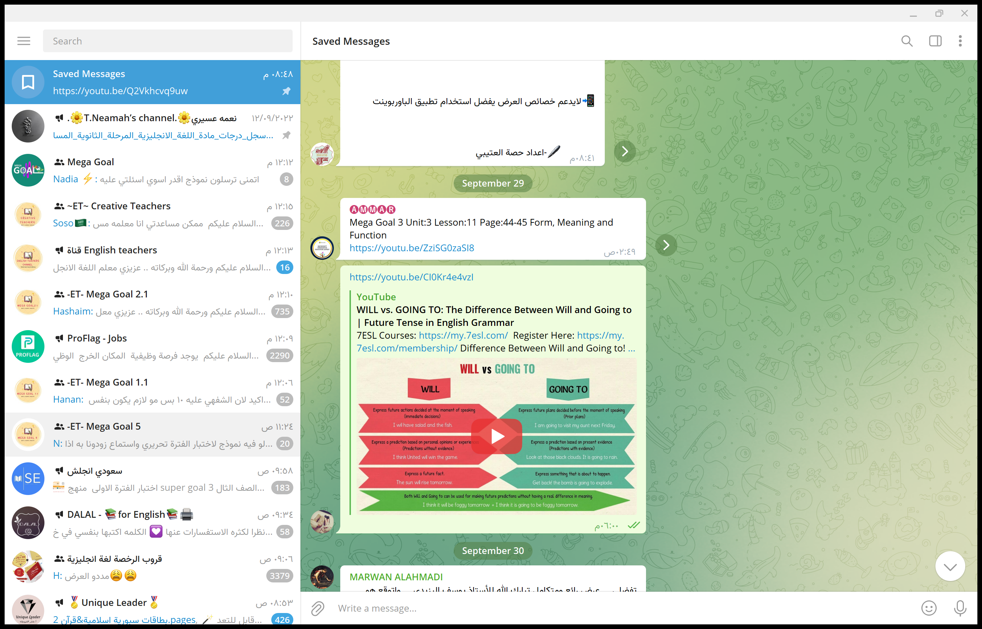

Flipped Classroom

Slide 3
Open your Student’s book at page: 36

Slide 4

Lesson Goals
01
02
03
04
use
make
will & be going to make predictions about the future
negative & questions in the future and answer them
the future
know
use
the differences between will and be going to
the future progressive for continuous actions in the future

Slide 5

Quick Check
Future? Yes | No
They are playing football right now.
We will travel to Jeddah.
I was playing football at 4:30.
I’m going to visit my old friend.
He is going to take the car.
Sara is meeting her sister at the moment.
They are going to stay in the hotel.

Slide 6
Quick Check
Future key words?
We will travel to Jeddah.
I’m going to visit my old friend.
He is going to take the car.
They are going to stay in the hotel.
They are playing football right now.
We will travel to Jeddah.
I was playing football at 4:30.
I’m going to visit my old friend.
He is going to take the car.
Sara is meeting her sister at the moment.
They are going to stay in the hotel.

Slide 7
01
Future with will orBe Going To

Slide 8
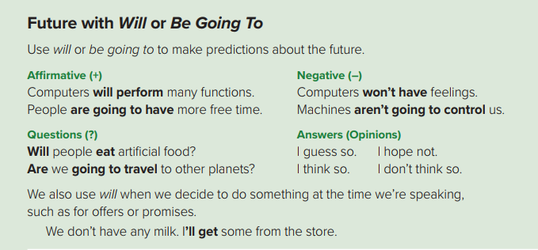

Slide 9
There are several ways to express the future
Let’s see two of those ways
Will ( ‘ll )
1
be going to
2

Slide 10
Future with will or Be Going To
Use: To make predictions about future.
affirmative
Answers
(opinions
negative
Question?
The kids will go to the museum alone
The kids won’t go to the museum alone
Will the kids go to the museum alone?
I guess so
I think so
(Yes Response)
He is going to watch
a movie tonight
He isn’t going to watch
a movie tonight
Is he going to watch
a movie tonight?
I don’t guess so
I don’t guess so
( No Response)

Slide 11
Negative
Subject
will
not
Main verb
They will not ( won’t ) fix their car .
Will + not = won’t
Subject
am / is / are
not
going to
Main verb
The sky is not going to rain .

Slide 12
Questions
Will
Subject
Main verb
?
Will Sami visit Jeddah next week ?
Am / Is / Are
Subject
going to
Main verb
?
Are they going to play tomorrow ?

Slide 13

Find the fib
She is going to joins us

Slide 14

Find the fib
I will visited my old friend

Slide 15

Find the fib
They is going to stay.

Slide 16



Is the vision optimistic about the future of Saudi Arabia?

Slide 17
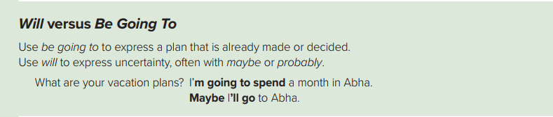
02
will versus Be Going To

Slide 18
will versus Be Going To
Will
be going to
We use will with :
1) a promise
I will call you when I arrive .
2) an offer
She will look after the children .
3) Expressing uncertainty ,
often with maybe or probably .
He will probably arrive late tomorrow
We use be going to with :
1) Expressing a plan that is already made or decide
We are going to spend our vacation in Abha .
2) Predictions based on what we can see
at the moment
Look at the clouds ! It is going to rain .

Slide 19
Venn digram strategy
Be + Going to
will

Slide 20
Venn digram strategy
Be + Going to
will
Future
actions
Predicting
Uncertain plans
a promise
offer
Future plans
Predictions based on what we can see at the moment
V + inf

Slide 21
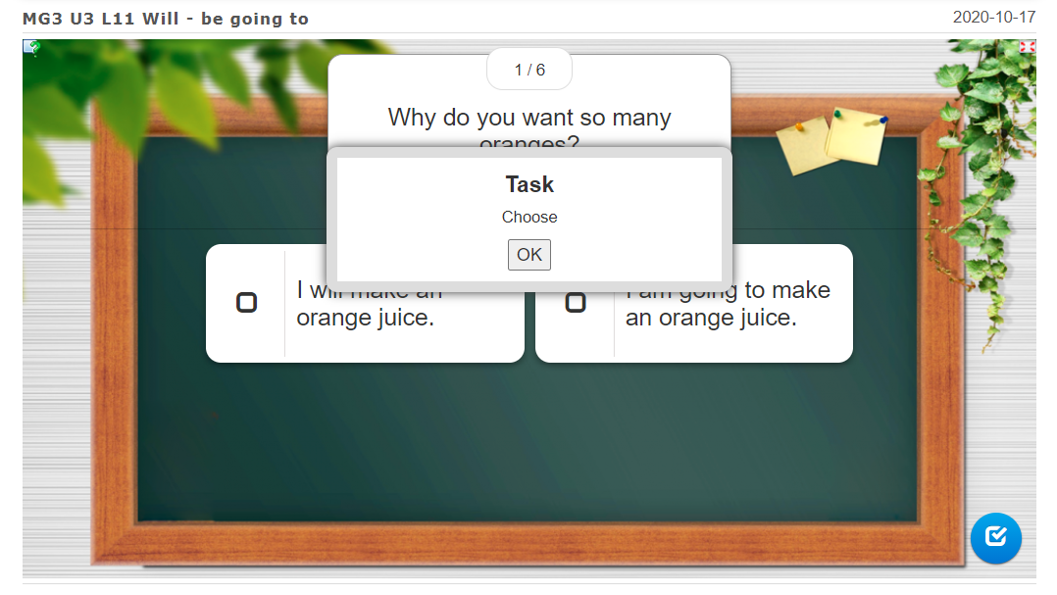

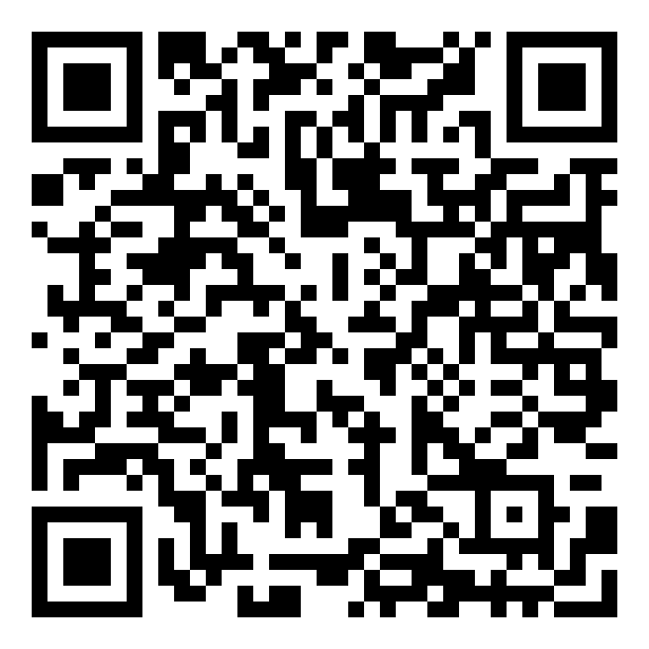
Quick Check
https://learningapps.org/watch?v=piqc6dghc20

Slide 22
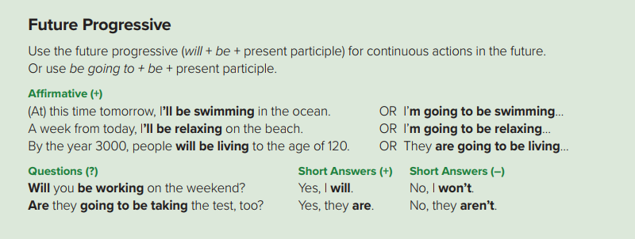
03
future progressive

Slide 23
Futuer
progressive
Now
2022
future
We use it for continuous actions in the future
Subject
Will
be
V- ing
Subject
am / is / are
going to
be
V- ing
At this time tomorrow, I will be swimming in the ocean
At this time tomorrow, I’m going to be swimming in the ocean .

Slide 24
Questions
Will
Subject
be
V- ing
?
Will they be working on the weekend ?
Am / Is / Are
Subject
going to
be
V- ing
?
Are they going to be working on the weekend ?

Slide 25

Quick Check

Slide 26


Next weekend,
what will you be doing?
In weekend, ………..

Slide 27
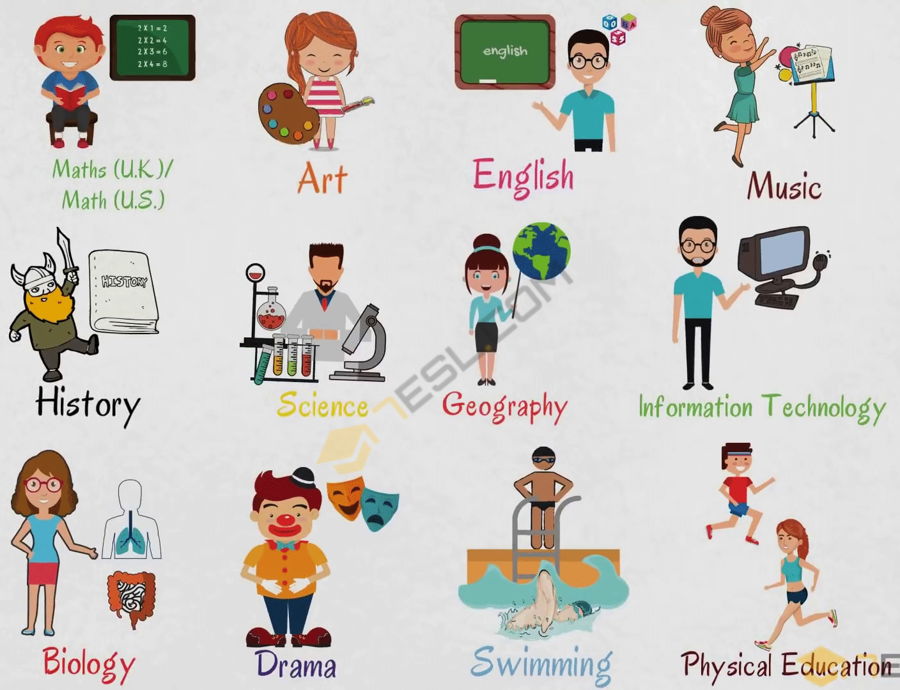
Witch of the folowing (subjects ) do you think
students at the secondary level
will still be studying in the next 10 years?
Whitch of the following
do you think will be
taught in the next 10 years ?

Slide 28
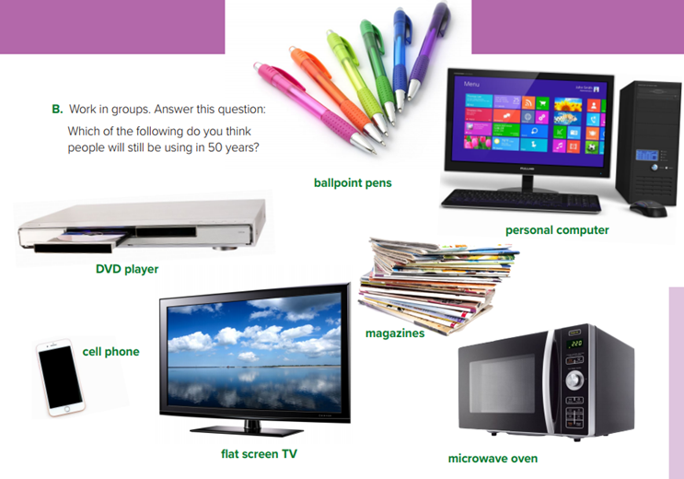
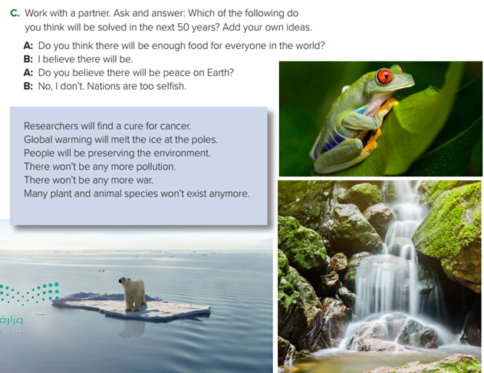
St Book
p. 37

Slide 29
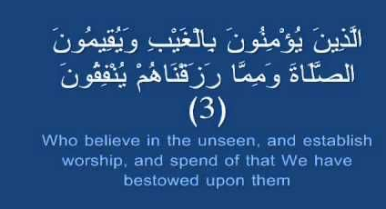

Slide 30

Workbook P. 101
Exercise D

Slide 31
Have a nice day
THANK YOU!
Lesson done by: Manal AlThagafi

