Slide 1
Unit3
What Will Be , Will Be
Grammar
Mega Goal 1.1
Done by : Entisar Al-Obaidallah

Slide 2
Lesson Objectives
Use
Make
01
02
Ask
Distinguish
03
04
will & be going to make predictions about the future
negative sentences using future tense
Questions using the future tense
Between will and Be going to correctly

Slide 3
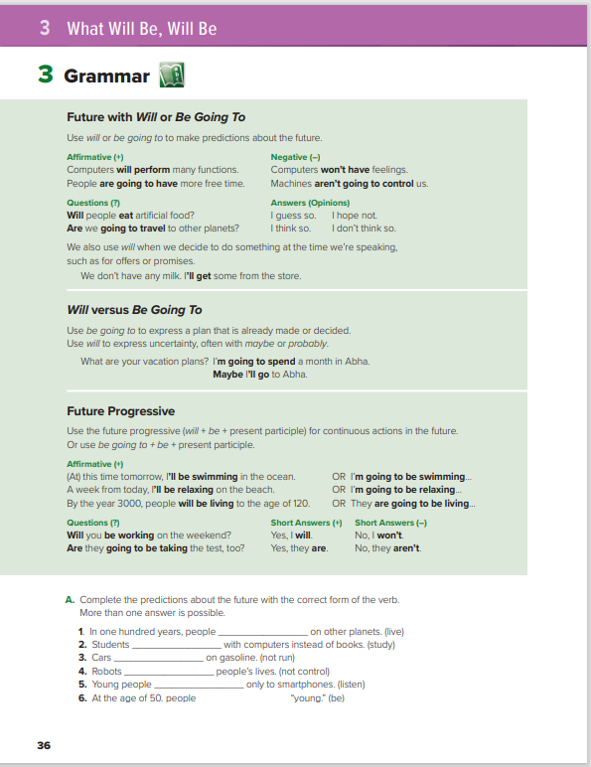
Open
Student’s book ,p.(36)

Slide 4
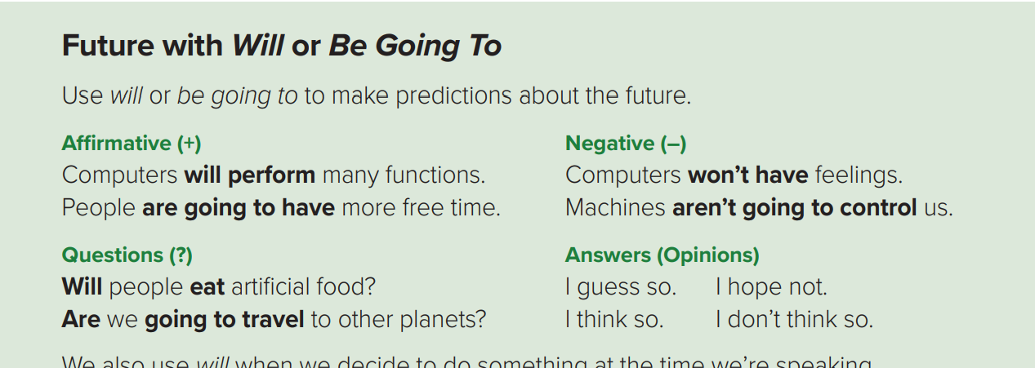

Slide 5
Form:
Affermative
Will / Going to
V ( infinitive)
Negative
Will / Going to
Not
V ( infinitive)
Question
Wh-Word
Will
subject
V ( infinitive)
Wh-Word
Be( am-is-are)
subject
V ( infinitive)

Slide 6
Examples OF will
Positive (+)
They will watch a horror film.
Negative (-)
They won’t (will not) watch a horror film.
Question (?)
Will they watch a horror film?
Yes, they will. / No, they won’t.

Slide 7
Examples OF BE GOING TO
Positive (+)
He is going to travel to England in the summer.
Negative (-)
We aren’t going to enter the exam.
Question (?)
Are you going to come to school tomorrow?
Yes, I am. / No, I am not.

Slide 8
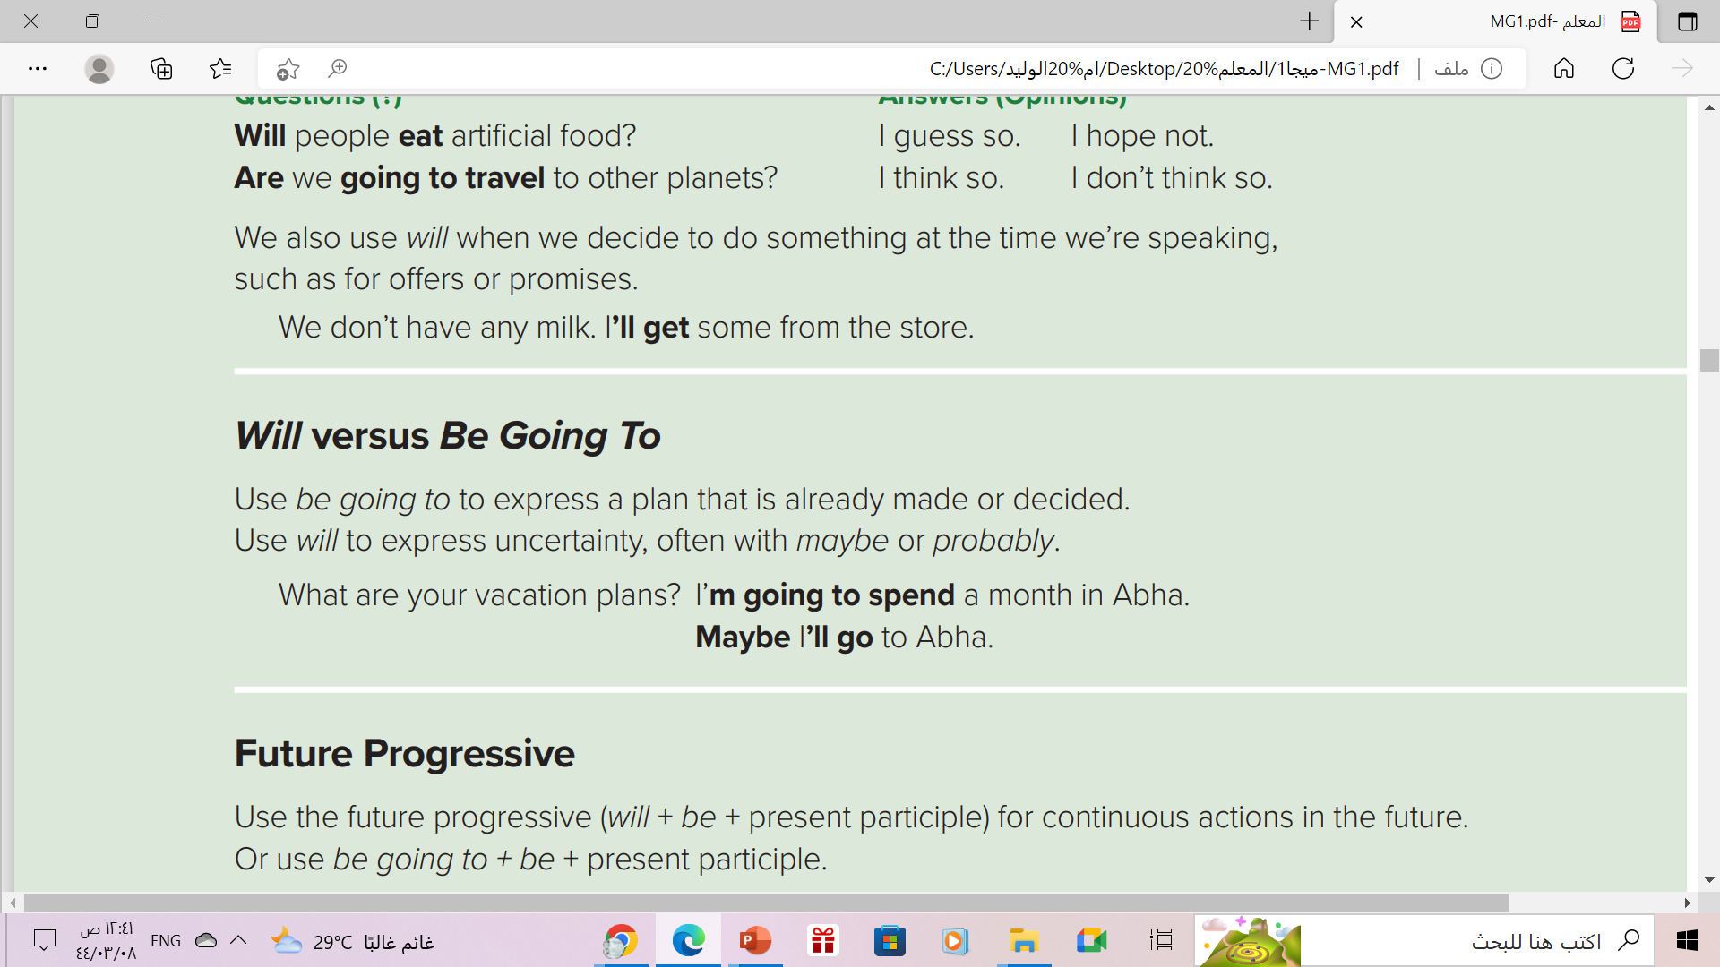

Slide 9

We use Will for:
1- Predictions & uncertainty , especially after I think.., maybe or probably
e.g. I think it will rain.
2- Offers
e.g. I will lend you some money.
3- Promises
e.g. I won’t tell anyone.
4- Decisions you make while you are speaking.
e.g. There isn’t any milk left. I will go to the shops and get some.

Slide 10
We use be going to for:
1- Predictions with proof
e.g. Look at those clouds. It is going to rain today.
2- Planned actions
e.g.
A: Would you like to go to the cinema tonight?
B: Sorry! I am going to study for my Maths test.
3- Intentions
e.g. I am going to work hard next term.

Slide 11
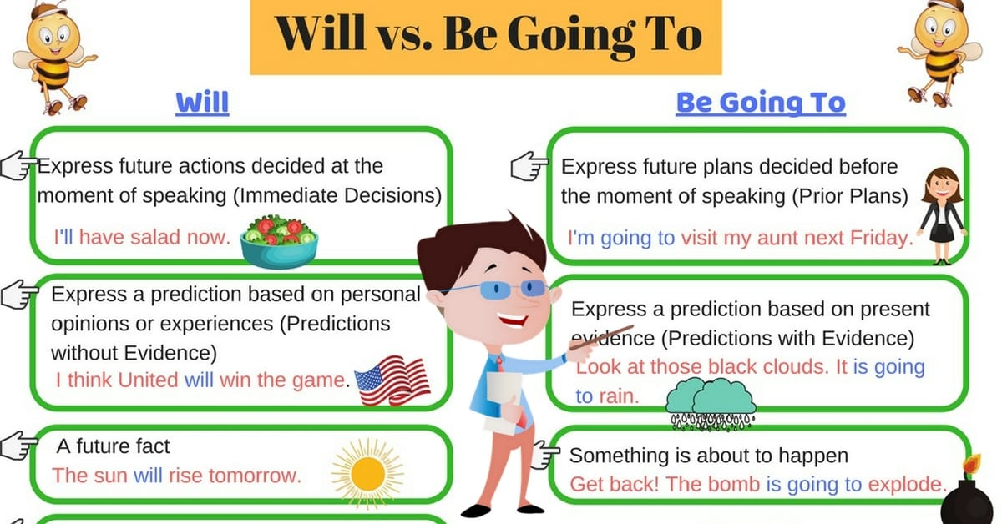

think maybe probably

Slide 12
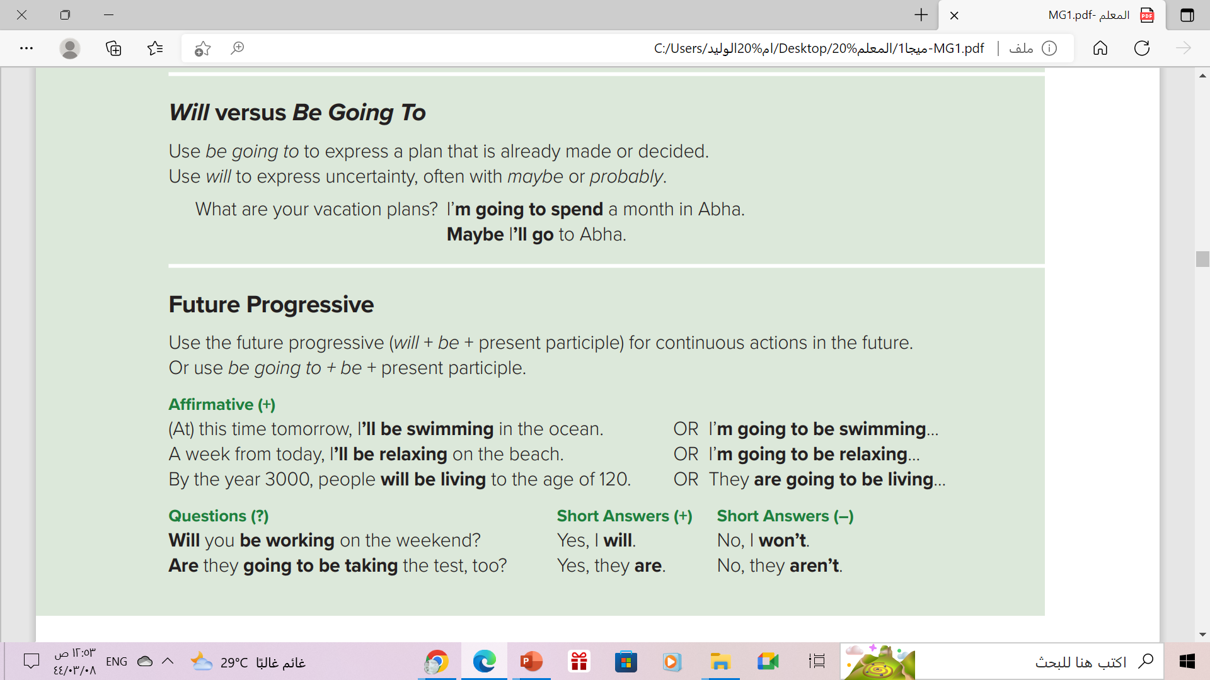

Slide 13
Future Progressive
use for continuous actions in at a certain time in the future *
Use
Form
Will / be going to
be
V -ing
Example
In two months, I will be graduating.
positive(+)
Will you be graduating in two months?
Question(?)
Yes , I will
Short answer (+)
Negative ( - ):
I/you/He/She/It/We/They
will not/won’t be graduating
No , I won’t
Short answer (-)

Slide 14
Future Progressive
S + will + be + V-ing
S + be going to + be + v-ing
At this time tomorrow, I’ll be shopping in the mall.
At this time tomorrow, I’m going to be swimming in the ocean.

Slide 15
The Expressions for the Future Progressive
In two months, …
In a year, …
A week from today, ….
At this time tomorrow, …
This time tomorrow, …
On Thursday
During the next three months
By the year 200……………………
➔(These expressions refer to a specific point
time or to a period of time.)

Slide 16
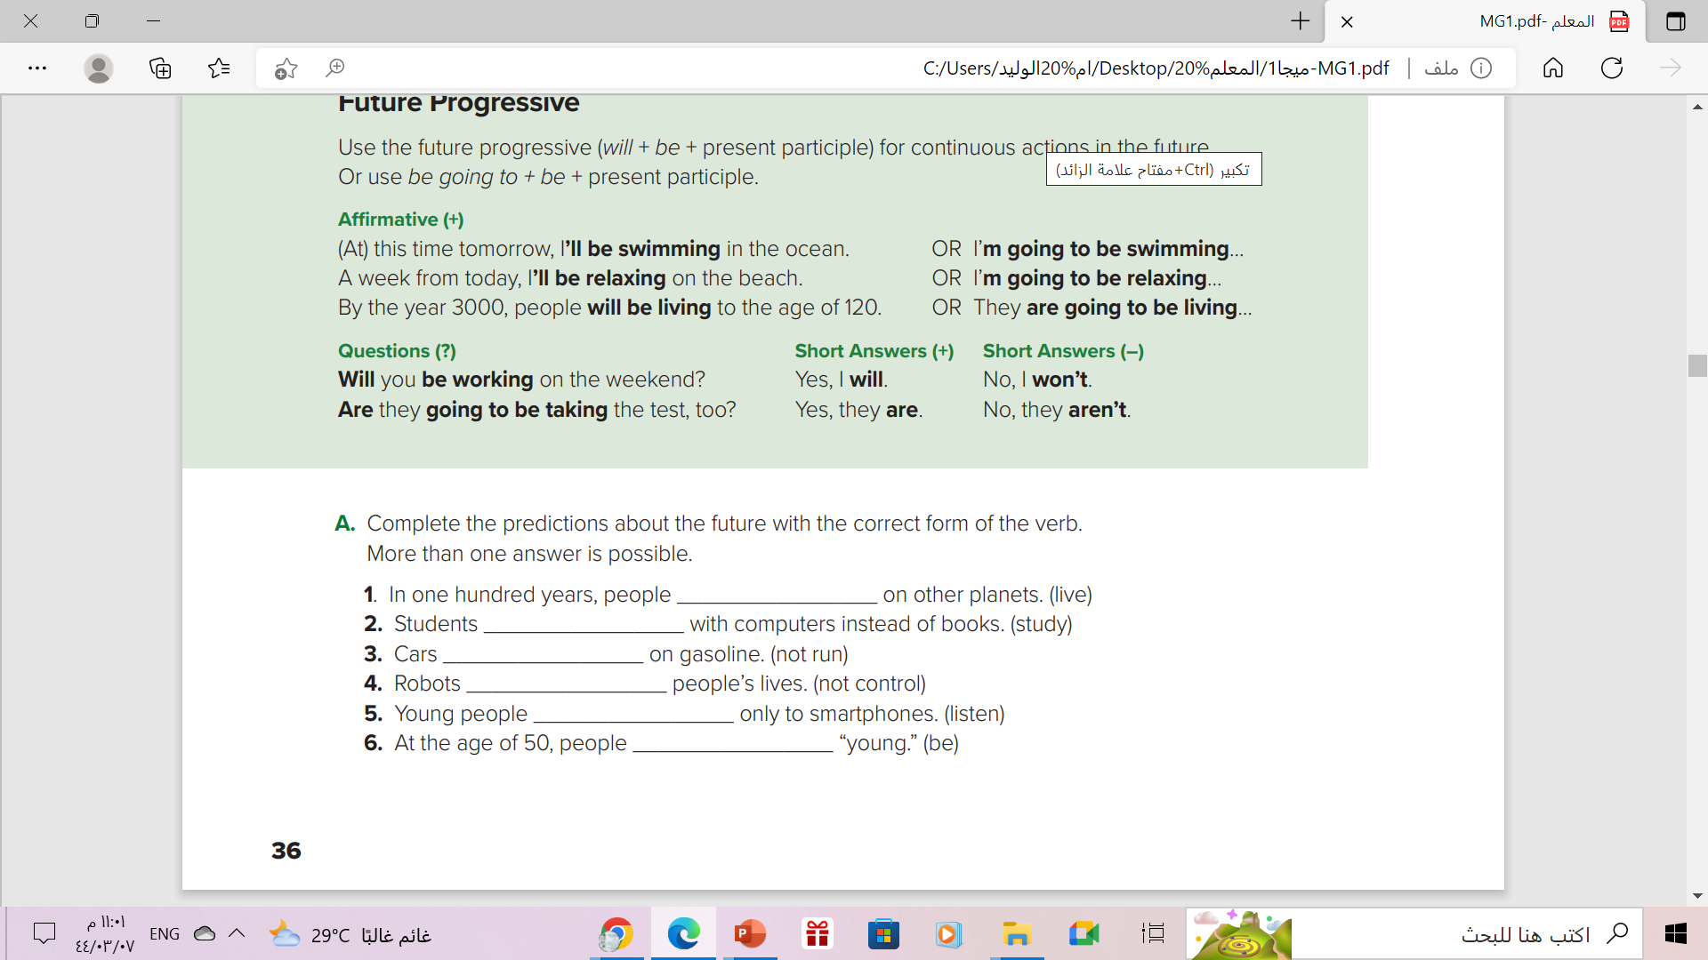
will live / are going to live
1 will live/are going to live/will be living/are going to be living
2. will study/are going to study/will be studying/are going to be studying
3. won’t run/aren’t going to run/won’t be running/aren’t going to be running
4. won’t control/aren’t going to control/won’t be controlling/aren’t going to be controlling
5. will listen/are going to listen/will be listening/are going to be listening
6. will be/are going to be
will study/are going to study
won’t run/aren’t going to run
won’t control/aren’t going to control
will listen/are going to listen
will be/are going to be

Slide 17
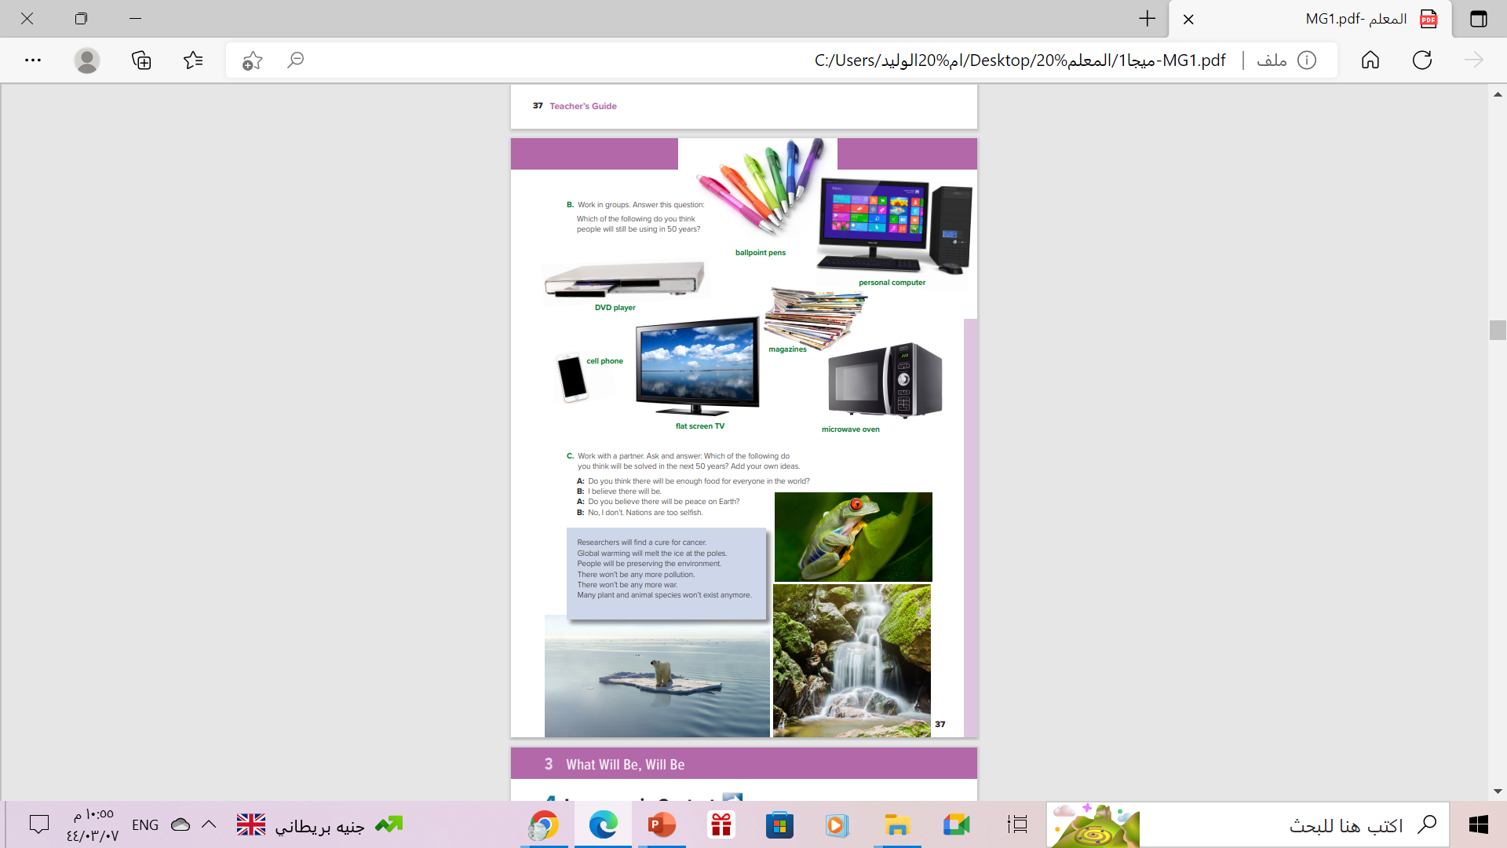
Open
Student’s book ,p.(37)

Slide 18
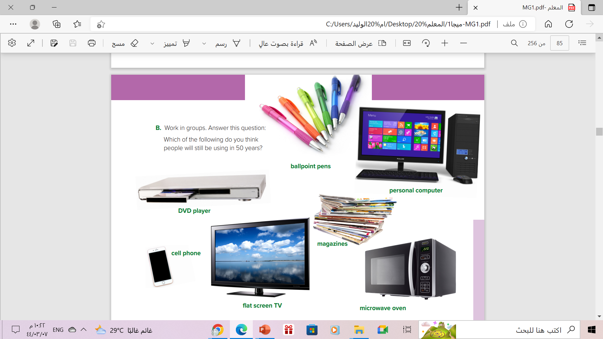

People probably will be using ballpoint pens. People will always need to write. We can’t use computers for everything.
People won’t be reading magazines like we have today. I think people will only read them electronically.

Slide 19
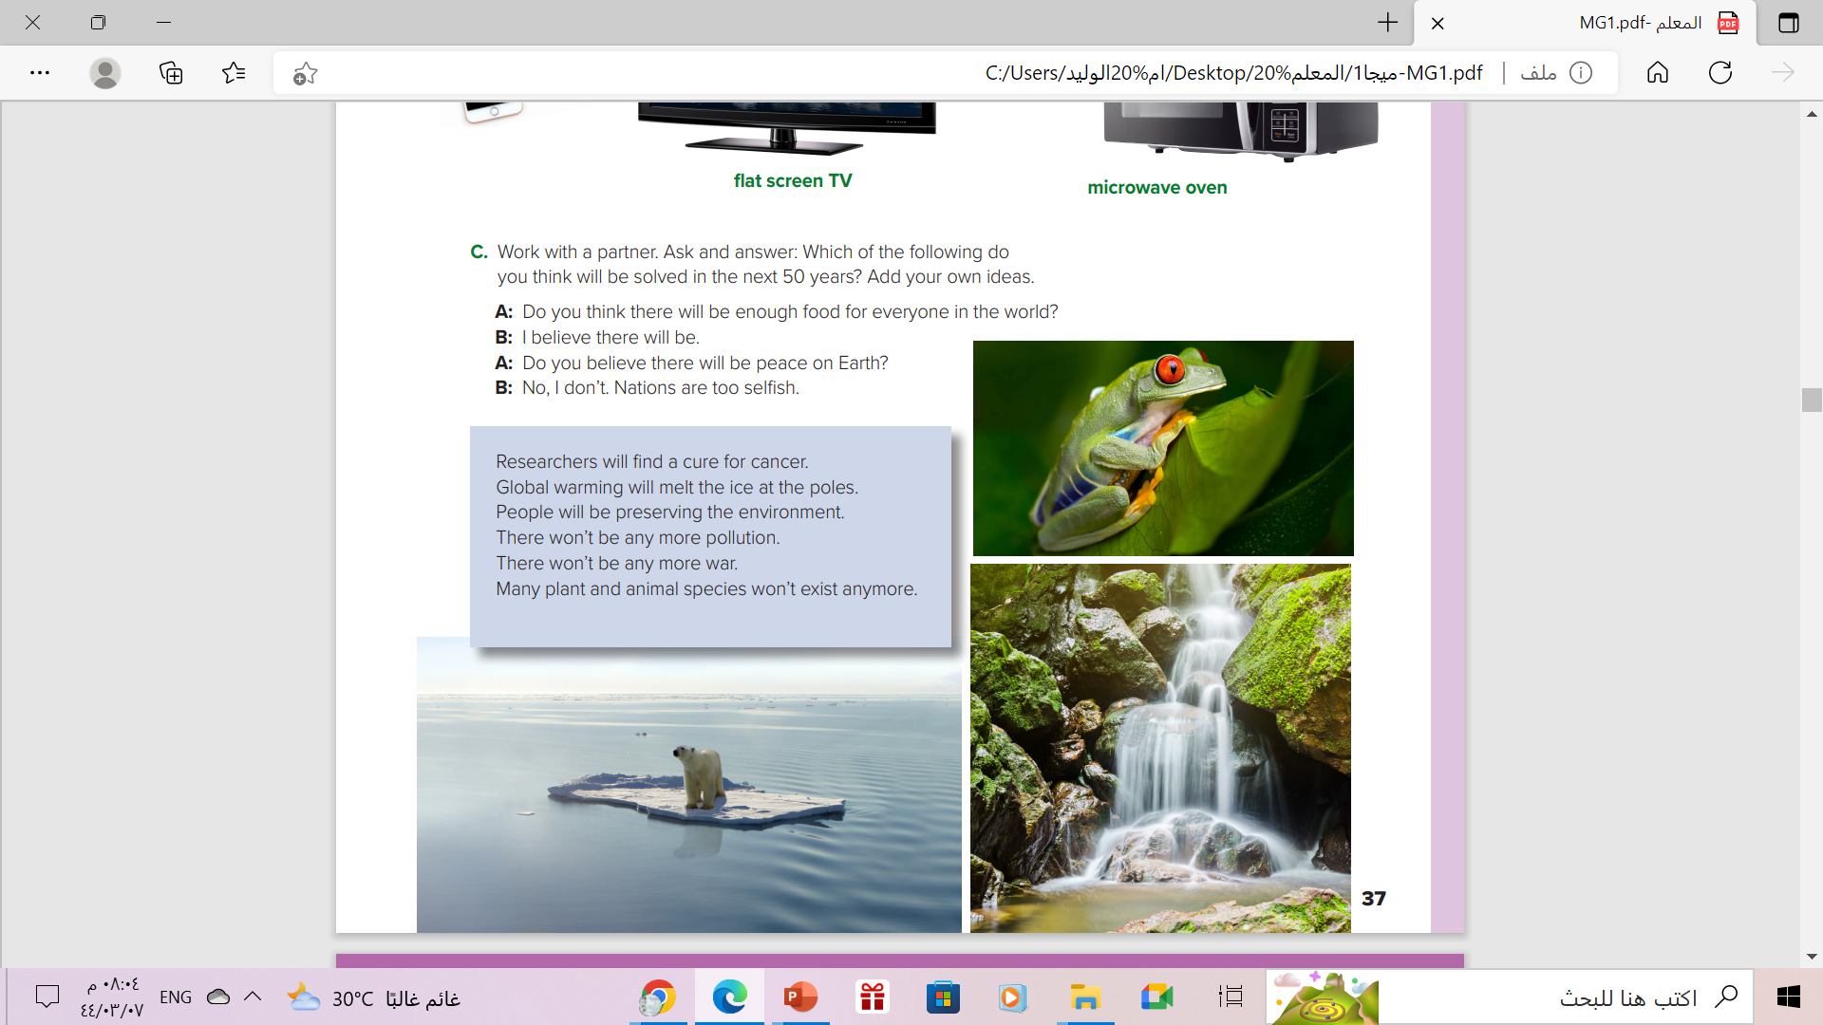
Answers will vary. Sample answer:
A: Do you think there will be enough food for everyone in the world?
B: I believe there will be. Scientists will figure out a way to feed more
people with the resources we have

Slide 20
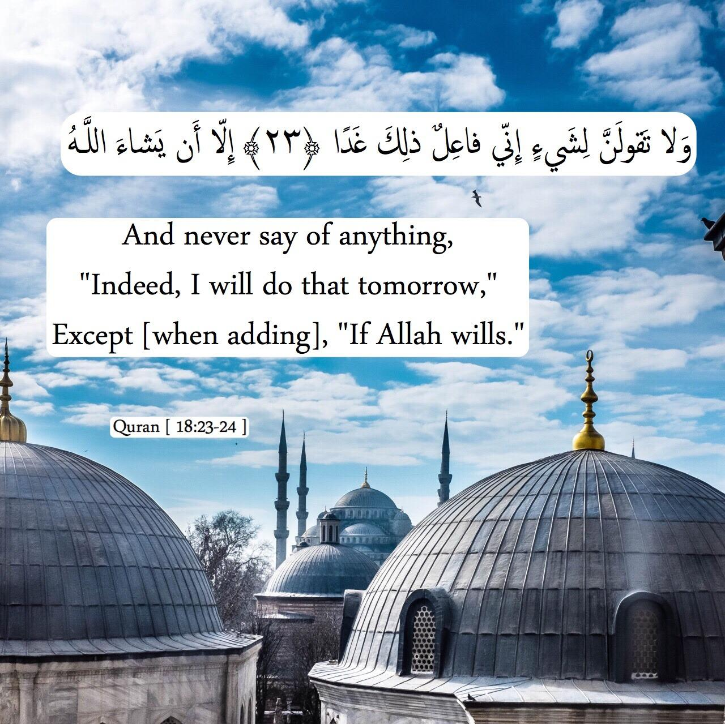

From The Holy Quran

Slide 21
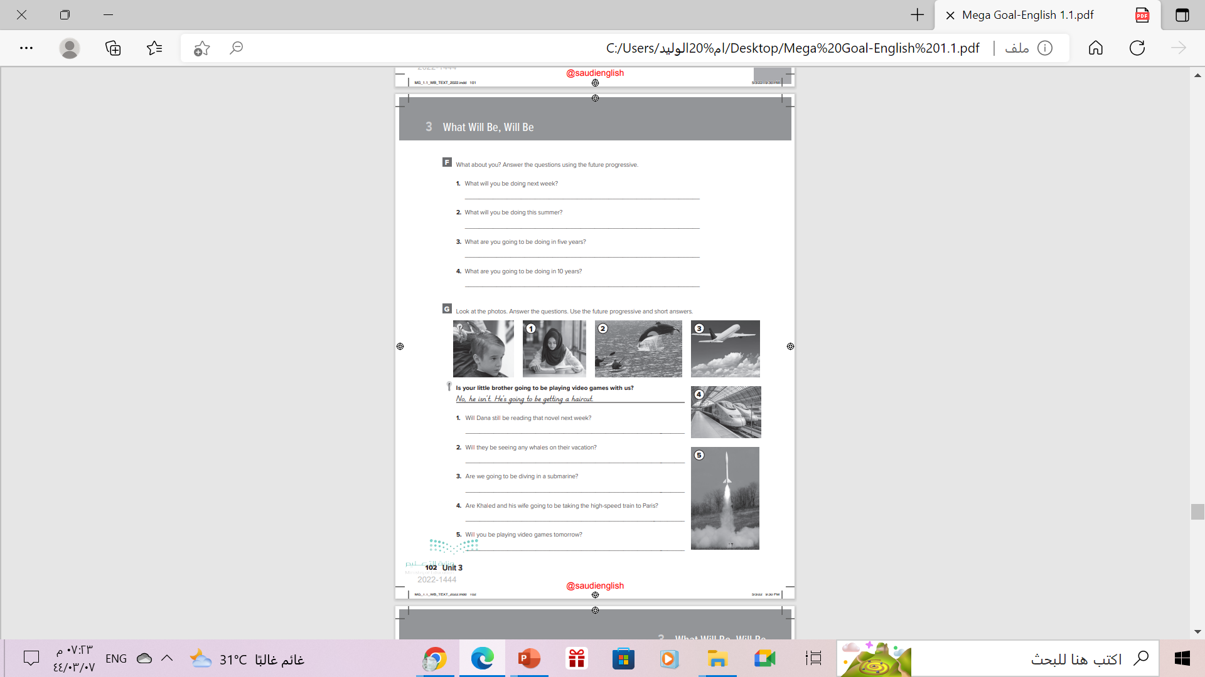
Homework
Workbook P. (102) ,
exercise (F-G)

Slide 22

Thanks!

