Slide 1
Mega Goal 1.1
Unit 3
What Will Be , Will Be
Reading
Done by: Entisar Al-Obaidallah

Slide 2
Lesson Objectives
01
02
03
04
Read
Match
for specific information
the heading to each paragraph correctly .
Deduce
Answer
the meaning of some new words correctly
Some questions about the article corectly

Slide 3
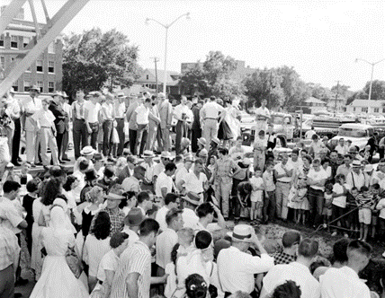
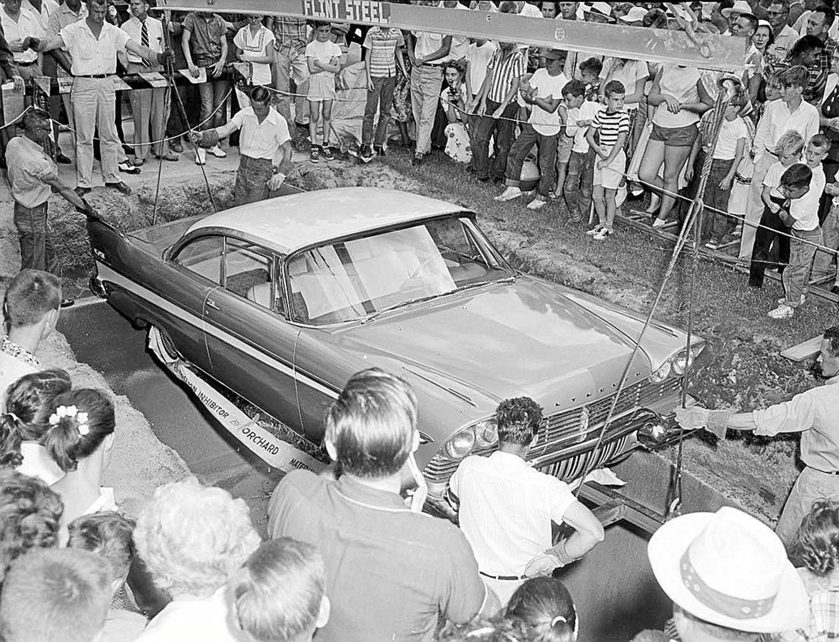
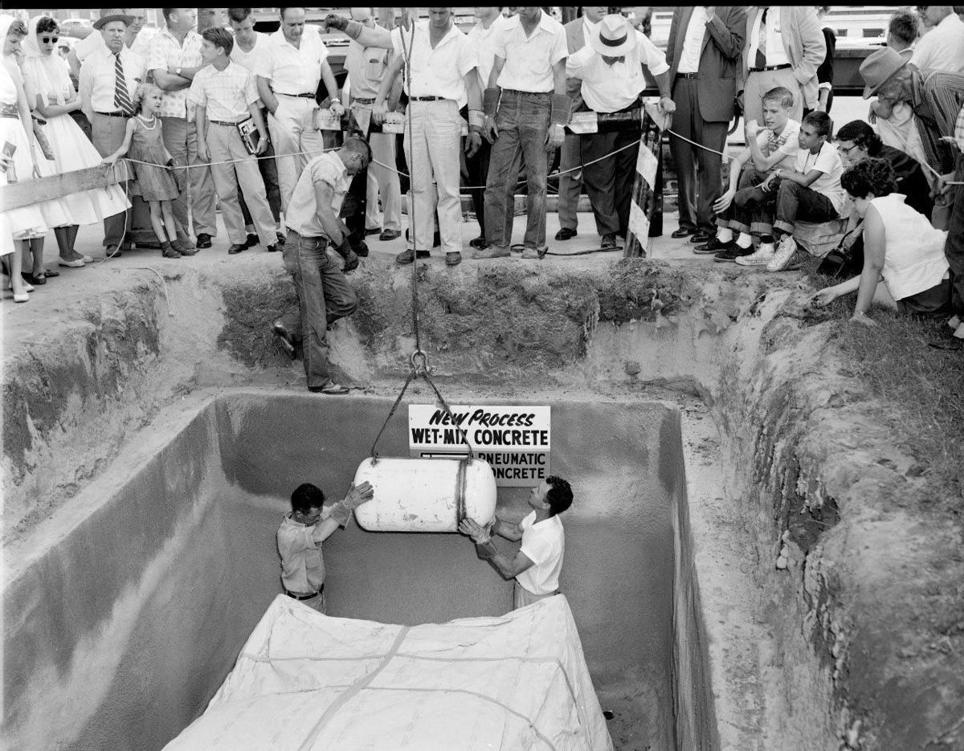
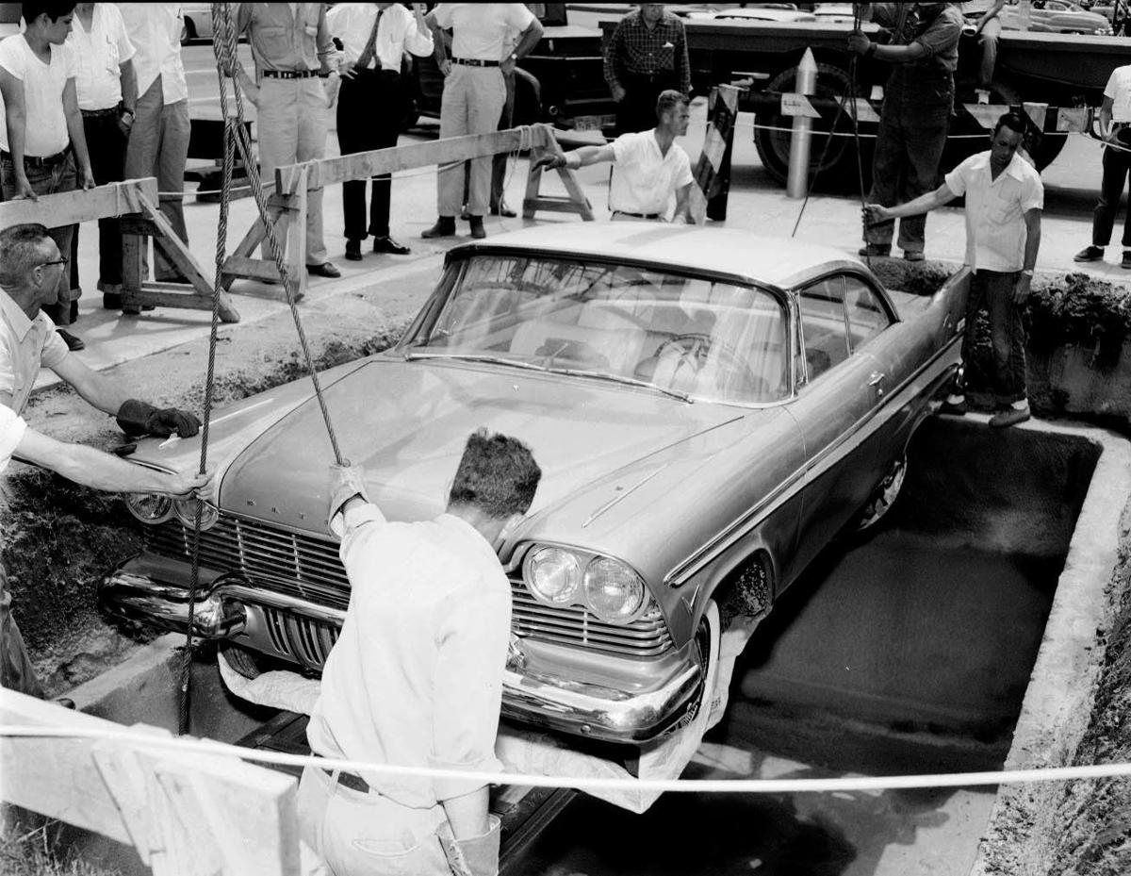
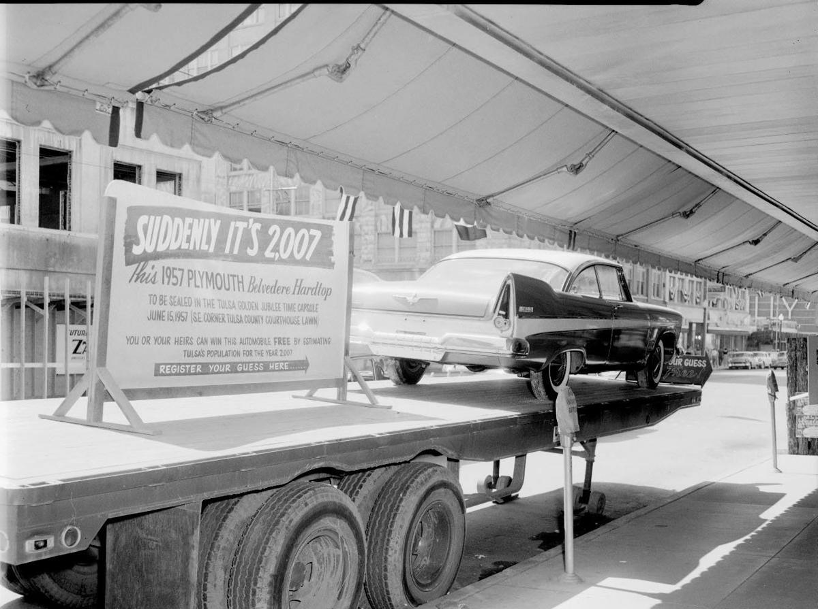
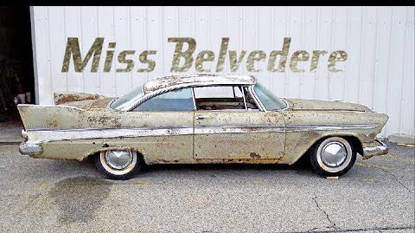
Warm Up: What had happened?

Slide 4
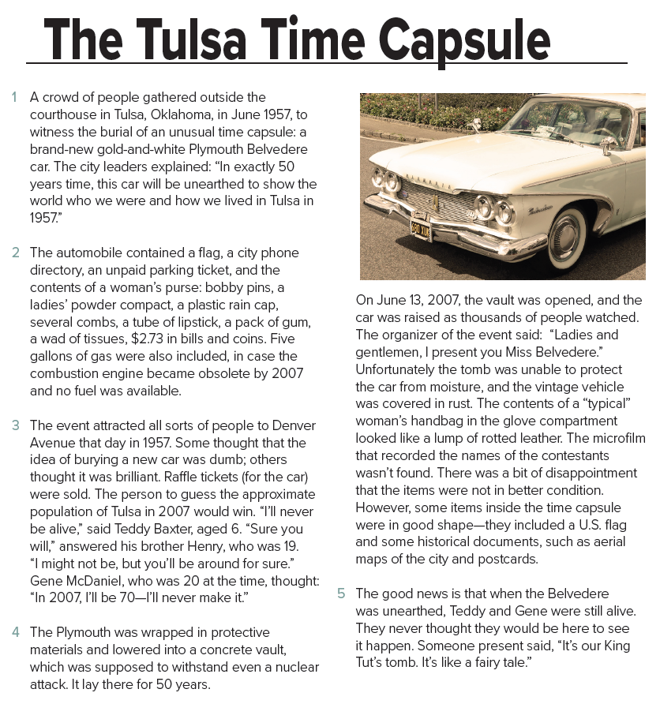
Open
Student’s book at page (40)

Slide 5
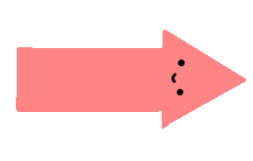
What’s the title of the article ?
An old car
How many paragraphs are there?
What does the picture show?

Slide 6
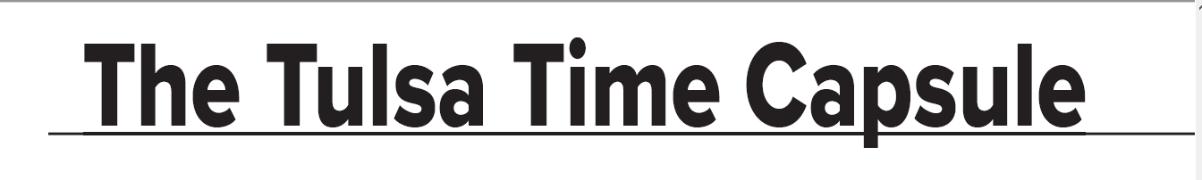
Before Reading
Time Capsule = a container storing a selection of objects chosen as being typical of the present time, buried for discovery in the future.

Slide 7
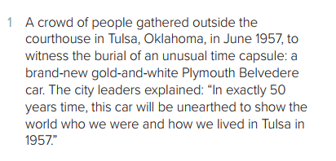
The main ideas of the entire
article are summarized in the first paragraph.
A crowd people gathered outside the courthouse
Where ?
In Tulsa, Oklahoma
When ?
In June 1957
Why?
To witness the burial of an unusual time capsule
Why did people bury things?
To show the world who we were and how we livedin Tulsa in 1957

Slide 8
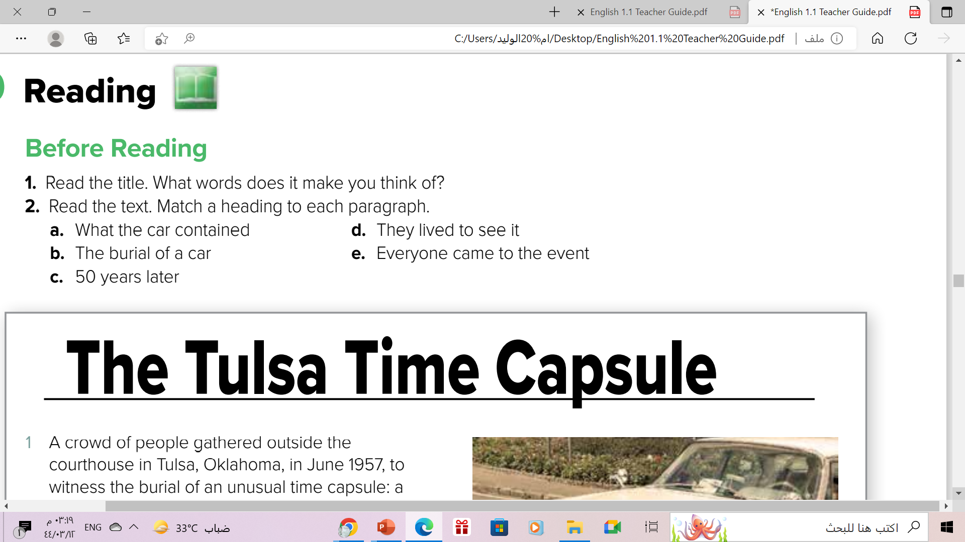

Slide 9
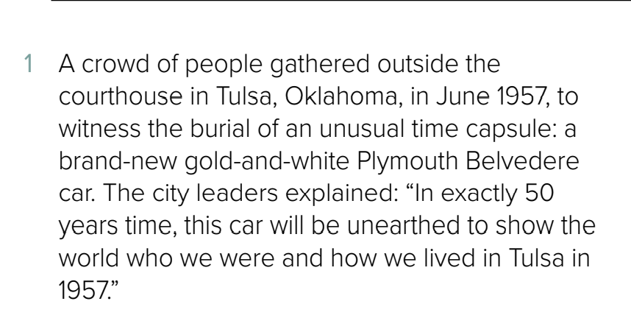

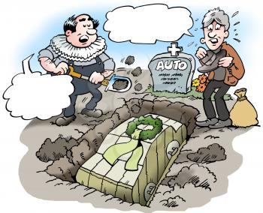
The heading to the paragraph is ...
What was the purpose of burying the car for 50 years?
B- The burial of a car
Burial of car

Slide 10
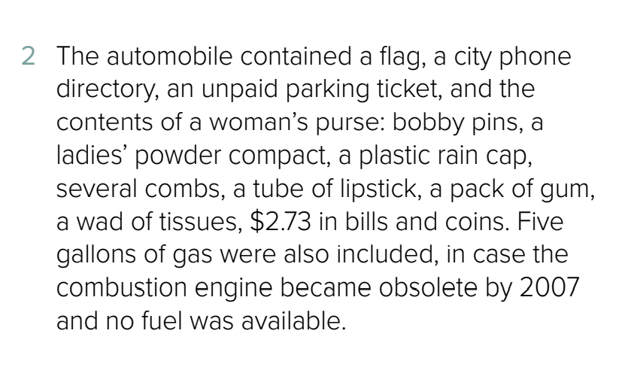





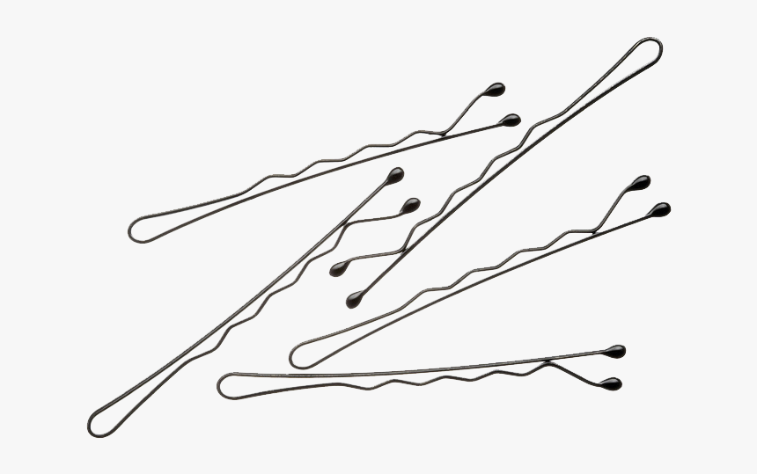
The heading to the paragraph is ...
Why did the organizer include 5 gallons of gas for the car?
a- What the car contained

Slide 11
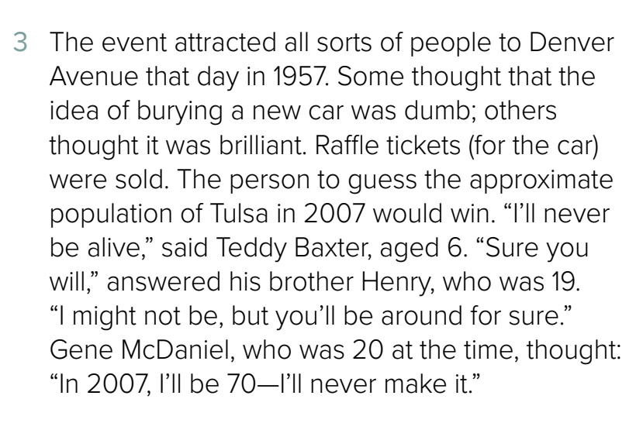
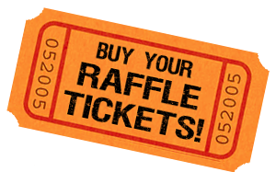
The heading to the paragraph is ...
How did people react to the event?
e- Everyone came to the event
a type of contest in which you buy
a ticket for a chance to win a prize

Slide 12
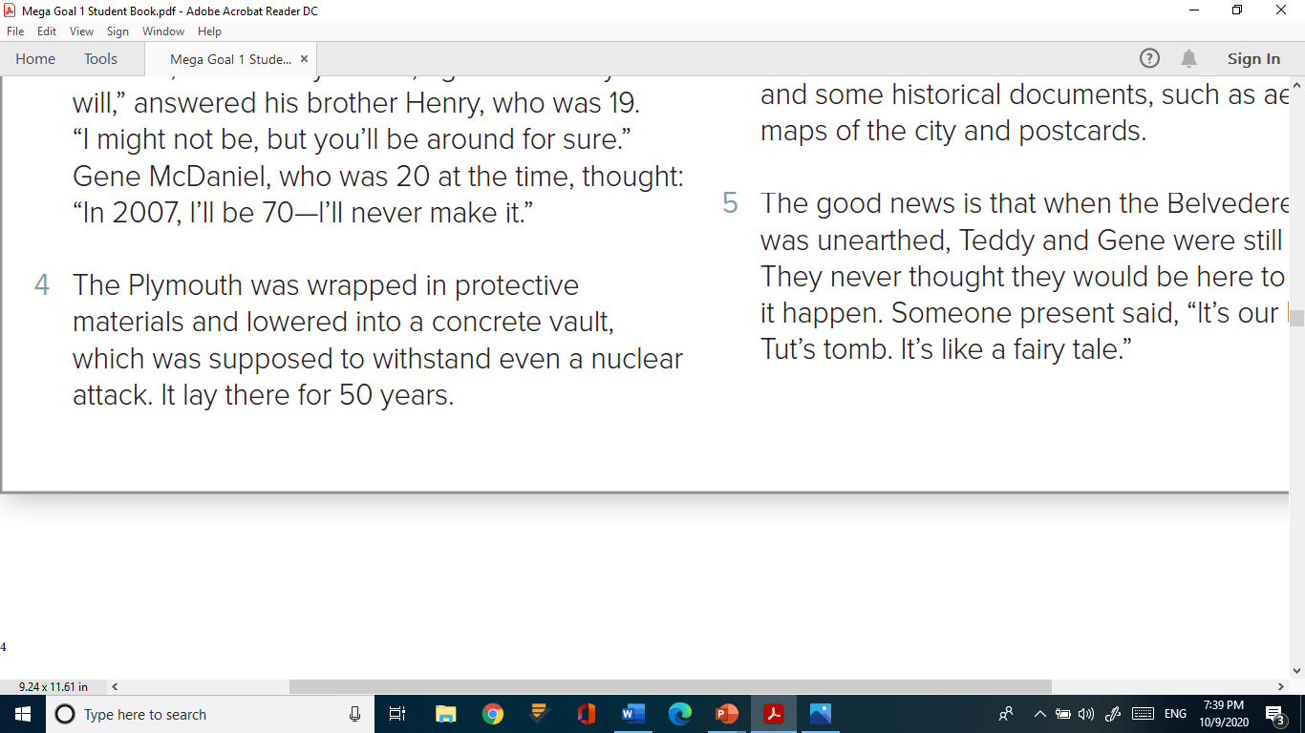
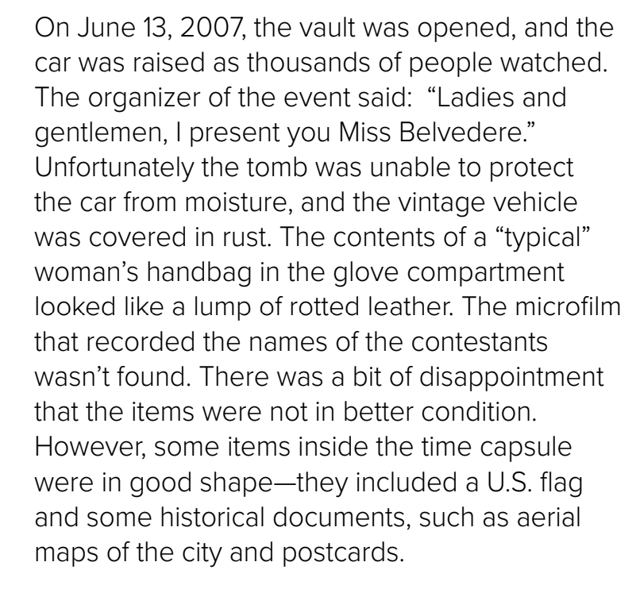
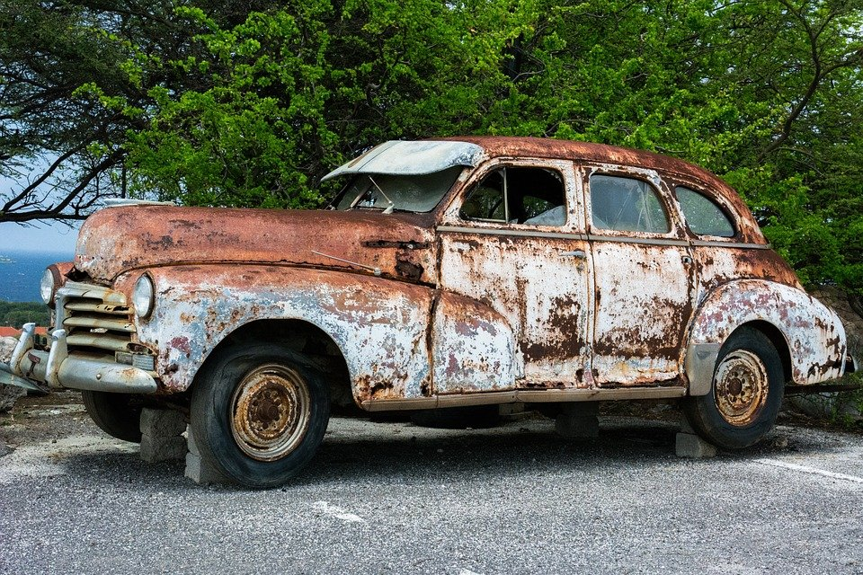
The heading to the paragraph is ...
What was the car like when it was found?
C- 50 years later
Covered in rust

Slide 13
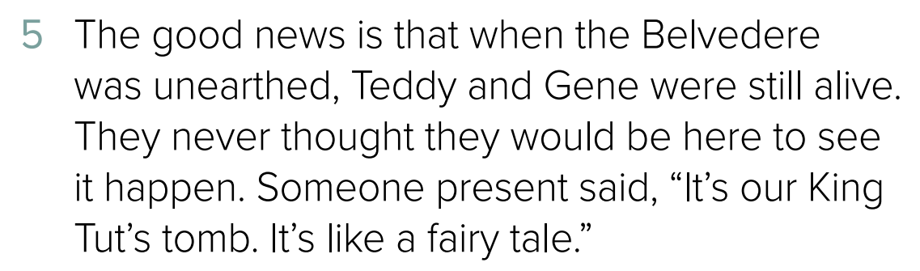
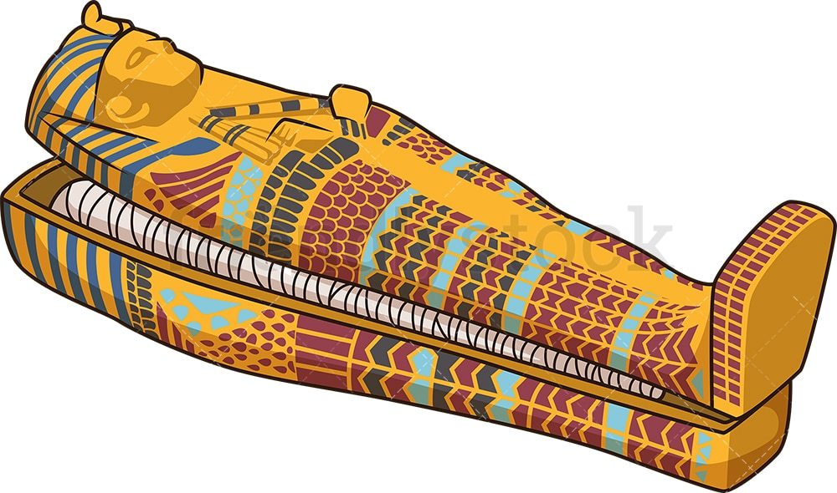
The heading to the paragraph is ...
What was it meant by saying, “It’s our King Tut’s tomb?”
Tut’s tomb
D-They lived to see it

Slide 14
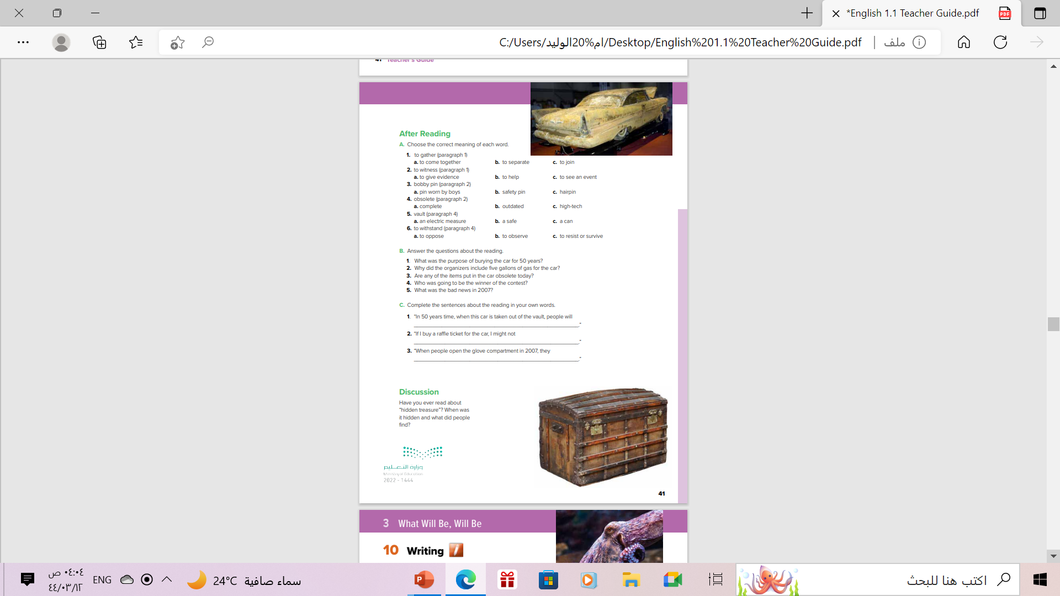
Open
Student’s book at page (41)

Slide 15
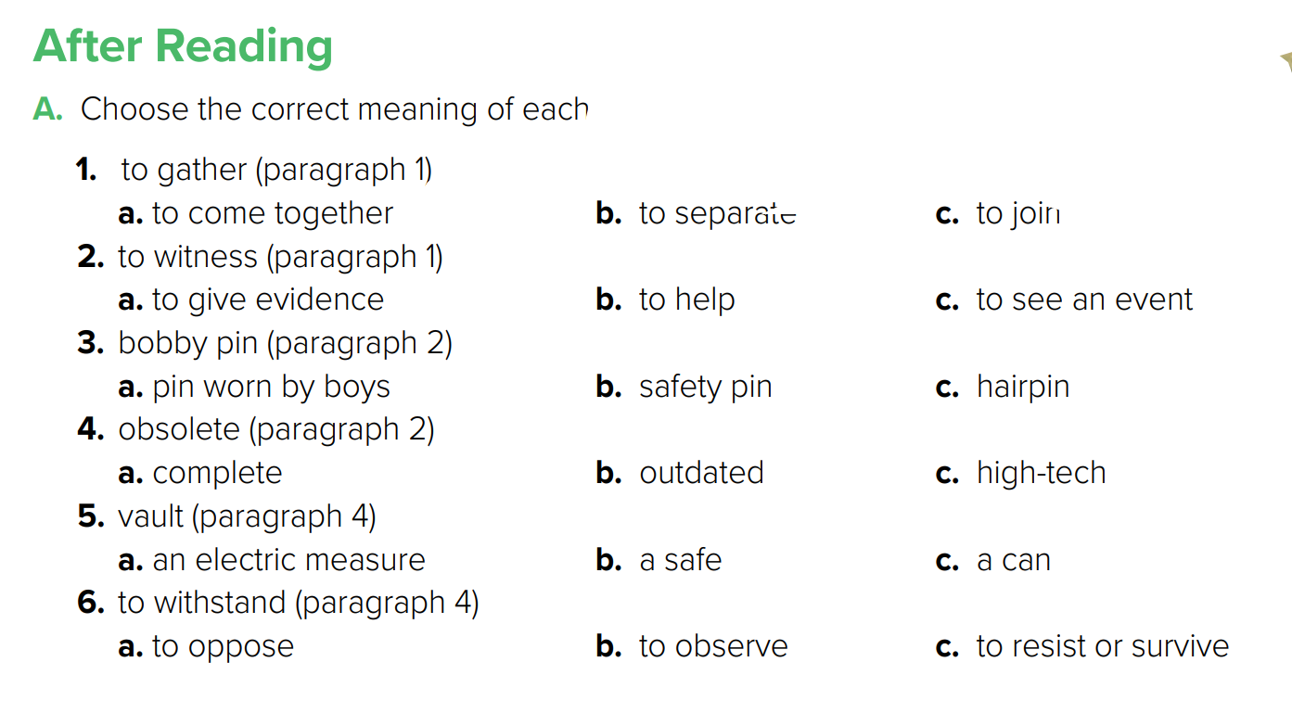

Slide 16



Slide 17
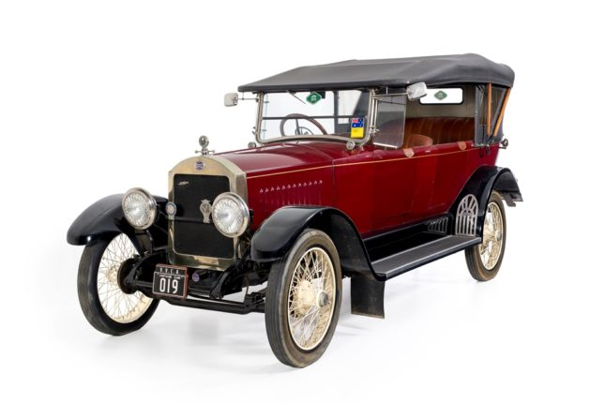
Vintage Vehicle
An old car made between 1919 and 1930

Slide 18
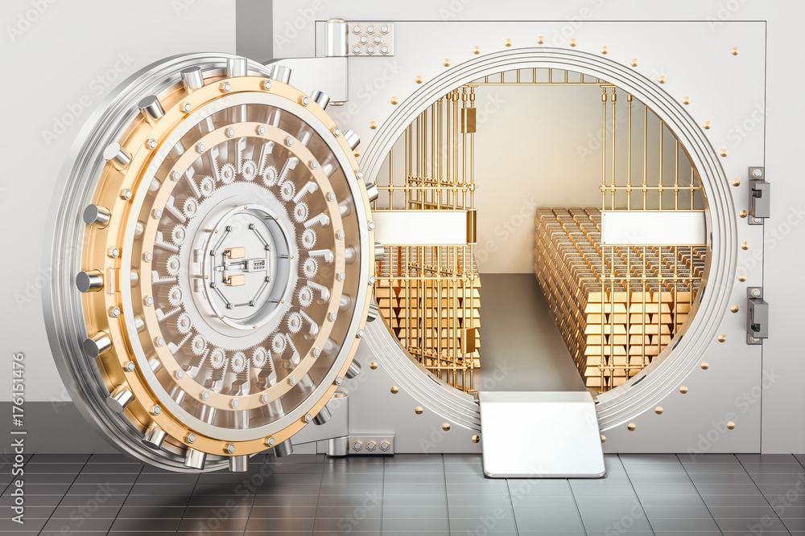
vault
An underground room with thick walls and a strong door for the safekeeping of valuables

Slide 19
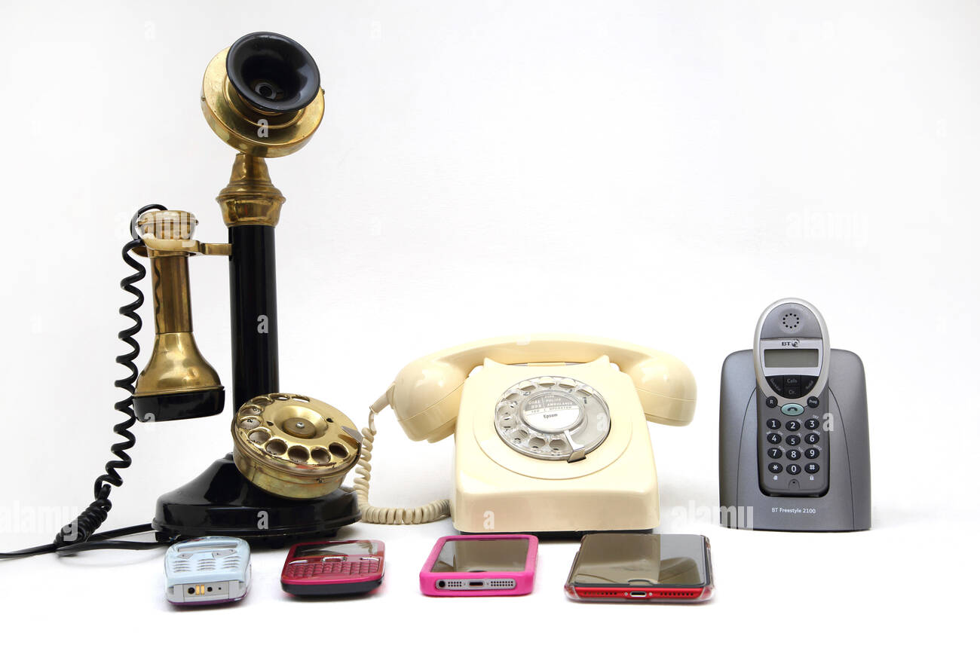
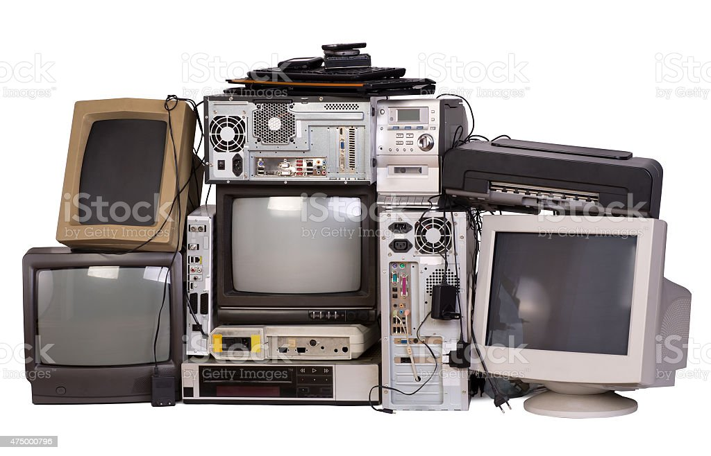
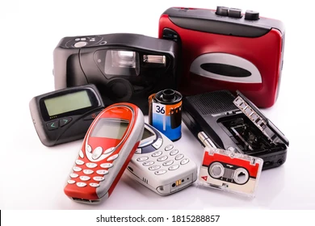
No longer used , useful or needed, usually because something newer and better has replaced it
Obsolete

Slide 20
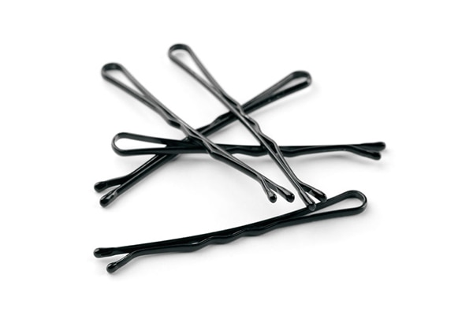
bobby pin
a type of hairpin, usually of metal or plastic, used to hold hair in place.

Slide 21
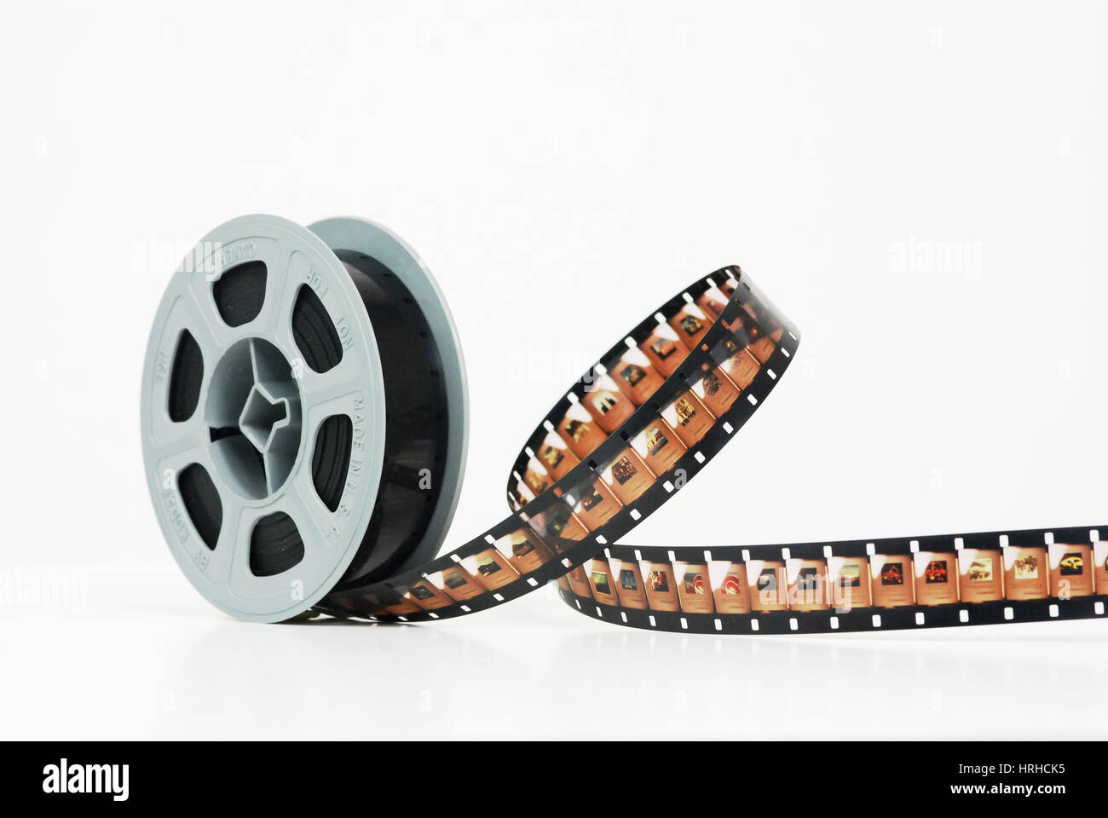
microfilm
No longer used , useful or needed, usually because something newer and better has replaced it

Slide 22
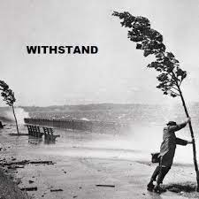
withstand
to stand up against or resist to survive

Slide 23
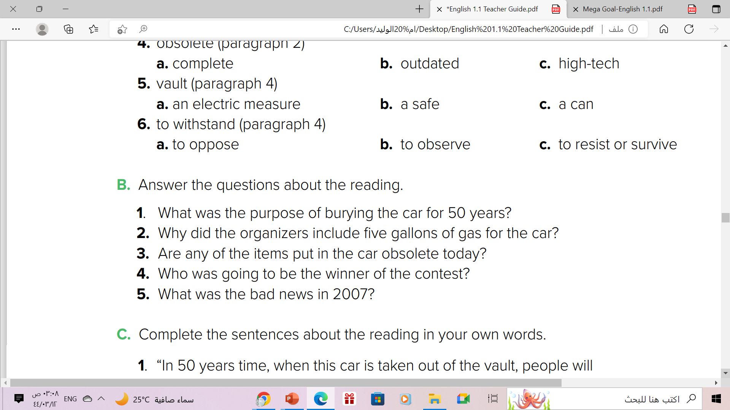
1. The purpose was to show how people lived in Tulsa in 1957.
2. They included the gas in case the combustion engine became obsolete.
3. The microfilm is obsolete.
4. One who guessed the population of Tulsa in 2007.
5. Water got into the vault, and the car was covered in rust.
The microfilm for the contest wasn’t found

Slide 24
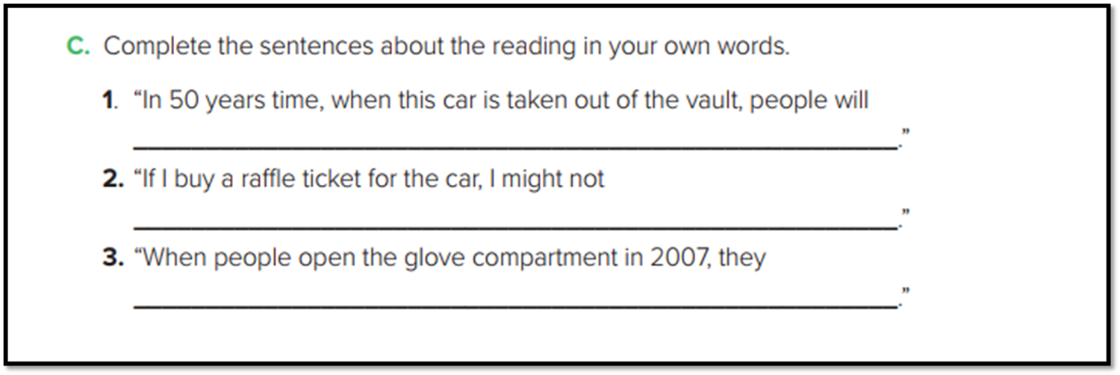
See what Tulsa was like in 1957
live long enough to win the prize
will find a woman’s purse and its contents

Slide 25
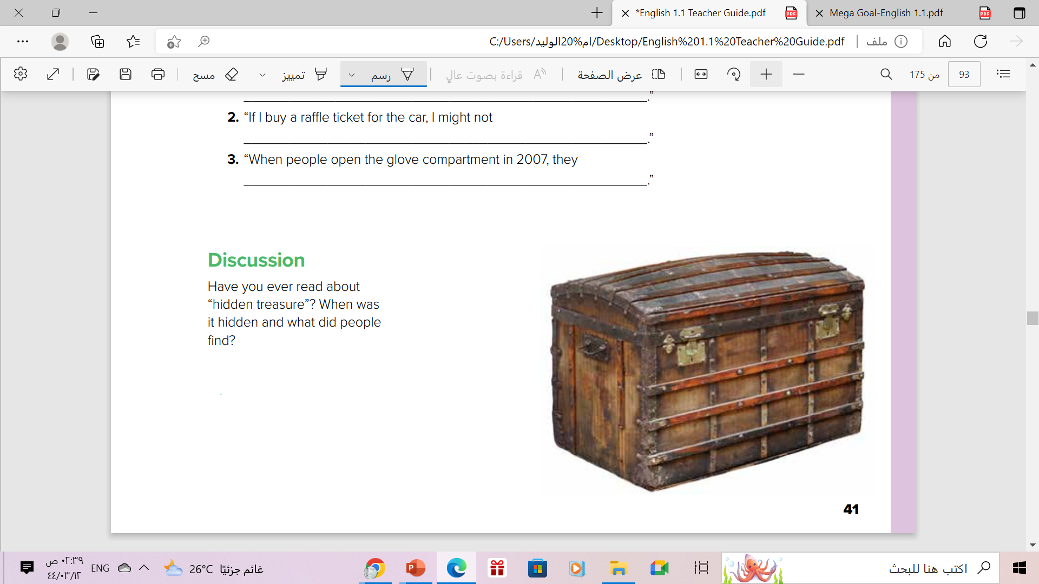
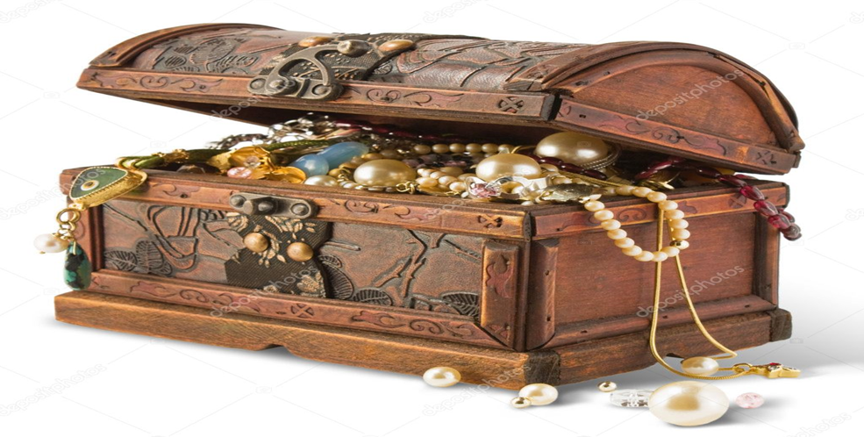

Discussion

Slide 26

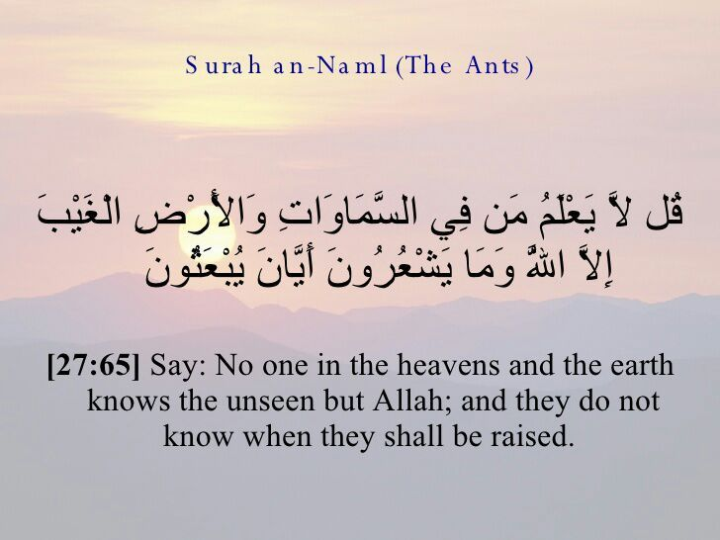
From The Holy Quran

Slide 27
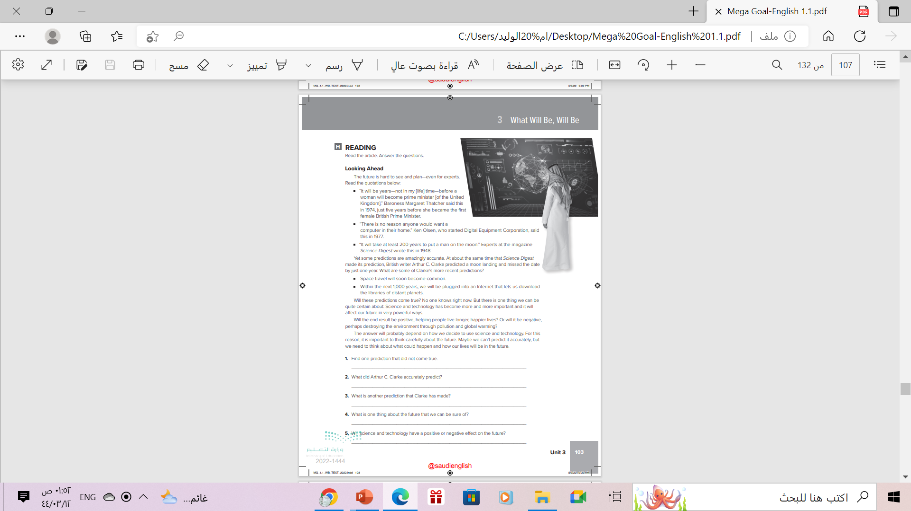
Homework
Workbook Exercise (K) .
P.(103)

Slide 28

Thanks!

