Slide 1




Unit3
What Will Be , Will Be
Mega Goal 1.1
Form , Meaning & Function
Done by : Entisar Al-Obaidallah

Slide 2
Lesson Objectives
3
4
1
Distinguish
Use
Form
2
Make
Form tag questions correctly
future sentences with time expressions correctly
suggestions and its responses correctly .
between the use of present simple and present progressive .

Slide 3

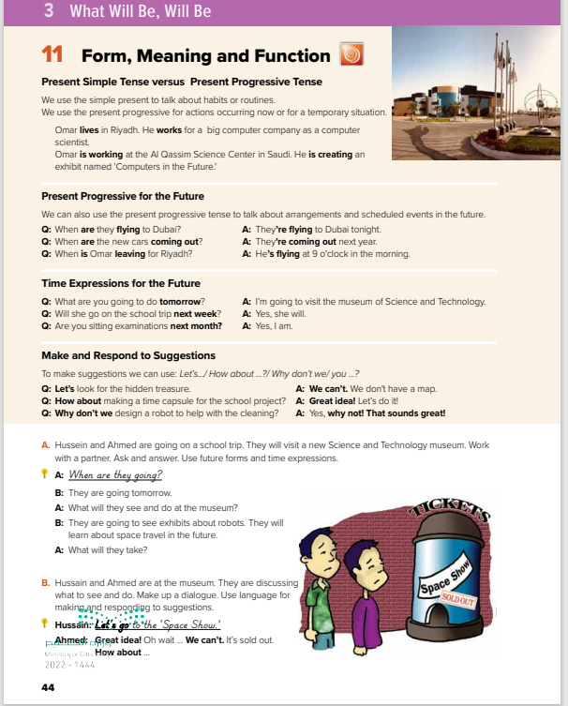
Book Open
Page (44)

Slide 4



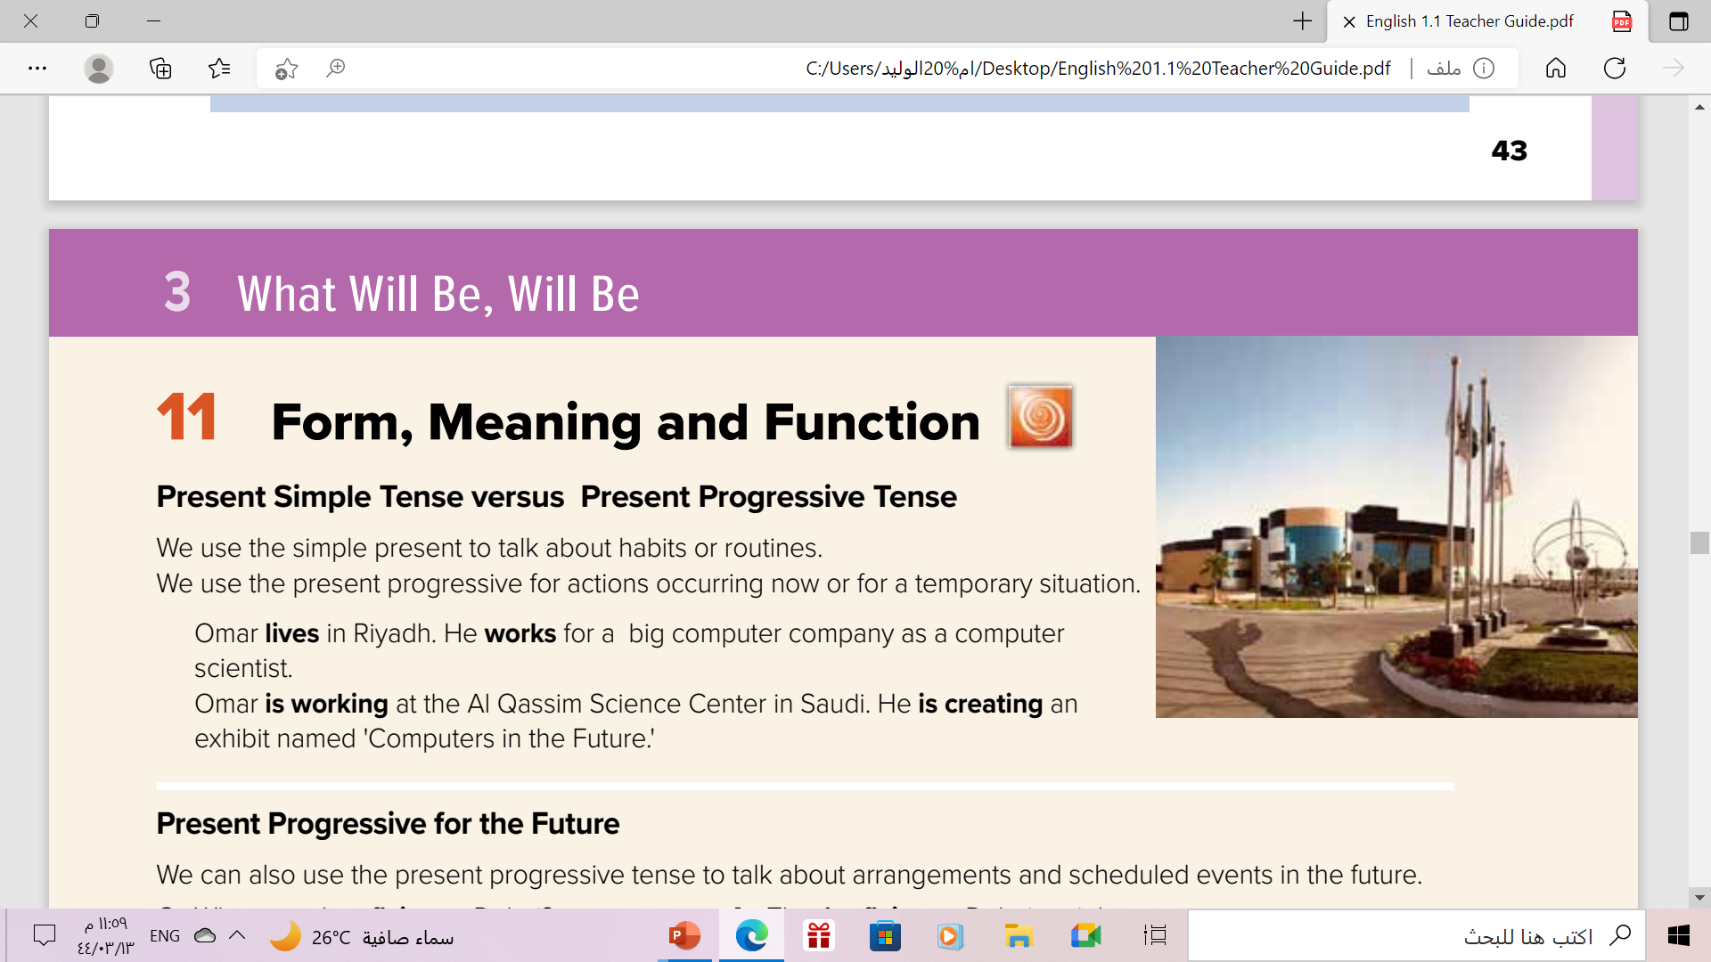


Slide 5
Present Simple vs Present Progressive
Present Tense
Present Simple
Present Progressive
Habits
routins
Actions happenong now
Temporary situation
permenant
Temporary
I usually work in the mornings
I am working this morning

Slide 6
Form of Present Progressive
am + ing
is + ing
are + ing
I
He
She
It
You
We
They
I am reading a new book right now
He can’t talk now . He is brushing his teeth
They are watching a movie at the moment.

Slide 7
Form of Present Simple
He
She
It
singular
I
You
We
They
He cleans his room.
V+ ( s – es – ies)
He goes to school by car.
He studies English
I clean my room.
V + ( infinitive)
They go to school by car.
We study English

Slide 8
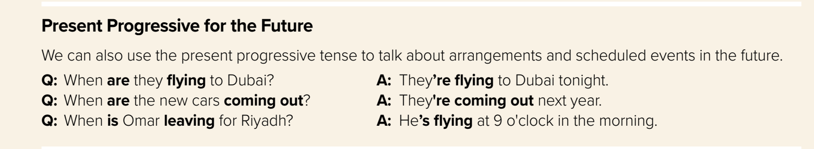
Use:
to talk about arrangements and scheduled events in the future
Examples:
My friend is coming to visit us next week.
I’m leaving to Dubai tomorrow.
They are playing football tonight.

Slide 9
Time Expressions
Present Simple
Present Progressive
always
usually
often
Sometimes
Rarely
Never
ever
every day .. week .. month
On Friday…
once…
Today
right now
now
at the moment
at present
currently
these days
Nowadays
tonight *
RAINBOWS
I go to school everyday .
He usually goes to bed early.
I’m playing football now.
He is working hard these days.

Slide 10
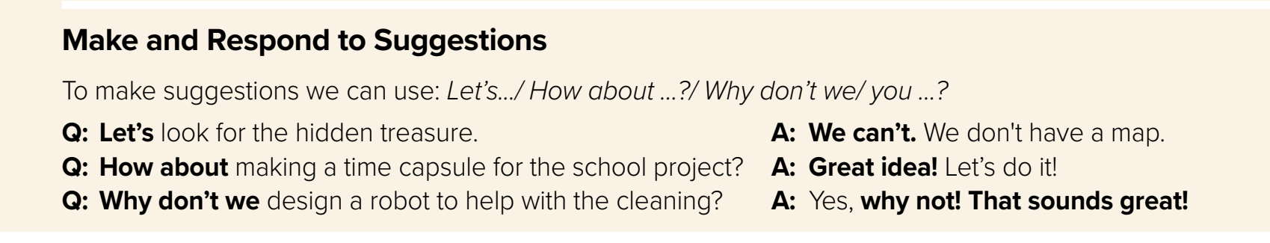
Make and respond to suggestions
Let’s
How about
Why don’t we/you
V1
V-ing
V1
Let’s revise our lesson.
How about watching TV?
Why don’t we go to the mall?

Slide 11
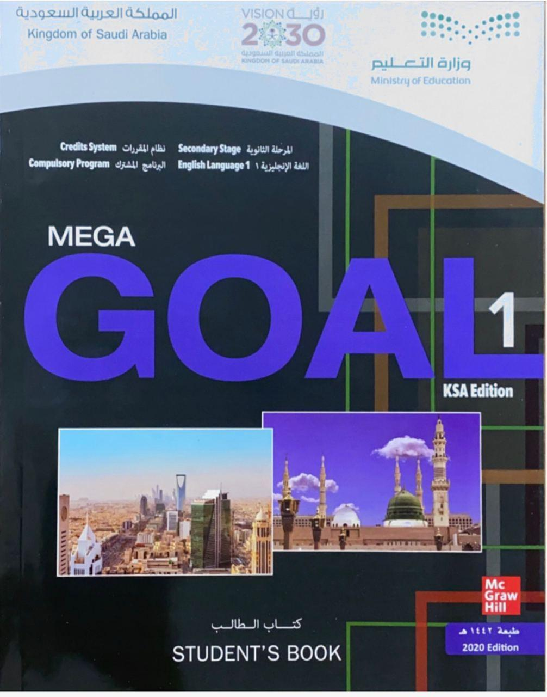
Book Open
Page (45)

Slide 12
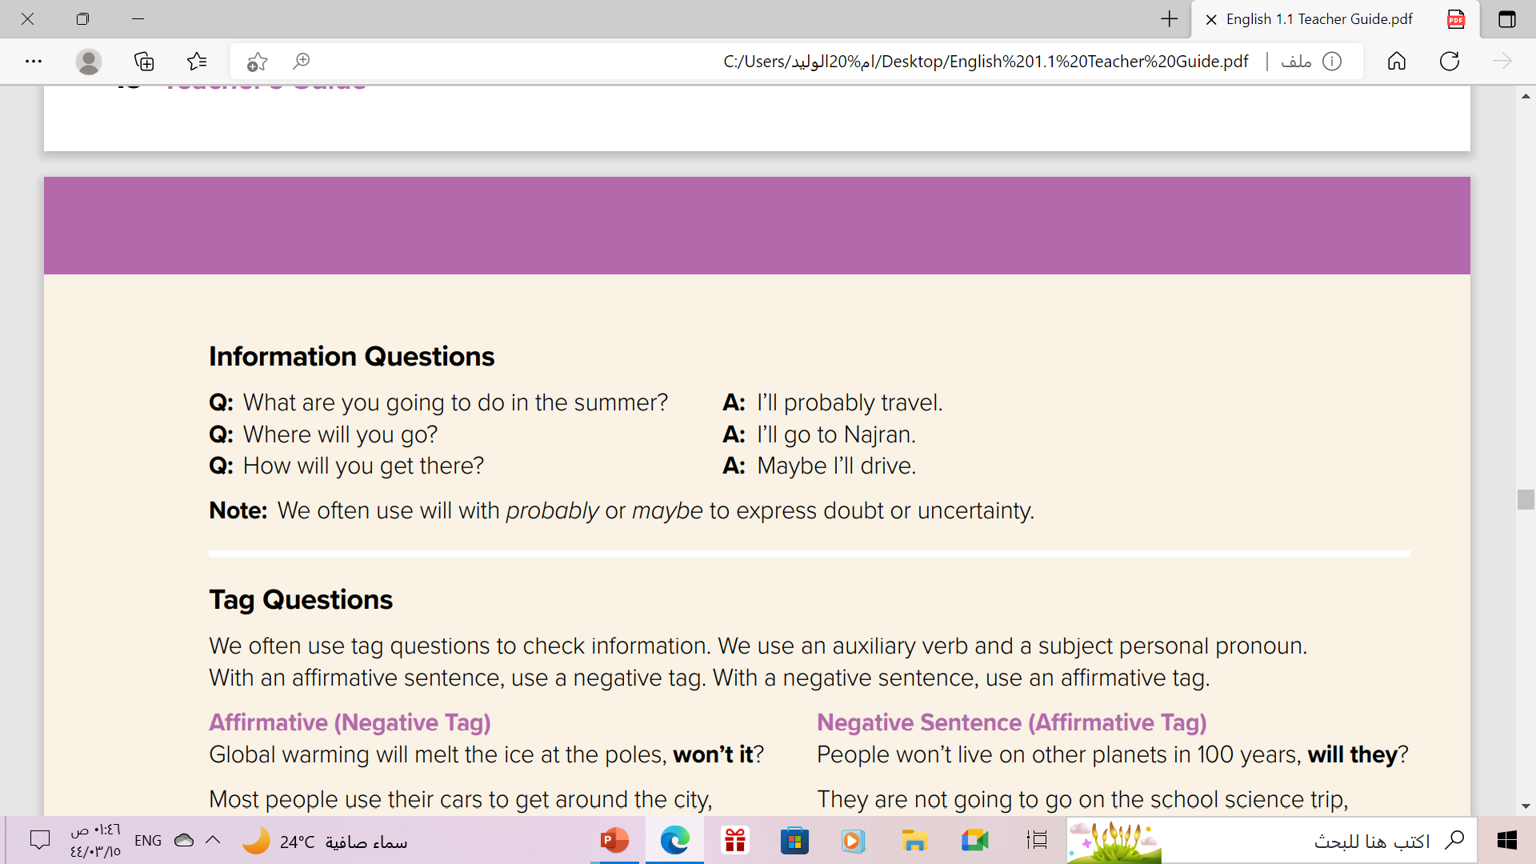

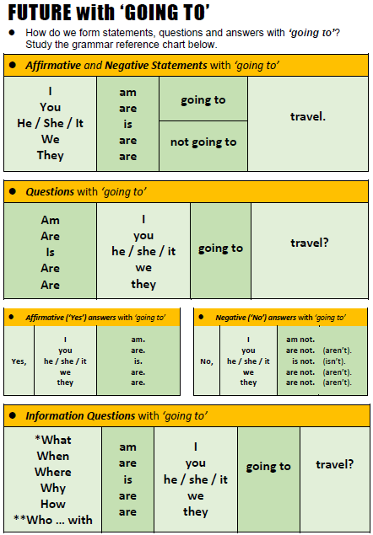
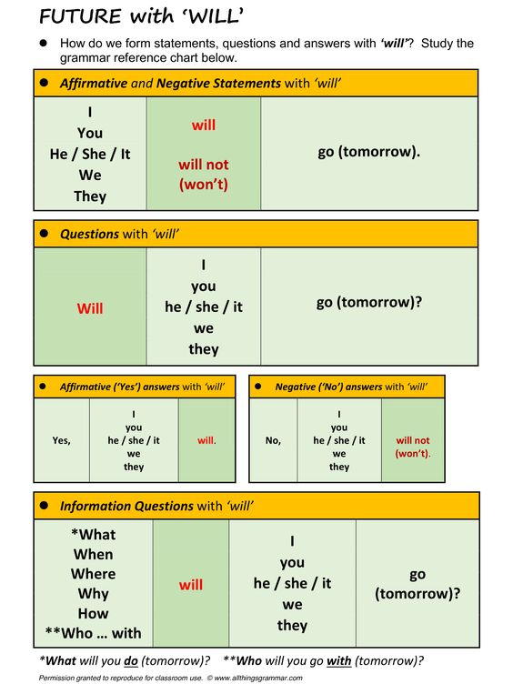

Slide 13


Slide 14

She to school every day
goes
Where does she go every day?

Slide 15
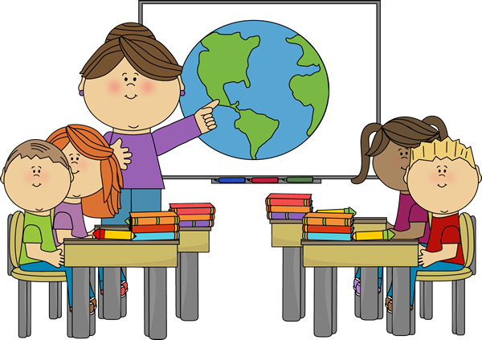
She the students
is teaching
What is the teacher doing right now?

Slide 16
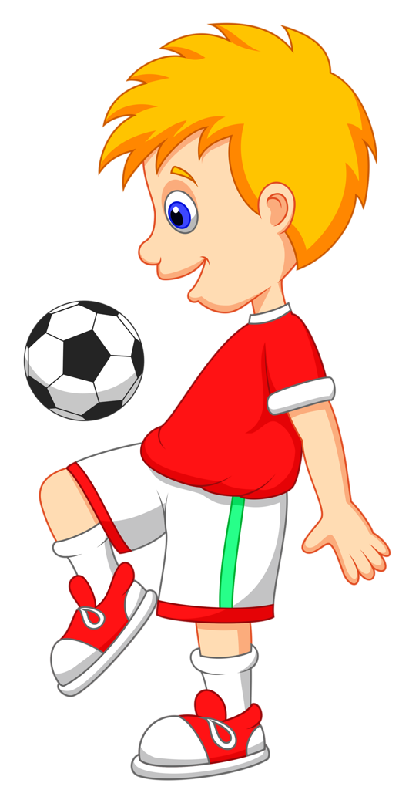
He football every day
plays
What does he do every day?

Slide 17

He a book
is reading
What is the boy doing now?

Slide 18

The moon the Earth
orbits
What does the moon do?

Slide 19
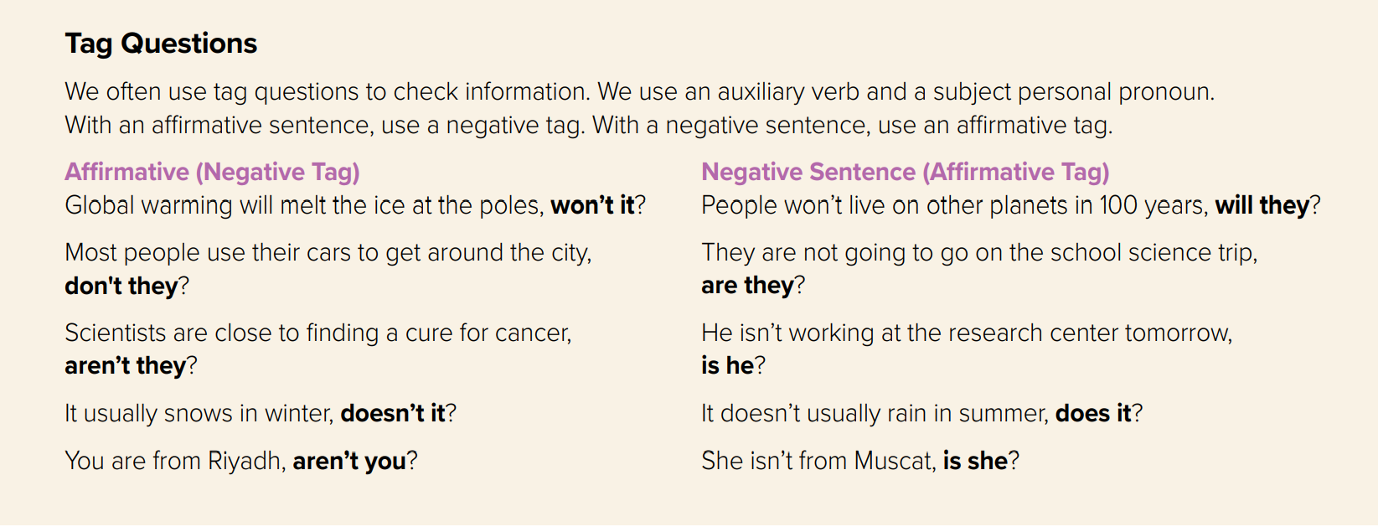

Slide 20
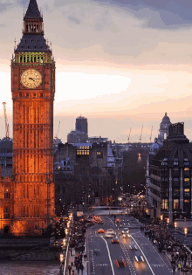
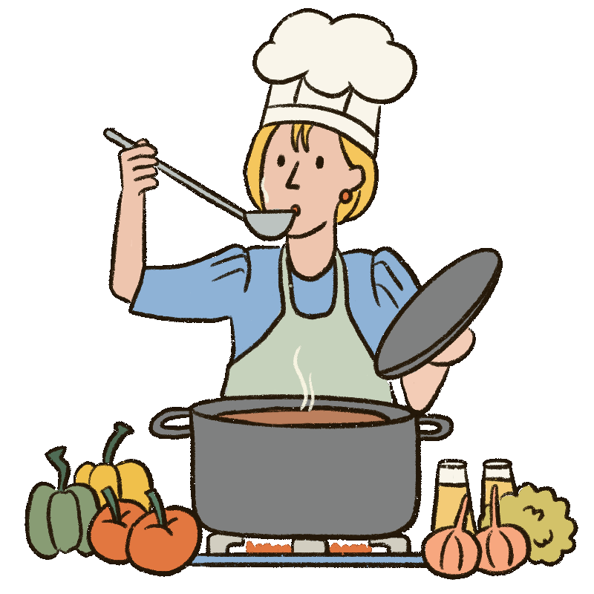
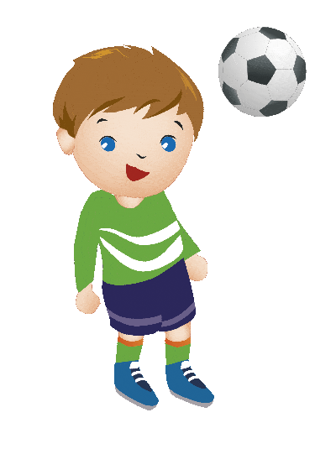
Form of Tag Questions
affirmative
Negative
She is from London,
isn’t she ?
affirmative
Negative
My mom will cook the dinner,
won’t she ?
affirmative
Negative
doesn’t he ?
He likes football,

Slide 21
Form of Tag Questions
Negative
Affermative
She isn't from London,
is she ?
Negative
Affermative
will she ?
My mom won’t cook the dinner,
Negative
Affermative
He doesn’t like football,
does he ?

Slide 23
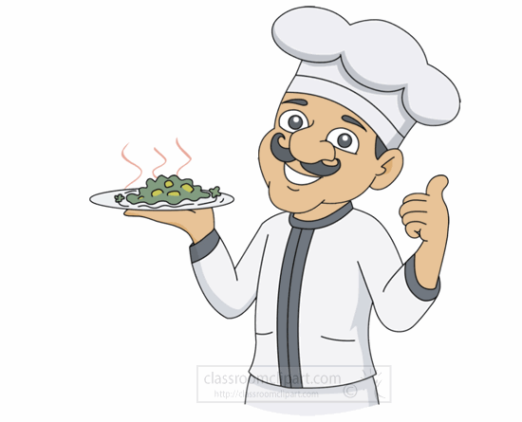
Complete the question tag
He is a good cooker,
isn’t he ?

Slide 24
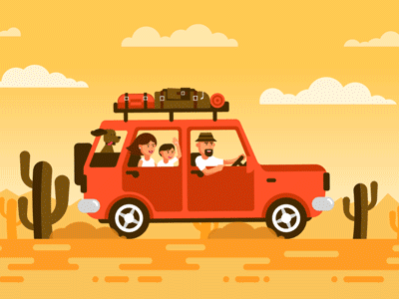
Complete the question tag
They will travel ,
won’t they ?

Slide 25
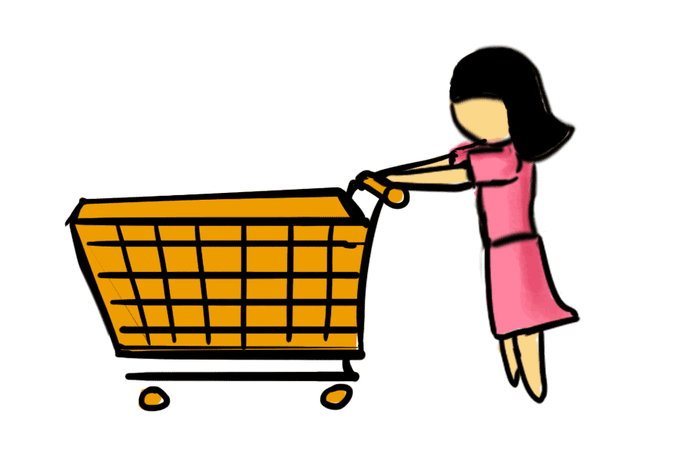
Complete the question tag
She didn’t buy anything,
did she?

Slide 26
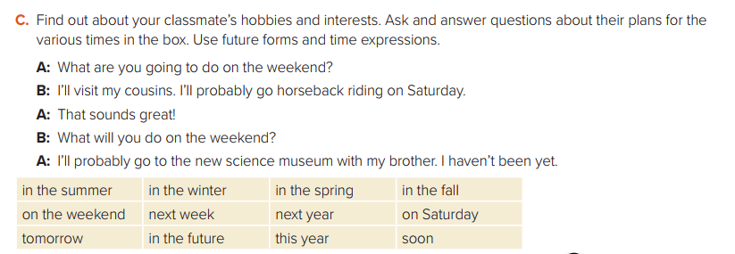

Slide 27
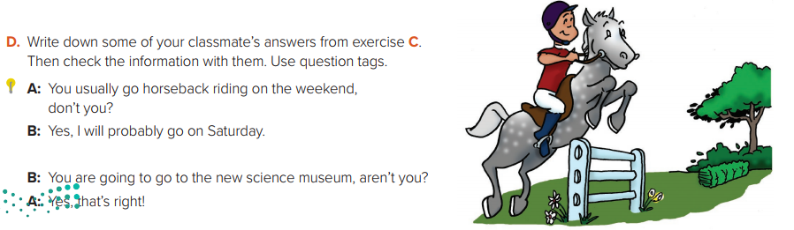

Slide 28

Homework
Workbook
Page (107) , exercise
( N-O)

Slide 29

THANKS!

