Slide 1
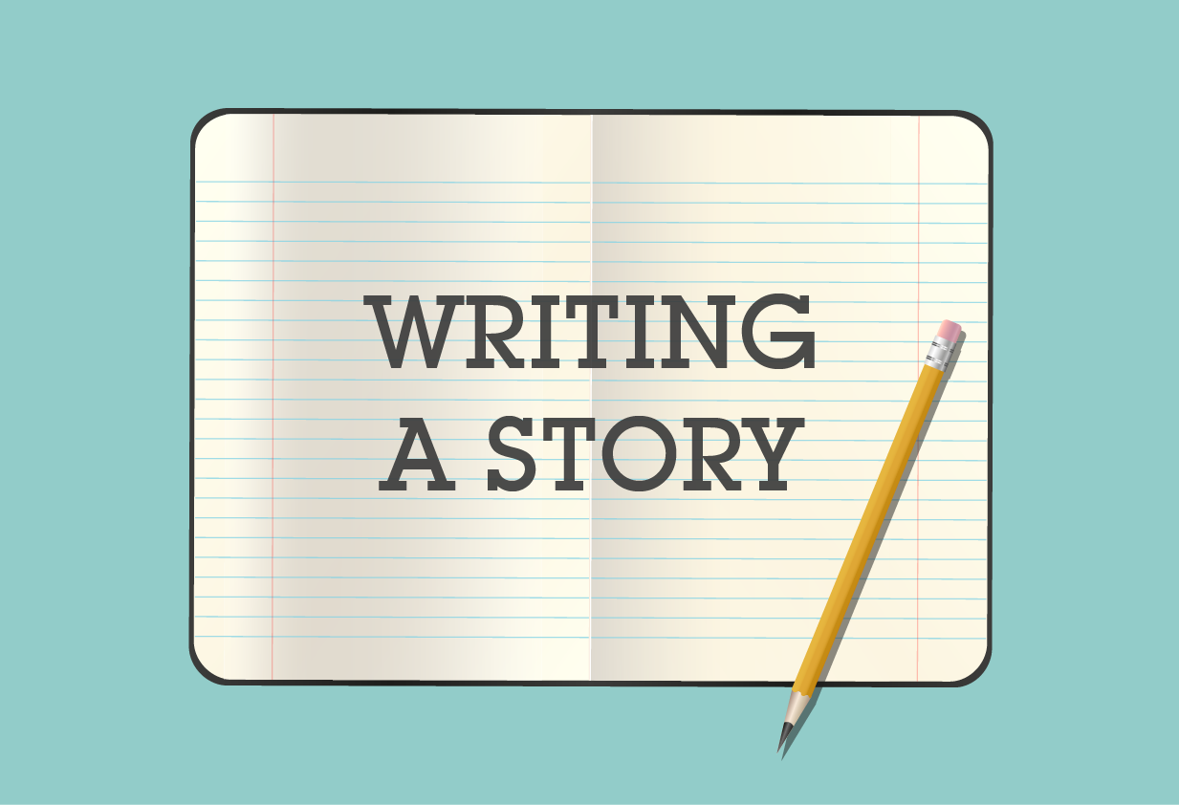
Mega Goal 1
U: 3
What will be , will be
Writing
By: Yousef Hilal Alyazedi

Slide 2
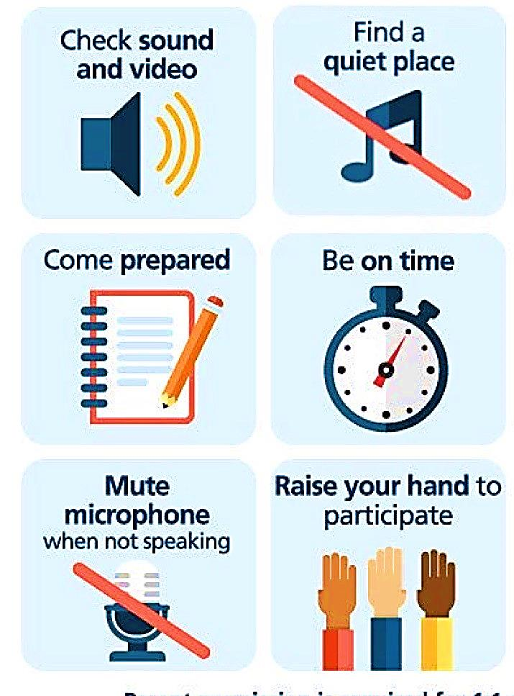
Online Classroom Rules

Slide 3
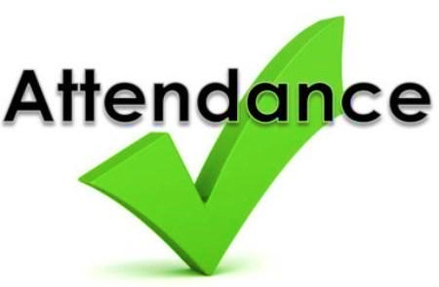

Slide 4
Lesson Goals
Read the story and make notes about it .
Identify some new words .
Write a story .

Slide 5
Warm Up
Have you ever found a treasure ?
Have you ever watched a movie about finding a treasure?

Slide 6
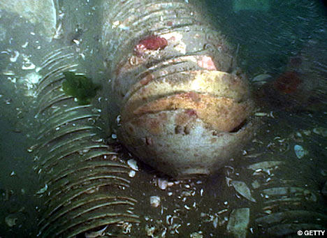
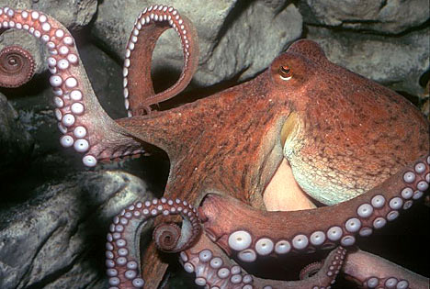
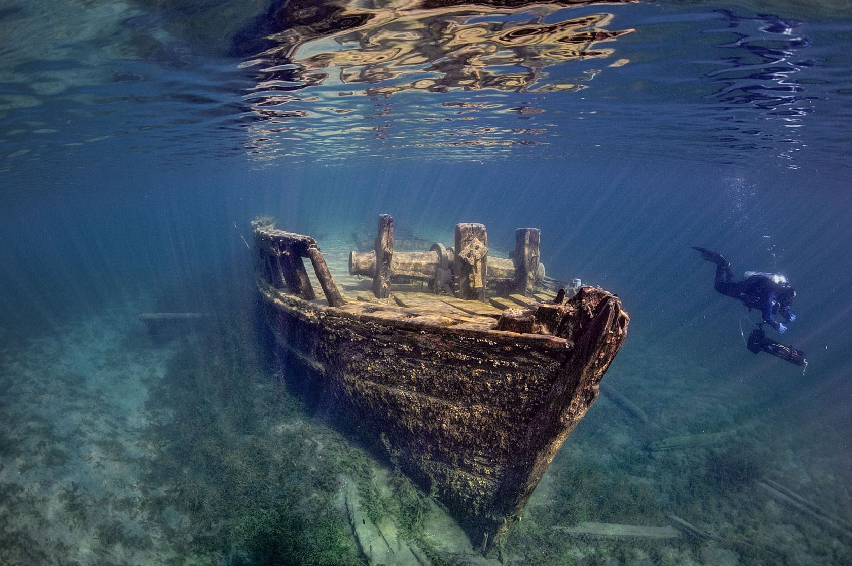
Discuss the following pictures .

Slide 7
Open your Student’s book at page: 42

Slide 8
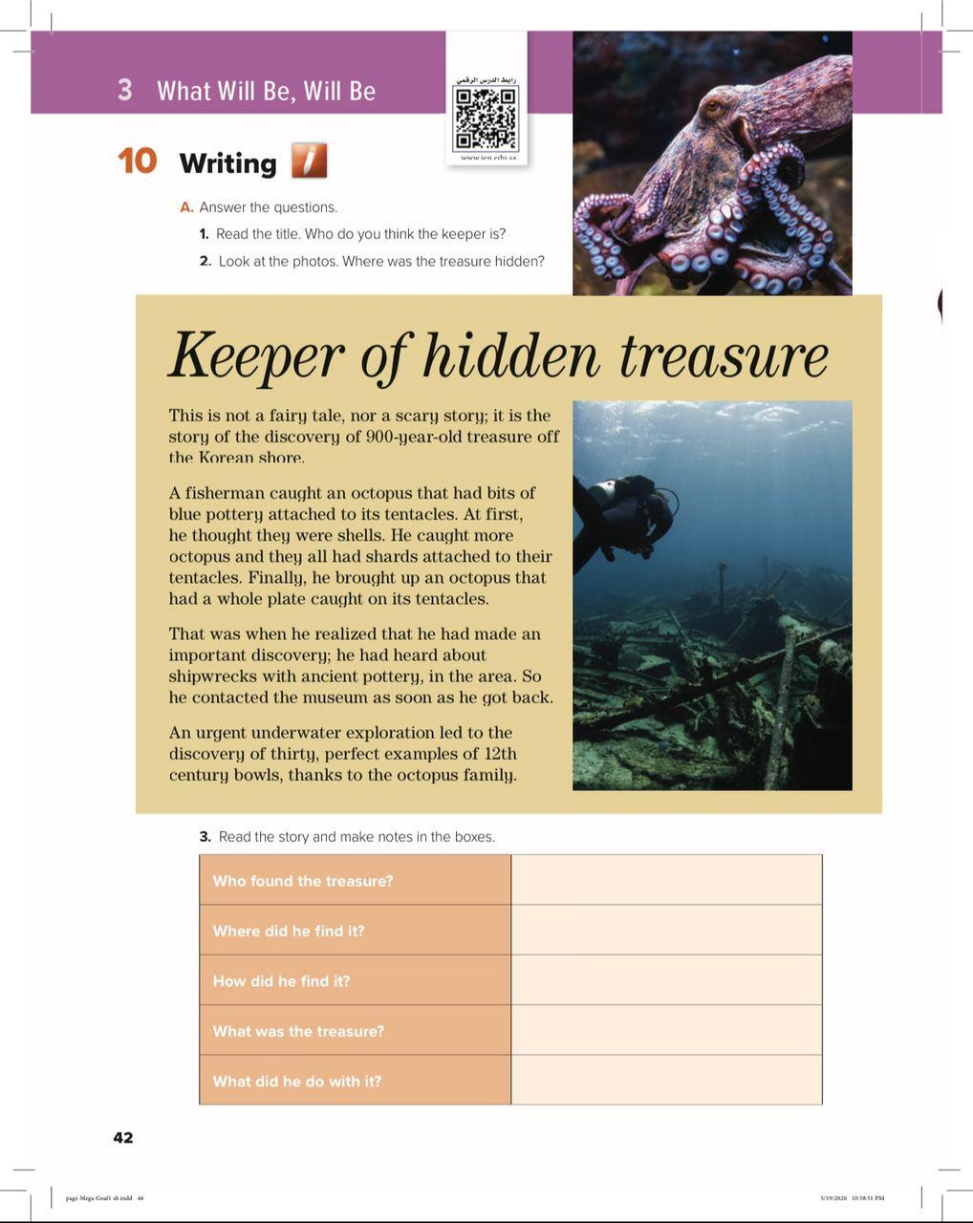
Look at page 42 .
What kind of lesson is it ?
What’s the title of the story ?
How many photos ?
What a keeper is ?
What the treasure might be ?
Where the treasure might be hidden ?

Slide 9
Read and Listen

Slide 10
Our strategy will be

Slide 11
Who found the treasure ?
A Korean fisherman .
Where did he find it ?
Off/ near the Korean shore .
He caught an octopus with blue shards attached to its tentacles/then caught another octopus with a whole plate .
How did he find it ?
Thirty perfect 12th century bowls.
What was the treasure ?
What did he do with it ?
He contacted the museum / He reported it to the museum .

Slide 12
Open your Student’s book at page: 43

Slide 13
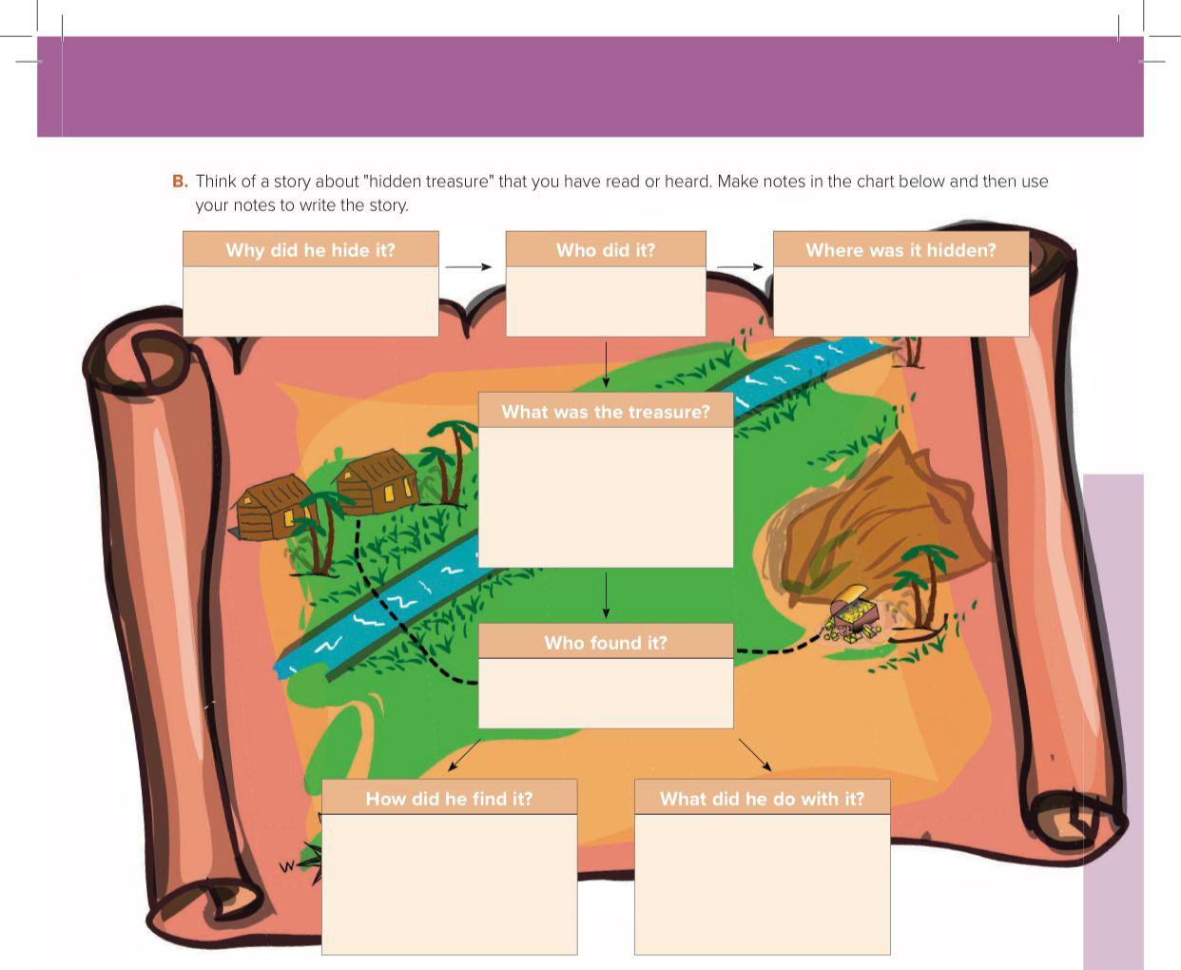
To keep it for himself
The farmer
Under the tree
A box of gold and silver
His wife
she was digging near the tree
gave it to the authority

Slide 15
The stages of the writing process
Prewriting ( planning )
Drafting
Revision
Editing ( proofreading )
Publishing

