Slide 1
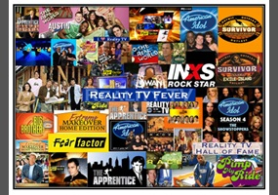
Unit 4
The Art of
Advertisement
Reading
Mega Goal 1.1
Done by: Entisar Al-Obaidallah

Slide 2
Lesson Objectives
Use passive voice with different tenses .
Use a comparative and superlative with adjectives
Use as … as to show two items are the same .
Use “ look, smell, sound, taste ” with like + noun

Slide 3
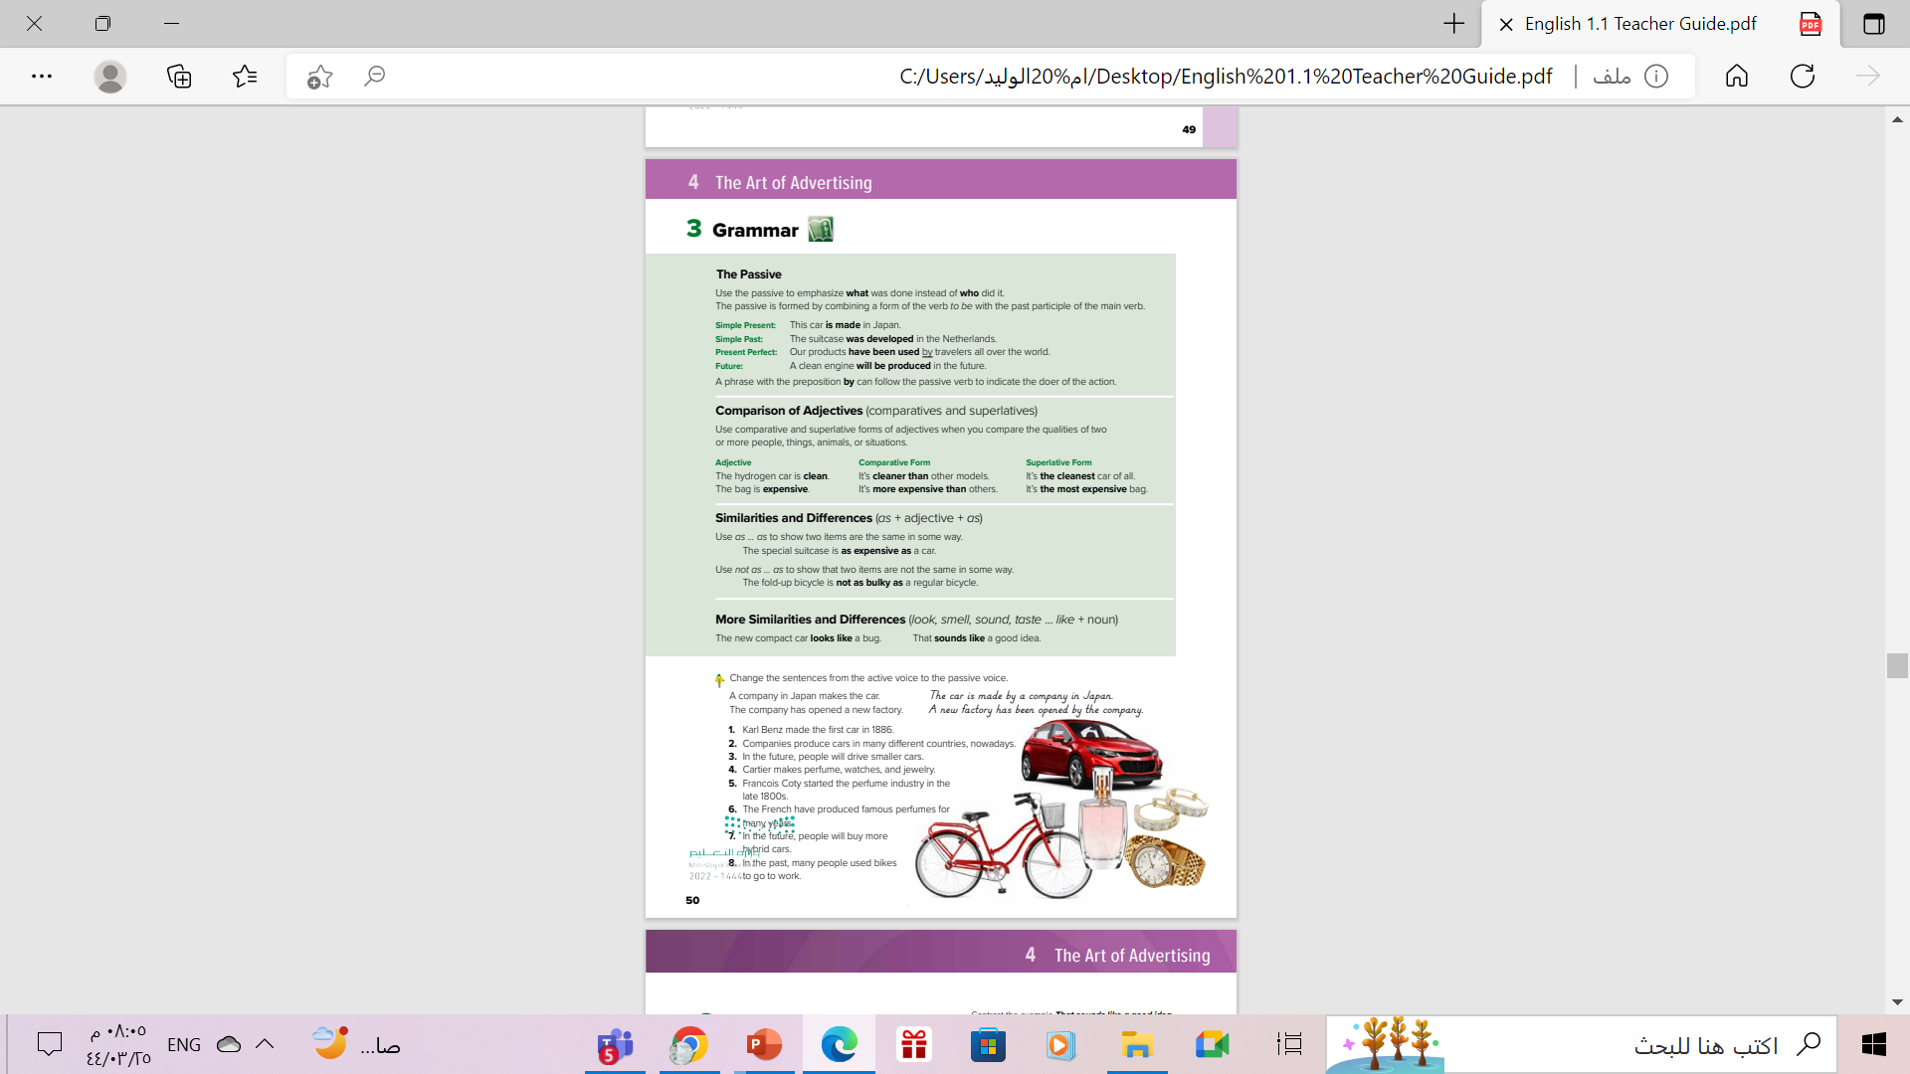
Open
Student’s book , P.(50)
.

Slide 4
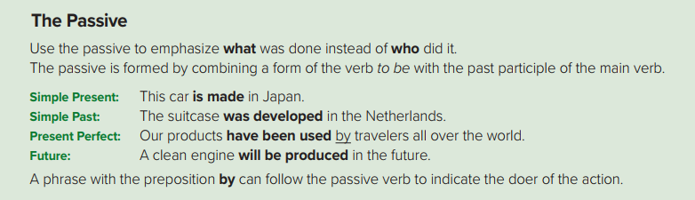

Slide 5
subject
verb
object
Sara cleans the room
This is active sentence
Do we know WHO did the action?
Yes
Form:
subject
verb
object
object
Verb to Be
V.P.P(3)
The room is cleaned.
This is Passive sentence
Do we know WHO did the action?
No
Form:
Object
Be
Vp.p(3)

Slide 6
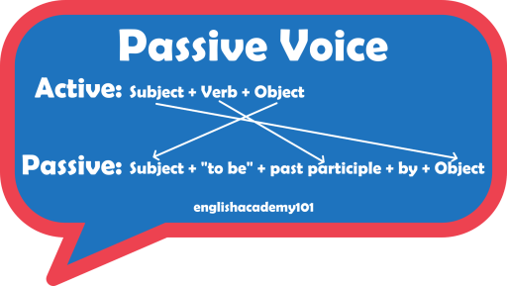

We use the passive to emphasize what
was done instead of who did it.
The structure is O + be + p.p + by + S
Sometimes we can make a sentence
without ( by +S)

Slide 7

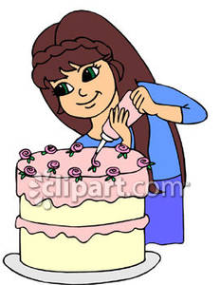
Present passivetense
O + be + p.p (v-ed /v3)
subject
verb
object
active
Reema decorates the cake.
Passive
The cake is decorated by Reema.
object
Be
V.P.P(3)
subject

Slide 8

Past passivetense
O + be + p.p (v-ed /v3)
subject
verb
object
active
Ali studied the lessons.
Passive
The lessons were studied by Ali.
object
Be
V.P.P(3)
subject

Slide 9
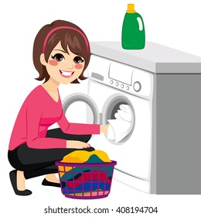
Present Perfect passive
O + be + p.p (v-ed /v3)
subject
verb
object
active
Rana has washed the clothes
Passive
The clothes have been washed by Rana
object
Be
V.P.P(3)
subject

Slide 10
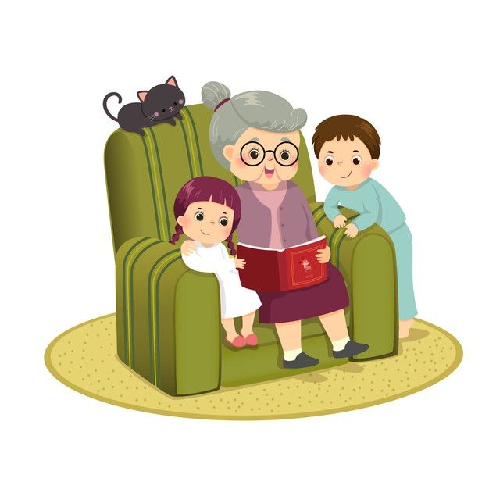
Future passive
O + be + p.p (v-ed /v3)
subject
verb
object
active
Grandma will tell a story
Passive
A story will be told by Grandma
object
Be
V.P.P(3)
subject

Slide 11


Slide 12

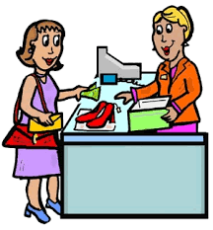
Find two passive sentences
Mother tells her children a story
1. A story is told to the children by mother
2. The children are told a story by mother
They pay the cashier 800 $
1. The cashier is paid 800 $ (by them)
2. 800 $ are paid to the cashier (by them)

Slide 13
Active OR Passive?
1. Salem cleans his room.
2. The problem is solved.
3. My hair is often cut
4. Ali studies his lesson
active
passive
passive
active

Slide 14
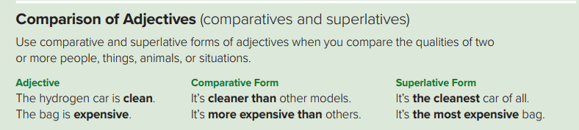

Slide 15
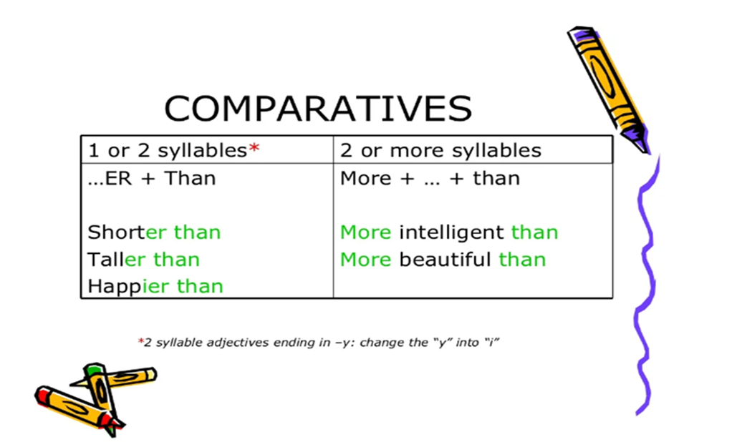
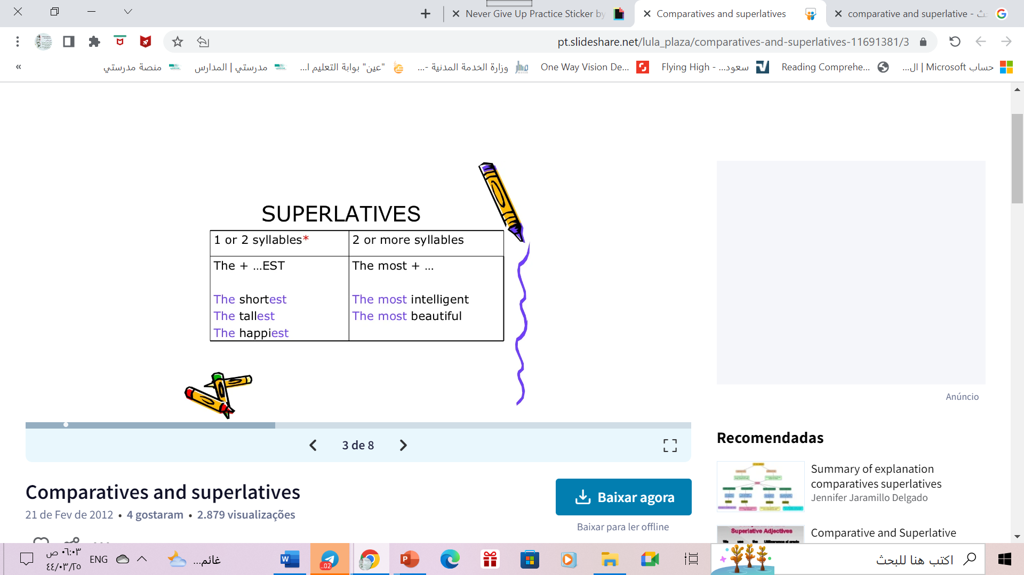
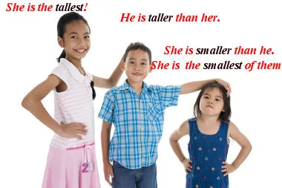

Slide 16
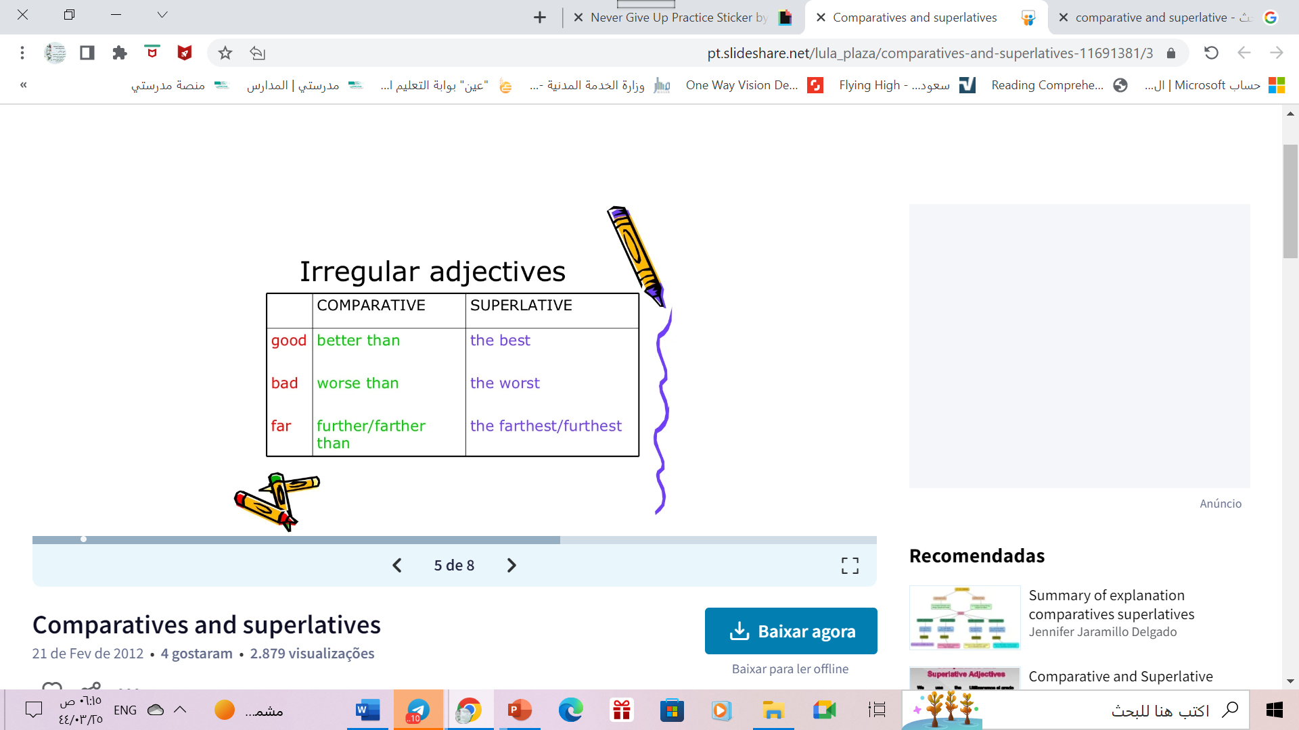

Slide 18

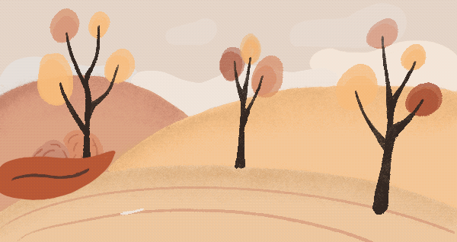
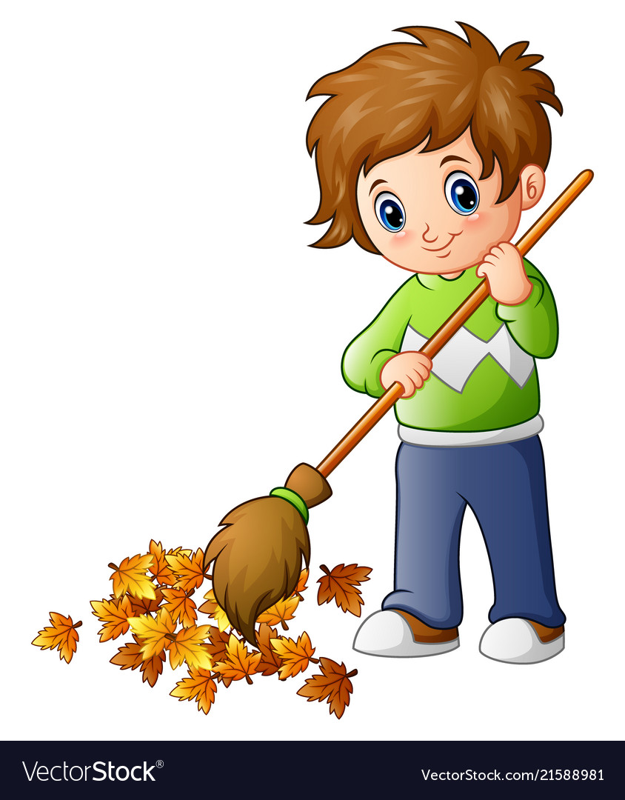
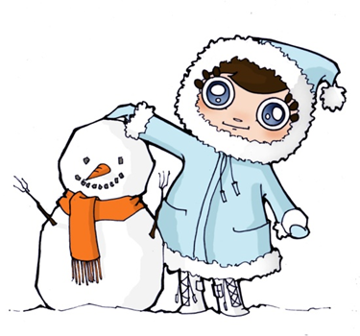
Cold
colder than
Winter is ______________Autumn.

Slide 19

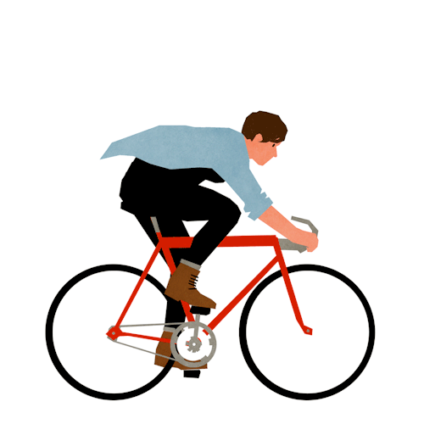
fast
faster than
A car is ______________a bike .

Slide 20
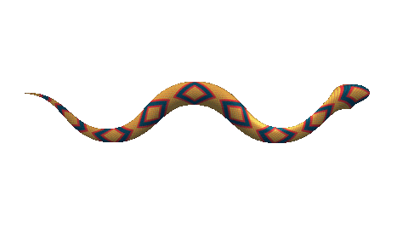

dangerous
A snake is ____________________
earthworm .
more dangerous than

Slide 21
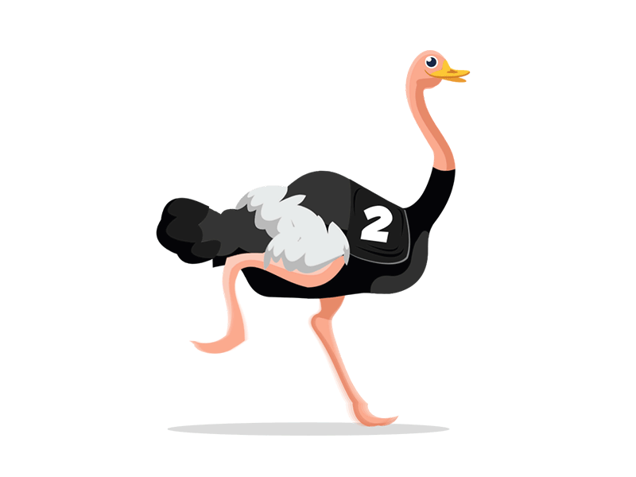
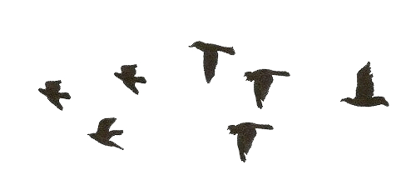
big
the biggest
Ostriches are__________ birds in
the world

Slide 22
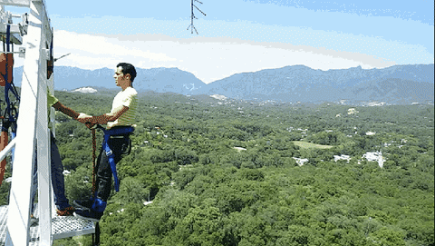
Exciting
Bungee jumping is one of ________________adventures
the most exiting

Slide 23
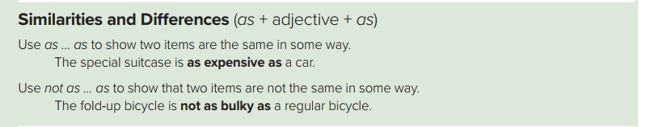
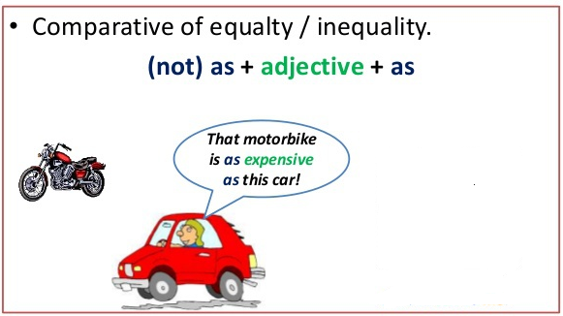
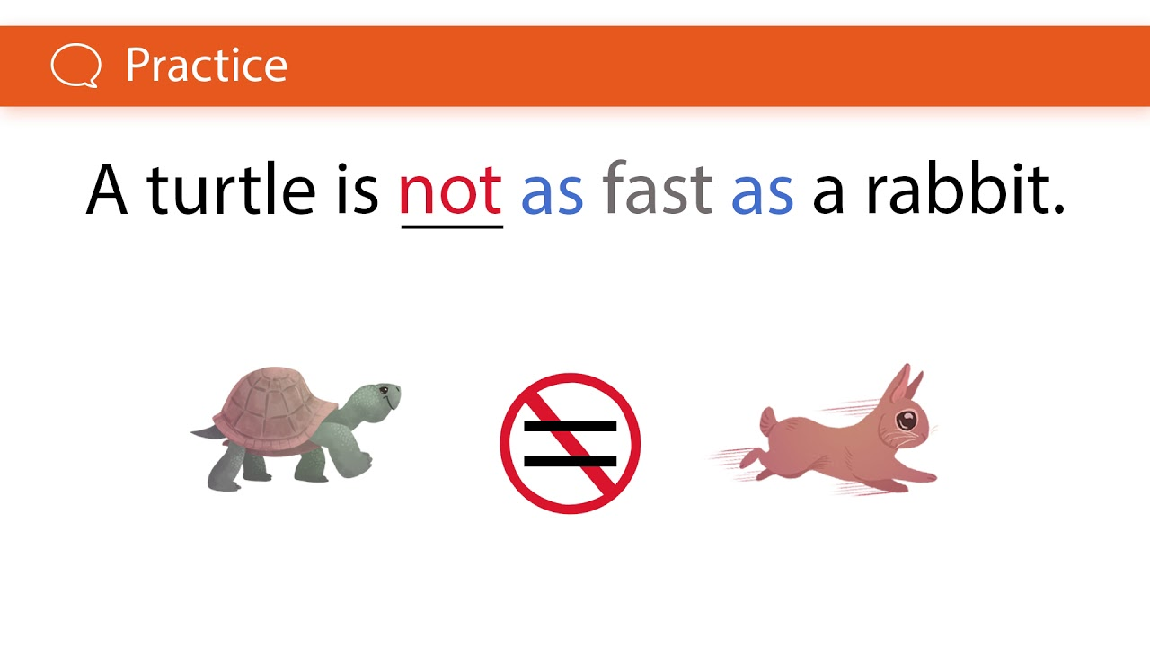
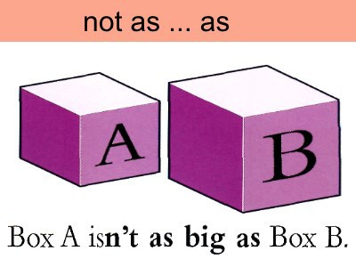

Slide 24
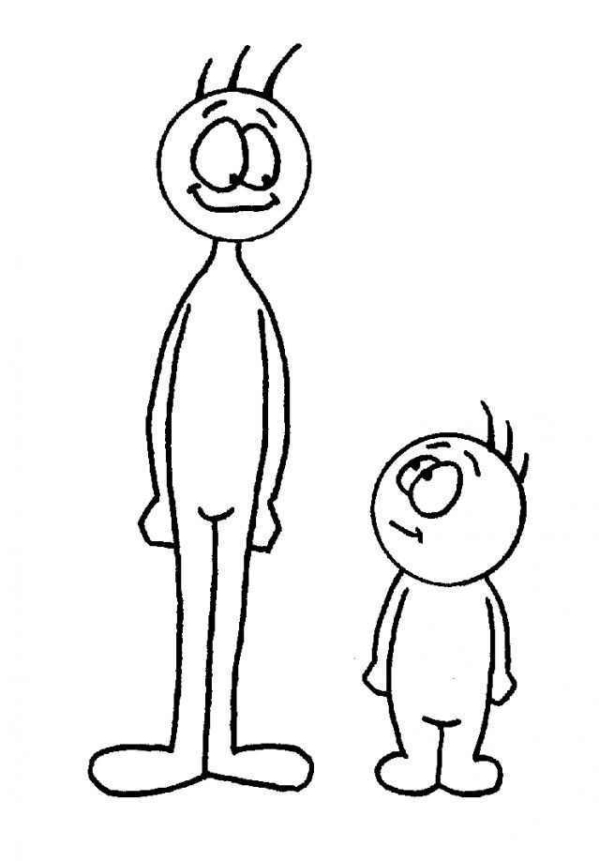
as adj as
Sam
is
as
tall
as
Dan
Dan
Sam
tall

Slide 25
not as adj as
Tom
is
not
as
tall
as
Sam
Tom
Sam
tall

Slide 26

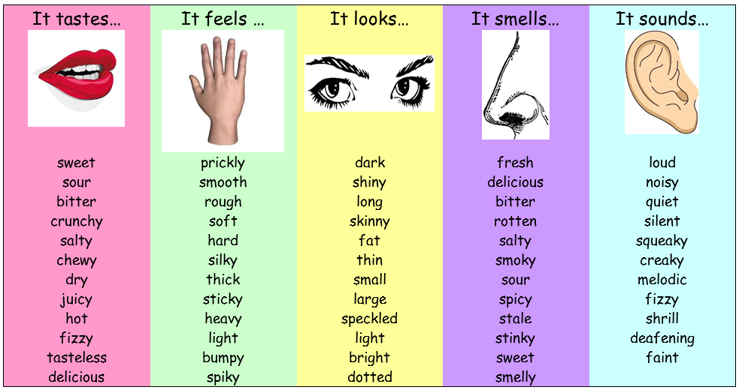
We use: sense verbs + like + noun in descriptions .

Slide 27
https://www.liveworksheets.com/kc2785833ng

Slide 28
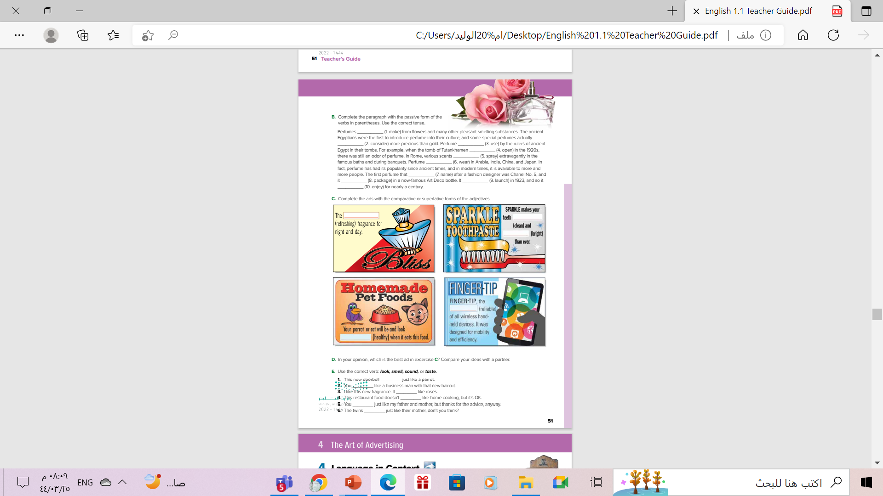
Open
Student’s book , P.(501)
.

Slide 29
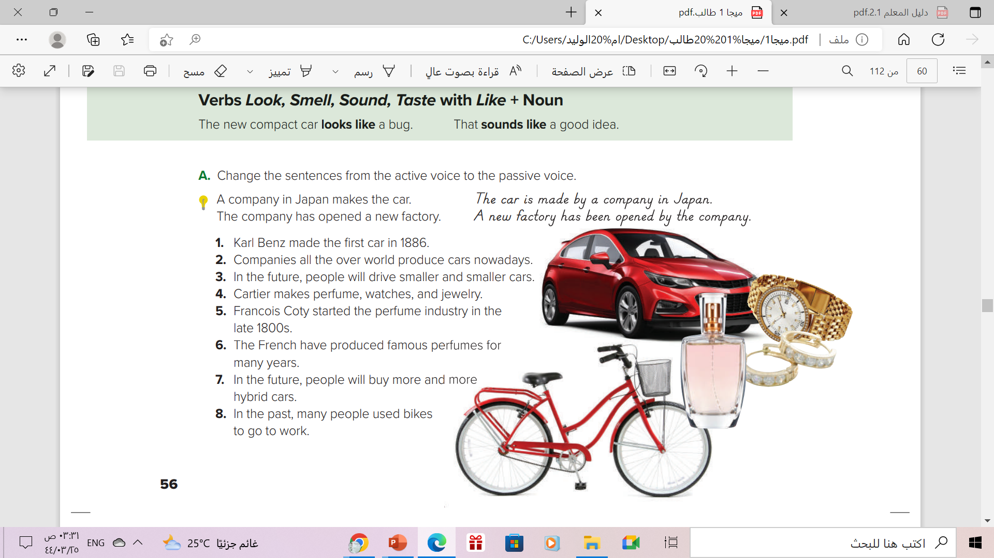
1. The first car was made by Karl Benz in 1886.
2. Cars are produced (by companies) all over the world nowadays.
3. In the future, smaller cars will be driven (by people).
4. Perfume, watches, and jewelry are made by Cartier.
5. The perfume industry was started by Francois Coty in the late 1800s.
6. Famous perfumes have been produced by the French for many years.
7. In the future, more hybrid cars will be bought (by people).
8. In the past, bikes were used by many people to go to work.

Slide 30
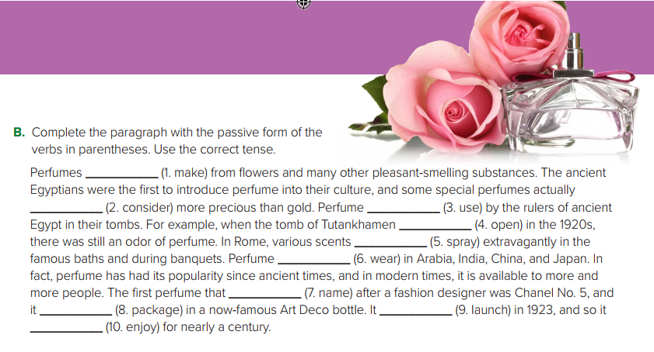
are made
were considered
was used
was opened
were sprayed
was worn
was named
was packaged
was lunched
has been enjoyed

Slide 31
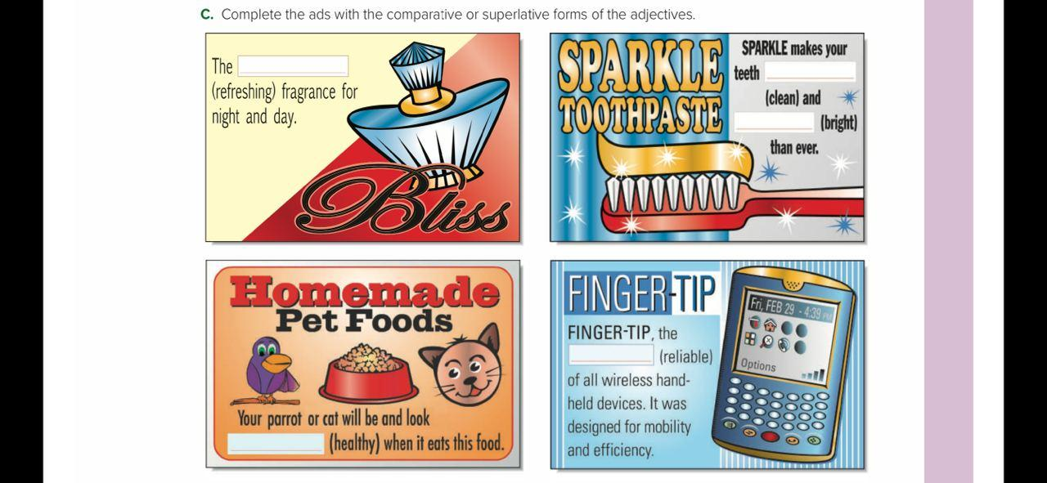
Most refreshing
cleaner
brighter
most reliable
healthier

Slide 32
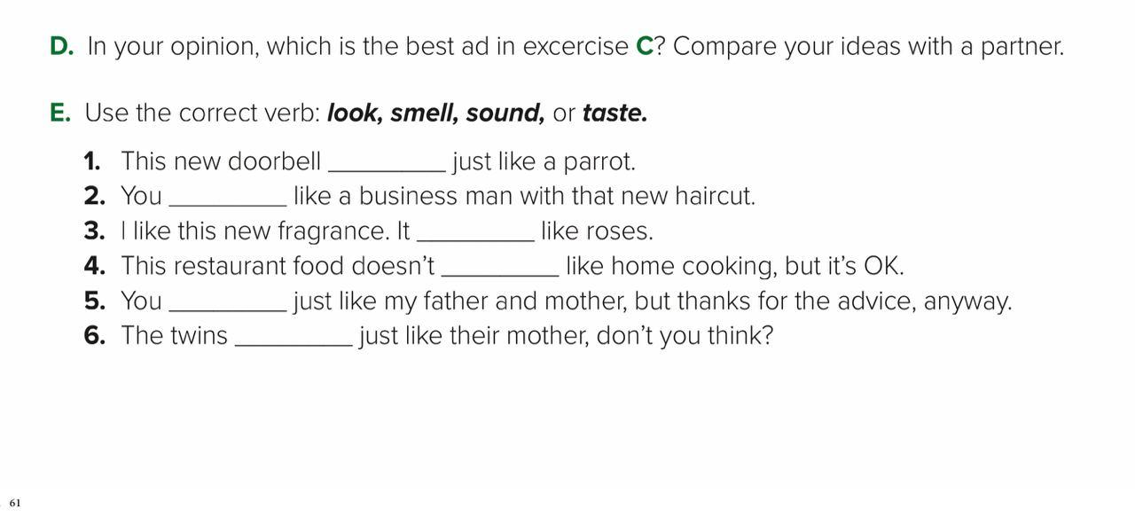
Sounds/look
look
smells
taste
sound
look

Slide 33
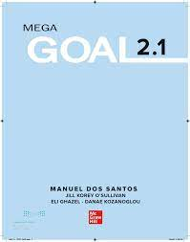
Homework
Workbook , P.(111)
Exercise (D)
.

Slide 34
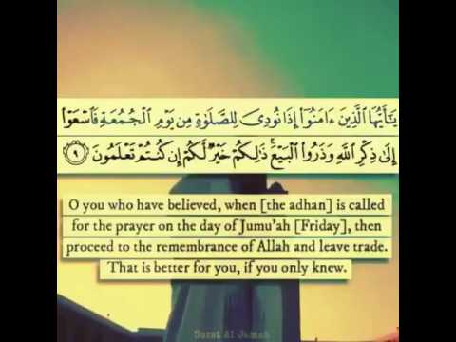
From The Holy Quran

Slide 35

Thank you!

