Slide 1
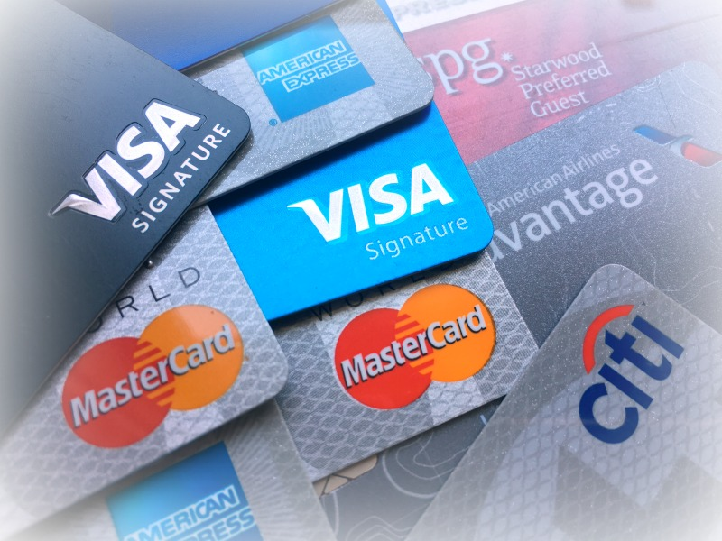
Mega Goal 1.1
U: 4
The Art of Advertising
Reading
By: Yousef Hilal Alyazedi

Slide 2
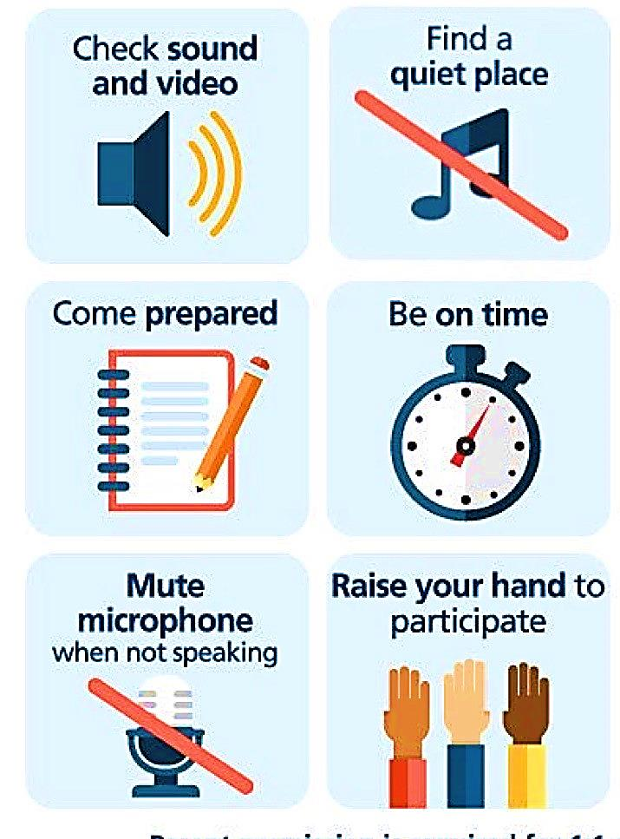
Online Classroom Rules

Slide 4
Lesson Objectives
The students will be able to :
Analyze the ideas of the reading passage .
Know the history of credit cards .
Identify the meaning of some new words .
Discuss the reading .
Answer some questions .

Slide 5
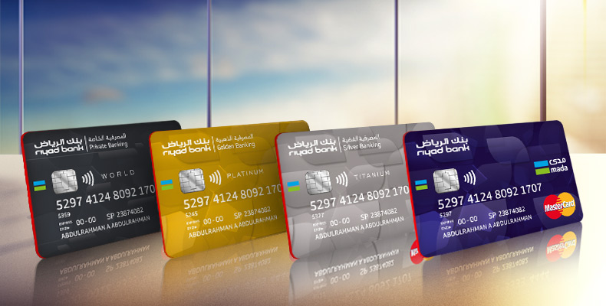
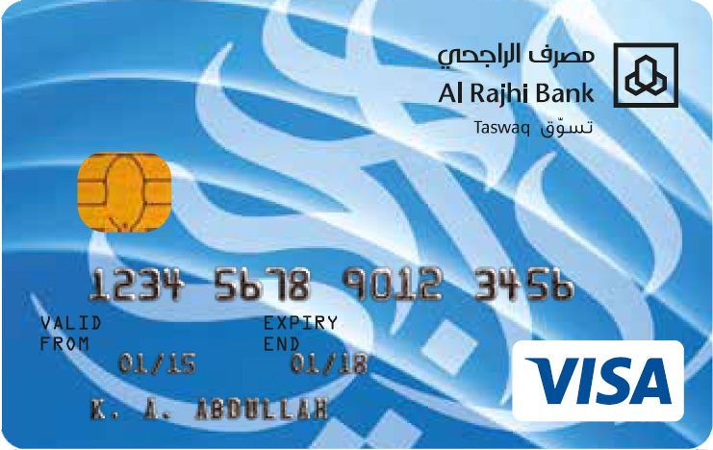
Warm Up
Have you seen cards like these ?
Where can we use them ?

Slide 6
Open your Student’s book at page: 60

Slide 7
Before Reading

Slide 8
Read and Listen

Slide 9
What’s the title?
How many paragraphs?
How many photos ?
What kind of photo is it ?

Slide 10
What is a credit card ?
A small plastic card that we use to buy goods or services and pay for them later .
How was the world without the use of cash ?
Inconceivable
How would be an economic universe without the use of plastic cards ?
Impractical
What is the use of credit card ?
To pay for goods and services .

Slide 11
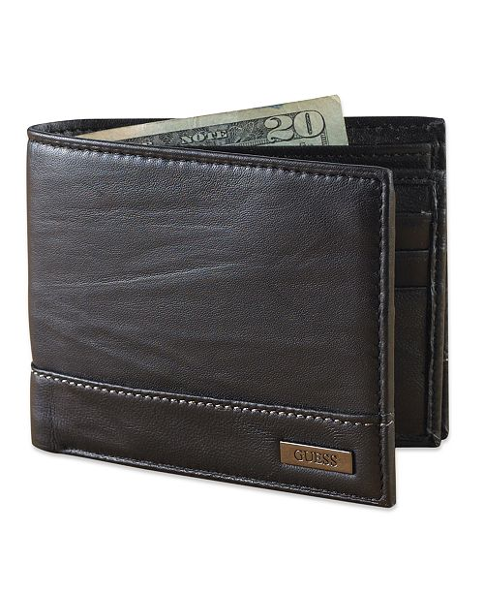
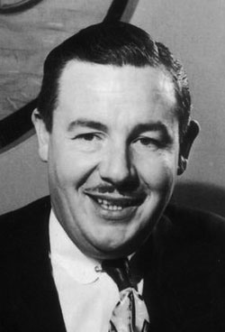
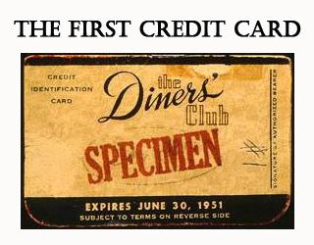
The beginning of the invention of credit card
In 1949, businessman called “ Frank McNamara “ forgot his wallet while dining out in a restaurant but the situation was solved .
A year later, McNamara returned to the restaurant . When the bill arrived , McNamara paid with a small cardboard card, known today as
a Diner’s Club Card .
Frank McNamara founded Diners Club .
“ The First Supper ” is the story of how Frank McNamara came up with the idea of the Diner’s Club .
In 1952, Diner’s Club Card was accepted by thousands of businesses .

Slide 12
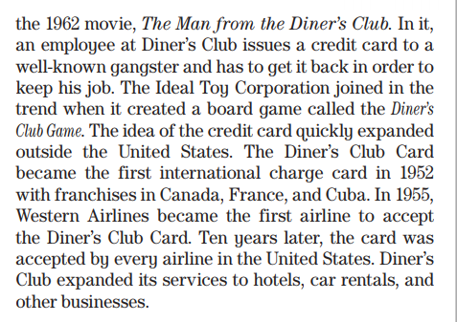
The spread of the credit card.
What was the name of the movie ?
The Man from the Diner’s Club .
What did the Ideal Toy Corporation do ?
It created a board game called the Diner’s Club Game to joined the trend of Diner’s Club Card .
Did the credit card expand outside USA ?
Yes, it did .
Where did it expand ?
Canada
France
Cuba
In 1952, Diner’s Club Card became the first international charge card
In 1955, Western Airlines became the first airline to accept the Diner’s Club Card

Slide 13
Have there other international credit cards been created after Diner’s Club Card ?
Yes, there have .
What are they ?
American Express , Visa and MasterCard .

Slide 14
When was the first card members rewards program created ?
In 1984 .
What did the first card members rewards program mostly aim ?
It aimed mostly at business travelers .

Slide 15
This is a conclusion of the whole passage .
The business world has completely changed after the forgotten wallet.

Slide 16
Timeline of the Diner’s Club Card
In 1949 , Frank couldn’t pay for dinner because he forgot his wallet .
In 1950 , Frank returned to the same place and paid the money with Diner’s Club Card .
In 1952 , The Diner’s Club Credit was accepted by thousands od businesses across USA .
In 1952 , The Diner’s Club Credit became the first international charge card .

Slide 17
Quick Check
https://www.liveworksheets.com/1-ks1398786yc

Slide 18
Open your Student’s book at page: 61

Slide 19
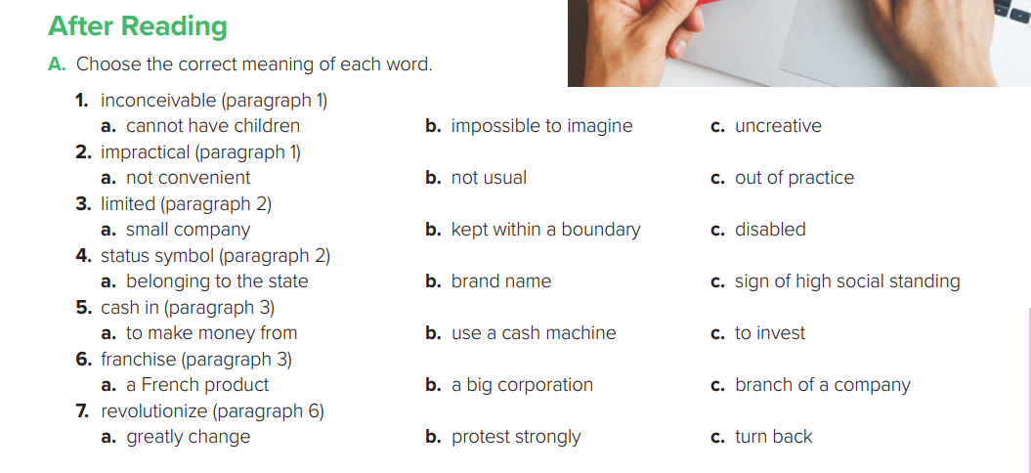

Slide 20
incorrect
invalid
inactive
impatient
immature
impossible

Slide 21
1 - Since the 1950s.
2- He didn’t have enough money to pay for a business dinner
3- He thought people should be able to spend what they could afford not only what they are carrying in cash .
4- “charging it”
5 - Hollywood made a film about it, and a board game called
Diner’s Club was created.
6- It became a status symbol.
7 - It started for use in restaurants and then expanded to other
businesses and to other countries.

Slide 22
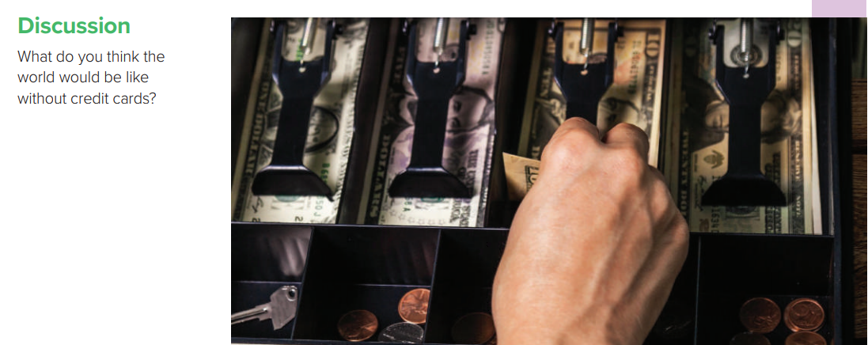

Slide 23
Workbook P. 113
Exercise G

