Slide 1
1 Listen & discuss 2 pair work
Today:
Date:
- -1444
Page 2-3
By: Dalal Al-Juaid

Slide 2
Apply greetings in a simple conversation.
Introduce a friend to others.
Warm up
1-Listen
New words
Quick check
2-Pair work

Slide 4
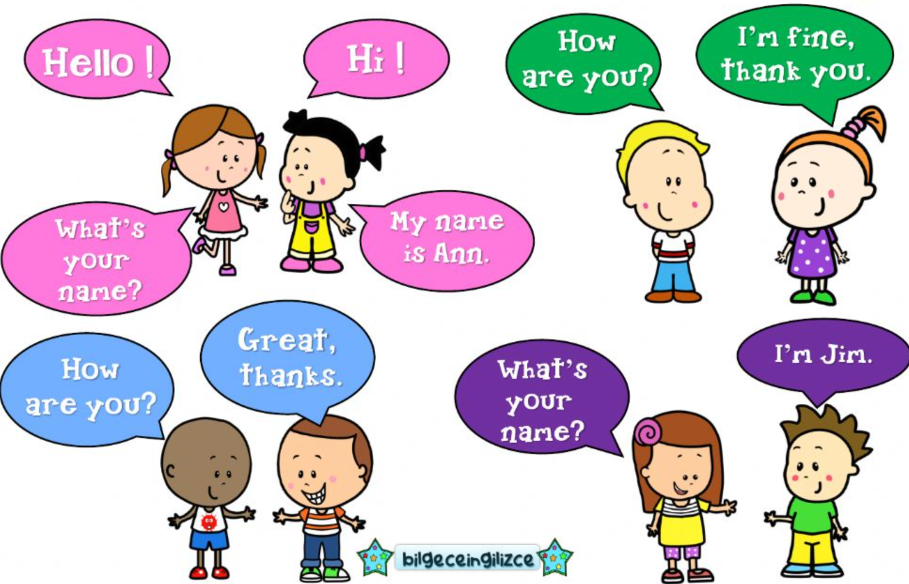
Warm up
1-Listen
New words
Quick check
2-Pair work

Slide 5
Page 2
Warm up
1-Listen
New words
Quick check
2-Pair work

Slide 6
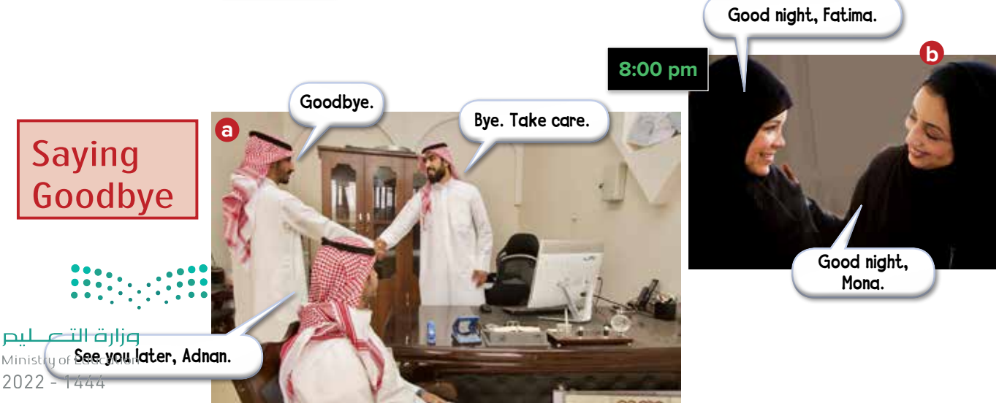
Page 2
Warm up
1-Listen
New words
Quick check
2-Pair work

Slide 7
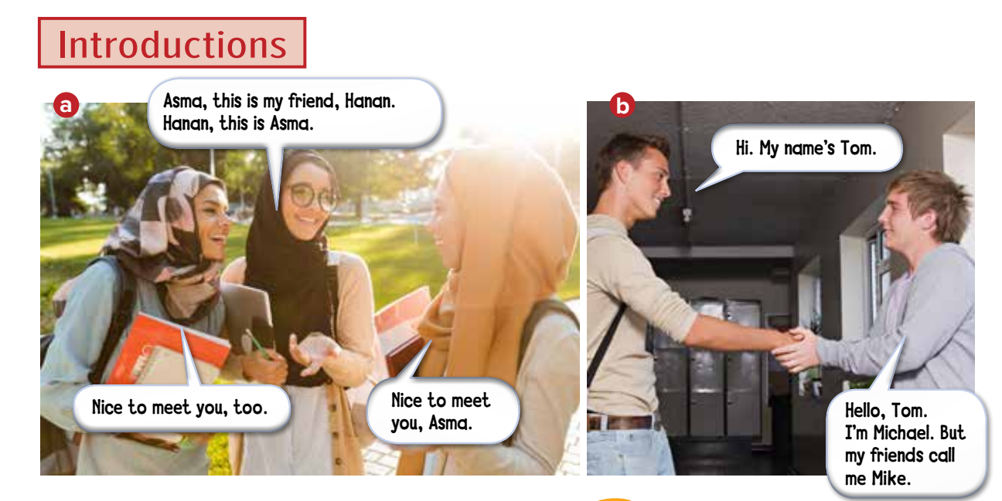
Warm up
1-Listen
New words
Quick check
2-Pair work

Slide 8
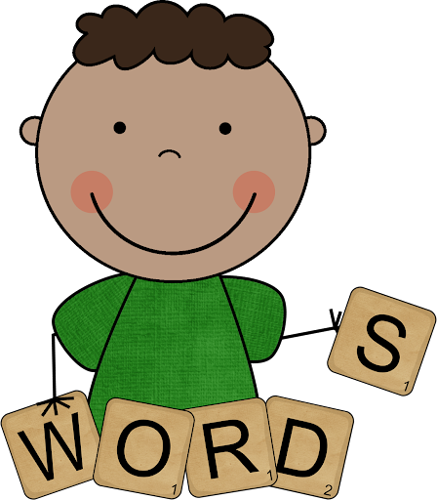
New Words
Greetings:
Hello
Hi
Good morning
Good afternoon
Good evening
Goodbye
Farewells:
Good night

Slide 9
Page 3
no
no
Warm up
1-Listen
yes
New words
no
Quick check
2-Pair work

Slide 10
Warm up
1-Listen
New words
Quick check
2-Pair work

Slide 11
page 187 Ex (A)
for practice with new words
Warm up
1-Listen
New words
Quick check
2-Pair work

Slide 12
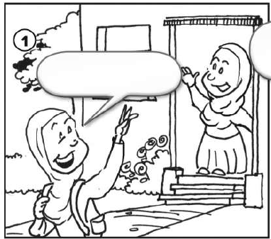
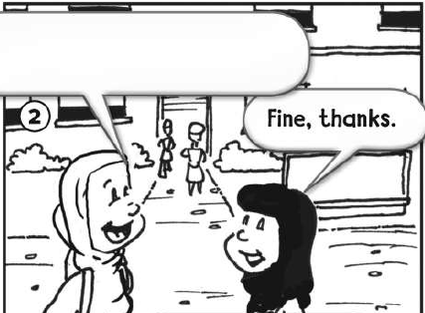
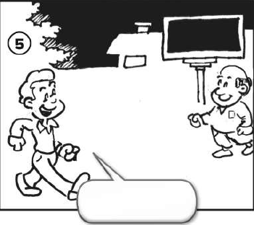
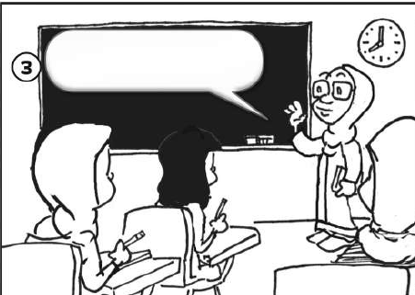
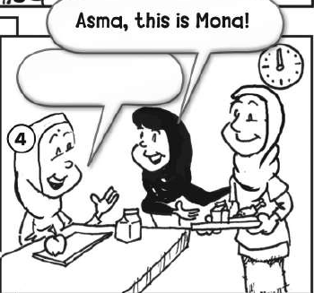
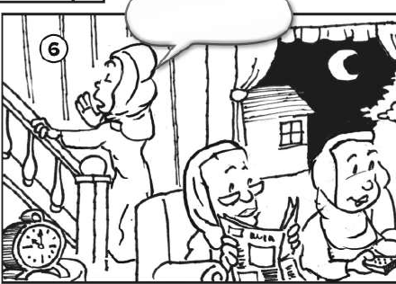
p.187
Hi. How are you?
Goodbye.
Good evening.
Good morning.
Warm up
Nice to meet you.
Good night.
1-Listen
New words
Quick check
2-Pair work

