Slide 1

Unit 1
Lifestyle
Part 3

Slide 2
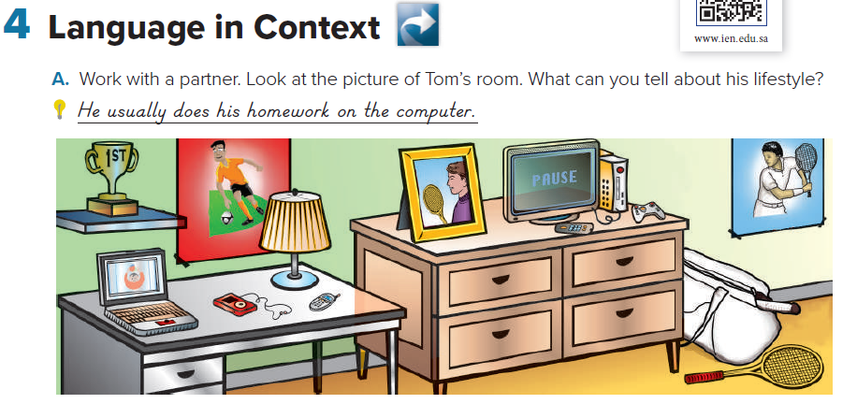
Sample answers:
He likes football.
He plays computer games.
He plays tennis.
He has a trophy.
He sends text messages.
He likes tennis a lot.
Sample answers:
I have posters on the wall.
My room isn’t as neat.

Slide 3
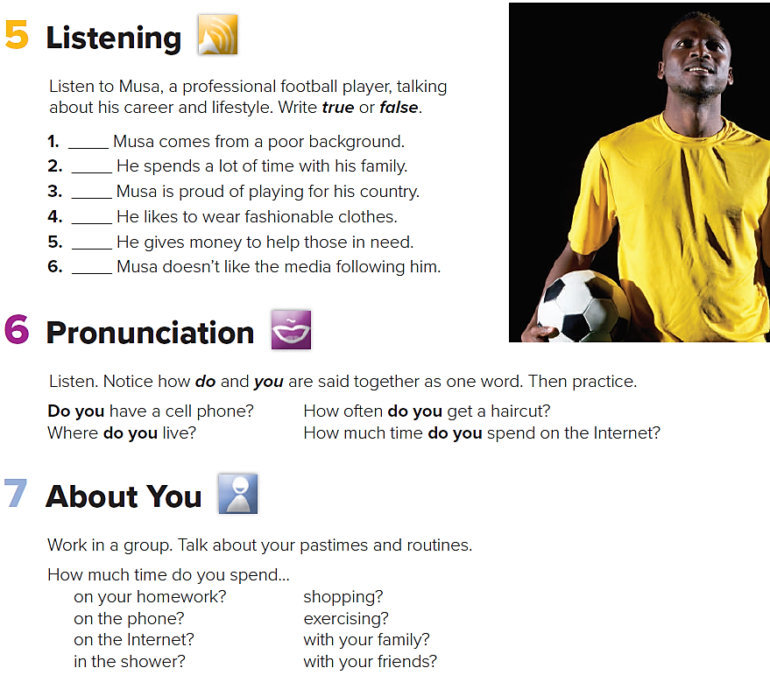

true
false
true
true
true
true

Slide 4
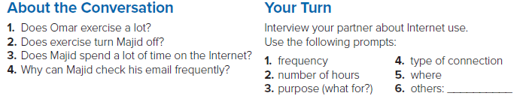
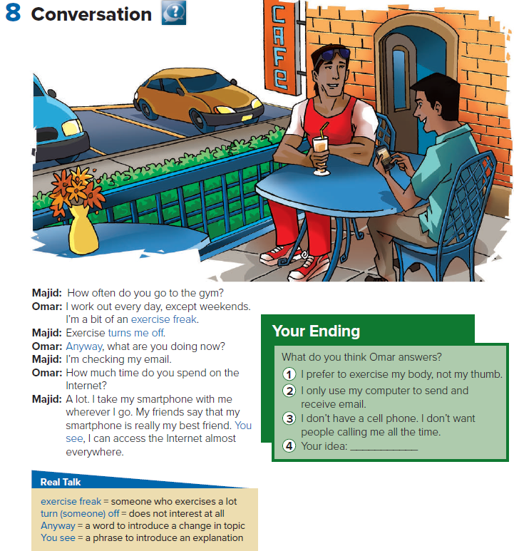

1. Yes, he does. He works out every day except weekends.
2. Yes, it does.
3. Yes, he does.
4. He has a smartphone, and he can access the Internet almost everywhere.

Slide 5
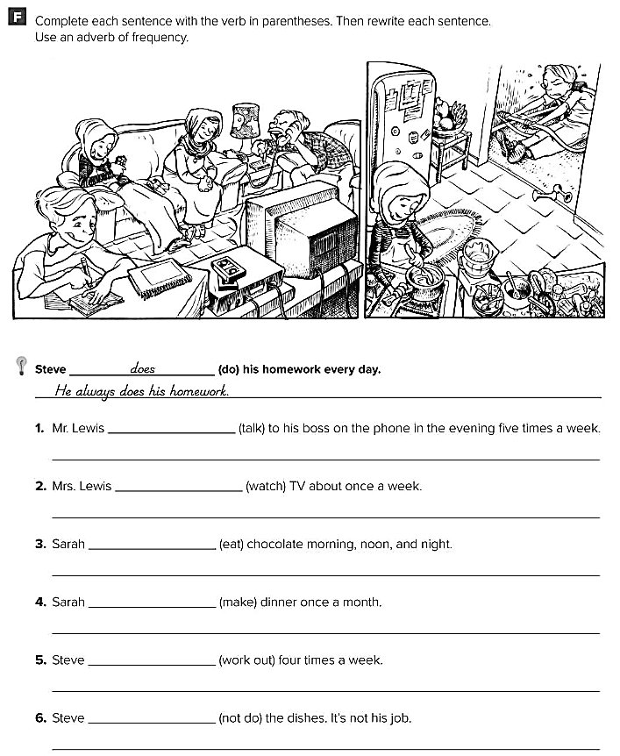
talks
He frequently talks to his boss on the phone .
watches
Mrs. Lewis sometimes watches TV .
eats
She eats chocolate all the time .
makes
She rarely makes dinner
works out
He frequently works out .
does not
He never does the dishes .

