Slide 1


Welcome to class
T.

Slide 2

1
Unit 2

Slide 3


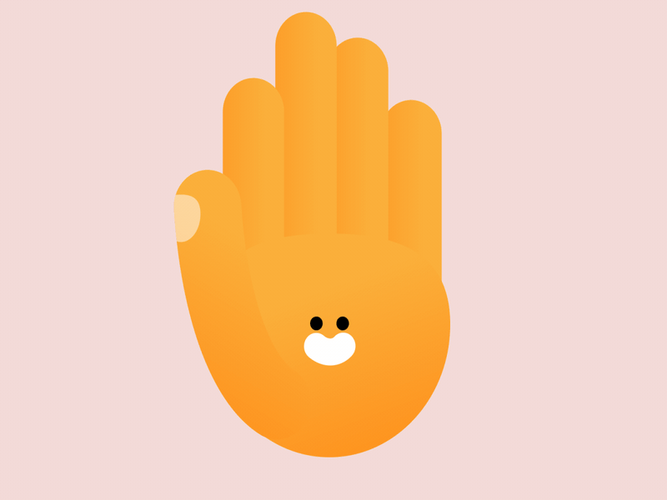

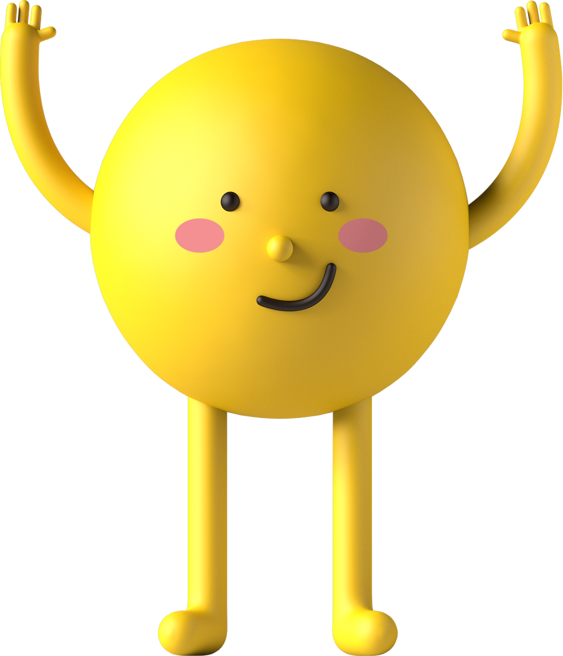
workbook
Pages 53 , 54

Slide 4

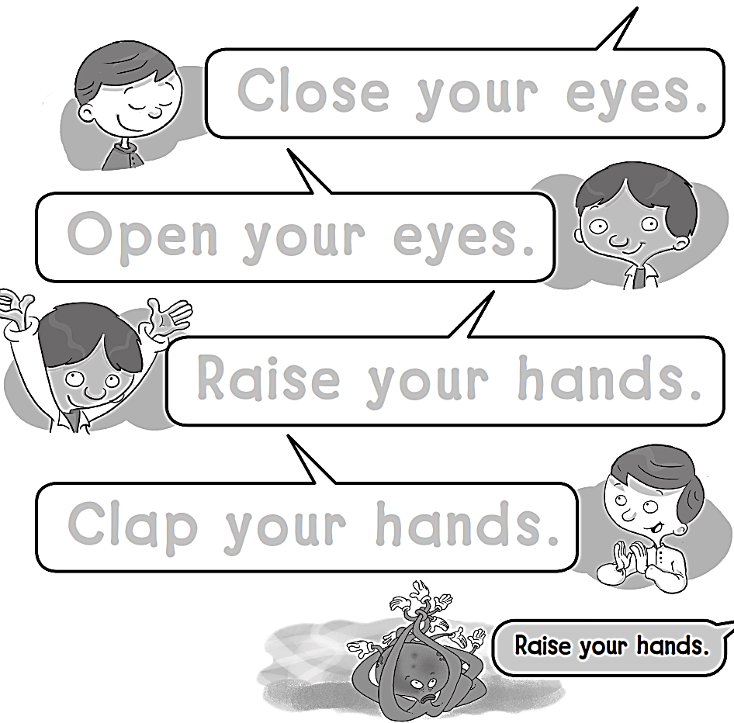
Close your eyes.
Open your eyes.
Raise your hands.
Clap your hands.

Slide 5

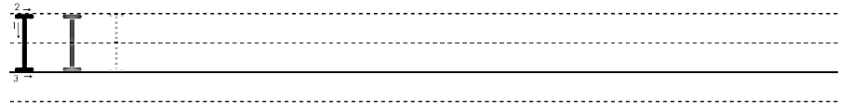
I I I I I I I I I I I

Slide 6
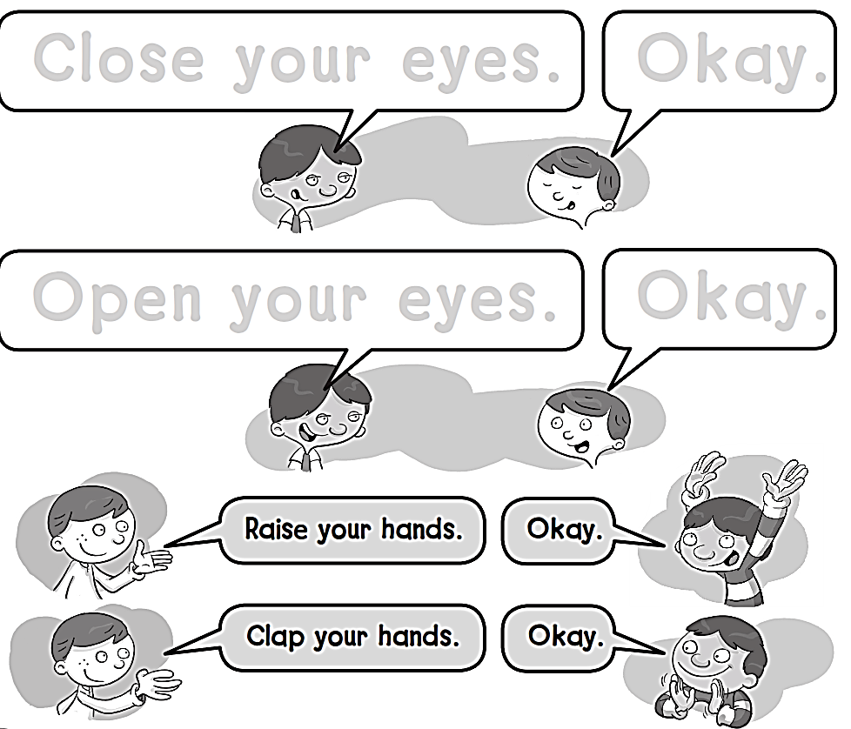
Close your eyes.
Okay.
Open your eyes.
Okay.

Slide 7

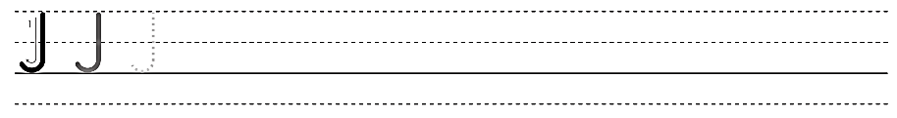
J J J J J J J J J

Slide 8
workbook
Pages 55 , 56

Slide 9

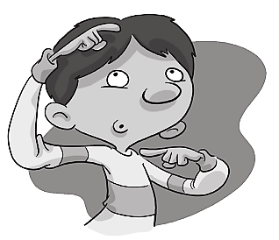


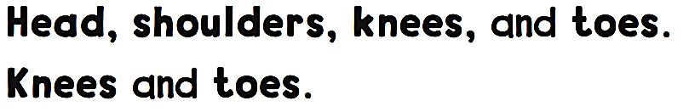
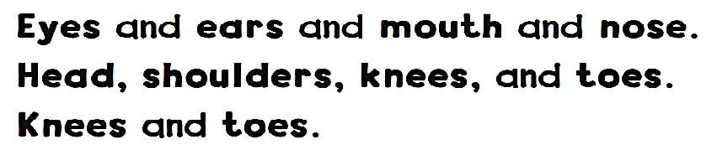
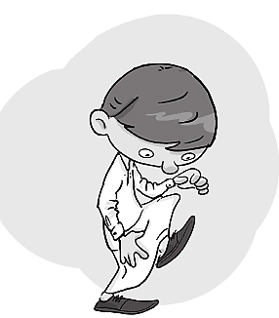
Head , shoulders
knees
toes

Slide 10

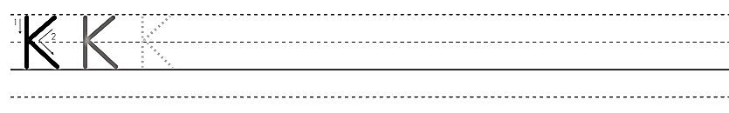
K K K K K K K

Slide 11
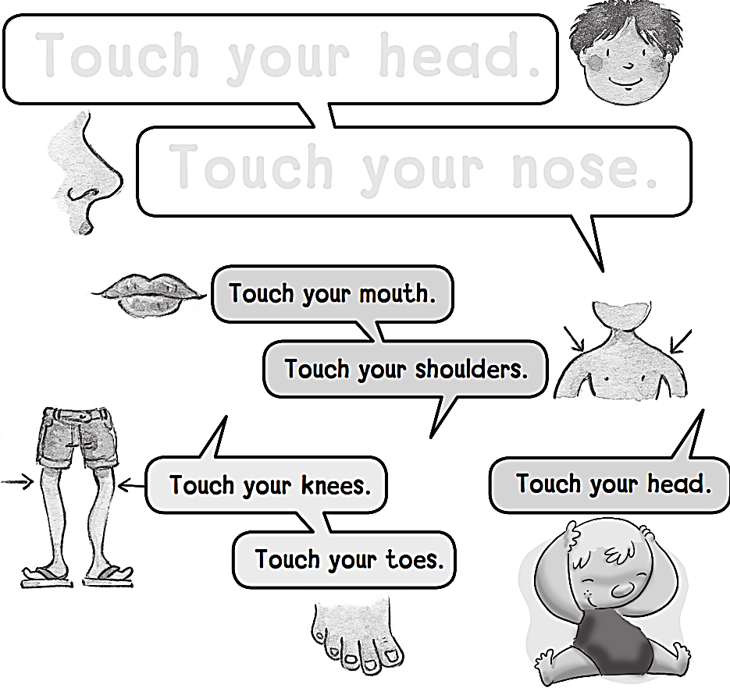
Touch your head .
Touch your nose.

Slide 12

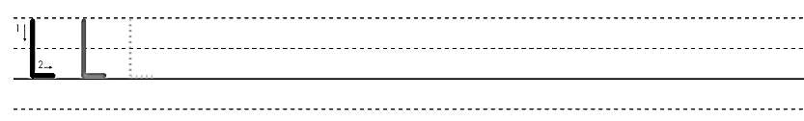
L L L L L L L L

Slide 13
workbook
Pages 57 , 58

Slide 14
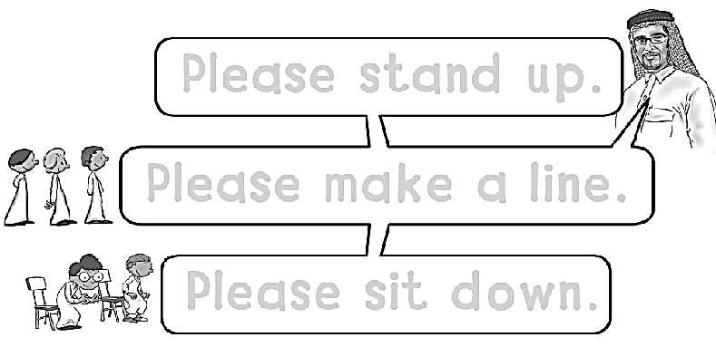
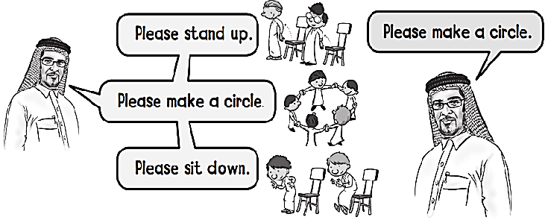
Please stand up .
Please make a line .
Please sit down .

Slide 15

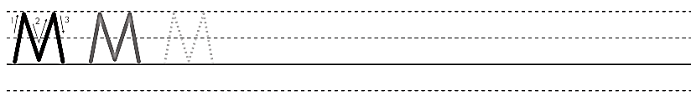
M M M M M

Slide 16


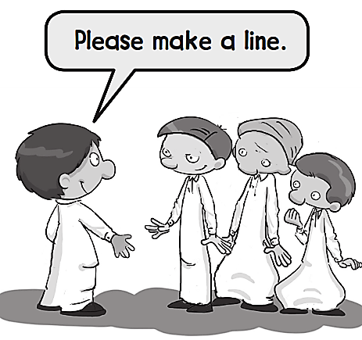
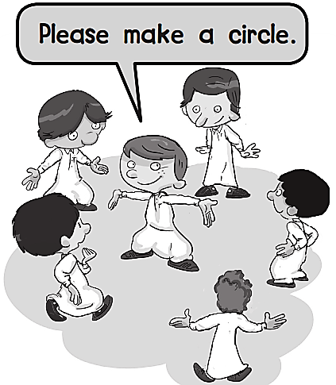
Please stand up .
Please come
to the front .

Slide 17

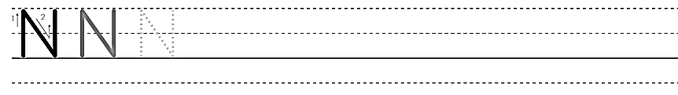
N N N N N N N

Slide 18
workbook
Pages 59 , 60

Slide 19




Slide 20

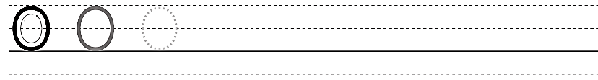
O O O O O O

Slide 21



Slide 22

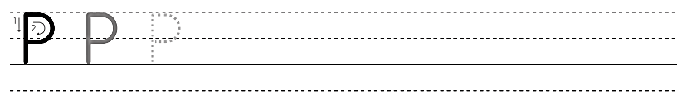
P P P P P P P P

Slide 23


