Slide 1
Welcome to class
T.

Slide 2
1
Unit 3

Slide 3
workbook
Pages 61 , 62

Slide 4
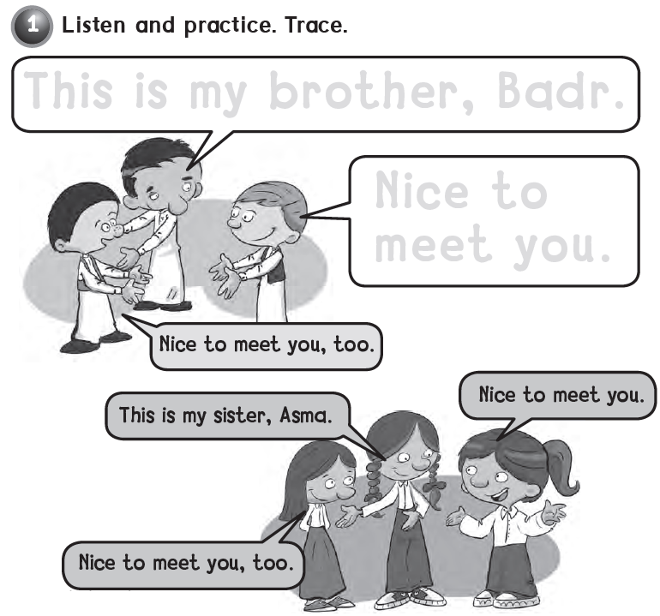
This is my brother , Badr .
Nice to
meet you .

Slide 5
Q Q Q Q Q Q

Slide 6
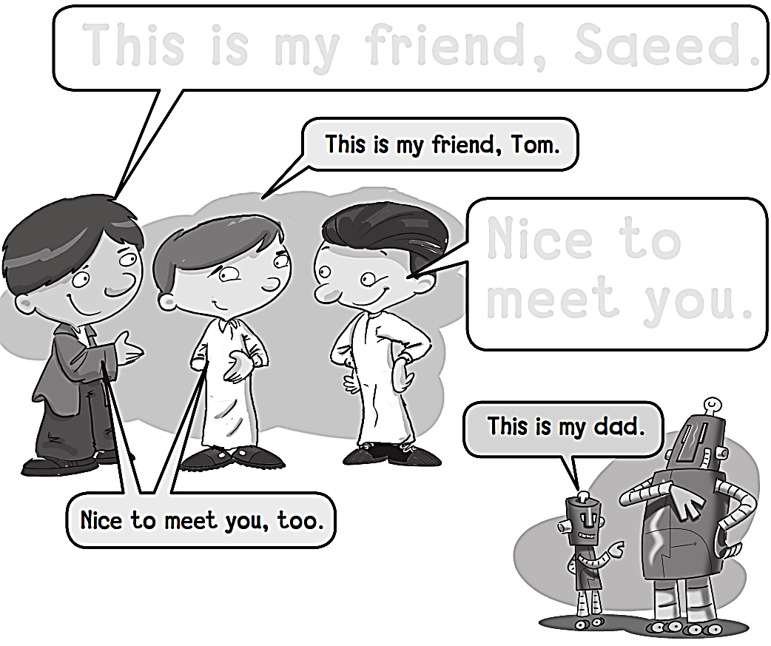
This is my friends, saeed.
Nice to
Meet you.

Slide 7
R R R R R R R

Slide 8
workbook
Pages 63 , 64

Slide 9
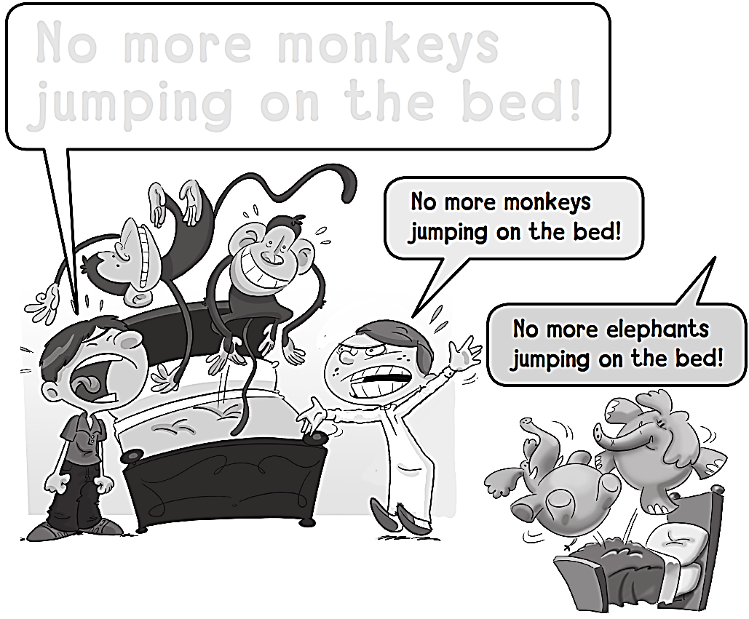
NO MORE MONKEYS JUMPING ON THE BED!

Slide 10
S S S S S S S

Slide 11
Five little monkeys
jumping on the bed

Slide 12
T T T T T T T T

Slide 13
workbook
Pages 65 , 66

Slide 14
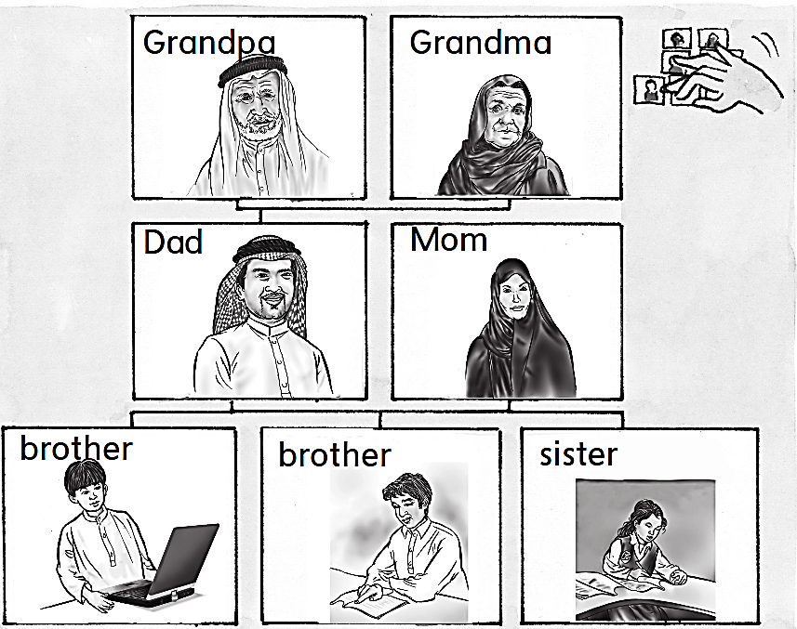

Slide 15
U U U U U U U

Slide 16
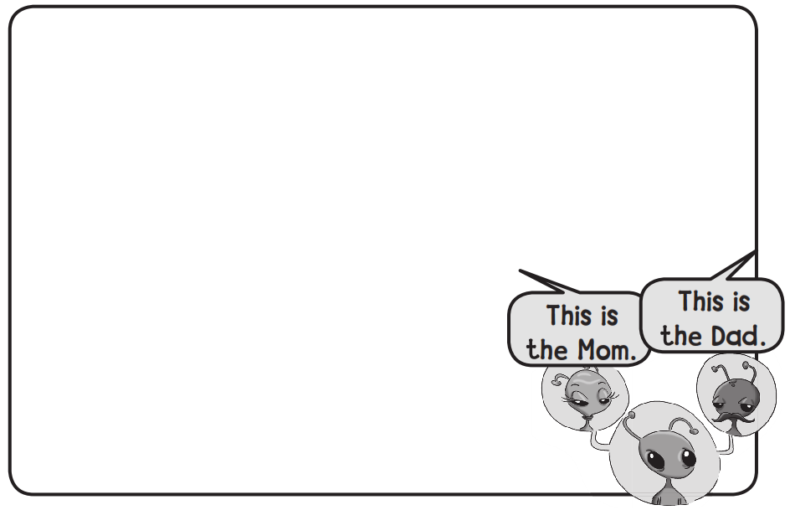
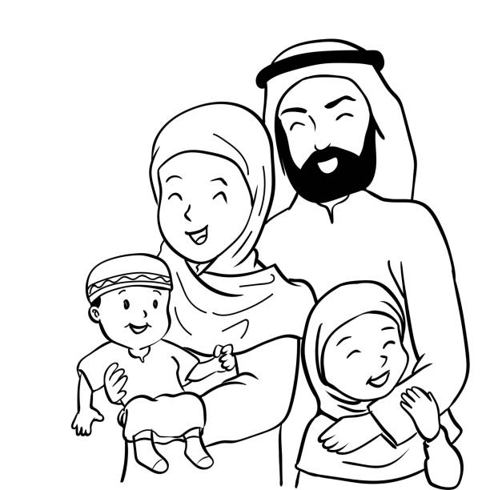

Slide 17
V V V V V V V V

Slide 18
workbook
Pages 67 , 68

Slide 19
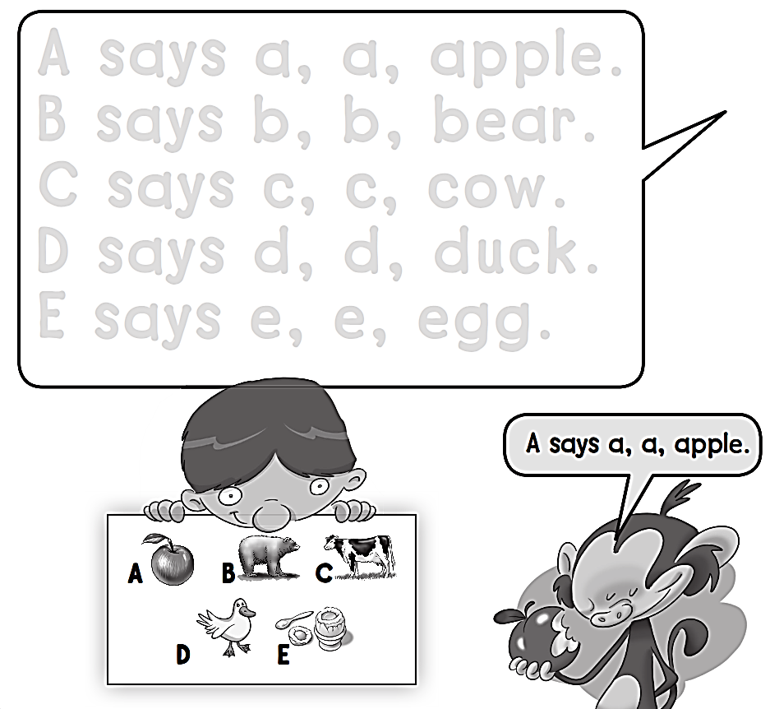

Slide 20
W W W W W W

Slide 21
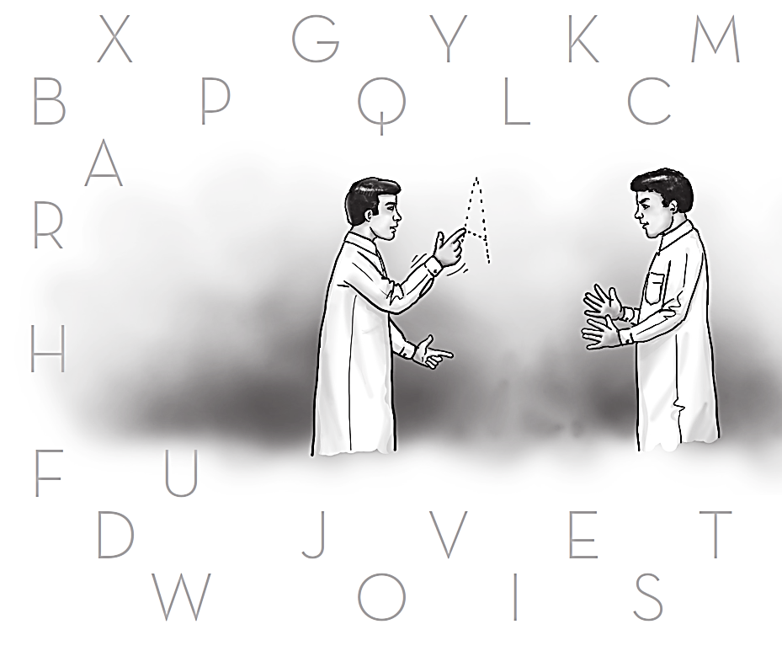
X
Z
G
M
Y
K
B
P
Q
L
C
A
R
H
F
U
D
N
J
V
E
T
W
O
I
S

Slide 22
X X X X X X X X

