Slide 1


Welcome to class
T.

Slide 2

3
Unit 1

Slide 3





workbook
Pages 139 , 140

Slide 4

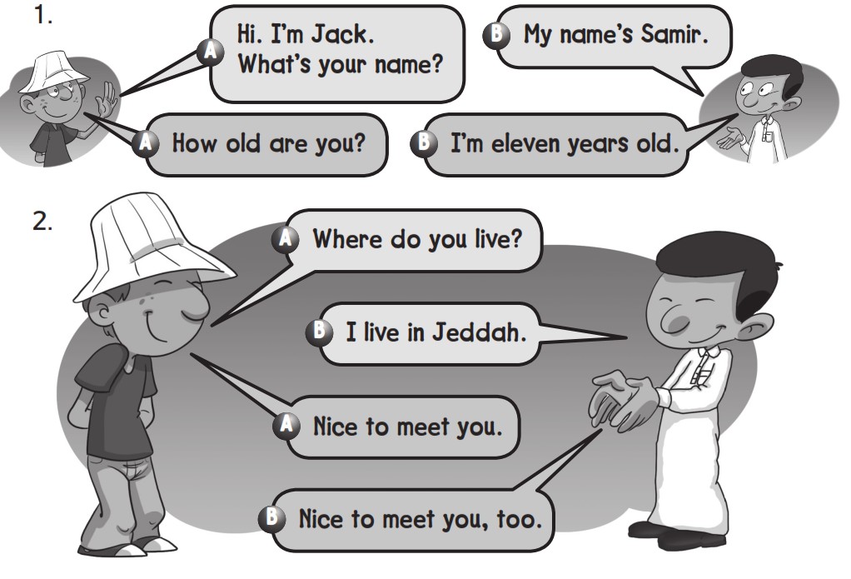

Slide 5
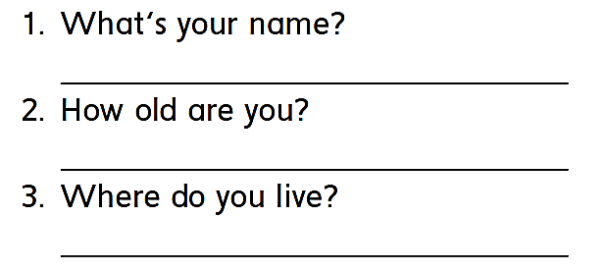
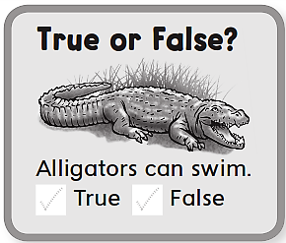

My name is …………………
I’m ….. years old
I live in ………………

Slide 6

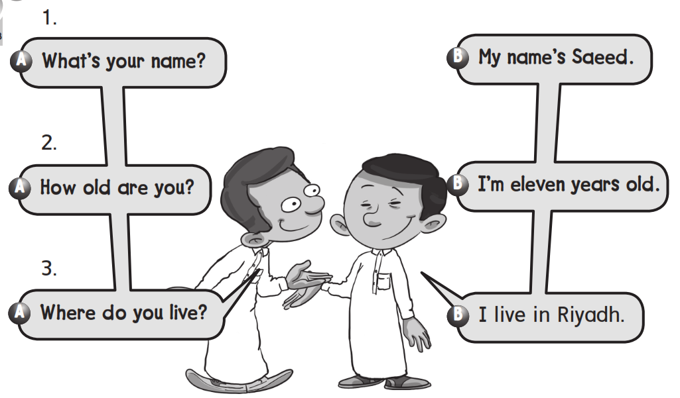

Slide 7
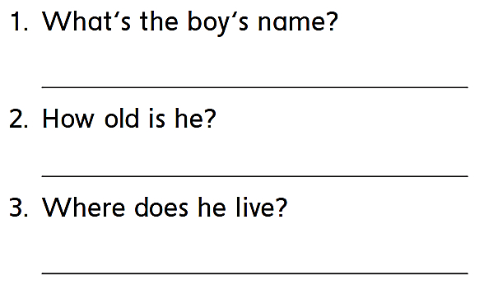
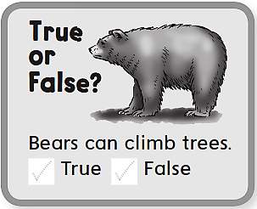
His name is Saeed
He is 11 years old
He lives in Riyadh

Slide 8
workbook
Pages 140 , 142

Slide 9

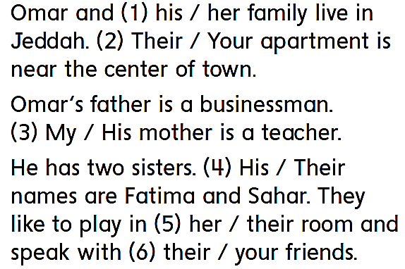

Slide 10
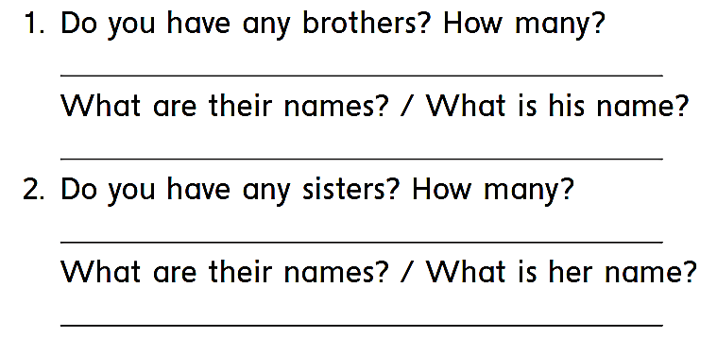
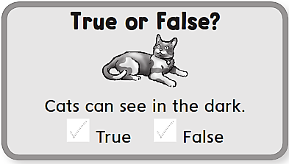

Slide 11

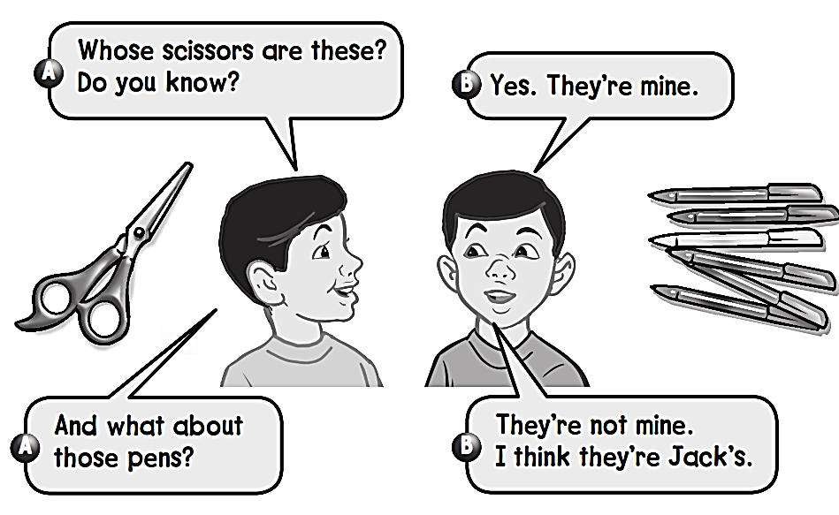

Slide 12

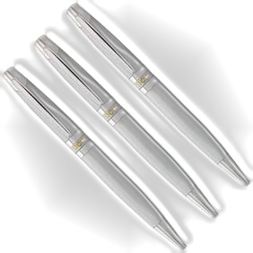
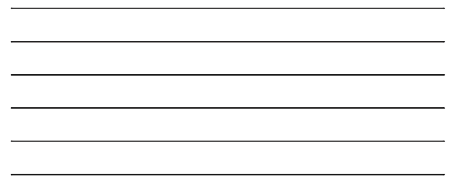
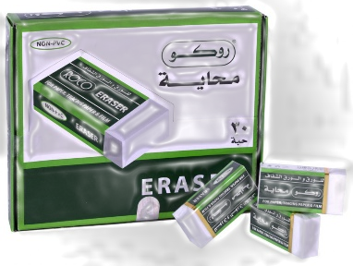
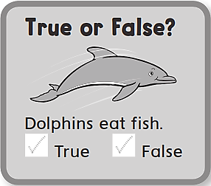
Whose pens are these ? Do you know ?
Yes , they’re mine
And what about those erasers ?
They’re not mine
I think they’re Faisal’s

Slide 13
workbook
Pages 143 , 144

Slide 14

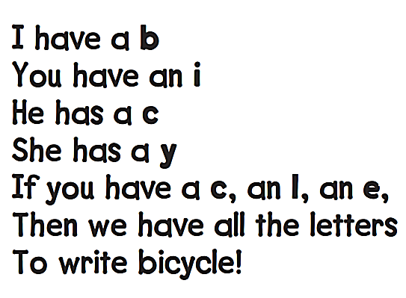
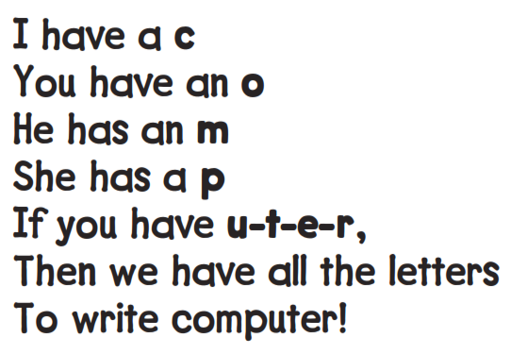
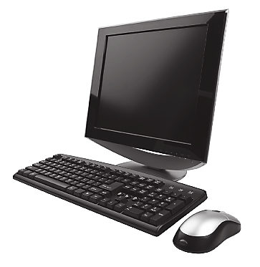

Slide 15
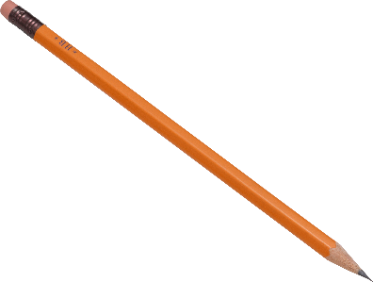

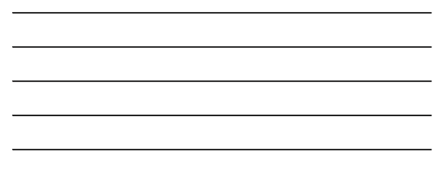
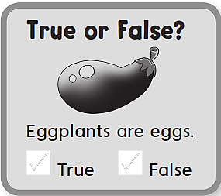
I have a p
You have an e
He has an n
If you have a c , an i , an l
Then we have all the letters to write pencil

Slide 16

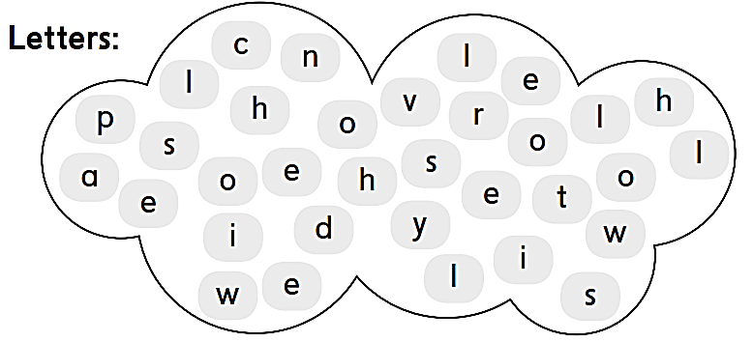

Slide 17
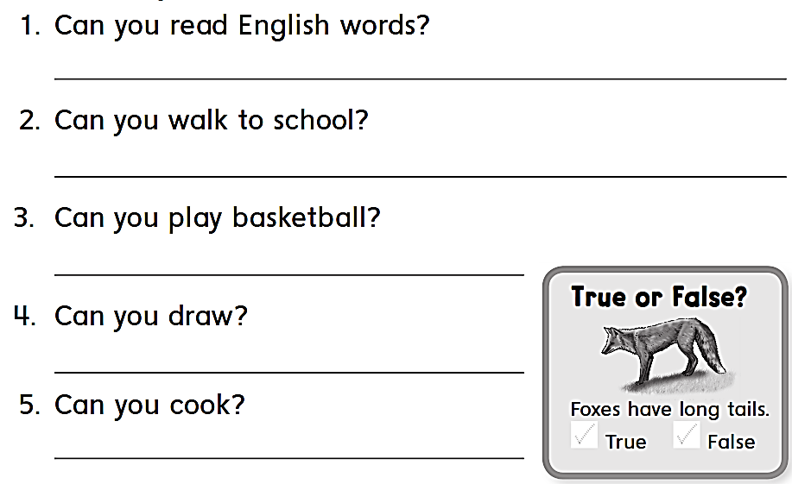
Yes , I can .
No , I can’t
Yes , I can .
Yes , I can .
No , I cant

Slide 18
workbook
Pages 145 , 146

Slide 19

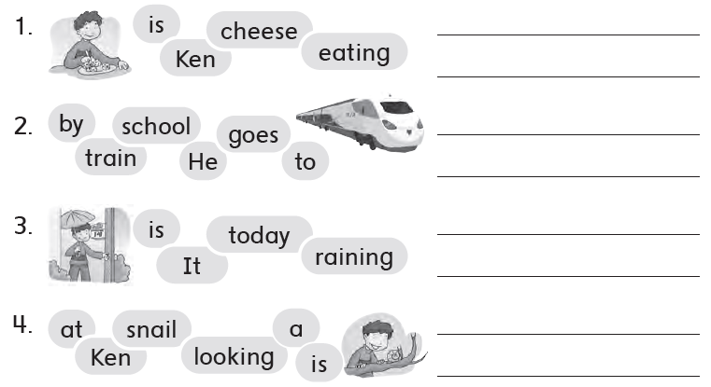
Ken is eating cheese
He goes to school by to train
It is raining today
Ken is looking at a snail

Slide 20

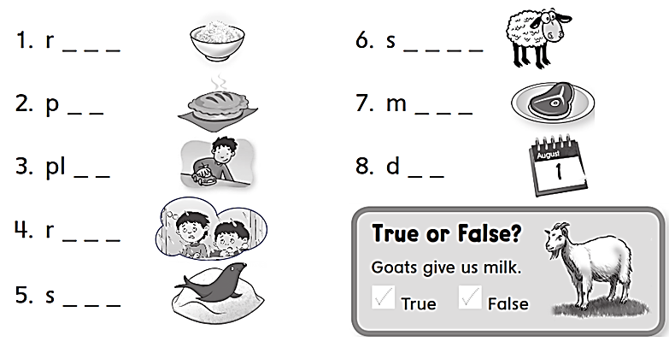
i c e
h e e p
i e
e a t
a y
a y
a i n
e a l

Slide 21

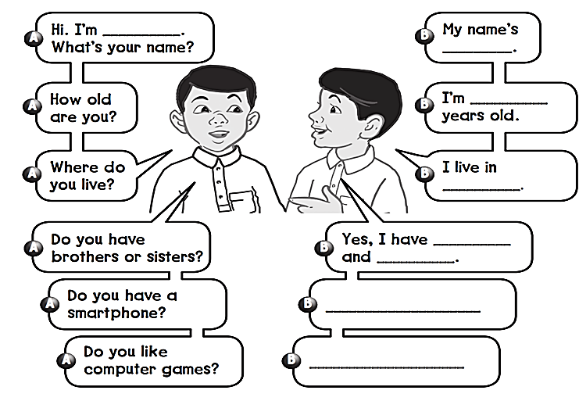
Imad
Sayid
12
Najran
2 brothers
3 sisters
Yes , I do
Yes , I do

Slide 22


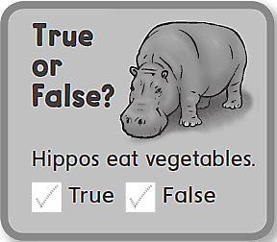
Do you have a social media account ?
What’s your account ?

Slide 23


