Slide 1

Unit 1
Big Changes
Grammar
Mega Goal 1.1
Done by : Entisar Al-Obaidallah

Slide 2
Lesson Objectives:
01
02
03
Use
Use
Differentiate
04
05
06
Differentiate
Form
Apply
simple present tense correctly
Present progressive correctly
between simple present and present progressive
between simple past and present perfect
Meaningful sentences using the correct form of present tense
The rules to do the exercises correctly

Slide 3
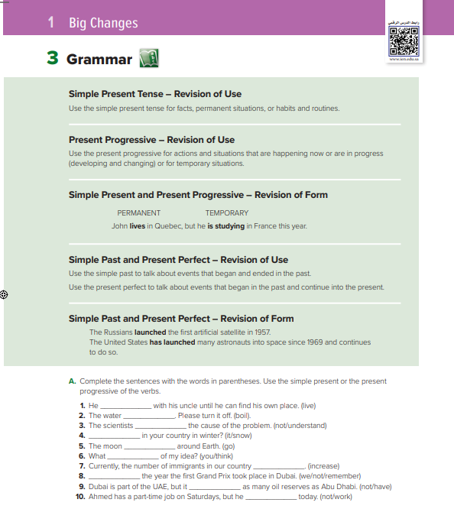
Book Open
p.( 8 )

Slide 4
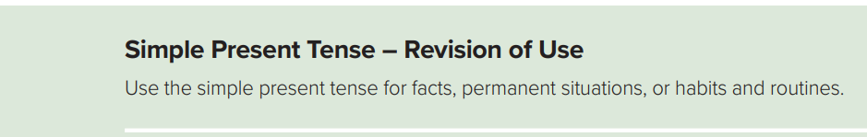

Use
Form:
verb to Be (am – is – are)
do – does
Subject (She- He –It – singular)
V ( s- es- ies)
Examples:
He cleans his room.
He goes to school by car.
He studies English
Subject (I -you - we - They - plural)
V ( infinitive)
Examples:
We study English
I clean my room.
They go to school by car.

Slide 5
We use simple present with facts, permanent situations, or habits and routines.
1) Habitual Action:
I usually work until 2:00 p.m.
My family comes to visit me every year.
2) General or Permanent Situations:
My family lives far away.
My father doesn’t work on Saturday.
3) Facts:
Riyadh is the capital city of Saudi Arabia.
The sun rises in the east ..
Use & Examples:

Slide 6

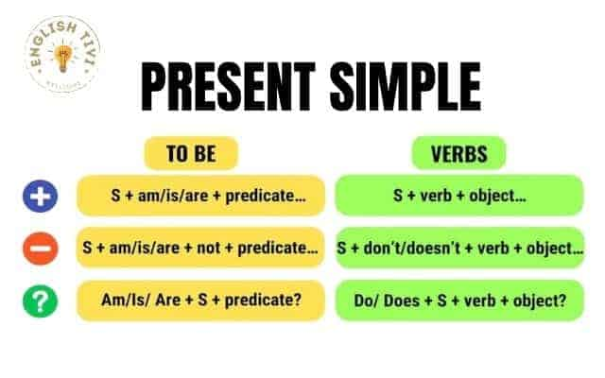

Slide 7
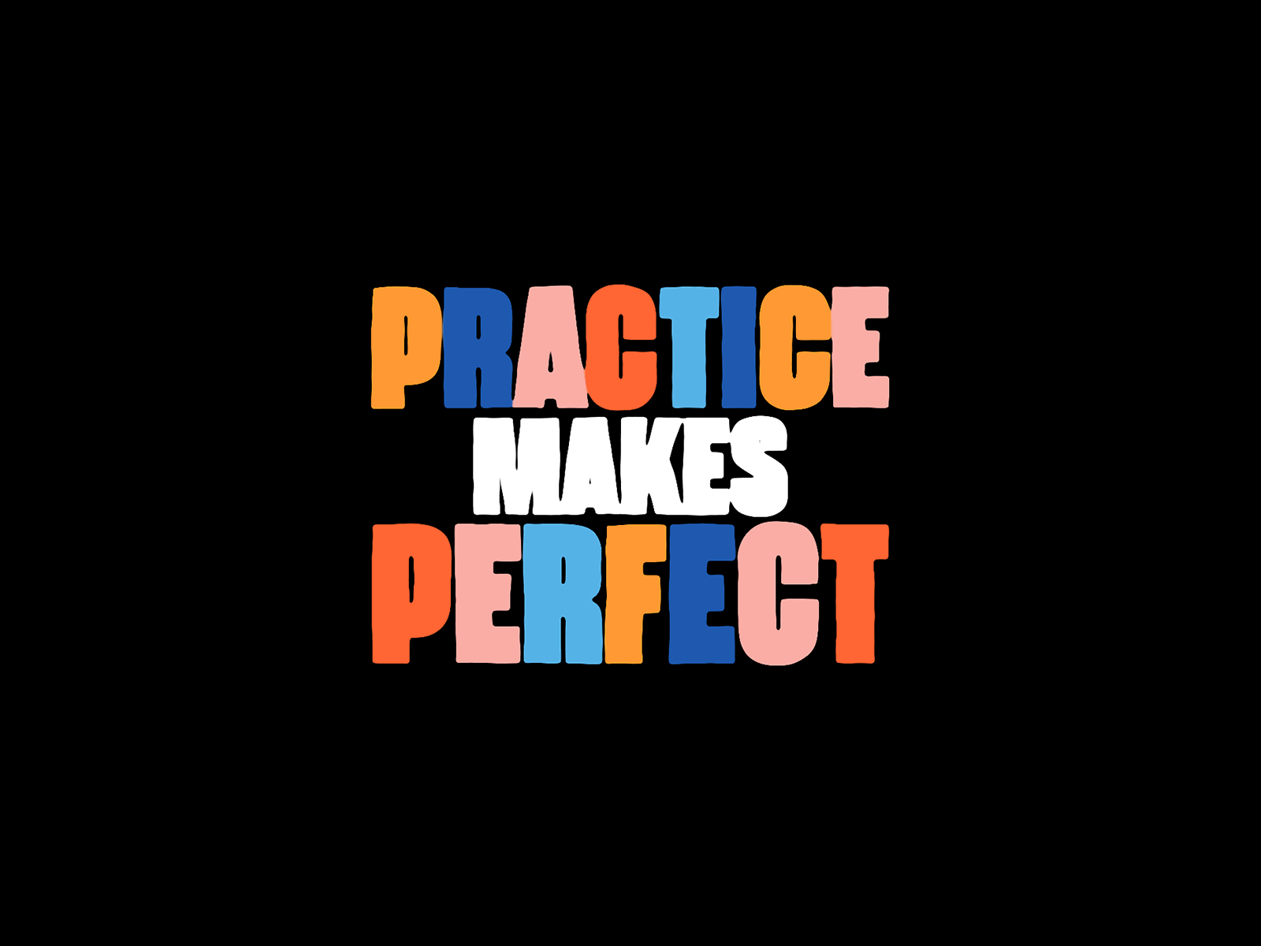

Slide 8

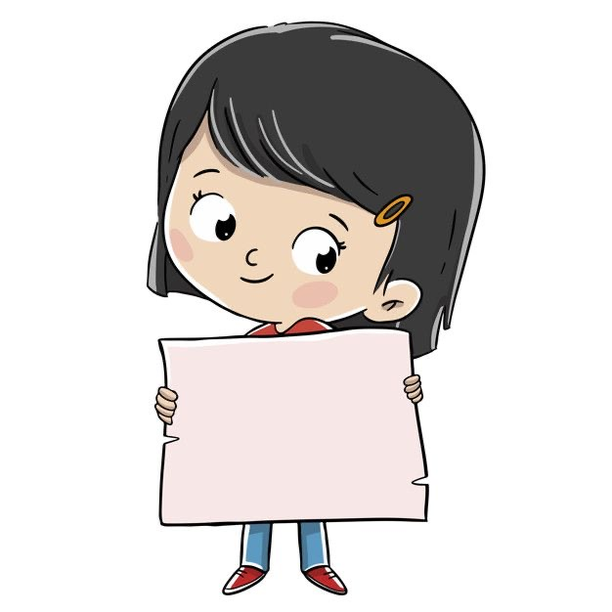
Say if the following sentences are facts, permanent situations, or habits and routines in the conversation?
Sara works as a nurse
Permanent

Slide 9
Say if the following sentences are facts, permanent situations, or habits and routines in the conversation?
The Earth is round.
Fact

Slide 10
Say if the following sentences are facts, permanent situations, or habits and routines in the conversation?
habits
and routines
Nora goes shopping every week

Slide 11
Say if the following sentences are facts, permanent situations, or habits and routines in the conversation?
Water boils at 100 degrees
Fact

Slide 12
Say if the following sentences are facts, permanent situations, or habits and routines in the conversation?
They live in London
Permanent

Slide 13
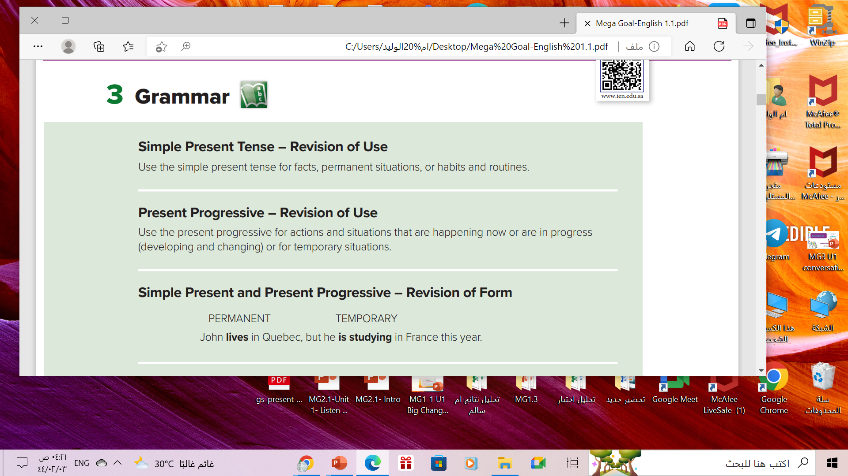
Use
Form of Present Progressive
I
He
She
It
You
We
They
am + ing
I am reading a new book right now
He can’t talk now . He is brushing his teeth
is + ing
are + ing
They are watching a movie at the moment.

Slide 14
We use present progressive with actions and situations that are happening now or are in progress or for temporary situations
➔Present Progressive Examples:
1) actions happening at the moment of speaking:
I am swimming. (happening now)
2) actions in progress:
I am reading an excellent book. (in progress)
3) Temporary actions:
I am working in Jeddah this month. (temporary actions)
Use & Examples:

Slide 16

Correct the verb using Present Progressive Tense :
is watching
Ali ________________(Watch) film at the cinema right now.

Slide 17
Complete using Present Progressive:
are waiting
They ______________ (wait)at the bus stop right now.

Slide 18
Complete using Present Progressive:
I ______________ (cook)the dinner tonight
am cooking

Slide 19
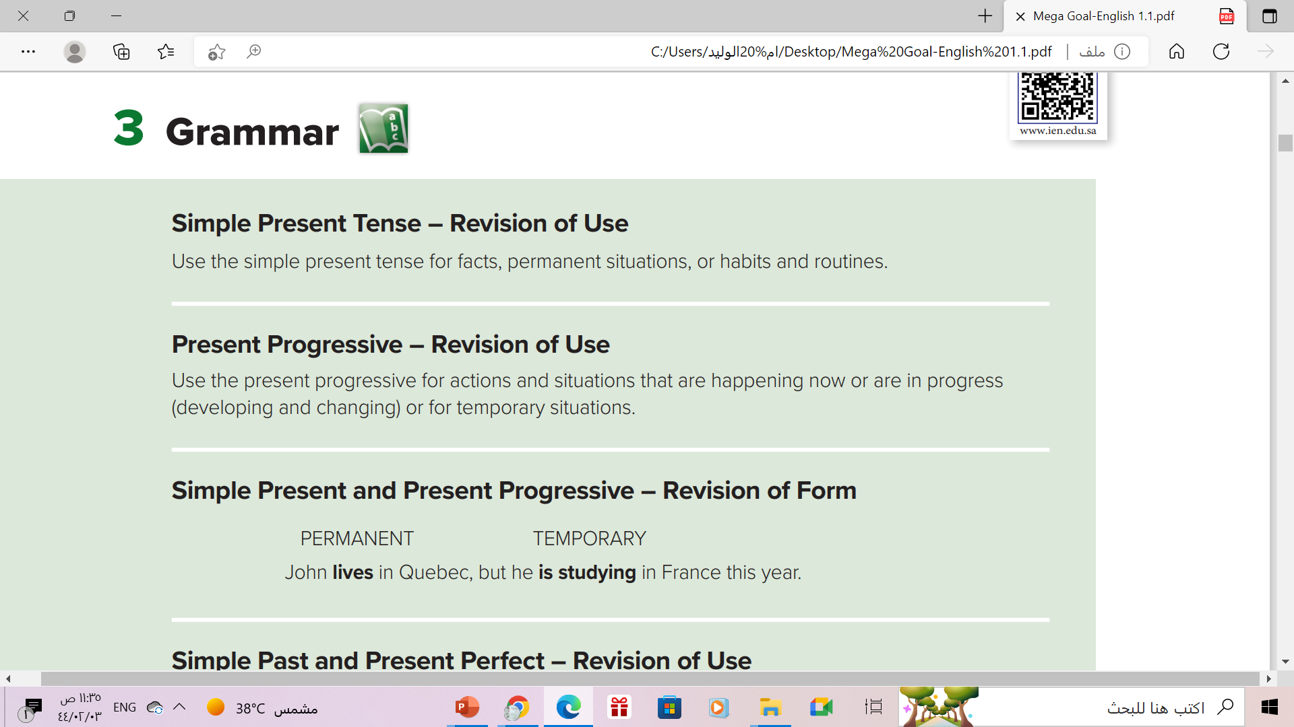

Slide 20
Present Simple vs Present Progressive
Present Tense
Present Simple
Present Progressive
Actions happening now
Temporary
actions
Habits & routines
permenant
permenant
Temporary
I usually work in the mornings
I am working this morning

Slide 21
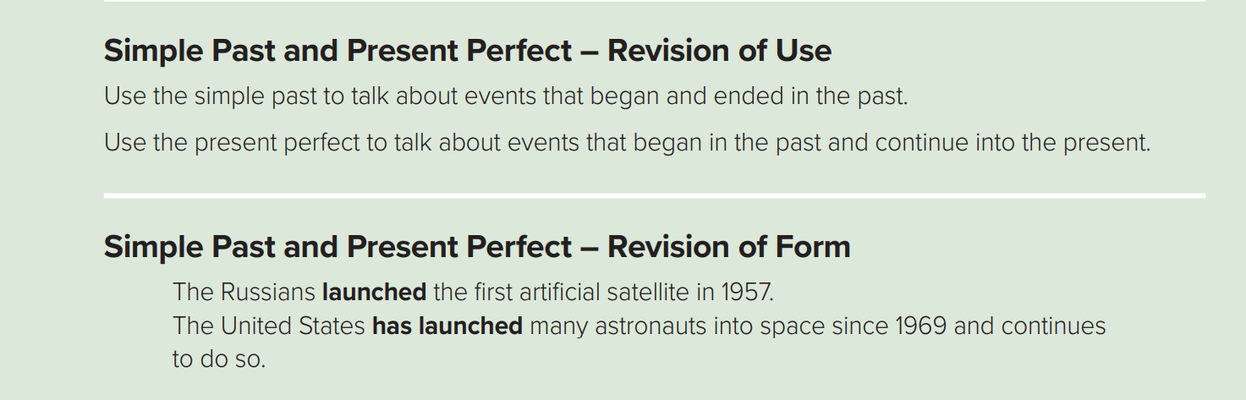

Slide 22


Simple Past Tense:
Use
to talk about actions that started and ended in the past
Form:
Regular (ed )
Subject
V (2)
Irregular (no ed)
Example
He washed his car two days ago
I saw a movie yesterday.
His mother arrived yesterday .
Last year, I travelled to Japan.

Slide 23

Simple Past of the Verb Be :
The past tense of To Be in English has two forms: WAS and WERE
To Be - Affirmative
I
She
He
It
You
We
They
Was
Were
Example
He was poor .
They were happy with their test results.

Slide 24
Present Perfect Tense :
Use
-to talk about an event or action that was completed in the past.(an indefinite time)
- to talk about events that started in the past and continue into the present
Form
Subject
Has/ have
V (P.P.3)
She
He
It
I
You
We
They
Has
Have
Example:
He has washed the car.
I have washed the car.

Slide 25
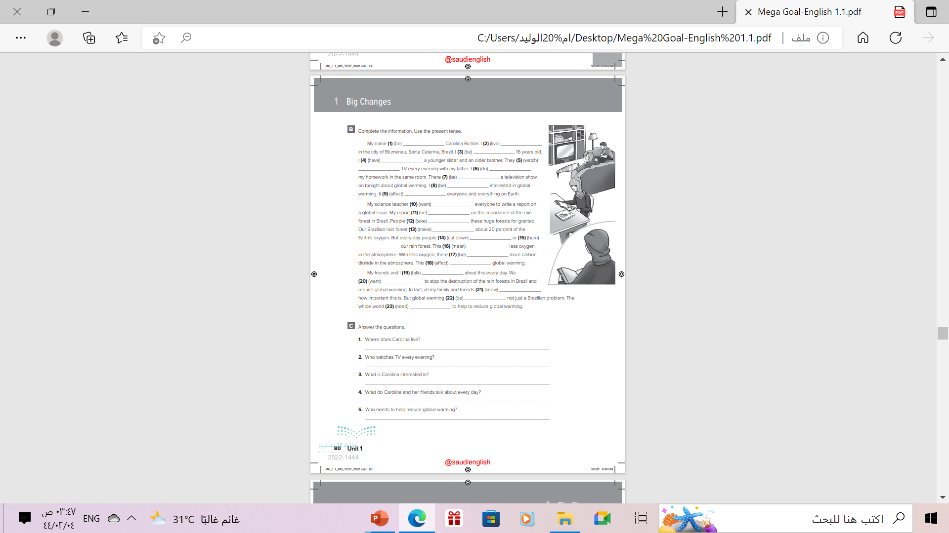
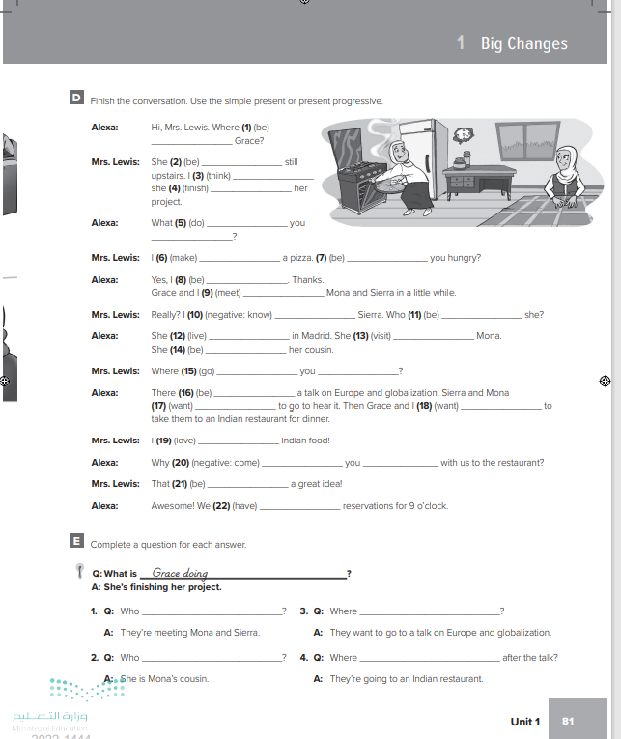
Homework
p.( 81-82 ), exercise ( B-D)

Slide 26
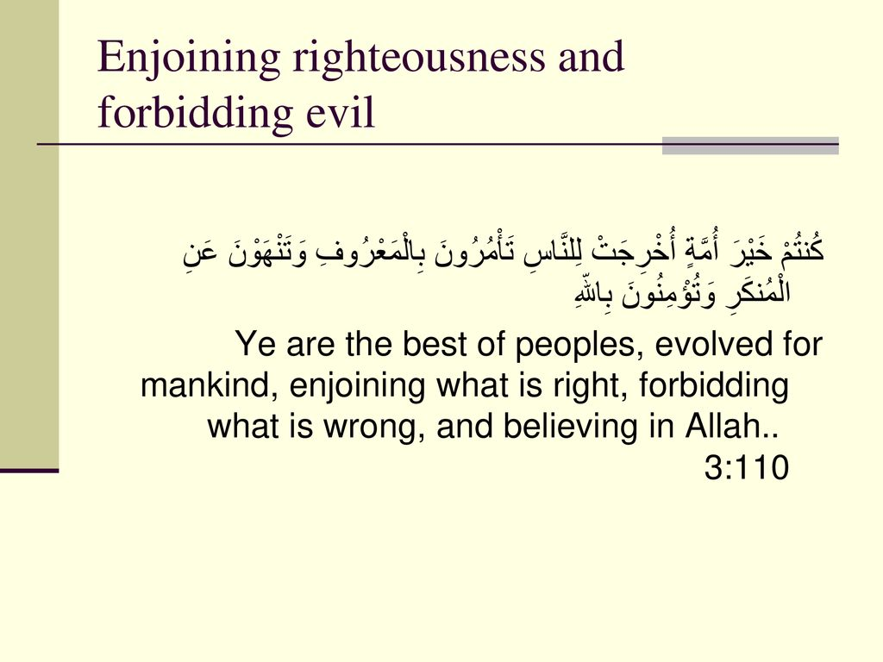
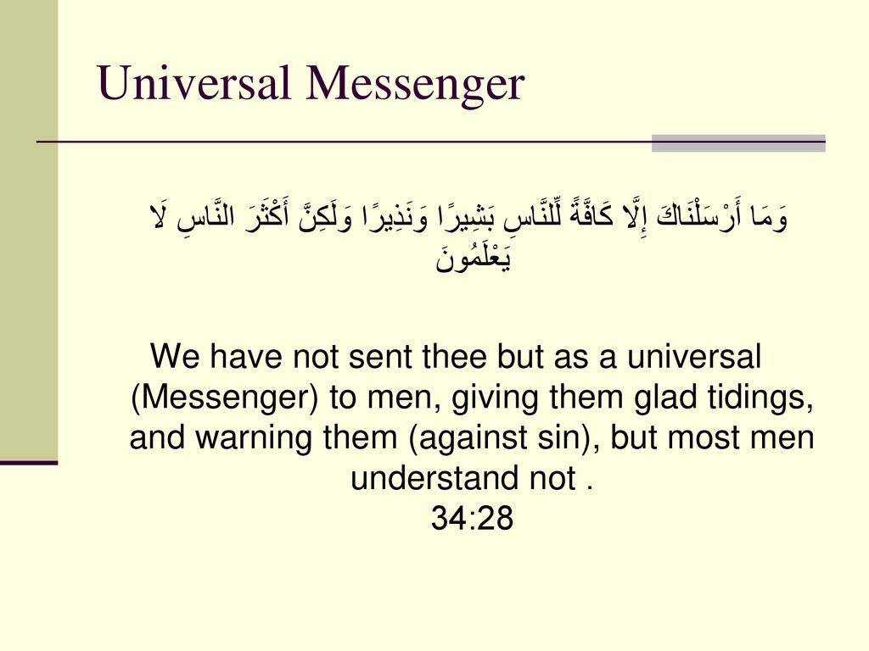

Slide 27

THANKS!

