Slide 1



Unit 1
Big Changes
Listen & Discuss
Mega Goal 1.1
D0ne by : Entisar Al-Obaoidallah

Slide 2



Lesson Objectives:
{01}
{02}
{03}
{04}
Discuss
Answer
world events and present effect.
Some questions about the text correctly
Talk
Ask
about global problems
questions on facts from the text

Slide 3
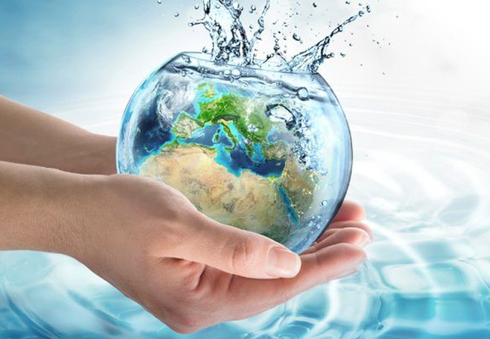
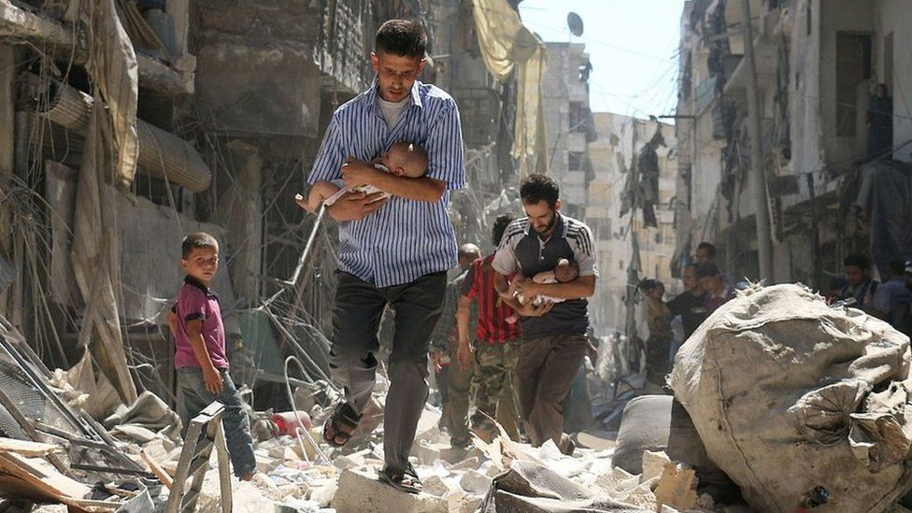
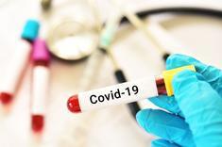
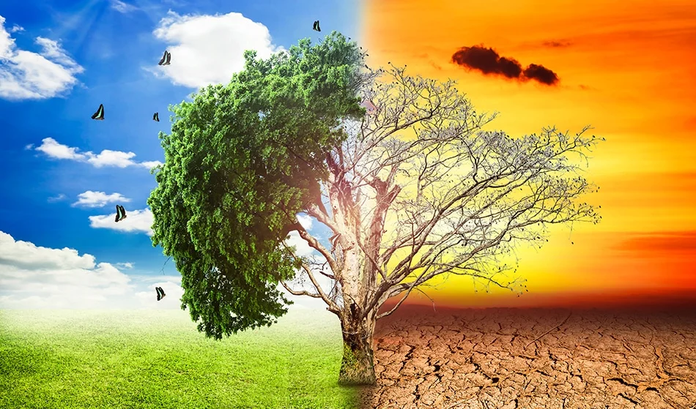
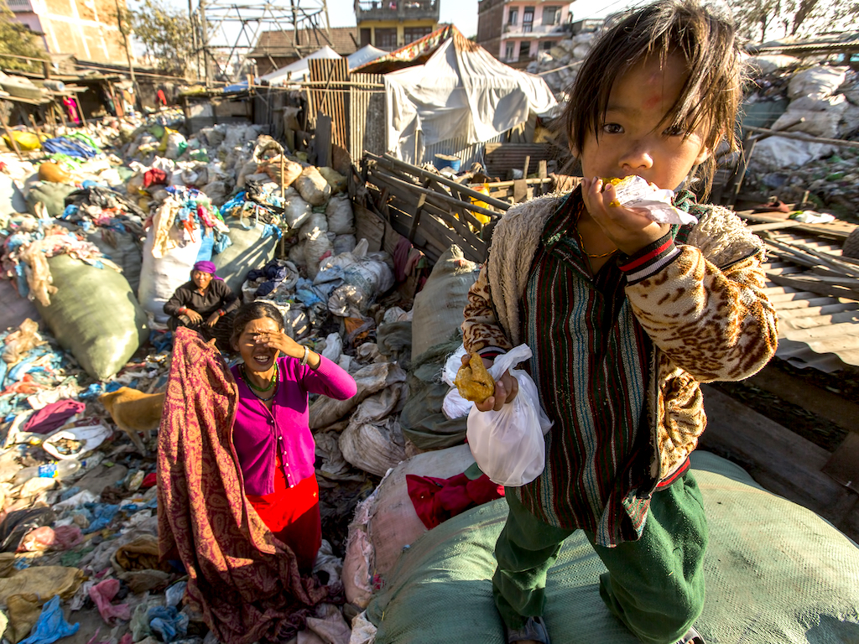
Warm Up
Are there any other changes that have impacted our world significantly?
What have you read or seen on TV about these issues?
Which issues are positive and which are
negative?

Slide 4
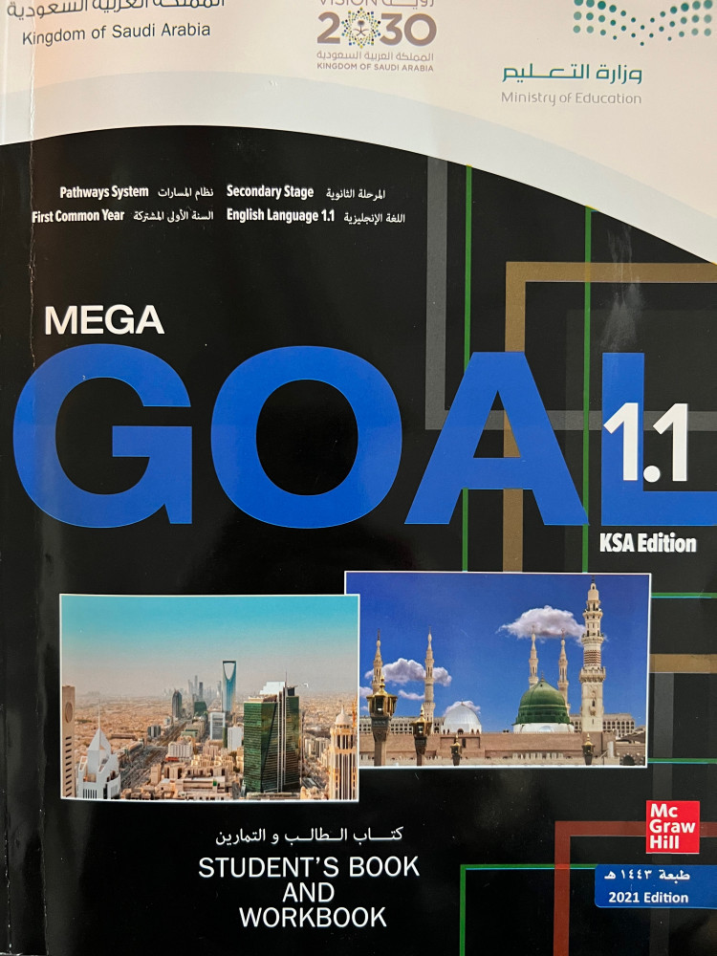
Your book , p.(6)
Open

Slide 5
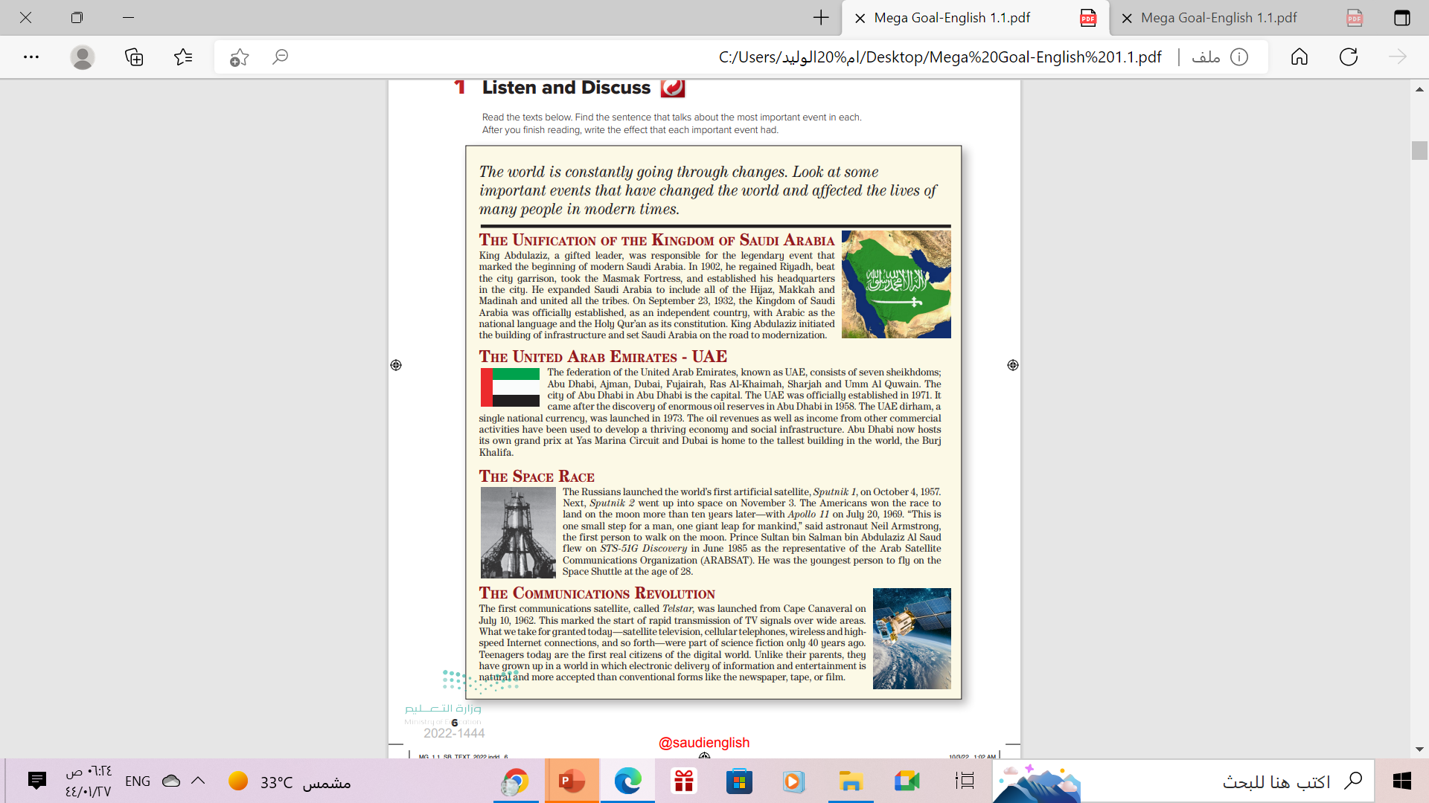
Scanning
What does each photo show ?
The Saudi flag; the UAE flag,
a spacecraft; a communication satellite
What happened On September 23, 1932?
Saudi Arabia was established
What does UAE stand for?
United Arab Emirates
What countries were involved in Space Race?
The United States and Russia

Slide 6

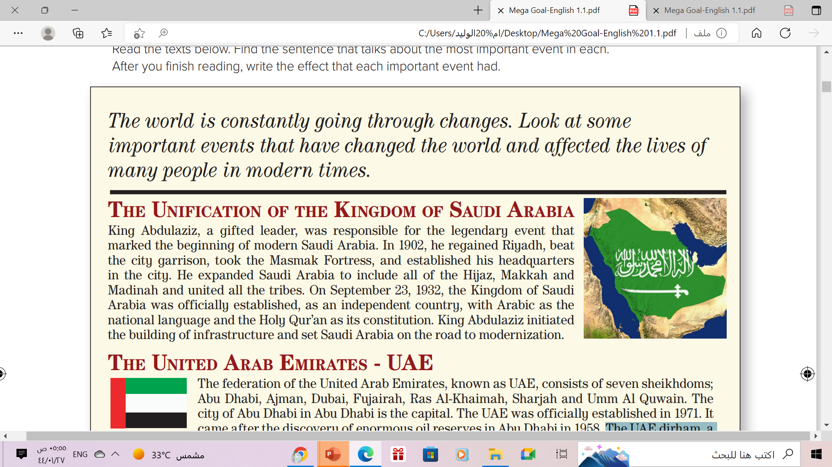
What happened in 1902?
King Abdulaziz regained Riyadh, and took the Masmak Fortress
When was Saudi Arabia officially established?
On September 23, 1932

Slide 7
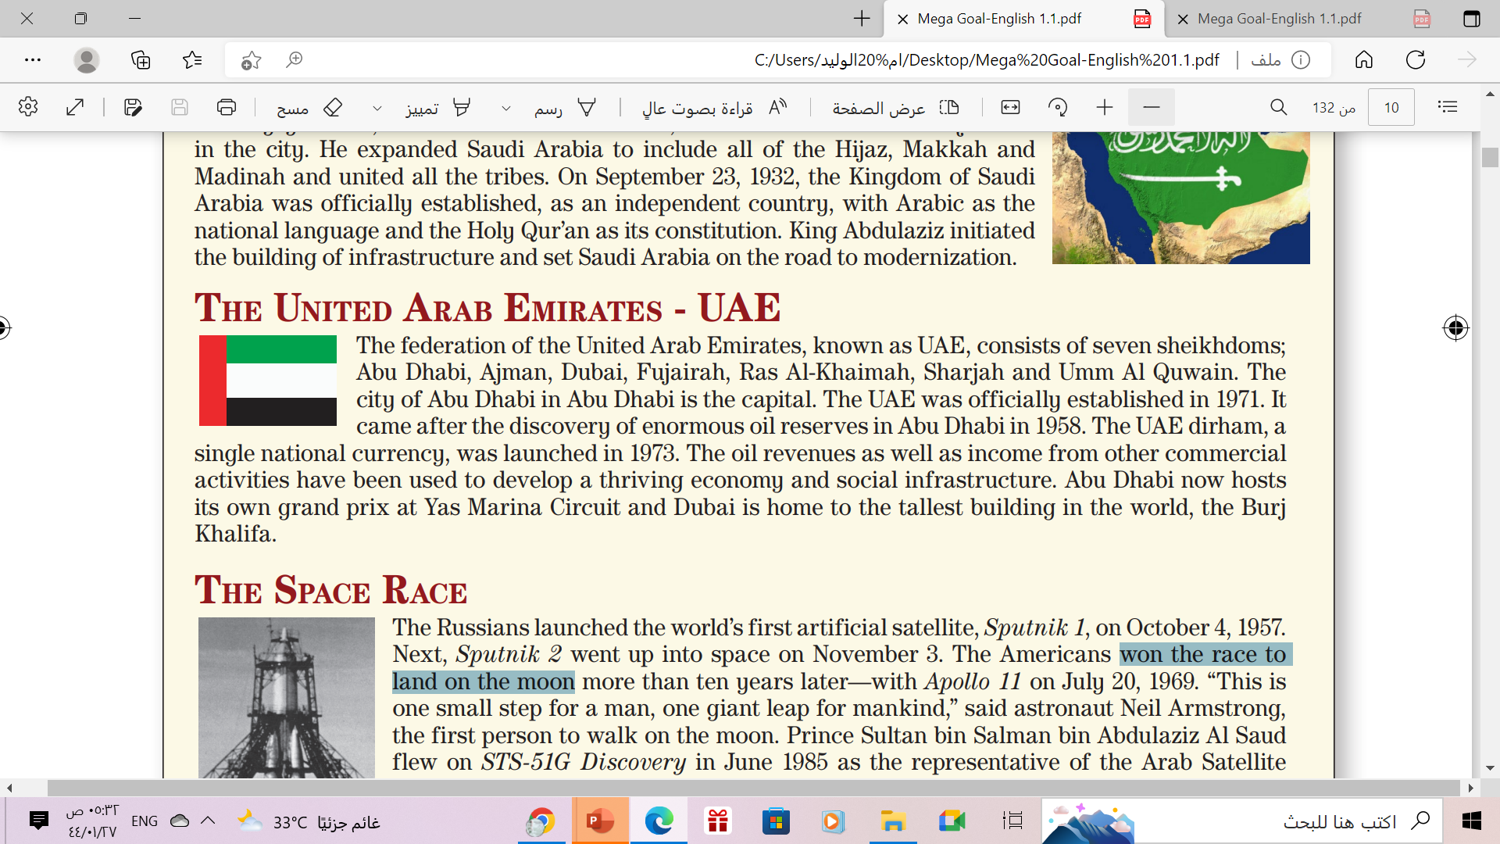
How many sheikhdoms does UAE consist of?
seven
How When was UAE established?
In 1971
What happened in the UAE in 1973?
The UAE dirham, a single national currency, was launched

Slide 8
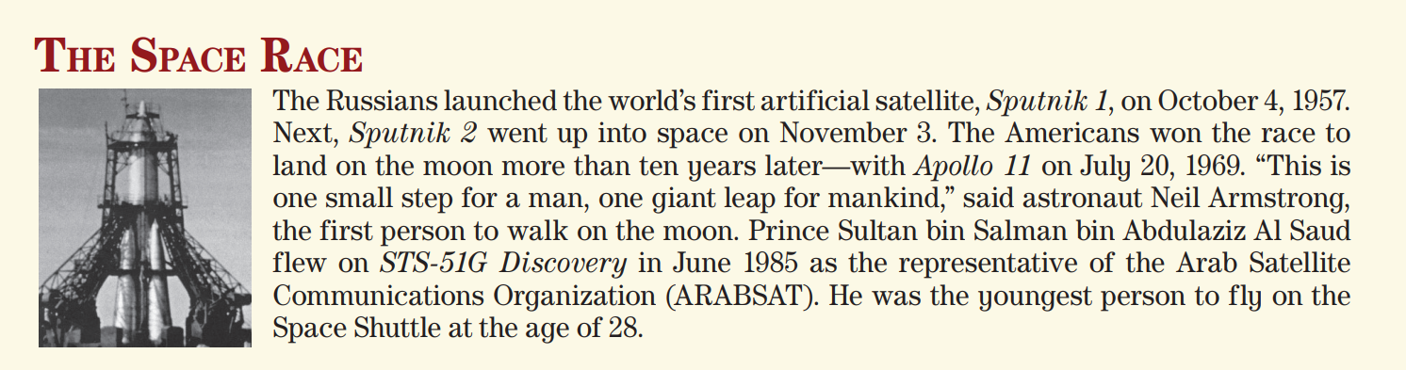
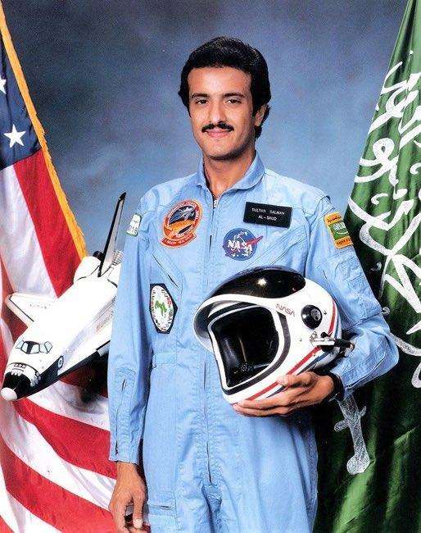
Who launched the world’s first artificial satellite ?
How old was Sultan bin Salman when he flew on the Space Shuttle?
The Russians
Who won the race to land on the moon?
The Americans
28

Slide 9
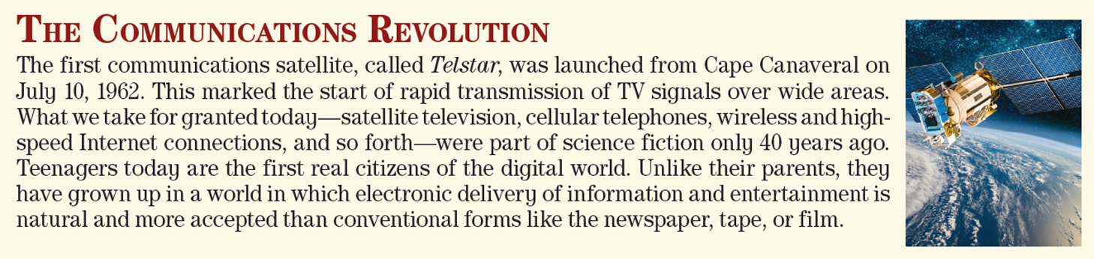
What was the first communications satellite called ?
Telstar
When was Telstar launched?
On July 10, 1962

Slide 10

Your book , p.(7)
Open

Slide 11
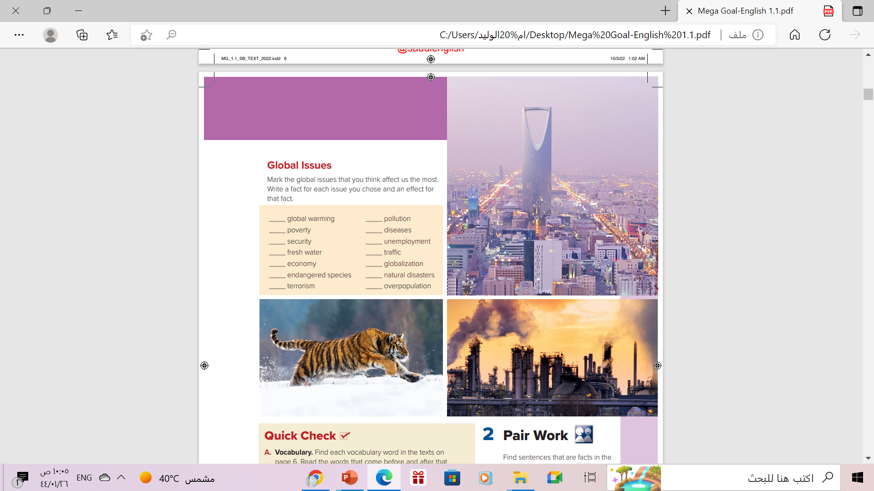
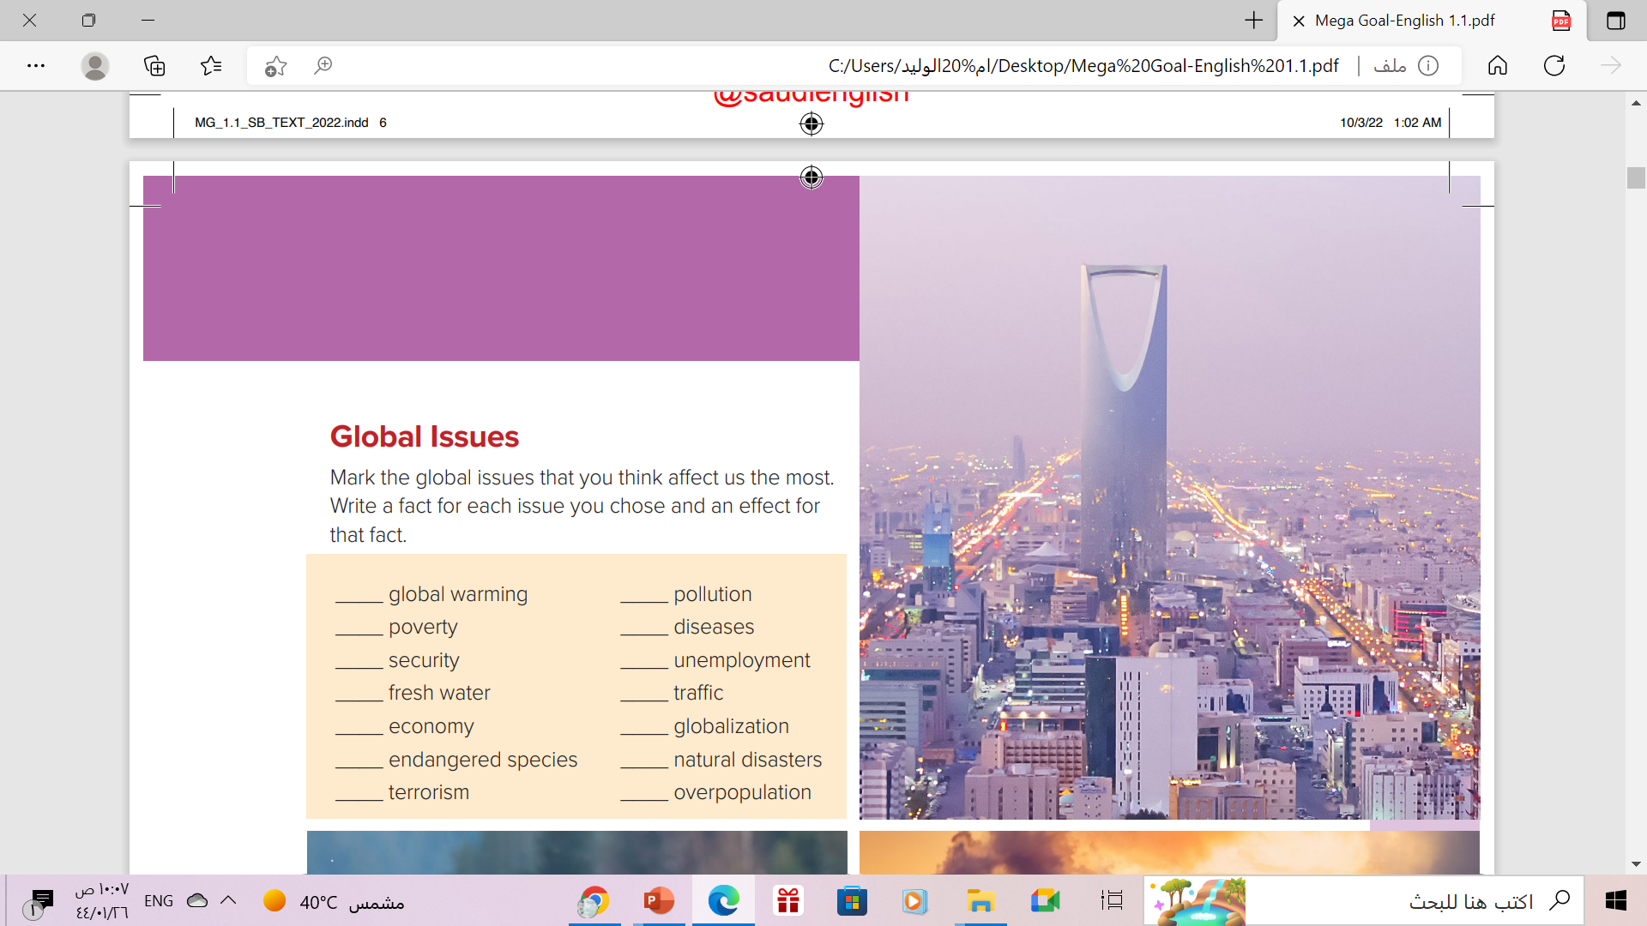

Global Issues
7

Slide 12

Global Issues
What does each
picture show?

Slide 13

Global Issues
Listen
&
Follow along

Slide 14
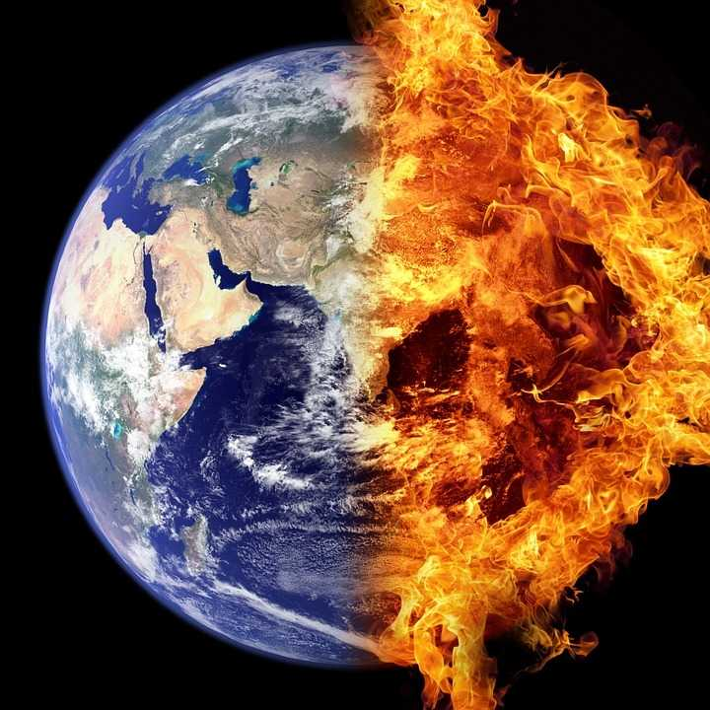
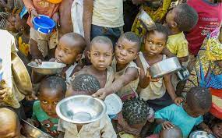

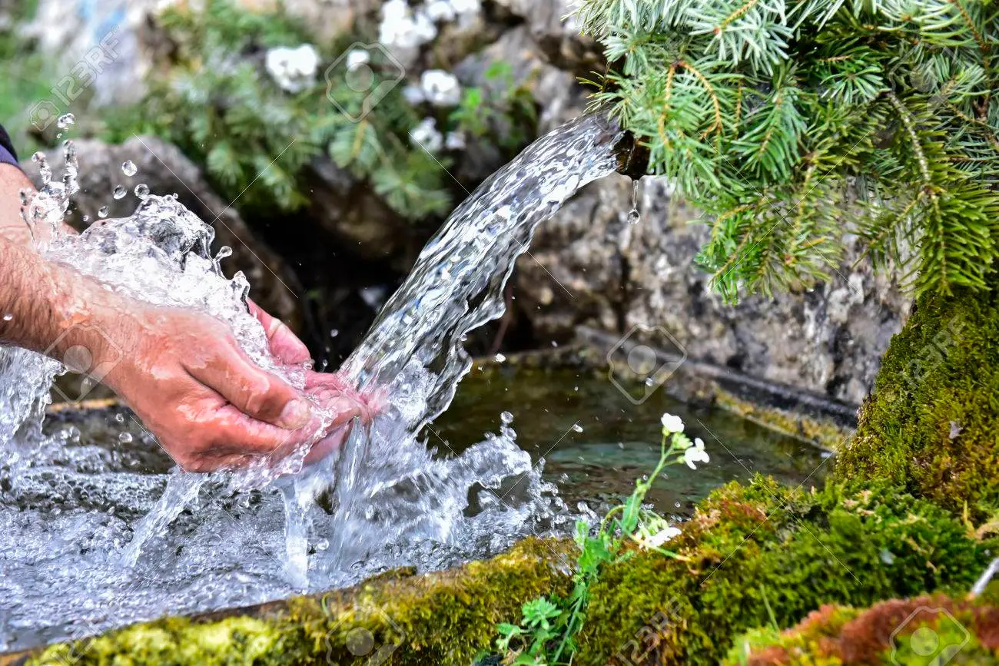
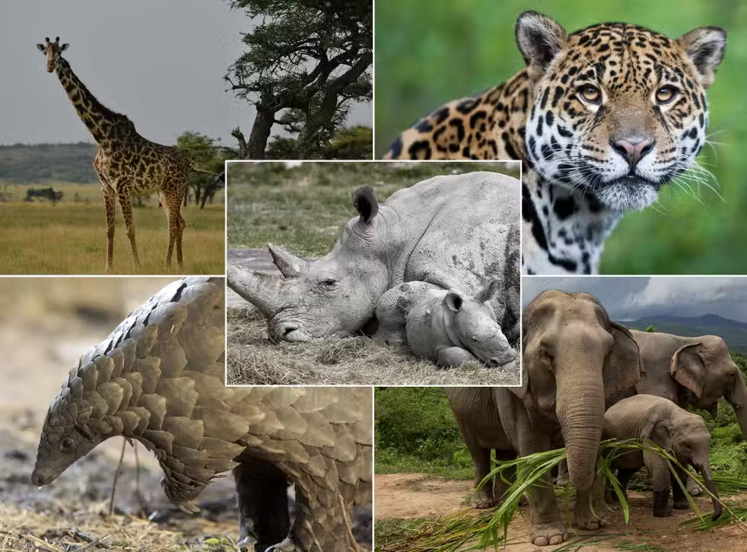
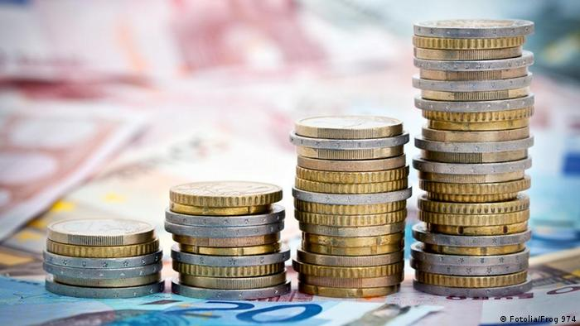
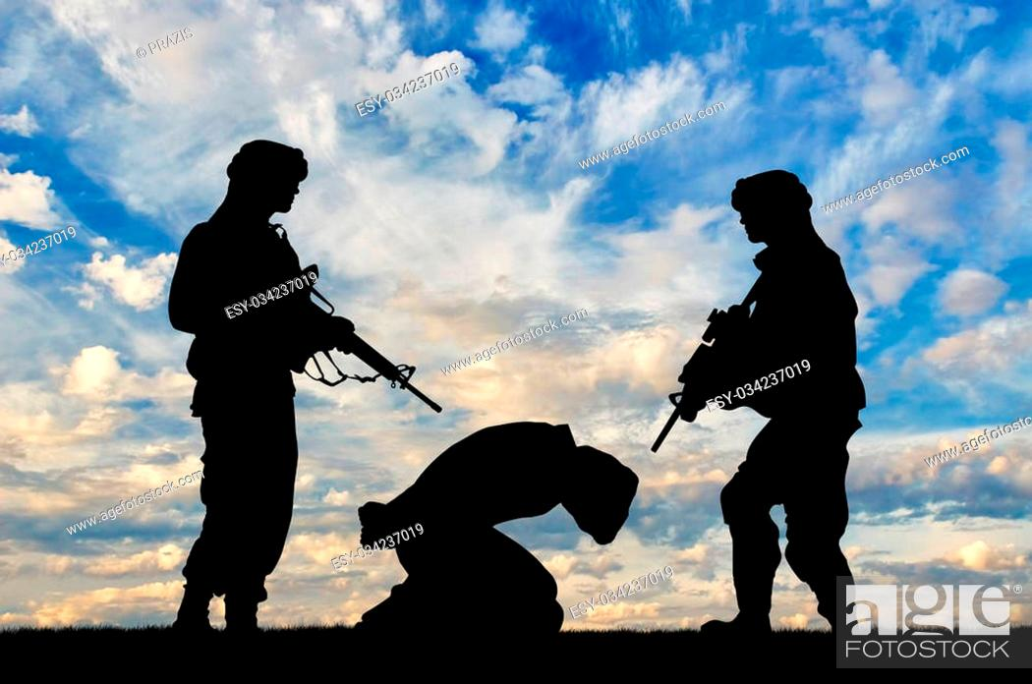
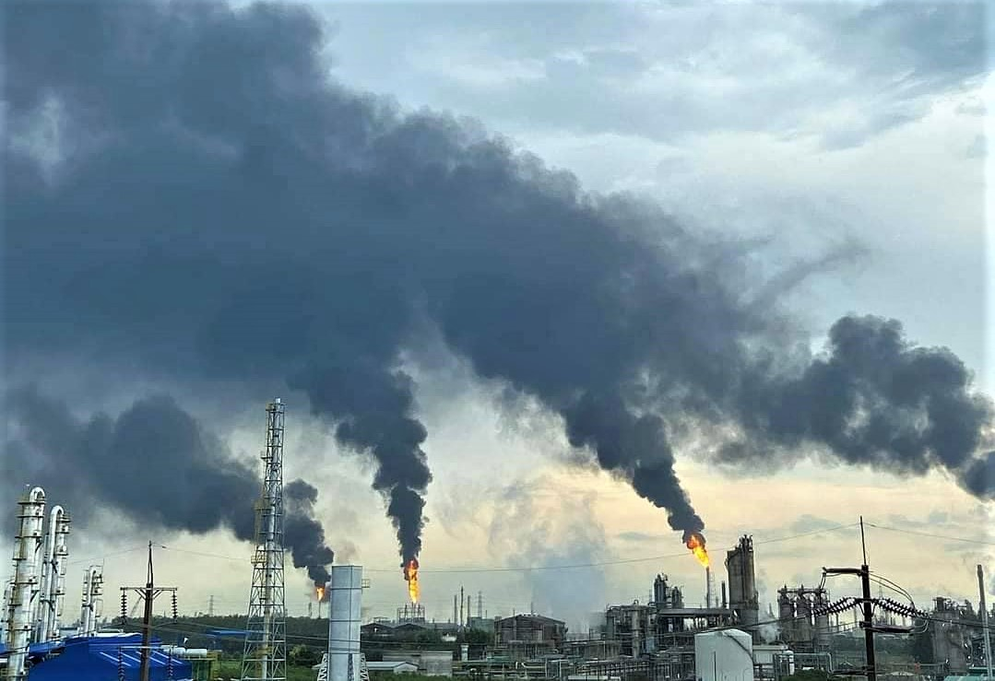
Global Warming
Poverty
Security
Fresh Water
Endangered
species
Economy
Terrorism
Pollution

Slide 15
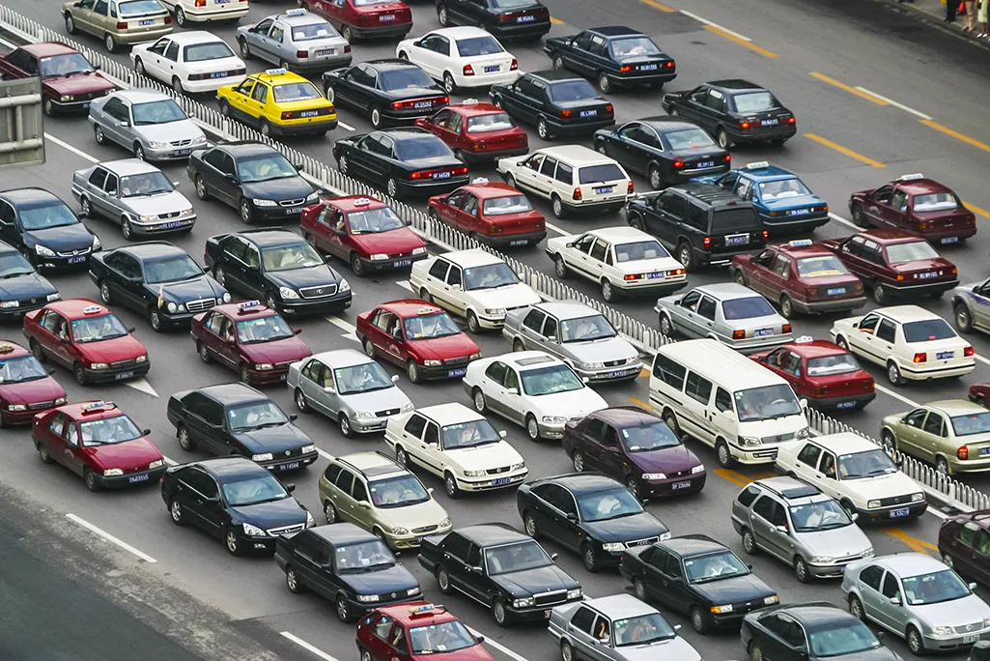
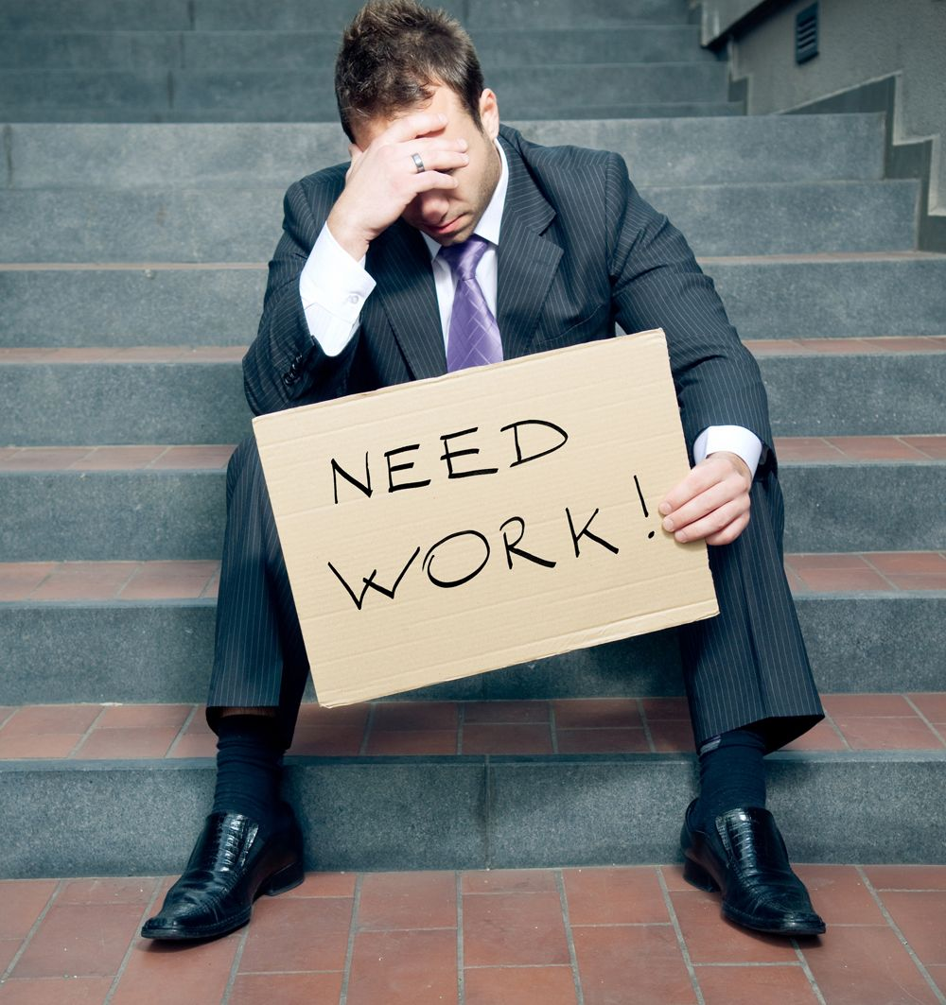
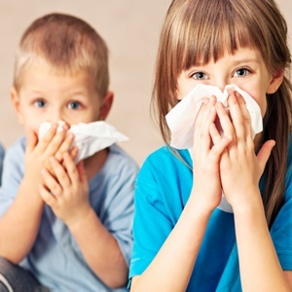
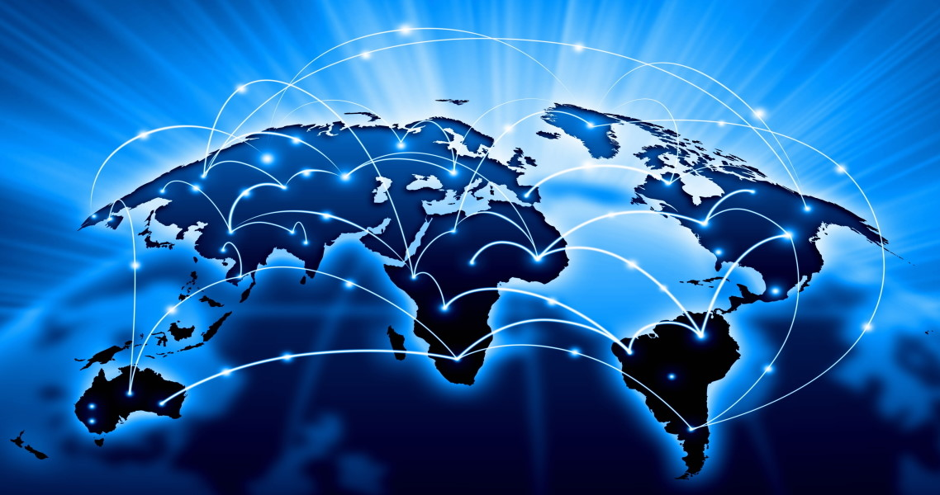
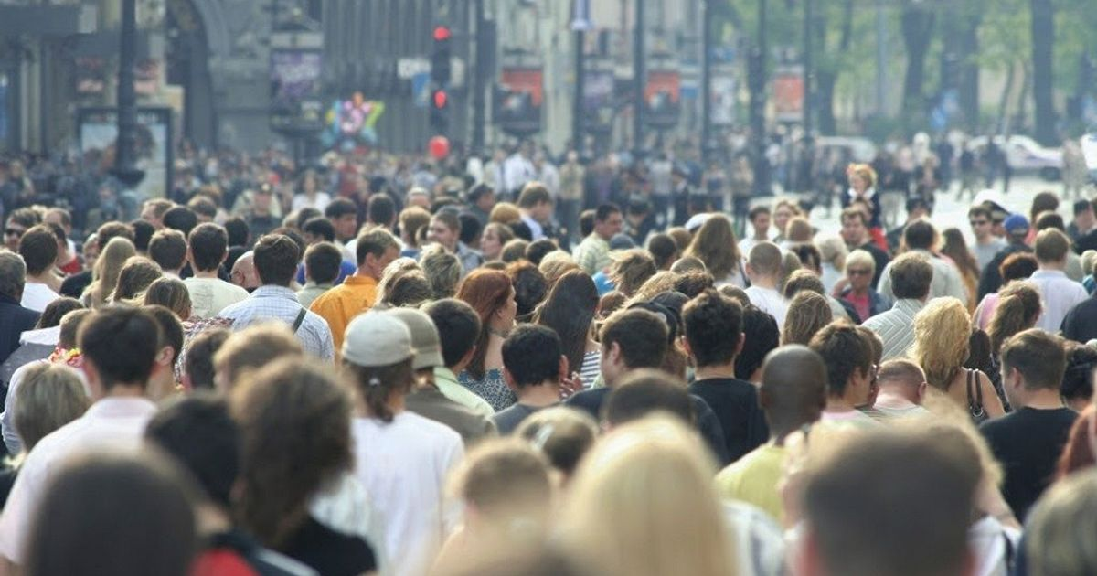
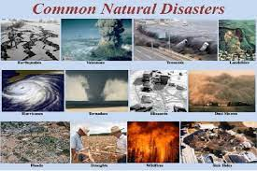
traffic
Unemployment
Diseases
Globalization
Overpopulation
Natural Disaster

Slide 16
Choose an issue and write fact & effect abut it
effect | fact | issue
 | .
Endangered
Species
Species Extinctions are
happening more
frequently than before
Loss of biodiversity and
balance of ecosystem
over 2.7 billion people
face water shortages
Water shortage can be
detrimental to human
health and lives
Fresh Water

Slide 17

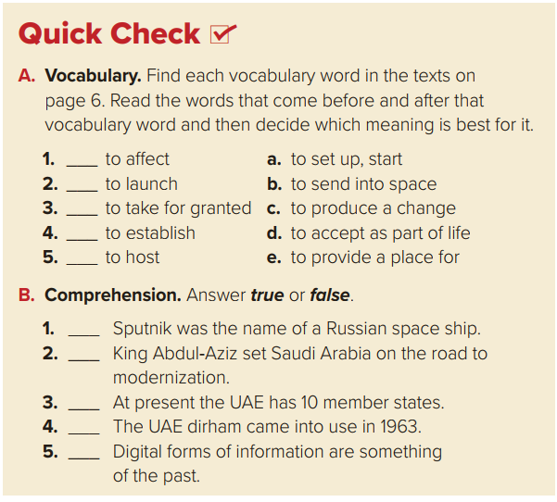
c
b
d
e
a

Slide 18


True
True
False
False
False

Slide 19
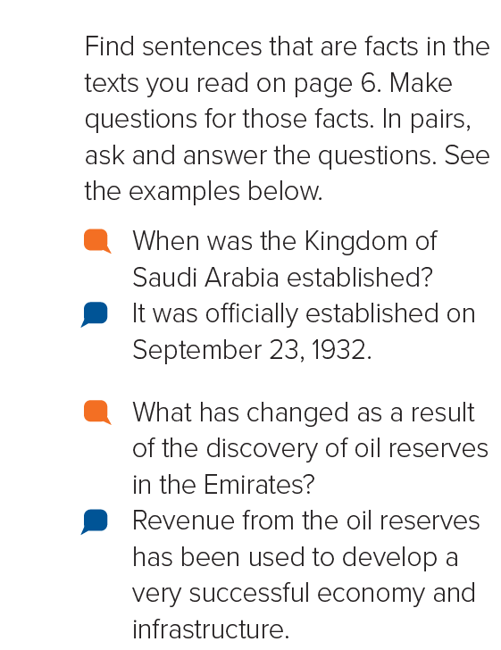



Slide 20
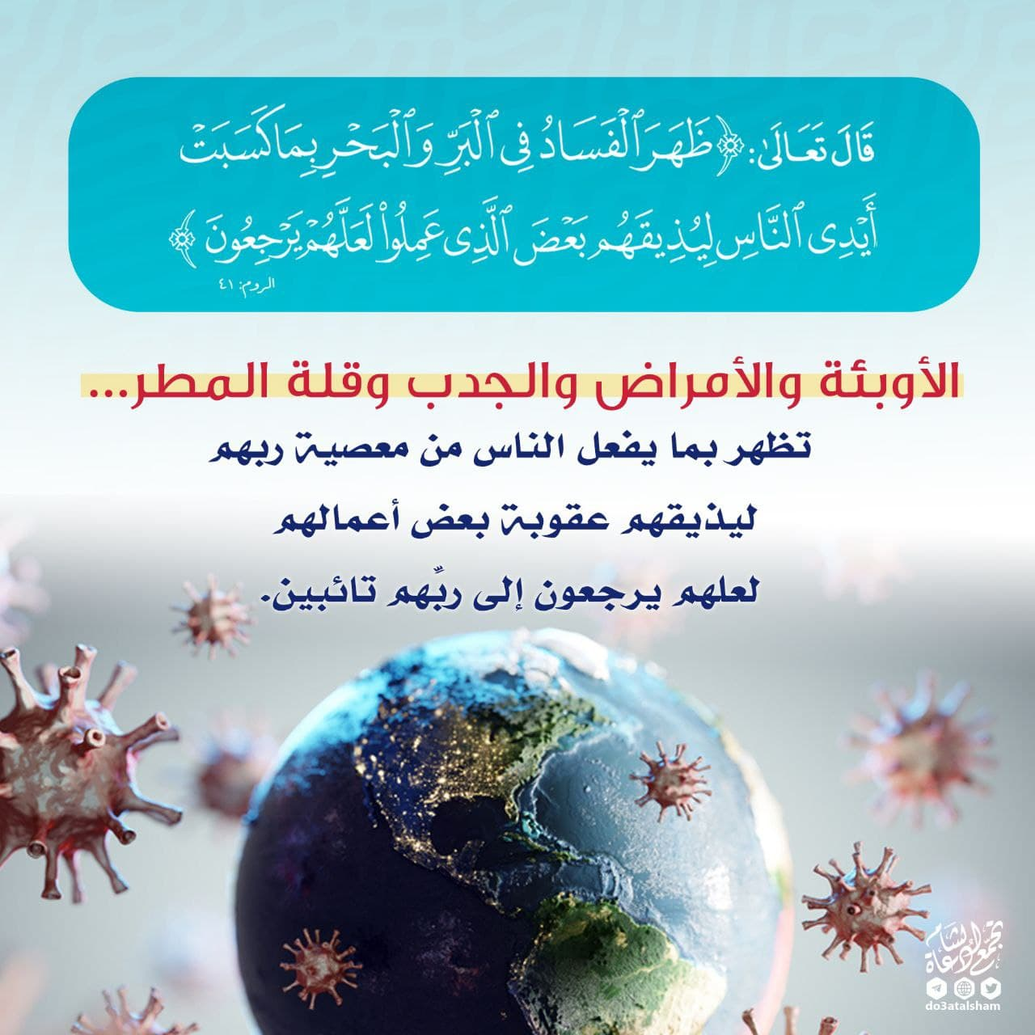
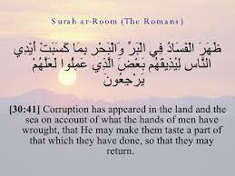

Slide 21

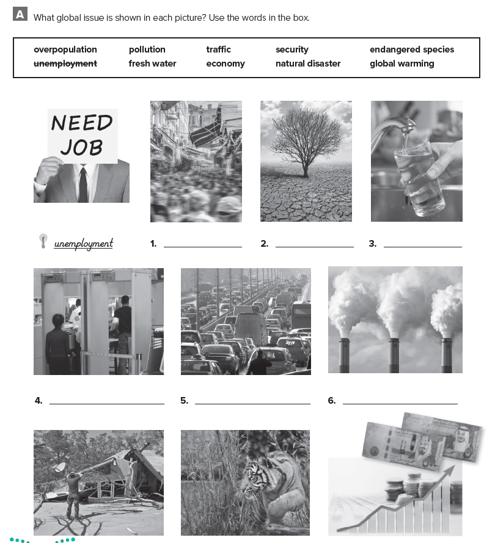
Homework
WORKBOOK
Page (79) Exercise ( A )

Slide 22

Thanks!

