Slide 1

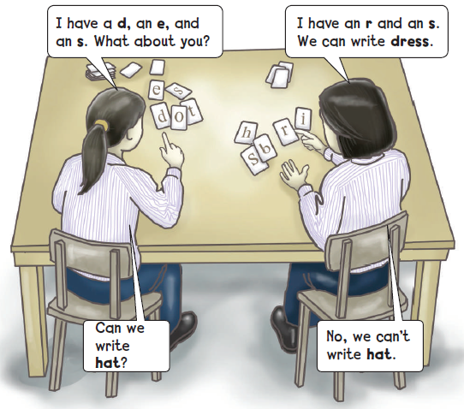

Letter sharing game
Can you write words with your partner?
4

Slide 2
Letter Guessing Game
Q
a
r
u
n

Slide 3
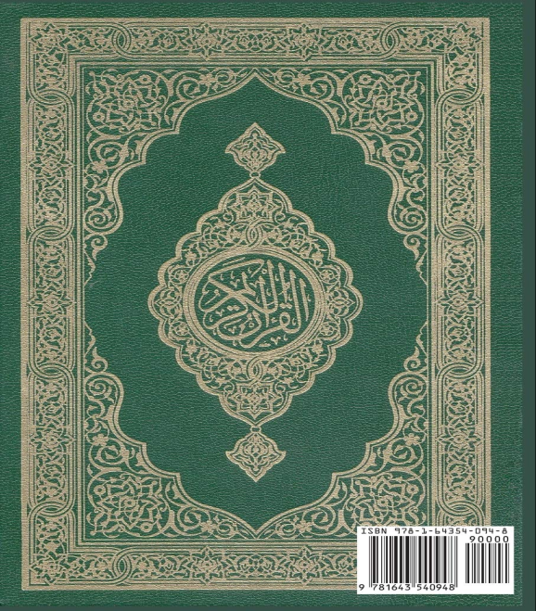
Can I write Quran ?

Slide 4

Letter Guessing Game
Q
u
r
a
n

Slide 5
Letter Guessing Game
S
a
r
i
a
b
a
u
d
A
i

Slide 6

Can I write Saudi Arabia ?

Slide 7

Letter Guessing Game
S
a
u
d
i
A
r
a
b
i
a

Slide 8
Letter Guessing Game
n
a
n
k
g
l
i
S
a

Slide 9
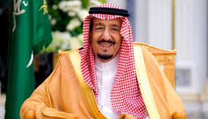
Can I write King Salman?
God bless him.

Slide 10
Teacher : Anfal Al-Ghamdi
@englishanfal

