Slide 1


Super goal 3
Unit 1
Lesson 5 writing
اعداد المعلم / يحيى المنقري متوسطة المأمون بالهفوف

Slide 2

Learning Objectives
*By the end of this lesson, Ss will be able to:
1- Write a polite form of a request .
2- Build a hotel or a hostel registration form .

Slide 3


Slide 4


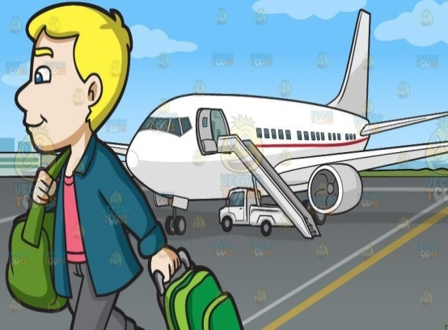


Passport
Date
Arriving

Slide 5
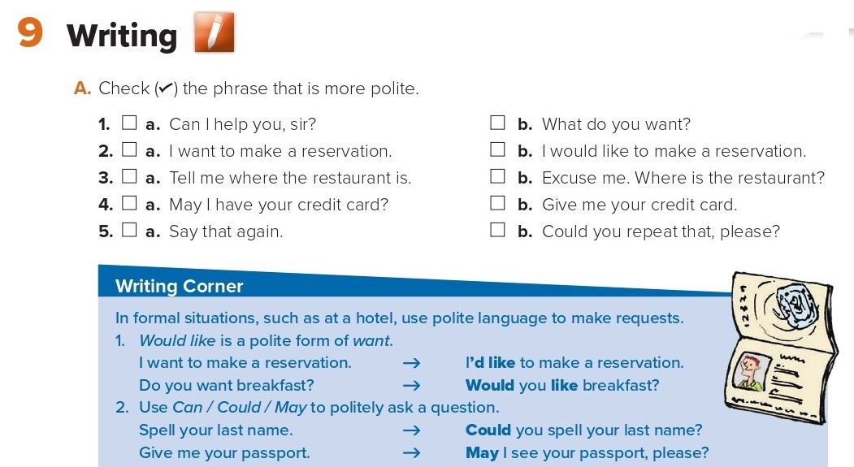
✔
✔
✔
✔
✔

Slide 6
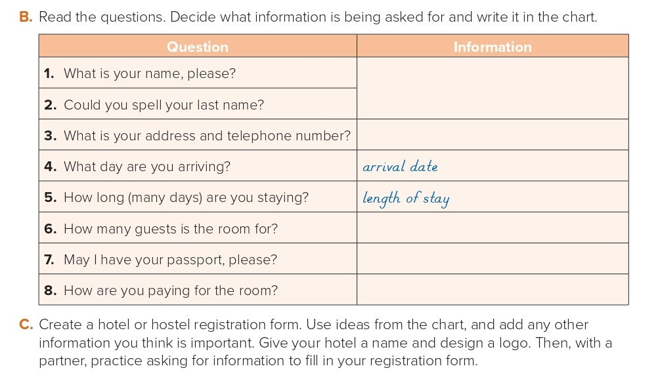
first name of guest
Letter of last name of guest
address and telephone number
number of guests
passport/identification
method of payment (credit card/cash)

Slide 7
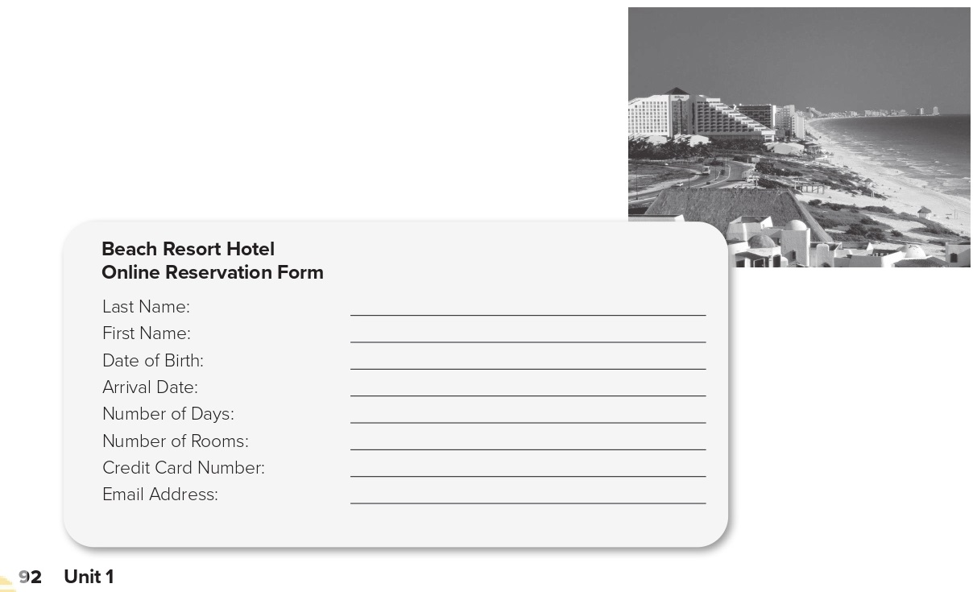
Adnan
Sarah
March 2, 1992
Arrival Date: July 24
5
1
65748 57463 8749
Sarah55@gmail.com

Slide 8

Choose the correct answer :
1-
Which phrase is more polite
Can I help you , sir ?
What do you want ?
2-
(Where is the meeting room?) is a polite question.
True
False
3-
4-
date
Departure
Castle
Arriving

Slide 9


Slide 10


Back

Slide 11


Back

