Slide 1
Unit 1
Connected by Technology
Listen & Discuss
Mega Goal 2.1
Done by: Entisar Al-Obaidallah

Slide 2
Lesson Goals
01
02
03
04
Name
some popular apps to contact with others
Find
important details from a person’s internet profile
Match
personality actions with the suitable person
Decide
which person each proverb describes best

Slide 3



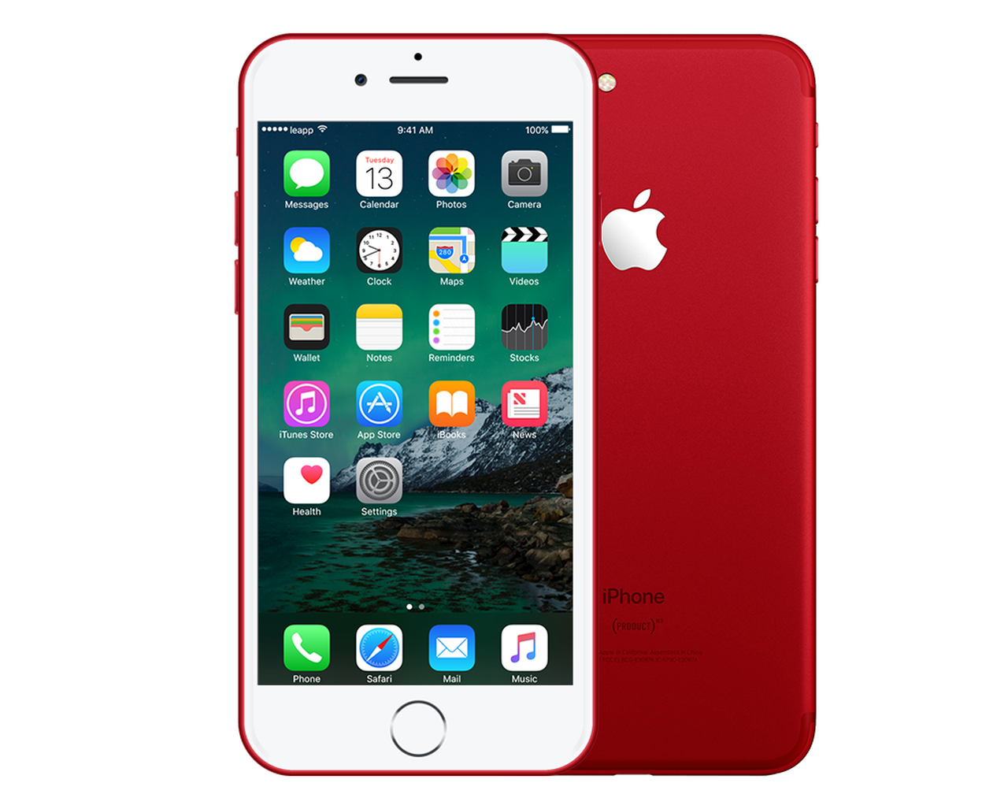


Warm Up
How do you communicate with your friends when you are not in the school ?

Slide 4

Warm Up
Name some means of communication involved technology?

Slide 5


Warm Up
How did you communicate with your teacher to get your lessons during the Corona crisis ?

Slide 6

Open
your student's book
p . (6 -7)

Slide 7

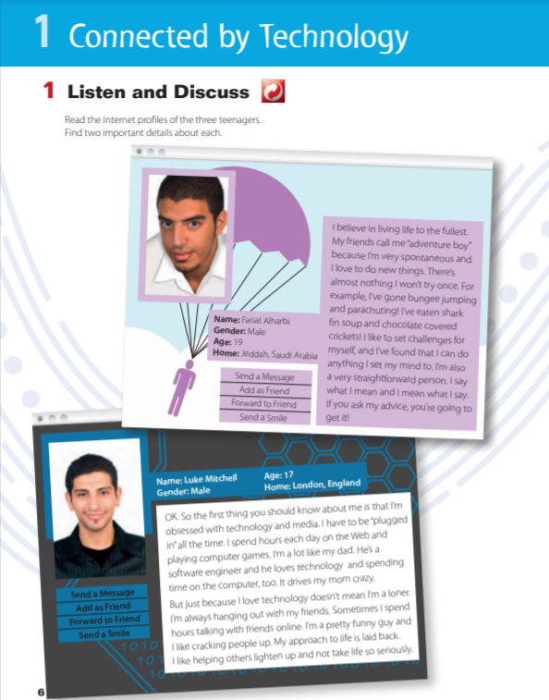
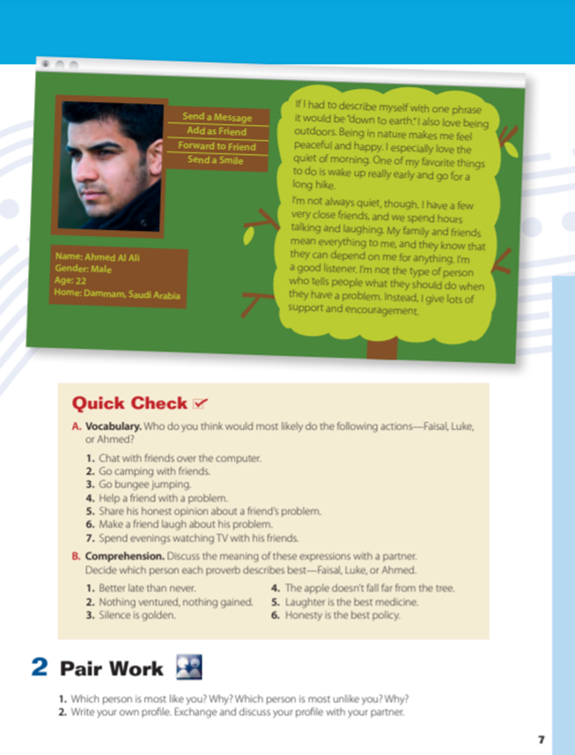

Listen

Slide 8
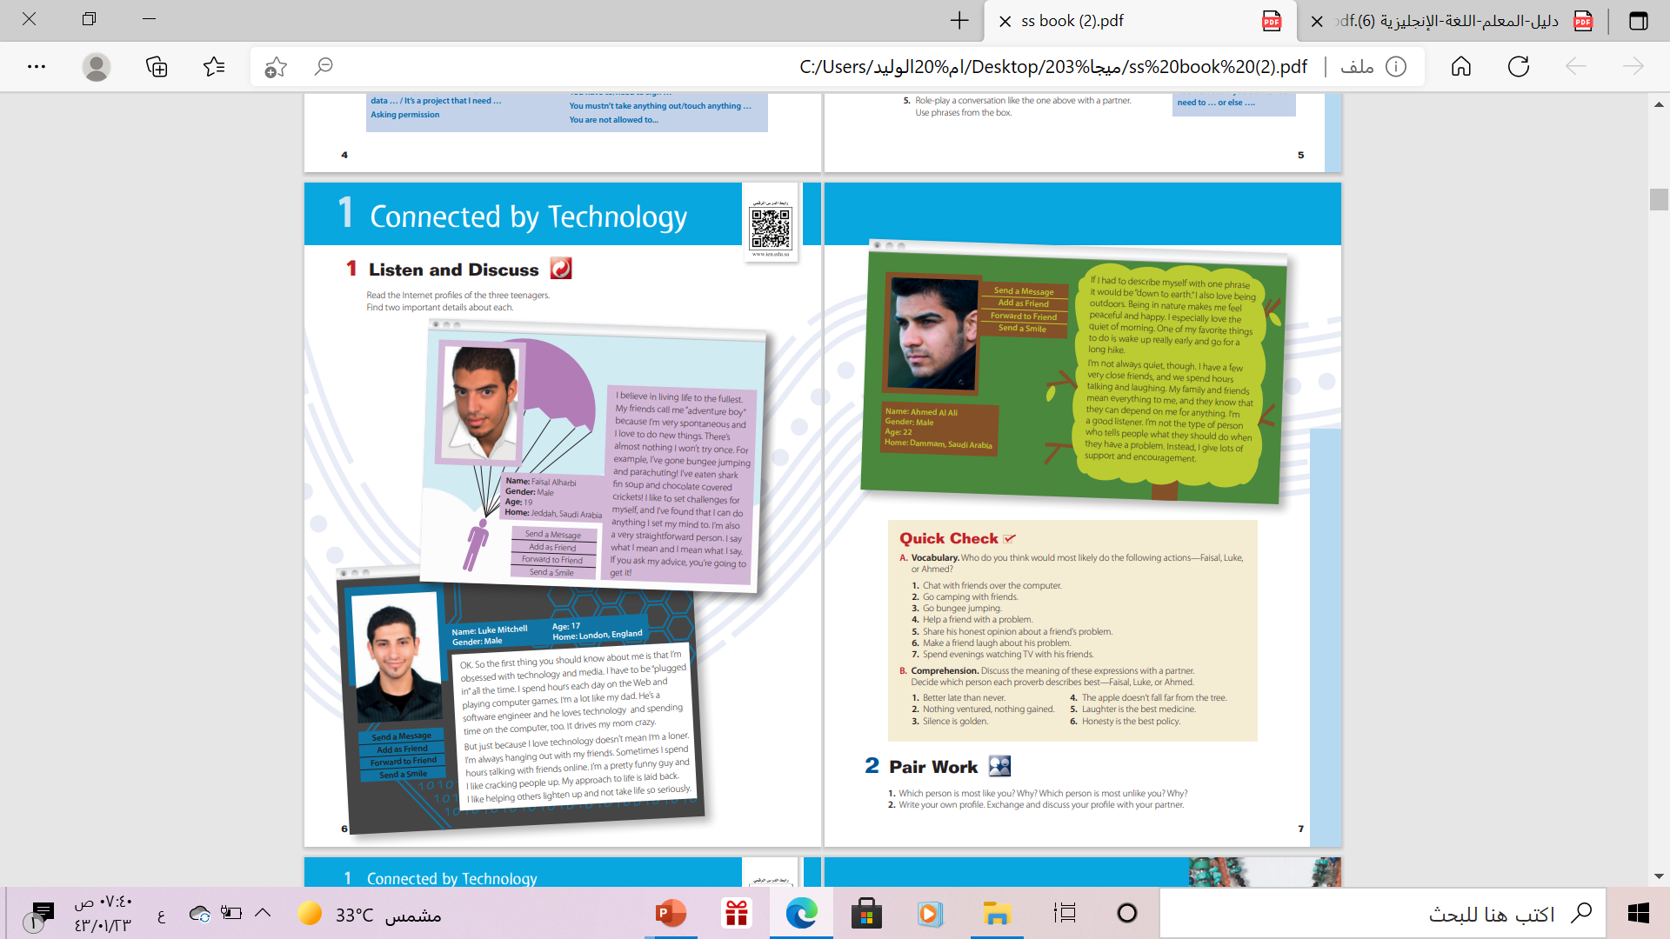
How many characters are there ?
Three characters
What are these called ?
Internet profiles
Where do you see like these in?
In the internet – in the social networking sides

Slide 9

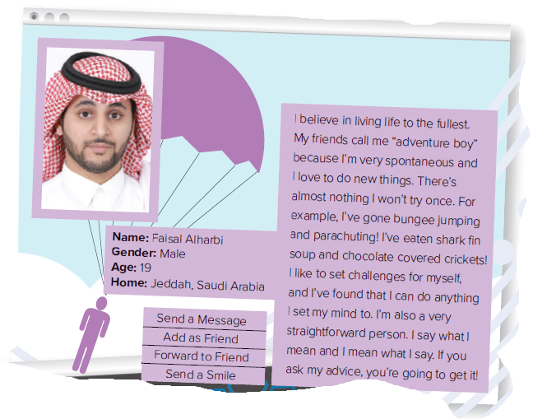
Listen & Answer
Who is he ?
He is Faisal Alharbi
Where is he from ?
From Jeddah . Saudi Arabia

Slide 10
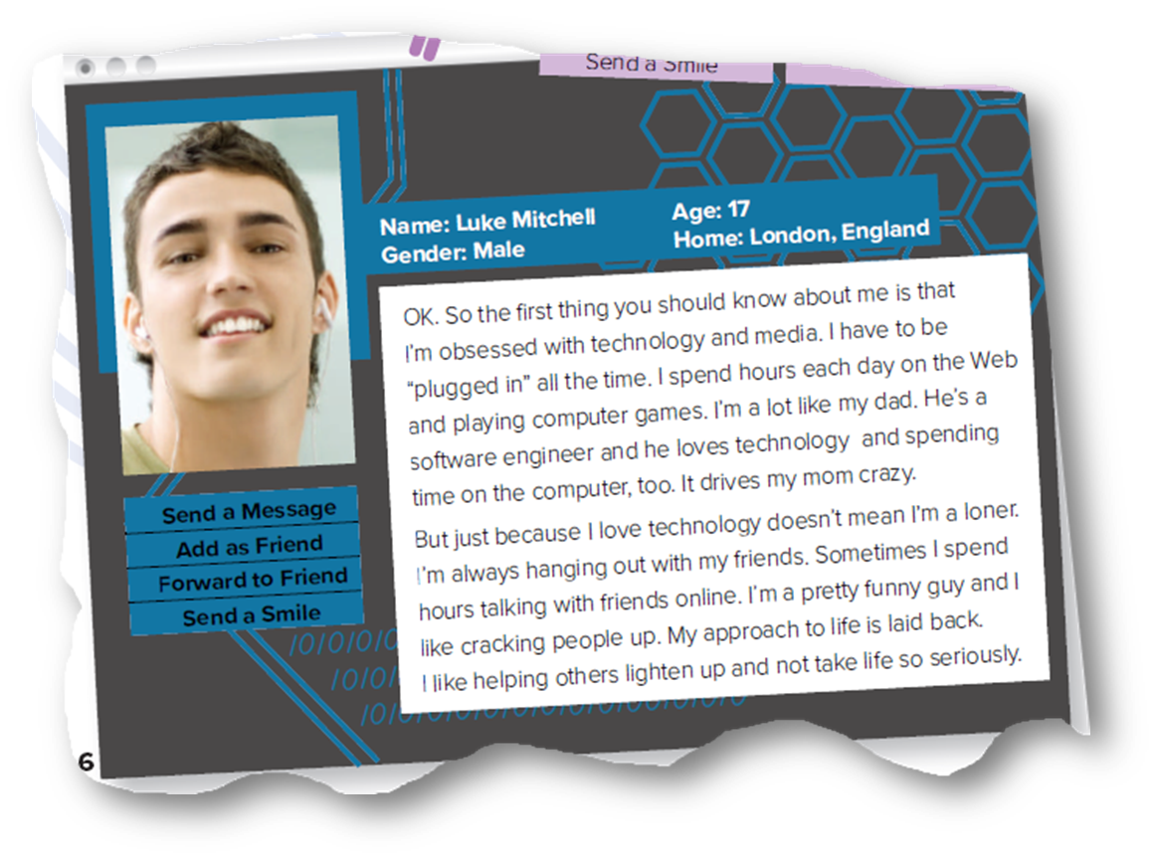
Listen & Answer
What is his name ?
Luck Mitchell
How old is he ?
17

Slide 11
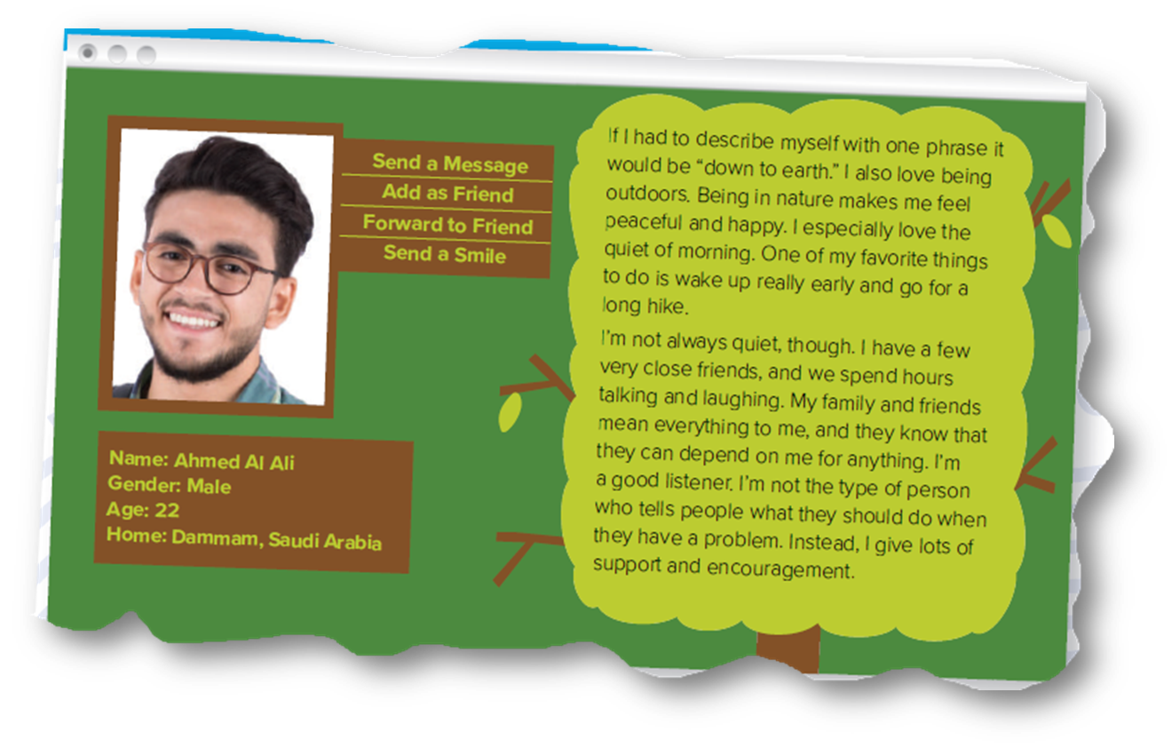
Listen & Answer
What is his name ?
Ahmad Al Ali
Does he live in Jeddah?
No , he doesn’t .He lives

Slide 12

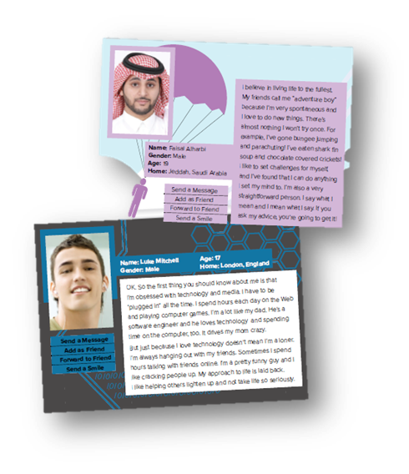
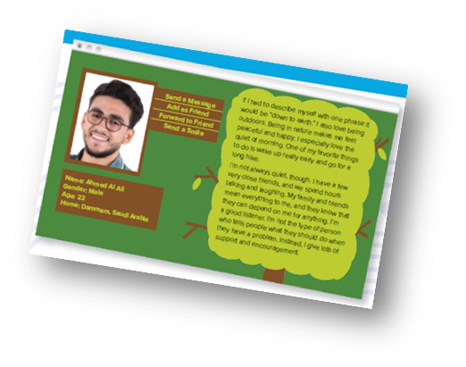
Reading Time
Find 2 important details about each
List 3 or 4 words or phrases that describe the person’s personality

Slide 13
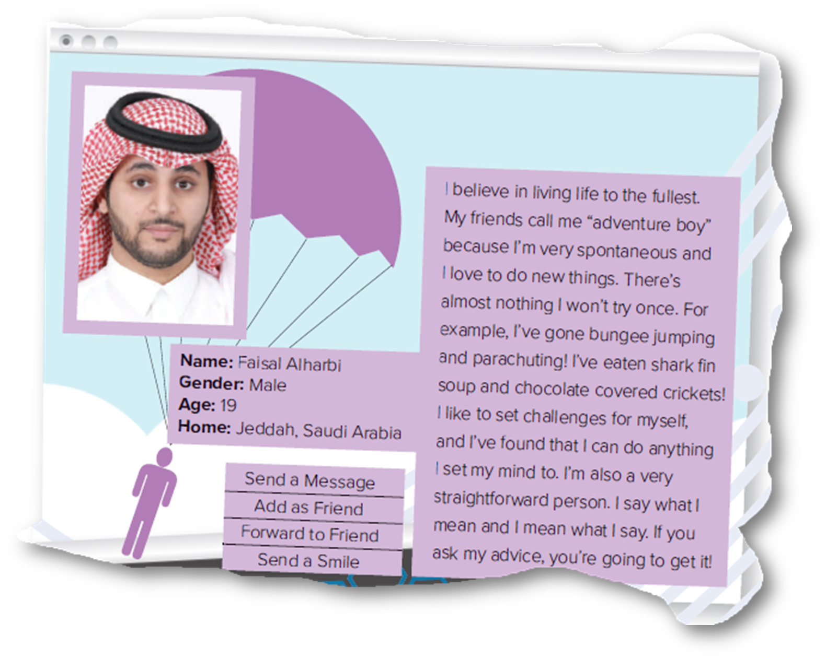
Spontaneous
likes to set challenges
straightforward

Slide 14
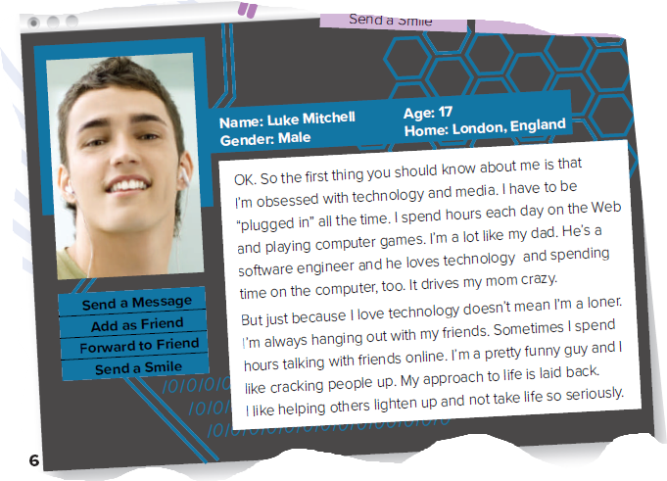
obsessed with
technology
not a loner
funny
Laid back

Slide 15
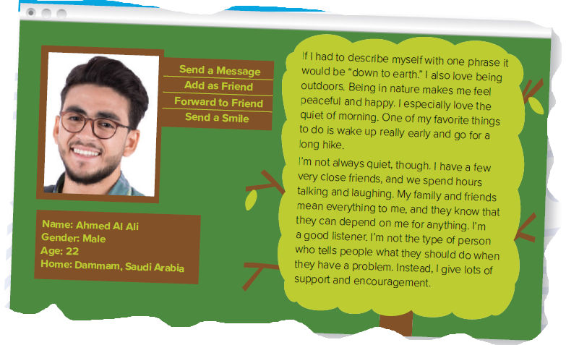
down to earth
loves being outdoors
a good listener

Slide 16


Slide 17

Match the word with the suitable meaning:
(be) plugged in
Make people laugh
Not to be too serious
Realistic & practical
To be connected to someone
Correct Answer

Slide 18
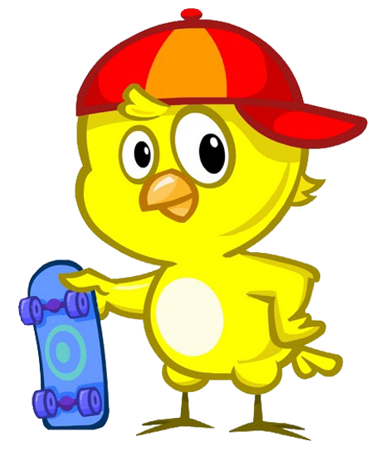
Match the word with the suitable meaning:
Crack people up
Make people laugh
Realistic & practical
Make people laugh
To be connected to someone
Correct Answer

Slide 19
Match the word with the suitable meaning:
Lighten up
Make people laugh
to be connected to someone
Realistic & practical
Not to be serious
Correct Answer

Slide 20
Match the word with the suitable meaning:
Down to earth
Realistic & practical
Make people laugh
Make people laugh
To be connected to someone
Correct Answer

Slide 21

Open book p.( 7)

Slide 22
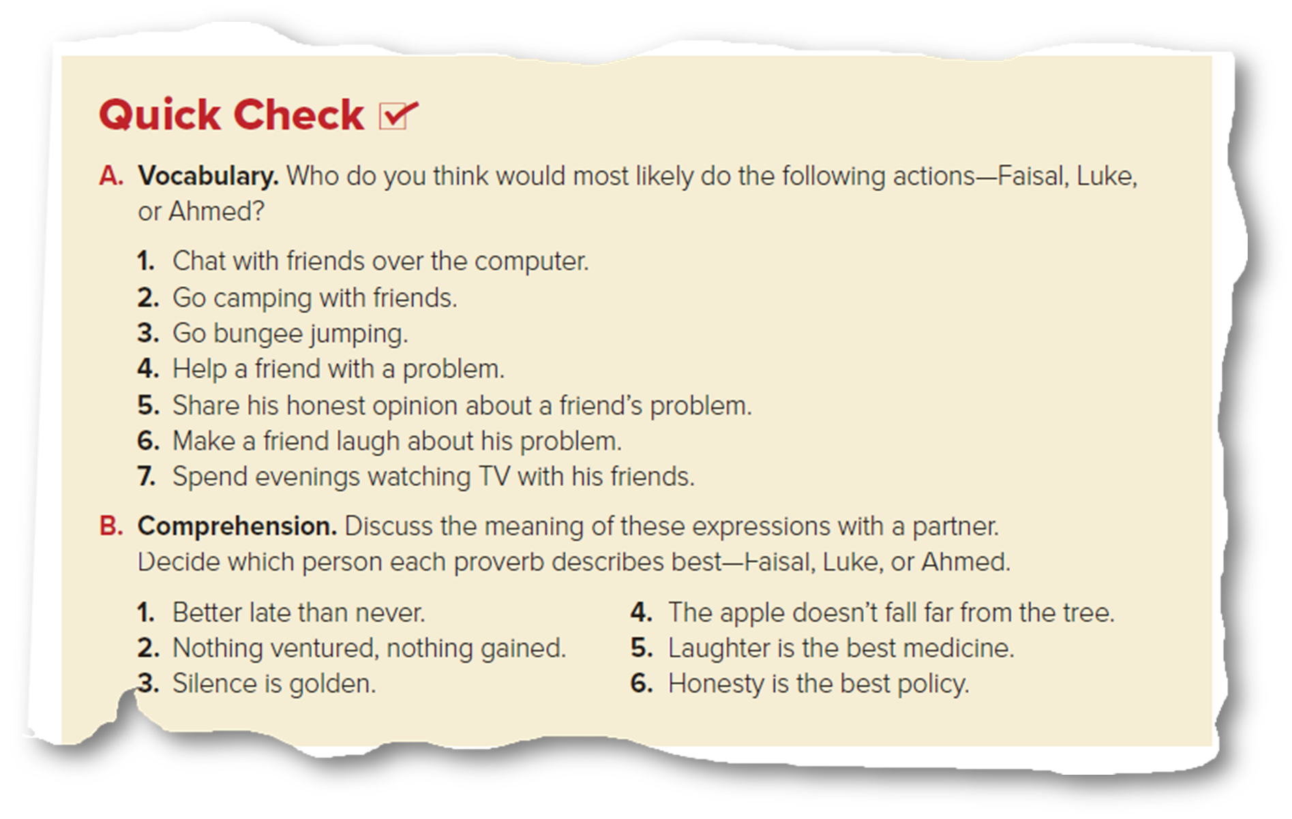
Understanding the Problem
Luke
Ahmed
Faisal
Ahmed
Faisal
Luke
Luke

Slide 23
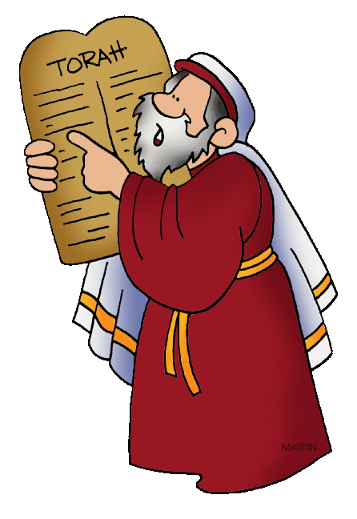
What is the meaning of “ proverb”??
Proverb
A proverb is a short sentence that gives advice
or expresses some common truth ..
Faisal
Luke
Faisal
Luke
Ahmad
Faisal

Slide 24
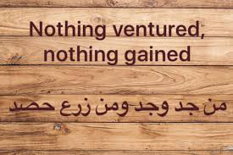





Examples of Proverbs

Slide 25


Slide 26

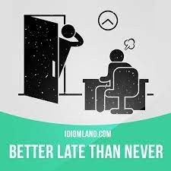
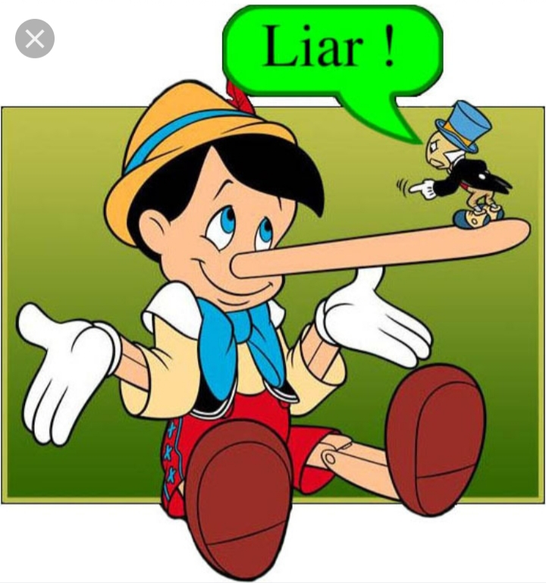


Match the picture with the correct proverb:
Laughter is the best medicine
Better late than never
Honesty is the best policy
Laughter is the best
medicine
Better late than never
Honesty is the best policy

Slide 27
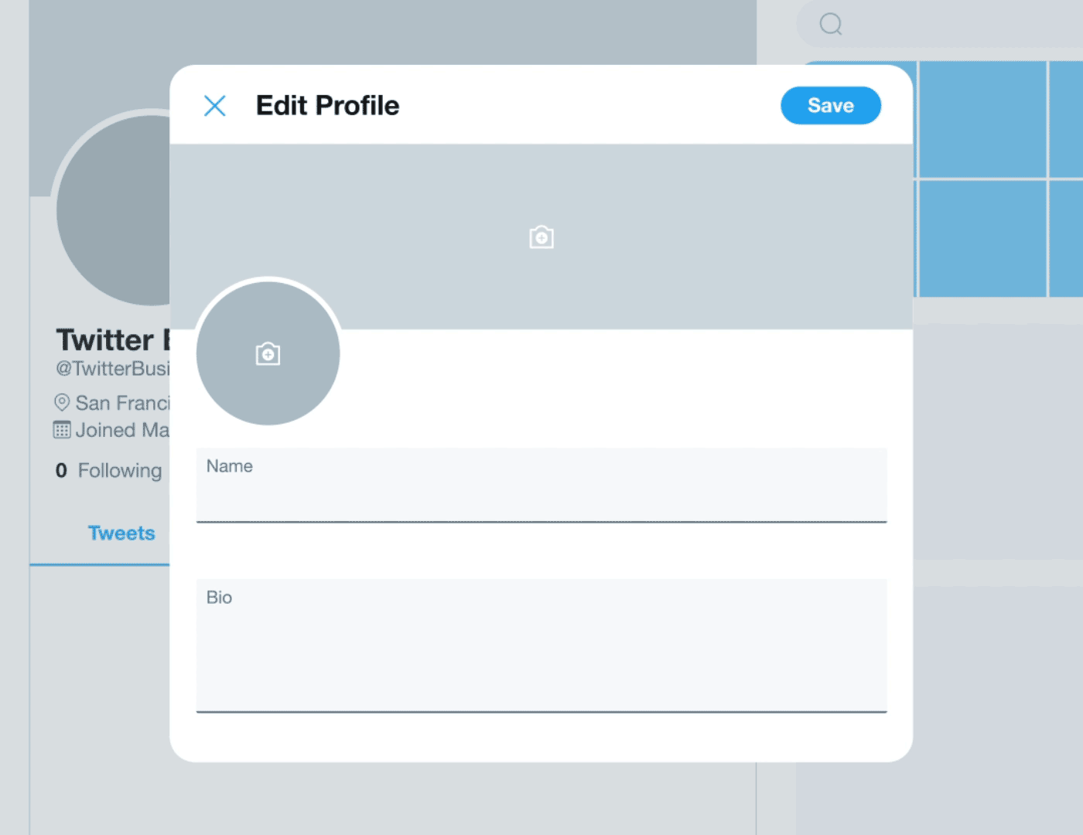



Now , Write your own profile

Slide 28
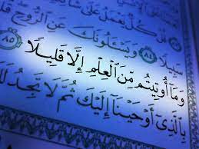
From The Holy Qur'an

Slide 29

Remember…..

Slide 30


Homework
Workbook exercise ( A & B ), page (1)

Slide 31


Thanks!

