Slide 1
Unit 1 Connectd by Technology Grammar
MG2.1
Done by: Entisar Al-Obaidallah

Slide 2
Lesson Goals
01
02
03
04
Use
Use
the auxiliary verbs (do, have and be) in the correct way
auxiliary verbs with the main verbs correctly.
Use
Use
(Be) with progressive statements.
( be ) with passive statements

Slide 3
Open
Your student’s book p. ( 8 -9 )

Slide 4
Focus on the words written in bold.. What are they called ?
Verb to ( do)
Verb to (have)
Verb to ( be)

Slide 5
Auxiliary Verb
Do
have
be
Do
Does
Did
has
have
had
am
is
are
Used with :
Simple tenses
Perfect tenses
Continuous tenses

Slide 6
The Uses of Auxiliary Verbs

Slide 7
Verbs to (do)

Slide 8
Rules for using verb ( to do)
1
DO
Does
Did
Present tense
Present tense
Past tense
I
you
we
they
she
He
it
All

Slide 9
Uses of Auxiliary Verb
Form :
Negative
subject
do-does- did
not
infinitive V
Example:
He doesn’t eat meat .
They don’t play football .
I didn’t watch TV last night .

Slide 10
Uses o Auxiliary Verb
Form :
Question
Do-Does- Did
subject
Infinitive V
?
Example:
Does he eat meat ?
Do they play football ?
Did you watch TV last night ?
Yes , he does
No , he doesn't
Yes , they do
No , they don't
Yes , I did
No , I didn't

Slide 11
Uses o Auxiliary Verb
Choose
1- I (does / do ) not like coffee.
2- ( He / They / I ) doesn’t arrive on time.
3- She ( didn’t / doesn’t / don’t ) call me yesterday.
4- ( Do / Does ) he drink tea?

Slide 12
Verbs to (have)

Slide 13
Rules for using verb ( to have)
2
have
has
had
Present Perfect
Present Perfect
Past Perfect
I
you
we
they
she
He
it
All

Slide 14
Rules for using verb ( to have)
Form :
Affirmative
subject
has- have - had
V.P.P(3)
Example:
I have finished my lunch.
He has taken the car .
They had gone home earlier than usual .

Slide 15
Rules for using verb ( to have)
Form
Negative
subject
have – has - had
not
V.P.P(3)
Examples:
He hasn’t arrived yet .
We haven’t eaten the lunch yet .
I hadn’t ever gone to USA .

Slide 16
Rules for using verb ( to have)
Form
Question
Have – Has - Had
subject
V.P.P(3)
?
Examples:
Has he arrived the school ?
Have they brought the book ?
Had she started the lesson ?
Yes , he has
No , he hasn't
Yes , they have
No , they haven't
Yes , she had
No , she hadn't

Slide 17
Verbs to (be)

Slide 18
Rules for using verb ( to be)
3
Be
am
is
are
Present continuous
Present continuous
Present continuous
I
she
He
it
you
we
they

Slide 19
Rules for using verb ( to be)
3
Be
was
were
Past continuous
Past continuous
I
she
He
it
singular
you
we
they
plural

Slide 20
Rules for using verb ( to be)
Form :
Depends on the subject
Affirmative
subject
Be ( am – is – are )
V -ing
Examples:
I am reading a story .
He is studying English .
They are playing football.

Slide 21
Rules for using verb ( to be)
Form :
Depends on the subject
Affirmative
subject
Be ( was - were)
V -ing
Examples:
I was watching TV .
He was driving his car .
We were praying at the Mosque.

Slide 22
Rules for using verb ( to be)
Form :
Negative
subject
Be ( am- is - are)
not
V -ing
Examples:
I am not sleeping early .
It isn’t raining now.
They aren’t painting the wall.

Slide 23
Rules for using verb ( to be)
Form :
Negative
subject
Be ( was - were)
not
V -ing
Examples:
I wasn’t sleeping early .
He wasn’t travelling abroad.
We weren’t studying hard.

Slide 24
Rules for using verb ( to be)
Form :
Be ( am – is – are)
Question
subject
V -ing
?
Be ( was – were )
Examples:
Is he visiting his friend?
Are they enjoying the party?
Was she working yesterday?
Yes , he is
No , he isn't
Yes , they are
No , they aren't
Yes , she was
No , she wasn't

Slide 25
Rules for using verb ( to be)- Passive tense
Form :
Depends on the tense of the verb
affirmative
subject
(Be)
V .P.P(3)
Example:
The teacher orders them to leave the class .
My father punishes me .
They are ordered to leave the class by the teacher.
I am punished by my father.

Slide 26
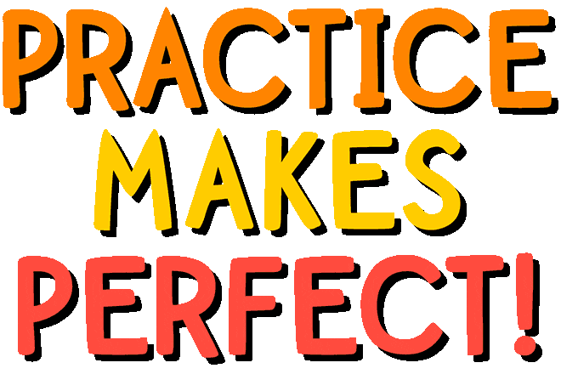

Slide 28
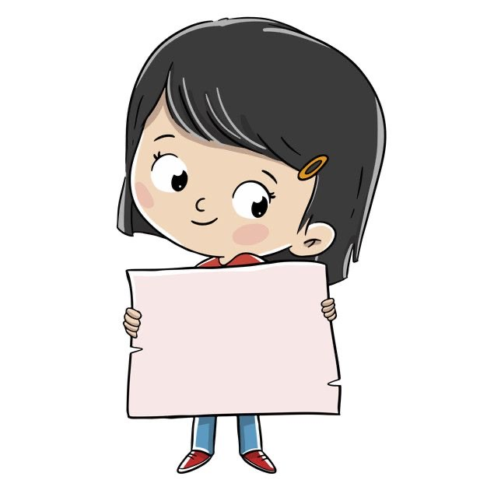
She ………………..arrived yet
Haven't
hasn't

Slide 29
-Are you an engineer?
-No, I…………….
am not
was not
السؤال الثالث

Slide 30
ا
Ali.….….…....tall, but he
doesn’t play basketball..
is
are
السؤال الرابع

Slide 31
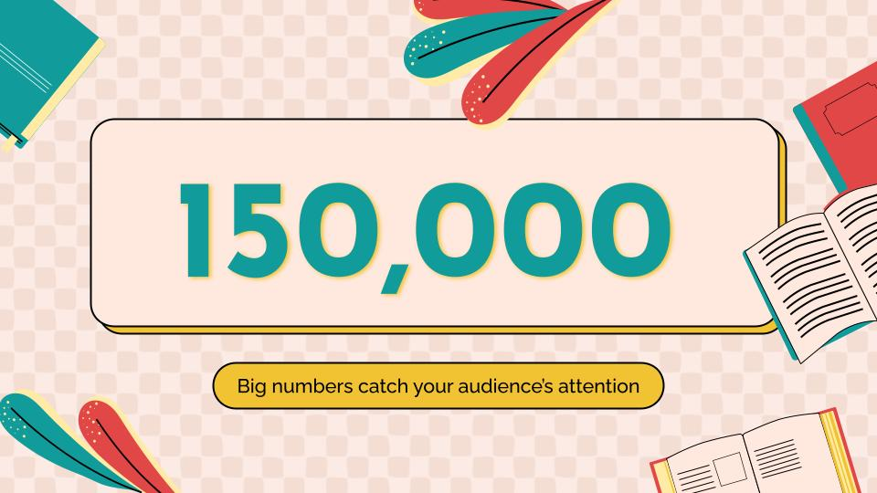
Homework
Workbook p.(84-85) exercise( C- E)

Slide 32
Thanks!

